Slide 1
Correlations between DTT Activity and PM Constituents
Wing Tuet
April 24 2014

Slide 2
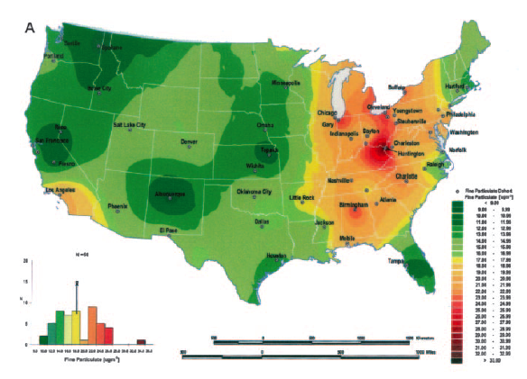
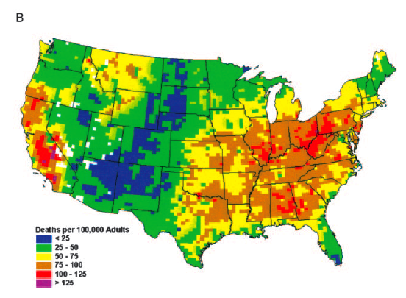
Motivation
Many epidemiological studies link PM to respiratory and cardiovascular diseases
Including asthma, COPD, arrhythmia, heart failure
WHO classified PM as Group I carcinogen
Adverse health effects caused by oxidative stress
Exposure
Risk
Notes:
A = exposure
B = risk of death
(PM cardiovascular disease study)

Slide 3
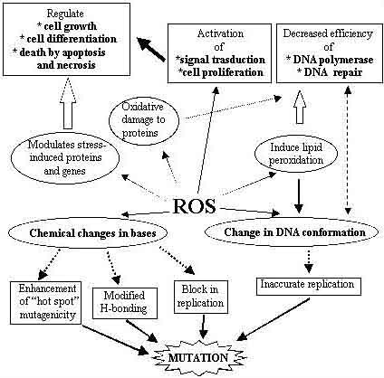
Reactive Oxygen Species (ROS)
Includes hydrogen peroxide, hydroxyl radicals, superoxides
ROS → inflammatory cascades → chronic inflammation → cellular damage → disease

Slide 4
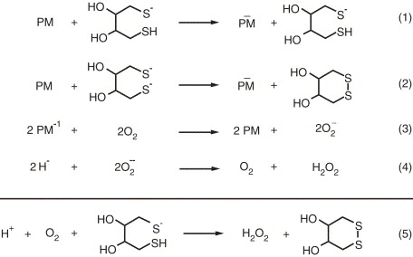
DTT Assay
Measures ability of PM to directly generate ROS
PM catalyzes transfer of electrons from DTT to oxygen
Oxygen → superoxide
DTT → oxidized
Unoxidized DTT reacts with DTNB to produce fluorescent compound
Measure absorbance at 412 nm

Slide 5
Filter Samples
Filters from Jefferson Street (JST)
Site located 4.2 km from central Atlanta
Urban emissions from vehicles/industry and biomass burning
38 filters collected between June 2012 and July 2012
23 hour sampling time

Slide 6
DTT Activity
DTT activity = slope of averages from time series data
Discrete data points
Reaction must be quenched before adding DTNB
Zero points have been omitted from the plot
Automated system is cleaned between each measurement

Slide 7
Volume of Air and Mass Basis
Volume of air pulled through filter
DTT activity calculated in units of nmol/min/m³
PM components analyzed in units of concentration ug/m³
Convert to PM mass on filter basis
Divide all values by concentration of PM on the filter
DTT activity units become nmol/min/ug
PM components become fractions of components
Ex: ug of WSOC per ug of PM

Slide 8
Correlation Coefficients (R)
 | Volume of Air Basis | PM Mass Basis
WSOC | 0.91 | 0.61
OC | 0.93 | 0.63
Ca | 0.75 | 0.38
Zn | 0.85 | 0.12
3 highest correlated components for each basis
R > 0.70 indicates significant correlation (Verma et al. Dec 2009)
Ca slope (0.0003) → highly correlated but barely any effect
Negative R values indicate decreasing DTT activity with increasing of a particular component of PM
2 components (Ba and Pb) had negative correlation coefficients for mass basis
Ba slope was close to zero → likely does not affect DTT activity
Inconclusive for Pb

Slide 9
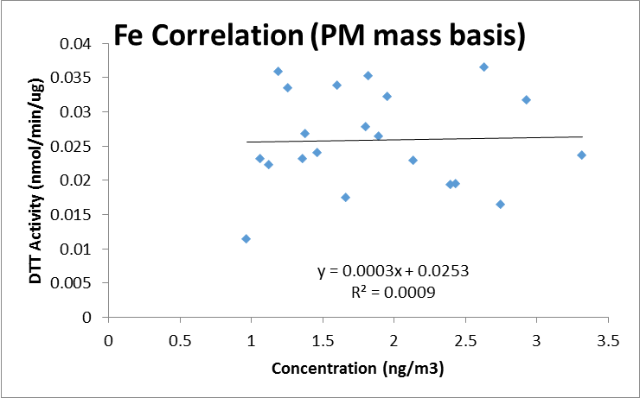
Differences between Basis
All correlation coefficients were much lower for mass basis versus volume basis
Many components had significant correlation coefficients with volume basis (R > 0.70)
None were significant with mass basis
Mass of component is important for health effects
Mass normalized basis gets rid of mass effects
Many correlation slopes were close to zero
Volume basis more reflective of exposures
Volume of air we breathe in
Notes:
How much stuff (concentration) is important
Fraction of stuff is less important for health effects

Slide 10
Conclusions
Particulate matter linked to adverse health effects through ROS production
DTT is a chemical assay that measures ability of PM to directly produce ROS via electron transfer reactions
Mass is important for determining health effects
Eliminating mass effects by normalizing with respect to mass results in correlations close to zero

