Slide 1
Evaluation of Wildfire Impacts in CAM5
Yufei Zou
2014-04-24

Slide 2
Content
Introduction
Numerical Experiment
Modeling results
Discussion
Conclusion

Slide 3
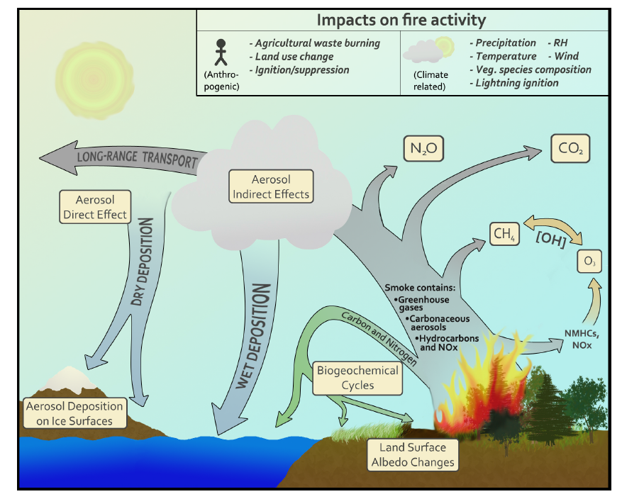
Introduction—wildfire impacts on the climate
(Ward, et al., 2012)
Schematic of wildfire impacts on the climate

Slide 4
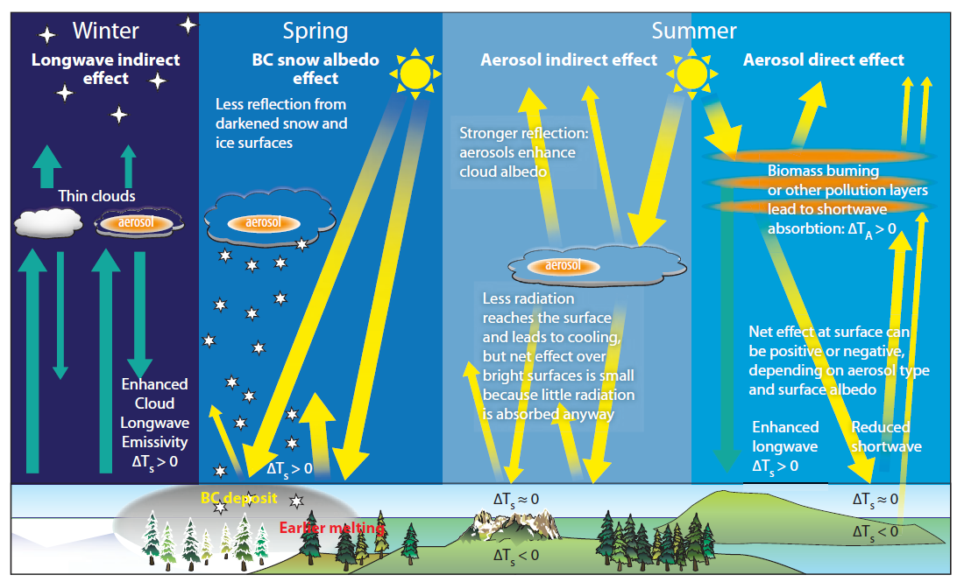
Introduction—aerosol forcing in the Arctic
Forcing mechanisms in the Arctic due to short-lived aerosols
(P.K. Quinn, et al., 2011)

Slide 5
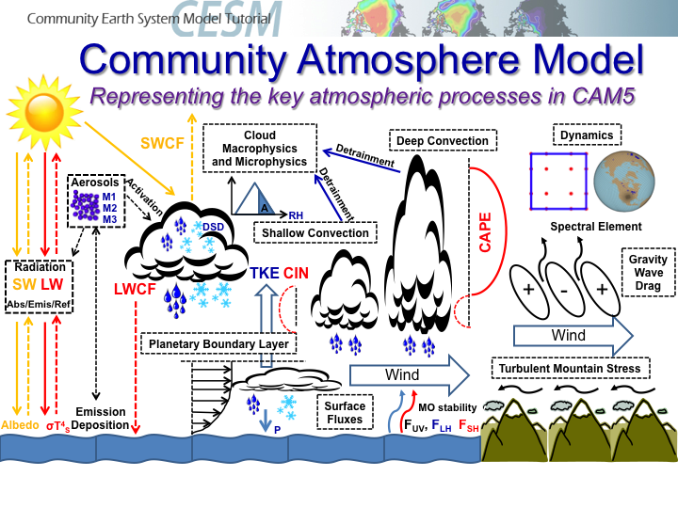
Method—numerical experiment
Name | Fire forcing | Non-Fire emissions | Others | Remarks
CAM_fire_on | GFED3 (2000-2009) | IPCC AR5 (Anthro), MOZART (NH3,BVOCs), Martensson_2003 (Sea Salt), DEDM (Dust) | 7 members with prescribed SST, Sea Ice, etc. | Sensitivity
CAM_fire_off | No fire emis | See above | See above | Control
Chemistry: gas-phase chemistry for sulfate aerosols and SO2 oxidation in aqueous phase;
SOA: assume fixed mass yields for AVOCs/BVOCs precursor;
Nucleation: binary (MAM3)/ternary(MAM7)/boundary layer nuclear;
Condensation: dynamical treatment using standard mass transfer expressions;
Coagulation: fast/approximate algorithms of CMAQ
Water Uptake: Kohler theory
(www2.cesm.ucar.edu/)

Slide 6
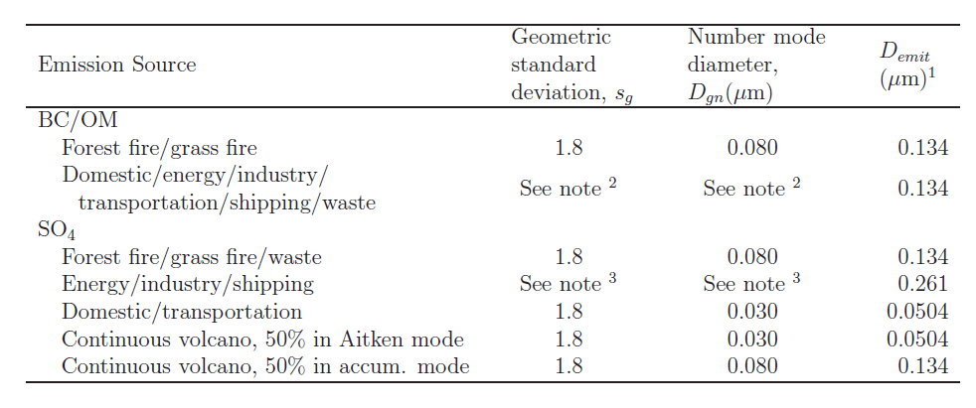
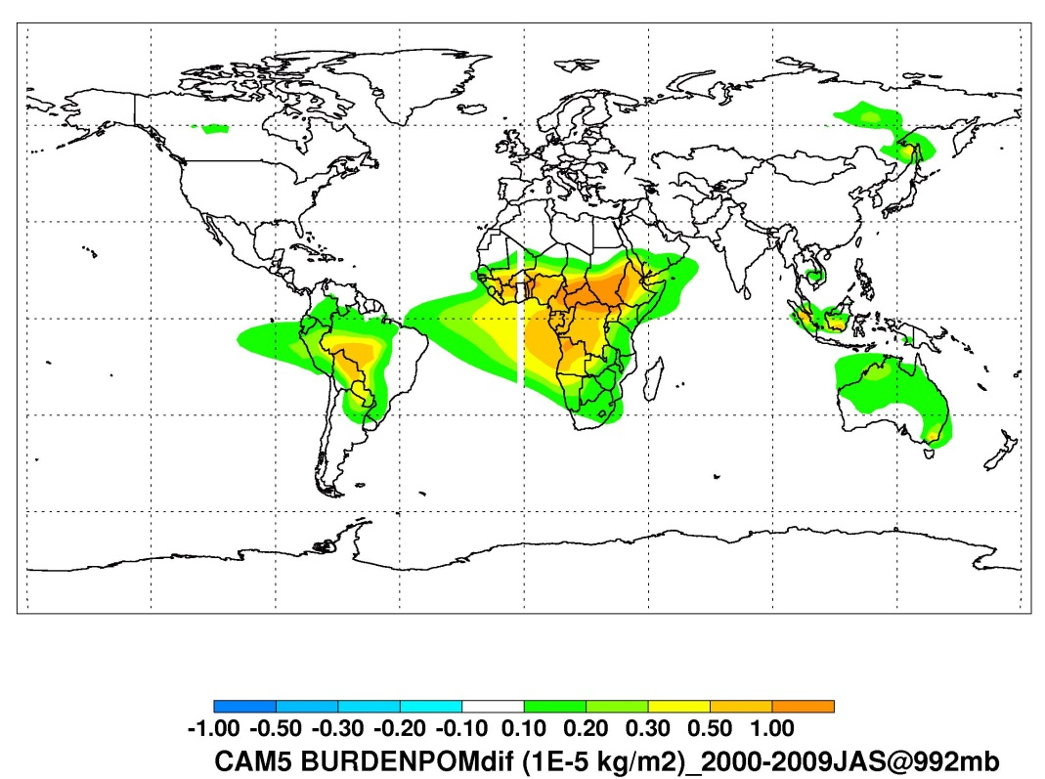
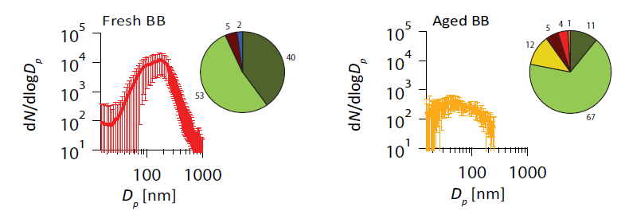
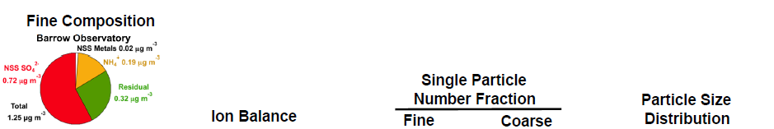
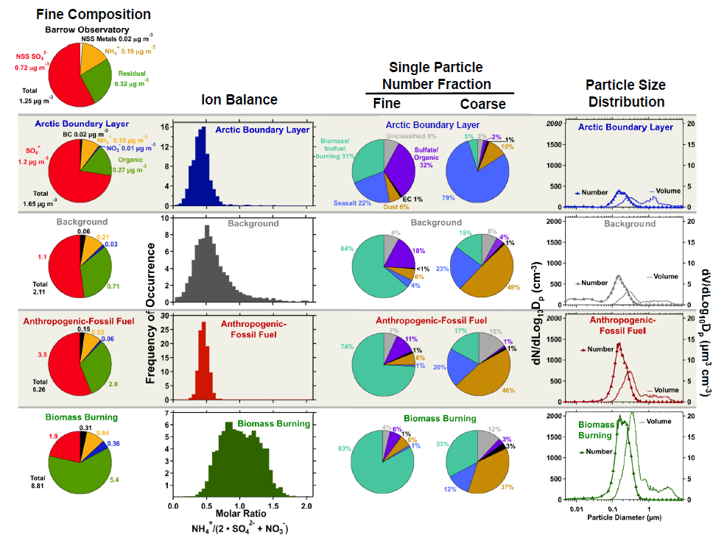
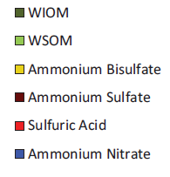
Method—Emissions in CAM5
(Lathem et al., 2013)
Sulfate/
Organic
SO4
BC
NH4
NO3
Biomass
Burning
Seasalt
Residual
(Brock et al., 2011)
Dust

Slide 7
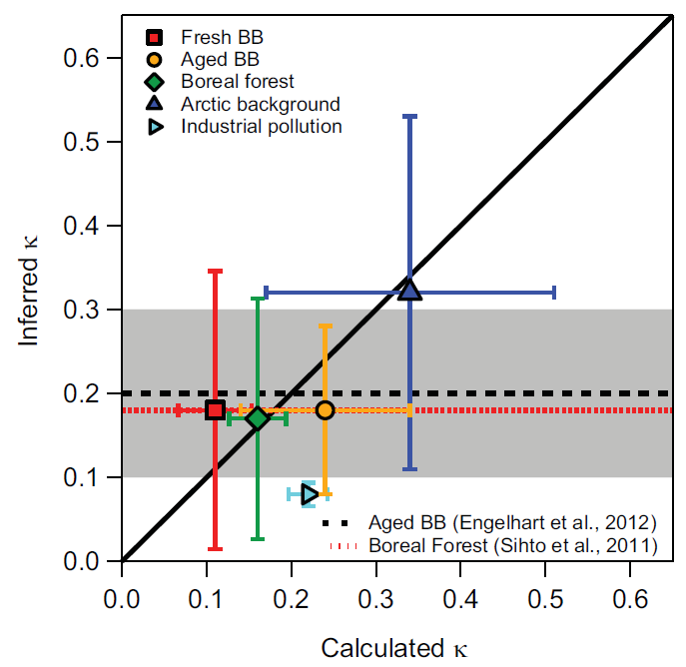
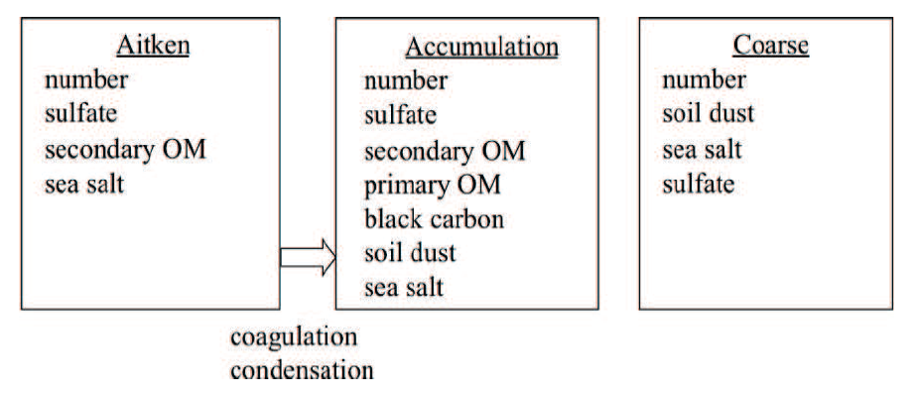
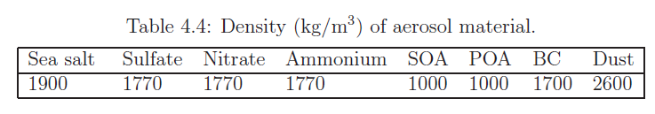
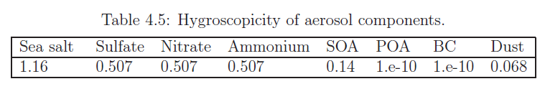
Method—MAM3 in CAM5
Aerosol mode in MAM-3
(Lathem et al., 2013)
BURDEN2
BURDEN1
BURDEN3

Slide 8
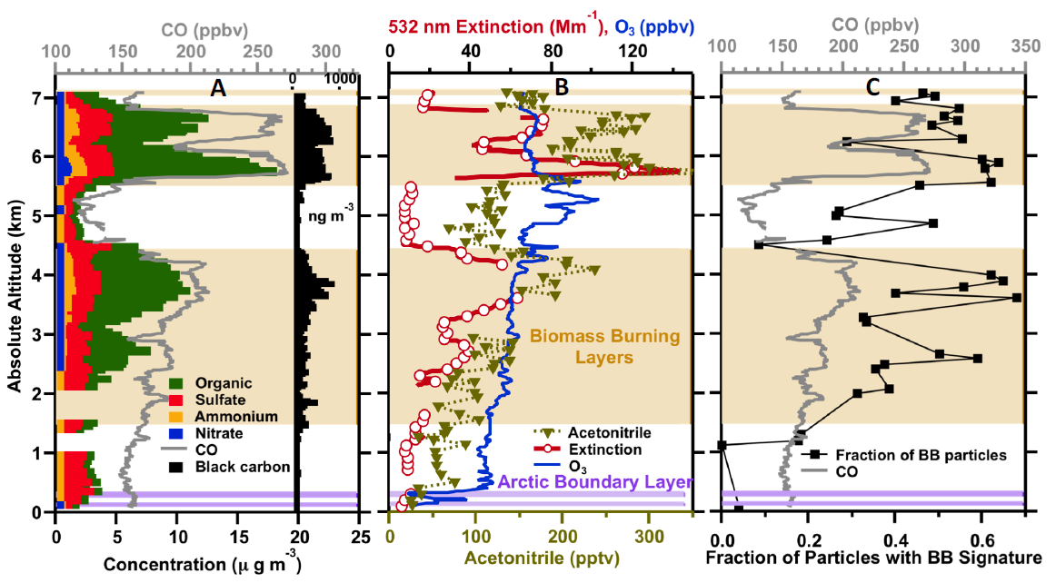
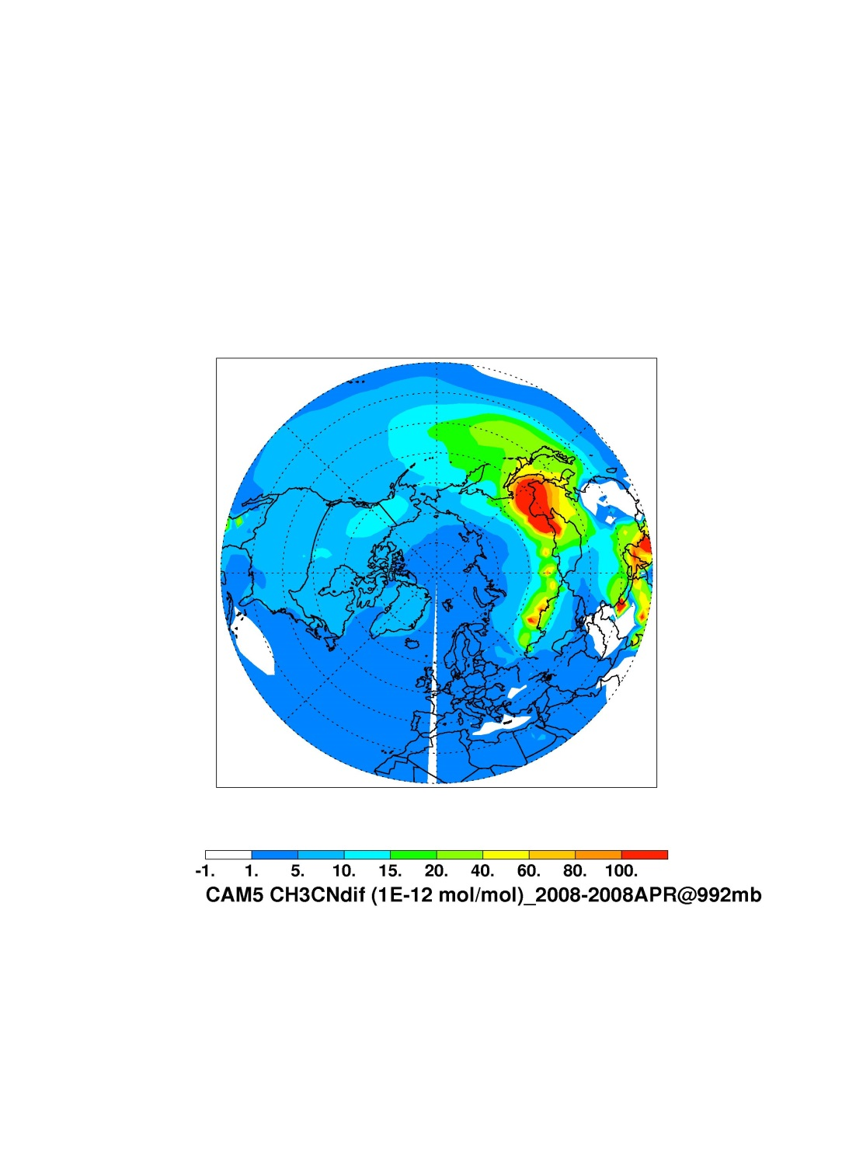
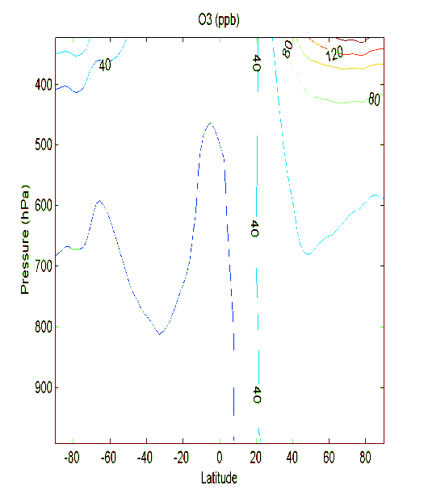
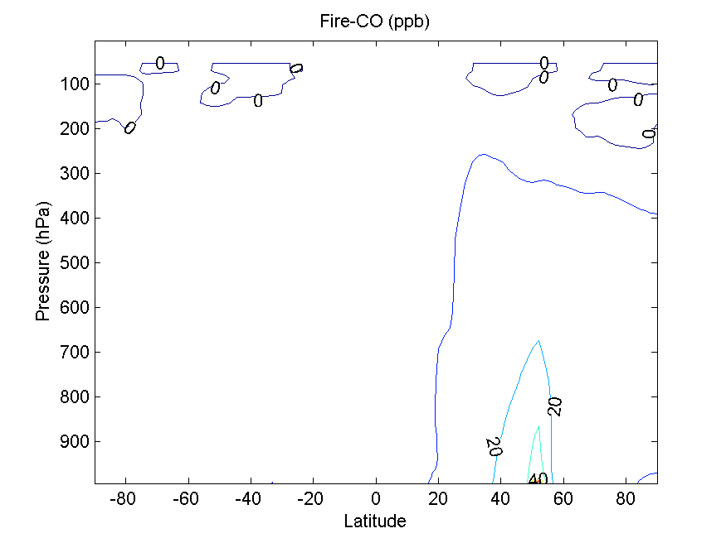
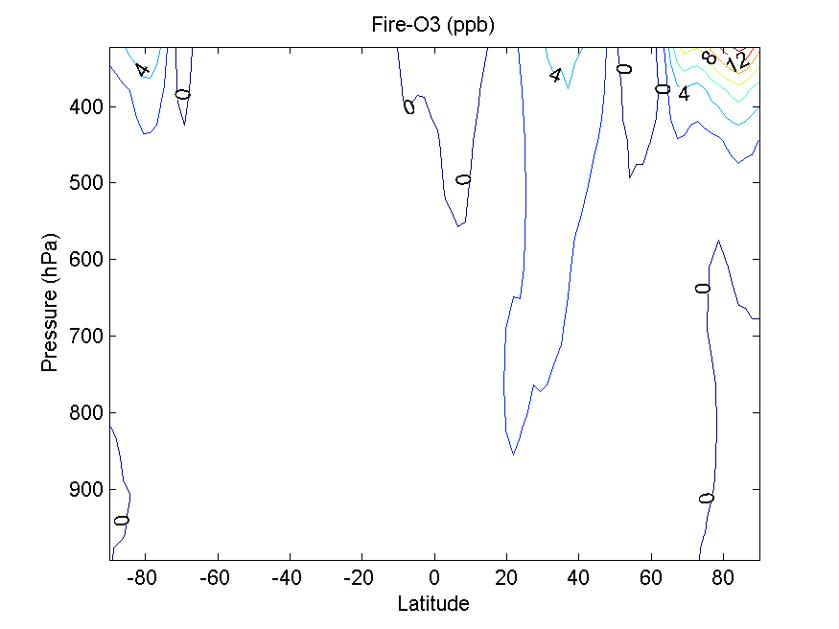
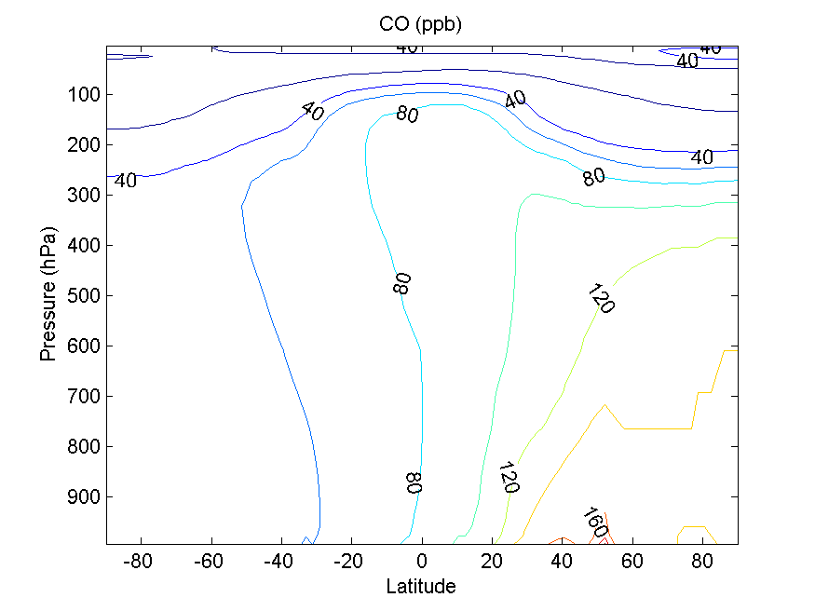
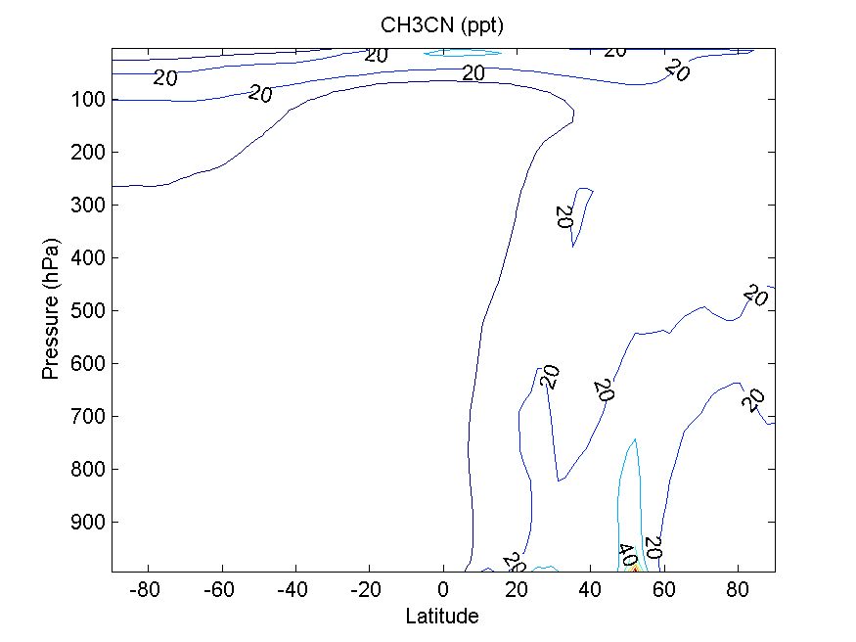
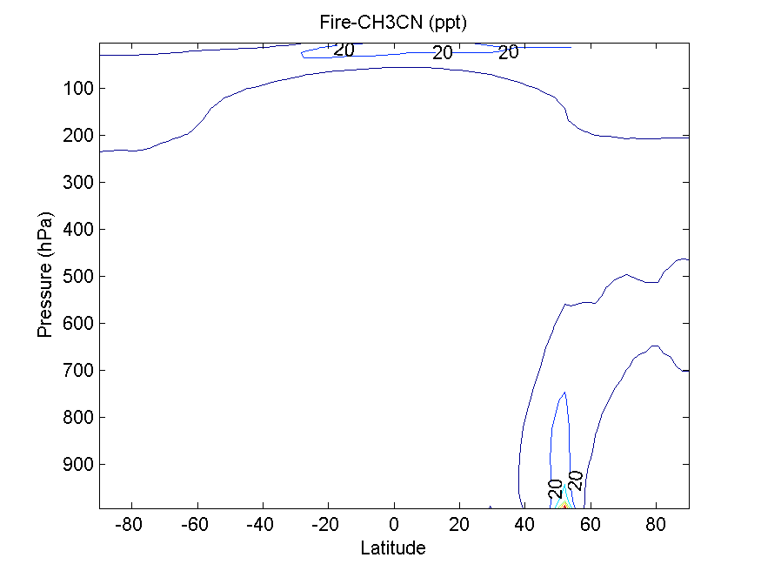
Results—fire case in April 2008
ARCPAC measurements on 18 April 2008
(Brock, et al., 2011)
Fire counts for April 2008
Fire_CH3CN
CO
Trop_O3
CH3CN

Slide 9
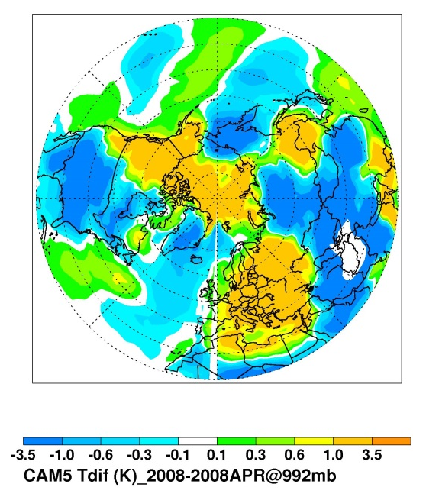
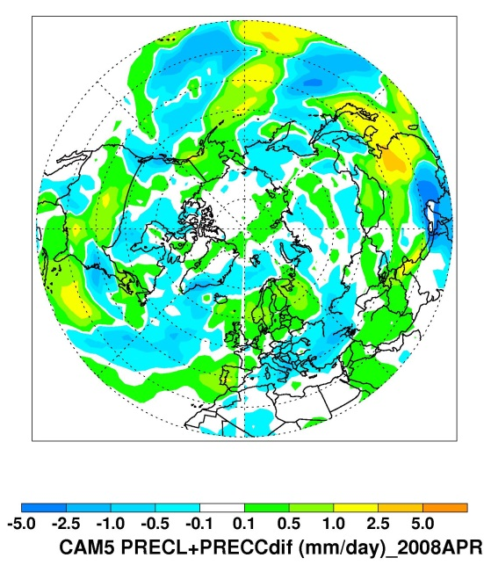
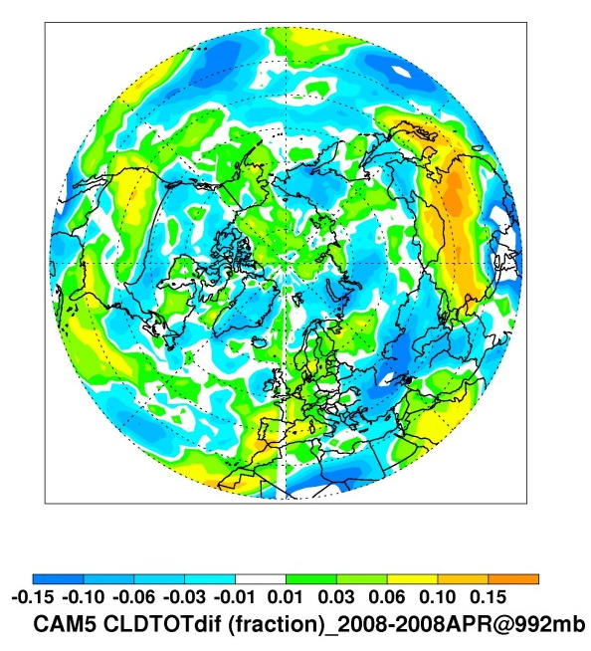
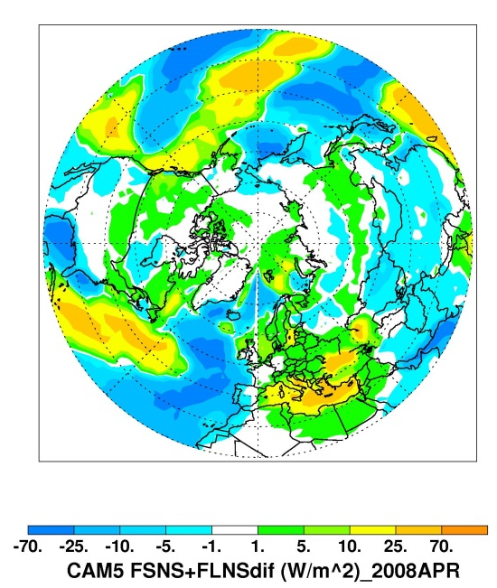
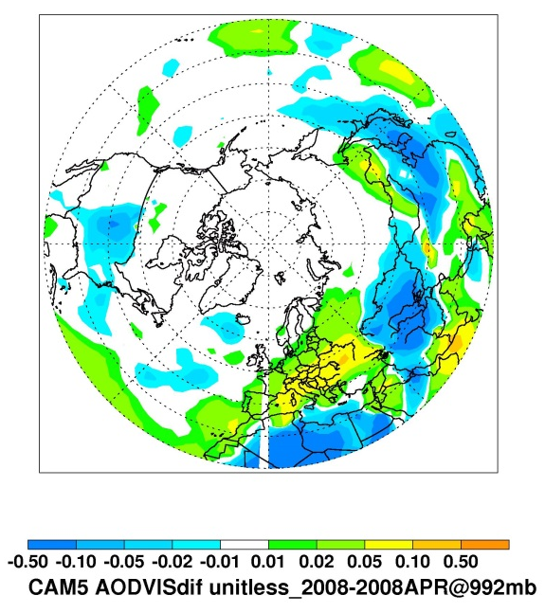
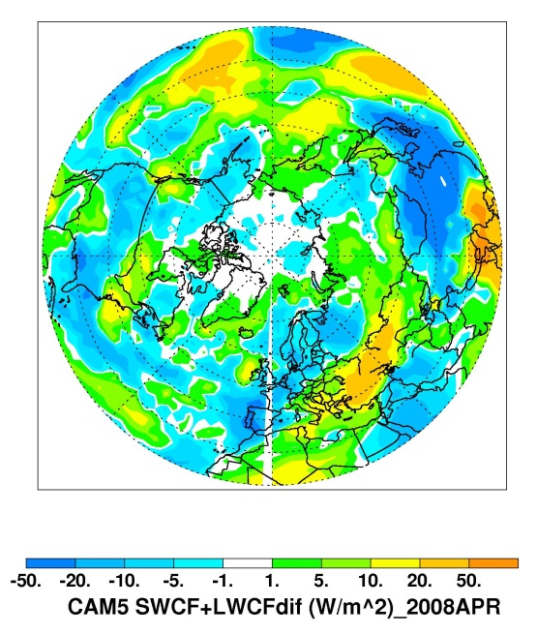
Results—fire case in April 2008
Δ SAT
Δ PREC
Δ CLDFrac
Δ TOT_RF@surface
Δ AOD@550nm
ΔCLDRF

Slide 10
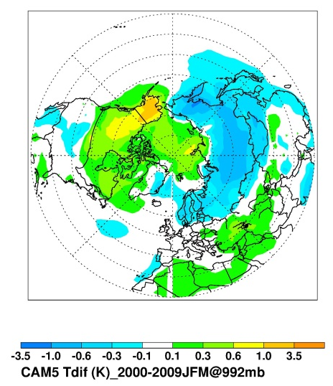
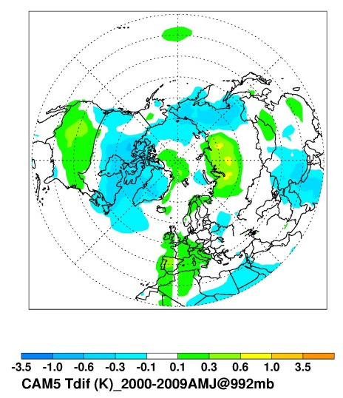
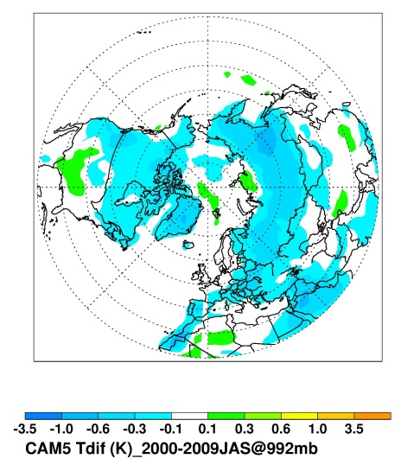
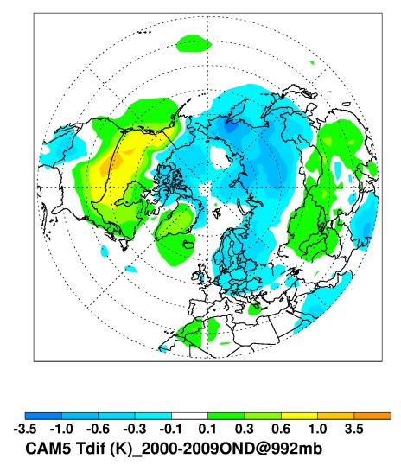
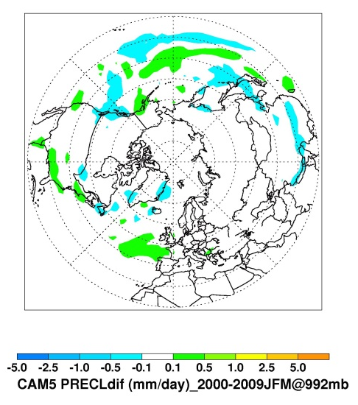
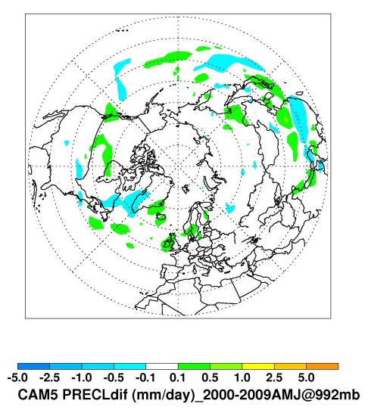
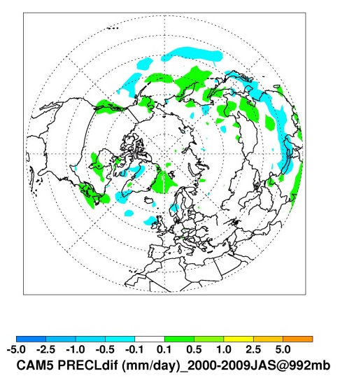
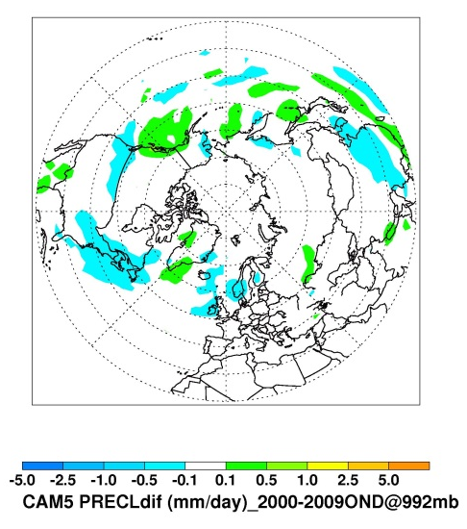
Results—fire impacts in each seasons (2000-2009)
Δ SAT
Jan-Feb-Mar
Apr-May-Jun
Jul-Aug-Sep
Oct-Nov-Dec
Δ PRECL

Slide 11
Summary
Aerosol module and prescribed properties in CAM5 are generally consistent with observational results;
Current fire emission with out plume rise limits its vertical and long-range transport;
Fire activities exert significant impacts on local and remote climate conditions with seasonal variability;

