Slide 1
Glyoxal emission over East Pacific: A primary biogenic source?
Ruixiong Zhang
04/24/2014
Advisor: Dr. Yuhang Wang

Slide 2
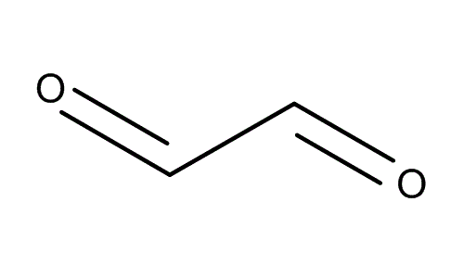
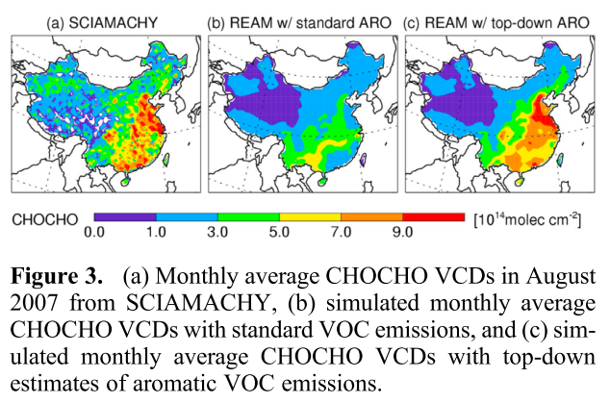
Glyoxal (C₂H₂O₂)
Smallest di-carbonyl
Oxidation of many VOCs
Very small primary sources
Great for constraints of emissions
Substantial underestimate of aromatics in China by a factor of 4-10. (Liu et al., 2012)
Notes:
What is glyoxal and why we care about glyoxal

Slide 3
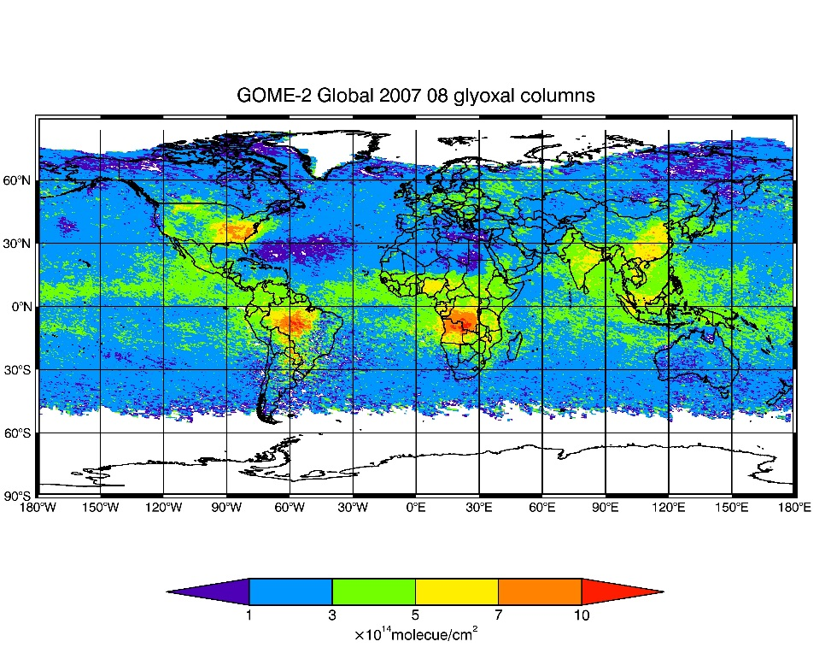
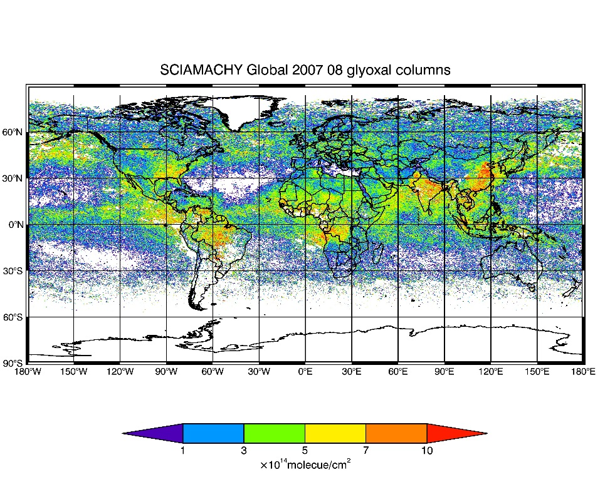
Satellite retrieved glyoxal Vertical Column Densities (VCDs)
Overpassing time:
GOME-2 9:30 LT
SCIAMACHY 10:30 LT
Notes:
SCIMACHY larger than GOME-2 over land. China->Aromatics, South Africa, Southeast US, South America->biomass burning related, fire activities. Turn to next page (this really low values are due to water vapor interference). But what is going on these remote ocean regions?

Slide 4
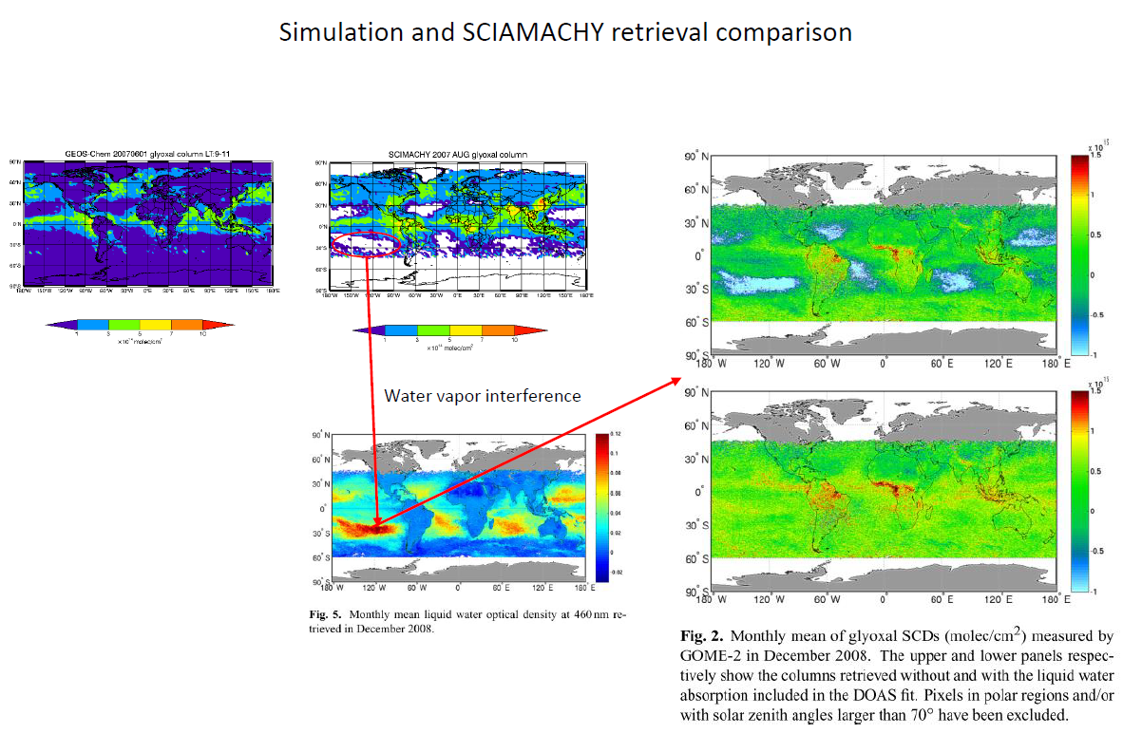
Notes:
SCIA retrievals. Water vapor interference.

Slide 5
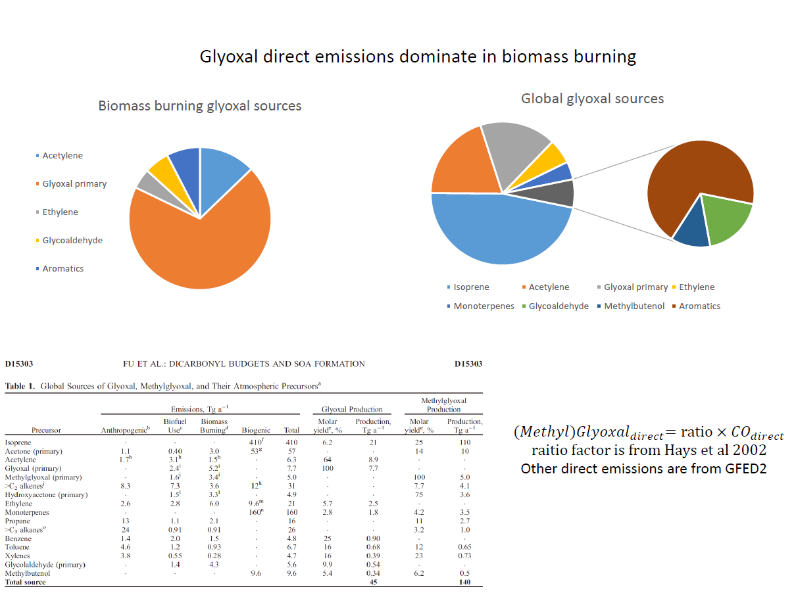
Glyoxal sources
Is glyoxal over Pacific due to Acetylene or Glyoxal Primary sources?
(Fu et al., 2008)

Slide 6
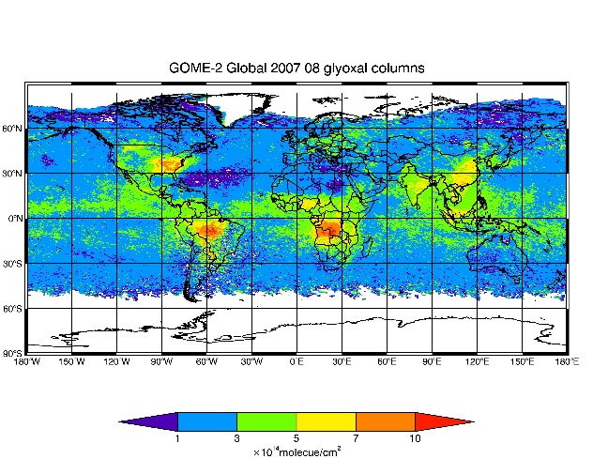
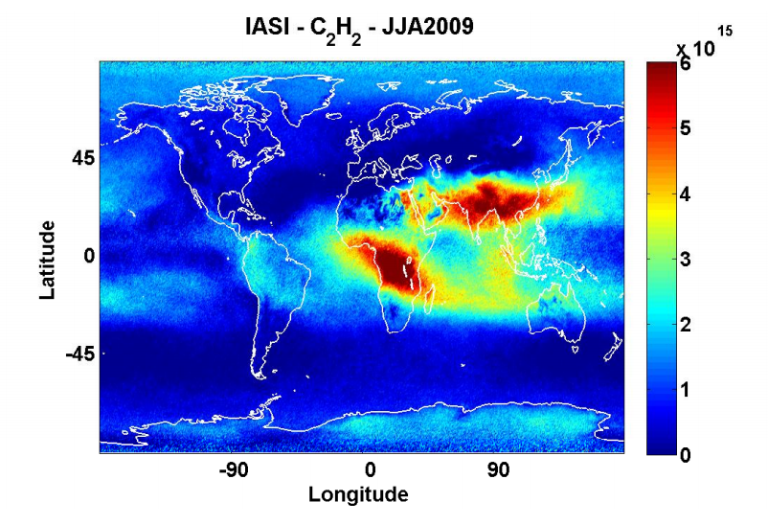
Comparison between glyoxal and acetylene VCDs
Acetylene doesn’t appear to be the source of glyoxal over oceans
Possible glyoxal primary sources?
(Duflot et al., 2013; Kanakidou et al 1988)

Slide 7
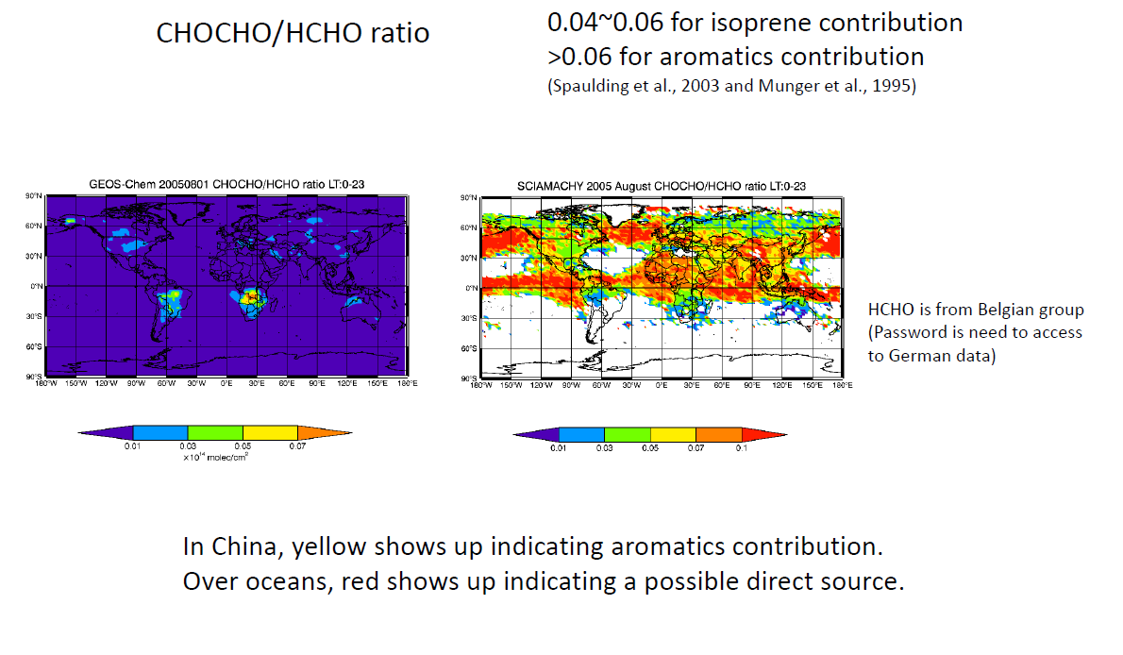

Slide 8
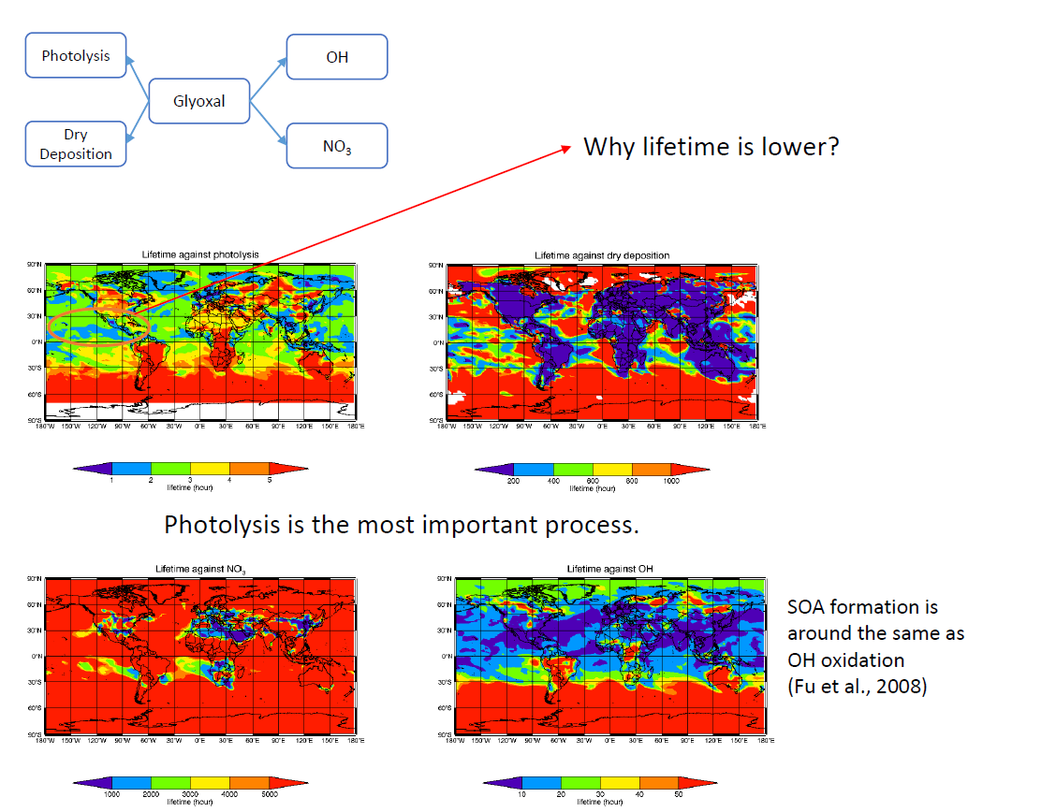

Slide 9
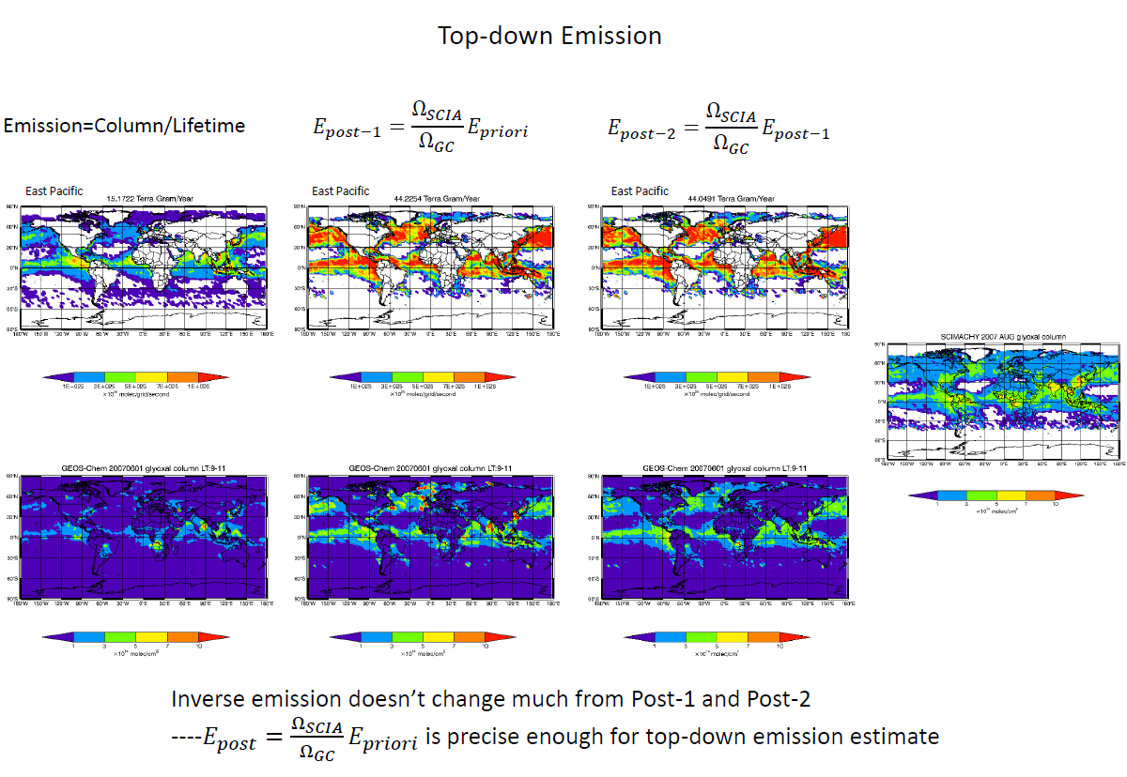

Slide 10
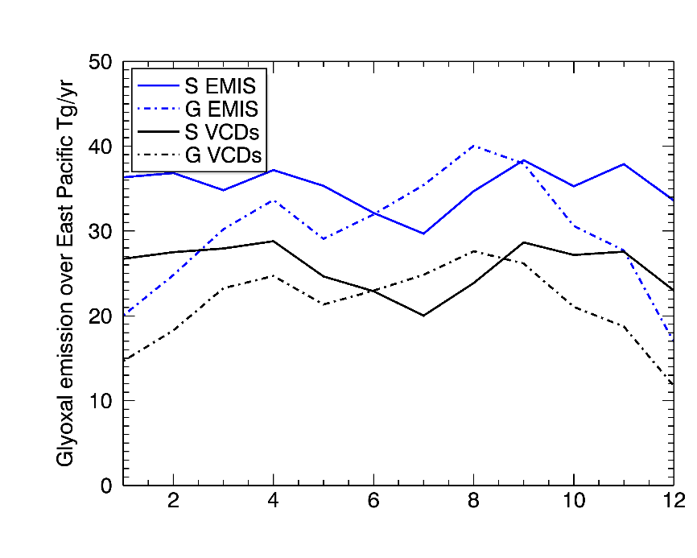
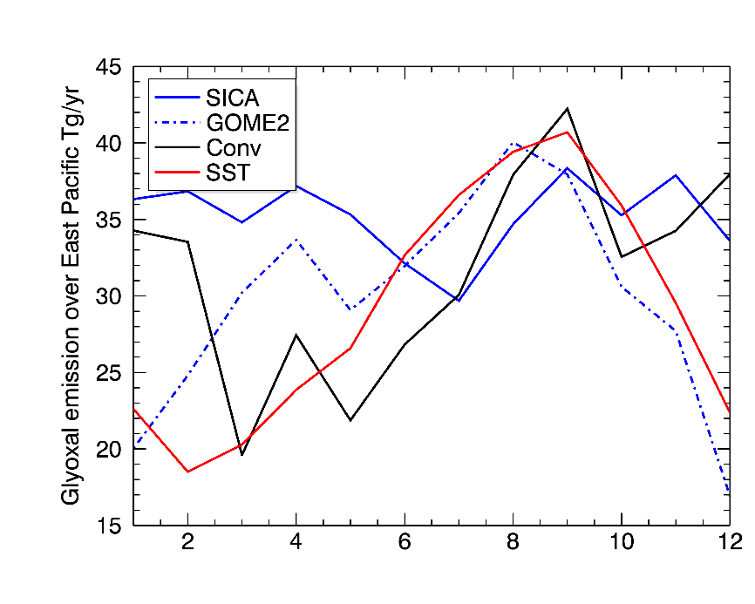
2007 Estimated glyoxal emission over Pacific (20-40 Tg/yr)
(Global continential glyoxal emission ~45Tg/yr (Fu et al., 2008))
May lead to 2.8-5.6 Tg C/year of SOA
Posteriori emission follows the pattern of VCDs indicating that meteorology variation
is trivial.
Notes:
We may use VCDs temporal pattern to represent that of emissions.

Slide 11
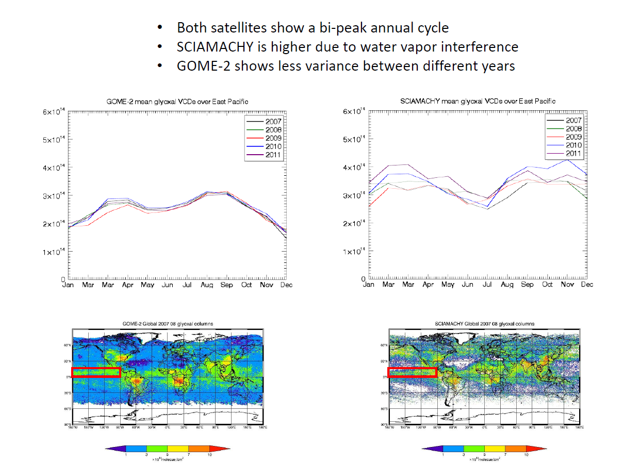
Why?

Slide 12
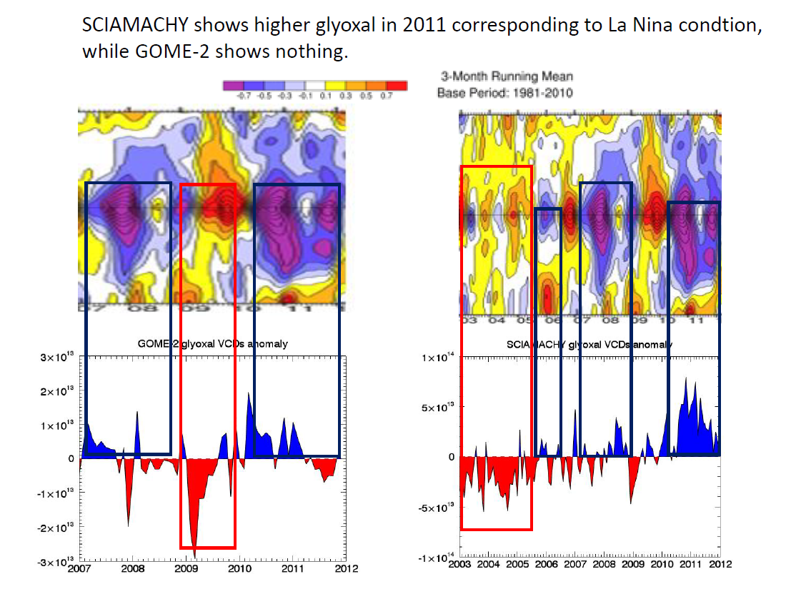
Glyoxal anomaly versus ENSO (related to biogenic activity)
A possible direct biogenic sources over oceans

Slide 13
Conclusions and future work
A very possible glyoxal biogenic primary source in Pacific (20-40 Tg/yr)
Find out why glyoxal VCDs exhibit a bi-peak seansonal cycle

Slide 14
Thank you!
Question time!

