Slide 1
Biomass Burning Effects on Clouds
Sara Purdue and Haviland Forrister

Slide 2
Introduction
Direct effects: biomass burning aerosols absorb light (BC and BrC) and scatter light (OA, sulfate)
Semi-direct effects: heating effects of aerosols in and around clouds
Cloud burnoff, cloud suppression (and sometimes invigoration)
Indirect effects: biomass burning aerosols affecting cloud microphysics
Twomey effect: increased cloud droplet number and albedo
Albrecht effect: increase in lifetime, suppressing precipitation
In turn, clouds remove some biomass burning aerosols through rain
Also cloud processing
Limitations of research
Meteorology also influences smoke (dilution, transportation, inversions, low pressure regions accumulate aerosol and preferentially form clouds), confounding the direct smoke-cloud effect
Remote sensing can be used to detect smoke and clouds, but with limitations: cloud/smoke detections not as good over water and ice

Slide 3
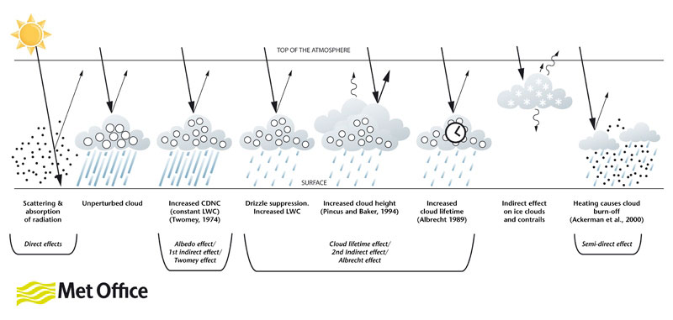

Slide 4
CCN and IN Properties

Slide 5
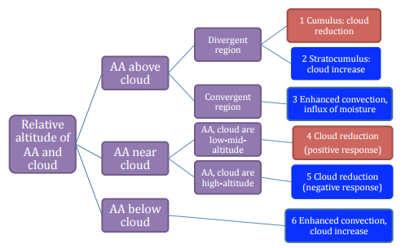
Black carbon semi-direct effects on cloud cover Review and synthesis Koch & Del Genio, 2010
Review of studies on semi-direct effect of black carbon on clouds
Includes models and measurements
Summary of effects of black carbon on cloud cover provided by figure to the right
caveat mentioned by the paper is that their framework should be considered tentative rather than definitive due to differences between model and field studies (altitudes used, model differences, etc.)
WARNING:
REVIEW PAPER

Slide 6
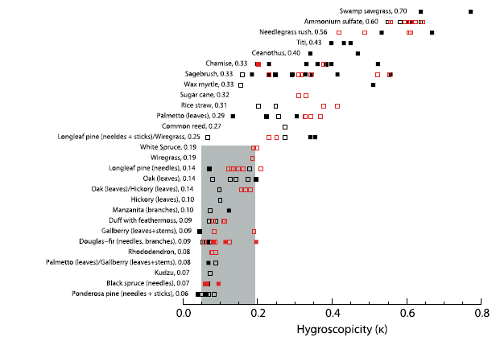
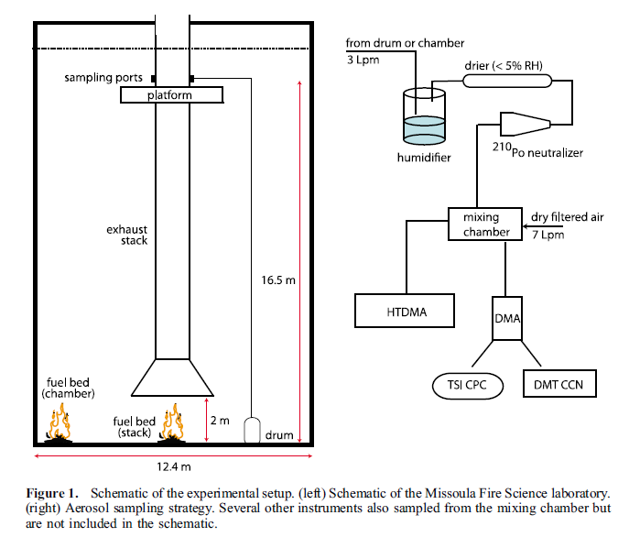
Cloud condensation nucleation activity of biomass burning aerosol Petters, et al. 2009
Looked at the hygroscopicity (HTDMA) and CCN activity (CCN100) of 24 different “fuel” types
Fresh smoke particle size was correlated to the emission’s hygroscopicity
Smaller particle = lower Hygroscopicity
Smoke emissions should have 0.1 < κ <0.4
(little to no size dependence)
Most of the samples could serve as CCN in “vigorous updrafts”
“fuels” growing in more saline soils are better CCN (they have more inorganic content)
Organics coating soot particles in general only increases CCN activity because of the increase in size
WARNING:
LAB STUDY
Notes:
“Fresh biomass burning emissions have complex hygroscopic behavior. Individual activation spectra show that smokes are generally externally mixed, that Hygroscopicity generally decreases with particle size, and that more and less hygroscopic modes are frequently observed at a single size. This behavior complicates size-resolved CCN measurements and the correct removal of multiply charged particle effects.”
“older” emissions harder to correlate to a single kappa across a size distribution though
Ammonium sulfate has kappa = 0.6
Normally organics would decrease hygroscopicity and CCN activity

Slide 7
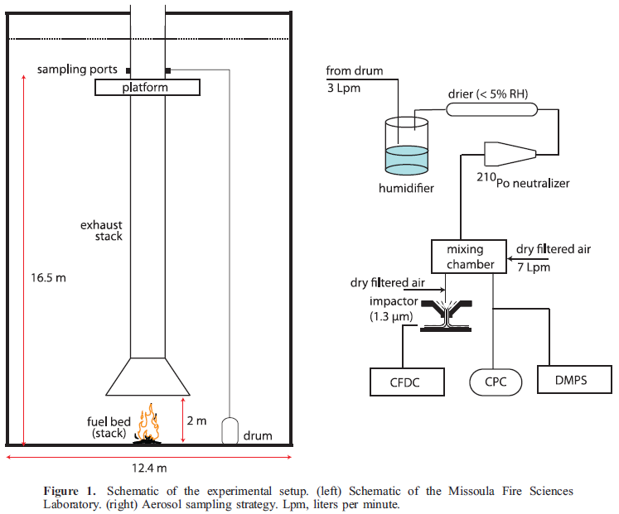
Ice nuclei emissions from biomass burning Petters, et al. 2009
21 different fuels (i.e. plants)
Out of 72 burns, only 21 produced ice
The largest IN fraction was from swamp grass, producing ~1 IN for every 100 particles detected
In general, not good IN (compared to other sources)
However, this ability exists, meaning biomass burning emissions have even more capability to affect cloud formation, beyond CCN activity
Emissions that did act as IN tended to have low organic carbon fraction, high water-soluble ion content, and be assoc. with a more flaming fire phase (rather than smoldering which has more OC content)
WARNING:
LAB STUDY

Slide 8
Semi-Direct Effect

Slide 9
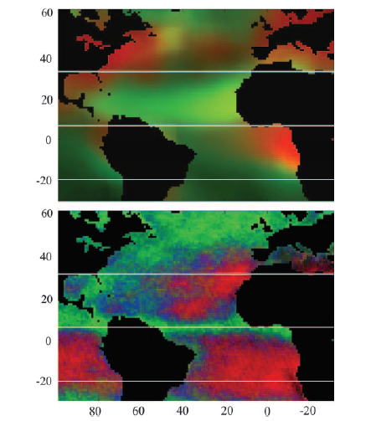
The effect of smoke, dust, and pollution aerosol on shallow cloud development over the Atlantic Ocean (Kaufman et al, 2005: PNAS)
Background:
Increased aerosol number: more but smaller cloud droplets
In turn: precipitation is suppressed and cloud lifetime increases
Absorbing aerosols in the cloud can absorb light and reduce cloud cover
Data: Terra MODIS data for 3 months from four regions of the Atlantic: marine aerosol, smoke, mineral dust, and pollution aerosols
Results:
Shallow clouds increase from .2-.4 from clean to polluted/smoke/dust
Spatial coverage of shallow clouds extend further for smoke/dust than for clean
LWC increases for polluted/dust, not for smoke
Radiative effect at TOA is -11 W/m2 (66% due to aerosol-induced cloud changes, 33% due to aerosols directly affecting radiative properties)
Lowest: dust
Highest: pollution
Never published in more formal journal because Kaufman died months later
WARNING:
SATELLITE DATA STUDY
TOP: Red: sub-um particles, smoke, pollution, Green: dust and sea salt
BOTTOM: Red: shallow clouds, Green: deep convective clouds, Blue: mixed

Slide 10
On smoke suppression of clouds in Amazonia Feingold, et al. 2005
Large eddy simulations to study cloud-smoke interactions and cloud suppression (i.e. semi-indirect effect)
The effect of smoke/biomass burning aerosol on clouds is dependent on location of the aerosol layer and temperature of the emissions
If smoke is well mixed just below the cloud layer, the uniform heating destabilizes the surrounding atmosphere and can increase convection
Emission of hotter smoke can cause even stronger convection, and affects the amount and duration of clouds
If smoke is only within the cloud, the heating causes cloud reduction
If smoke layer causes atmospheric stabilization, it can reduce the cloud fraction
Cloud fraction significantly reduced when smoke optical depths ≈ 0.6
Consistent with other observational and modeling studies
Changes in the cloud fraction and appearance of the cloud layer are in general dependent on the optical properties, amount of, and location of the smoke
WARNING:
MODELING STUDY

Slide 11
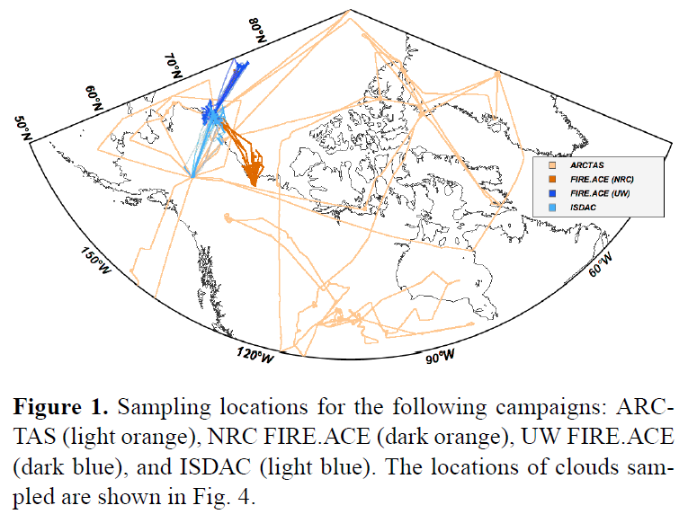
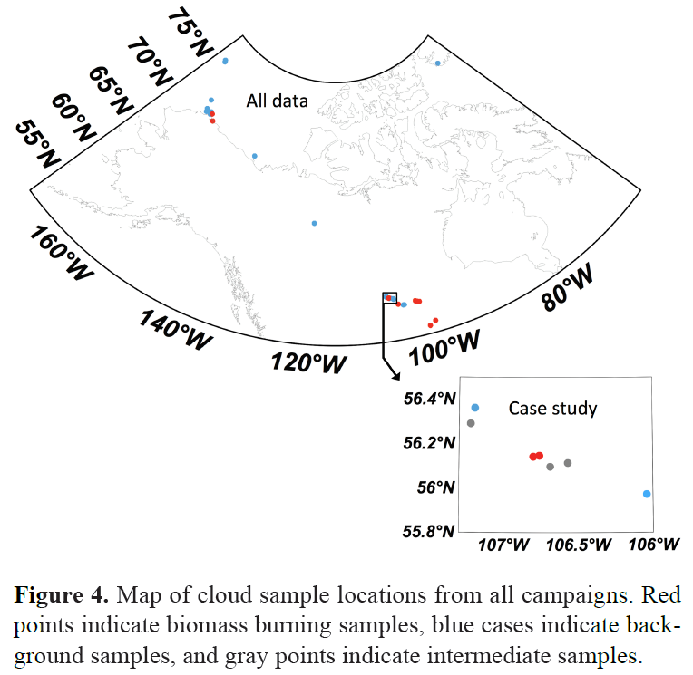
Aircraft-measured indirect cloud effects from biomass burning smoke in the Arctic and subarctic (Zamora et al, 2016: ACP)
Background: Tietze et al, 2011, modeled how smoke reduces cloud droplet radius and enhances cloud albedo in Arctic liquid clouds (ACI = .04 - .11, possible underestimate)
Data: from aircraft campaigns over Arctic and subarctic
Subarctic cumulus cloud case study
Multi-campaign data assessment of Arctic/Subarctic clouds
Aerosol cloud interactions (ACI)
How a cloud property (cloud droplet number) changes relative to some aerosol tracer (acetonitrile)
.33 indicates all smoke aerosol nucleate cloud droplets
Discoveries:
Smoke-affected cloud droplets were 40-60% smaller than background clouds: would inhibit precipitation and increase cloud lifetime
ACI = .16 (multi-campaign)
ACI =.05 (case study with low LWC and high aerosol), more aerosol = more smoke CCN, so greater water vapor competition, decreasing cloud droplet activation and, thus, ACI
WARNING:
FIELD STUDY

Slide 12
Indirect Effects

Slide 13
Influence of biomass burning on CCN number and hygroscopicity during summertime in the eastern Mediterranean Bougiatioti, et al. 2016
Fire events increased the number of particles w/ Dp > 100nm by more than 50%
Particles 60nm and smaller contained mostly organic compounds (82% mass) and were less CCN-active/had the lowest hygroscopicity
Particles 100nm and larger were mostly ammonium sulfate and had much higher hygroscopicities
Hygroscopicity of the events ranged between 0.2-0.3 (attributed to differing chemical composition)
Freshly emitted biomass burning organic aerosol (BBOA) had к ≈ 0.06
BBOA that had been more atmospherically-processed had 0.14 < к < 0.17
BB plumes that are ‘newer’ and relatively unprocessed by the atmosphere are less CCN active
Fresher plume = more organic content = less CCN active
WARNING:
FIELD STUDY
Notes:
“60nm particles exhibited the lowest hygroscopicity”

Slide 14
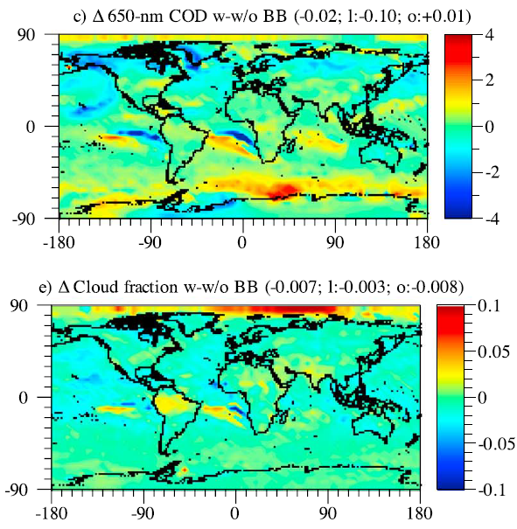
Effects of biomass burning on climate, accounting for heat and moisture fluxes, black and brown carbon, and cloud absorption effects (Jacobson, 2014: JGR)
Goal: to investigate effects of open biomass burning on climate and pollution
Considers: gases and aerosols (BC, BrC, tar balls, reflective particles), cloud absorption effects, aerosol semidirect and indirect effects on clouds
Results:
20 year simulations show net global warming of .4 K: 32% caused by cloud absorption effects, 7% by anthropogenic heat fluxes
Cloud optical depth decreased by open biomass burning
Direct aerosol cooling and indirect effects = outweighed by cloud absorption effects, semidirect effects, and anthropogenic heat and moisture fluxes
Particle burn-off of clouds (caused by BC) may be a major underrecognized source of global warming (cloud depletion = surface warming)
WARNING:
MODELING STUDY

Slide 15
Clouds Affecting BB Aerosol

Slide 16
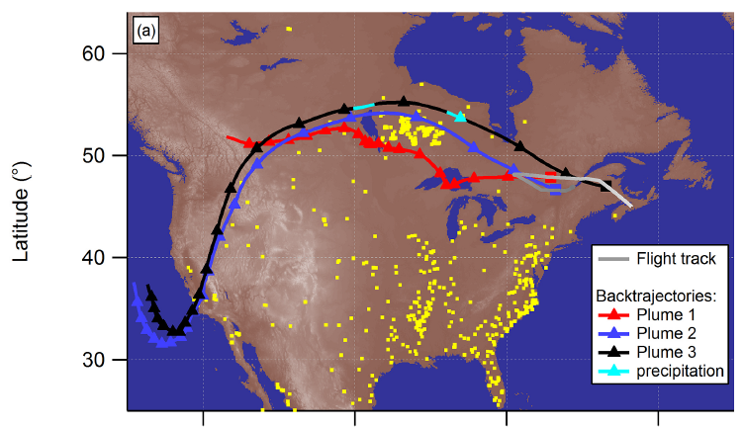
Size-dependent wet removal of BC in Canadian biomass burning plumes (Taylor et al, 2014: ACP)
Background:
Wet deposition is the dominant removal mechanism for BC
Nevertheless: few case studies in ambient environments exist
In biomass burning plumes, hydrophobic BC is coated in (relatively more) hydrophilic organic material within hours after emission
Data: BORTAS-B aircraft campaign, BC size distributions + coating properties
Results:
Plumes passing through precipitating clouds (Plume 3) showed reductions in BC number & mass
BC particles with large coatings were preferentially removed; organic material coatings removed
WARNING:
FIELD STUDY

Slide 17
Summary
Biomass burning aerosol has different effects on clouds depending on the circumstances of the aerosol
i.e. plume height, temperature, organic content, extent of atmos. aging, etc.
Biomass burning aerosols can:
Increase CCN/droplet numbers and thereby increase cloud spatial extent and lifetime
Invigorate convection
Suppress cloud formation or cause cloud burn off
In turn, clouds can affect biomass burning aerosol emissions through wet deposition and cloud processing

Slide 18
Useful papers to read
Biomass burning effect on cloud dynamics: Earle et al., 2011; Jouan et al., 2012; Lance et al., 2011; Lindsey and Fromm, 2008; Rosenfeld et al., 2007; Tietze et al., 2011
Biomass burning effect on precipitation and regional heating: Kay et al., 2008; Kay and Gettelman, 2009; Lubin and Vogelmann, 2006; Vavrus et al., 2010

Slide 19
References
Bougiatioti, A., S. Bezantakos, I. Stavroulas, N. Kalivitis, P. Kokkalis, G. Biskos, N. Mihalopoulos, A. Papayannis, and A. Nenes. "Influence of Biomass Burning on CCN Number and Hygroscopicity during Summertime in the Eastern Mediterranean." Atmospheric Chemistry and Physics Discussions Atmos. Chem. Phys. Discuss. 15.15 (2015): 21539-1582.
Feingold, Graham. "On Smoke Suppression of Clouds in Amazonia." Geophys. Res. Lett. Geophysical Research Letters 32.2 (2005): n. pag.
Jacobson, Mark Z. "Effects of Biomass Burning on Climate, Accounting for Heat and Moisture Fluxes, Black and Brown Carbon, and Cloud Absorption Effects." Journal of Geophysical Research: Atmospheres J. Geophys. Res. Atmos. 119.14 (2014): 8980-9002.
Kaufman, Y. J., I. Koren, L. A. Remer, D. Rosenfeld, and Y. Rudich. "The Effect of Smoke, Dust, and Pollution Aerosol on Shallow Cloud Development over the Atlantic Ocean." Proceedings of the National Academy of Sciences 102.32 (2005): 11207-1212.
Koch, D., and A. D. Del Genio. "Black Carbon Semi-direct Effects on Cloud Cover: Review and Synthesis." Atmospheric Chemistry and Physics Atmos. Chem. Phys. 10.16 (2010): 7685-696.
Petters, Markus D., Christian M. Carrico, Sonia M. Kreidenweis, Anthony J. Prenni, Paul J. Demott, Jeffrey L. Collett, and Hans Moosmüller. "Cloud Condensation Nucleation Activity of Biomass Burning Aerosol." J. Geophys. Res. Journal of Geophysical Research 114.D22 (2009): n. pag.
Petters, Markus D., Matthew T. Parsons, Anthony J. Prenni, Paul J. Demott, Sonia M. Kreidenweis, Christian M. Carrico, Amy P. Sullivan, Gavin R. Mcmeeking, Ezra Levin, Cyle E. Wold, Jeffrey L. Collett, and Hans Moosmüller. "Ice Nuclei Emissions from Biomass Burning." J. Geophys. Res. Journal of Geophysical Research 114.D7 (2009): n. pag.
Taylor, J. W., J. D. Allan, G. Allen, H. Coe, P. I. Williams, M. J. Flynn, M. Le Breton, J. B. A. Muller, C. J. Percival, D. Oram, G. Forster, J. D. Lee, A. R. Rickard, and P. I. Palmer. "Size-dependent Wet Removal of Black Carbon in Canadian Biomass Burning Plumes." Atmospheric Chemistry and Physics Discussions Atmos. Chem. Phys. Discuss. 14.13 (2014): 19469-9513.
Zamora, L. M., R. A. Kahn, M. J. Cubison, G. S. Diskin, J. L. Jimenez, Y. Kondo, G. M. Mcfarquhar, A. Nenes, K. L. Thornhill, A. Wisthaler, A. Zelenyuk, and L. D. Ziemba. "Aircraft-measured Indirect Cloud Effects from Biomass Burning Smoke in the Arctic and Subarctic." Atmospheric Chemistry and Physics Discussions Atmos. Chem. Phys. Discuss. 15.16 (2015): 22823-2887.

