Slide 1
Coal Refuse FirE and pollution emissions
nicole swartwood
atmospheric chemistry
april 19, 2016

Slide 2
Motivation
“The contribution of coal fires to the global pool of atmospheric CO₂ is little known but potentially significant.” –USGS, 2009
Coal fire remediation project costs exceeds $1 million
90% of these funds in PA and WV
No accurate inventory unofficial estimates ~150 uncontrolled surface and underground mine fires in US as of 2003.

Slide 3
What is coal refuse? aka Gob piles, slate dumps, coal refuge, and waste piles
EPA: waste products of coal mining, physical coal cleaning, and coal preparation operations containing coal, matrix material, clay and other organic and in organic material.
PA regulations: “any waste coal, rock, shale, slurry, culm, gob, boney, slate, clay and related materials, associated with or near a coal seam, which are either brought aboveground or otherwise removed from a coal mine in the process of mining coal or which are separated from coal during the cleaning or preparation operations. The term includes underground development wastes, coal processing wastes, excess spoil, but does not mean overburden from surface mining activities.”

Slide 4
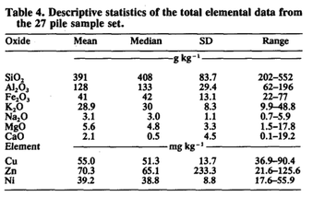
Chemical composition
Carbon makes up about 1/3 of
coal refuse.
Stewart, 1992.

Slide 5
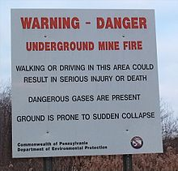
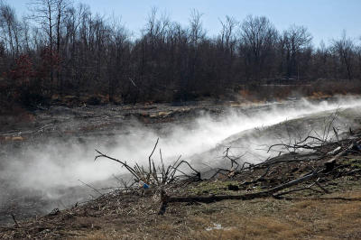
Coal refuse fires
Natural and anthropogenic
Difficult to extinguish
long lifetimes
Particularly dangerous if they reach original coal seam

Slide 6
Mechanism
Notes:
Particle size—smaller size exposese greater total surface area to oxidation, more rapid oxidation, but fine, tight packed can reduce air flow and reduce oxidation.

Slide 7
Products of combustion
Gases
Hydrocarbons
Hydrogen
Carbon monoxide
Complete combustion: CO2 and H2O
Others
Particulates
Products of incomplete combustion: carbon suspended as smoke.
Notes:
Dependent on
o2 concentration in the pile – particle size, type of surface, and windspeed.
type of coal
relative humidity
moisture content of coal
type of refuse
temperature

Slide 8
Fell Township, PA
a case study

Slide 9
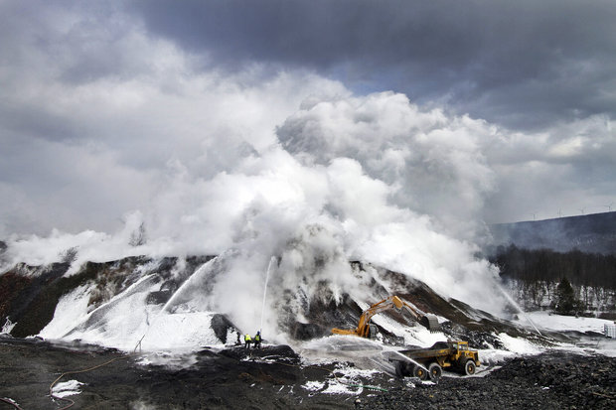
FELL TOWNSHIP, PA
December –May 2014
Notes:
Covers approximately 7 acres in simpson PA /FELL TOWNSHIP/LACKAWANNA COUNTY
LIKELY STARTED BY BURNING TRASH, TIRES

Slide 10
“Our air sampling during the peak of the fire indicated that the public was not at risk of inhaling dangerous fumes.” Northeast Regional Office Director, Mike Bedrin
http://thetimes-tribune.com/news/dep-fell-twp-fire-extinguished-1.1690008

Slide 11
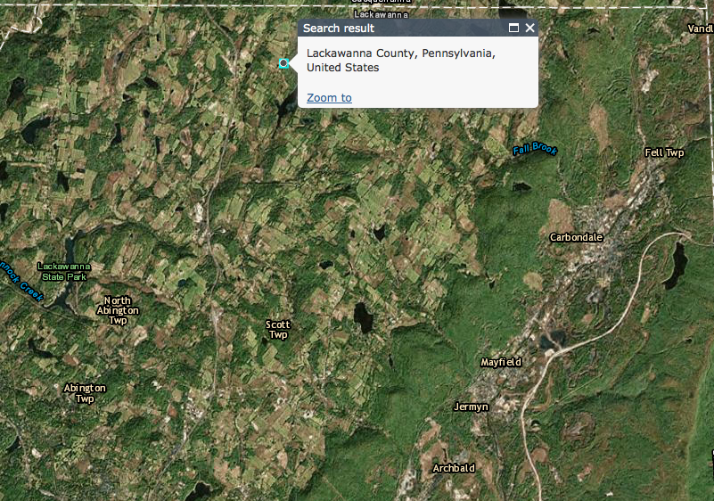
EPA
AirData

Slide 12
Notes:
National standard of 9 ppm for 8 hours

Slide 13
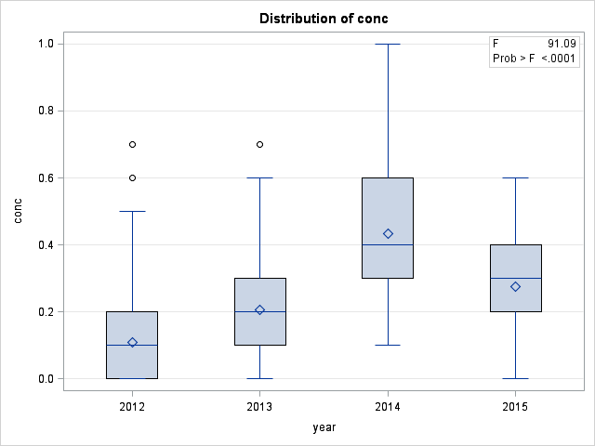
Estimated .237 ppm increase in daily high average.

Slide 14
Notes:
National standard of 12

Slide 15
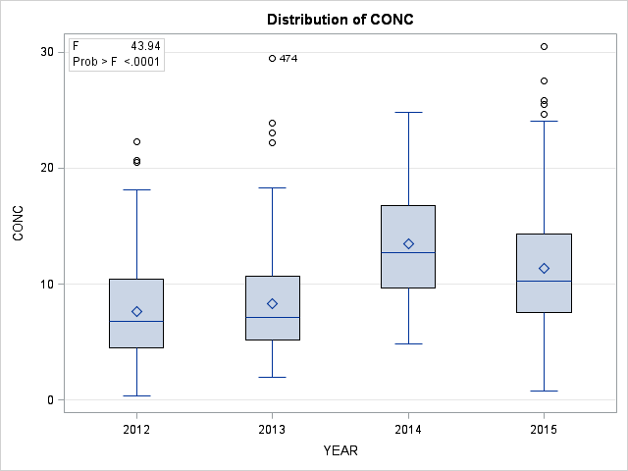
Estimated 4.38 ug/m3 increase in daily high average.

Slide 16
Notes:
53 ppb over one year

Slide 17
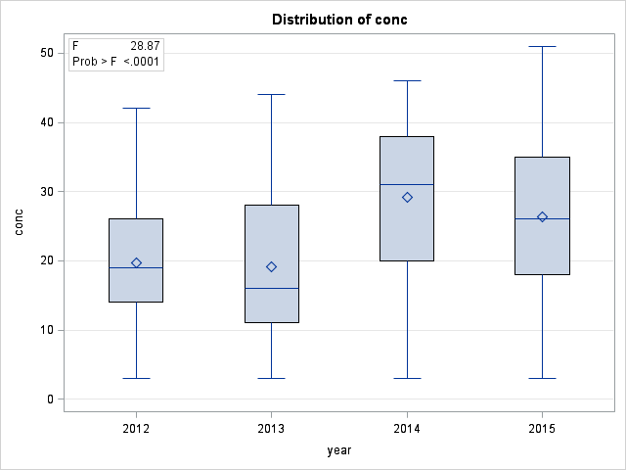
Estimated increase of 7.425 ppb, daily high average.

Slide 18
Notes:
8 hours of 0.070

Slide 19
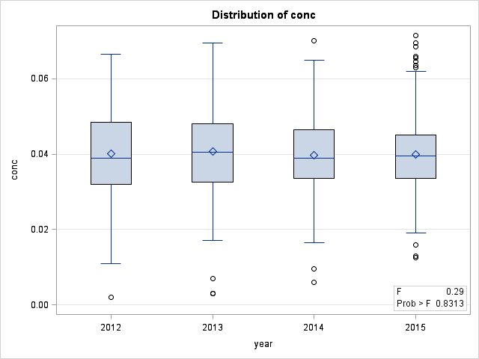
Estimated 0.0006 ppm increase daily high average.

Slide 20
Impacts
Health effects are unclear
Research focuses on industrial combustion by products
Chemical differences between industrial useful coal and coal refuse makes these studies weak.
Finkelman, 2004.

Slide 21
references
EPA. 1978. Source Assessment: Coal Refuse Piles, Abandoned Mines and Outcrops, State of the Art.
Finkelman, R.B., 2004, Potential health impacts of burning coal beds and waste banks: International Journal of Coal Geology, v. 59, p. 19–24.
Stewart, B.R. and W.L. Daniels. 1992. Physical and Chemical Properties of Coal Refuse from Southwest Virginia: J. Environ. Qual, v. 21, p. 635-642.
USGS. 2009. Emissions from Coal Fires and Their Impact on the Environment: Fact Sheet.

