Slide 1
The effect of natural and anthropogenic emissions on the IN activity of mineral dust

Slide 2
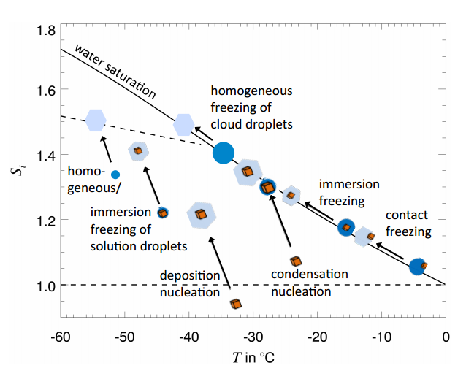
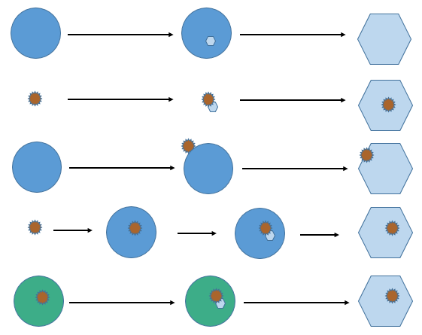
Freezing Pathways
Homogenous →
Deposition →
Contact →
Condensation →
Immersion →
Hoose & Mohler, 2012

Slide 3
Stochastic Freezing Model
Classical Nucleation Theory
Nucleation is a stochastic process
$f_{ice}=\frac{n_{ice}}{n}=1−\exp\left(−J_{hom}Vt\right)$
Single Component Stochastic Model
If IN are present, it enhances nucleation efficiency but assumes it’s still a time-dependent process
$f_{ice}=\frac{n_{ice}}{n}=1−\exp\left(−J_{het}st\right)$
Critical cluster
Notes:
--homogenous nucleation is purely stochastic

Slide 4
Singular Model
Nucleation depends on nucleation sites with a characteristic temperature, rather than time and random fluctuations
Predicts if there is only one type of nucleation site, all drops will freeze at the shared T_{c}
$f_{ice}=\frac{n_{ice}}{n}=1−\exp\left(−n_{s}\left(T\right)s\right)$
T_{c}

Slide 5
Multi-Component Stochastic Model
Assumes droplets have many different active sites, each with different efficiencies
The most efficient site determines the characteristic temperature
Allows for some time dependence while accounting for the higher T_{c} from efficient IN
Equations to fit data:
$f_{ice}=\frac{n_{ice}}{n}=1−\exp\left(−J\left(T\right)st\right)$
$J\left(T\right)= \frac{−ln⁡(1−f_{ice})}{SA∙∆t}$
Parameterizations based off of fit for climate models:
$\ln\left(J_{i}\left(T\right)\right)=−a_{i}∙T+ b_{i}$
$a_{i}$ and $b_{i}$ are adjustable parameters based on probabilities of nucleation sites

Slide 6
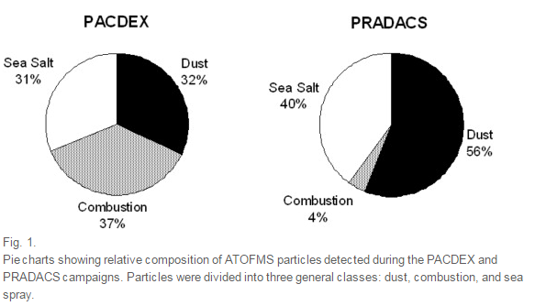
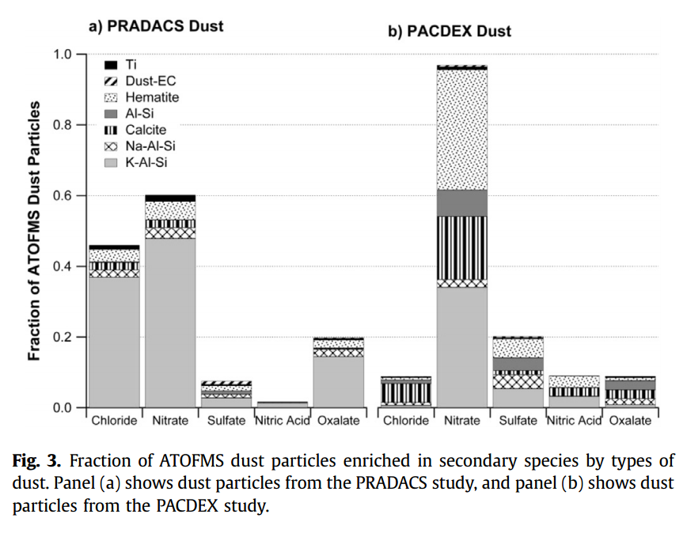
Dust and Ice Nucleation
Pure dust is a relatively efficient ice nuclei (IN)
Depending on mineral composition, size, etc. freezing temperatures range from ~ -20 to -35ºC
Transport can affect the composition of cloud droplets containing dust (or even the dust itself)
This can change the temperatures at which dust will freeze in a given cloud
Fitzgerald, et al., 2015

Slide 7
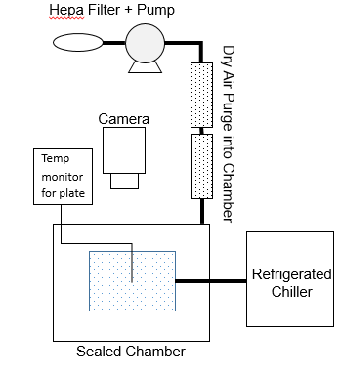
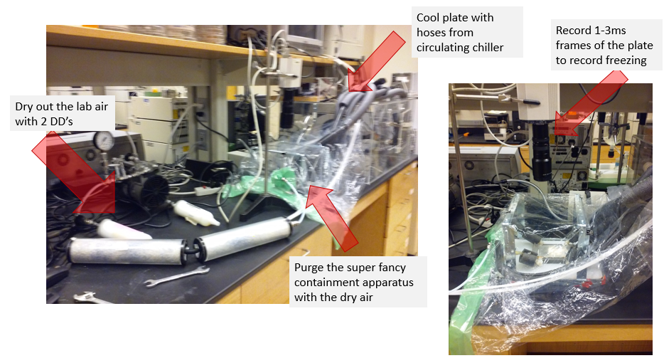
Instrument Development/Set-Up
Continuous video recording of the plate to monitor freezing

Slide 8
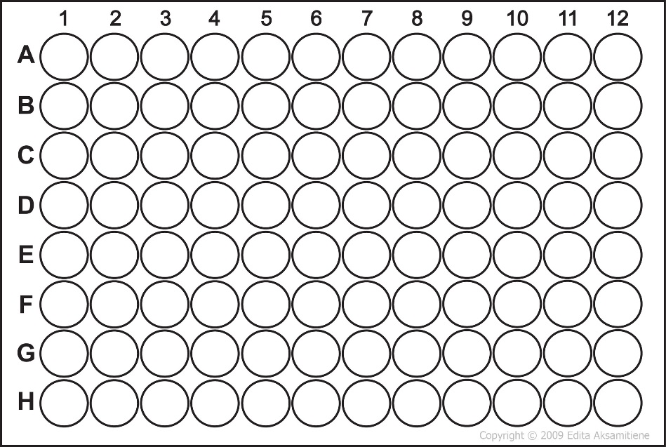
Methods
Hydrophobic slides (contact angle at least 100º) to maintain droplet shape
Samples with four different concentrations of ATD and salts
12 droplets per sample
Droplets cooled at a constant rate of -0.5ºC per minute
Cooled from ambient temperature to homogeneous freezing temp (~36ºC)
Temp of plate and bath continuously recorded to compare against time of recording
Sample 1
Decreasing concentration
Sample 2
Sample 3
Sample 4

Slide 9
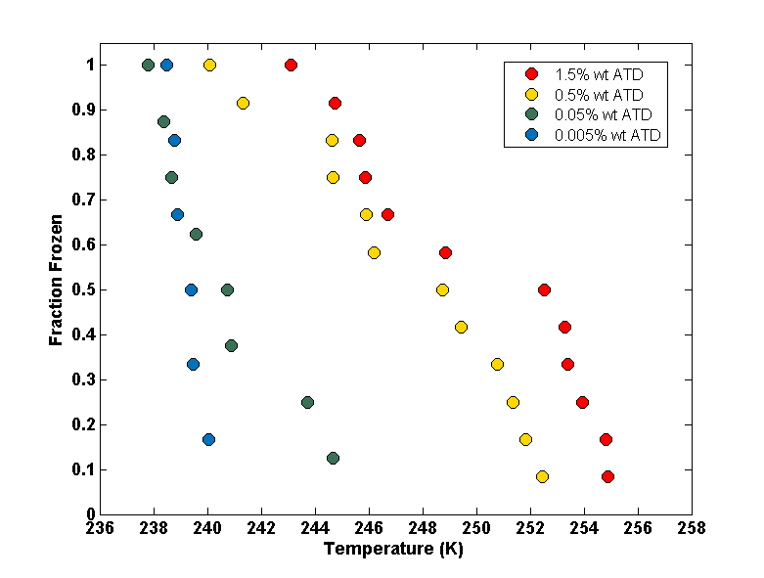
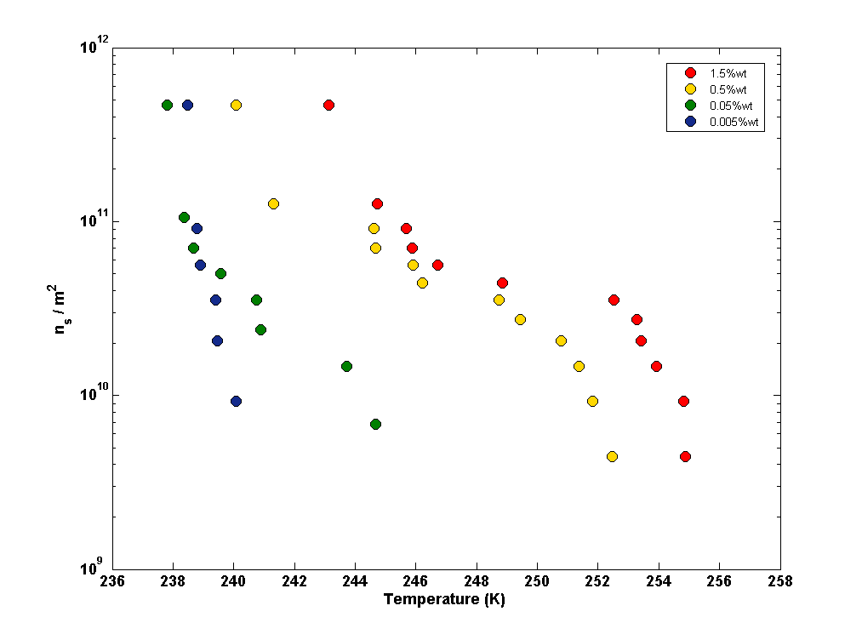
Pure ATD samples
Study | Onset Nucleation Temp*
Welti, et al. 2009 | ~250-240K depending on Dp
Kanji and Abbatt, 2010 | ~250-235K for Dp = 100nm
Marcolli, et al. 2007** | ~250-245K depending on wt%
Kanji, et al. 2011 | ~255-235K for Dp > 5µm
Koehler, et al 2010 | ~250-235 depending on Dp
*the temp at which 1% of drops have frozen
**the concentrations they used were 1-20% wt which raised onset temps slightly

Slide 10
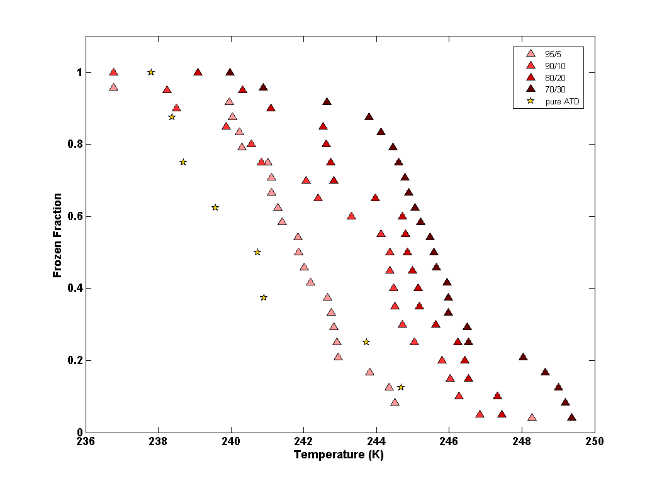
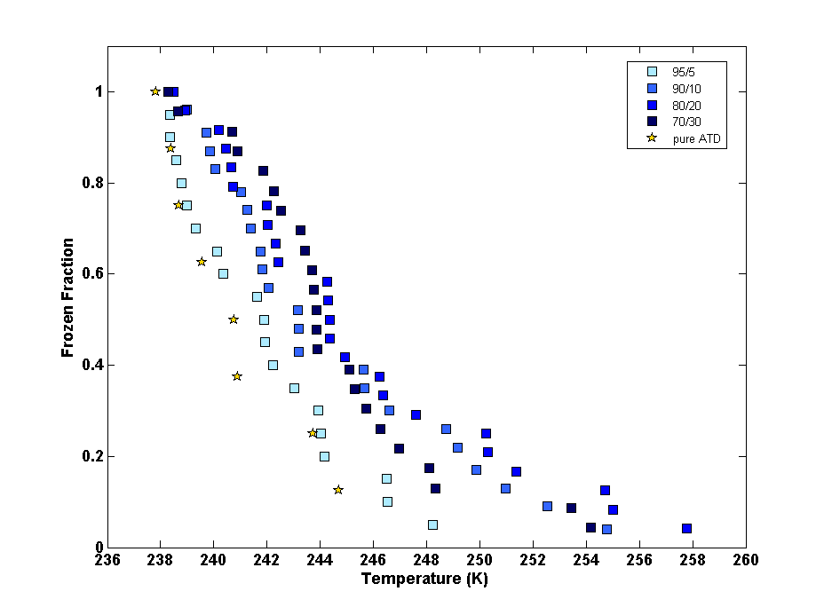
Ammonium Sulfate vs. Sodium Chloride (anthropogenic vs. sea transport influences)
Ammonium Sulfate
Sodium Chloride

Slide 11
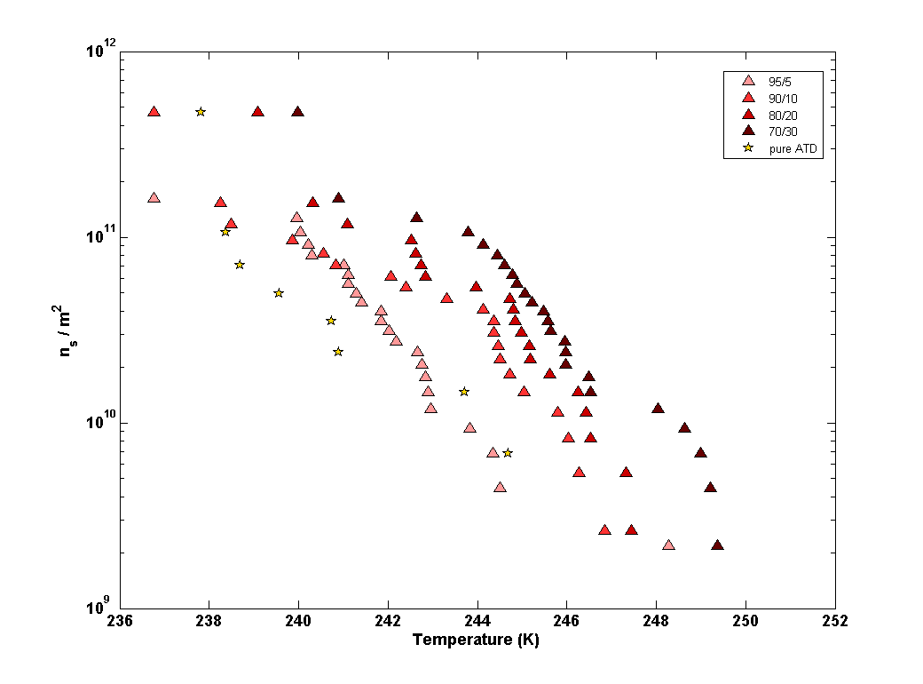
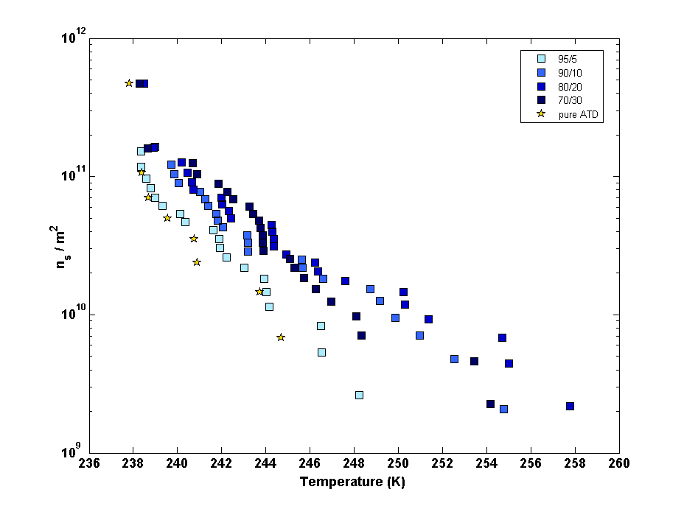
Ammonium Sulfate vs. Sodium Chloride (anthropogenic vs. sea transport influences)
Ammonium Sulfate
Sodium Chloride

Slide 12
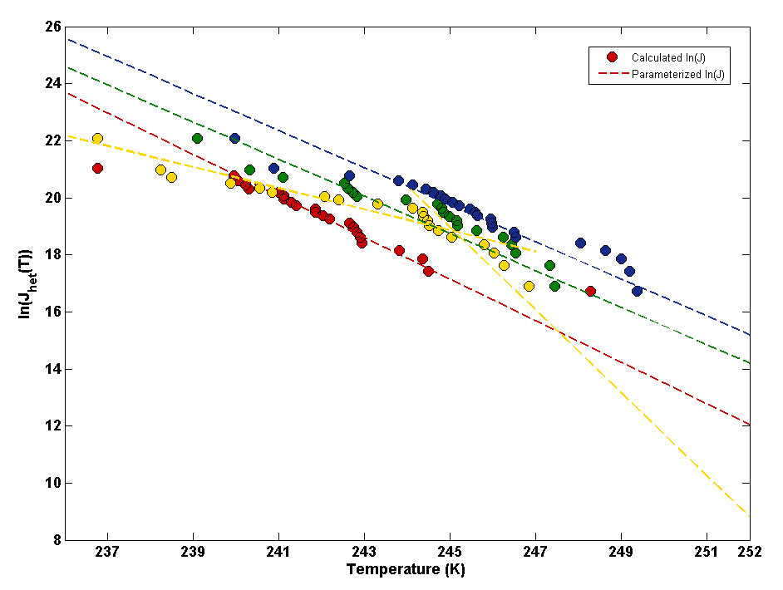
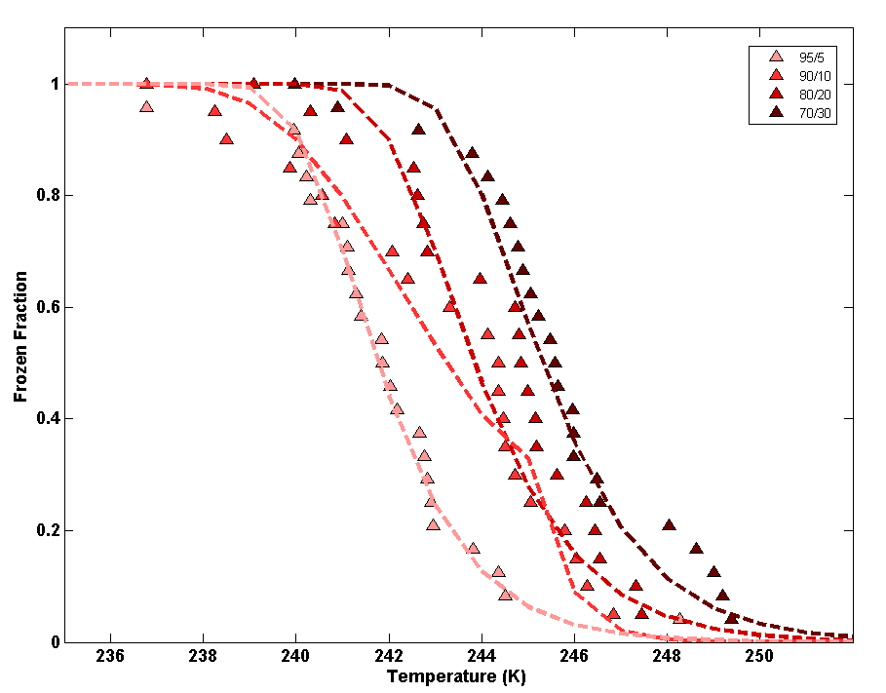
Suggested Parameterizations Based on the Data: Ammonium Sulfate
Sample | a |  | b
95/5 (red) | 0.728 |  | 195.50
90/10 (yellow) | T > 245 → 1.45 | T < 245 → 0.37 | T > 245 → 374.2 | T < 245 → 109.5
80/20 (green) | 0.650 |  | 178.00
70/30 (blue) | 0.650 |  | 178.95

Slide 13
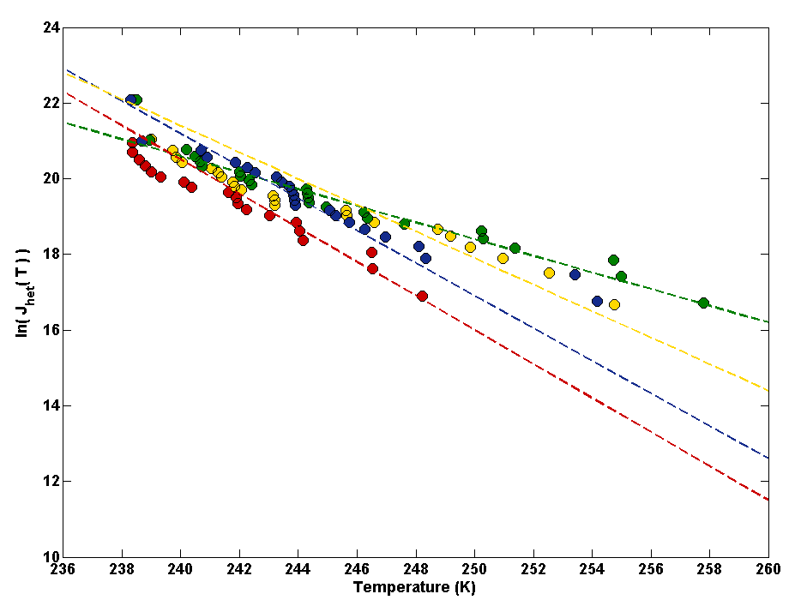
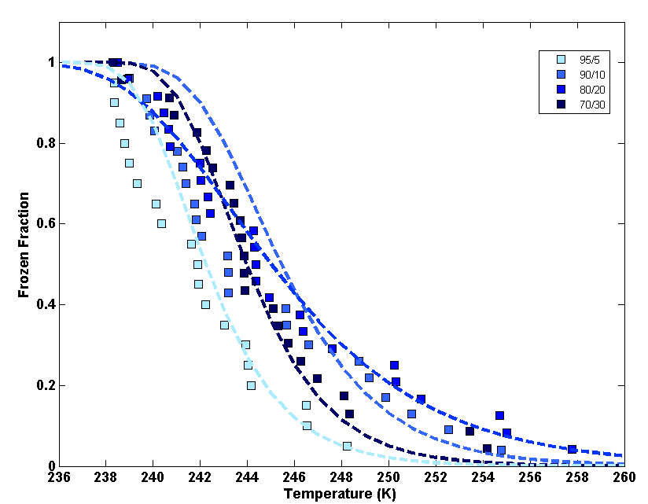
Suggested Parameterizations Based on the Data: Sodium Chloride
Sample | a | b
95/5 (red) | 0.450 | 128.50
90/10 (yellow) | 0.350 | 105.40
80/20 (green) | 0.220 | 73.40
70/30 (blue) | 0.430 | 124.4

Slide 14
Summary and Conclusions
Results were VERY different from what I expected
Salts normally depress freezing temp of droplets so why did it increase IN potential?
(obviously this study is very limited and more analysis would be needed to determine the mechanics behind this effect)
Potentially, transport across seas/oceans will increase IN potential of desert dust more than transport through polluted areas
Suggested parameters for these specific conditions calculated
(however these are somewhat basic and improved params. would require further evaluation of the data)

Slide 15
Acknowledgements
The Rousseau group for letting me adopt their cold stage
The Ng group for contributing the Teflon sheeting to make my chamber
My group, especially:
My advisor, Dr. Nenes
My mentor and post doc in our group, Samantha Waters

