Slide 1
Ambient Size Distributions and Estimated Deposition of Oxidative Potential in Human Respiratory System
Ting Fang, Linghan Zeng, Rodney Weber
Thursday, April 21th, 2016

Slide 2
Background
Particulate matters (PM) lead to adverse health effects [Aust et al., 2002; Pope et al., 2004; Harkema et al., 2004 and more…]
Mechanisms are unclear
PM has varying toxic components (metals, PAHs, etc)
PM mass is currently used in air quality standards
need a more biological relevant metric than the bulk PM concentration
Reactive Oxygen Species (ROS) induce oxidative stress [Li et al., 2003]
OP is defined as the capability of particles to generate ROS
OP was measured with the (dithiothreitol) DTT and (ascorbic acid) AA assay
DTT assay | AA (Ascorbic Acid) assay
chemical surrogate to biological antioxidant | physiological antioxidant in lung lining fluid
PM
PM
$$DTT+ O_{2}+H^{+}$$
$${DTT}_{ox}+H_{2}O_{2}$$
$$AA+2 O_{2}$$
$${AA}_{ox}+2 O_{2}^{∙}$$
pH=7.4
T=37°C
pH=7.4
T=37°C
[Cho et al., 2005]
[Ayres et al., 2008]

Slide 3
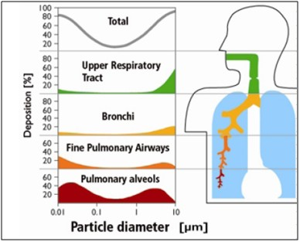
Why we care about size?
From: www.icao.int/environmental-protection/PublishingImages/HealthEffects_2.jpg
Size → deposition → chemical components

Slide 4
Method
Sampling tool (0.056 – 18 µm):
Micro-Orifice Uniform Deposit Impactors
10 stages
Duration:
7 days
Sampling site: rooftop (GT) and next to highway (RS)
IC – sulfate
OC, EC
Water-soluble DTT activity
Water-soluble AA activity

Slide 5
Results – collected on different days
Two modes for OC/EC;
OC EC higher by the road;
Sulfate mainly in fine mode.
Dpg (µm)

Slide 6
Results – collected on different days
Not typical size distributions.

Slide 7
GT site

Slide 8
GT site
sulfate

Slide 9
GT site
Total Cu:
Mechanical generation
sulfate

Slide 10
GT site
Total Cu:
Mechanical generation
sulfate
WS_Cu:
Mechanical generation

Slide 11
GT site
Low pH effect
Total Cu:
Mechanical generation
sulfate
WS_Cu:
Mechanical generation

Slide 12
GT site
Low pH effect
Total Cu:
Mechanical generation
Solubilized Cu
sulfate
WS_Cu:
Mechanical generation

Slide 13
GT site
Low pH effect
Total Cu:
Mechanical generation
Solubilized Cu
sulfate
WS_Cu:
Mechanical generation

Slide 14
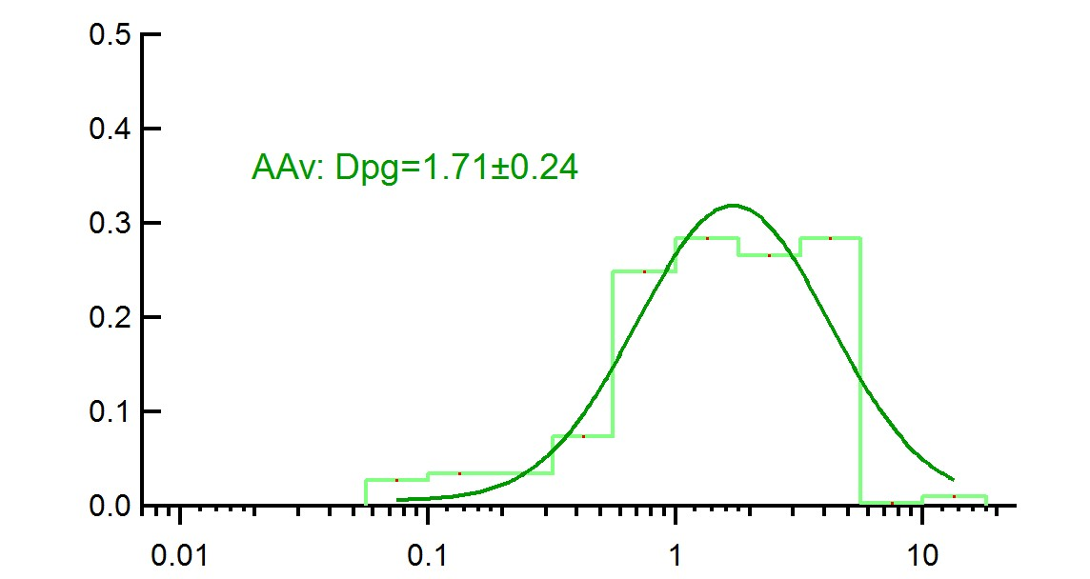
GT site
Solubilized Cu
WS_Cu:
Mechanical generation
AA activity is mainly correlated with Cu. [Fang et al., 2016; Janssen et al., 2014; Künzli et al., 2006]

Slide 15
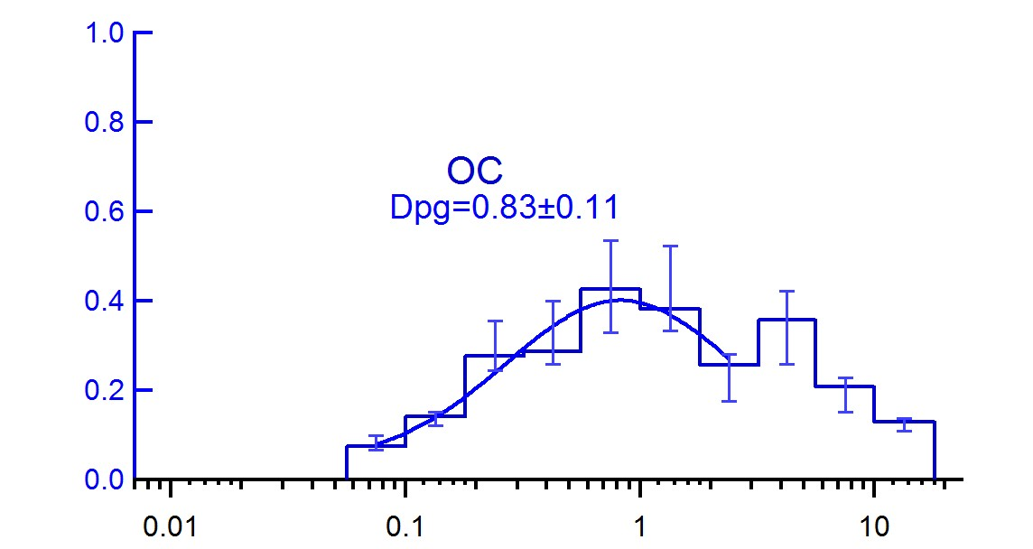
GT site
Solubilized Cu
WS_Cu:
Mechanical generation

Slide 16
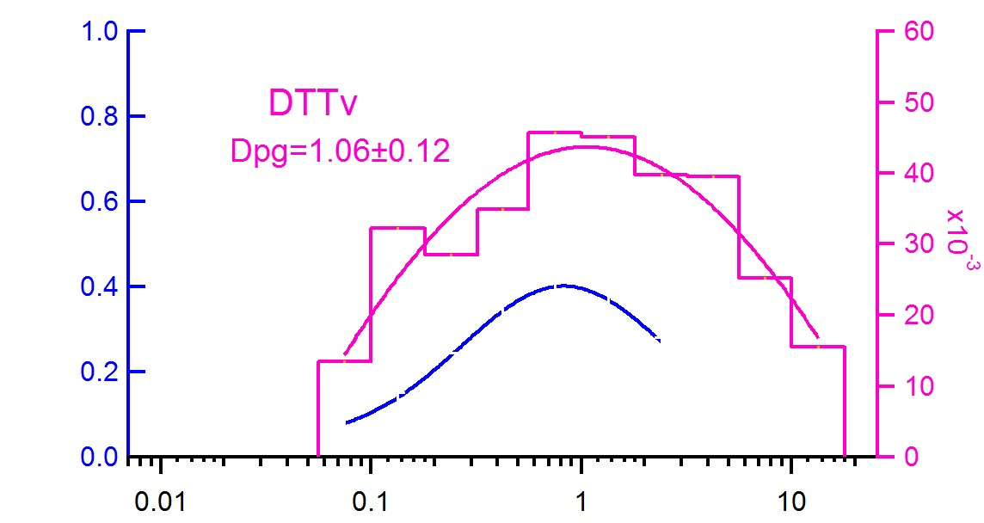
GT site
Contribution from both organics and metals
OC
Cu
DTT activity is correlated with Organic and metals [Fang et al., 2016].

Slide 17
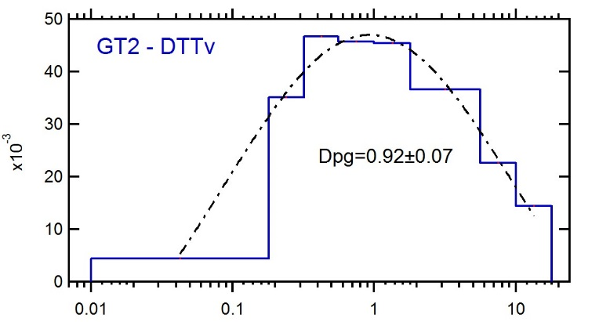
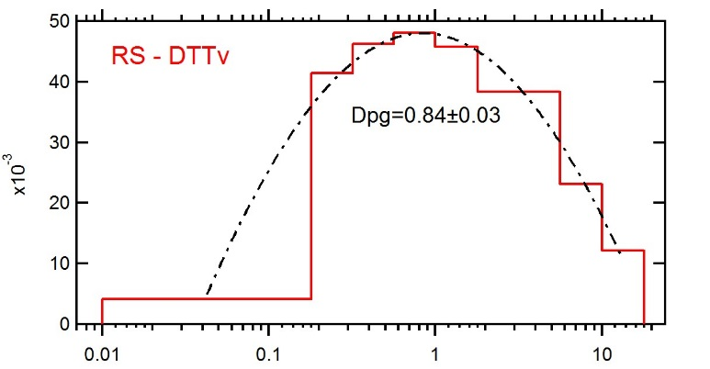
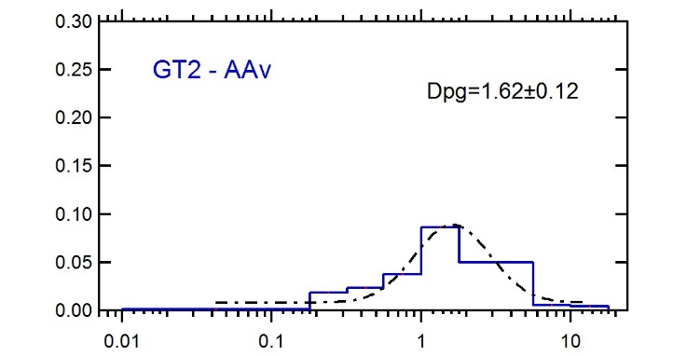
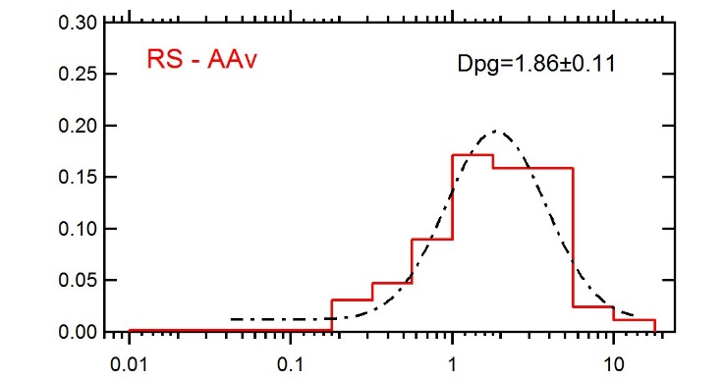
Comparing sites – collected simultaneously
Similar DTT levels between sites;
RS has higher AA levels than GT site;
AA peaks at larger sizes than DTT.

Slide 18
Ultrafine particles have higher intrinsic OP, but are UF the most important?
Compared DTT/OC to EPA CAPs data

Slide 19
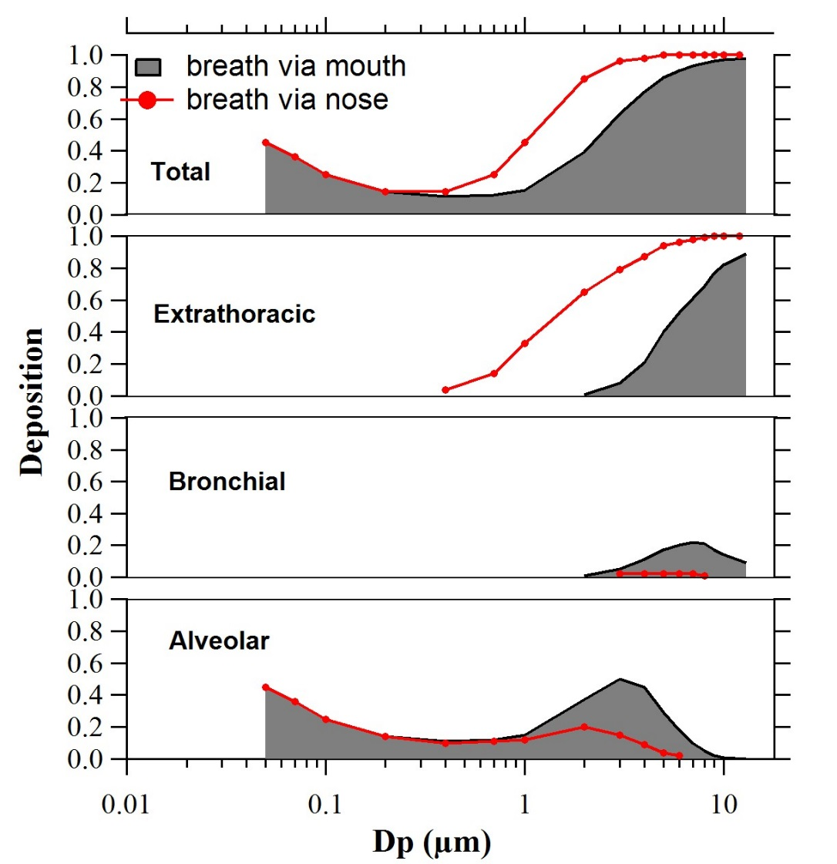
Deposition of aerosols in human respiratory tract
750 cm³/s mean flow rate; breathing cycle period of 4 s; 1500 cm³ tidal volume. [Heyder et al,, 1986]
[Dombu and Betbeder, 2013]

Slide 20
Deposition of aerosols in human respiratory tract
Deposition of oxidative potential in human respiratory tract
750 cm³/s mean flow rate; breathing cycle period of 4 s; 1500 cm³ tidal volume. [Heyder et al,, 1986]

Slide 21
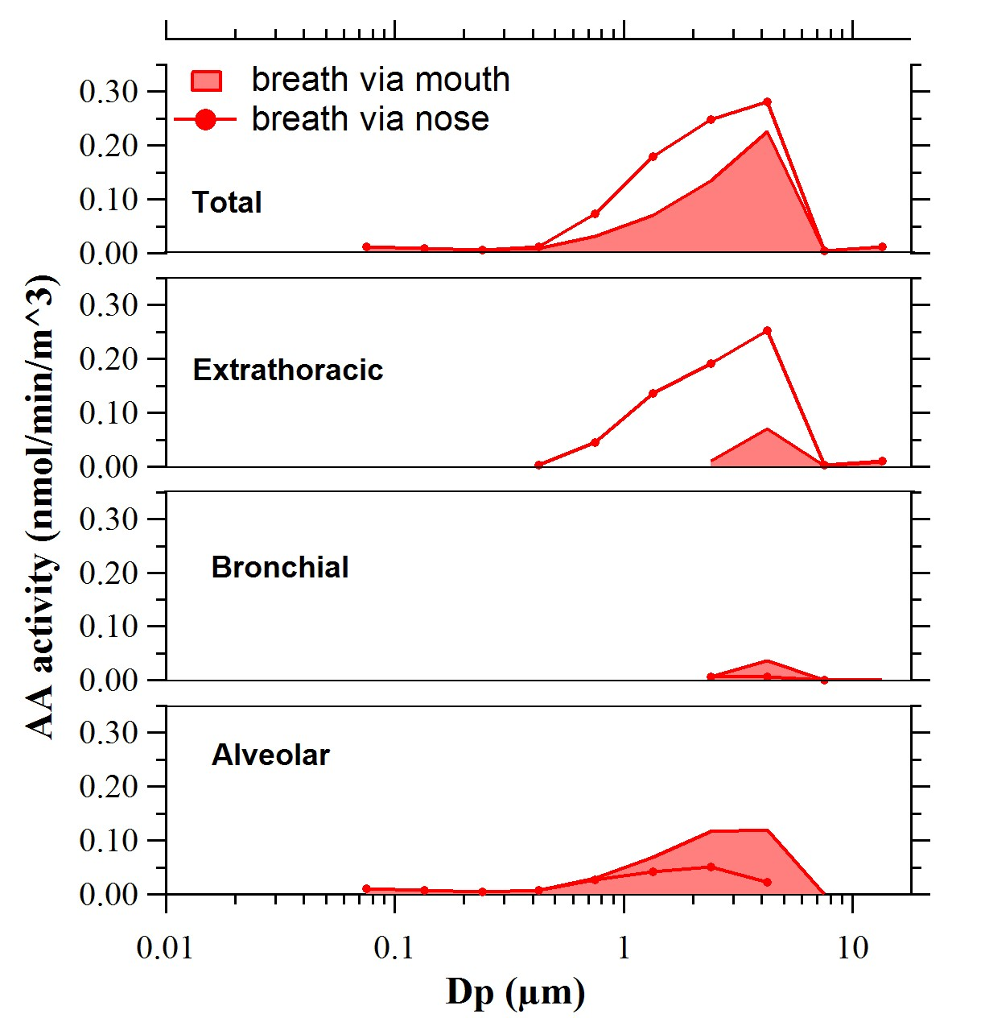
GT DTTv
Deposition of OP in human respiratory tract
GT AAv

Slide 22
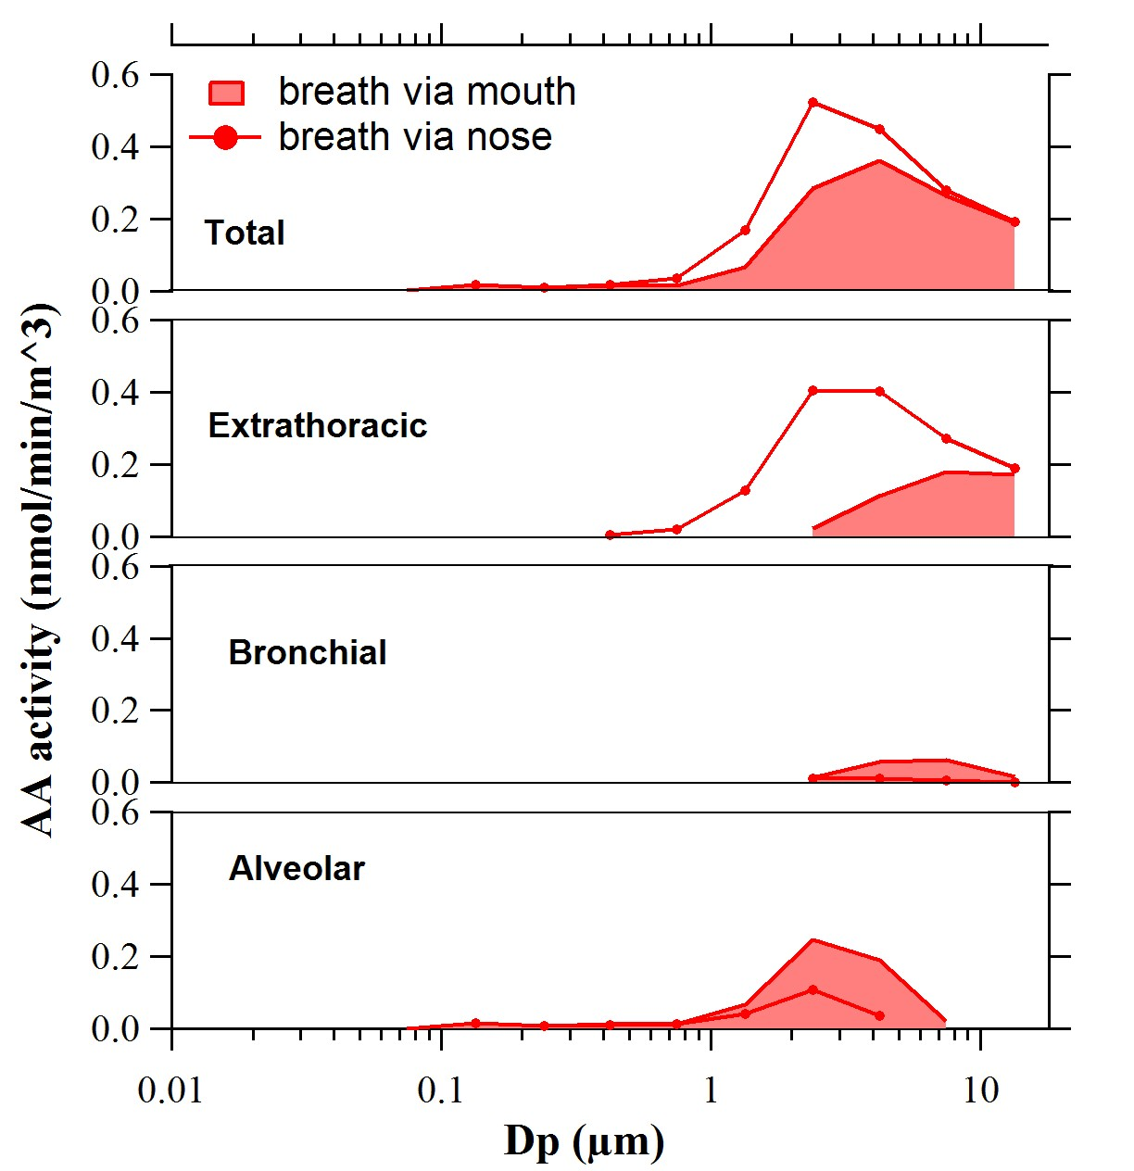
RS DTTv
Deposition of OP in human respiratory tract
RS AAv

Slide 23
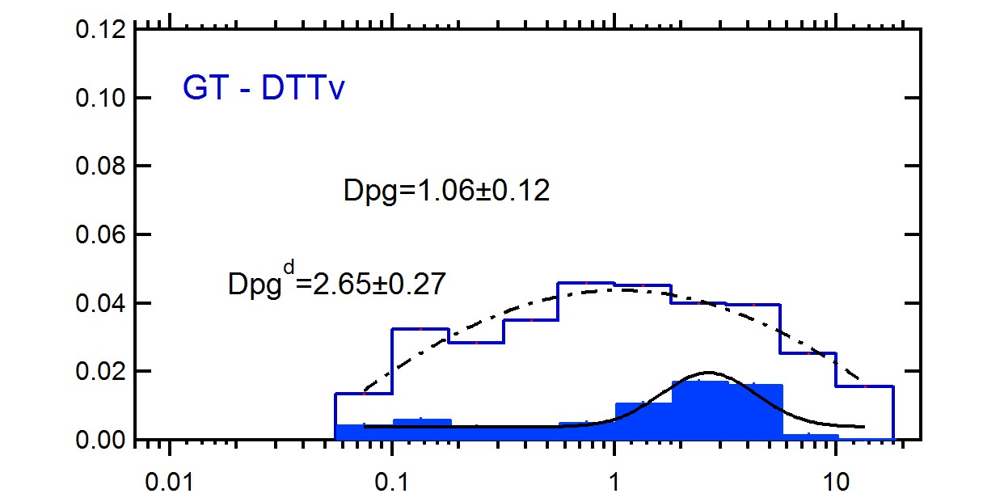
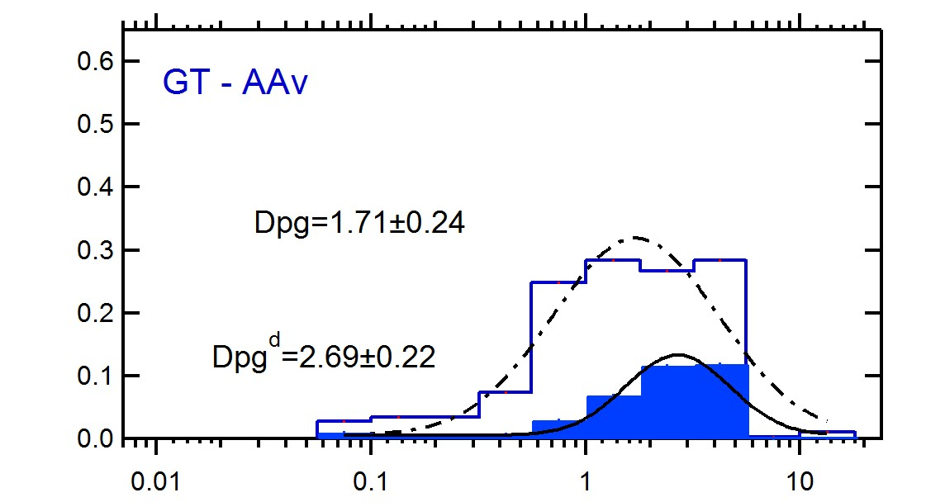
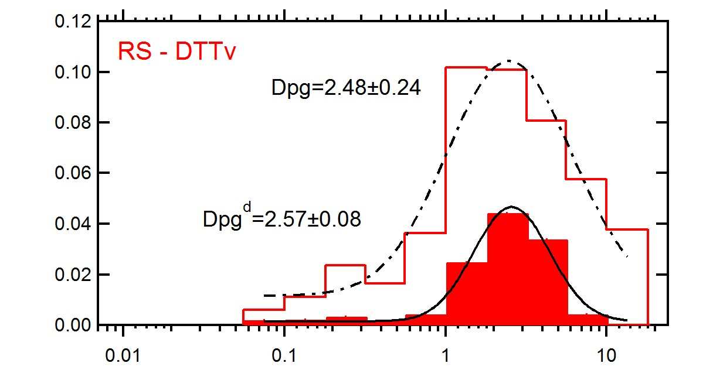
How much from ambient might get into blood circulation?
Cityscape – ambient size distribution; bars – deposited in alveolar regions
Breath via mouth

Slide 24
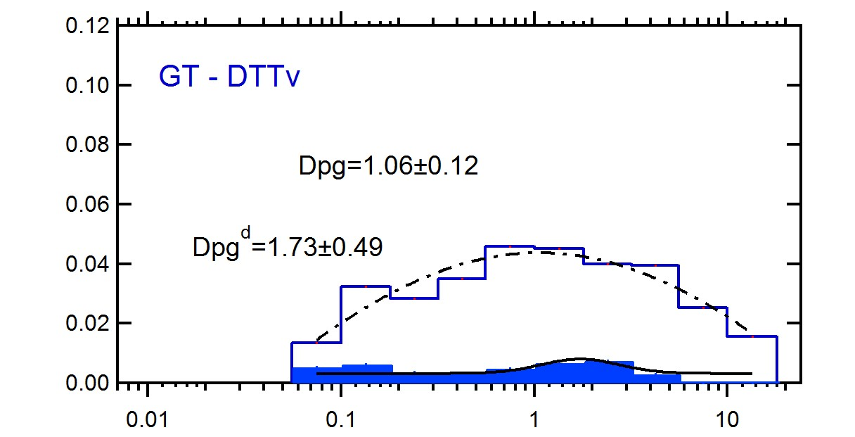
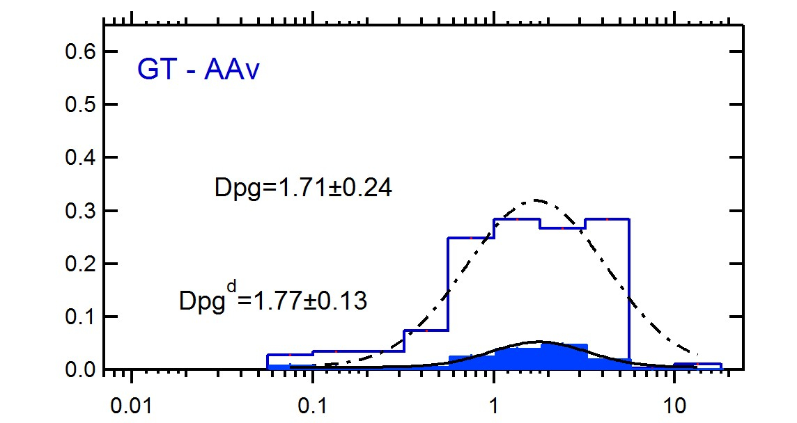
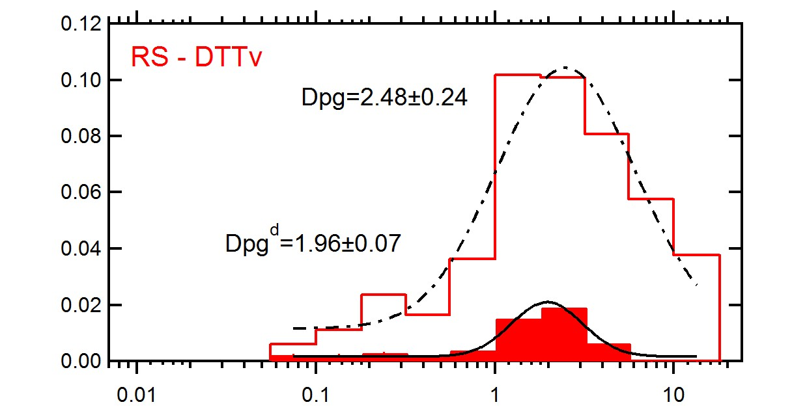
How much from ambient might get into blood circulation?
Cityscape – ambient size distribution; bars – deposited in alveolar regions
Breath via nose

Slide 25
Summary
DTT and AA activity size distributions are not typical textbook distribution (DTT peaks ~1µm; AA peaks ~2µm);
Size distribution adds insights into the contribution of organic and metals species to DTT and AA;
Although ultrafine particles have generally higher intrinsic OP, fine and coarse particles contribute largely to most of the inhaled (and deposited) aerosols OP, so are potentially more important in terms of health effects.

Slide 26
References
Ayres JG, Borm P, Cassee FR, Castranova V, Donaldson K, Ghio A, et al. 2008. Evaluating the toxicity of airborne particulate matter and nanoparticles by measuring oxidative stress potential-a workshop report and consensus statement. Inhalation toxicology 20:75-99.
Cho AK, Sioutas C, Miguel AH, Kumagai Y, Schmitz DA, Singh M, et al. 2005. Redox activity of airborne particulate matter at different sites in the los angeles basin. Environmental research 99:40-47.
Aust AE, Ball JC, Hu AA, Lighty JS, Smith KR, Straccia AM, et al. 2002. Particle characteristics responsible for effects on human lung epithelial cells:Health Effects Institute.
Dombu CY, Betbeder D. 2013. Airway delivery of peptides and proteins using nanoparticles. Biomaterials 34:516-525.
Fang T, Verma V, Bates JT, Abrams J, Klein M, Strickland MJ, et al. 2016. Oxidative potential of ambient water-soluble pm2.5 in the southeastern united states: Contrasts in sources and health associations between ascorbic acid (aa) and dithiothreitol (dtt) assays. Atmos Chem Phys 16:3865-3879.
Harkema JR, Keeler G, Wagner J, Morishita M, Timm E, Hotchkiss J, et al. 2004. Effects of concentrated ambient particles on normal and hypersecretory airways in rats. Res Rep Health Eff Inst 120:1-68.
Heyder J, Gebhart J, Rudolf G, Schiller CF, Stahlhofen W. 1986. Deposition of particles in the human respiratory tract in the size range 0.005–15 μm. Journal of Aerosol Science 17:811-825.
Janssen NAH, Yang A, Strak M, Steenhof M, Hellack B, Gerlofs-Nijland ME, et al. 2014. Oxidative potential of particulate matter collected at sites with different source characteristics. Science of The Total Environment 472:572-581.
Künzli N, Mudway IS, Götschi T, Shi T, Kelly FJ, Cook S, et al. 2006. Comparison of oxidative properties, light absorbance, and total and elemental mass concentration of ambient pm(2.5) collected at 20 european sites. Environmental Health Perspectives 114:684-690.
Li N, Hao M, Phalen RF, Hinds WC, Nel AE. 2003. Particulate air pollutants and asthma: A paradigm for the role of oxidative stress in pm-induced adverse health effects. Clinical Immunology 109:250-265.
Pope CA, Burnett RT, Thurston GD, Thun MJ, Calle EE, Krewski D, et al. 2004. Cardiovascular mortality and long-term exposure to particulate air pollution: Epidemiological evidence of general pathophysiological pathways of disease. Circulation 109:71-77.

Slide 27
Acknowledgement
Rodney Weber
Hongyu Guo; Linghan Zeng; Dong Gao
R834799
THANK YOU! QUESTIONS?
This work was made possible by US EPA grant R834799. The contents are solely the responsibility of the grantee and do not necessarily represent the official views of the US EPA. Further, US EPA does not endorse the purchase of any commercial products or services mentioned in the work.

