Slide 1
Temporal relationship between Ozone and PM2.5
Congmeng Lyu

Slide 2
Content
1.Introduction
2.project background
3. Results
4. Interpret
5. More to do

Slide 3
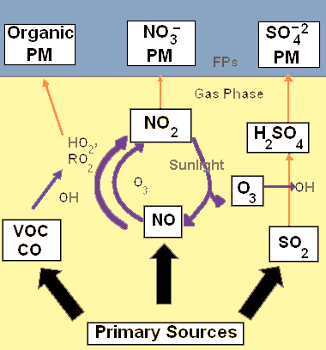
1. Introduction
Tropospheric Ozone and PM2.5 share common sources and formation routes.

Slide 4
1.Introduction
Questions:
What’s the relationship between ozone and PM2.5 concentrations?
Is it possible to control these two pollutants together?
Which species will be the most effective one ?

Slide 5
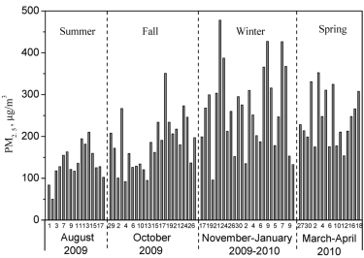
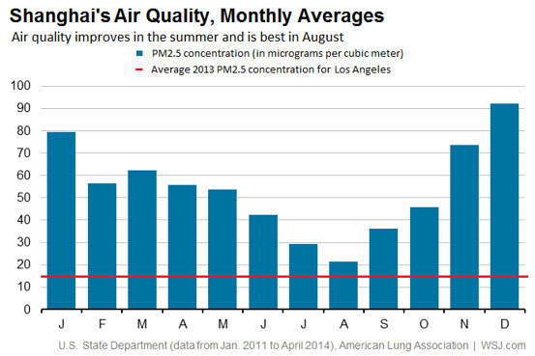
Seasonal variations
Seasonal variations of PM2.5 in China
PM2.5 concentration variation in Taiyuan

Slide 6
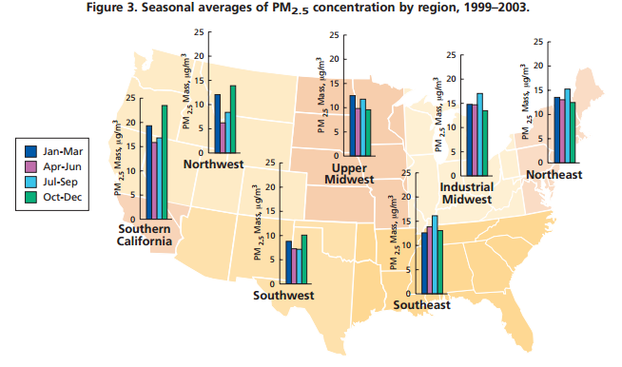
Seasonal variations
Seasonal variations of PM2.5 in US

Slide 7
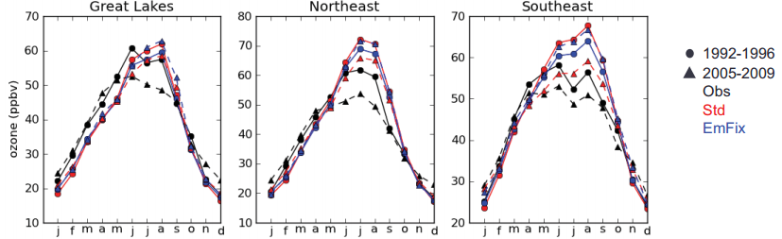
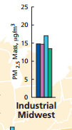

Seasonal variations
Seasonal variations of Ozone in US
Seems match?

Slide 8
2.project background
Location: Indiana State
Ft. Wayne- Beacon St. site

Slide 9
2.project background
Time interval : 8/1/2014---9/30/2014
Data sources: EPA Ozone daily
PM2.5 daily
PM2.5 species daily
meteorology data daily:
RH, T , wind speed

Slide 10
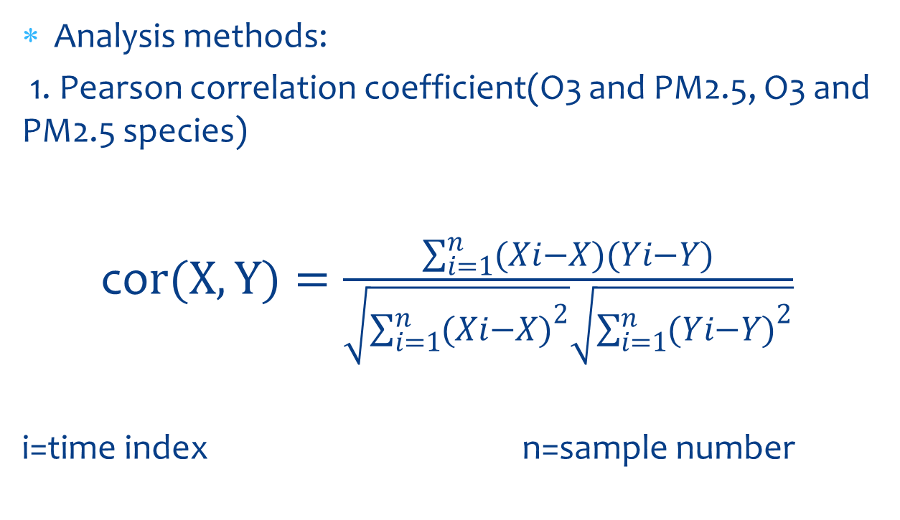
2.project background
Analysis methods:
1. Pearson correlation coefficient(O3 and PM2.5, O3 and PM2.5 species)
co$r(X,Y)=\frac{\sum_{i=1}^{n}{(Xi−X)(Yi−Y)}}{\sqrt{\sum_{i=1}^{n}{{(Xi−X)}^{2}}}\sqrt{\sum_{i=1}^{n}{{(Yi−Y)}^{2}}}}$
i=time index n=sample number

Slide 11
2.project background
Meteorology effects：
RH
T
Wind speed
Gas to particle conversion
Dilution, residence time
PM
O3
Correlation?
Dilution, residence time
OH
Rxn rate
RH
T
Wind speed

Slide 12
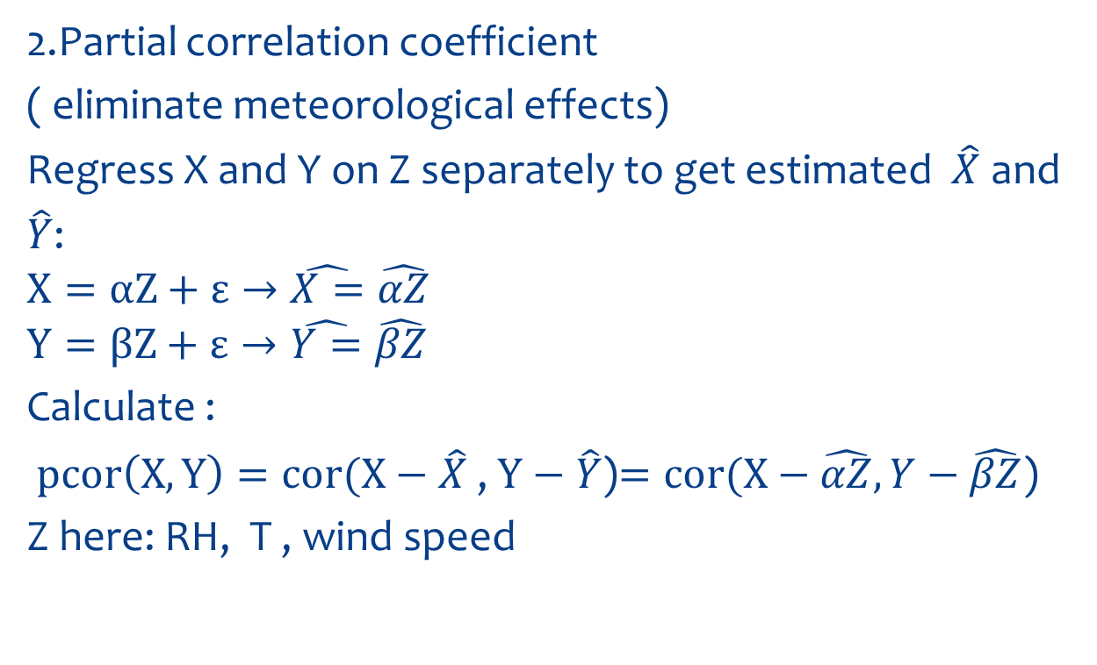
2.project background
2.Partial correlation coefficient
( eliminate meteorological effects)
Regress X and Y on Z separately to get estimated $\hat{X}$ and
$\hat{Y}$:
$$X=αZ+ε→\hat{X=}\hat{αZ}$$
$$Y=βZ+ε→\hat{Y=}\hat{βZ}$$
Calculate :
$pcor\left(X,Y\right)=cor(X−\hat{X}$ , $Y−\hat{Y}$)$=cor(X−\hat{αZ}, Y−\hat{βZ}$)
Z here: RH, T , wind speed

Slide 13
3. Results

Slide 14
3. Results

Slide 15
3. Results

Slide 16
3. Results

Slide 17

4. Interpret
Is it possible to control these two pollutants together?
Which species will be the most effective one ?

Slide 18
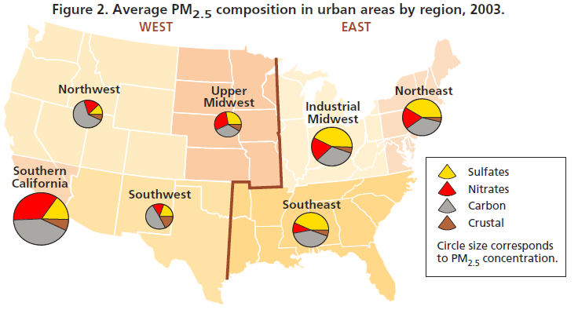
4. Interpret

Slide 19
4. Interpret
EAS6430 Lab 1 in result:

Slide 20
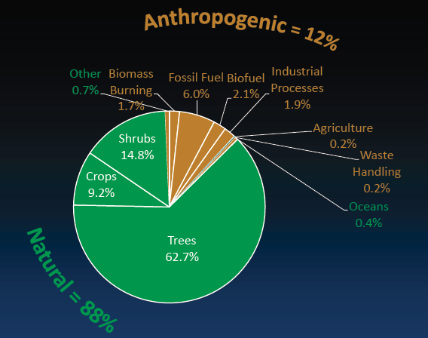
4. Interpret
Main sources of VOCs:

Slide 21
5. More to do
1. Rainfall data should be applied.
2. Hourly PM2.5 species data is not completely
available .(only sulfate)

Slide 22
Thank you!

