Slide 1
The relationship between summertime ozone peak hour and NOx and VOC emissions
Jianfeng Li
April 21, 2016

Slide 2
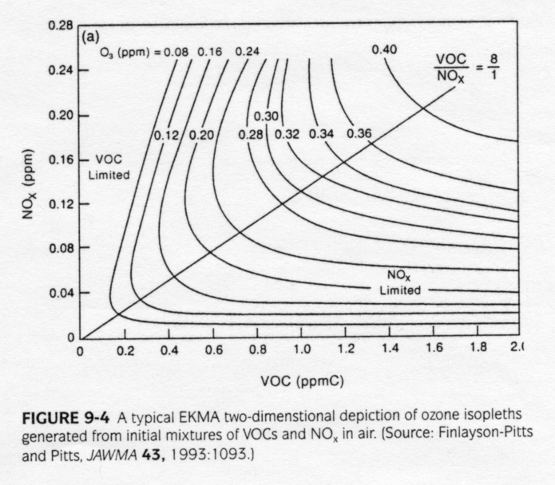
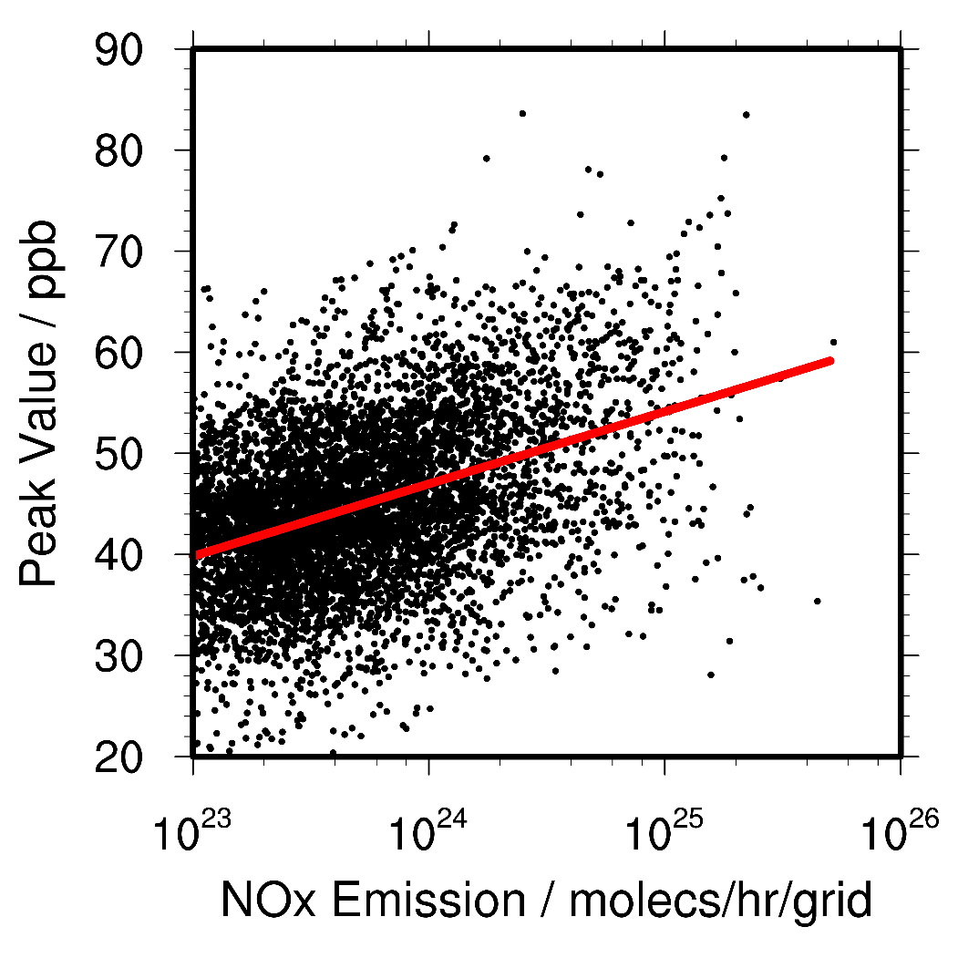
A relationship between Ozone peak value and emissions
A positive correlation between NOx emission and ozone peak value in the United States.

Slide 3
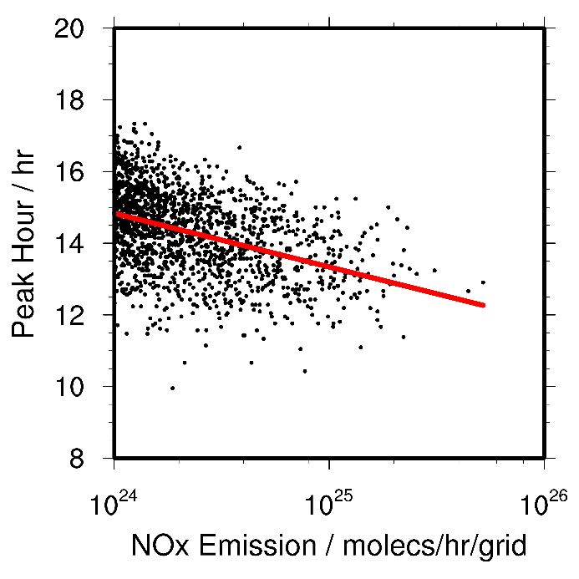
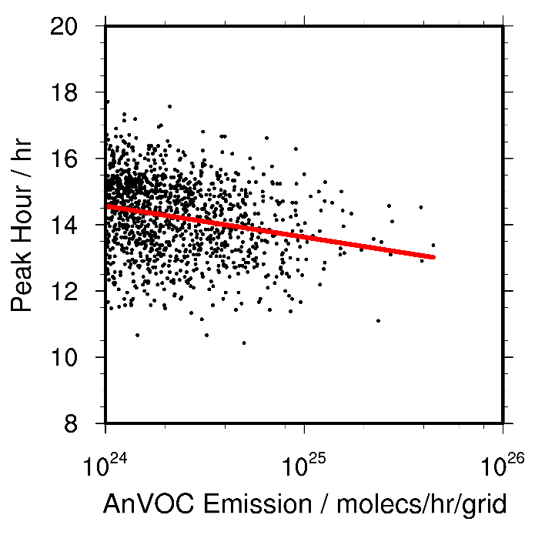
Do we expect a relationship between ozone peak hour and emissions?
China, from Hang Qu

Slide 4
Ozone observation sites distribution

Slide 5
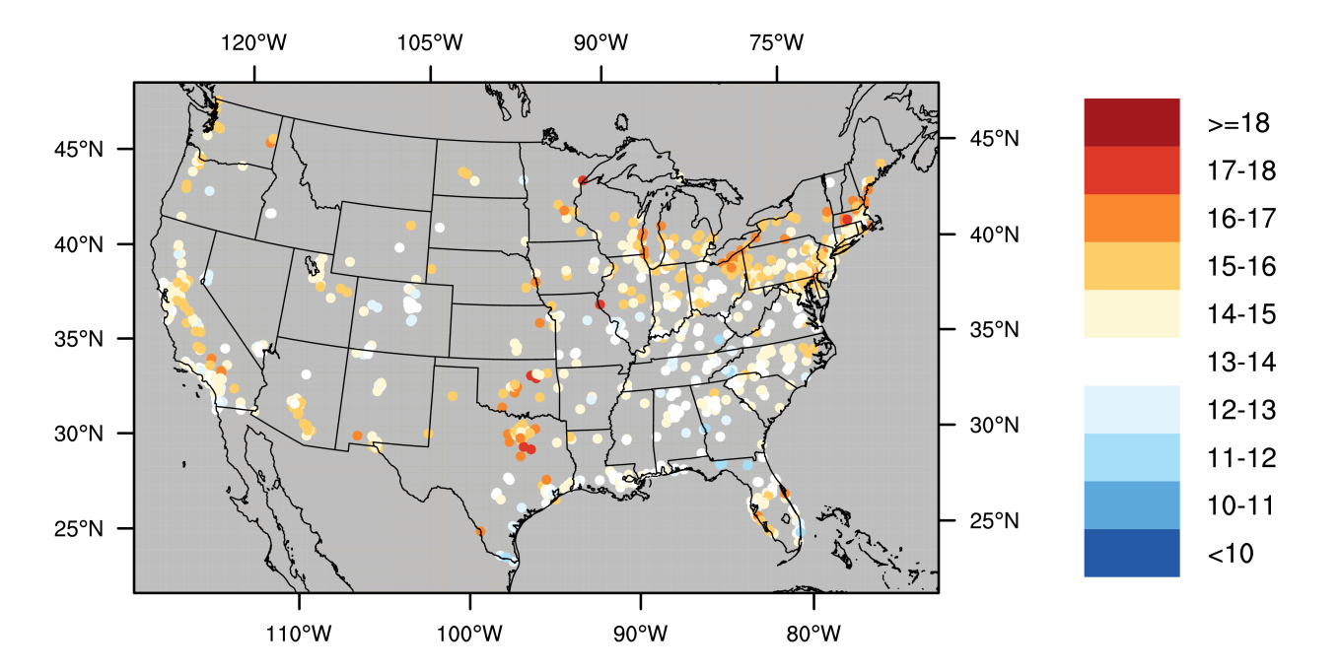
Comparison between model and observations
observation
simulation
REAM - OBS
Use peak hour difference to adjust emission!

Slide 6
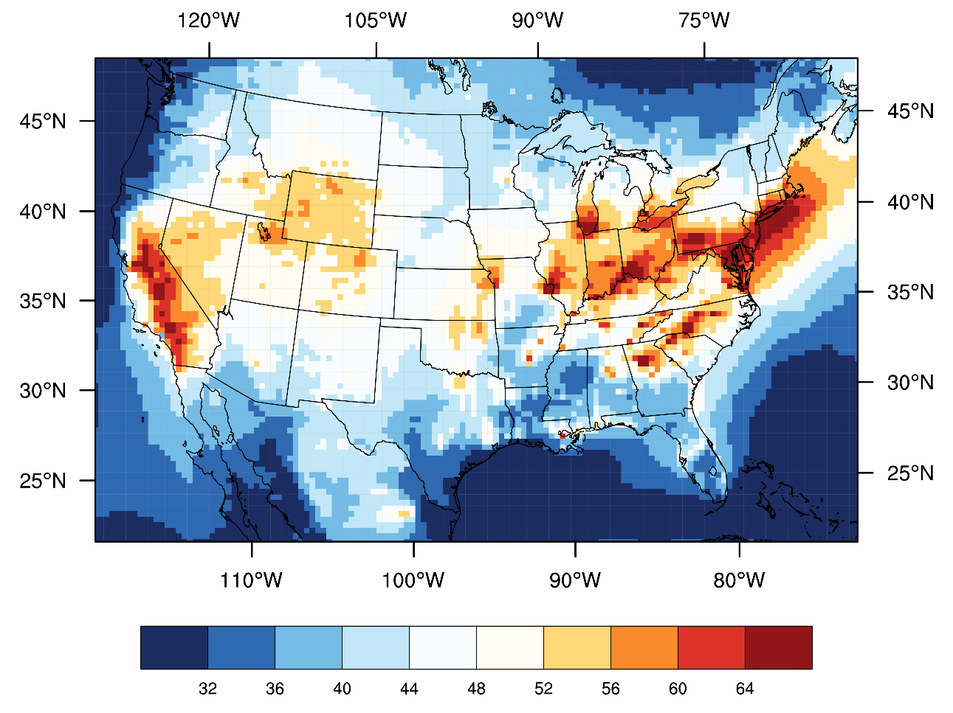
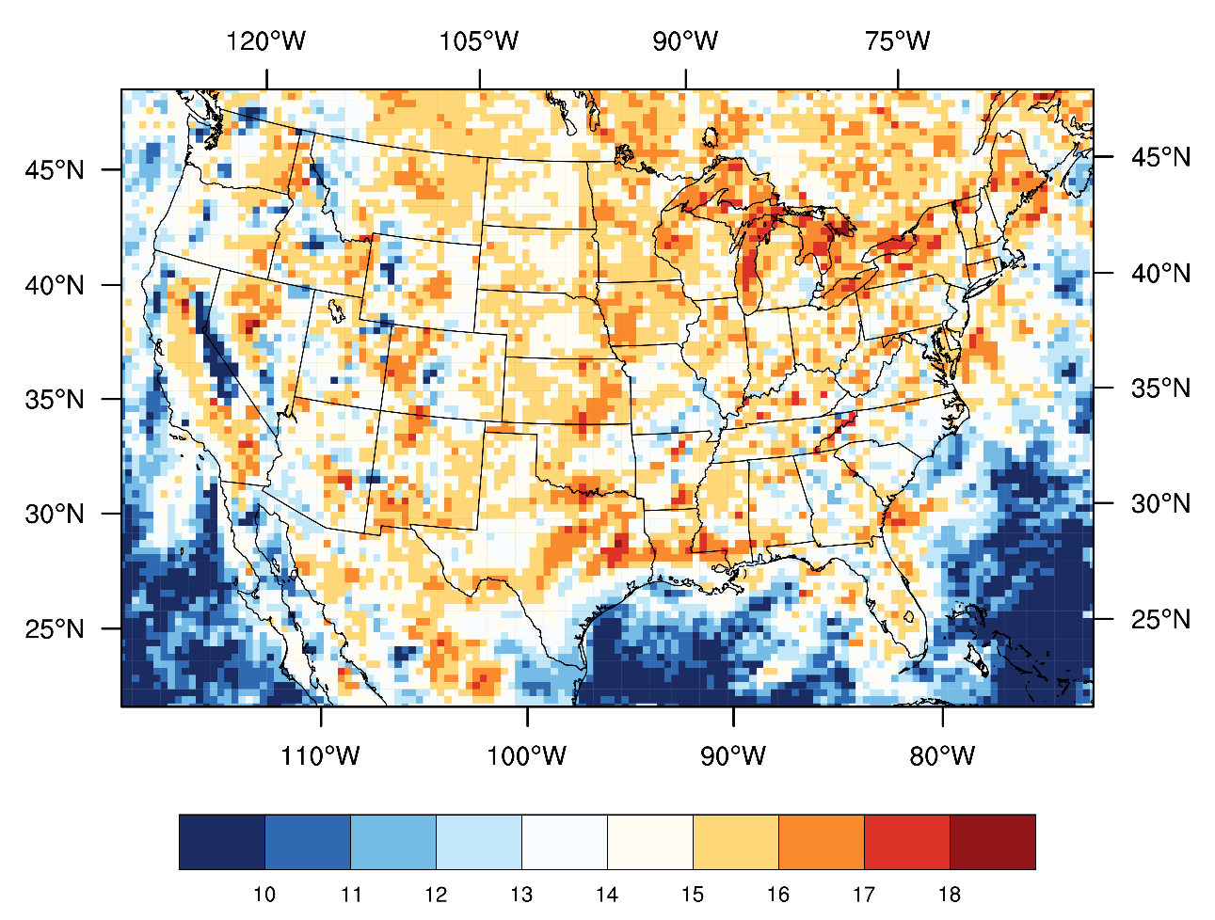
Future work
Sensitivity test to check whether increasing or decreasing emission could lead to better peak hour comparison.

