Slide 1
Measurements of brown carbon in and around clouds
Haviland Forrister

Slide 2
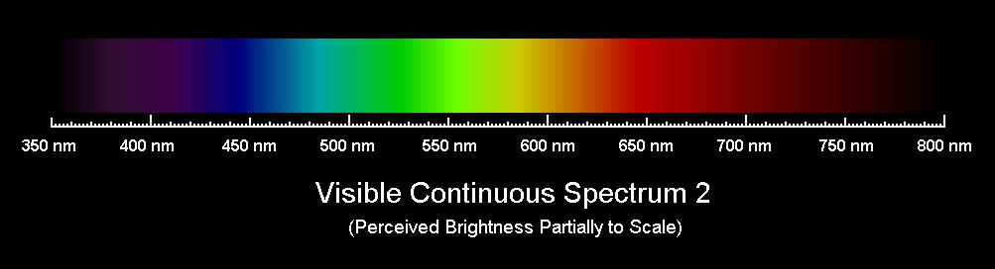
What is brown carbon?
350 nm
800 nm
Light-absorbing component of organic aerosol (OA)
Sources:
  Fossil fuel/biomass combustion (wildfires)
  Secondary formation, carbonyl/aromatic compounds
Is it important?
  Ubiquitous in atmosphere
  Can account for ~20% TOA direct radiative forcing
  Potential to completely offset global cooling by OA
Absorbs most at near UV, may affect photochemistry and radiation balance

Slide 3
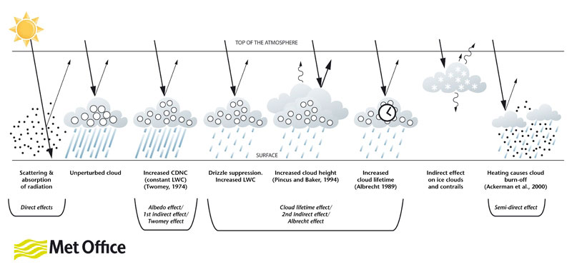
Previously discussed:
Effect of wildfires on cloud dynamics
Biomass burning aerosols have the potential to increase cloud lifetime and spatial extent in the atmosphere
Light-absorbing aerosols (black + brown carbon) can cause heating and cloud burn-off
How much ambient black carbon vs brown carbon is in a typical cloud?

Slide 4
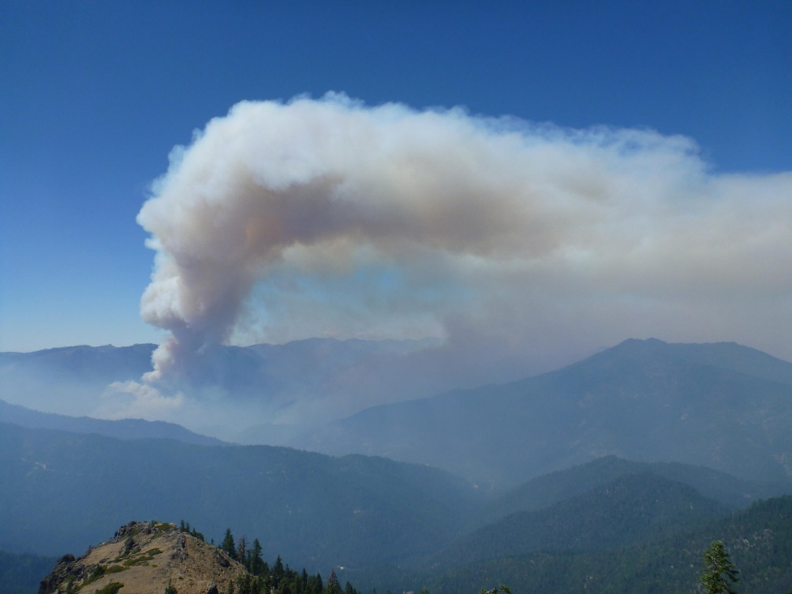
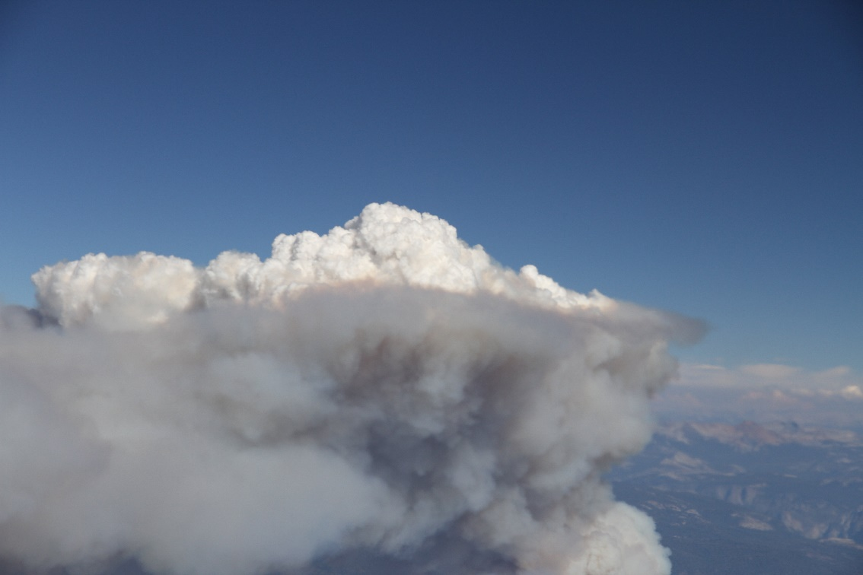
Term Project Theory:
Analyze smoke/cloud interaction, focusing on brown carbon
Smoke should contain BrC—how is the amount impacted by cloud presence?
Salmon River Complex: Aug 6
Photo INCI Web

Slide 5
SEAC4RS Airborne Campaign
Studies of Emissions, Atmospheric Composition, Clouds, and Climate Coupling
Clouds encountered:
  Low cumulus (clean and polluted)
  Thin cirrus
  Thick cirrus (inflow & outflow of a cold front)
  Rain in the boundary layer below cumulonimbus
Brown carbon near clouds: similar to background levels over remote U.S.
  BrC measured on filters → absorption measurement, not concentration

Slide 6
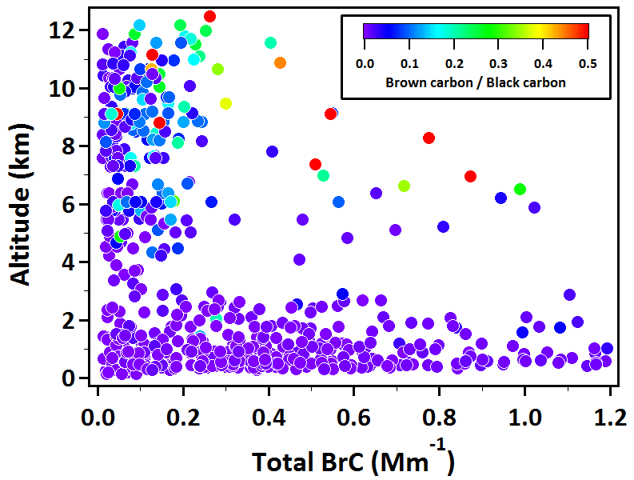
Ambient brown carbon: Typical values
Ubiquitous over the U.S.
Highest: 0-2 km
Lowest: where air density is lowest
Clouds impacted: from 1-12 km
  Cumulus
  Cirrus

Slide 7
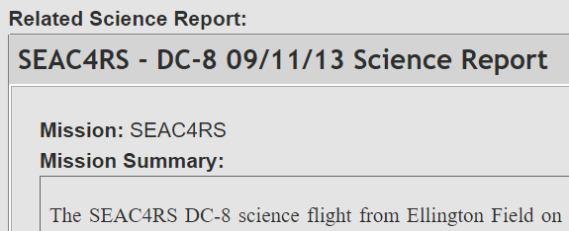
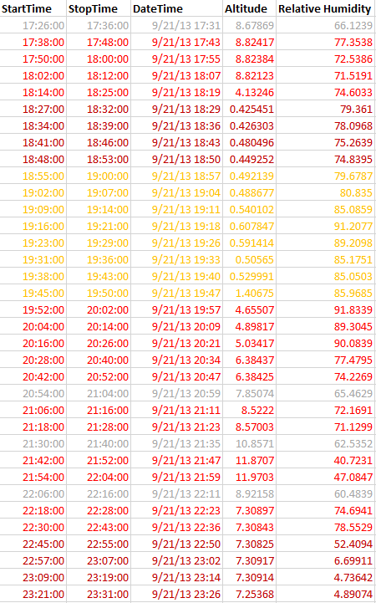
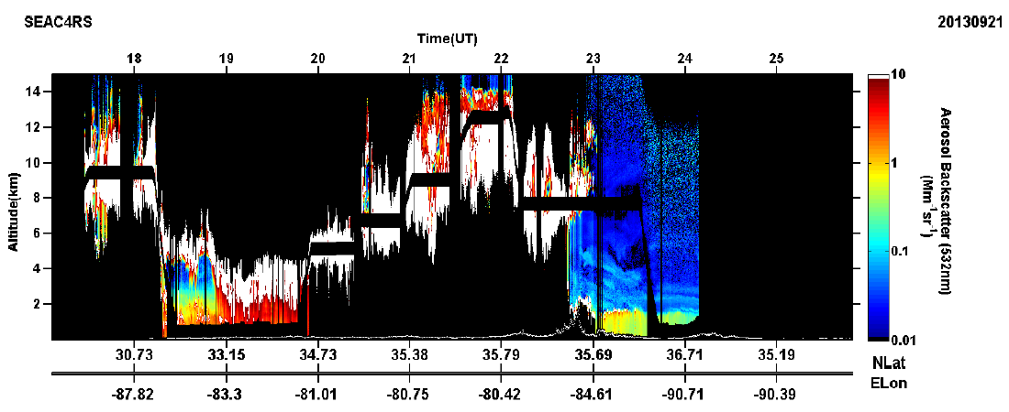
Cloud detection:
Combining remote sensing & relative humidity measurements

Slide 8
Case Study #1: Cold Front around Pollution
Black carbon + Organic aerosol = low in cloud
Outflow, cirrus
Inflow, BL
Background
Precipitation

Slide 9
Case Study #1: Cold Front around Pollution
Black carbon + Organic aerosol = low in cloud
Outflow, cirrus
Inflow, BL
Background
Precipitation

Slide 10
Case Study #1: Cold Front Inflow/Outflow
Brown carbon: low in cloud, but water-soluble increases
Outflow, cirrus
Inflow, BL
Background
Precipitation

Slide 11
Case Study #1: Cold Front Inflow/Outflow
Water-soluble BrC formation = secondary?
Outflow, cirrus
Inflow, BL
Background
Precipitation

Slide 12
Case Study #2: Tropical Storm, Clean Air
Black carbon + Organic aerosol = higher outside cloud
Outflow, cirrus
BL beneath
Unknown
BL off coast

Slide 13
Case Study #2: Tropical Storm, Clean Air
Black carbon + Organic aerosol = higher outside cloud
Outflow, cirrus
BL beneath
Unknown
BL off coast

Slide 14
Case Study #2: Tropical Storm, Clean Air
Black carbon + Organic aerosol = higher outside cloud
Circle Size: BrC/BC
Outflow, cirrus
BL beneath
Unknown
BL off coast

Slide 15
Multi-day Cloud Analysis
Warm, Mixed Phase, and Cirrus Clouds
Circle size: Relative Humidity (RH)
Low clouds: variable water-soluble and water-insoluble amounts
As altitude of cloud increases, water-soluble portion increases
  Directly correlates with water vapor available: less water, higher WS-BrC
  Lower cloud RH at given altitude: higher WS-BrC

Slide 16
Multi-day Cloud Analysis
Warm, Mixed Phase, and Cirrus Clouds
Circle size: Relative Humidity (RH)
Low clouds: variable BrC/BC ratios
Higher clouds: BrC/BC ratios increase with altitude in-cloud, dependent on RH
  Lower RH increases total brown carbon at given altitude
  BrC/BC ratio lower at high altitudes if RH is lower

Slide 17
Conclusions + Future Work
Black carbon:
  Decreases significantly inside clouds (60-80% compared to BL air and similar altitude air)
Total brown carbon: convection likely drives BrC in clouds
  Clean conditions: BrC increases by 20% in clouds, compared to BL air
  Polluted conditions: 80% lower than BL air, 80% higher than similar altitude air
Water-soluble BrC fraction increases in cloud, compared to out of cloud
  Secondary formation, partitioning, or cloud processing changing chemical nature of compounds?
Water-insoluble BrC: higher outside of clouds (similar to BC behavior)
Brown carbon/black carbon ratio increases with height in cloud

Slide 18
Outflow, cirrus
Inflow, BL
Background
Precipitation
Outflow, cirrus
BL beneath
Background
BL off coast

Slide 19
Wildfires increasing
Global warming
Temperature
Wet areas: wetter
Dry areas: drier
Higher T spring/summer
Earlier spring snow-melt
Soil dry for longer
Increased drought likelihood
Precipitation
As temperatures on Earth increase, we expect fires to increase
In the southwest, season of fire potential 7 months → all year
Wildfires: one of the primary sources of BrC in the atmosphere
Hot + dry
Fires last longer and are more intense

