Slide 1
EAS 6410 Term project
The Estimation of Relationship between Solar-Induces Fluorescence and Biogenic Volatilizable Organic Carbon Emission
Aoxing Zhang
Georgia Institute of Technology
azhang76@gatech.edu
Apr. 21, 2016

Slide 2
Volatilizable Organic Carbon—— Why VOC?
One of the most important precursors of ozone;
Have a great amount of natural source;
Many of them are directly emitted by plants.
Isoprene:
The most part of biogenic emission;
Related to photosynthesis of plants.
Formaldehyde(HCHO):
Product of many VOC oxidation reactions
  (e.g. isoprene)
It’s VOC itself.

Slide 3
Solar-Induces Fluorescence——What is SIF?
Light
Fluorescence
Chlorophyll
Chemical Energy
(Meroni et al., 2009)

Slide 4
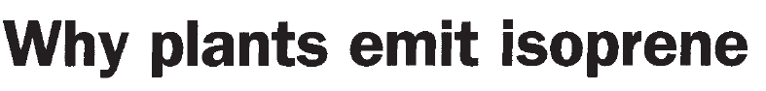
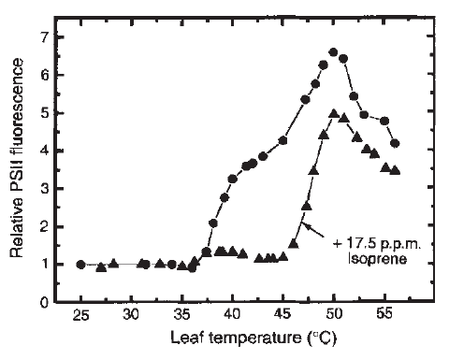
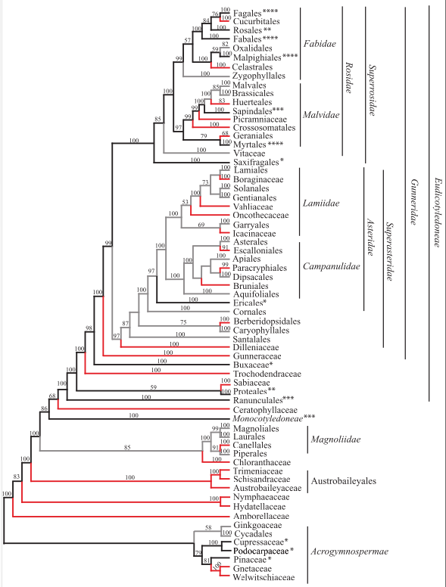
Why only some plants emit isoprene
Sharkey et. al., 1995
Monson et al., 2013
Isoprene typically accounts 2% of photosynthesis carbon (30C, aspen and oak)
---- No photosynthesis, no isoprene
2. Both Isoprene and photosynthesis are temperature sensitive: Isoprene MORE.
Plants do not emit isoprene until induces by treatment at 30C for 4-6 h.

Slide 5
Data
SIF level 3 and level 2 data from satellite (GOME2A) (2007-2013)
HCHO level 2 data from satellite (GOME2A) (2009-2013)
Isoprene data: monthly, from MEGAN model. (2007-2010)
Meteorology field: CSFR reanalysis data. (2011-2013)
PFT landcover data (2010)

Slide 6
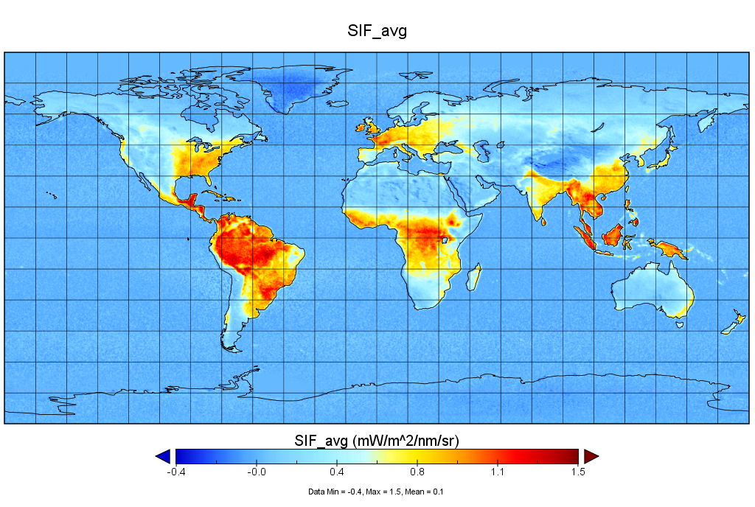
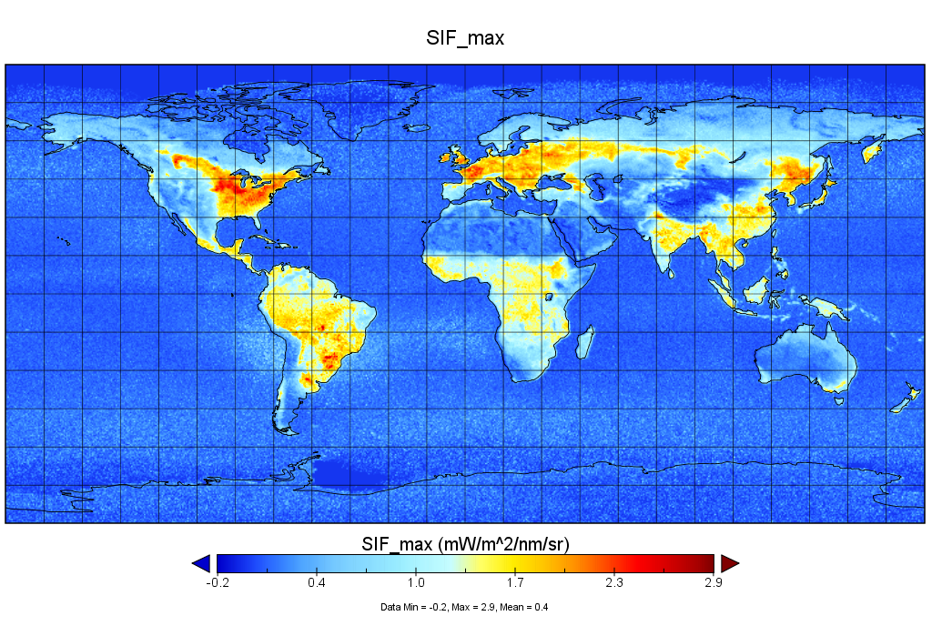
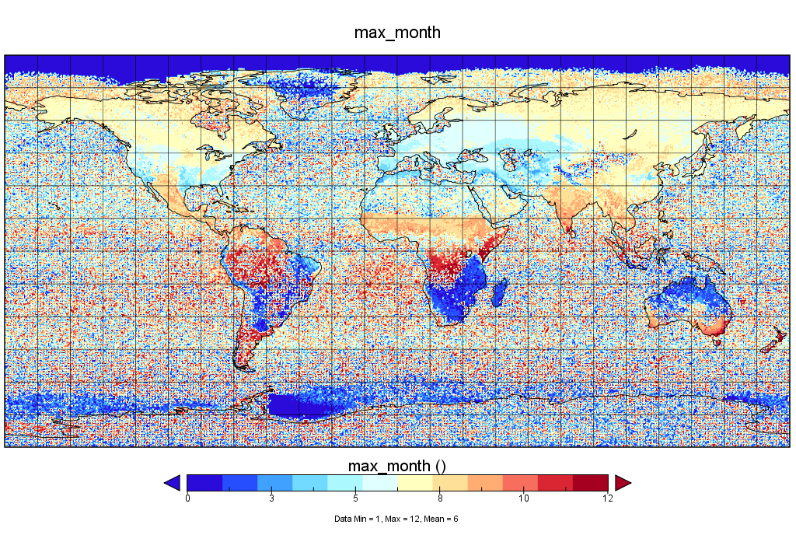

Slide 7
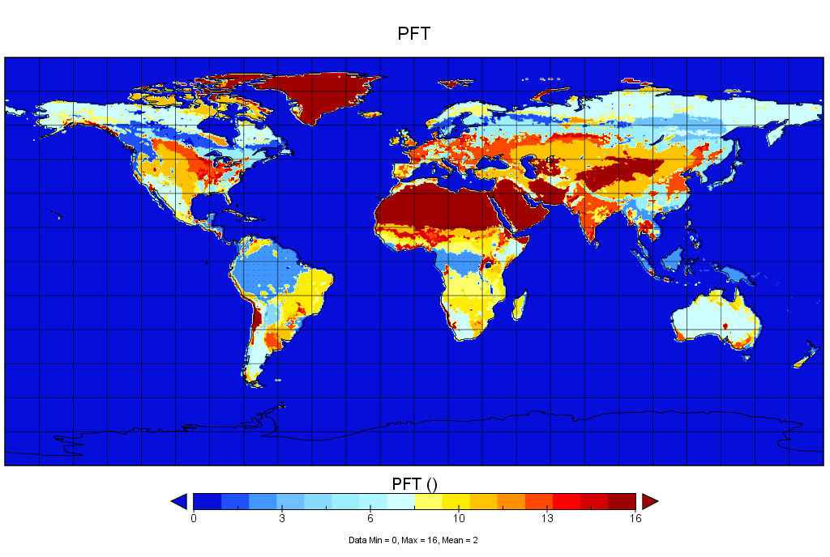
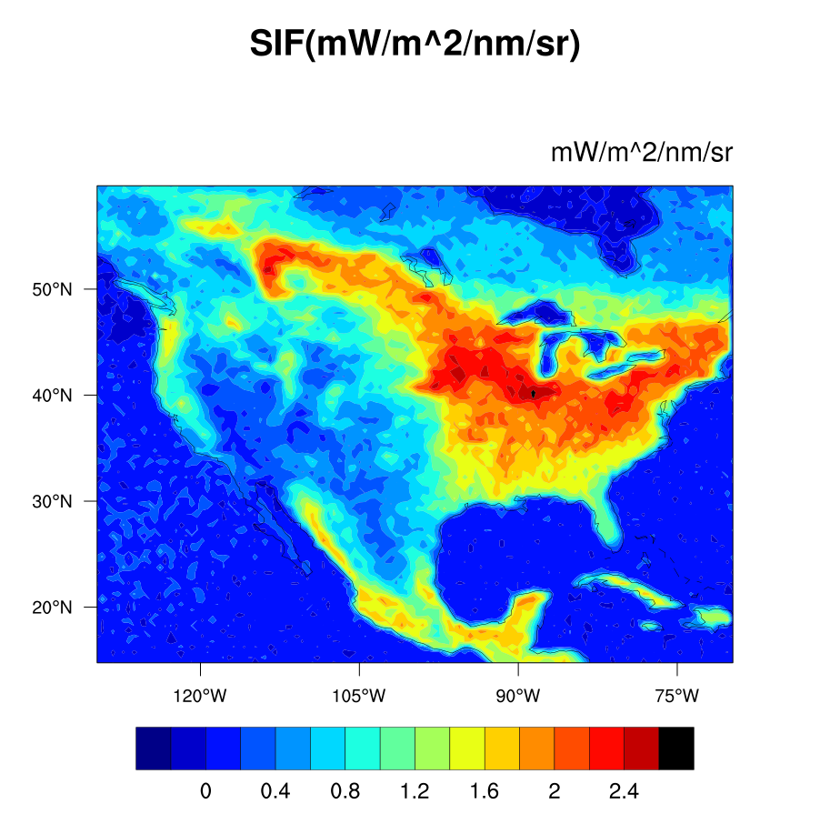
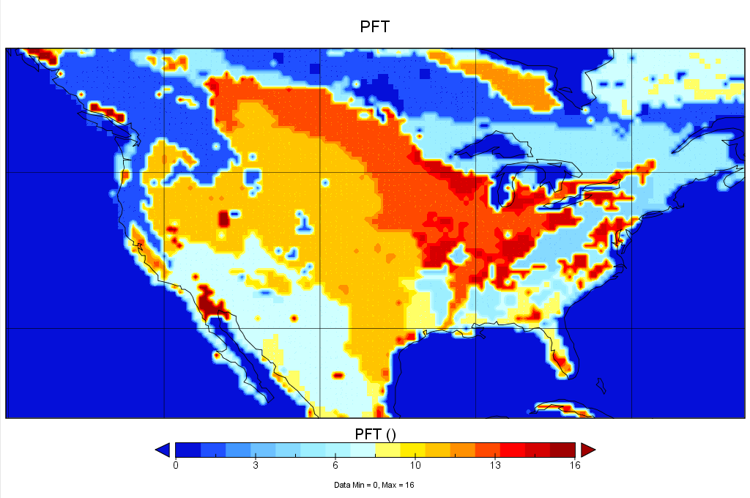

Slide 8
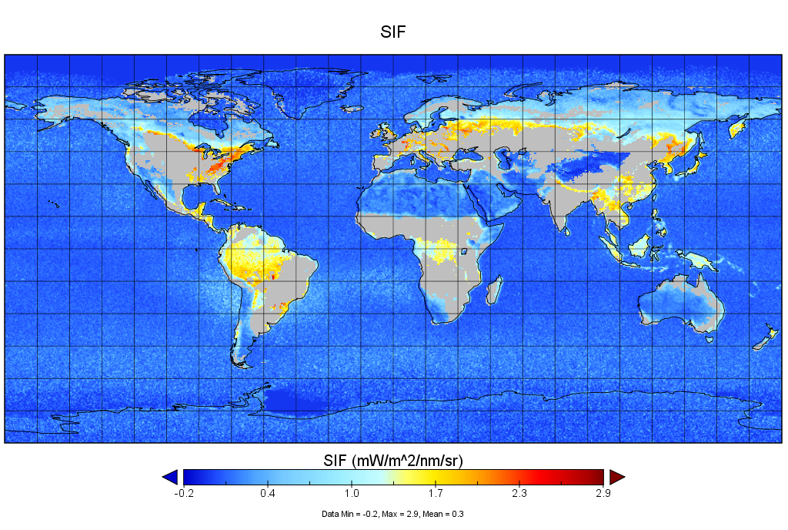
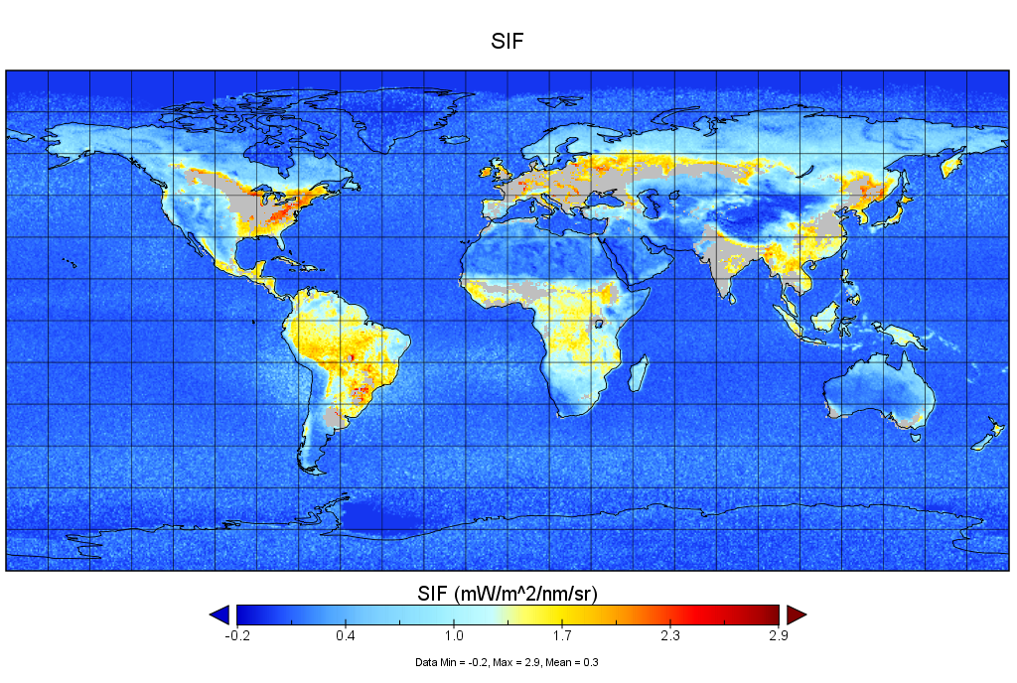
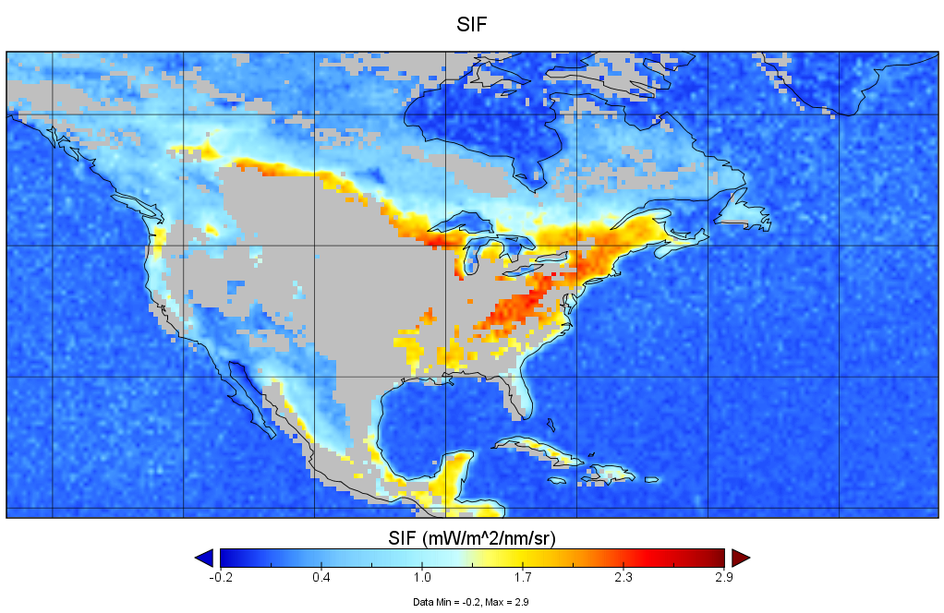
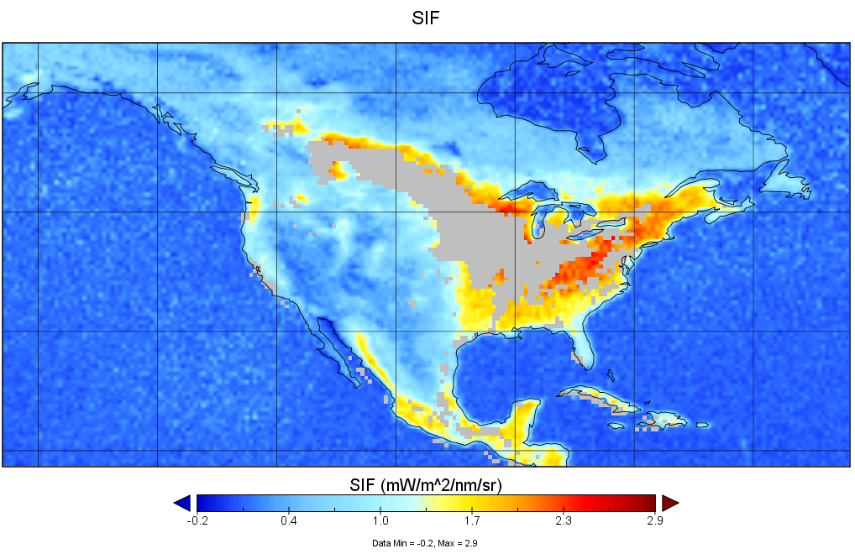
Where?
No Crop or Grassland
No Crop

Slide 9
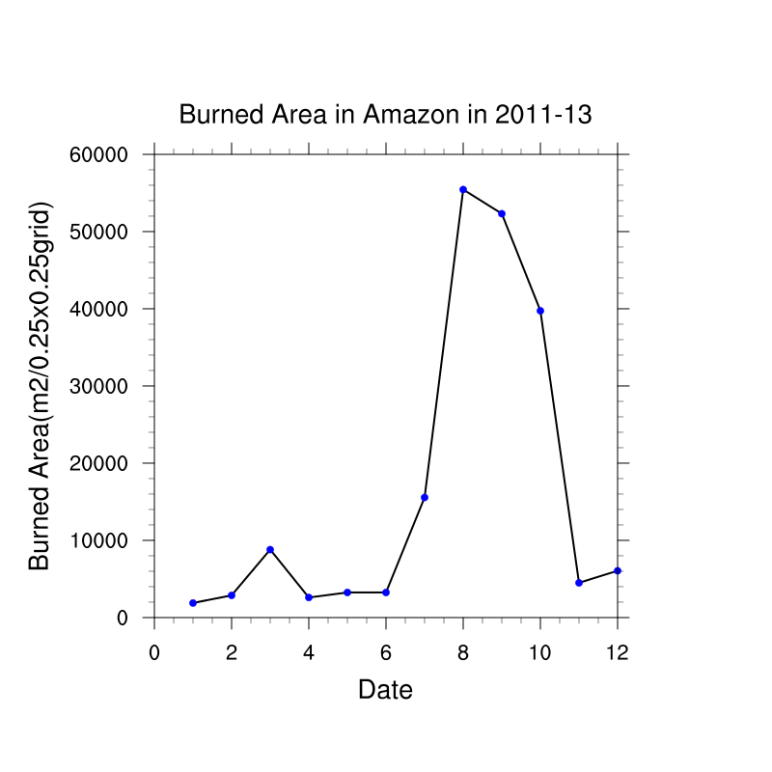
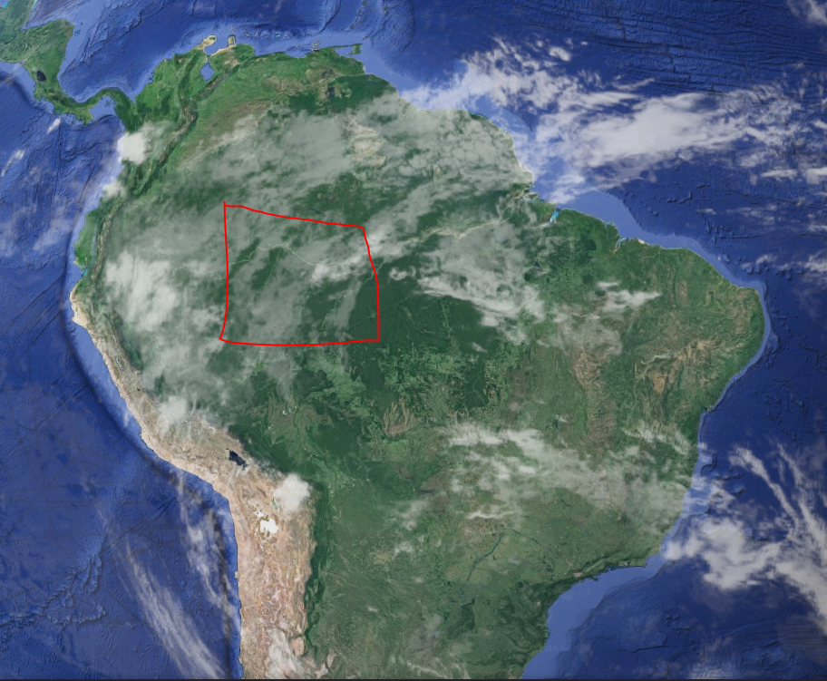
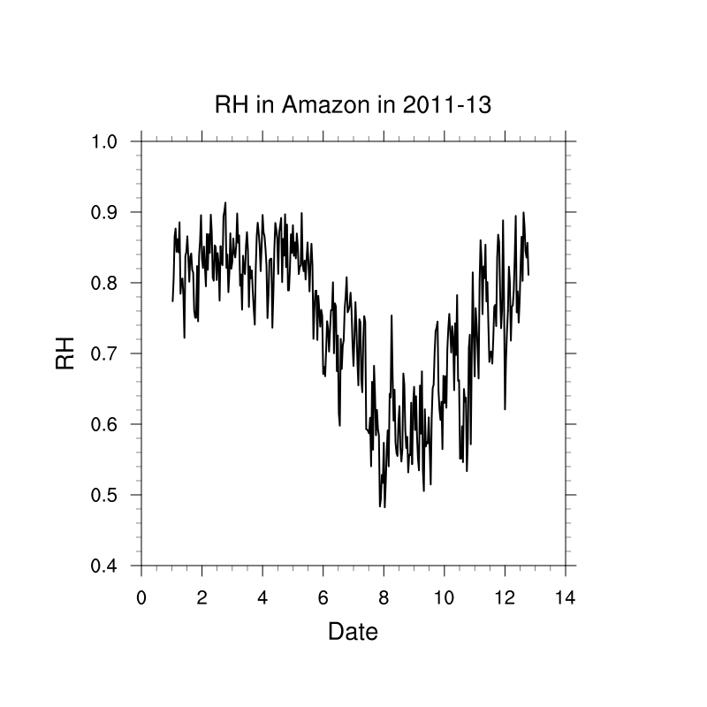
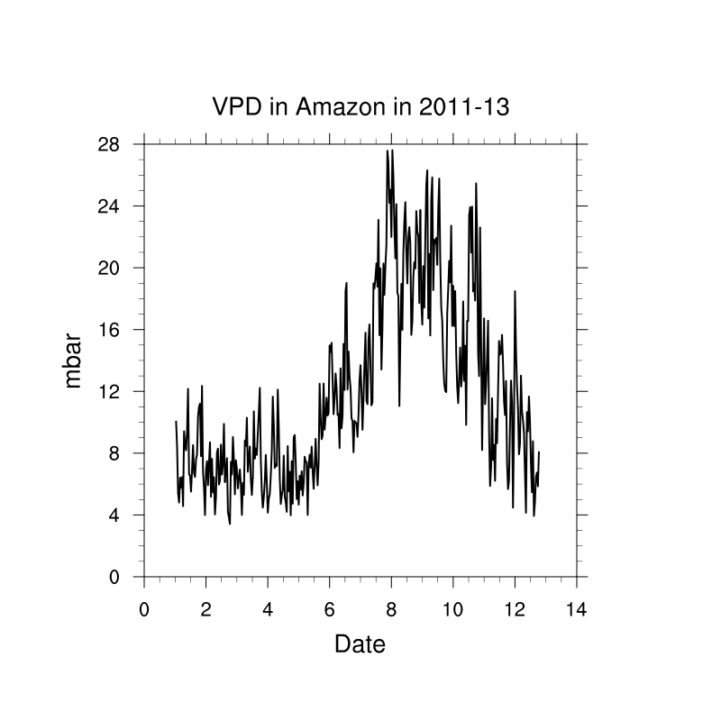
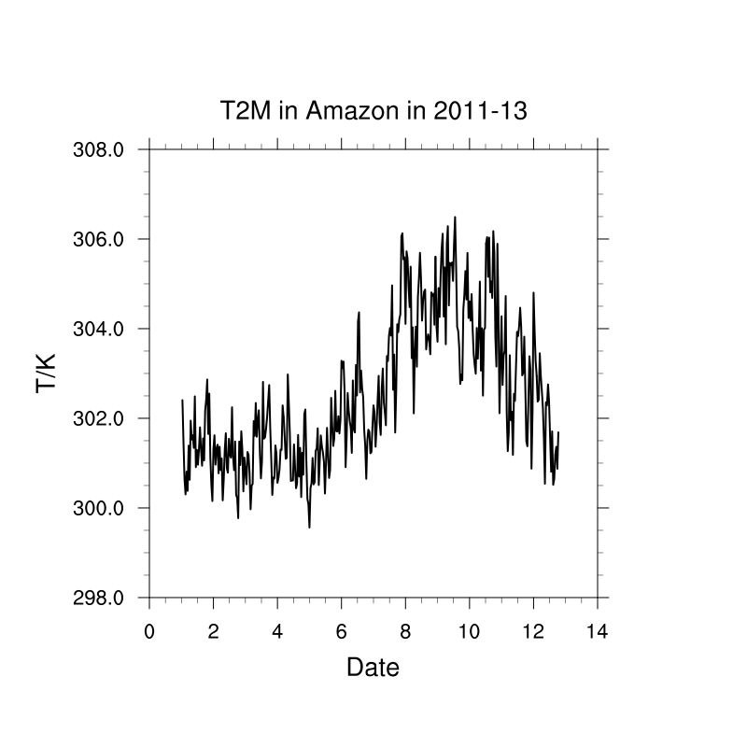
When?

Slide 10
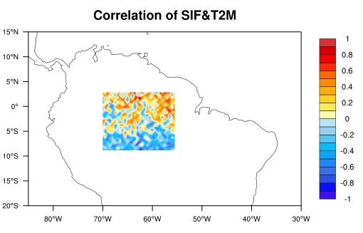
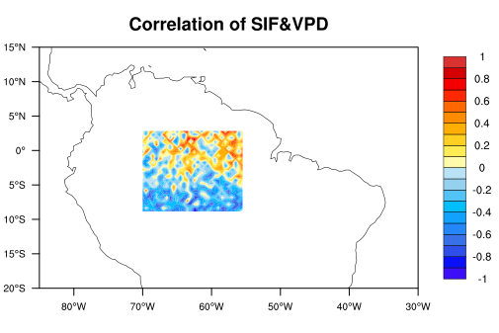
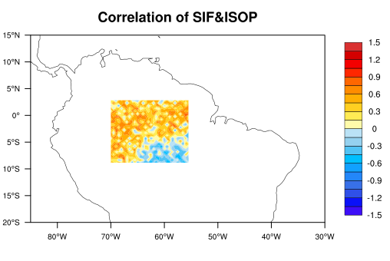
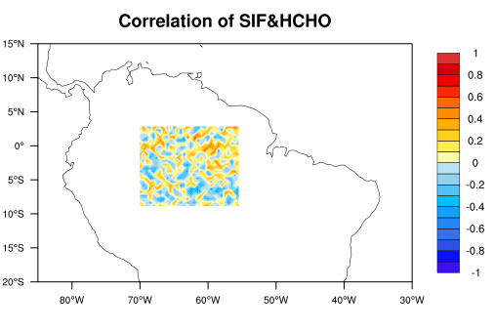
Correlation from August to October
VPD = e(saturated)-e

Slide 11
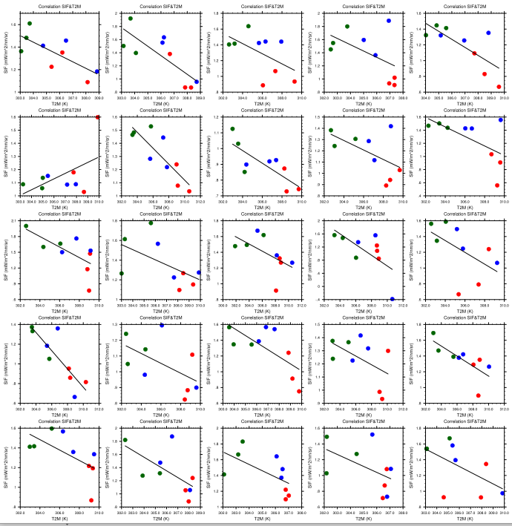
Correlation in amazon:
SIF and Temperature
Negative part
August
September
October
2011-2013

Slide 12
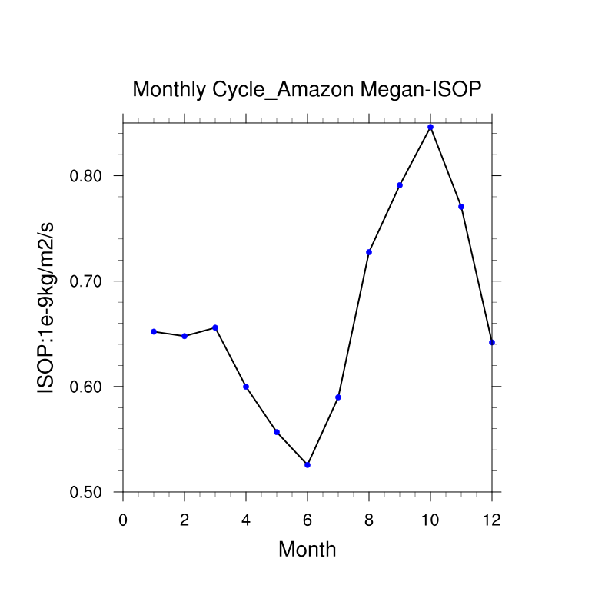
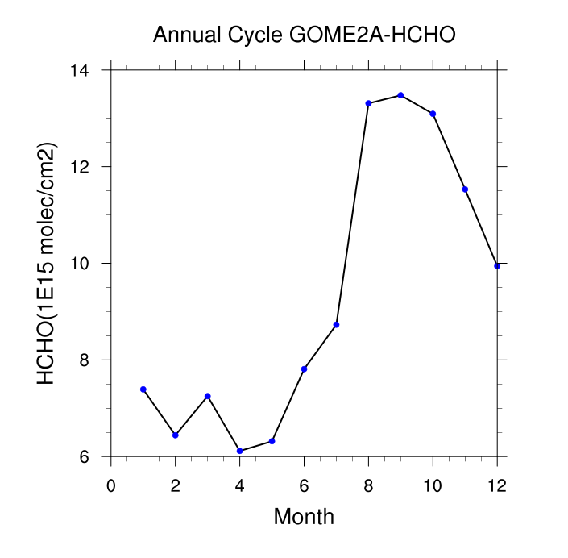
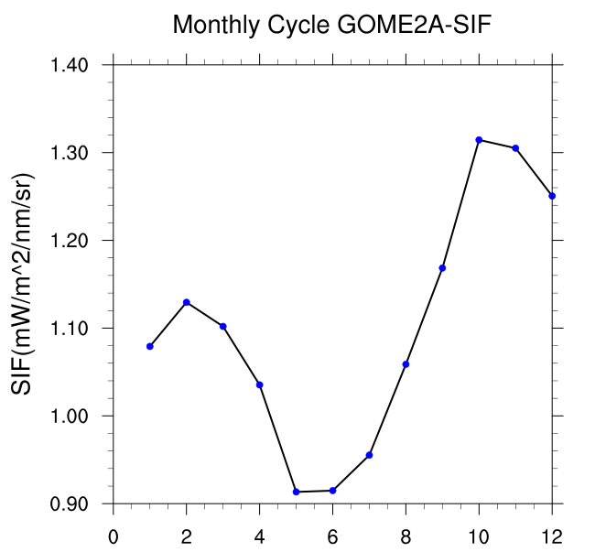

Slide 13
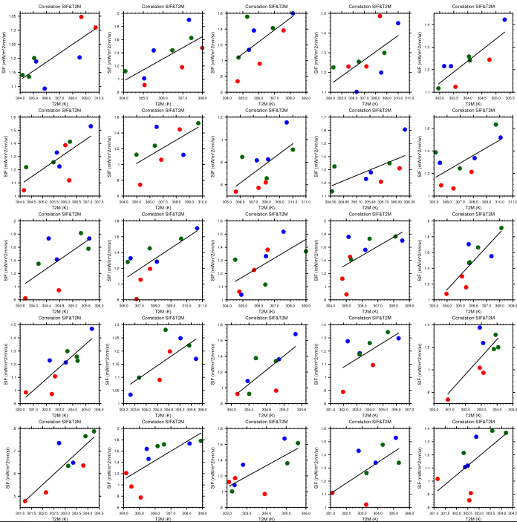
Correlation in amazon:
SIF and Temperature
Positive part
August
September
October
2011-2013

Slide 14
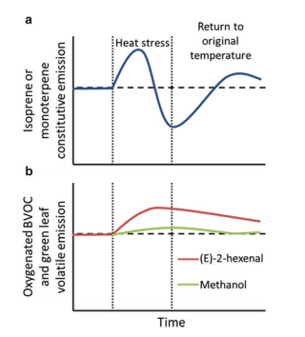
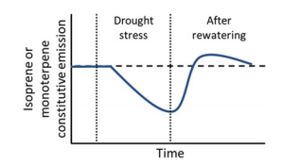
M. Possell and F. Loreto, Biology, Controls and Models of Tree Volatile Organic Compound Emissions, P215-216

Slide 15
Conclusion
In the hot and burn season, SIF have a significant positive correlation with Isoprene, approximately (but not perfectly) corresponding to the meteorology field.
But this correlation may be different due to region.
Isoprene emission is not perfectly obey to temperature change in a monthly time period.
Formaldehyde doesn’t have significant correlation with SIF in Amazon region, at least in the monthly time period.

Slide 16
Conclusion
We didn’t see correlation between SIF and HCHO. The possible reason is that HCHO is column density data which can be considered as average of profile. Chemical reactions and transports have impact on this. SIF and Isoprene are only emit from surface.
Isoprene model output is still doubtful.

Slide 17
Thank you!
Aoxing Zhang
Georgia Institute of Technology
azhang76@gatech.edu

