Slide 1
Oxygen Chemistry in Europa’s Exosphere
By Ayanna Jones and
Marilyn Jones
Atmospheric Chemistry
Group Project

Slide 2
Europa
Europa is the smallest of the three jovian moons discovered by Galileo Galilei in January 1610¹.
On July 9. 1979, one of the first close up images of Europa’s surface was obtained from Voyager 2¹.
Over the decades, Europa has gathered numerous interest from the scientific community as Europa’s unique potential for habitability has been realized.

Slide 3
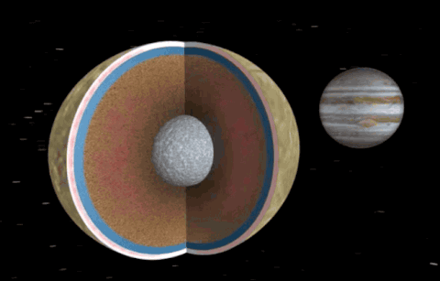
Why study Europa?
There are numerous reasons why the study of Europa has become a hot topic within the scientific community. Some of the main reasons are Europa’s …
Interior Saline Oceans
Unique Resurfacing Processes
Complex Atmosphere
Notes:
which may be able to be an analog for other icy moons or planets with potential for habitability.

Slide 4
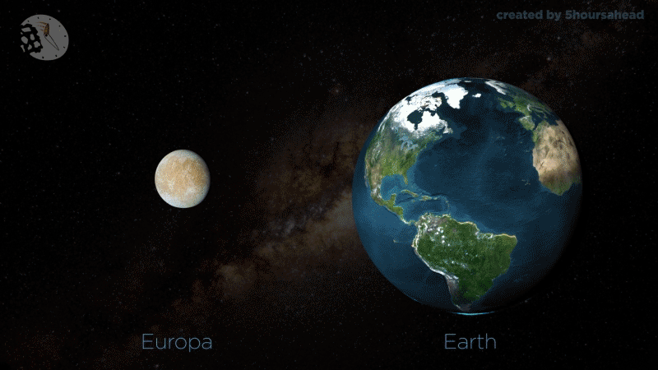
Europa’s Oceans
Electromagnetic induction signals measured by the Galileo magnetometer established the existence of Europa’s ocean.
Did you know that there is more water in Europa’s oceans than there are on the entire Earth?!
The most likely place to find life in our solar system today! Because of Europa’s subsurface ocean, Europa is the most likely place to find life in our solar system today! We know this because on Earth, wherever we find water, we find life.
Notes:
The discovery of Europa’s subsurface ocean by the Galileo spacecraft has driven the planetary community in new directions in terms of the search for habitable environments in the solar system, pushing the location of liquid water far beyond the traditional ‘Goldilocks zone’ to the icy worlds of the outer solar system. While many studies followed from these limited observations of Europa’s induced magnetic field in an effort to better characterize the depth, thickness and salinity of the subsurface ocean more observations are required to fully constrain this coupled parameter space.

Slide 5
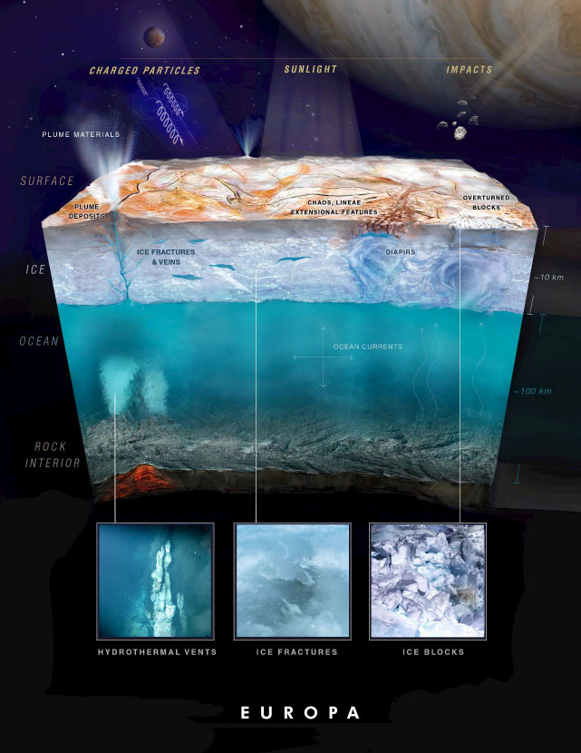
Surface Processes at Europa
Europa is tidally locked to its parent as one side permanently faces Jupiter allowing the trailing hemisphere to develop deep cracks (lineae) most likely caused by tidal stressing.
Charged particles hit Europa’s surface and are released back into Europa’s atmosphere in a process known as sputtering.
Notes:
The Galilean satellites are subject to continuous irradiation by ions and electrons. The collisional impact of the magnetospheric ions is the main source for Europa’s tenuous, gravitationally bound atmosphere. The ions originate from the solar wind and from volcanic release on Jupiter’s moon Io. The latter form a neutral gas and plasma torus in the vicinity of the orbit of Io. Upon ionization they are picked-up by the Jovian magnetosphere, accelerated, and ultimately some of these ions hit Europa, which orbits just outside of Io’s plasma torus at a radial distance of about 9 Jovan radii. Furthermore, neutral atoms and molecules in Europa’s exosphere can be ionized and then impact the moon again.

Slide 6
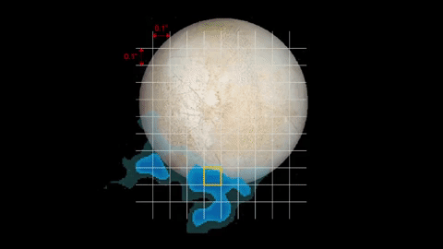
Europa’s Complex Atmosphere
Jupiter’s moon Europa is surrounded by a thin surface-bound neutral exosphere.
The neutral species in Europa’s atmosphere are mostly provided by ion sputtering of the water ice surface.
Energetic ions and electrons from the Jovian magnetosphere produce molecular oxygen O₂, the dominant species in Europa’s atmosphere, by radiolytic decomposition of water ice

Slide 8
Europa’s Exosphere
The interaction of magnetospheric plasma with Europa’s surface results in the creation of an atmosphere ¹.
Groundbased observers using the Goddard High-Resolution Spectrograph of the Hubble Space Telescope independently confirmed observations of an atmosphere at Europa.
Molecular oxygen was also observed in Europa’s atmosphere (Spencer and Calvin, 2002)The observed emission lines suggested that the emission was a result from the electron impact dissociation of O2, a process which leaves one oxygen atom in an excited state.
Notes:
Define exosphere
Define sputtering
Diagram of sputtering
Connection between surface chemistry and atmospheric chemistry

Slide 9
Europa’s Oxygen Chemistry
The relative strengths of the atomic oxygen emission lines allow inference of a dominant O₂ component. Oxygen, sodium, and potassium are known minor constituents. A relatively dense ionosphere has also been detected on several occasions by Galileo radio occultation measurements, the presence of which appears to require a sunlit trailing hemisphere. Neither the spatial distribution of the oxygen emission associated with the atmosphere, nor the obvious variability of the atmospheric emissions and the ionospheric densities, has been adequately explained to date.

Slide 10
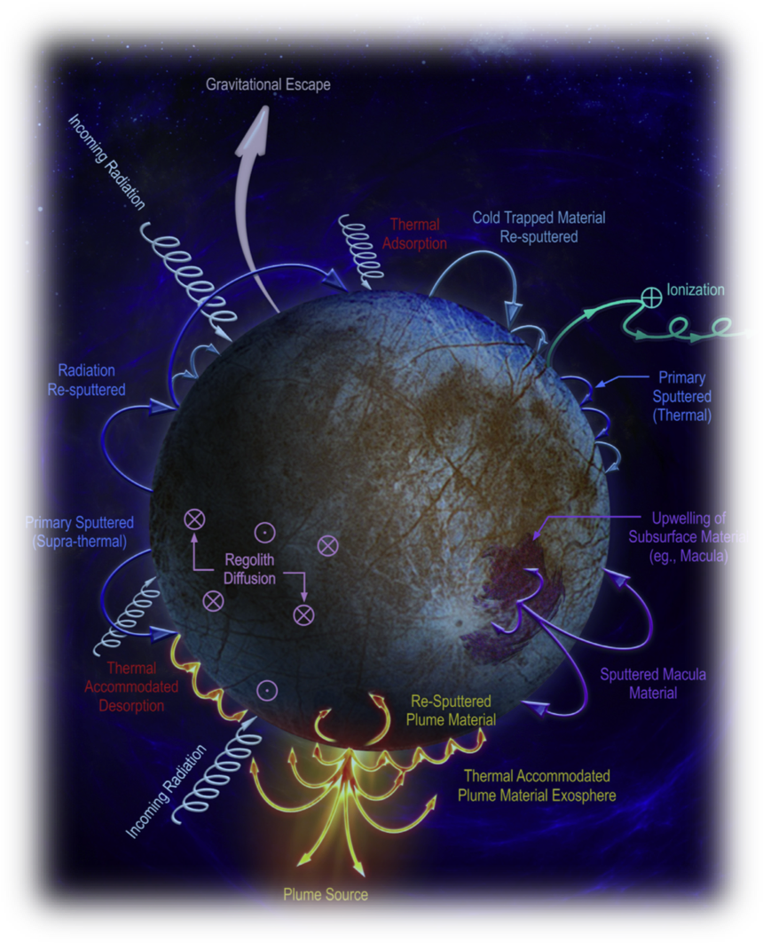
Sputtering at Europa
The heavy energetic ions of the jovian plasma can erode the surface of Europa via ion sputtering
Photons impinging the surface may result in neutral atom release via photolysis
Europa’s oxygen chemistry is of importance due to the fact that it is one of the most common molecular reactions known on Europa.
Notes:
Space weathering processes occur on Europa. The heavy energetic ions of the jovian plasma (H+, O+, S+, C+) can erode the surface of Europa via ion sputtering. Sputtering yields can be determined theoretically or with labo- ratory experiments.

Slide 11
Johnson et. al. 2009

Slide 12
Johnson et. al. 2009
Notes:
Representative modeling atoms and molecules ejected from the surface or formed in the atmosphere are tracked between collisions, and a stochastic scheme is used to choose the position, type and outcome of the next collision.

Slide 13
2001
2009
Shematovich et. al. 2001 and Johnson et. al. 2009
Notes:
The differences between Figs. 4a and 4b are due to the choice of sputtering rates (shown in Table 2). Smyth and Marconi (2006) chose larger ejection rates for O2 and H2O and small additional sources of O, OH, H2, and H directly ejected from the surface. The larger H2O (near-surface) density in Smyth and Marconi (2006) was due to their use of too small a sublimation energy for H2O. In both simulations the main origin of O and OH is predominantly due to the dissociation of O2 and H2O. At the upper altitudes in Fig. 4b, the H2 decays as ~r–2.8 and the O2 as ~r–3.5,roughly consistent with analytic models (Johnson et al., 1990).

Slide 14
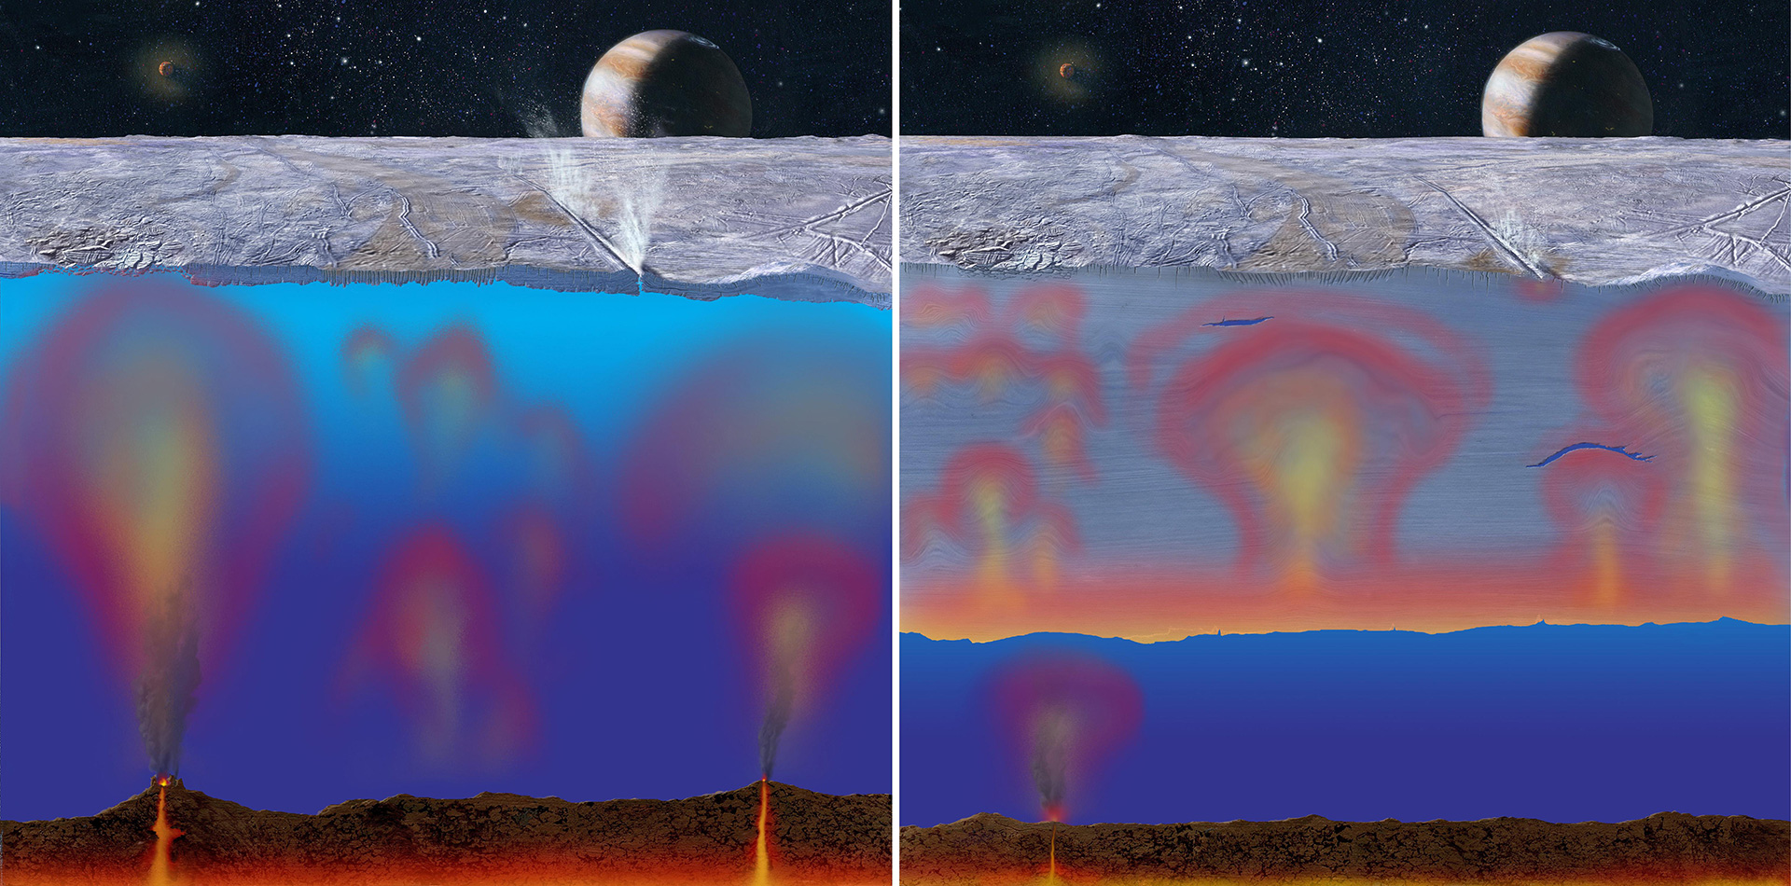
europa.nasa.gov

Slide 15
Past Missions to Better Understand Europa’s Exosphere
Voyager (1979)
Sent back first data and variations among the Galilean moons
Galileo (1994)
A significant discovery was the possibility of a salty subsurface ocean at Europa
Over the past decade, NASA and the National Research Council (NRC) have recognized Europa’s astrobiological potential.
The last NRC Planetary Decadal Survey recommended a Europa orbiter flagship mission as the number one priority for solar system exploration over the next decade.(1)
Notes:
The Voyager and Galileo missions also provided indications of an interior ocean

Slide 16
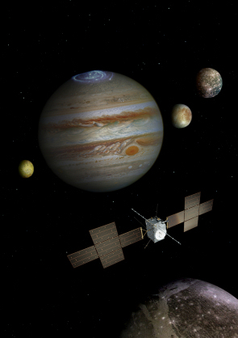
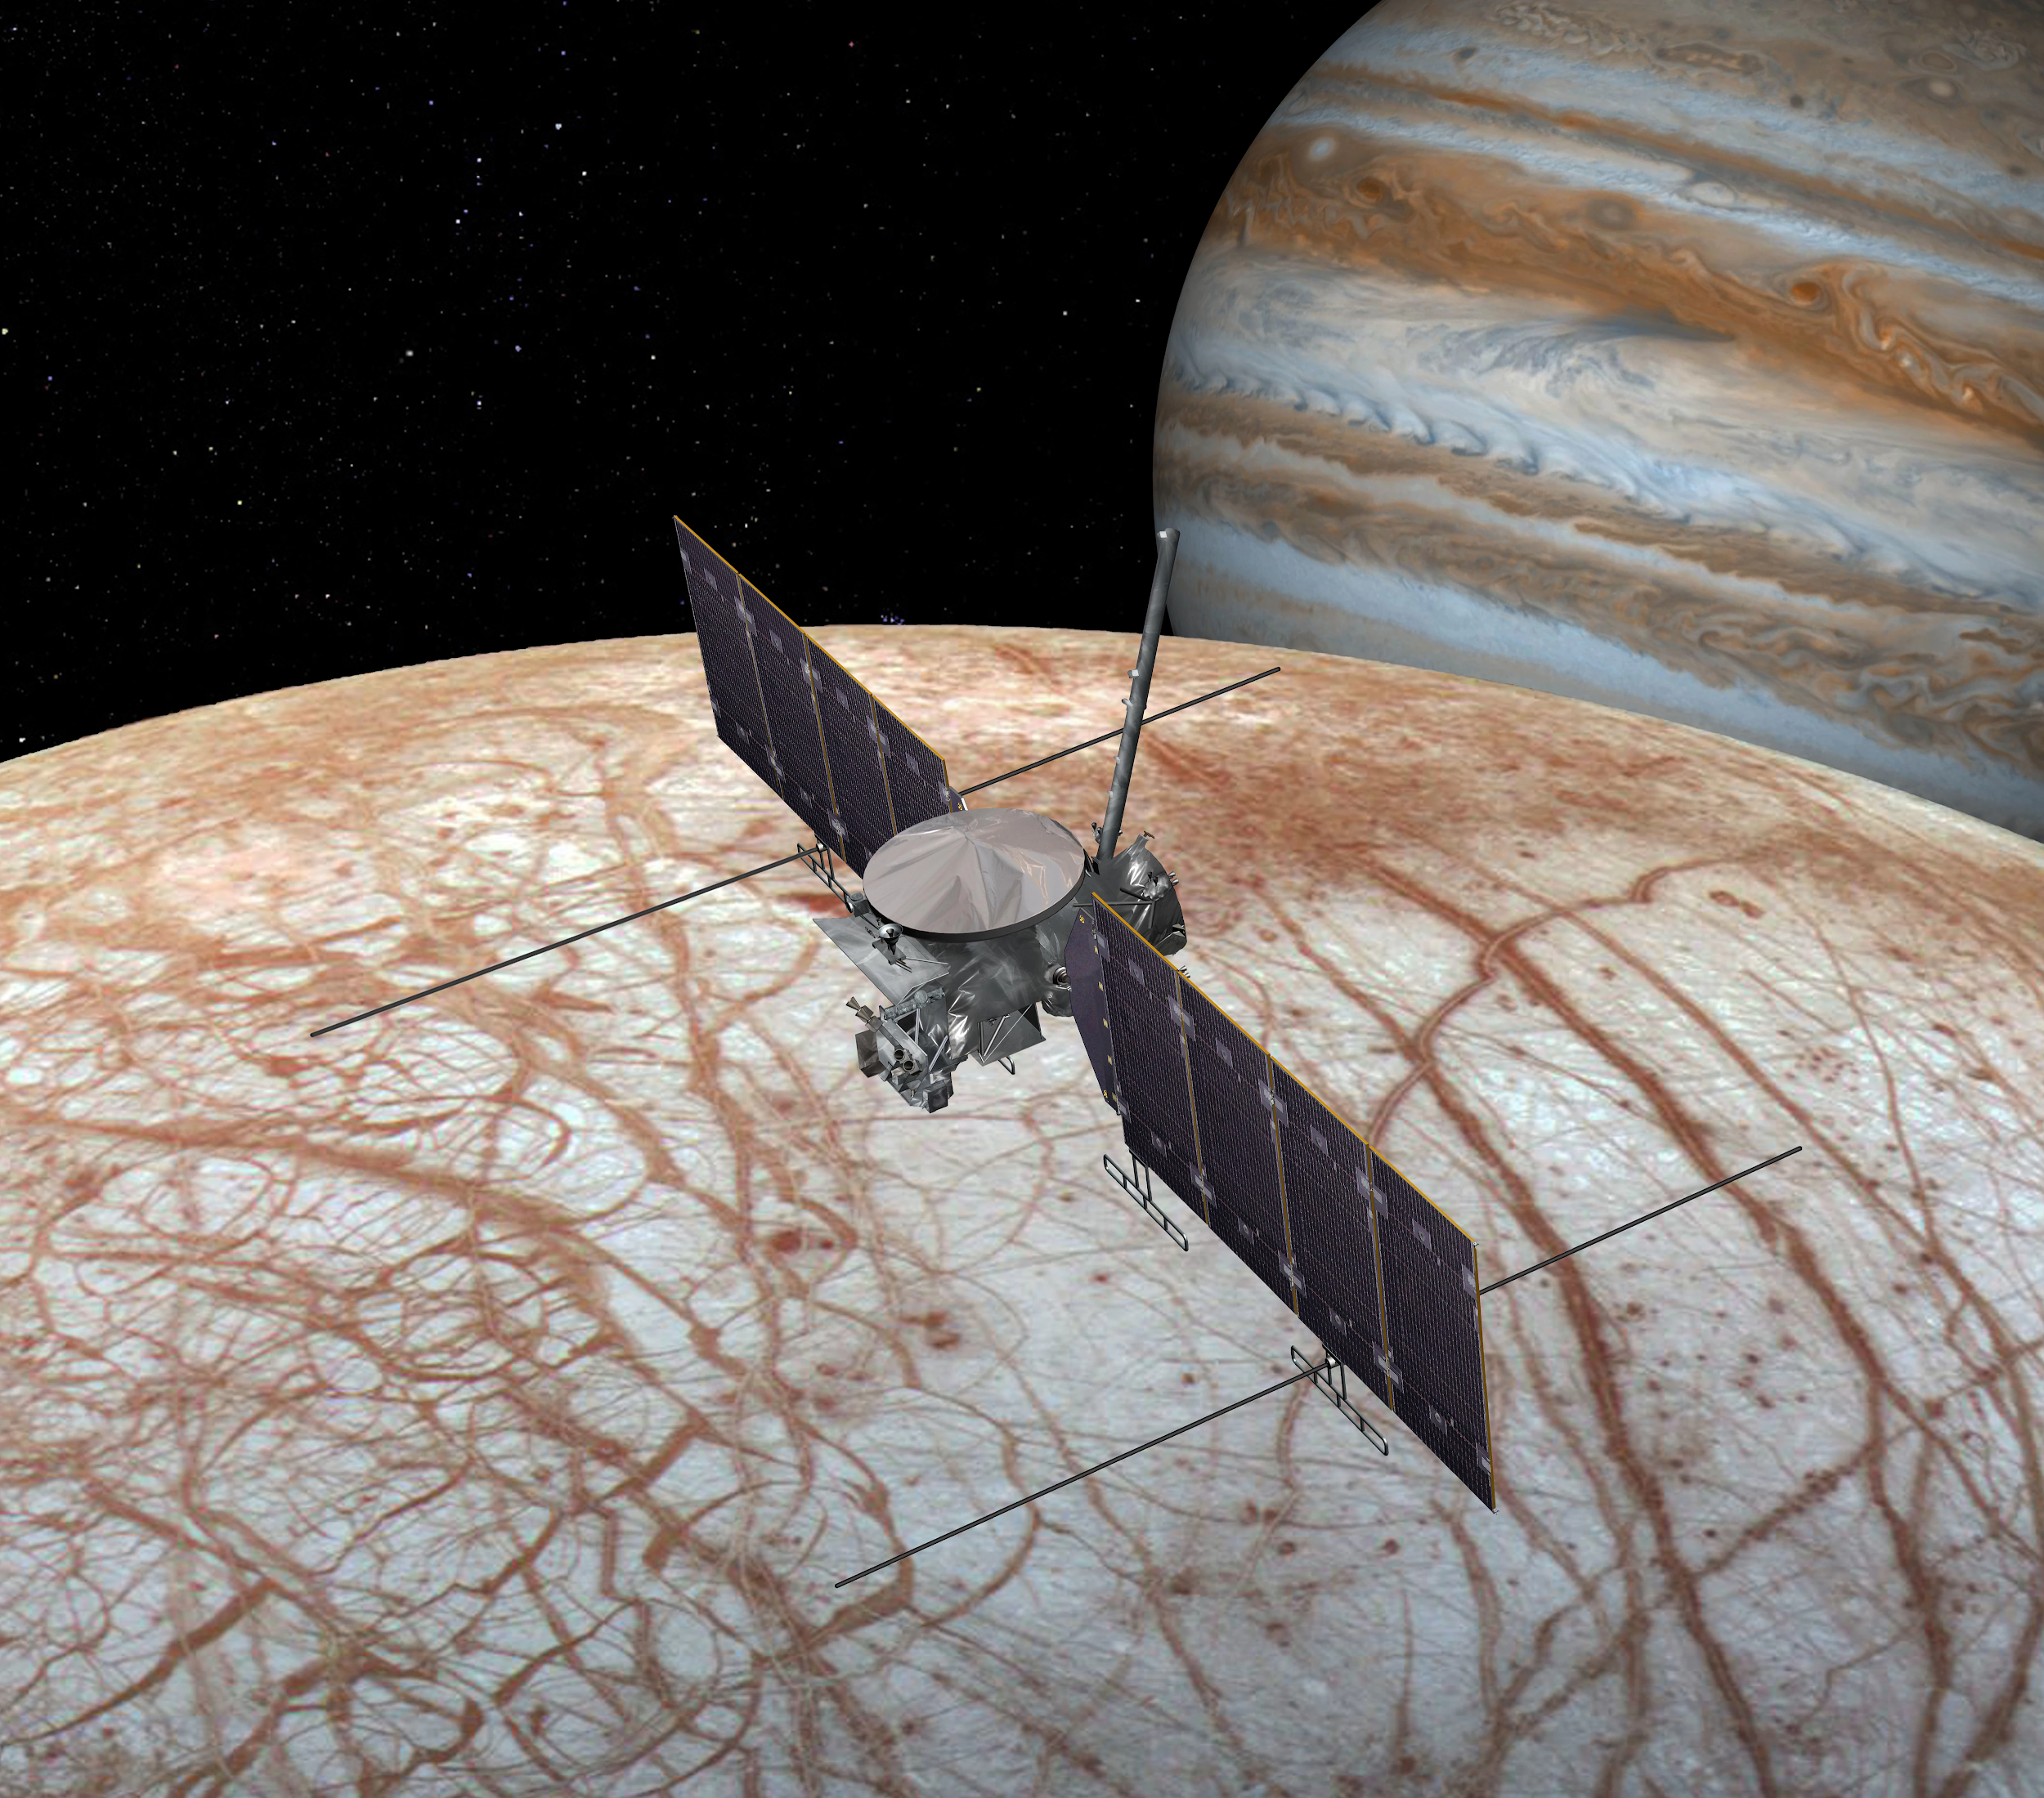
Future
European Space Agency mission- JUpiter ICy Moons Explorer (JUICE)
Characterization of the ocean layers and detection of putative subsurface water reservoirs
Characterization of the internal mass distribution, dynamics and evolution of the interiors
Investigation of the exosphere
NASA mission-Europa Clipper (2020’s)
From Decadal Survey (2nd on the list)
9 instruments on board

Slide 17
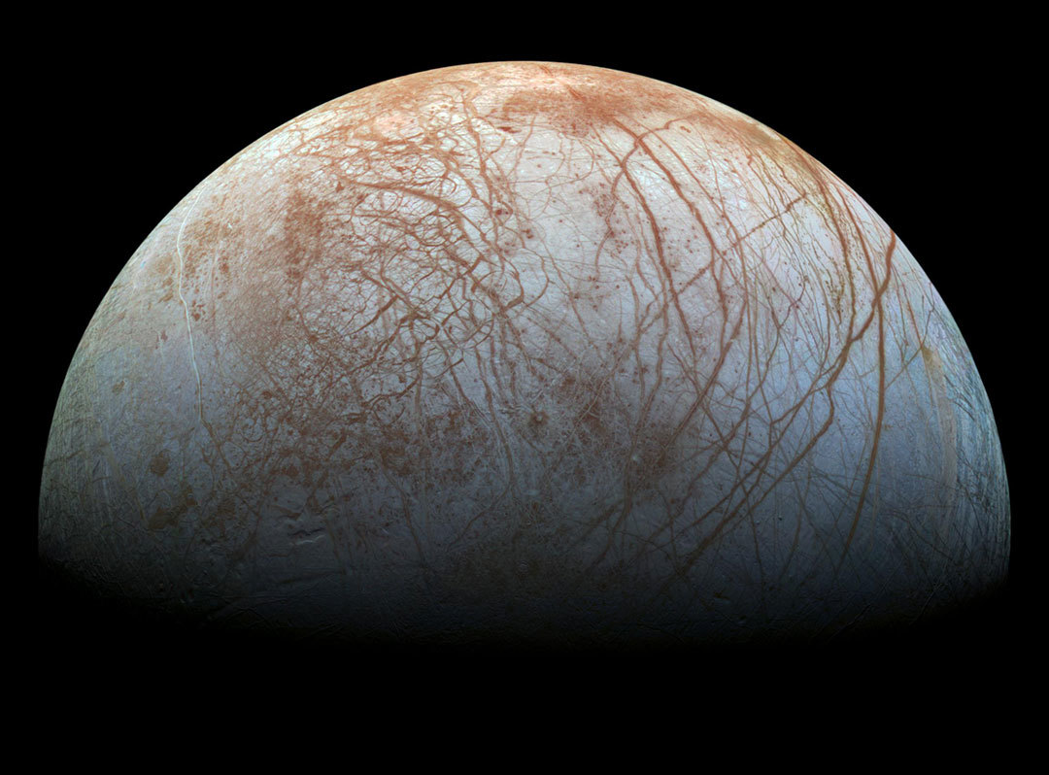
Conclusion
Important to study Europa’s atmosphere (Possibility for life)
The past research continues to spark interest for the future research
solarsystem.nasa.gov

Slide 18
Ayanna’s References
Alexander C. and Carlson R. (2009) The exploration history of Europa. Europa, Edited by Robert T. Pappalardo, William B. McKinnon, Krishan K. Khurana. University of Arizona Press, Tucson, pp. 59-83.
Johnson R.E., Burger M.H., Cassidy T.A., Leblanc F., Marconi M., Smyth W.H. (2009) Composition and detection of Europa’s sputter-induced atmosphere. Europa, Edited by Robert T. Pappalardo, William B. McKinnon, Krishan K. Khurana. University of Arizona Press, Tucson, pp. 507-527.
McGrath M.A., Hansen C.J., Hendrix A.R. (2009) Observations of Europa’s tenuous atmosphere. Europa, Edited by Pappalardo R.T., McKinnon W.B., Khurana K.K. Univ of Arizona Press, Tucson, AZ, pp 485-505.
Schubert G., Sohl F., Hussmann H. (2009) Interior of Europa. Europa, Edited by Robert T. Pappalardo, William B. McKinnon, Krishan K. Khurana. University of Arizona Press, Tucson, pp. 353-367.
Spencer J.R. and Calvin W.M. (2002) Condensed O₂ on Europa and Callisto. Astron. J., 124, 3400-3403.

Slide 19
Marilyn’s References
Galli, A., Vorburger, P., Wurz, M., and Tulej, M.. Sputtering of water ice films: A re-assessment with singly and doubly charged oxygen and argon ions, molecular oxygen, and electrons.Science Direct, Icarus. pp. 36-45
Howell, Elizabeth. “JUICE: Exploring Jupiter's Moons.” Space.com, Space.com, 24 Mar. 2017, www.space.com/35692-esa-juice-facts.html.
Johnson, R. E., Burger, M. H., Cassidy, T. A., Leblanc, F., Marconi, M., & Smyth, W. H. (2009). Composition and Detection of Europa’s Sputter-induced Atmosphere. Europa, 507-528.
Shematovich, V.I. and Johnson, R.E.. (2001) Near-Surface Oxygen Atmosphere at Europa. Adv. Space Res. Vol. 27. No. 11. pp1881-1888.

Slide 20
Questions?

