Slide 1
Secondary Organic Aerosols Enhancement by Sulfuric Dioxide
Atmospheric Chemistry
EAS 6410
Gabriela Saavedra, Taekyu Joo
April 19th, 2018

Slide 2
Organic Aerosol
20-90% of submicron particle mass

Slide 3
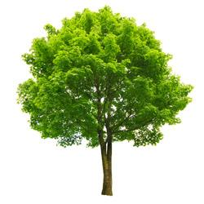
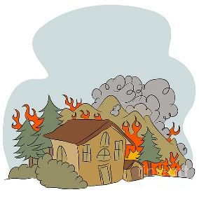
Sources
Secondary Organic Aerosol (SOA)
Gas-Particle partitioning
Volatile products (remain in gas phase)
Volatile products (remain in gas phase)
Semi-volatile, non-volatile products
Primary Organic Aerosol (POA)
BVOCs
AVOCs
Oxidation by OH, O3, NO3
Oxidation by OH, O3, NO3
https://goo.gl/nTjr2z
https://goo.gl/asJnA2
https://goo.gl/kn9jMT
https://goo.gl/UXcwrJ
https://goo.gl/BCR8JH
shorturl.at/jJ134

Slide 4
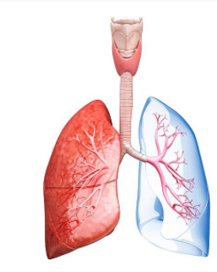
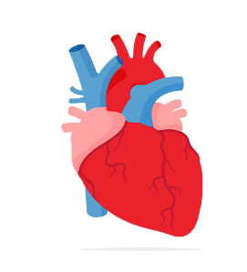
SOA: Potential adverse effects
Radiative forcing
Human health
Epidemiological studies have found associations between SOA and pulmonary and cardiovascular adverse effects
Absorption
Scattering
shorturl.at/jKU69
Induce oxidant production, known as Reactive Oxygen and Nitrogen Species (ROS/RNS)
Inflammatory cascades lead to oxidative stress and cellular damage
Prolonged stimulation of inflammatory cascades lead to chronic inflammation
Visibility
shorturl.at/nMNUV
shorturl.at/kpEIY
(Tuet et al., 2017)

Slide 5
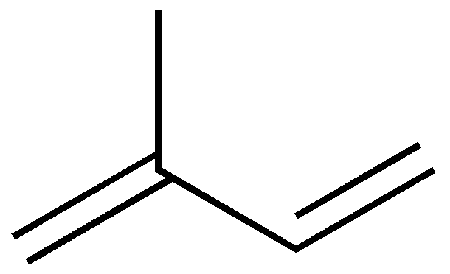
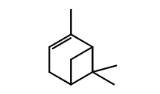
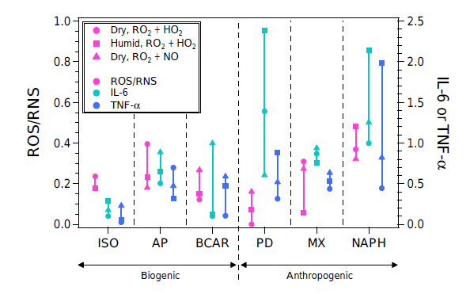
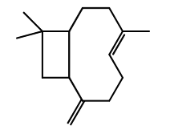
SOA: Potential adverse effects
Isoprene
Arashiro et al., 2016 showed that Isoprene-derived SOA increases the expression of IL-8 and COX-2 (both Linked to inflammation and oxidative stress).
Tuet et al., 2017 determined that exposure to isoprene SOA induced the lowest levels of TNF-a and IL- 6 among the six different SOA precursors (Naphthalene generated the greatest inflammatory response).
Monoterpenes
α-pinene
Sesquiterpenes
β-caryophyllene

Slide 6
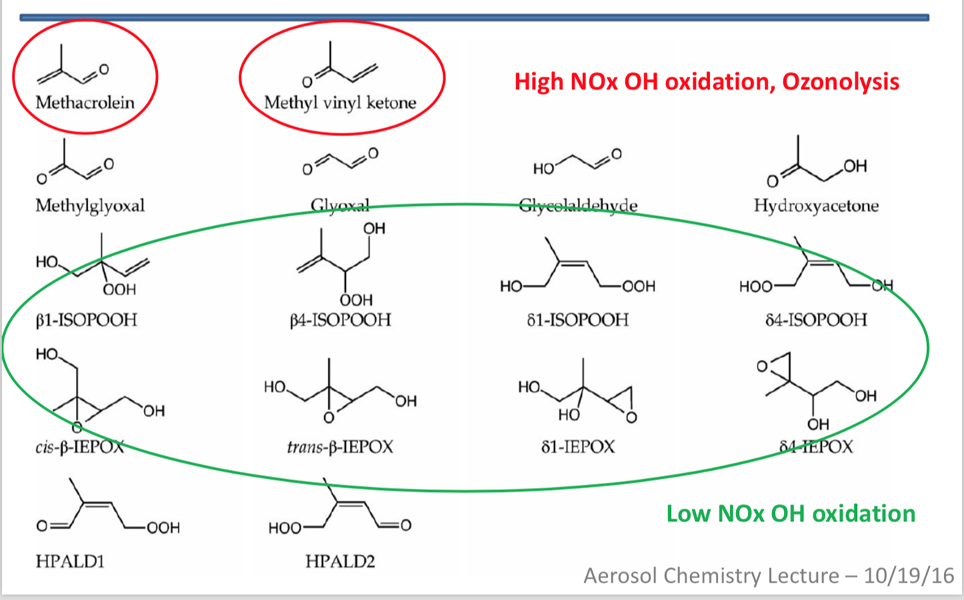
Isoprene Oxidation products
High-NO_{x}
RO2+NO
RO2+NO2
Isoprene SOA
Low-NOx
RO2+HO2
RO2+RO2
Isomerization
Isoprene SOA under Low-NOx condition can be enhanced by SO₂ level
This is important because of the NOx decreasing trend around the world
Arashiro et al., 2016

Slide 7
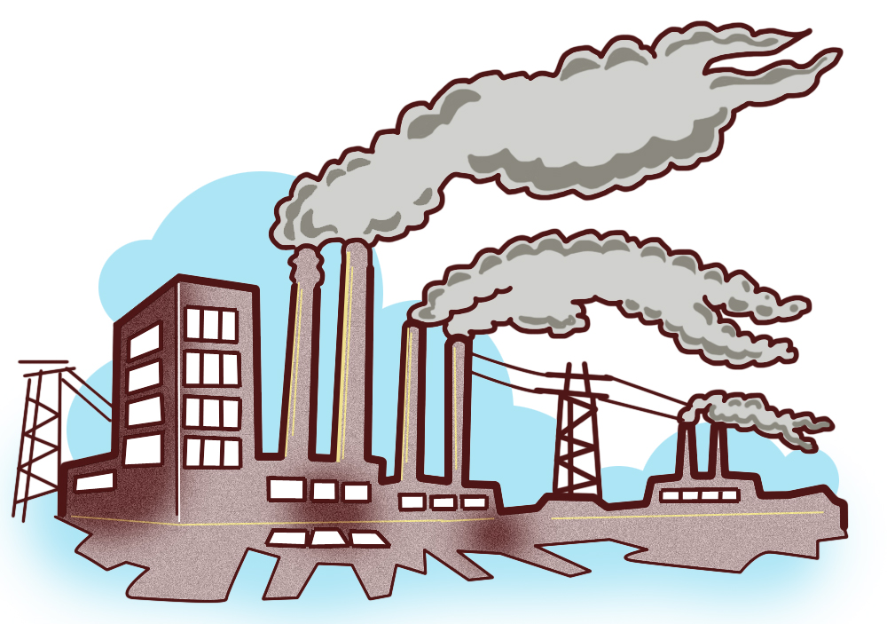
Sulfuric dioxide (SO₂)
High RH (aqueous)
Low RH
Dry salts
HSO$4$
SO₄
SO₂
Oxidation
H₂SO_{4 (aq)}
SO₄
SO₂
Sulfate plays an important role in Isoprene-OA formation (Xu et al., 2015)
Sulfur dioxide reacts with Crigee intermediate, and increase limonene-SOA yield (Ye et al., 2017)
SO₂
SO₂
https://goo.gl/BxQZEx
Modified from Aerosol Chemistry Lecture-Chapter 9

Slide 8
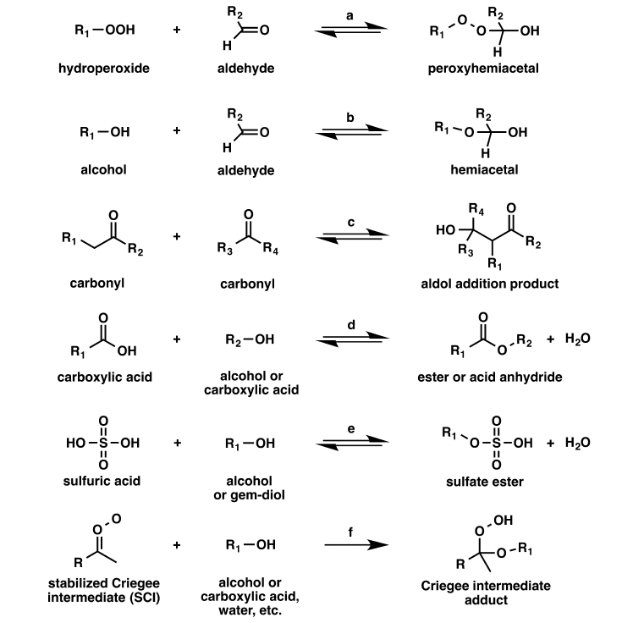
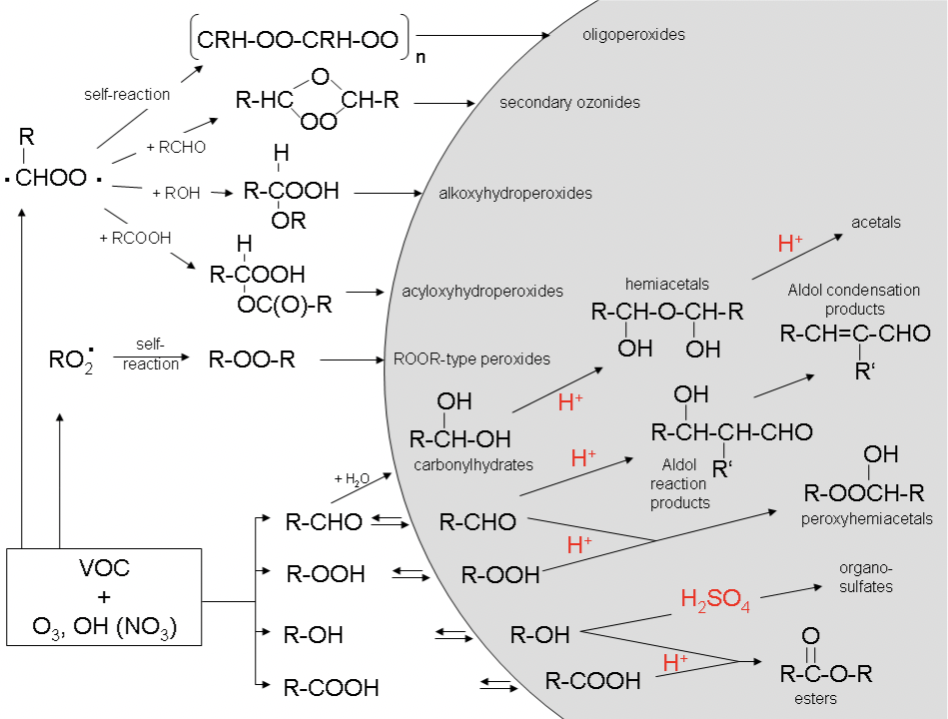
Particle phase accretion reaction
Acid catalyzed reactions
This is how oligomers are formed in particle
Irreversible reactions
→ uptake of SV-VOCs onto particle surface will continued
Hallquist et al., 2009; slide from Aerosol Chemistry and Physics class

Slide 9
Isoprene SOA enhancement by sulfate
Higher sulfate & low pH
→ more isoprene SOA
Increase in sulfate
→ acidity & surface area increase
→ Reaction rate & uptake coefficient will increase (strong correlation between uptake coefficient & acidity)
→ Oligomerization & particle-phase reaction will be more active
Xu et al., 2015, 2016

Slide 10
Isoprene SOA enhancement by sulfate
H+ attach to IEPOX SOA
Ring-opening
Organosulfate & Methyltetrols formation
Methyltetrol is one of isoprene SOA marker
Xu et al., 2015

Slide 11
Criegee Intermediate reaction with sulfur dioxide
Ozone is also one of important oxidants in the atmosphere
Monoterpenes’ reaction with ozone is important
Another channel that is important for sulfur dioxide’s oxidation, becoming H2SO4
Ye et al., 2017

Slide 12
Limonene ozonolysis process
(Primary ozonoide)
Maksymiuk et al., 2007

Slide 13
Limonene SOA enhancement by sulfur dioxide
Higher yield when SO2 concentration is increased.
Formation of organosulfate
Increase in oxidation state
Higher O/C usually related with organic acids formation
→ Lower volatility species
In most of studies, both oligomerization and functionalization increase by sulfate
But a couple of study shows suppressed oligomerization by sulfate
→ functionalization exceeds effect of suppression in this case
Ye et al., 2017

Slide 14
Conclusions
BVOCs are important SOA precursors
Higher amount compared to AVOCs
Isoprene, which is the most abundant non-methane hydrocarbon in the atmosphere, can contribute more to SOA formation when….
NOx emission keep decreases as it is these days
IEPOX, which is water-soluble product, will increase
SO2 emission is also decreasing, but low-NOx condition will enhance Isoprene-SOA even with low level of SO2 in the atmosphere
Limonene ozonolysis SOA mass increase with the existence of SO2
On-going research topic currently, not yet well understood

