Slide 1
Bromine and Chlorine Chemistry in the Troposhere
By: Ifayoyinsola Ibikunle and Qiyang Yan

Slide 2
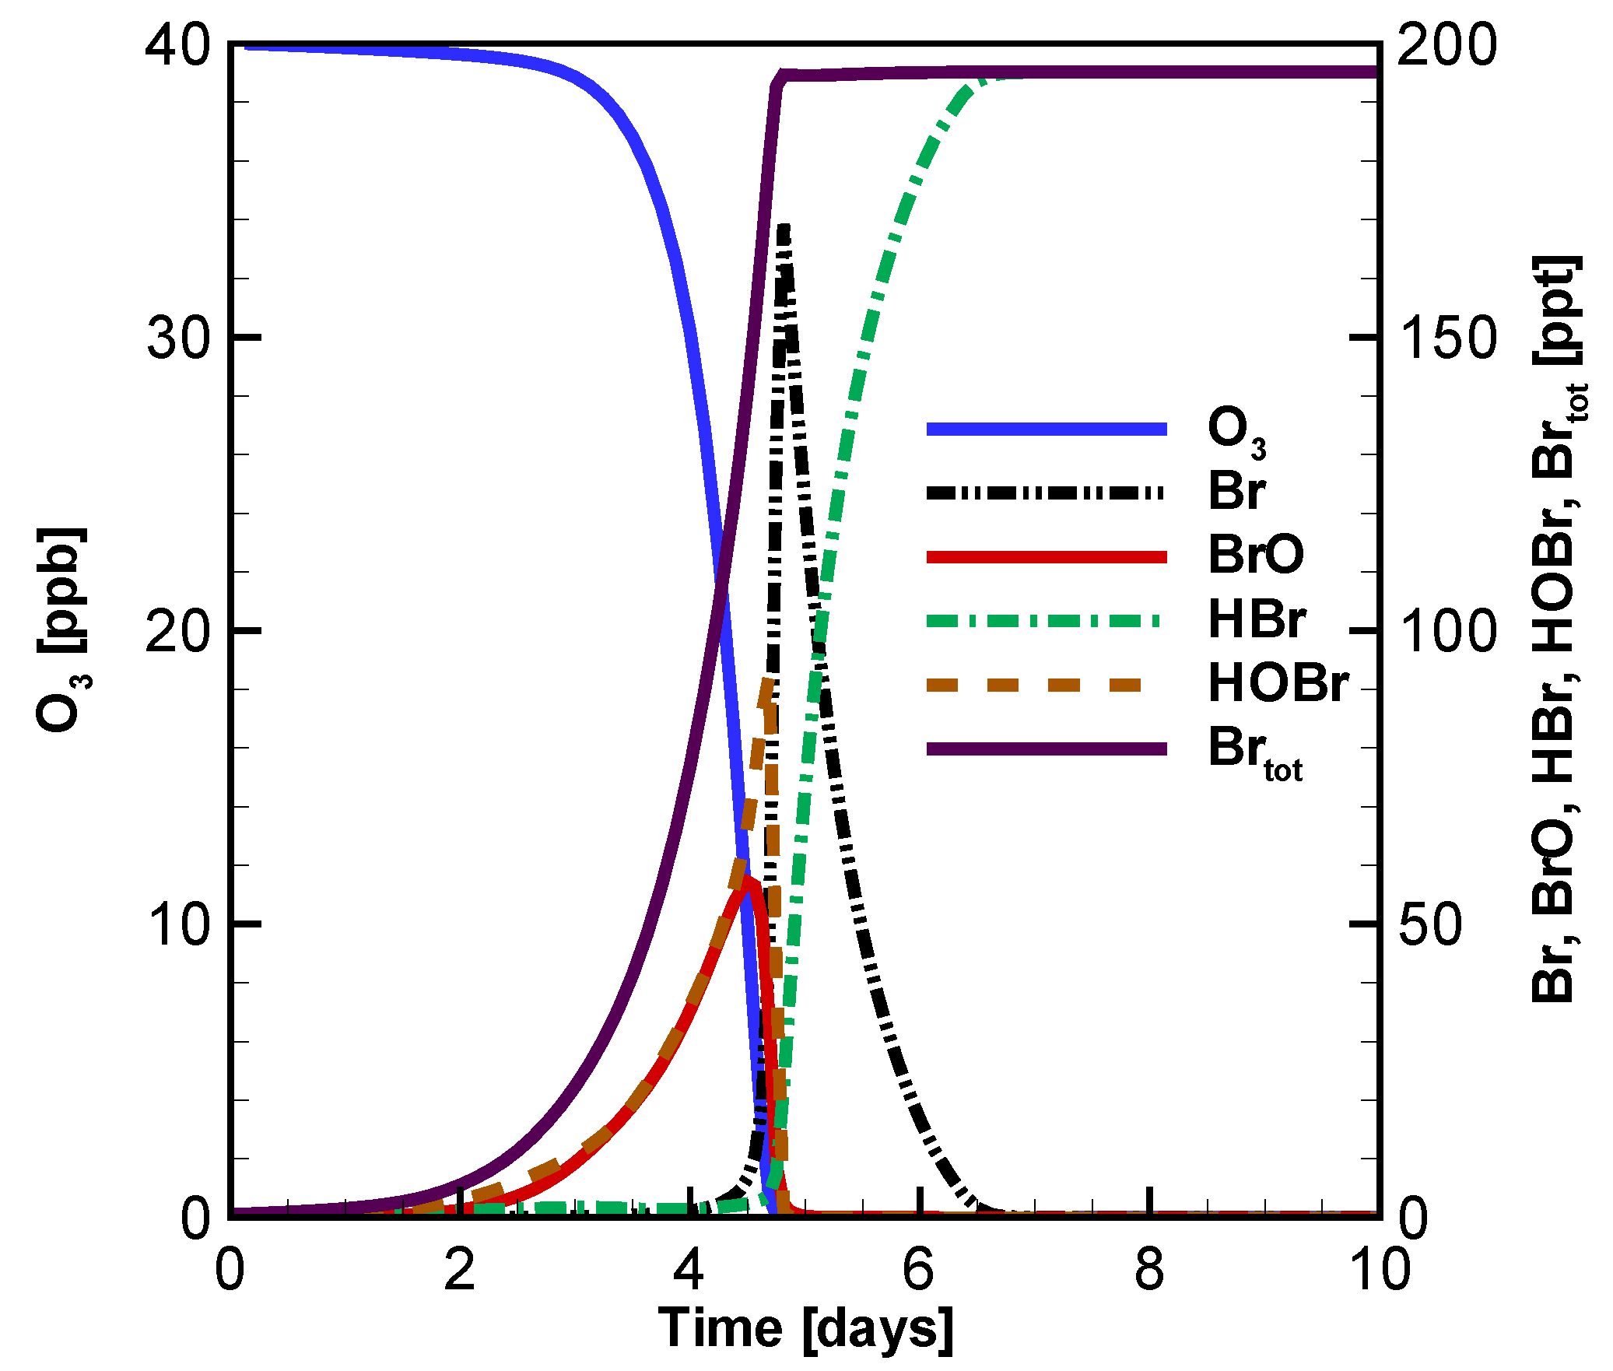
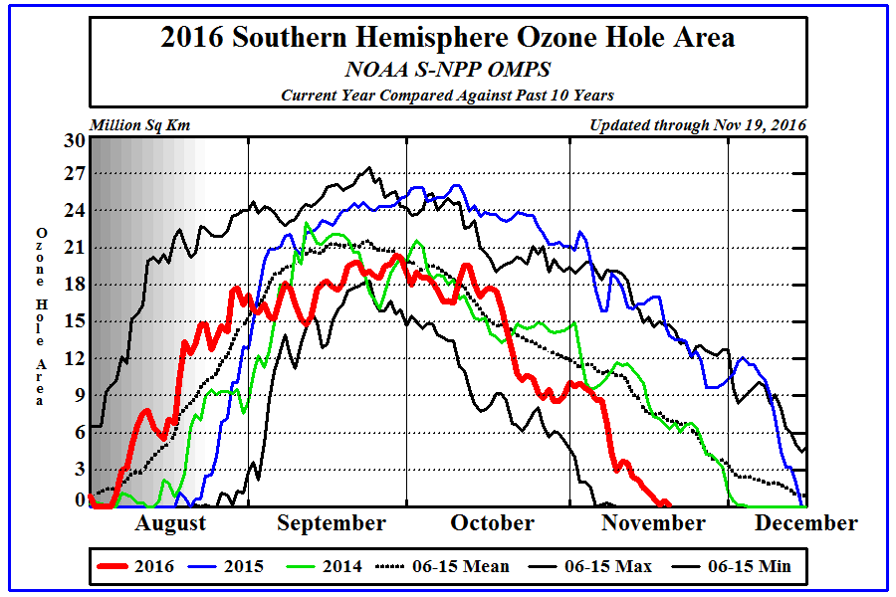
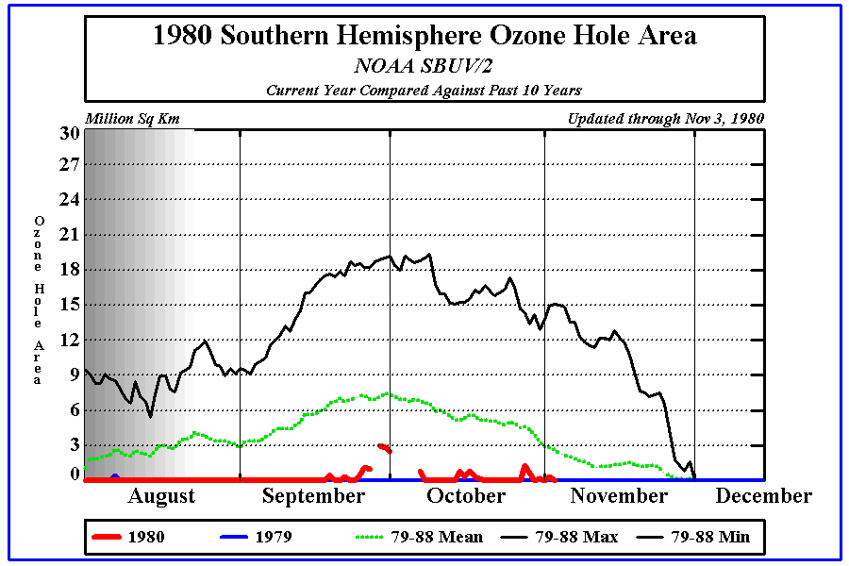
Halogens exert a powerful influence on chemical composition of the atmosphere
Cao, L., et. al (2016)
http://www.cpc.ncep.noaa.gov/products/stratosphere/polar/gif_files/ozone_hole_2016.png
http://www.cpc.ncep.noaa.gov/products/stratosphere/polar/gif_files/ozone_hole_1980.png
Notes:
Reactive halogens generally destory ozone in catalytic cycles
Temporal evolution of ozone and principal bromine species in a 200 m boundary layer with the original initial atmospheric composition. General trend is that bromine species remain in atmosphere after ozone depletion events
We can see that over the years, the ozone hole has increased in size
Why is there a peak during september months?

Slide 3
Troposhpheric Ozone is “bad ozone”
Tropsheric Ozone
Acts as air pollutant and green house gas
Impact on humans
skin cancer
eye damage
accerlated aging of skin
hinder lung functioning
Stratospheric Ozone
Organisms do not live in the stratosphere so ozone is not harmful
prevents penetration of UV-C rays and eliminate most UV-B rays from Earth’s surface
Notes:
http://www.mdpi.com/2073-4433/7/10/124/htm
Stratospheric O3 prevents penetration of UV-C rays and eliminates most UV-B rays. Essentially protect life on Earth from harmful solar radiation. This process both warms the air, creating the stratosphere between 15 and 50 km altitude, and protects the biological activities at the Earth's surface from this damaging radiation. In the last half-century, the chemical mechanisms operating within the ozone layer have been shown to include very efficient catalytic chain reactions involving the chemical species HO, HO2, NO, NO2, Cl and ClO. The NOx and ClOx chains involve emission of stable molecules in very low concentration at the Earth's surface (N2O, CCl2F2, CCl3F, etc.), which wander in the atmosphere for as long as a century before absorbing ultraviolet radiation and decomposing to create NO and Cl in the middle of the stratospheric ozone layer. Here Ozone depletion would cause deletrious health effects for life on earth. Ultraviolet radiations (UVR), are high energy electromagnetic waves emitted from the Sun. UV radiation includes UV-A, the least dangerous form of UV radiation, UV-B, and UV-C, which is the most dangerous. UV-C is unable to reach the Earth's surface due to stratospheric ozone's ability to absorb it. The real threat comes from UV-B, which can enter the Earth's atmosphere, and has adverse effects.
On the other hand, troposhperic O3 acts as both a pollutant and green house gas. It has been linked to tissue damage and … Hence troposhperic ozone depletion by way of halogen chemistry can be beneficial for life on earth.
Impact on Humans
Skin cancer: Exposure to ultraviolet rays poses an increased risk of developing several types of skin cancers, including malignant melanoma, and basal and squamous cell carcinoma.
Eye damage: Direct exposure to UV radiations can result in photokeratitis (snow blindness), and cataracts.
Immune system damage: Effects of UV rays include impairment of the immune system. Increased exposure to UV rays weakens the response of the immune system.
Accelerated aging of skin: Constant exposure to UV radiation can cause photo allergy, which results in the outbreak of rashes in fair-skinned people.
Other effects: Ozone chemicals can cause difficulty in breathing, chest pain, throat irritation, and hamper lung functioning.

Slide 4
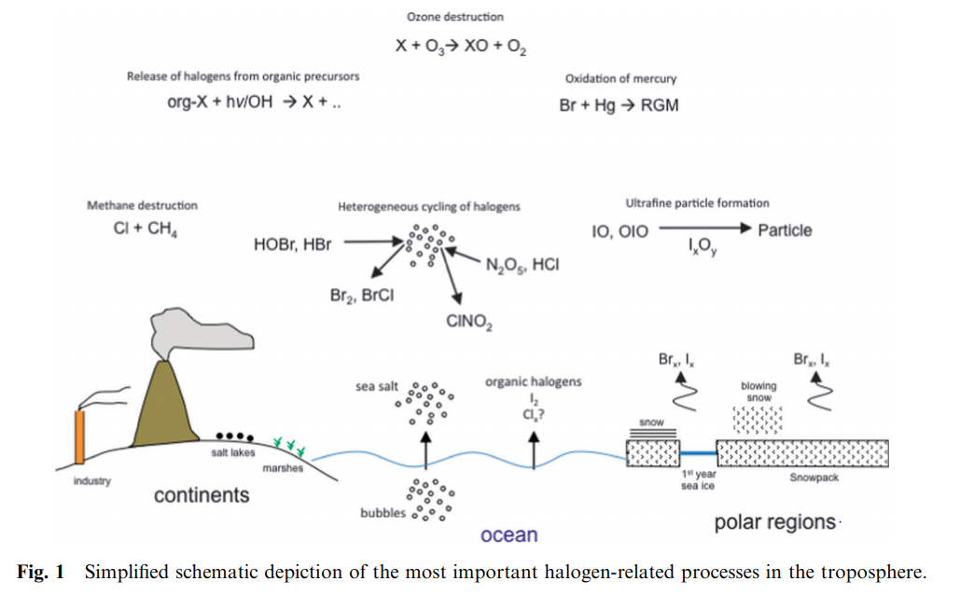
Notes:
Halogen precursors- polluted/urban environments with high Nox, marine boundary layer (Cl is more prevalent here), polar regions (Arctic --more likely to fine Bromine here).
Lost of interest in reactive halogen chemistry occurring in pollued regions. Activation is driven by N2O5 to form nitryl halides. These compounds photolyze and contribute to the morning radical budget.
more than 70% of the earth’s surface is covered by oceans. Sea spray aerosol released from the oceans is together with dust the largest natural source of aerosol particles. large amounts of bromide and chloride are present in MBL because they are present in seawater. Cl is the most abundant halide in the MBL and is released from sea salt as HCl by acid displacement.
Bromine was present during boundary layer ozone depletion events in polar regions, so halogens were considered to be the cause of depletion.

Slide 5
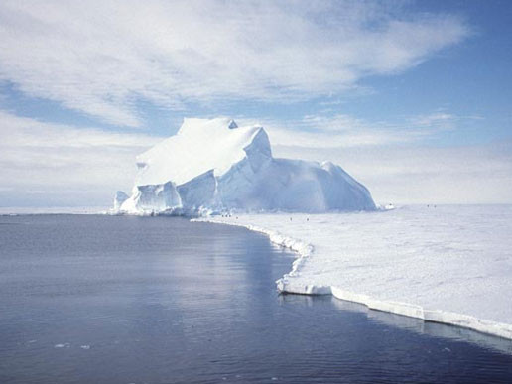
Heterogeneous Chemistry of Halogens requires a reactive surface
Net reaction: X+ HO₂+ X⁻/ HX (on surface) + h𝝂 → 2X +OH⁻/H2O
Heterogeneous surfaces:
snowpack
open water
ice forms (frost flowers)
aerosol particles
Notes:
From the net reaction, we see that two X radicals form from one starting X radical, making it an autocatalytic cycle that builds up a pool of reactive halogen radicals. This process is called halogen explosion.
Heterogenous surfaces for the production of photolabile halogen gases
Ice surfaces: combination of cryoconcentration of impurities and polarizability of halogen atoms
explain the difference between OH radical chemistry and halogen radical chemistry

Slide 6
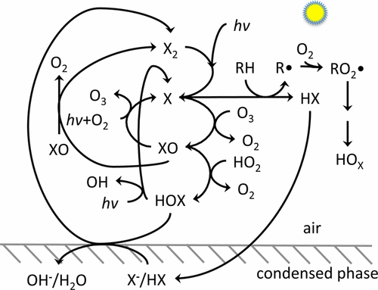
Chemistry: Halogen Radical Reactions
Radical reactions involve:
Initiation steps
dihalogen bonds broken homolytically
Propagation reactions
occur between radical and non radical
Termination reactions
combine two radicals to form a non radical
Simpson, W. R., et. al. Chemical reviews (2015).
Notes:
Simplified reaction diagram for halogen atoms, represented as “X” in this diagram, key chemical reaction pathways. Note that many species on this diagram are radicals, but for simplicity, only organic radicals and organic peroxy radicals, denoted by R• and RO2 •, are explicitly shown with an unpaired electron.
Initiation: formation of two radicals by breaking a bond between species with all paired electron bonds. Occurs through photochemistry. Halogen photochemistry absorption spectra lies in the visible to near UV region of spectrum whereas ozone photochemistry requires less abundant UV photons near 300 nm. As a result O3 photolysis (to produce OH radical) is slower than that of halogen photolysis.
Propagation: step conserves the number of radicals
Reactive halogens (X and XO) have short lifetimes (seconds to min), typically only being present during the day while the reservoir species are longer lived and often build at night.
Discuss the two major pathways of X radical propogation: directly react with O3 (bromine in polar regions like the arctic) or react with hydrocarbon (chlorine in the marine boundary layer). Pathway that consumes ozone can also form it as well in the presence of light and O2.
Discuss termination reactions as well.
What does the HOx radical impact ozone production

Slide 7
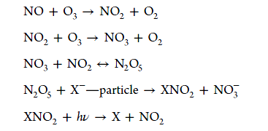
Polluted region: Chemistry
← compete hydrolysis; mainly ClNO2; pH related
← X+RH secondary HOx, second day ozone increase
Notes:
The reactivity and or solubility of BrNO2 and INO2 are likely much greater than ClNO2, such that once produced they either react away to other halogen products or remain in the condensed phase.
Roberts and co-workers showed that at highly acidic pH (pH <2), N2O5 can directly oxidize chloride to Cl2, which may be responsible for production of molecular chlorine on acidic aerosol particles

Slide 8
Recent advances in tropospheric halogen chemistry
Polar region
Polluted region

Slide 9
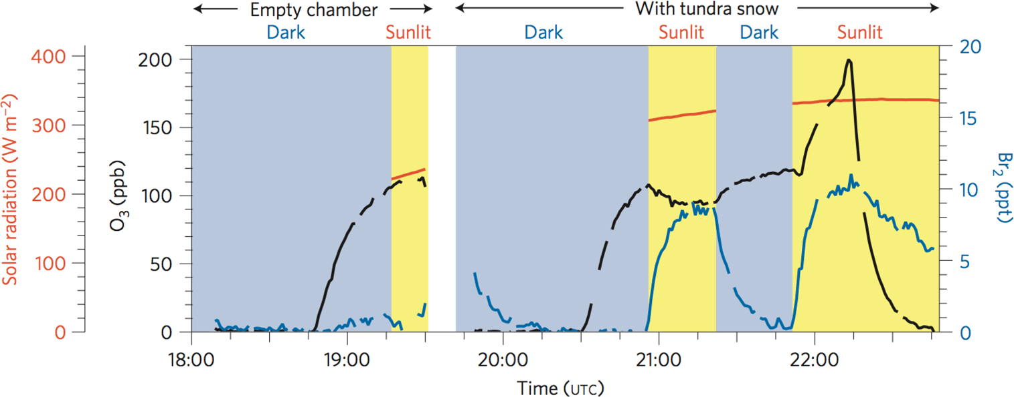
Polar region: chamber studies
Pratt et al. (2013).
Notes:
bromine was produced when the snow was exposed to natural sunlight, and that production of bromine increased upon addition of ozone gas.

Slide 10
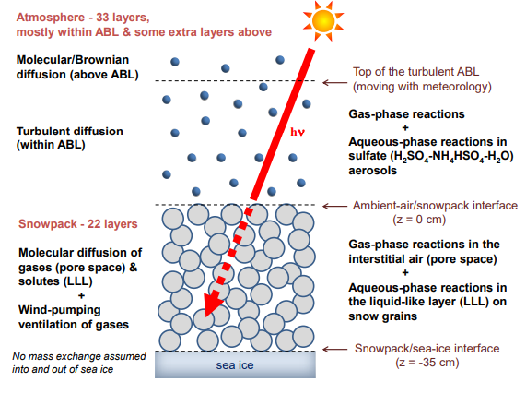
Polar region: 0-D → 1-D model
Chemistry of HOx, NOx and halogen chemistry (Cl, Br and I)
Surfaces (snowpack, open water, ice forms and aerosol particles)
Radical sources (HCHO, HONO)
Wind speed and boundary layer height
Observations: satellite, airborne and surface
Higher wind, higher BrO and more ozone depletion
Toyota et al. (2014)
Notes:
More recently, Toyota and co-workers developed a 1-D model with explicit snowpack chemistry that coupled bromine, ozone, and mercury chemistry in the air and snowpack. This study investigated the role of snowpack production of halogens and vertical transport of reactive
halogens and found that enhanced vertical mixing led to higher BrO VCD due to increased vertical extent of snowpack influence on the atmosphere.

Slide 11
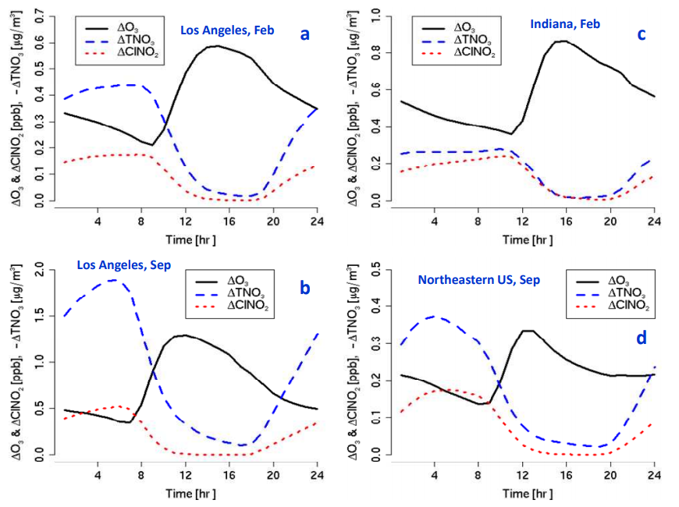
Polluted region: 3-D model
Model simulation (CMAQ) using new
chemistry mechanism with heterogenous
reactions and reactions of chlorine with
organic species.
Next day ozone increases.
Ozone impact persists into late afternoon.
Notes:
The peak ClNO2 levels in February occurred somewhat later in the morning than those in September due to the lower photolysis rate and late sun rise.
enhancement started in the morning and reached a peak value in the afternoon and then decreased
these model simulations predict that its effect on O3 continues well into the day meaning that ClNO2 production will have a noticeable impact of 8-h daily maximum O3.

Slide 12
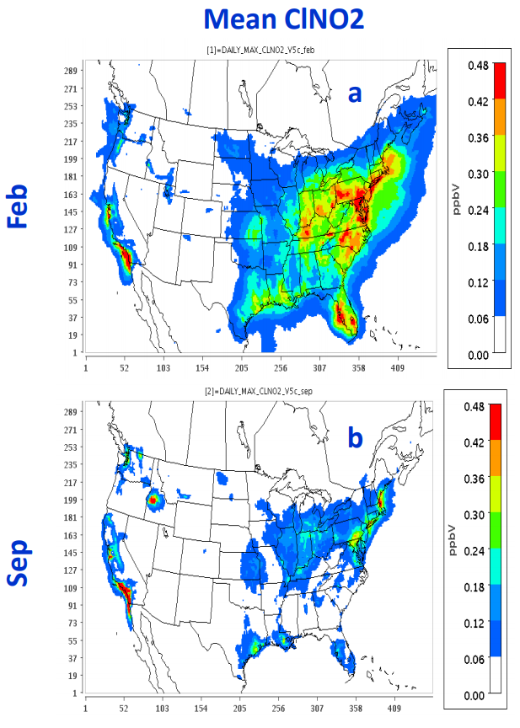
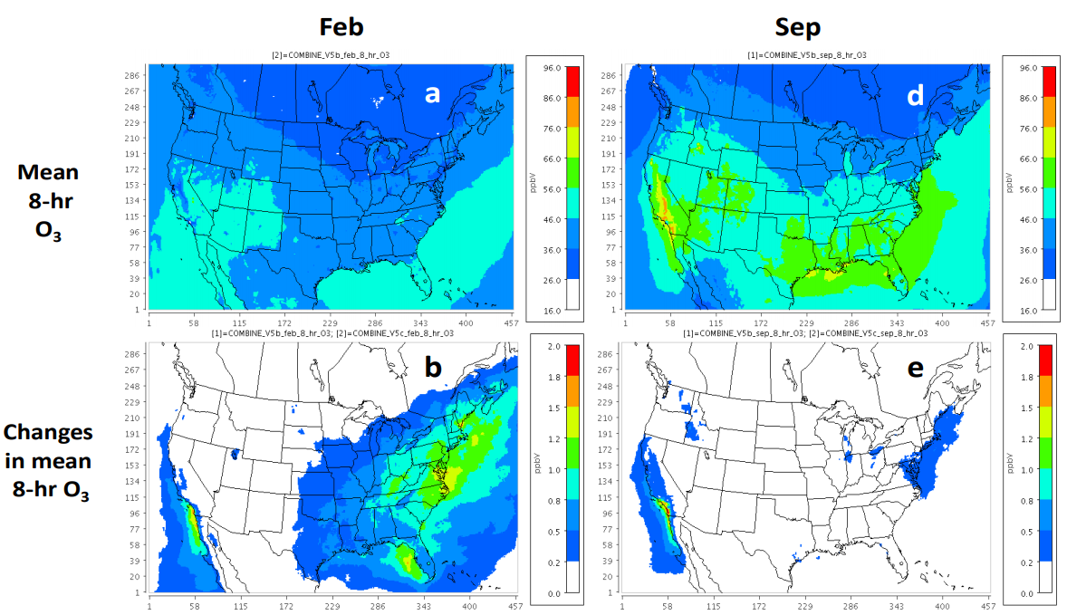
Sarwar et al. 2012. Feb and Sep in 2006
Notes:
Predicted mean 8-h daily maximum O3 without the heterogeneous production are greater than 46 ppbv in most of the United States in September while predicted values are lower than 46 ppbv in February.
The heterogeneous production enhanced the monthly mean 8-h daily maximum O3 by up to 1.7 ppbv in February and 1.9 ppbv. On a percentage basis, the enhancement reached up to 4 % and 3 % in February and September, respectively. The largest monthly mean impact occurred in Los Angeles both in February and September.

Slide 13
Future research needs
Observation with lower detection limits
Observation in free troposphere
Halogen activation surface property
Vertical interaction of surface and high altitude chemistry
Particulate chloride spatial and seasonal distribution and transport issues
Satellite missions
Notes:
Roberts and co-workers showed that at highly acidic pH (pH <2), N2O5 can directly oxidize chloride to Cl2, which may be responsible for production of molecular chlorine on acidic aerosol particles

Slide 14
References
Pratt, K. A., Custard, K. D., Shepson, P. B., Douglas, T. A., Pöhler, D., General, S., ... & Huey, L. G. (2013). Photochemical production of molecular bromine in Arctic surface snowpacks. Nature Geoscience, 6(5), 351.
Toyota, K., McConnell, J. C., Staebler, R. M., & Dastoor, A. P. (2014). Air–snowpack exchange of bromine, ozone and mercury in the springtime Arctic simulated by the 1-D model PHANTAS–Part 1: In-snow bromine activation and its impact on ozone. Atmospheric Chemistry and Physics, 14(8), 4101-4133.
Sarwar, G., Simon, H., Bhave, P., & Yarwood, G. (2012). Examining the impact of heterogeneous nitryl chloride production on air quality across the United States. Atmospheric Chemistry and Physics, 12(14), 6455-6473.
Simpson, W. R., Brown, S. S., Saiz-Lopez, A., Thornton, J. A., & von Glasow, R. (2015). Tropospheric halogen chemistry: Sources, cycling, and impacts. Chemical reviews, 115(10), 4035-4062.
Rowland F.S. (2009) Stratospheric Ozone Depletion. In: Zerefos C., Contopoulos G., Skalkeas G. (eds) Twenty Years of Ozone Decline. Springer, Dordrecht
Cao, L., et. al. (2016) Sensitivity of the Reaction Mechanism of the Ozone Depletion Events during the Arctic Spring on the Initial Atmospheric Composition of the Troposphere. Atmosphere. 7(10), 124

Slide 15
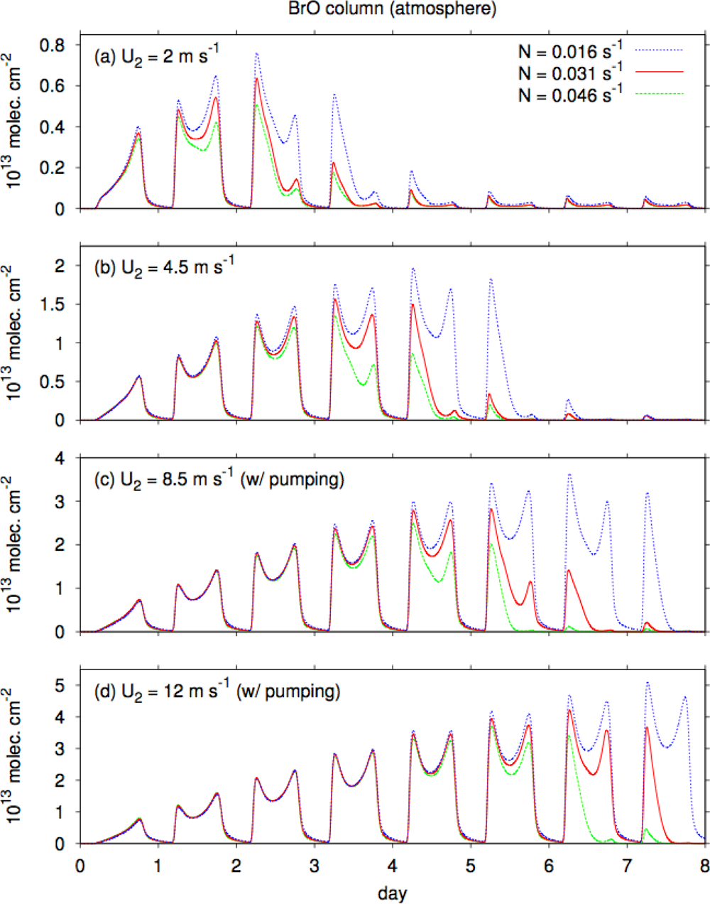
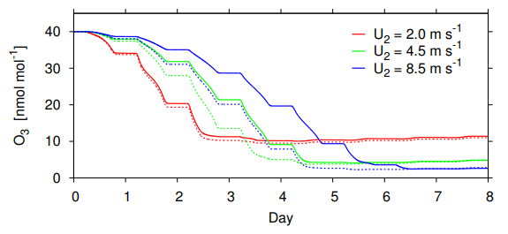
Notes:
N--buoyancy frequency larger stable.
U2--surface wind speed
As wind speed increases, a form drag associated with micro-topography on the snow surface develops, leading to pressure perturbations along mean streamlines on the upwind and downwind sides of the obstacles (Cunningham and Waddington, 1993; Andreas, 1995). This also creates pressure gradients within the porous snowpack and thus the ventilation of air, called “wind pumping”, according to Darcy’s law (Colbeck, 1989; Cunningham and Waddington, 1993; Albert, 1996). As in the previous similar model study by Thomas et al. (2011), the wind-pumping effect is superimposed as an additional, effective diffusivity (Dg, pump) to the effective molecular diffusivity

