Slide 1
Methylfuran Oxidation by Nitrate Radical
2018.04.24
Taekyu Joo

Slide 2
Importance of Aerosol Studies
SOA
POA
Affects climate
Visibility
Health effect
Organic Aerosol
20-90% of submicron particle mass
+OH, NO3, O3
VOCs
Biomass
Burning
Biogenic
Emission
Fossil Fuel
Combustion
Crutzen et al., 1990; Maria et al., 2004; Zhang et al., 2007; Tuet et al., 2017
2
Notes:
First of all, I would like start from why we need to think about Aerosol, especially organic aerosol. Aerosol is important because it affects climate, visibility, and human health. Among aerosol, Organic aerosol contributes from 20-90% of total submicron particle mass. POA, which is primary organic aerosol, is emitted directly from fossil fuel or biomass burning, and absorb sunlight. SOA, which is secondary organic aerosol, is coming from gas-to-particle partitioning when Volatile organic compounds, VOCs, are oxidized in the atmosphere. Among Organic aerosol’s source, biomass burning is one of the major source.

Slide 3
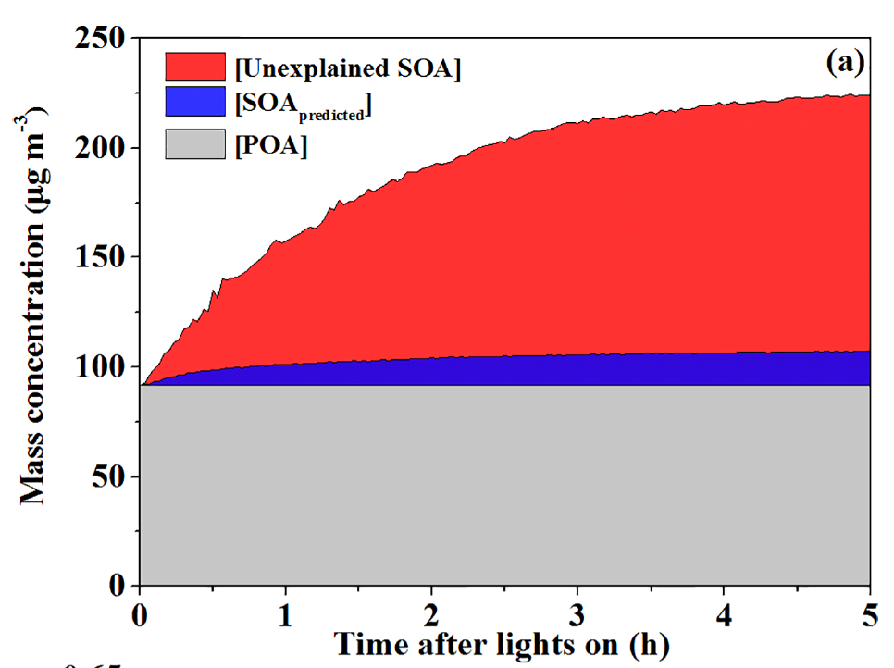
Biomass burning impact on OA
Biomass burning (BB)
Carbon emission: 2-5 petagram/yr
66-84% of tropic aerosol budget
Visibility & Health effect
Flame & smog chamber studies
Importance of SOA from understudied & unknown VOCs
Crutzen and Andreae, 1990; Fang et al., 2013; Shrivastava et al., 2015; Reddington et al., 2016
3
Notes:
Biomass burning emits 2-5 petagram of carbon in the atmosphere, as in both gas and particle phase. In case of tropical region, 66 to 84 percent of aerosol budget is coming from biomass burning, and up to 70% of global SOA is coming from biomass burning. Because thousands of VOCs are emitted from biomass burning, flame chamber studies have been conducted, and they consistently suggest that the importance of understudied/unknown SOA source is important as biomass burning plume ages.

Slide 4
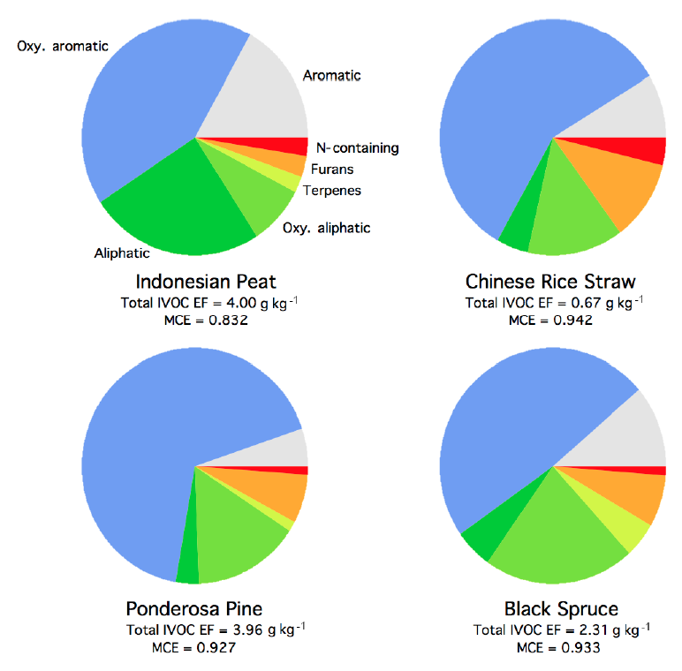
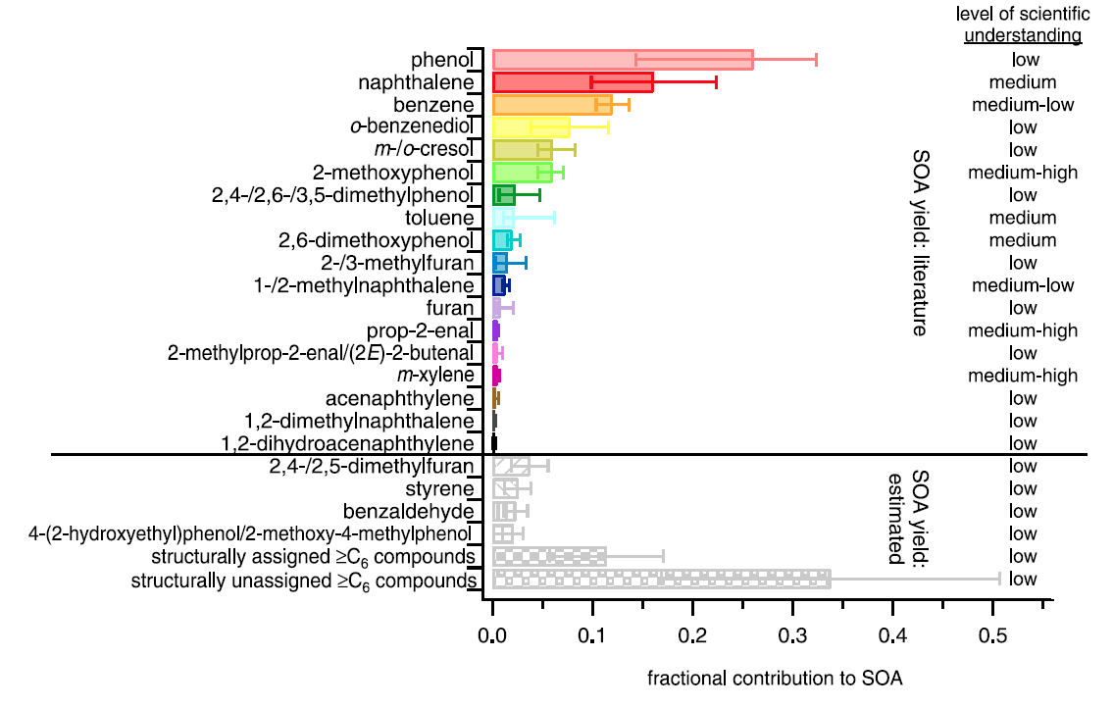
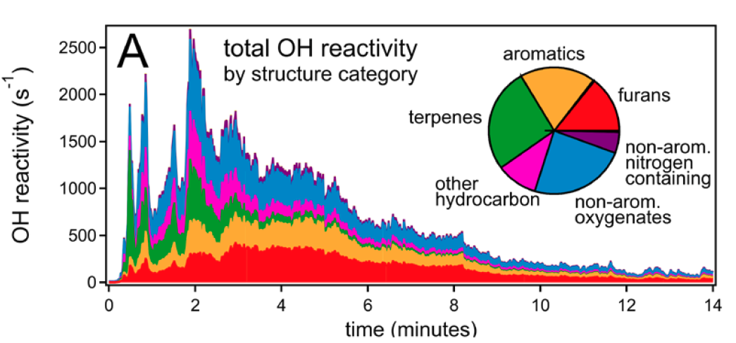
Importance of Furans
Importance of furans
One of major type of VOCs from BB
Understudied VOCs
SOA potential? 26% to 36%
High OH reactivity
Major furan species:
Methylfuran & furfural
Furans
Furans
Furans
Bruns et al., 2016; Hatch et al., 2017; Koss et al., 2017
4
Notes:
And among those understudied/unknown species, furans are considered as an important VOCs. As in this figure, furans are one type of major VOCs coming from biomass burning, and they are one of understudied important VOCs that contribute to SOA. And Furans are highly reactive to OH radical, which quickly oxidized after emitted. Among furans, major compounds coming from biomass burning are two isomers of methylfuran and furfural.

Slide 5
Research questions of Furans SOA studies
Previous Furan SOA studies
Only TWO previous studies exist
OH chemistry under high-NOx condition
Shortcomings
Inconsistent SOA yield
Only considered OH radical as the oxidant
No real-time measurement for both gas and particle products
Conditions | Alvarez et al., 2009 | Strollo et al., 2013
SOA yield (%) | 8.5 ± 2.5 | 12, 15, 9
Initial [3-MF] | 748 ± 224 ppb | 10 ppm
Seed | - | DOS (dry) & AS (wet)
Initial [NO] | 54 ± 4ppb | 10 ppm
Oxidant | HONO with NO, NO2 | OH with NO
Objective
Investigate SOA yield by NO3 oxidation
Determine oxidation pathway
Identify major species that partition into particle phase
Gomez Alvarez et al., 2009; Strollo et al., 2013
5
Notes:
There were only two SOA studies from furan oxidation, but all of them are conducted with OH radical, under high-NOx condition. There are couple of shortcomings from these studies. First, experiments are done only one or two times for each species, which makes it difficult to parameterize SOA yield. Second, only OH radical has been considered as the oxidant. Also, none of them conducted real-time measurement for gas and particle phase products. In this matter, our objectives are: to estimate SOA yield under RO2+NO3 condition, determine oxidation pathway, and identify major species that partition into particle phase from real-time measurement of gas and particle-phase.

Slide 6
Experiments: GTEC facility
Particle-phase
AMS
FIGAERO-HR-ToF-CIMS
Gas-phase
HR-ToF-CIMS
N2O5 injection through flow tube
Reaction in flow tube:
VOC : N2O5 ~ 1:4
Setting RO2+NO3 channel, and minimize RO2+HO2 channel
Boyd et al., 2013
6
Notes:
Experiments are conducted at Georgia Tech Environment Chamber facility. We used High-resolution AMS to analyze elemental composition of aerosol and used GC-FID and SMPS to estimate SOA yield. For the real-time measurement of gas- and particle-phase products, we used FIGAERO-ToF-CIMS. The inlet system cycle we set here was 1 hour for each cycle: 20 minutes for gas sampling, 15 minutes temperature ramp, 15 minutes soaking, and 10 minutes cooling. N2O5 was injected as the NO3 source. Below reaction here is expected reaction inside the flow tube. We tried to set VOCs:N2O5 ratio to be 1:4 to ensure all VOCs react with NO3 radical.

Slide 7
Experiments condition
Experiment | Condition | ΔHC (ppb) | ΔMo(μg/m3) | Yield (%)
1 | 3MF + NO3 | 562.58 | 45.28 | 2.40
2 | 3MF + NO3 | 328.42 | 23.81 | 2.16
3 | 3MF + NO3 | 171.76 | 10.54 | 1.83
4 | 3MF + NO3 | 96.15 | 5.22 | 1.62
5 | 2MF + NO3 | 438.89 | 49.75 | 3.38
6 | 2MF + NO3 | 270.14 | 25.64 | 2.83
7 | 2MF + NO3 | 91.19 | 6.68 | 2.18
8 | 2MF + NO3 | 180.76 | 18.83 | 3.10
Experiment | Condition | ΔHC (ppb) | ΔMo(μg/m3) | Yield (%)
1 | 3MF + NO3 | 562.58 | 45.28 | 2.40
2 | 3MF + NO3 | 328.42 | 23.81 | 2.16
3 | 3MF + NO3 | 171.76 | 10.54 | 1.83
4 | 3MF + NO3 | 96.15 | 5.22 | 1.62
5 | 2MF + NO3 | 438.89 | 49.75 | 3.38
6 | 2MF + NO3 | 270.14 | 25.64 | 2.83
7 | 2MF + NO3 | 91.19 | 6.68 | 2.18
8 | 2MF + NO3 | 180.76 | 18.83 | 3.10
SOA density: 1.24 g/cm3
Ammonium sulfate seed
RH < 5%
Temperature: 25⁰C
7
Notes:
We conducted 8 experiments in total, 4 experiments of 3-methylfuran plus NO3 and 2-methylfuran plus NO3 each. And in today’s talk, I will focus on 3-MF+NO3 experiment.

Slide 8
MF+NO3 SOA Yield
Yield
Yield = ΔMo/ΔHC
Two-product model fitting
2MF+NO3 yield is higher than 3MF+NO3
Yield is lower than β-pinene + NO3 or isoprene + NO3 oxidation experiments
Still, it can be important depending on abundance of emitted VOCs & emission type
SOA potential of furans: 26-36%
Odum et al., 1996; Ng et al., 2008; Boyd et al., 2013; Hatch et al., 2017
8
Notes:
From here is our results so far. From experiments with multiple initial VOCs concentration, we calculated SOA yield as the function of dMo, which is the amount of aerosol produced. We were able to observe higher yield for 2-methylfuran+NO3. And when we compare with a couple of other RO2+NO3 experiments, yield was around 3-5% of b-pinene+NO3 and 10-25% of isoprene+NO3 at same dMo. But still, it can be important depending on abundance of emitted VOCs & emission type.

Slide 9
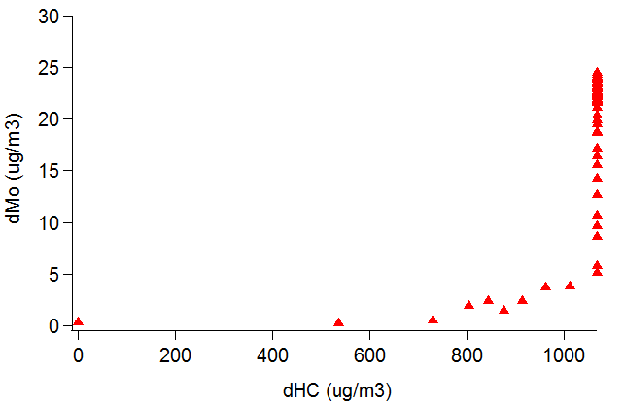
3MF+NO3 SOA formation behavior
All 3MF consumed
Aerosol continuously increasing after all MFs are oxidized
→ Multi-generational oxidation products contribute to aerosol growth
9
Notes:
When we take a look at the SOA formation behavior of 3MF+NO3 experiments, SOA was still growing after all 3MF was consumed. This could indicate that multi-generational oxidation products contribute to aerosol growth.

Slide 10
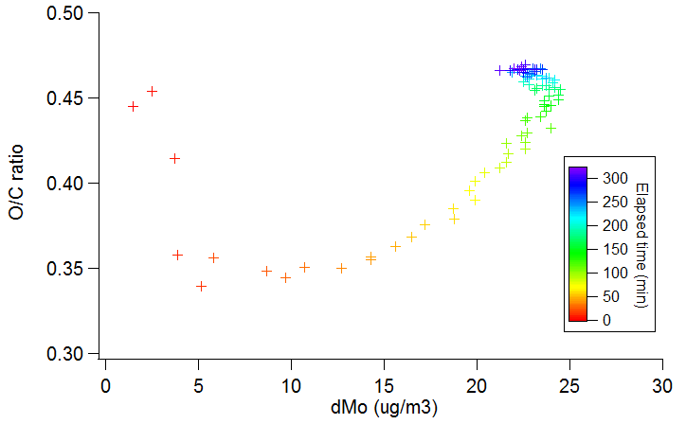
O/C ratio vs ΔMo
N2O5 injection until ~200 mins
In the beginning of the oxidation, less oxidized compounds are partitioning onto particle
More oxidized compounds partition as the oxidation continues

Slide 11
AMS Organic mass spectra
CHO1 comparable to CH species
Parent VOC: 3-MF (C5H6O)
Higher f44 compared to f43
Oxidized species in SOA
Could be acids fragment
Notable signal of m/z 82 (C₅H₆O⁺)
→ Can interfere Isoprene (IEPOX)-SOA signal
Higher NO⁺ than NO₂⁺
Organic nitrate formation
Duplissy et al., 2011
11
Notes:
Here, we tried to analyze organic fragments coming from each families. CHO1 species are comparable to CH families because parent VOC already has one oxygen atom. F44, which mostly coming from CO2+ fragment, was relatively higher than f43 and other fragments. As f44 is coming from organic acids from previous studies, we expect to measure acids from the CIMS. One interesting peak here was m/z 82, which is isoprene SOA signal. If methylfuran emission is large, it may interfere such signal. When we move on to NO and NO2 signal, NO is higher, which indicates that there is organic nitrate formation going on.

Slide 12
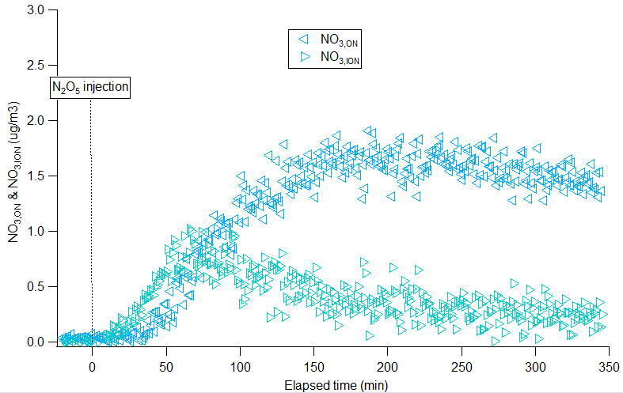
Organic nitrate in AMS
All 3MF consumed
All 3MF consumed
Organic nitrate estimation from total NO3 in AMS
R_{ON} (NO⁺/NO₂⁺) ~ 5.6
NO_{3,ON} contribution to Org
→ around 25%
NO₃/Org decrease
Inorganic nitrate formation in the beginning
Due to considerable amount of N2O5 injection
Farmer et al., 2010; Xu et al., 2015; Kiendler-Scharr et al., 2016
12
Notes:
So we tried to estimate organic nitrate that is measured as NO3 from the AMS. This equation is from Farmer et al., 2010, and Robs is measured NO/NO2 ratio, RNH4NO3 is NO/NO2 ratio from IE calibration, and RON used here is 5.6, which was the maximum value from this experiment. From the calculation, we estimate 25% of organic nitrate is measured as NO3 in AMS. And NO3/Org is decreasing in the beginning, which was unexpected trend. This is because we injected huge amount of N2O5, that can make some inorganic nitrate even though all experiments here are under dry condition.

Slide 13
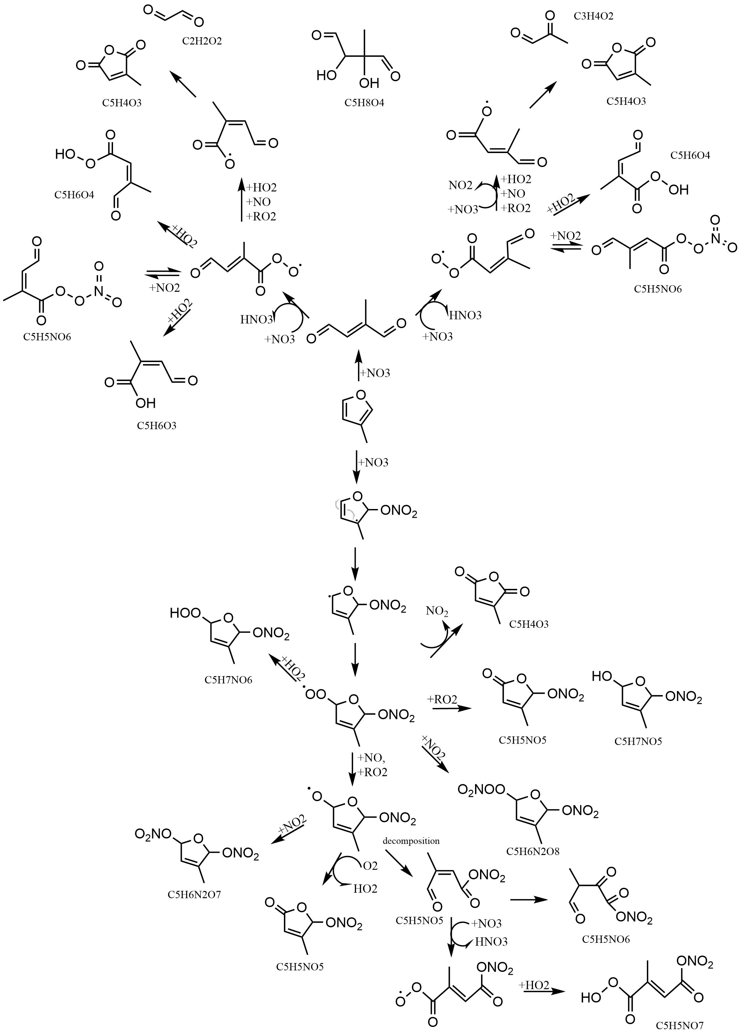
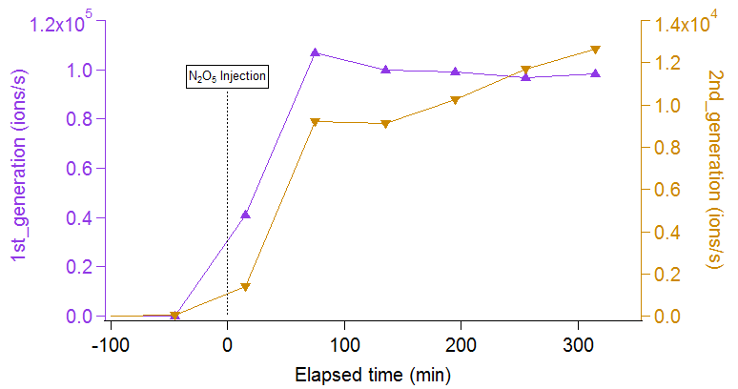
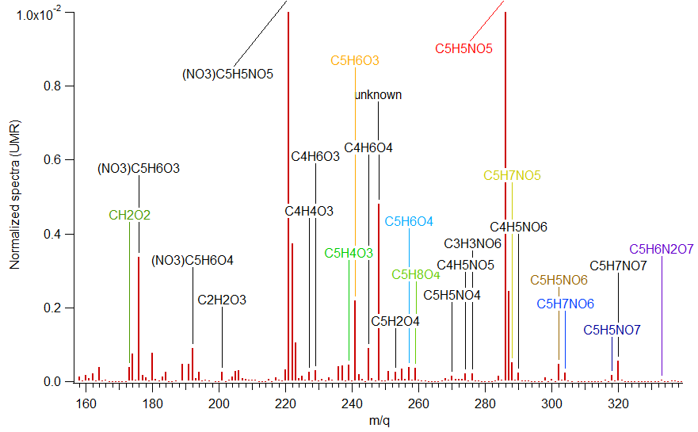
Oxidation mechanism & CIMS Gas mass spectra
All 3MF consumed
Mechanism from MCMv3.2
Mechanism from Tapia et al., 2011 & from this study
ONs form fast once N2O5 is injected into the chamber
2nd generation product increase continuously until the end of the experiment
13
Notes:
Now we move to CIMS data analysis to see which specific compound is contributing to aerosol. We normalized mass spectra with iodide signal and compare the results with oxidation pathway that was reported from previous studies. The major measured gas species was C5H5NO5, red boxed compound at this oxidation pathway figure, and C5H6O3 was the major particle compound, which boxed in orange. When we classify into 1st generation product and 2nd generation product based on this suggested pathway, we were able to observe keep increasing trend of the sum of 2nd generation compounds. This also supports the importance of multi-generational oxidation contributing to SOA.

Slide 14
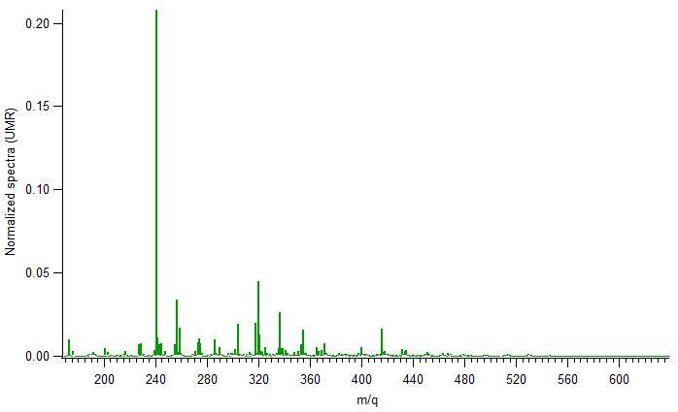
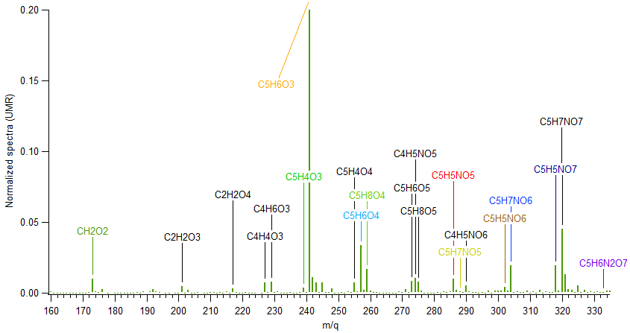
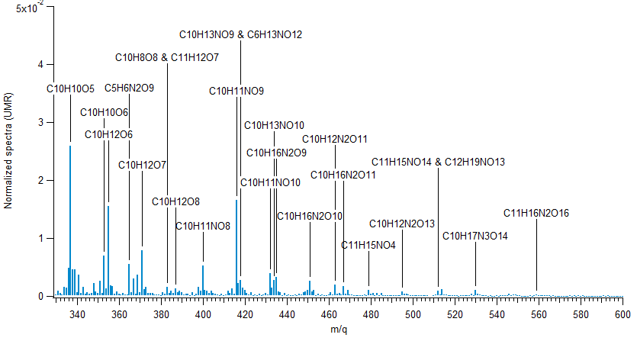
CIMS Particle mass spectra
Monomer region
Dimer region
Major monomer: C5H6O3
Carboxylic acid
Related to high f44 signal from AMS
Lower signal in dimer region
Low yield of SOA
Thermal decomposition of oligomers?
14
Notes:
From the particle phase mass spectra which was measure from FIGAERO-CIMS, we could classify into monomer region and dimer region. The major compound that we observed was C5H6O3, which has a carboxylic acid functional group. This species has stable structure, which makes sense that it shows high signal here.
Lower signal in dimer region would be the reason for low SOA yield. Also, such response might be due to fragile oligomers are consisting SOA.

Slide 15
Summary & future works
SOA yield of 3MF + NO3
Around 1.5-2% at ΔMo from 5-45 ug/m3
Aerosol growing behavior
Multigenerational oxidation product contribute to SOA
Organic nitrate contribution: ~25%
Major monomer
Gas: C5H5NO5: organic nitrate
Stays mostly in gas: low signal in particle phase
Particle: C5H6O3: Carboxylic acid
f44 also higher compared to the other fragments
Future studies
Identify major products’ pathway yet unknown
Identify how major oligomers are produced
Characterize particle composition
15
Notes:
Up to here is that has been done so far, and here is the summary of today’s talk. SOA yield was around ~~~~~

Slide 16
AMS Organic families normalized by SO4
All 3MF consumed
Normalizing by sulfate
Non-volatile
Reflecting Particle wall loss & collection efficiency
All species grow slowly, reaching maximum after all MF consumed
→ Multi-generational oxidation products contribute to aerosol growth
Stay constant after reaching the maximum
low-volatile compounds partitioning on sulfate
Oxidized species partition directly from gas-phase, less importance in particle-phase oxidation??
Henry and Donahue, 2012; Boyd et al., 2013
10
Notes:
We also tried to see how organic fragments from AMS would behave during the experiment. We normalized by sulfate because it is non-volatile and reflects particle wall loss and collection efficiency variation. As in the figure, all species grow slowly, which also indicates that multi-generational oxidation products contribute to aerosol growth. Another thing that is unusual is species stay constant after reaching maximum. We expect organics are partitioning to all size range of sulfate here. Also, we assume less particle-phase reaction is going on, because if there is particle phase reaction, one of the families here should decrease at certain point, rather than staying constant.

