Slide 1
Reactive Organic Carbon: The Fuel of Atmospheric Chemistry
Andrew Chen

Slide 2
Relevance of Reactive Organic Carbon
Carbon dioxide (CO₂), ozone (O₃), and particulate matter (PM) are central to atmospheric chemistry
Reactive organic carbon (ROC) is defined as all atmospheric organic species excluding methane
Includes volatile organic compounds (VOCs) and other lower-volatility organics
ROC is the single largest contributor to total reactive emissions that lead to secondary products of interest for air quality and climate (Heald 2020)

Slide 3
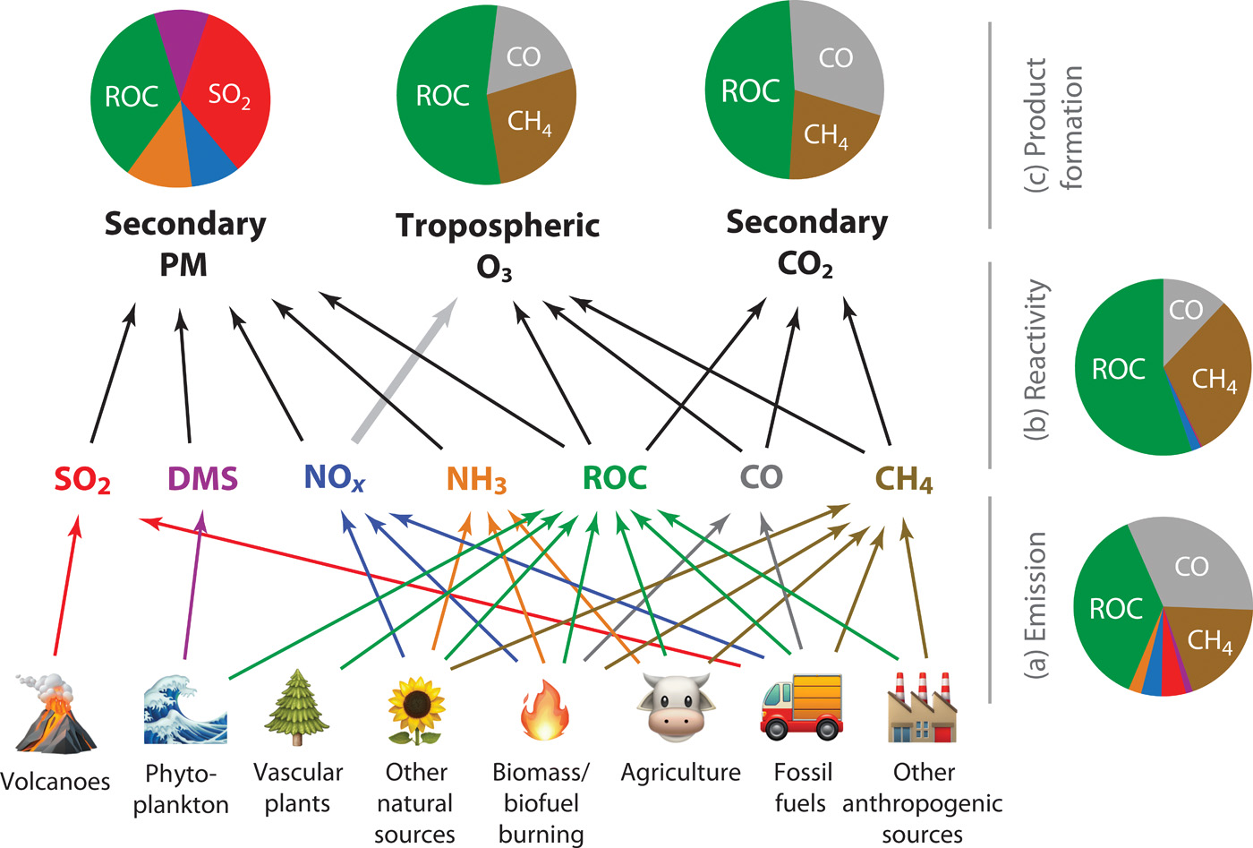

Slide 4
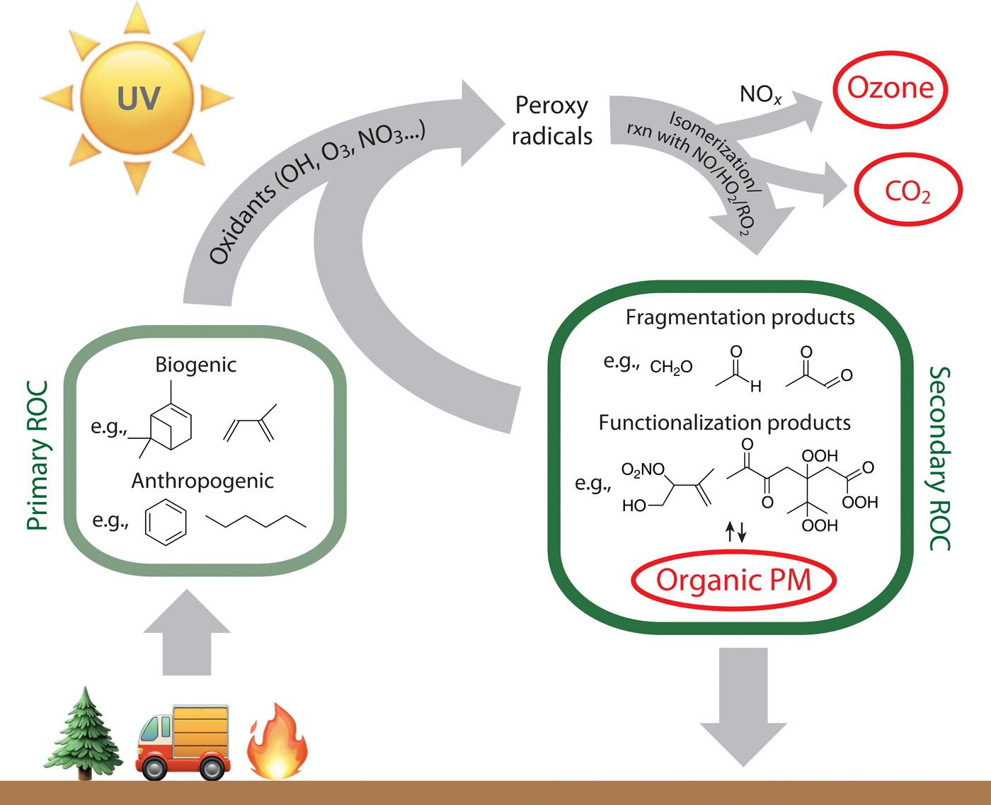
Complexity of Reactive Organic Carbon
ROC is an enormous class of molecules (>100,000)
Each one is subject to a complex assortment of atmospheric oxidative processes
Primary ROCs oxidized, then subsequent chemistry proceeds with peroxy radicals (RO₂) and can form ozone, CO₂, and secondary ROCs (Heald 2020)
Secondary ROCs highly complex and can condense and form organic PM

Slide 5
Understanding ROCs
Traditionally, ROCs are confronted by looking at individual components.
Specific individual oxidation steps are studied in the laboratory, or the sources/sinks of a specific organic component, like formaldehyde. (Fortems-Cheiney, F. 2012)
Issue: omits unknown/unmeasured/entire classes of compounds and ignores possible interactions between these compounds
Low volatility gas-phase organics, which are not easily detected, were only recently identified as a major class of ROCs (A. L. Robinson, 2007)
Early studies of organic PM were similar, but measurements revealed that simple descriptions underestimated organic PM loadings.

Slide 6
Challenges in Understanding ROC: Measurements
Development of online techniques have been beneficial for temporal resolution
Characterizing species not found purely in gas phase or condensed phase, but can transfer, is a significant challenge. They tend to be lost to surfaces and have low concentrations. (Robinson 2007)
Improvement in these areas have led to a more complete description of atmospheric ROC than previously possible (Heald 2020)

Slide 7
Challenges in Understanding ROC: Modeling
Most chemical mechanisms with 3D models reduce explicit schemes, which are based on laboratory studies (thus, focus on some but not all products) (Whitten 1980, Horowitz 1998)
Formation of minor products not often tracked, and chemical species often lumped (i.e. all alkanes with four or more carbon atoms) leading to some ambiguity in carbon number, molecular weight, and imperfectly balanced chemical reactions
Gaps in understanding in oxidation still exist in the atmosphere, so until these laboratory measurements/experiments finish modeling will not be fully accurate

Slide 8
Moving Forward: Perspective on Modeling
Two previous modeling attempts of ROC budgets have looked at only VOCs (Folberth 2005) or focused on organic nitrate and phosphorous (Kanakidou 2012)
Study by Safieddine et al. attempts to construct a holistic simulated budget of known ROC in the global troposphere using a 3-D chemical transport model
Provides insight on the flow of ROC in and out of the atmosphere, and opportunity to use observations to identify flaws in the lifecycle representation of ROCs

Slide 9
Model Description and Changes
The global chemical transport model GEOS-Chem v9-02 was used with modifications to develop first ROC global budget
Chemical mechanism for description of HO_{x}-NO_{x}-VOC-O₃-BrO_{x} includes 123 species and 357 reactions, including 64 photolysis reactions. (Bey et al., 2001)
Removal of gases and particles from wet and dry deposition. Emissions are input from various sources and calculations.
Added complete mass tracking of all reactive carbon species including short-lived intermediates and added wet/dry deposition where possible. (Saffieddine, 2017)
Ensured carbon closure in all reactions included in the GEOS-Chem mechanism and added 53 species and 97 chemical reactions, including 11 photolysis reactions (gas-phase chemistry of aromatics and monoterpenes, etc.)

Slide 10
Results: Annual Mean Global Distribution of ROC/OH Column Concentrations

Slide 11
Local Annual Mean Surface OH Reactivity

Slide 12
Global ROC 2010 Tropospheric Budget

Slide 13
Uncertainties
Not a complete simulation of all ROC sources and transformations
Computational limitations make it likely that the level of chemical detail is limited
Omitted poorly understood/constrained sources and transformations such as intermediate volatile organic compounds and precursors of SOA
Modeling scheme does not describe some chemical transformation relevant to SOA
Uncertainties remain large

Slide 14
Conclusions
Holistic modeling perspective using GEOS-Chem v9.02 on the budget of known ROC provides insight into the composition and fluxes of the global ROC budget.
The global annual mean ROC burden of 16 Tg C is dominated by species with long lifetimes, such as ketones, acids, alkanes, alkenes, and aromatic carbons.
Aldehydes and isoprene are the foremost ROC contributors to global OH reactivity.
The uncertainty of this model is estimated to be within 15%. Uncertainties on emissions, deposition, and chemical oxidation are the uncertainties that are not well characterized.

Slide 15
Works Cited
A. Fortems-Cheiney, The formaldehyde budget as seen by a global-scale multi-constraint and multi-species inversion system. Atmos. Chem. Phys., 12, 6699-6721 (2012).
A.L. Robinson et al., Rethinking organic aerosols: Semivolatile emissions and photochemical aging. Science 315, 1259-1262 (2007).
G. Folberth, D.A. Hauglustaine, P. Ciais, J. Lathiere, On the role of atmospheric chemistry in the global CO₂ budget. Geophysical research Letters. 32 (2005)
G. Isaacman-VanWertz et al., Chemical evolution of atmospheric organic carbon over multiple generations of oxidation. Nat. Chem. 10, 462–468 (2018).
G. Z. Whitten, H. Hogo, J. P. Killus,The carbon-bond mechanism: A condensed kinetic mechanism for photochemical smog. Environ. Sci. Technol. 14, 690–700 (1980).
L.W. Horowitz, J.Y. Liang, G.M. Gardner, D.J. Jacob, Export of reactive nitrogen from North America during summertime: Sensitivity to hydrocarbon chemistry. J. Geophys Res. Atmos. 103, 13451-13476
M. Kanakidou et al., Atmospheric fluxes of organic N and P to the global ocean. Global Biogeochemical Cycles, 26 (2012).
S.A. Safieddine, The global nonmethane reactive organic carbon budget: a modeling perspective. Geophysical Research Letters. 44 (2017).

