Slide 1
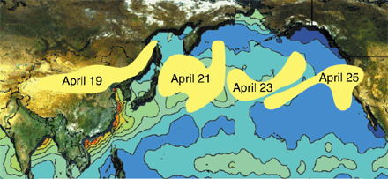
TRANS-PACIFIC TRANSPORT OF air POLLUTANTS
http://capita.wustl.edu/Asia-FarEast
EAS 6410 Personal Project
04/16/2020
Kezhen Chong

Slide 2
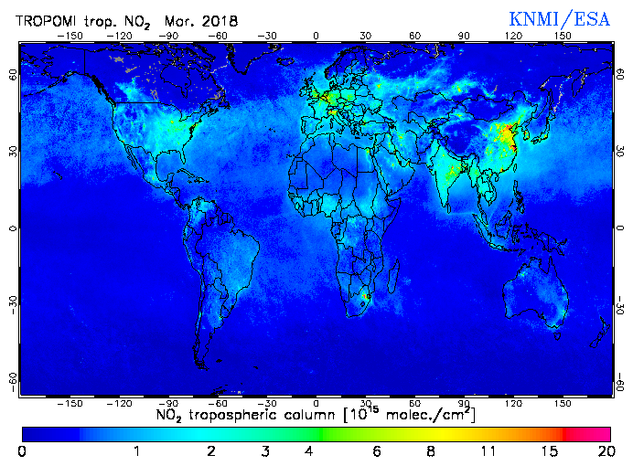
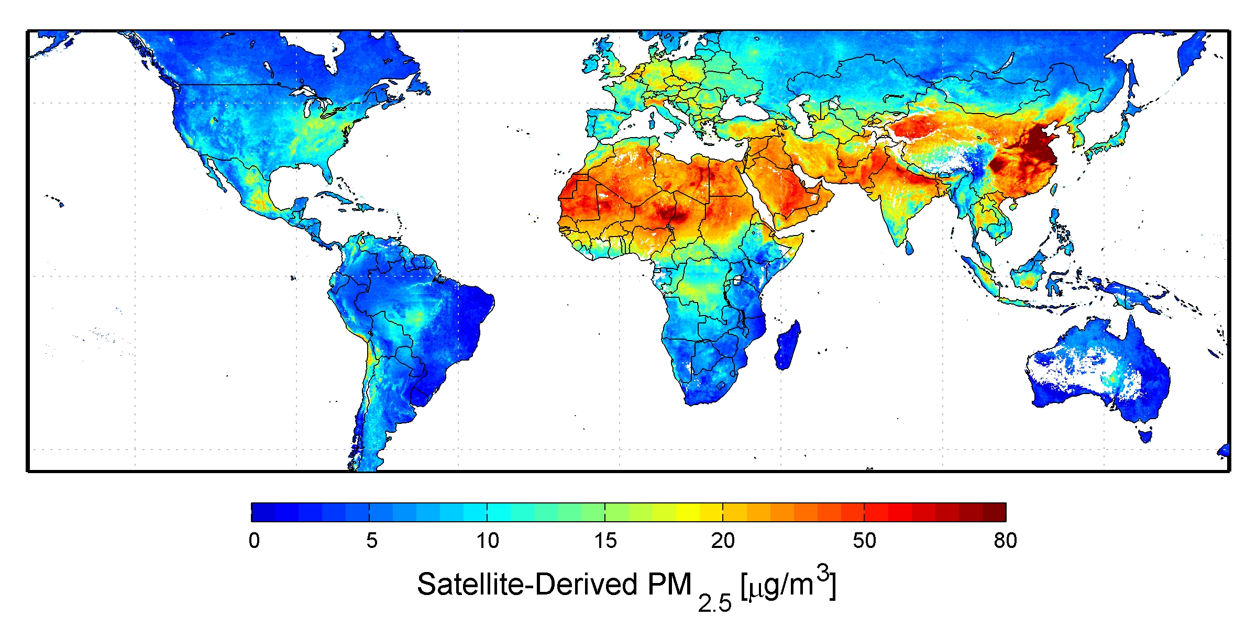
Introduction
East Asia has become a global hot spot of various air pollutants. Long-range transport leads to global impacts of this regional air pollution problem.
http://www.temis.nl/airpollution/no2col
How does the transport happen?
What is the temporal pattern?
Examples.
Credit: Dalhousie University, Aaron van Donkelaar

Slide 3
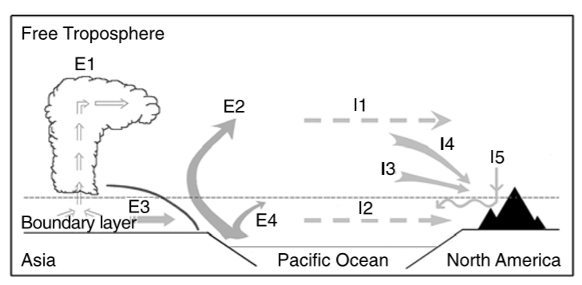
How does it happen?
Transport processes:
Lifting -> Westerlies -> Subsidence
Lifting:
Deep convection
Frontal lifting in warm conveyer belts (WCBs)
Orographic lifting
Liang et al., 2004
E1: convective lifting
E2: warm conveyor belt lifting
E3: postfrontal boundary layer transport
E4: low-level prefrontal jet transport
I1: advection in the mean free tropospheric westerly flow
I2: boundary layer transport
I3: large-scale subsidence in the Pacific High
I4: subsidence in the dry air stream of a cold front
I5: subsidence induced by mountain waves

Slide 4
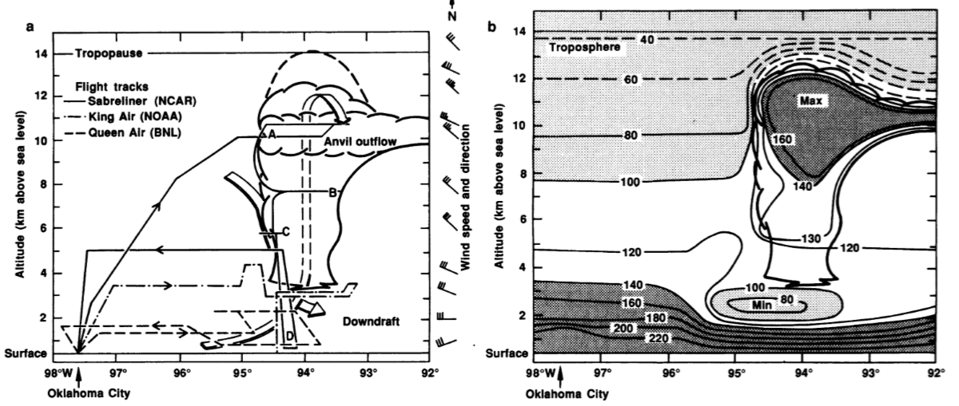
Lifting
Deep Convection
Deep Convection
Thermally driven turbulent mixing that drives air parcel from surface to upper troposphere.
Dickerson et al., 1987

Slide 5
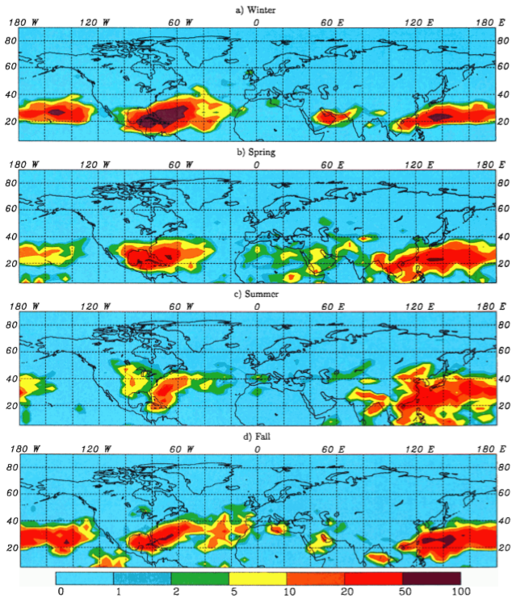
Lifting
Frontal lifting in warm conveyor belts (WCBs)
Banic et al., 1986: simultaneous peaks of NOx and particles near cold frontal surfaces
Warm Conveyor Belt
An airflow that rises ahead of the surface of the cold front.
Liu et al., 2003
Stohl et al., 2001
Liang et al., 2004

Slide 6
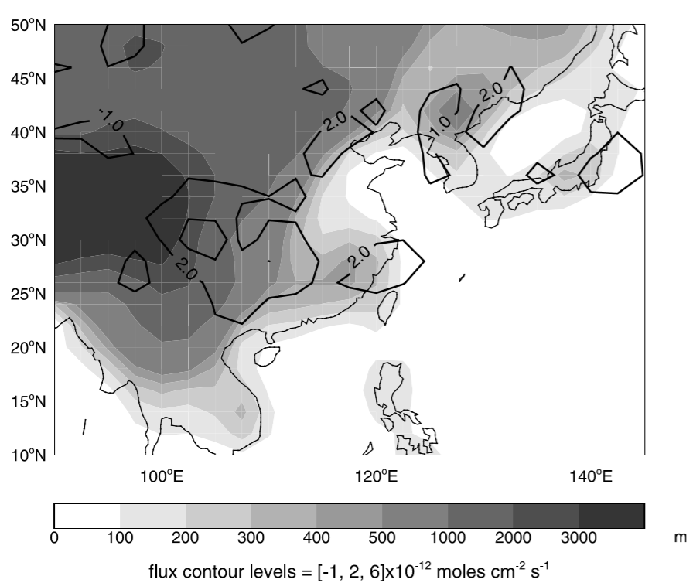
Lifting
Orographic lifting
Donnell et al., 2001: Orographic forced advection for air above the Alps.
Orographic Lifting
Air mass is lifted as it moves over rising terrain.
Liu et al., 2003

Slide 7
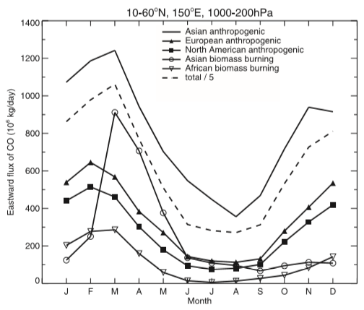
Temporal variation
Interannual variability: $El Ni\tilde{n}o$-Southern Oscillation (ENSO)
$El Ni\tilde{n}o:$weakened Siberian high, lower frequency of cold surges, and suppressed convection over Southeast Asia.
Seasonal variability: monsoon system
(Liu et al., 2003)

Slide 8
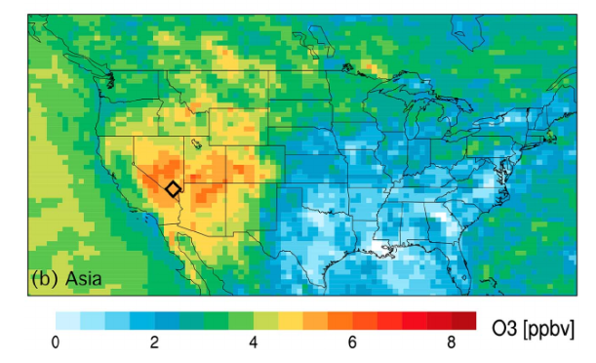
Transport of O3 pollution
Longer lifetime of O3
Higher O3 production efficiency (OPE) per unit NOx consumed (Liu et al., 1987)
Decomposition of peroxyacetylnitrate (PAN) (Heald et al., 2003; Zhang et al., 2008)
Langford et al., 2017

Slide 9
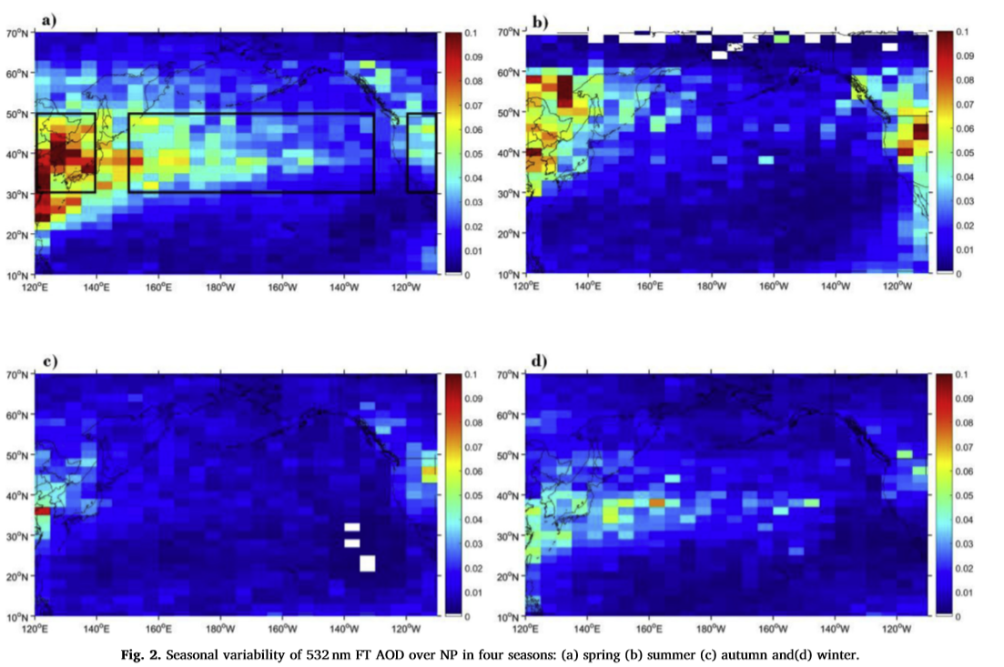
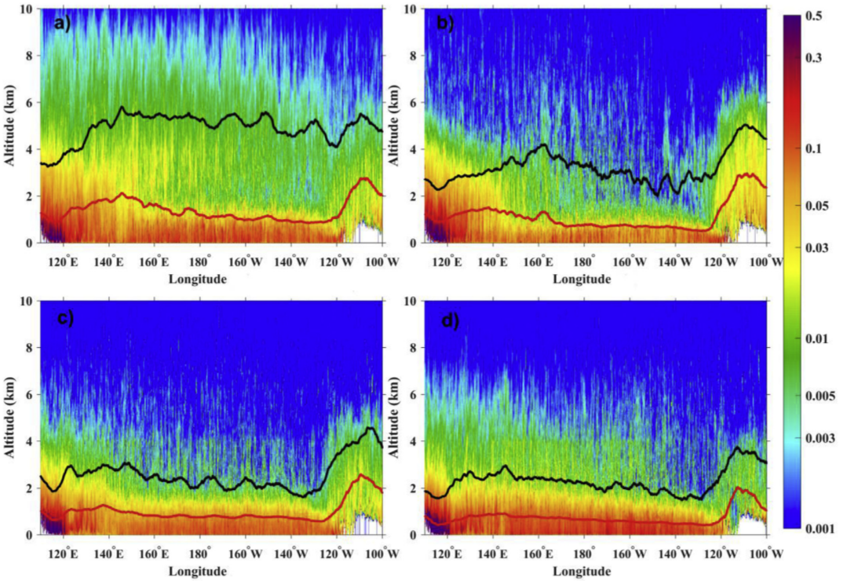
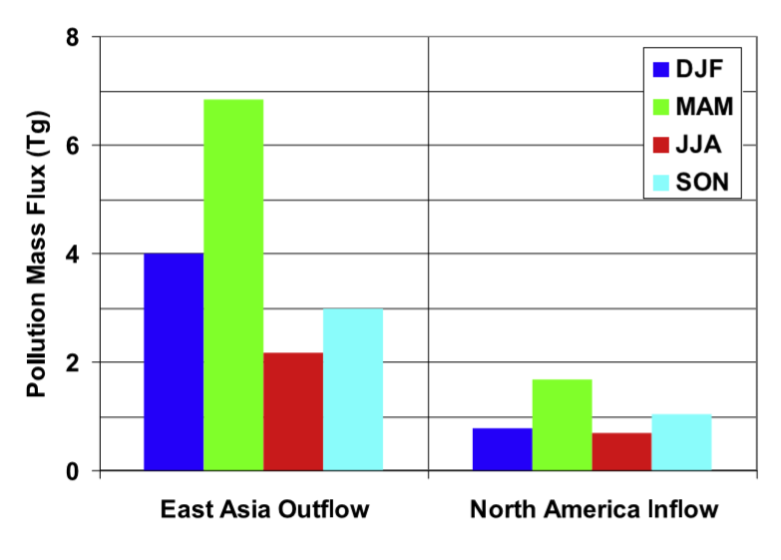
Transport of aerosol pollution
Aerosol transport in the FT contributed 19% of the AOD over western North America (NA) in the spring.
Xu et al., 2019
Yu et al., 2008

Slide 10
References
Banic, C. M., Isaac, G. A., Cho, H. R. & Iribane, J. V. (1986). The distribution of pollutants near a frontal surface: A comparison between field experiment and modeling, Water Air Soil Pollution, 30, 171–177, https://doi.org/10.1007/BF00305186
Dickerson, R. R., Huffman, G. J., Luke, W. T., Nunnermacker, L. J. et al. (1987). Thunderstorms—An important mechanism in the transport of air pollutants, Science, 235, 460–464, https://doi.org/10.1126/science.235.4787.460
Donnell, E. A., Fish, D. J., Dicks, E. M. & Thorpe, A. J. (2001). Mechanisms for pollutant transport between the boundary layer and the free troposphere, Journal of Geophysical Research, 106, 7847–7856, https://doi.org/10.1029/2000JD900730
Heald, C. L., Jacob, D. J., Fiore, A. M., Emmons, L. K., Gille, J. C., Deeter, M. N., et al. (2003). Asian outflow and trans‐Pacific transport of carbon monoxide and ozone pollution: An integrated satellite, aircraft, and model perspective, Journal of Geophysical Research, 108, 4804, https://doi.org/10.1029/2003JD003507
Langford, A. O., et al. (2017). Entrainment of stratospheric air and Asian pollution by the convectiveboundary layer in the southwestern U.S., Journal of Geophysical Research: Atmospheres, 122, 1312–1337. https://doi.org/10.1002/2016JD025987
Liang Q., Jaeglé, L., Jaffe, D. A., Weiss‐Penzias, P., Heckman, A. & Snow, J. A. (2004). long‐range transport of Asian pollution to the northeast Pacific: Seasonal variations and transport pathways of carbon monoxide, Journal of Geophysical Research, 109, D23S07, https://doi.org/10.1029/2003JD004402
Liu, S. C., Trainer, M., Fehsenfeld, F. C., Parrish, D. D., Williams, E. J., Fahey, D. W., Hübler, G., & Murphy, P. C. ( 1987). Ozone production in the rural troposphere and the implications for regional and global ozone distributions Journal of Geophysical Research, 92( D4), 4191– 4207, https://doi.org/10.1029/JD092iD04p04191
Liu, H., Jacob, D. J., Bey, I., Yantosca, R. M., Duncan, B. N. & G. W. Sachse (2003). Transport pathways for Asian pollution outflow over the Pacific: Interannual and seasonal variations, Journal of Geophysical Research, 108(D20), 8786, https://doi.org/10.1029/2002JD003102
Stohl, A. (2001). A 1‐year Lagrangian “climatology” of airstreams in the northern hemisphere troposphere and lowermost stratosphere, Journal of Geophysical Research, 106( D7), 7263– 7279, https://doi.org/10.1029/2000JD900570
Xu, J., Jia, J., Han, F., Zhang, Z., Du, X., & Wei, P. (2019). Trans-pacific aerosol vertical structure revealed by spaceborne lidar CALIOP, Atmospheric Environment, 201, 92–100, https://doi.org/10.1016/j.atmosenv.2018.12.035
Yu, H., Remer, L. A., Chin, M., Bian, H., Kleidman, R. G., & Diehl, T. (2008). A satellite‐based assessment of transpacific transport of pollution aerosol, Journal of Geophysical Research, 113, D14S12, https://doi.org/10.1029/2007JD009349Z
Zhang, L., Jacob, D. J., Boersma, K. F., Jaffe, D. A., Olson, J. R., Bowman, K. W., Worden, J. R., Thompson, A. M., Avery, M. A., Cohen, R. C., Dibb, J. E., Flock, F. M., Fuelberg, H. E., Huey, L. G., McMillan, W. W., Singh, H. B., & Weinheimer, A. J. (2008). Transpacific transport of ozone pollution and the effect of recent Asian emission increases on air quality in North America: an integrated analysis using satellite, aircraft, ozonesonde, and surface observations, Atmospheric Chemistry and Physics, 8, 6117–6136, https://doi.org/10.5194/acp-8-6117-2008

Slide 11
Thank You

