Slide 1
Lightning and NOx Emission
EAS 6410 Class Project
Fanghe Zhao
Earth and Atmospheric School
2020 / 04 / 14

Slide 2
Introduction
NOx play an important role in influencing tropospheric ozone concentration.
Oxidation of CH4, CO, VOCs within NOx leads to a significant amount of ozone production. [Crutzen 1973]
Lightning constitutes an important natural source of NOx in the free troposphere, especially in the tropics. [S.Beirle et al. 2010]. NOx produced by lightning (LNOx) is the most important free‐troposphere source throughout the year in the tropics and in the summer in the midlatitudes. [Allen et al. 2010]
A large-scale ozone enhancement due to lightning has been inferred from a multiple-year record of tropical troposphere ozone columns.[Martin et al. 2000]
Notes:
since von Liebig (1827) proposed it as a natural mechanism for the fixation of atmospheric nitrogen (Hutchinson, 1954). Lightning-induced nitrogen oxides (LNOx) have several important implications for atmospheric chemistry and climate

Slide 3
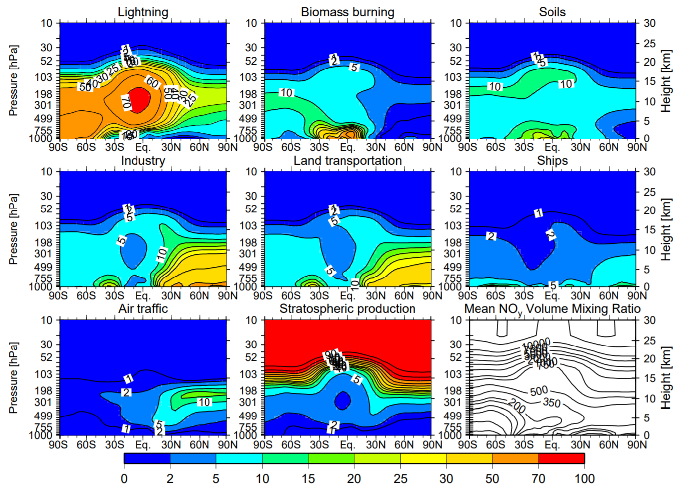
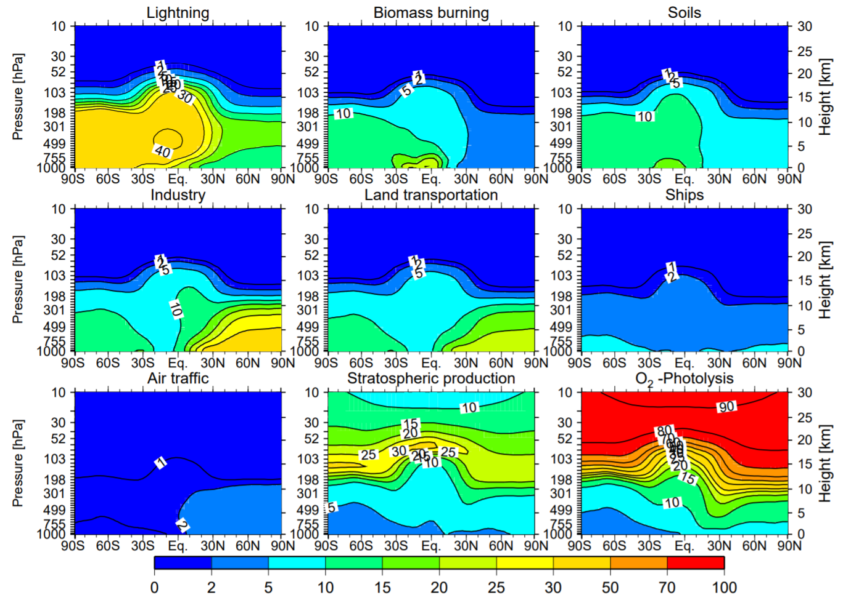
Introduction
Relative contributions (%) to the NOy budget
Relative contributions (%) to the O3 budget
[Grewe 2007]
Notes:
NO aviation

Slide 4
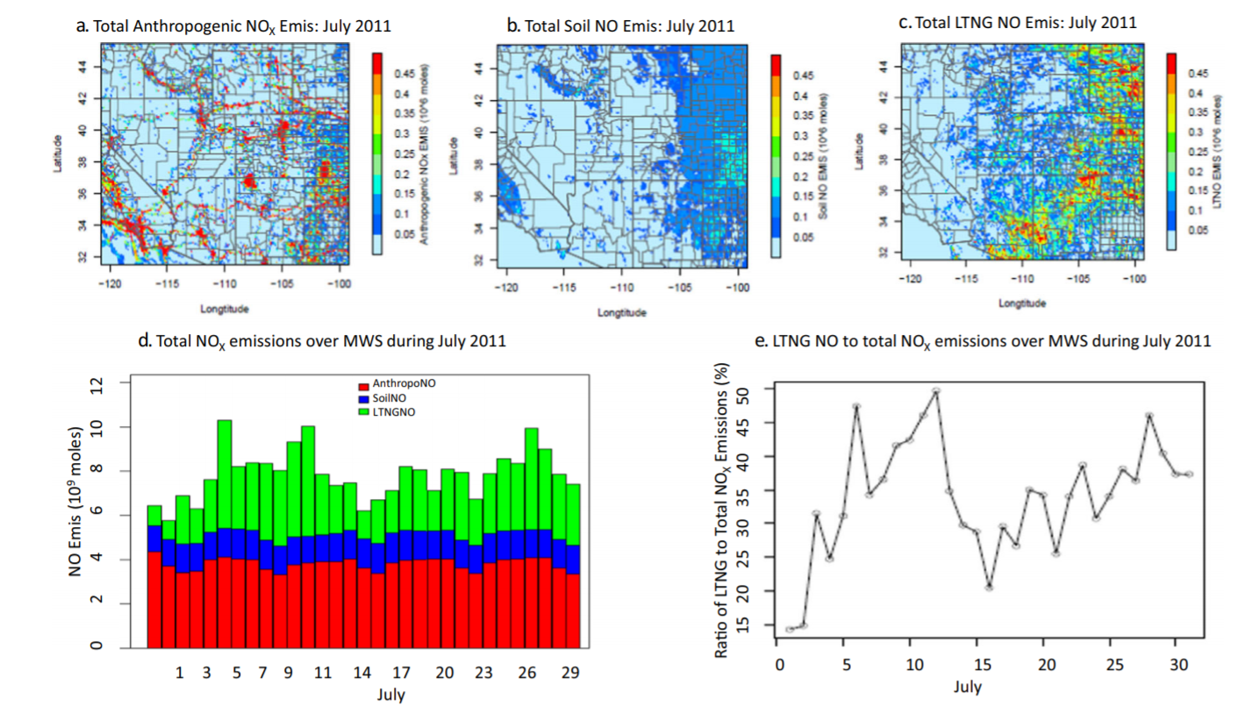
Introduction
[D.Kang, R. Mathur et al. 2020]

Slide 5
Introduction
NOx (NO + NO2)
nitrogen reservoirs
How the NOx emit from lightning ?
How many NOx emit from lightning ?
How can we simulate this process in model ?
Notes:
Lightning is a transient, high-current electric discharge over a path length of several kilometres in the atmosphere (Uman, 1987). The majority of lightning in the Earth’s atmosphere is associated with convective thunderstorms (MacGorman and Rust, 1998; Rakov and Uman, 2003). Lightning forms from the breakdown of charge separation in thunderstorms.

Slide 6
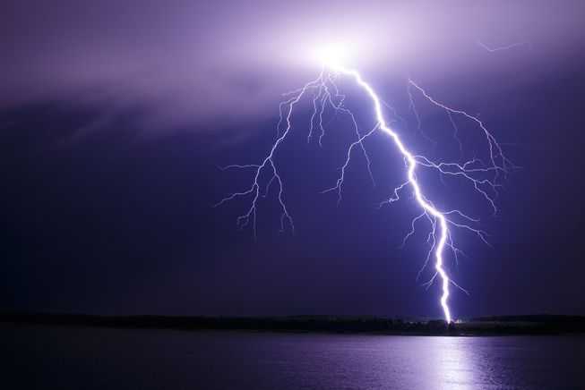
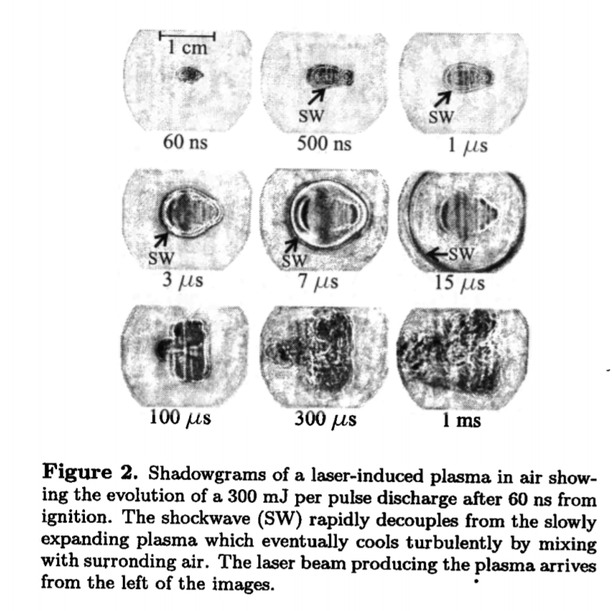
1. How the NOx emit from lightning
Intracloud (IC)
[Rafeal, Mayo et al. 2001]
Ground-Cloud (GC)
[NASA website]

Slide 7
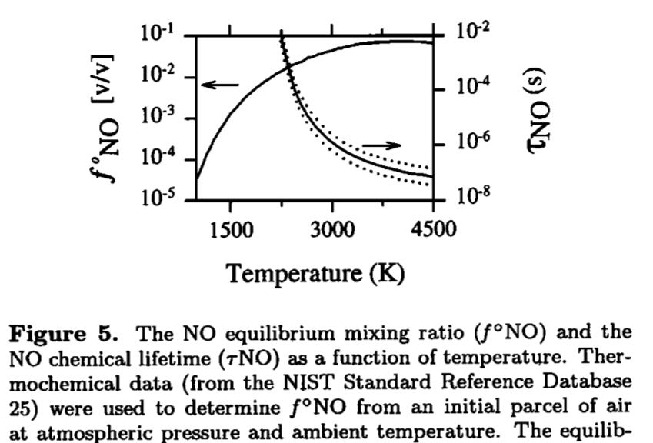
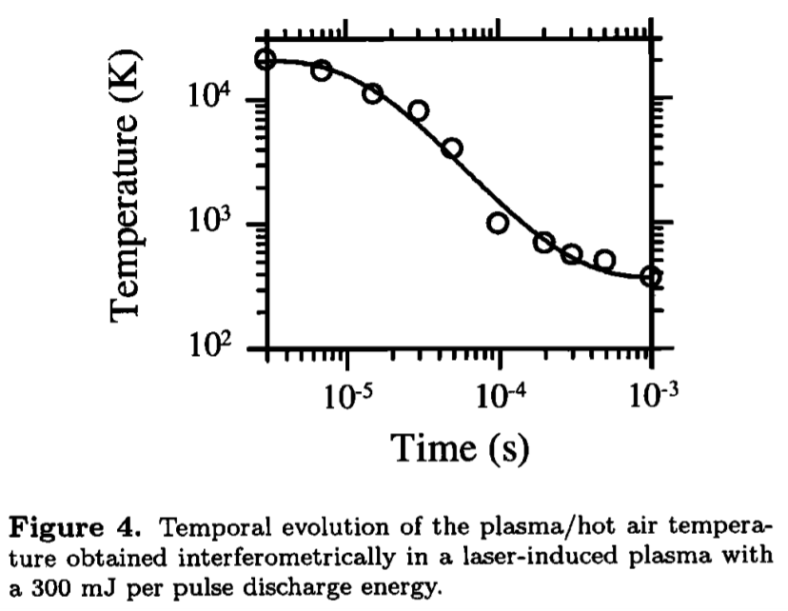
1. How the NOx emit from lightning
Zel’dovich mechanism [Zel’dovich & Raizer 1966]
thermal dissociation in plasma heat channel
And can also enhance NO2 and HNO3
[Rafeal, Mayo et al. 2001]

Slide 8
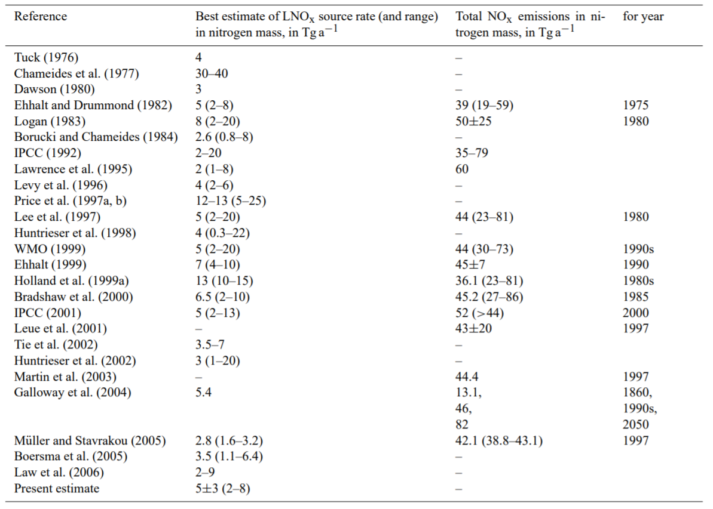
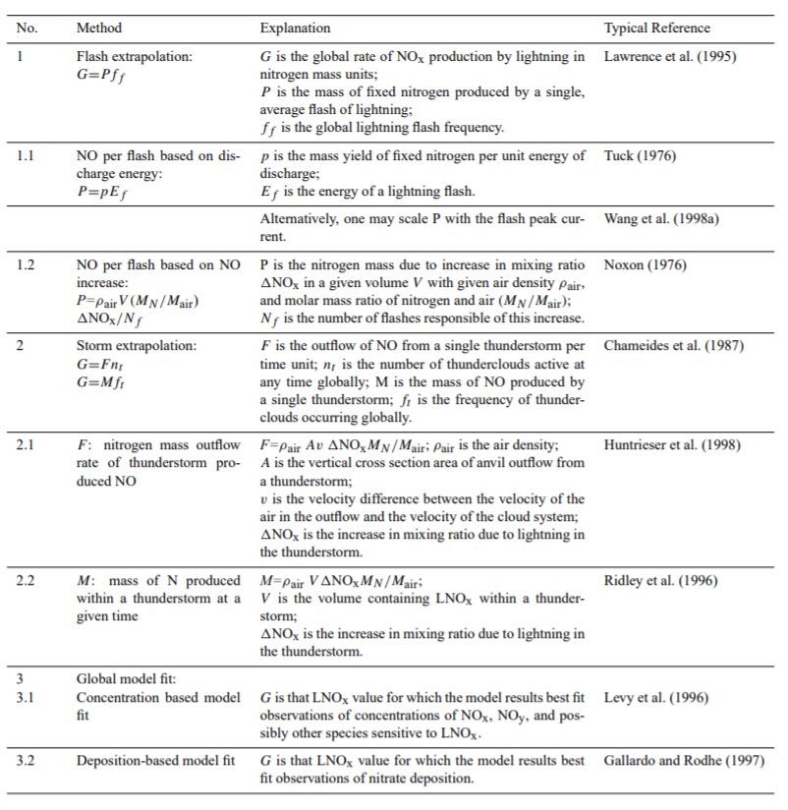
2. How many NOx emit from lightning ?
[U. Schumann and H. Huntrieser 2007]

Slide 9
2. How many NOx emit from lightning ?
Methods
Flash Extrapolation
Storm Extrapolation
Global model fit
Deposition-based LNOx determination
Ozone column
NOx NOy measurement
Per flash energy or peak current
Per flash length
Per flash
0.6-13 Tg/a
1-25 Tg/a
2-8 Tg/a
$G=A ∗B$
$$G=\sum{A_{i}∗B_{i}}$$
[U. Schumann and H. Huntrieser 2007]
Notes:
the concentrations of NOx in the upper troposphere and in the boundary layer over continents are of comparable magnitude, while the chemical lifetime of NOx in the upper troposphere is about one magnitude larger than in the boundary layer. For the same concentrations but larger lifetimes, the NOx source must be correspondingly smaller. Hence, the NOx source in the upper troposphere (partly from lightning) must be one order of magnitude smaller than the NOx source near the surface. For a total atmospheric NOx source of about 50 Tg a−1 (Table 1), released mainly near the surface, an upper tropospheric LNOx source of about 5 Tg a−1 is fully consistent with this estimate.

Slide 10
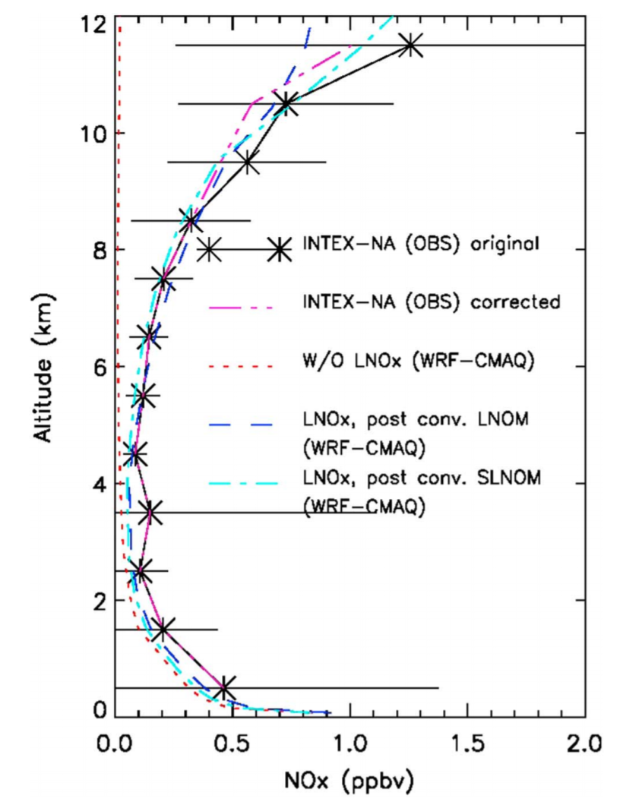
3. How can we simulate lightning NOx in model(large-scale) ?
[C. Luo, Y. Wang, W. Koshak 2017]
Parameterization lightning flash number and NOx produced from it.
Parameterize flash number
Use Flash number estimate LNOx
$$F=A ∗x^{n}$$
From Cloud Top, CAPE, UMF, CPR to estimate GC
250 mol NO per IC flash
500 moles per CG flash
From climatology Z ratio (IC / GC) and GC to estimate IC
$$Z=\frac{F_{IC}}{F_{GC}}$$

Slide 11
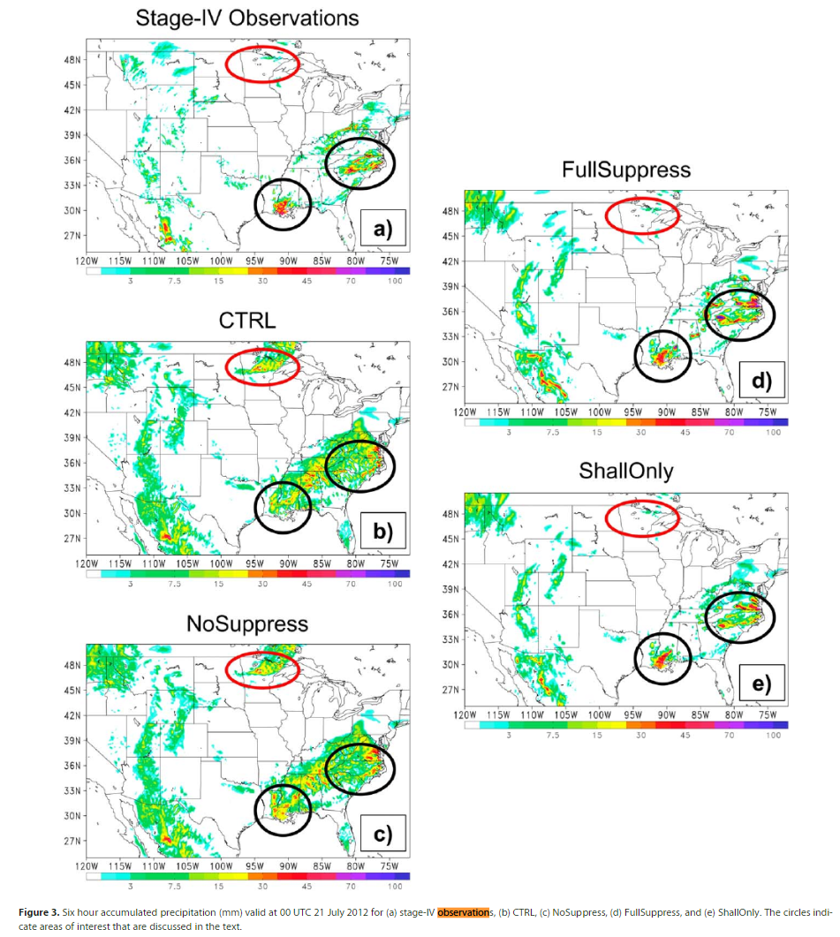
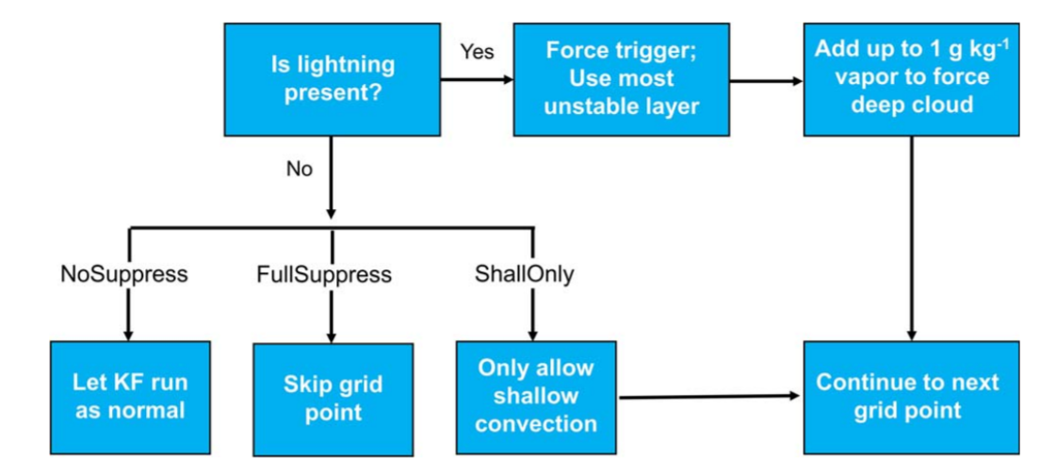
3. How can we simulate lightning NOx in model(large-scale) ?
[N. Heath, J. Pleim et al. 2016]

Slide 12
Conclusion
Because the limitation of computational resource, we are now applying parameterization on the large-scale meteorology and chemical transport model.
For the better forecast and estimate Lightning NOx, we can do assimilation with observation (NLDN, ENTLN etc.) [K. Miyazaki, H. Eskes et al. 2014].
We can also use per flash energy or peak current to implement lightning parameterization in large scale model.

Slide 13
Reference
R. Gonzalez, M. Muniz et al. 2001: The physical mechanism of nitric oxide formation in simulated lightning, GRL
X. Tie, R. Zhang, et al. 2001: Global NOx Production by Lightning, Journal of Atmospheric Chemistry
R. Martin, D. Jacob et al. 2000: Detection of a lightning influence on tropical tropical tropospheric ozone, GRL
U. Schumann and H. Huntrieser 2007: The global lightning-induced nitrogen oxides source, Atmo. Chem. Phys.
V. Grewe, 2007: Impact of climate variability on tropospheric ozone, Sci. Total Environ.
N. Heath and J. Pleim et al. 2016: A simple lightning assimilation technique for improving retrospective WRF simulations, JAMES
C. Luo, Y. Wang, W. Koshak et al. 2017: Development of a self-consistent lightning NOx simulation in large-scale 3-D models, JGR
D. Kang, R. Mathur et al. 2020: Significant ground-level ozone attributed to lightning-induced nitrogen oxides during summertime over the Mountain West States, Nature, climate and Atmo. Sci.
K. Miyazaki, H. Eskes et al. 2014: Global lightning NOx production estimated by an assimilation of multiple satellite datasets, Atmo. Chem. Phys.

