Slide 1

Estimating Isoprene Emissions from Terrestrial Ecosystems in the U.S.
A Comparison of MEGAN2.1 and MEGAN3.1
Shengjun Xi
xishj@gatech.edu
EAS6410 Term Paper Presentation
Apr 21st
Notes:
Good afternoon, everybody. I am Shengjun and my topic today is mainly about estimating Isoprene Emission with MEGAN, a widely used model calculating Biogenic VOC Emissions.

Slide 2

Background
Discussion
Results
PART FOUR
Method
PART ONE
PART THREE
04
01
03
PART TWO
02
CONTENTS
Notes:
Here is the outline of my presentation.

Slide 3
Background
The role of Isoprene in Atmospheric Chemistry
Most abundant hydrocarbon emitted into Earth’s atmosphere apart from methane.
Important role in both gas-phase atmospheric chemistry and secondary organic aerosol formation.
Jenkin et al., 2001
Notes:
Isoprene, as the most abundant BVOC emitted by the Terrestrial Ecosystem plays an important role atmospheric chemistry.
As the figure shown here, it could affect gas-phase atmospheric chemistry and SOA formation.

Slide 4
Background
Atmospheric Chemistry of Isoprene
(Seinfeld and Pandis, 3rd edition,2016)
HO₂ +OVOC
+O₂
+HO₂
IEPOX, OH
Isoprene + OH
[1,4] ~[0.64,0.36]
ISOPO₂
Important during daytime.
NO is sufficient high
+NO
O₃, OH
ISOPONO₂
2
minor, but significant
3
4
1
C₅H₈
HCHO
Methacrolein
Methyl vinyl ketone
Isoprene + O₃
Removes ~10% isoprene globally.
Reaction
(with NO₃, O3 , OH)
Photolysis
Deposition
Carbonyl Nitrates
Hydroxy nitrates
Nitrooxyhydroperoxides
Isoprene + NO₃
Dominant at night
Notes:
To be more specific about isoprene chemistry.
Isoprene mainly reacts with 3 species in the atmosphere.
During daytime, the reaction between OH and Isoprene is very important, you can see the products include OH radicals, which helps stabilize the OH concentration.
At night, the role of ozone and NO3 is more important. The reaction between Ozone and ISOP, producing formaldehyde and is responsible for around 10% removal of isoprene globally.
While, in most area, removal of isoprene by NO3 is dominant at night.
Therefore, we can see that a better understanding of isoprene emissions from vegetation is in need.

Slide 5
Method
Model of Emissions of Gases and Aerosols from Nature (MEGAN)
MEGAN2.1
Published in 2012, widely used, has been implemented into several CTMs;
Significantly over-predicts isoprene emissions in the contiguous United States.
( Luecken et al. 2018, Wang et al. 2016, Kaiser et al. 2019)
MEGAN3.1
Released in October 2019 and a final version was expected to be available in Spring 2020
Updating the algorithm for the effects of Soil Moisture.
Updating the calculation of factor account for temperature and radiation.
code source: https://bai.ess.uci.edu/megan/data-and-code
Notes:
Model of Emissions of Gases and Aerosols from Nature, which is known as MEGAN, is a widely used model calculating Biogenic VOC emissions.
MEGAN2.1 which is published in 2012, is widely-used has been implemented into several CTMs for now. However, several studies has shown that ..
MEGAN group published MEGAN3.1 last year and said it has updating the algorithm regarding to the effects of Soil Moisture, temperature and radiation. All of these has intrigued me to investigate the difference of different version MEGAN results.

Slide 6
Method
Meteorology Data
WRF 3.9 (36km)
Land Data
MEGAN website provides data for 2013.
data source: https://bai.ess.uci.edu/megan/data-and-code
Time Period
June and July, 2013
Notes:
Here is the data and Time I used to run MEGAN.
The reason I chose the June and July of 2013 is that MEGAN site only provides land data for 2013. Additionally, isoprene emission in the Southeastern US during summer is very important.

Slide 7
Method
OMI Observations
Data Source:
http://h2co.aeronomie.be/
Monthly HCHO VCD (June and July of 2013)
Spatial distribution compared with MEGAN results
Southeastern US
Isoprene emissions VS HCHO VCD observations
Variation of Isoprene emissions in July 2013.

Slide 8
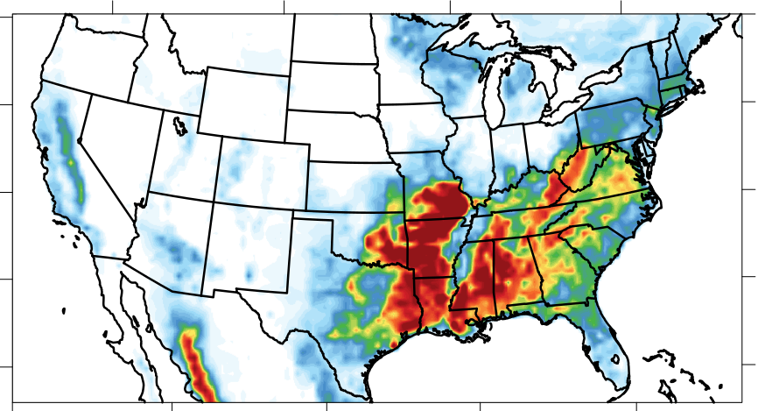
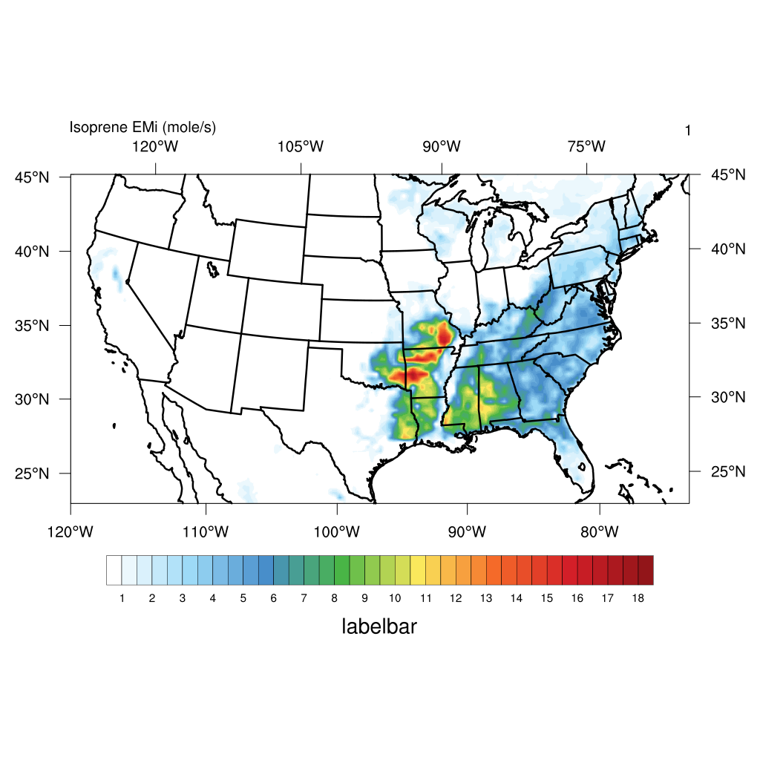
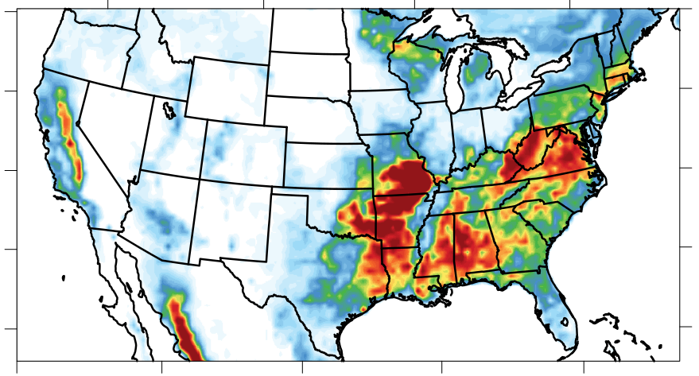
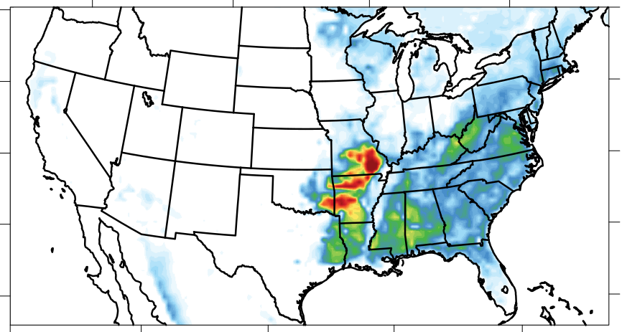
Results
MEGAN3.1 VS MEGAN2.1 - US
MEGAN2.1
MEGAN3.1
June Monthly Mean
MEGAN2.1
MEGAN3.1
July Monthly Mean
mol/s
1
18

Slide 9
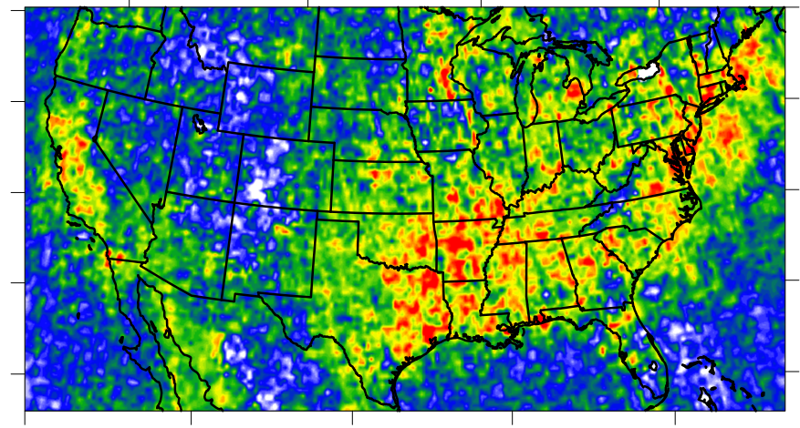
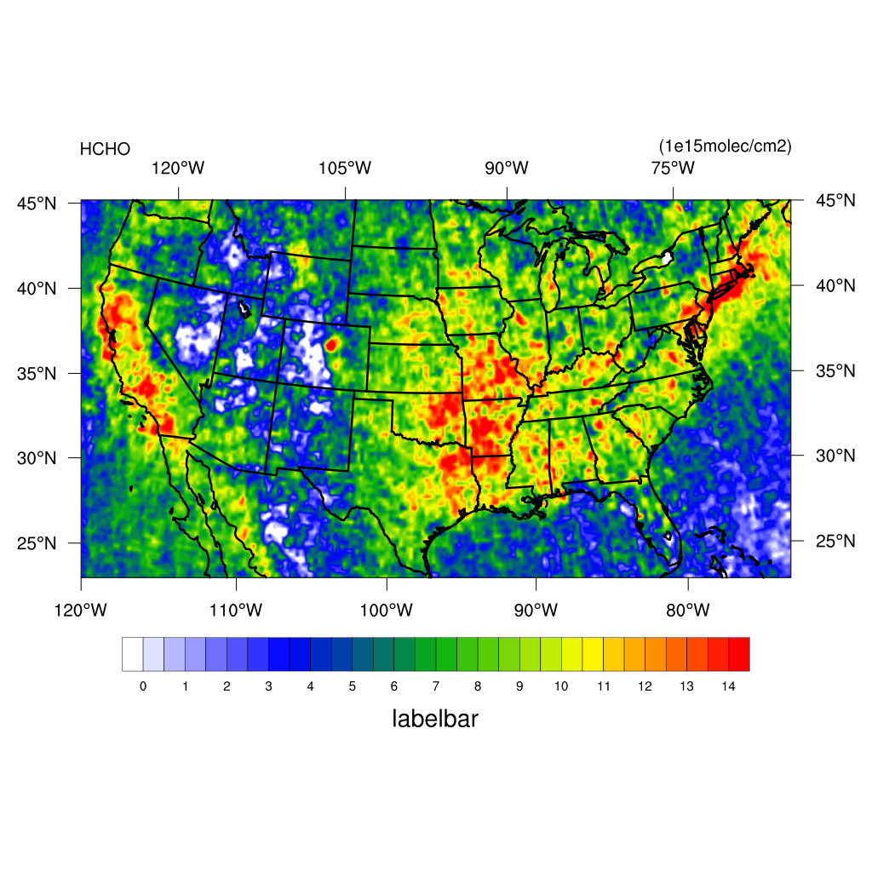

Results
Spatial Distribution of HCHO
June
July
0
14
$${10}^{15} molecules/{cm}^{2}$$
Notes:
add temperature

Slide 10
Results
Isoprene emissions
VS HCHO in the SE US
25
r = 0.218
r = 0.140
Jun
25
r = 0.415
r = 0.421
Moderately Strong Correlation
Jul
Notes:
add temperature

Slide 11
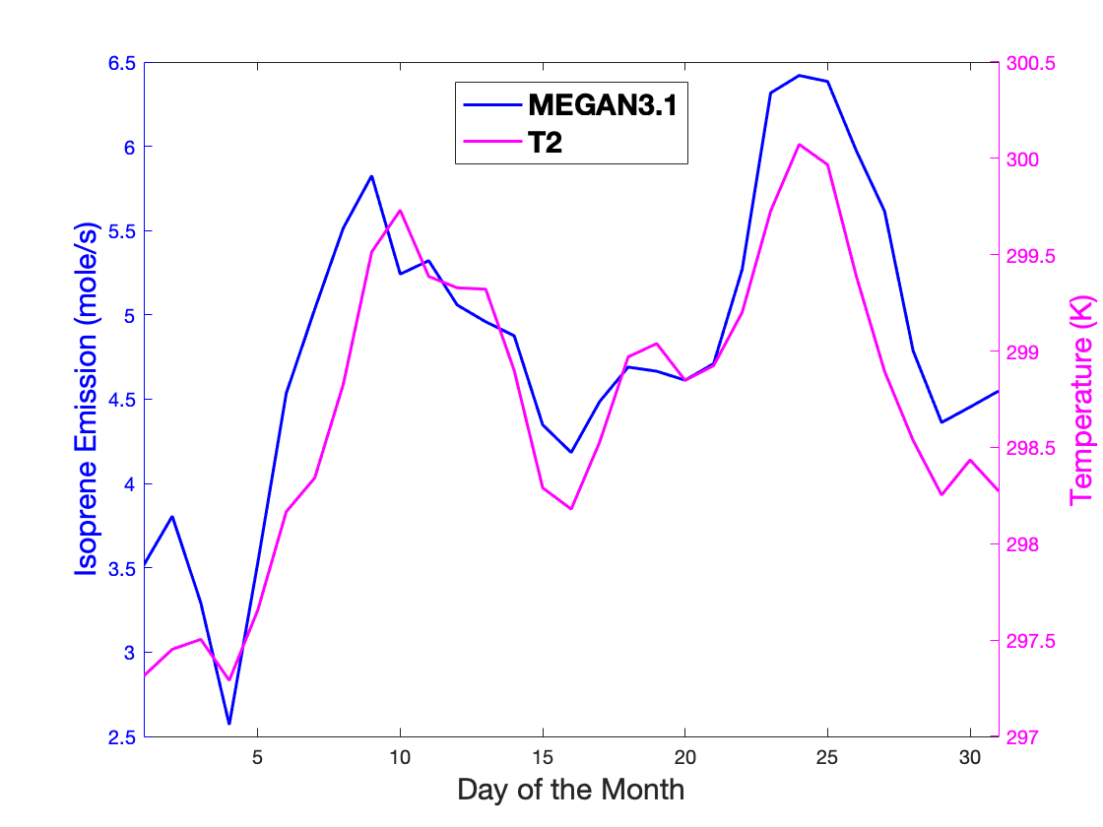
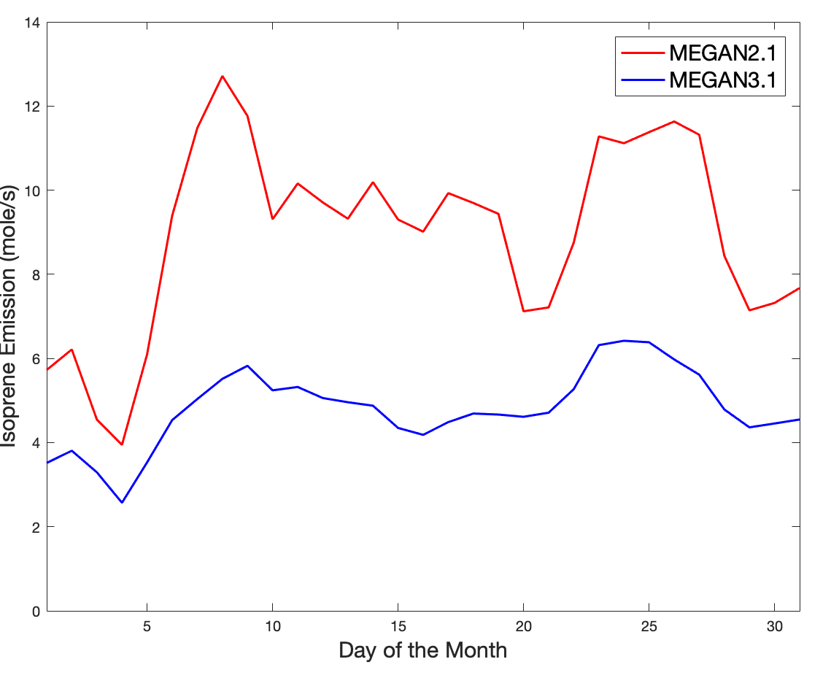
Results
Isoprene emissions time variation in SE US
(July 2013)
MEGAN 2.1 use T at the lowest layer (“T”)
MEGAN 3.1 use Temperature at 2m (“T2”)
$T_{processed}=\left(T1+300\right)×{(Pressure(Pa)÷{10}^{5})}^{(\frac{287.04}{1004}×\left(1−0.279×water mixing ratio\right))}$
Notes:
variation: trend mostly same,
T> T2
MEGAN3.1 closely relates to T2
std(T2) = 0.5(T)

Slide 12
Discussion
Results
Isoprene emissions estimated by MEGAN3.1 has decreased a lot comparing that by MEGAN2.1 in the whole U.S..
The distribution of MEGAN2.1 emissions agrees better with OMI HCHO VCD
There is a moderately strong correlation between MEGAN emissions and OMI HCHO observations in the Southeastern US during July 2013.
Using different type of temperature may affect the time variation of daily regional isoprene emission in the SE US.
Problems and Future work
Directly using OMI data
Additional cases need to be run to investigate the effects of temperature on emissions
Notes:
limited knowledge and time

Slide 13

THANK YOU!
Shengjun Xi
xishj@gatech.edu
EAS6410 Term Paper Presentation
Apr 21st

