Slide 1
Wildfire Impact on Ozone in California
Andrew Chen

Slide 2
Biomass Burning and Ozone
Wildfires release NO_{x} and VOCs, which cause elevated ozone concentrations in the atmosphere.
Photochemical reactions and ozone production can also occur in smoke plumes on the timescale of hours or less
Estimates that biomass contributes globally about 10% to the tropospheric ozone
Regional scale, they can have a much stronger impact
California has a significant amount of wildfires and a large population

Slide 3
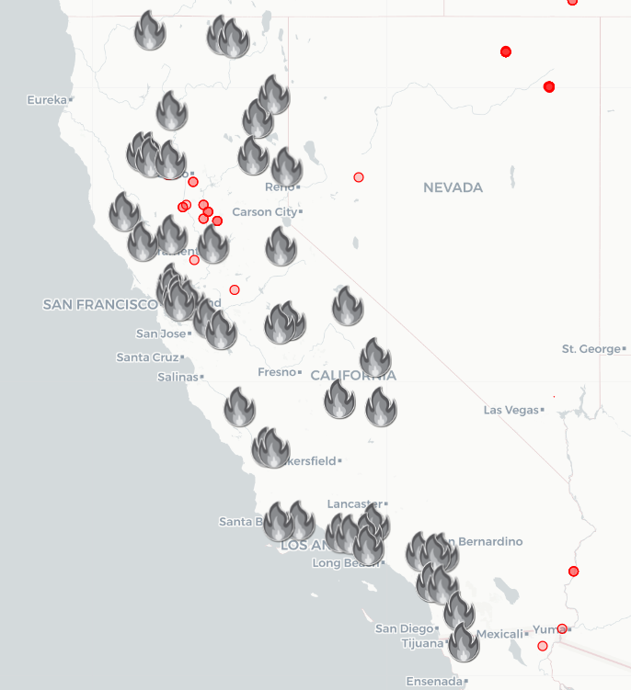
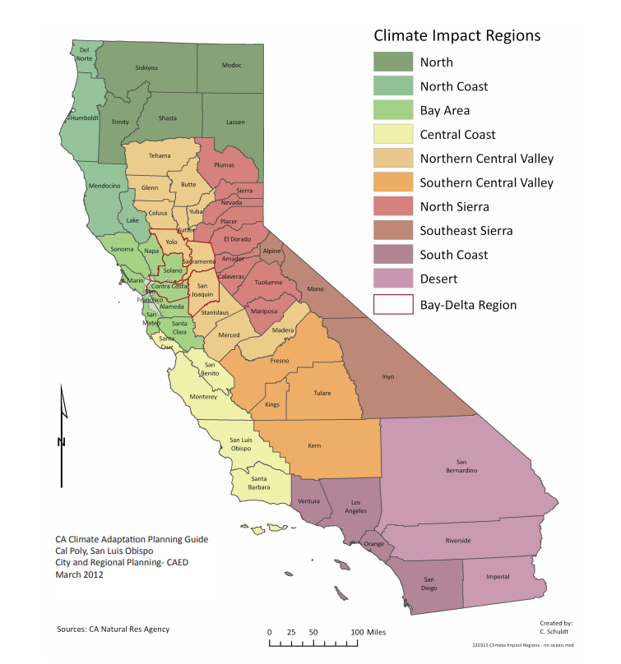
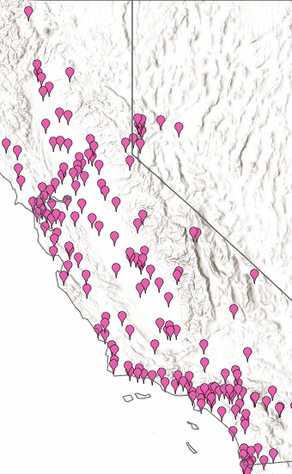
Wildfires in 2019
Impact Regions
EPA Observational Data

Slide 4
Name | Start | End | Acres Burned
Kincade | Oct 23rd | Nov 6th | 77,758
Walker | Sept 4th | Sept 25th | 54,608
Tucker | July 28th | August 15th | 14,150
Taboose | Sept 4th | Sept 25th | 10,296
Maria | Oct 31st | Nov 5th | 9,999
Red Bank | Sept 5th | Sept 13th | 8,838
Saddle ridge | Oct 10th | Oct 31st | 8,799
Impact Regions
Wildfires in 2019

Slide 5
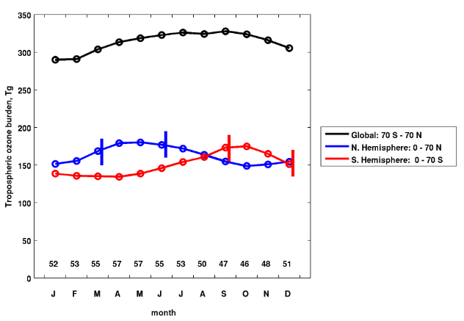
Seasonal Ozone Trends
Generally have a spring maximum and an autumn minimum for both hemispheres (Cooper 2014)
Ozone begins increasing again in the winter
Spring/Summer maximum due to photochemical production associated with anthropogenic emissions of NO_{x}, hydrocarbons, and CO from combustion of fossil fuels and biogenic activity

Slide 6
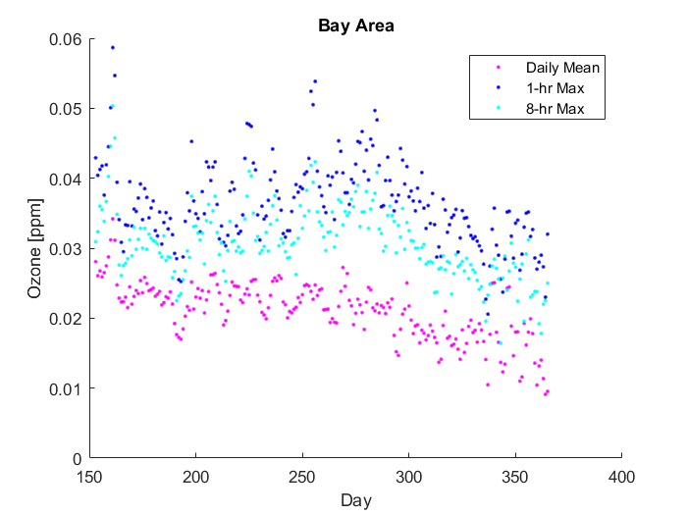
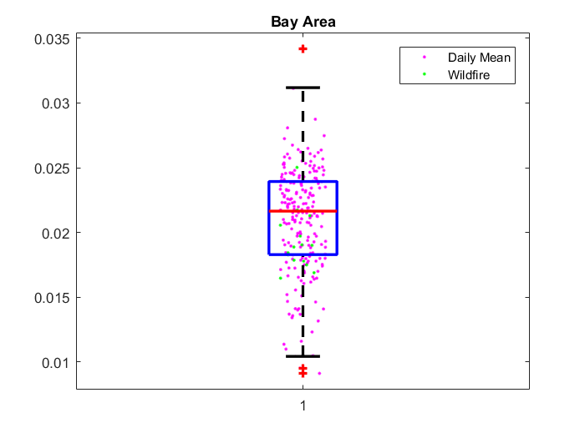
Bay Area Impact Region
Surprisingly-low mean ozone concentrations even during wildfire event
Kincade Wildfire (and subsequent smaller wildfires caused by it) occurred during an “extreme wind event”

Slide 7
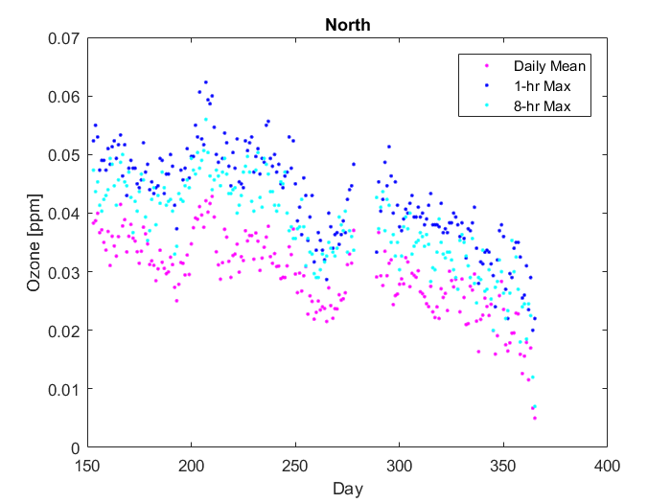
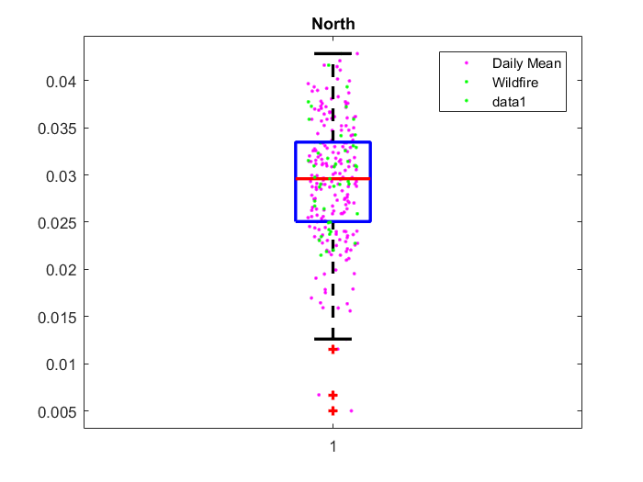
North Impact Region
Not many of the sites were near wildfires
Rural, mountainous and forested area

Slide 8
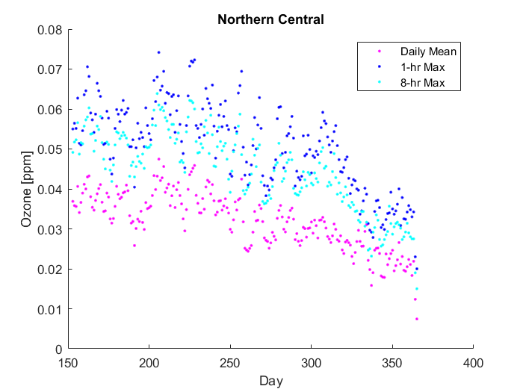
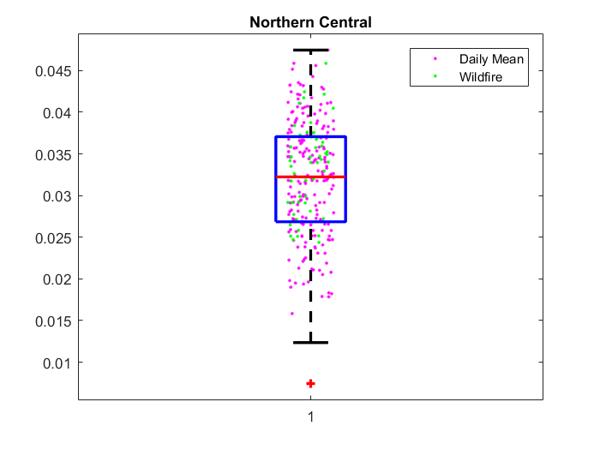
Northern Central Impact Region

Slide 9
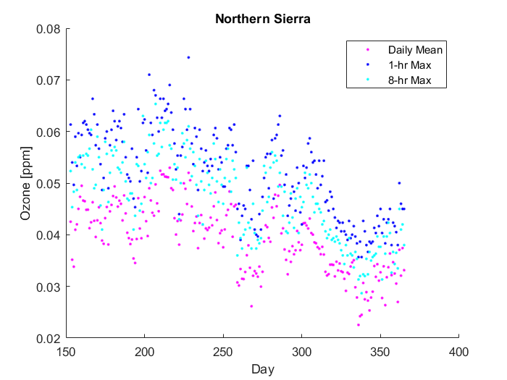
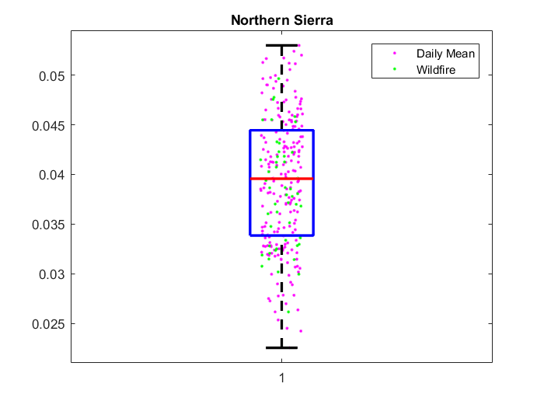
North Sierra Impact Region

Slide 10
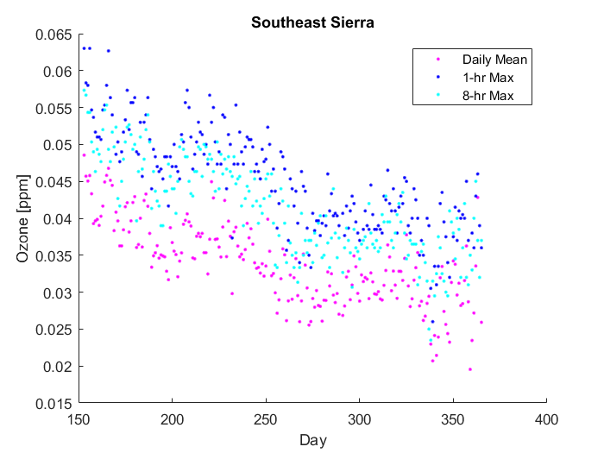
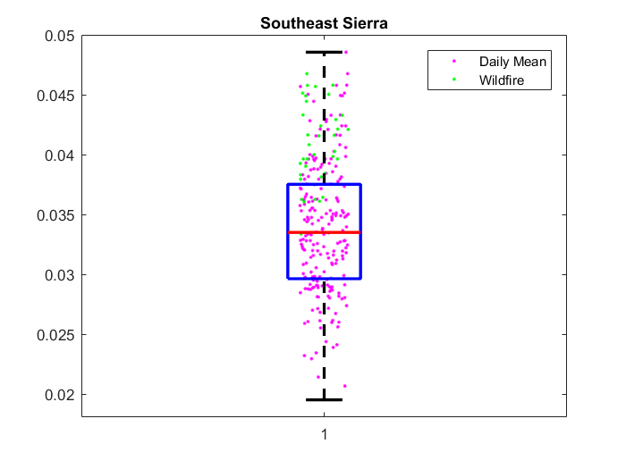
Southeast Sierra Impact Region

Slide 11
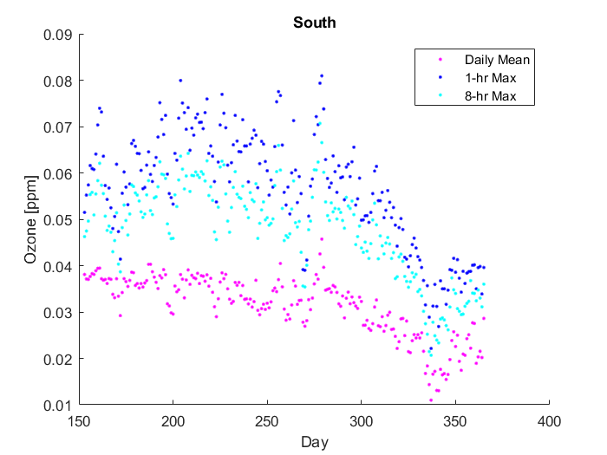
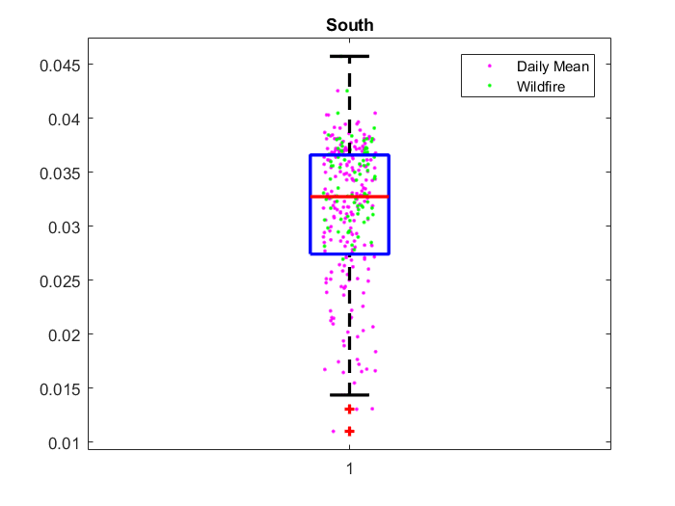
South Coast Impact Region

Slide 12
Conclusions
Ozone levels still generally followed seasonal trend
Clear, significant spikes of ozone levels that may correspond with wildfires
Ozone concentrations during wildfire events may not necessarily be measured to be higher than average, though this can be due to a variety of reasons (extreme weather events)
Could investigate weighted mean routine(?)
Looking forward, might need to tighten up ranges when examining wildfire events and can compare data to a different year with more wildfires (2018 had ~1.9 million acres burned vs. 2019 which had 260k)

Slide 13
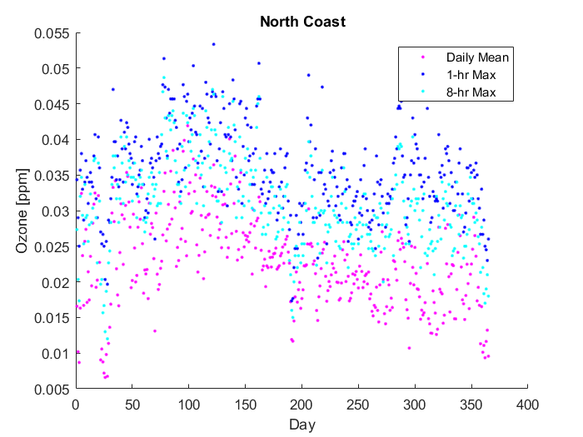
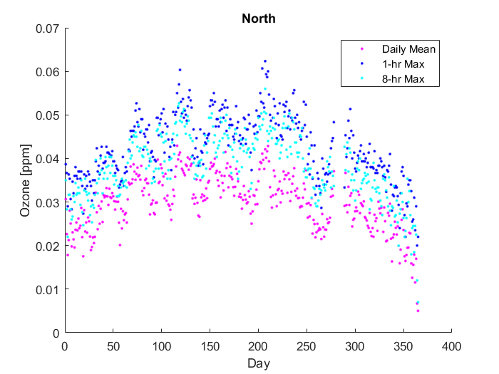

Slide 14
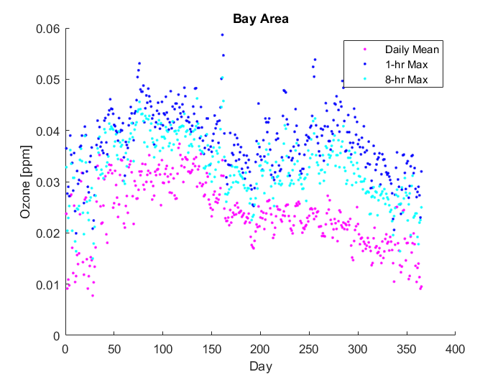
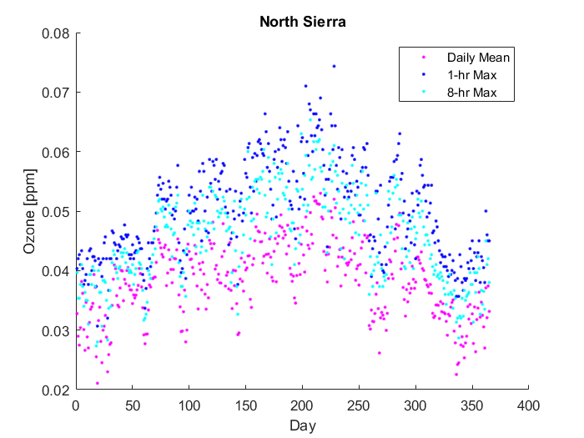

Slide 15
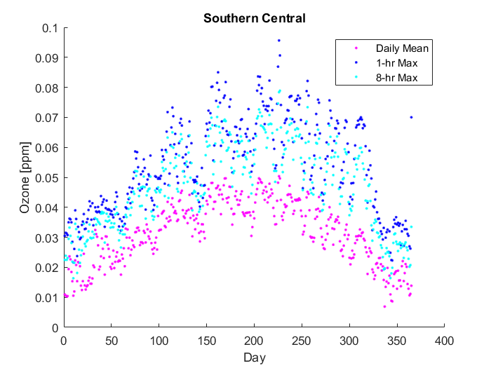
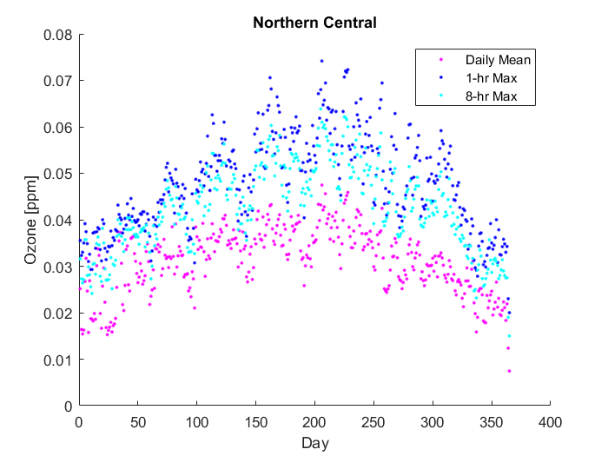

Slide 16
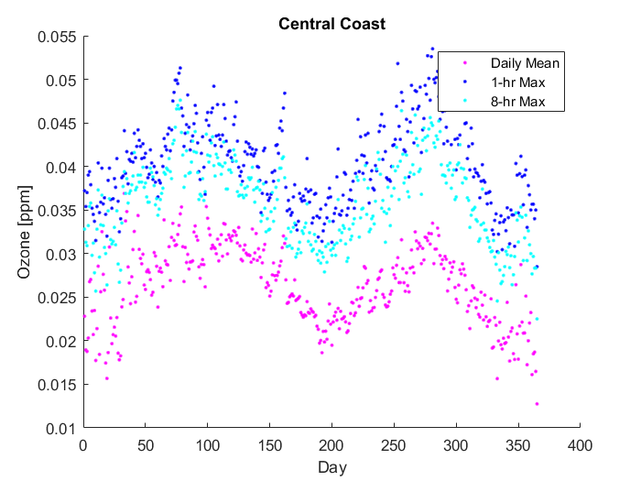

Slide 17
