Slide 1
Analysis of Generators Emissions in Lebanon
By
Rime El Asmar
Professor: Dr. Yuhang Wang

Slide 2
Content
Introduction
Implications
Hypothesis
Methods
Data/Results
Conclusion and Future Work

Slide 3
Introduction

Slide 4
Introduction
Lebanon, located on the eastern board of the Mediterranean, faces several challenges including an unregulated power generation sector.
This issue is mainly attributed to the destroy and/or the lack of maintenance during the years of war, and to the corruption that happened afterwards and is still happening until today.
The amplification of the air-quality crisis in Lebanon can be seen in the increase of concentrations of CO₂, CO, NO_{x}, SO₂, in addition to the PM_{2.5} in the country.
[1] A.Baayoun, W. Itani, J. El Helou , L. Halabi , S. Medlej , M. El Malki , A. Moukhadder , L. K. Aboujaoude , V. Kabakian, H. Mounajed , Tharwat Mokalled, Alan Shihadeh , Issam Lakkis , Najat A. Saliba: Emission inventory of key sources of air pollution in Lebanon

Slide 5
1. Generators spread
Environmental regulations are lax or laxly enforced in Lebanon.
Lebanon has had no capacity to supply 24-hour electricity since its 1975-1990 civil war.
Electricity consumption per capita has grown at an average rate of 7% per year and EDL is unable to meet the demand.
Households relies on their own generators or private neighborhood suppliers who charge hefty fees to keep a few lights on or other appliances running during regular daily cuts that can last several hours.
[2] Alan Shihadeh, Marc Al Helou, Najat Saliba, Sara Jaber, Nader Alaeddine, Elias Ibrahim, Zahra Salahieh, Maher Chiit : Effect of distributed electric power generation on household exposure to airborne carcinogens in Beirut, January 2013.

Slide 6
Problems of Using Generators
Diesel generators consume almost 1.6 million tons of fuel and emit about 2 Gg of fine particulate matter per year.
The generators typically operate inside or directly abutting residential buildings, in areas characterized by a dense, vertical urban morphology where air circulates poorly and pollutants can accumulate.
Their emissions are toxic and carcinogenic such as PAHs.
Exposure to diesel exhaust is associated with heart and lung diseases, neurological and developmental disorders in children, and a variety of cancers.
[1] A.Baayoun, W. Itani, J. El Helou , L. Halabi , S. Medlej , M. El Malki , A. Moukhadder , L. K. Aboujaoude , V. Kabakian, H. Mounajed , Tharwat Mokalled, Alan Shihadeh , Issam Lakkis , Najat A. Saliba: Emission inventory of key sources of air pollution in Lebanon

Slide 7
Background Information
The Mediterranean basin is characterized by high ozone levels during the summer due to the free cloud conditions, high solar radiation intensity, and the region's characteristic location as a crossroads of polluted air masses from Europe, Africa, and Asia. (Kallos et al., 2007)
The region is also characterized by high PM emissions related to industrial activities and transport sectors in urban areas.
At a national level, average ambient PM2.5 in Beirut, the capital of Lebanon, exceeds WHO guidelines by approximately 100%. (World Health Organization, 2019)
All the estimated annual emissions originating from on-road mobile sources during all the years of study for CO, NO_{x}, SO₂, NMVOC, PM₁₀ and PM_{2.5} are higher than those permitted by both national and international guidelines and rules.
[3] World Health Organization, 2019. Ambient (outdoor) air quality and health. [WWW Document]. https://www.who.int/news-room/fact-sheets/detail/ambient-(outdoor)- air-quality-and-health (Last accessed July, 2019).

Slide 8
Hypothesis
I hypothesize that there will be a 45% increase in the CO, NO_{x}, SO₂, CO₂ PM2.5 levels by 2023 due to generators emissions in Lebanon.

Slide 9
Implications
Due to the challenges of installing, operating, and maintaining air quality monitoring networks in most developing countries in the region, air quality modeling has become primary alternative solutions.
The monitoring stations in Lebanon were to be closed due to budget cuts where the Ministry of Environment is not in a position to continue financing for the maintenance of the stations monitoring air pollution in the country.
Data is not available online.

Slide 10
Methods

Slide 11
Methodology
In 2019, a Lebanese team from the American University of Beirut, published an article considered as an emission inventory of key sources of air pollution in Lebanon.
In their study, two approaches were adopted to estimate the fuel consumption of diesel generators in Beirut.
1- The first was a bottom-up approach that starts with calculating the fuel consumption for the diesel generators that were surveyed in a neighborhood region of Beirut, Hamra, and then extrapolating the findings according to the building ratio to the whole city, which suffers from a daily blackout of no less than 3 h.
2- The second was a top-down approach that started with the total fuel consumption of diesel generators in Lebanon and then focused on Beirut, including the area surveyed. In this case, both the socioeconomic factors and the population ratio were also considered in the calculation.

Slide 12
Surveying
The surface area surveyed in Hamra is 0.55 Km² and it contains 588 buildings, including 50 hotels.
The survey of the diesel generators in the area was conducted in the summer of 2017.
The fuel consumption was recorded according to a 3 h daily operation.

Slide 13
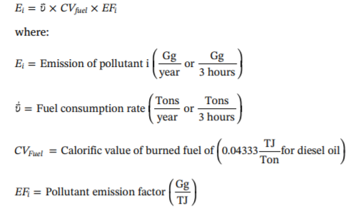
Emissions
Emissions of NO_{x}, CO, SO₂, and PM2.5 were calculated according to the European Monitoring and Evaluation Program/European Environmental Agency (EMEP/EEA) inventory guidebook using the Tier 2 methodology for reciprocating engine applications.
CO₂ emissions were estimated based on the Intergovernmental Panel on Climate Change (IPCC) default emission factors of Tier 1 for stationary diesel combustion because no CO₂ emission factors were listed in the EMEP/EEA guidebook.
TIER 2 for reciprocating engine applications (EEA)
Pollutant | Emission Factors (g/GJ)
NO_{x} | 942
CO | 130
SO_{x} | 48
PM _{(2.5)} | 30
PM₍₁₀₎ | 30

Slide 14
Amount of fuel consumed
The total amount of fuel consumed by diesel generators in Lebanon was derived from two sources:
1- The total amount of fuel imported and reported by the Central Administration of Statistics on behalf of the Ministry of Energy and Water.
2- The distribution by sector as stated by one of the major oil and gas companies.

Slide 15
Assumptions
These emission factors did not depend on generator age and were therefore, assigned for all generators.
Fuel consumption for the 2009–2014 period was based on that 80% deficit in the electric power supply was met by private generators.
The fuel consumption for 2016 was estimated using the top-down approach since the information about the deficit in the electric power was missing for 2015 and 2016.
Lack of Seasonality Data allowed to approach study by yearly estimates.
The difference in supply was assumed to be the same in the different regions of Lebanon.

Slide 16
My Work
No data for air quality were available online.
I contacted Professor Najat Saliba from the American University of Beirut who has done studies on the topic. She, along with the 1st author of the paper Abed Baayoun, were helpful and sent me the data sheets included in their study.
1) I used their calculated masses for PM2.5, NOx, CO, CO₂, and SO₂ for years 2009-2014 and 2016 to estimate the % increase for 2023 using microsoft excel forecast option.
2) Downscaled the data of PM2.5 to obtain the data distribution among the months of the year to get the seasonality from.

Slide 17
Downscaling
In the mentioned study, no calculations were done for monthly or seasonally emissions.
I decided to downscale to months based on calculating as the follows.
Deficit = total demand – total supply
Monthly Total Supply was taken from an excel sheet published by the EDL.
[4]http://www.cas.gov.lb/index.php/thematic-time-series

Slide 18
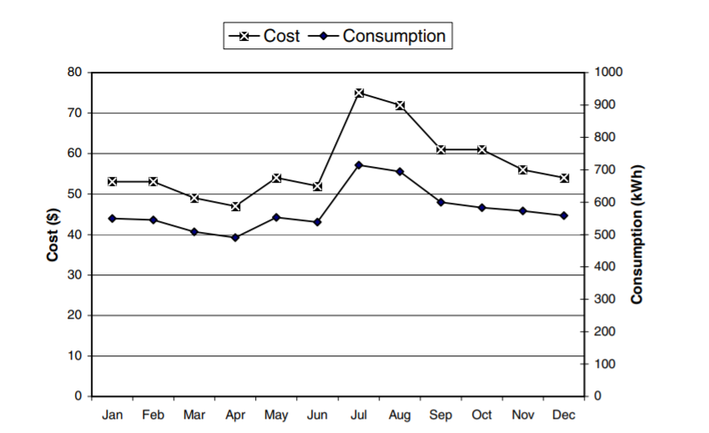
Total Demand
The annual consumption variation is used to determine the factor we need to multiply by the yearly demand to obtain the monthly demand.
Note that this study is done in 2002 but due to data deficit, I used it in my study.
Months | Consumption factor
January | 0.95
February | 0.93
March | 0.89
April | 0.84
May | 0.93
June | 0.91
July | 1.25
August | 1.22
September | 1.05
October | 1.03
November | 1
December | 0.98
[5]Ahmad Hourin,y and Samira Ibrahim-Korfali: Residential energy consumption patterns: the case of Lebanon, NTERNATIONAL JOURNAL OF ENERGY RESEARCH, 2015

Slide 19
Emissions were then calculated by multiplying the activity rate (fuel consumption over a certain period of time) by emission factors previously mentioned.
I then used the downscaling forecast with seasonal movement option in excel to determine the increase in the following years.

Slide 20
Data
End of the 1st national efficiency plan
End of lease for Turkish powerships

Slide 21
Data

Slide 22
Data

Slide 23
Data

Slide 24
Data

Slide 25
5.Conclusion & Future Work

Slide 26
Conclusion and Future Work
The increase deduced from these forecasts shows a 45% increase in the amount of emissions in all pollutants mentioned.
Monitoring should be resumed and data should be available for comparison.
More studies should be done taking more parameters into consideration along with the reactions happening in the atmosphere that effect the real levels found .
Deeper surveying should be done for fewer assumptions and more accurate results.

Slide 27
Questions

Slide 28
Thank You

