Slide 1
Effect of ammonia on aerosol acidity: A comparison between China and US
Term paper project for EAS 6410
Bingqing Zhang

Slide 2
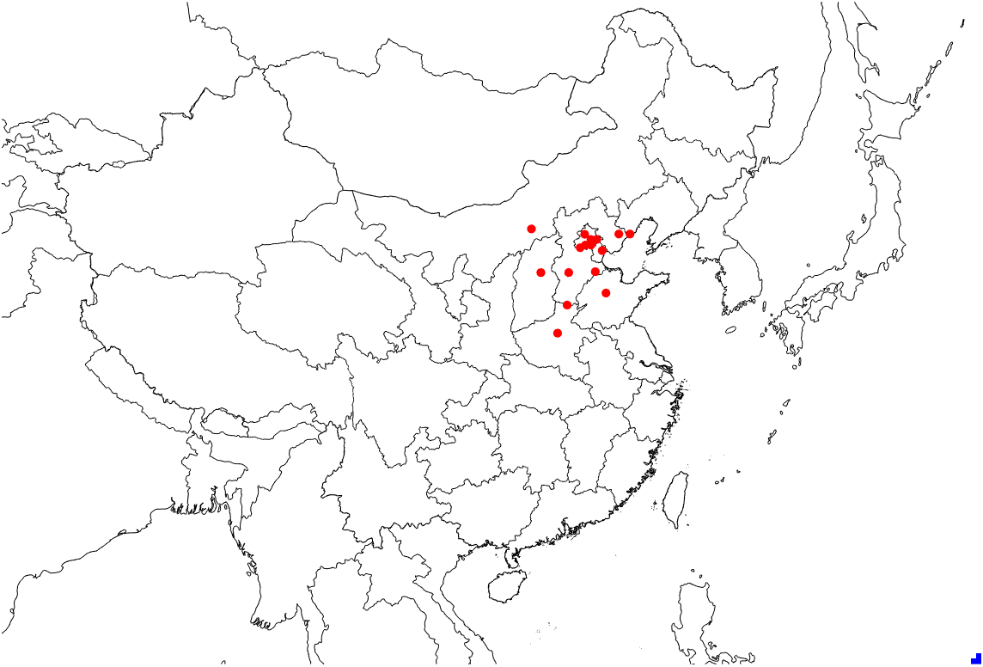
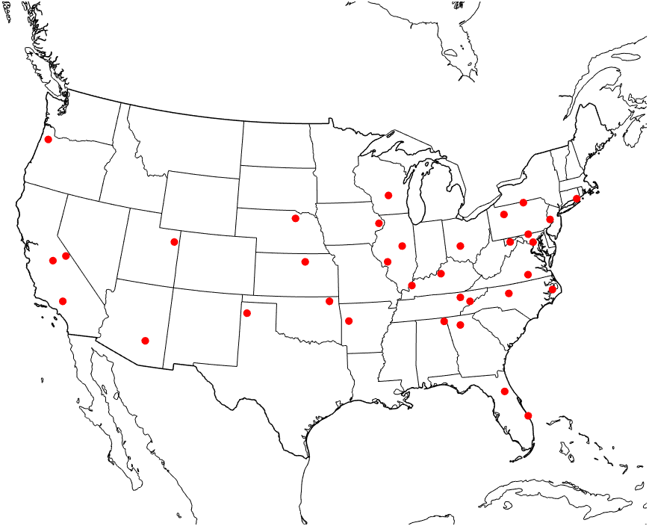
Data and Method
Observation Data:
  PM2.5 components from 16 monitoring sites in China, 2017;
  PM2.5 components from 36 monitoring sites in US, 2011;
Simulation data: Temperature and RH data simulated by CMAQ
pH calculation: ISORROPIA II
Monitoring sites in China
Monitoring sites in US

Slide 3
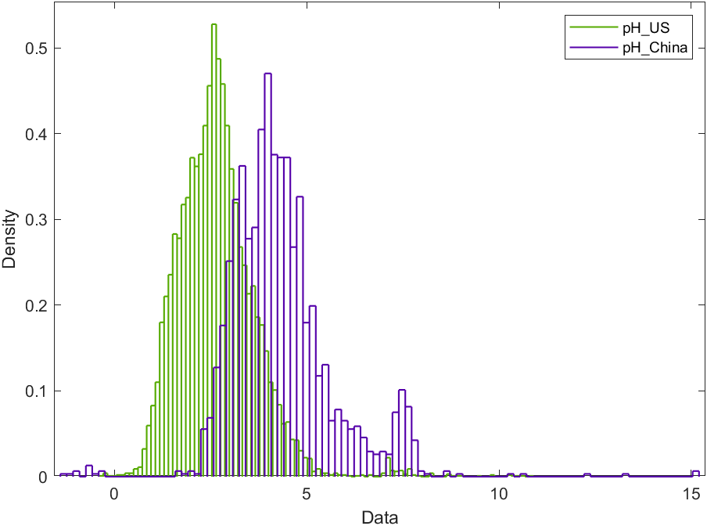
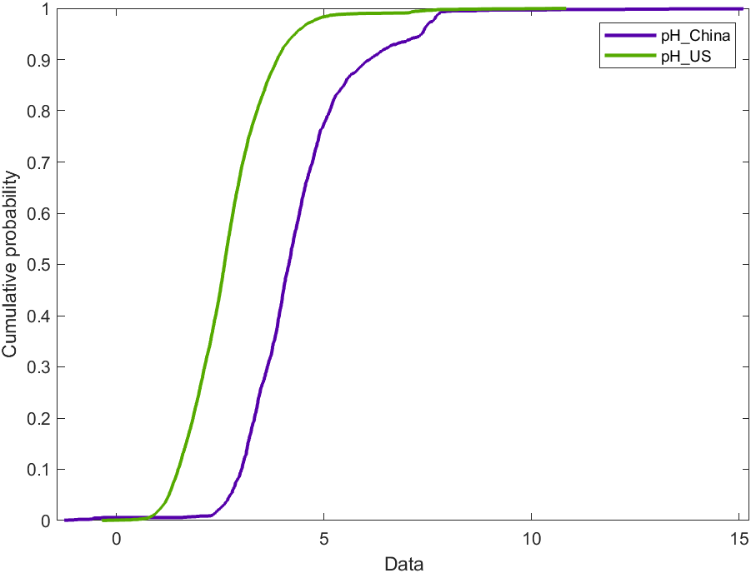
pH difference between China and US

Slide 4
Inorganic aerosol component in China and US
 | Na | SO4 | NO3tot | NH3tot | Cltot | K | Ca | Mg | RH | Temperature(K)
China | 1.03 | 6.12 | 11.12 | 23.72 | 2.79 | 0.61 | 0.84 | 0.24 | 0.44 | 287.38
US | 0.12 | 1.84 | 1.43 | 1.62 | 0.36 | 0.07 | 0.19 | 0.04 | 0.69 | 284.72
Note:
  The unit for each compounds is ug/m^3;
  NO₃tot=HNO₃(g)+NO₃⁻(aq); NH₃tot=NH₃(g)+NH₄⁺(aq); Cltot=HCl(g)+Cl⁻(aq)
  Different component concentration can have different effect on aerosol pH, which make it hard to find out the reason of pH difference by comparing the concentration.

Slide 5


Characterization of aerosol component contribution
Multi-steps method:
Reducing component concentration from Chinese
Level(background case) to US level (base case) by 100 steps;
△pHi—pH difference caused by changing
concentration of compounds i only；
△pHt—pH difference caused by changing concentration of all compounds ；
pH difference is mainly caused by difference of TNH3 and SO4 between two countries ;
Differences of TNO3, NVC, and TCl have negligible effect of pH difference.

Slide 6
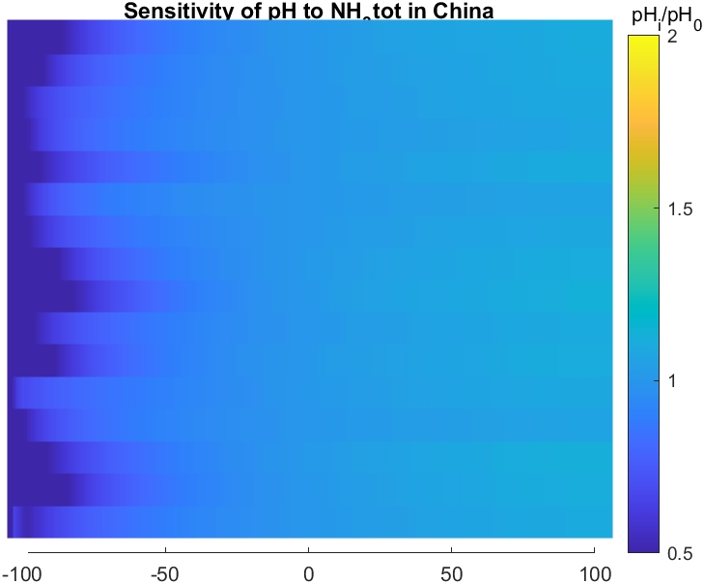
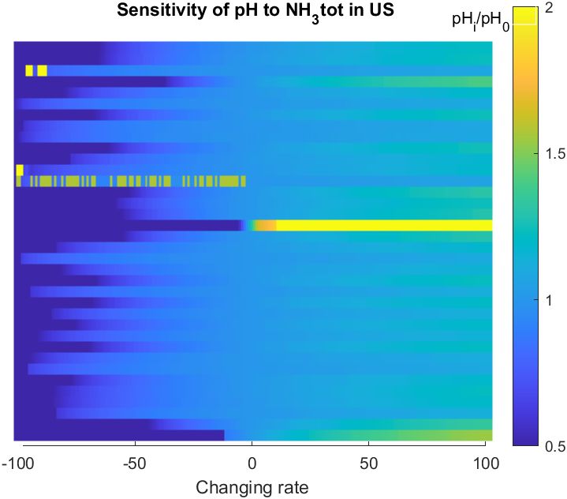
Sensitivity test
Decreasing ammonia concentration will cause larger pH change than increasing ammonia concentration;
Aerosol is more sensitive to ammonia change in US than in China.

Slide 7

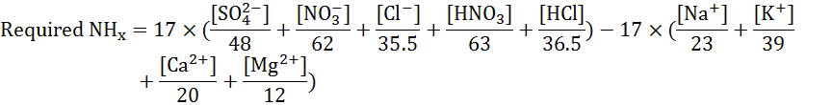

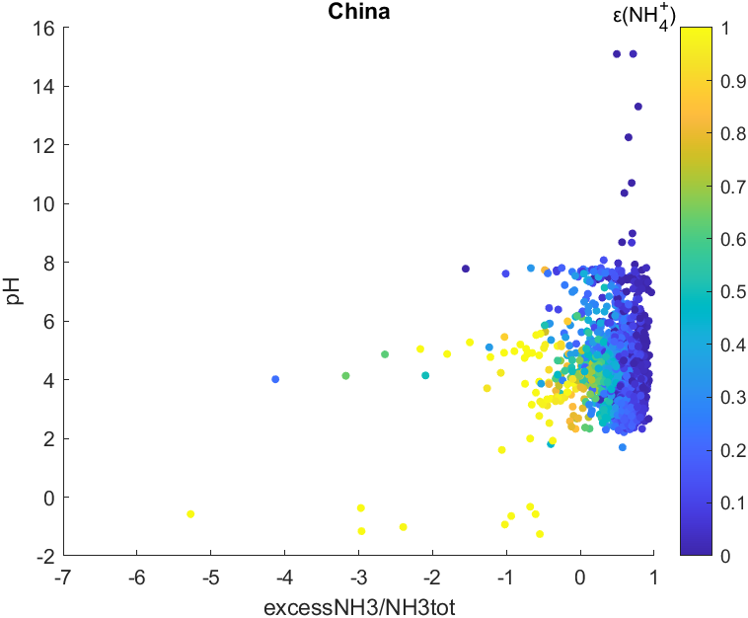
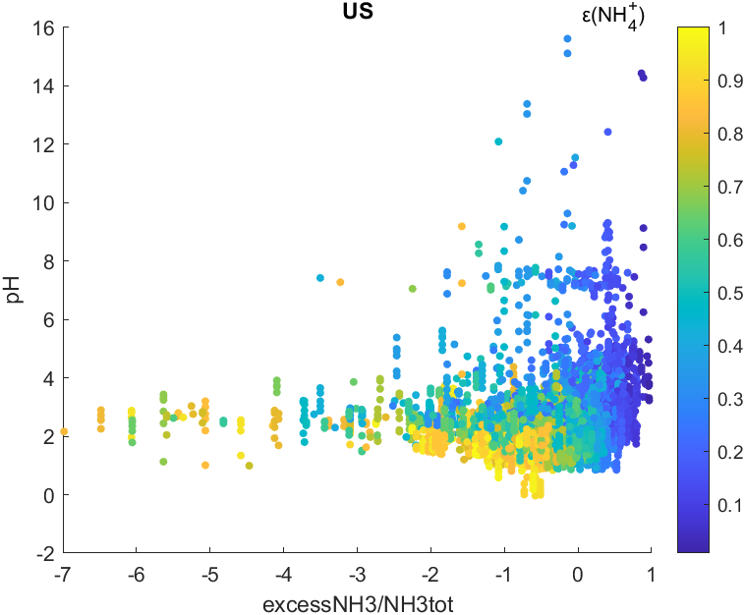
Effect of excessNH3 to aerosol pH
ExcessNH3 will cause pH increase in China and US;
In China, most of the case excessNH3 is larger than 0, and more ammonia is in the form of NH3 gas;
Ammonia can affect aerosol pH by:

Slide 8
Conclusion
Aerosol acidity difference between China and US is significant;
Aerosol acidity difference is mainly contributed by sulfate and ammonia aerosol;
Most of the ammonia in US is in the liquid phase, and aerosol acidity in US is more sensitive to that in China; most of the ammonia in China is in the gas phase.
Ammonia in China is far enough to neutralize aerosol acidity than US.

Slide 9
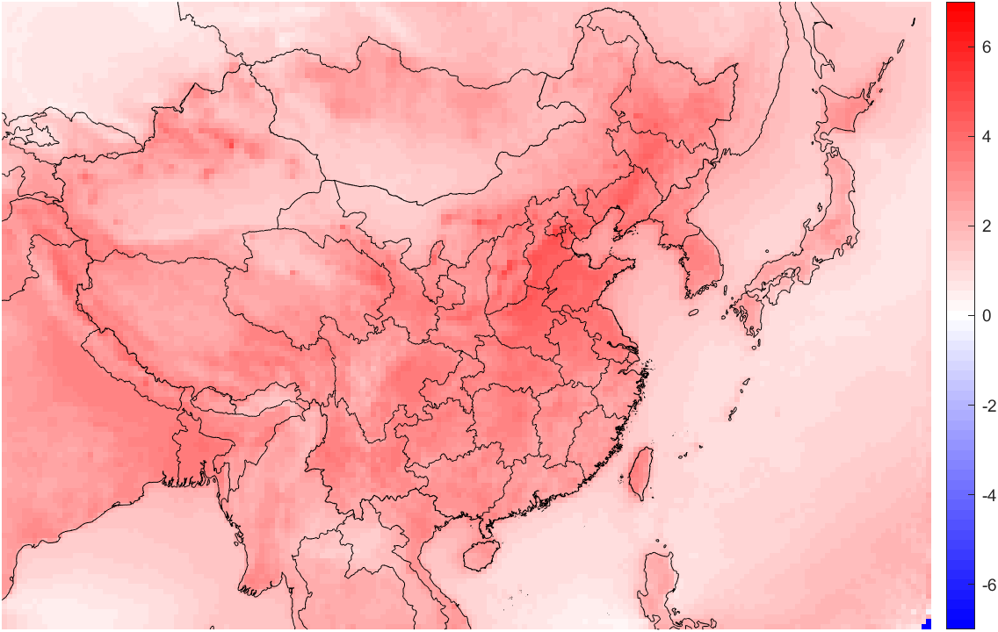
Limitation and future study
Limitation:
  Low observation data quality, lots of outliers;
  Low representativeness of observation data in China, all the monitoring sites are located in North China Plain;
  Large uncertainty of ISORROPIA output;
Future study:
  Aerosol acidity analysis base on simulated result

