Slide 1
Effect of Diacetyl and Aromatics on springtime ozone production
EAS 6410 Term paper presentation
Fanghe Zhao
Earth and Atmospheric School
2020 / 04 / 21

Slide 2
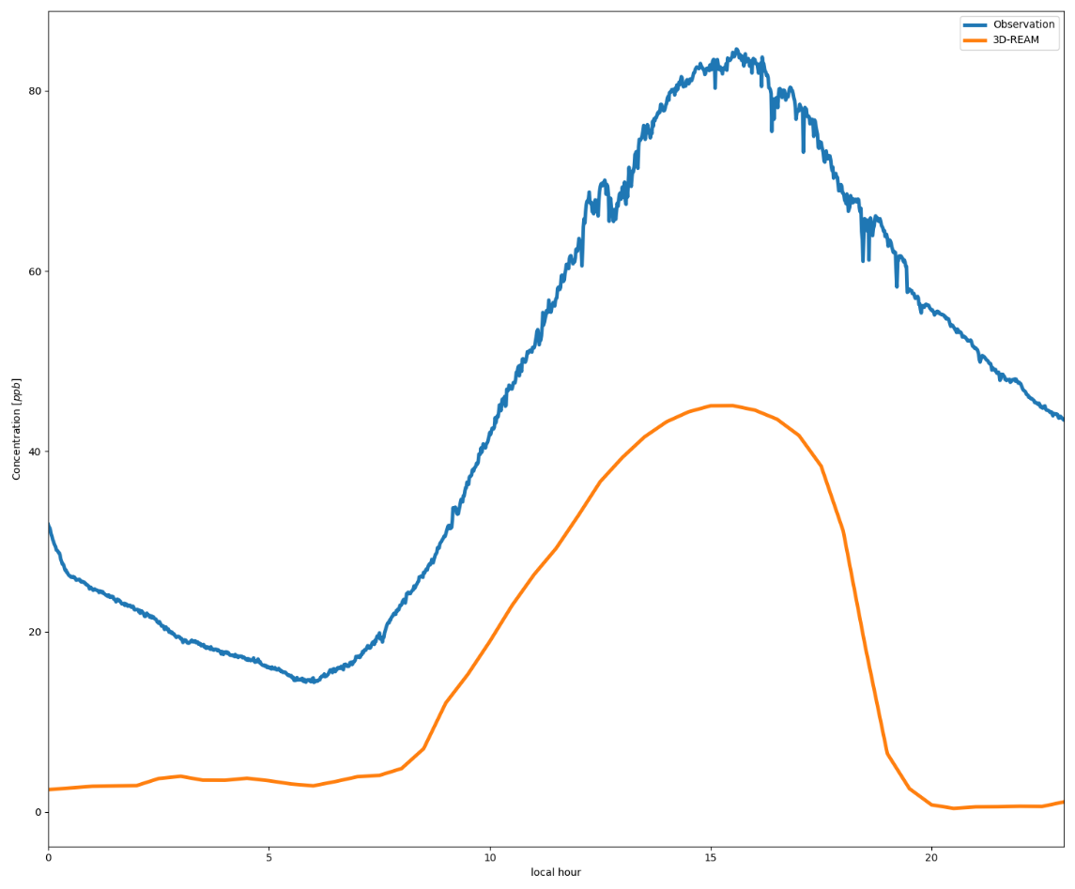
Introduction
Ozone diurnal cycle at DongYing from 2018 Mar to Apr

Slide 3
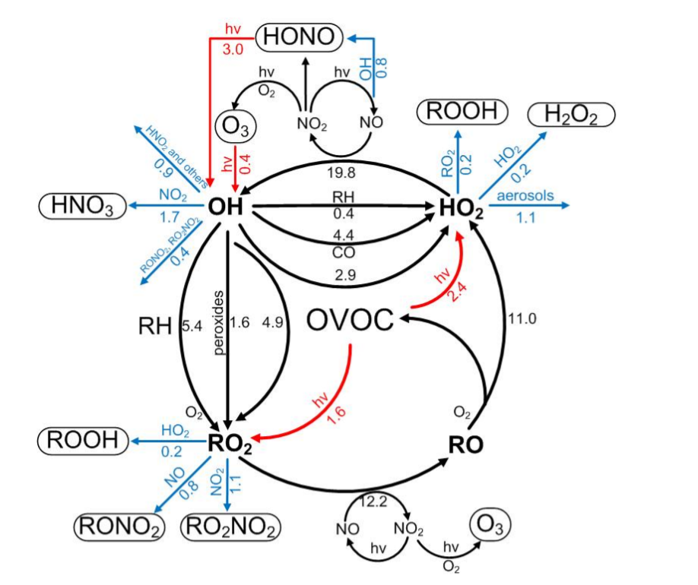
Introduction
Aromatics hydrocarbons plays important role in tropospheric photochemistry. [Seinfeld & Pandis, 2012]
Aromatics have been found to be the largest contributor of ozone formation in most urban areas in China. [Liu et al., 2012]
Aromatic emission inventories based on bottom‐up method featured large uncertainties [Wang et al., 2020]
[Liu et al. 2012]

Slide 4
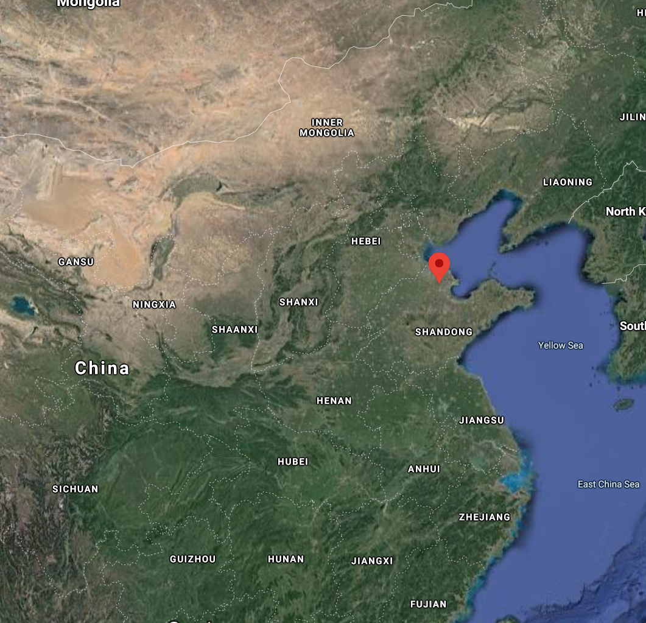
Method : Observation Data
We use observation data collected from Qu et al. at 2018 March and April in DongYing China NCP region with GC-FID method.

Slide 5
Method : Model Description
We use both box model and 3-D model to simulate diacetyl and aromatic concentration.
For box model we use two different mechanisms
Modified GEOS-chem mechanism (REAM mechanism)
220 species 649 reactions
Lump species into tracers
Master Chemical Mechanism v3.3 (MCM mechanism)
3640 species 11030 reactions
near-explicit chemical mechanism
Specification:
1minute timestep
Constrain surface concentration by observation

Slide 6
Method : Model Description
Regional Chemical Transport Model (REAM)
Cloud Resolving & Convection
(Kain–Fritsch eta scheme)
Horizontal Transport
(Input met data from WRF4.0)
Fast-J
REAM photochemistry
Mechanism
Emission
Anthropogenic Inventory(NEI2018)
Biogenic (MEGAN Online and Offline)
Vertical Transport
(Hybrid Vertical Coordinate)
Lightning NOx
Dry and Wet Deposition
Grids : 4km or 36km
(WRF’s lambert projection)
Land type(Olson land map)
Boundary Condition (From GEOS-Chem)

Slide 7
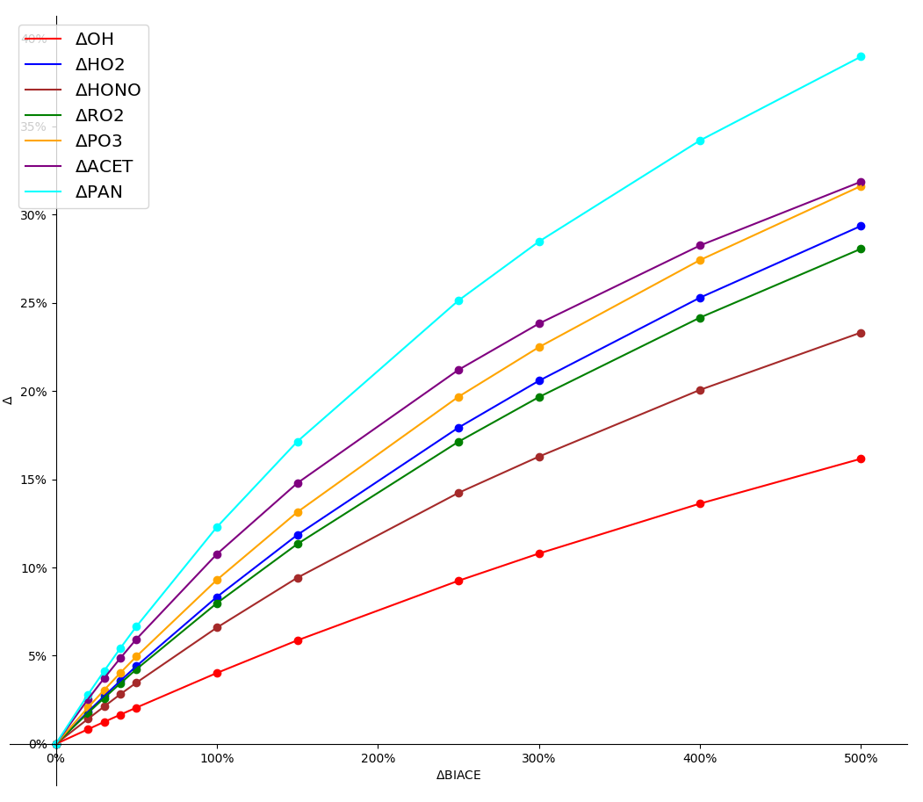
Result
Box model within REAM mechanism

Slide 8
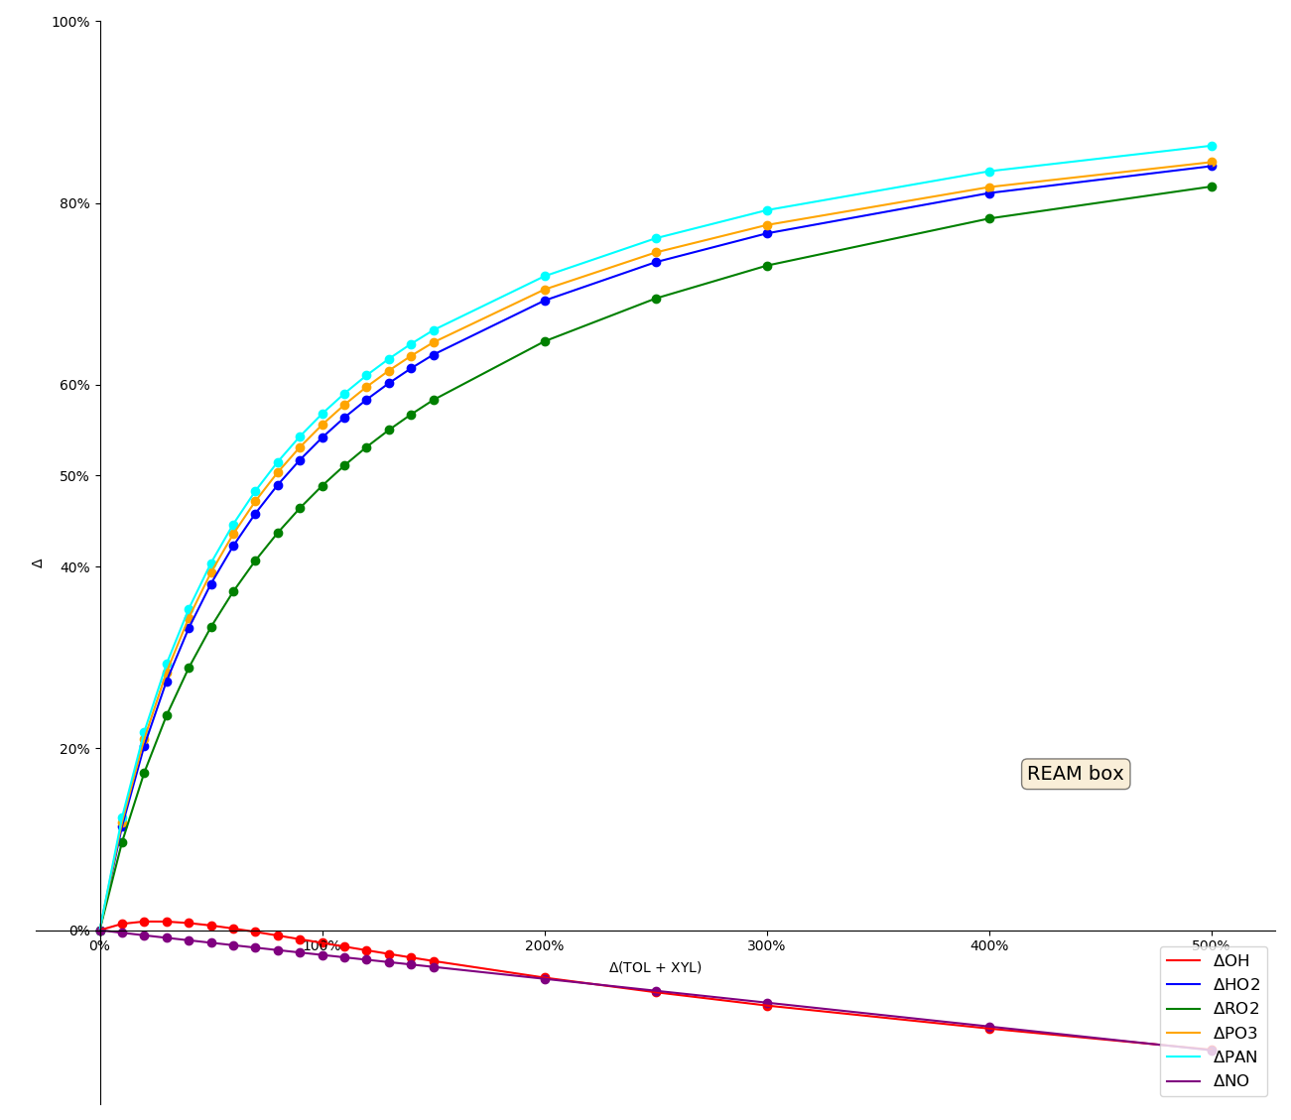
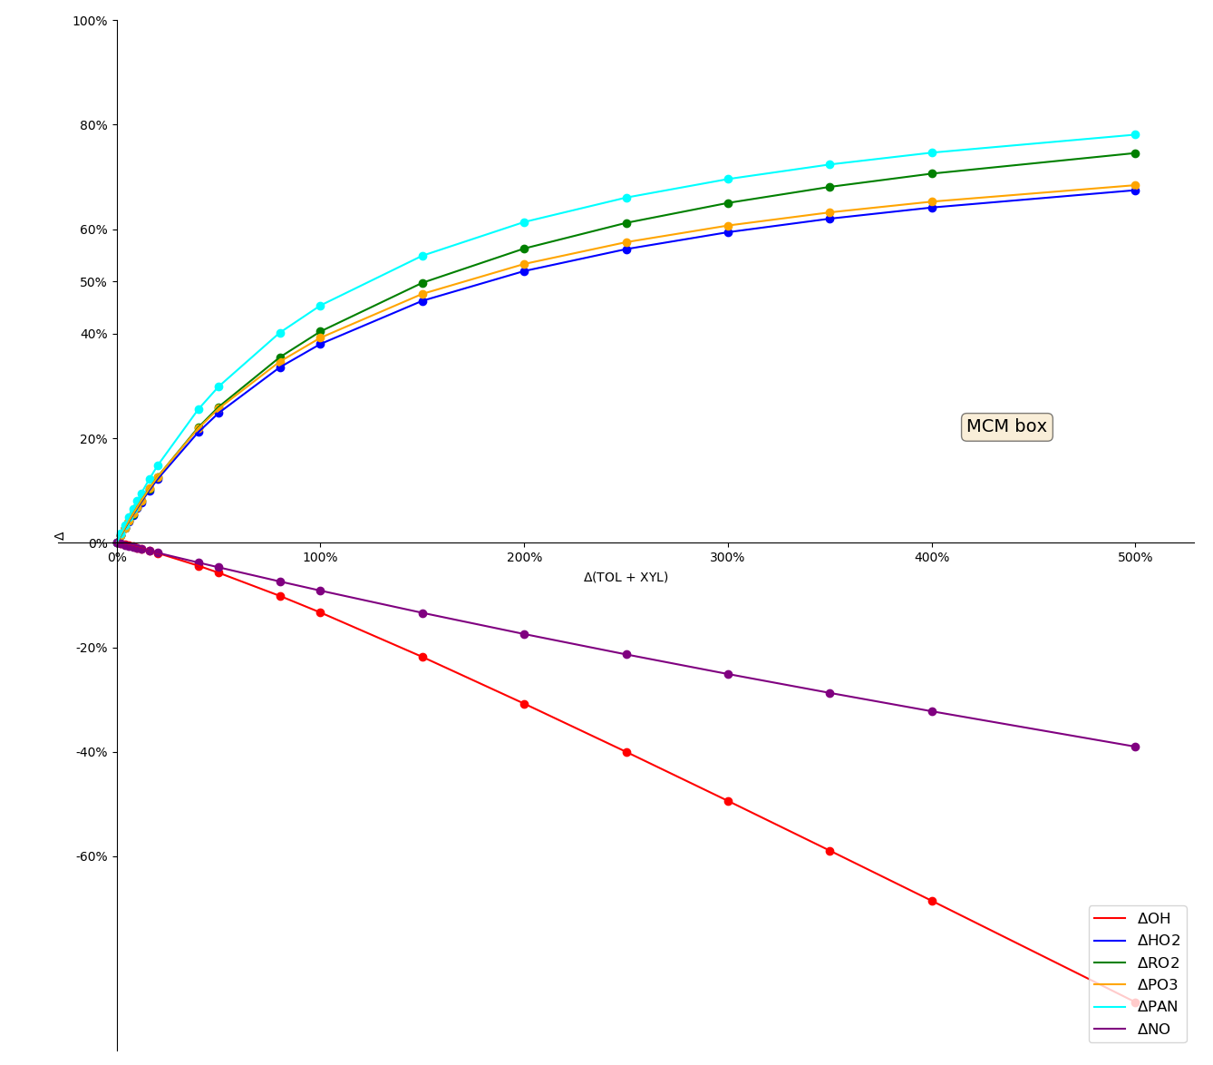
Result
Box model within REAM mechanism
Box model within MCM mechanism

Slide 9
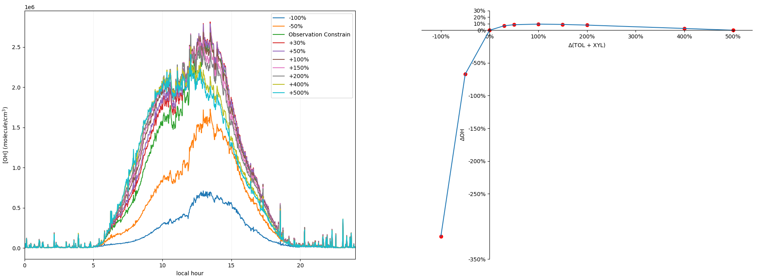
Result
Box model within REAM mechanism

Slide 10
Conclusion and Future work
We can adjust aromatics and diactyle emission rate to have more ozone production within further observation agreement.
China rural region springtime ozone production rate is more sensitive with aromatics change.

