Slide 1
Analysis of meteorological conditions enhancing high particulate matter episodes in Monterrey, Mexico
Ana Yael Vanoye García
Atmospheric Pollution Meteorology
April 16, 2009

Slide 2
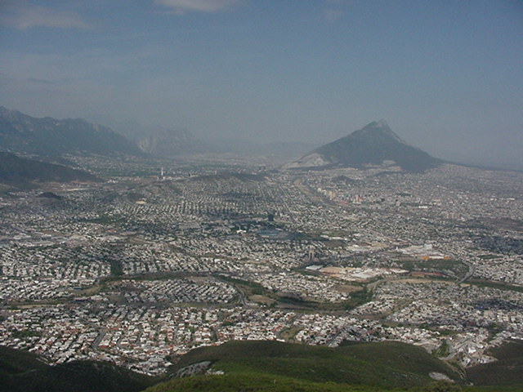
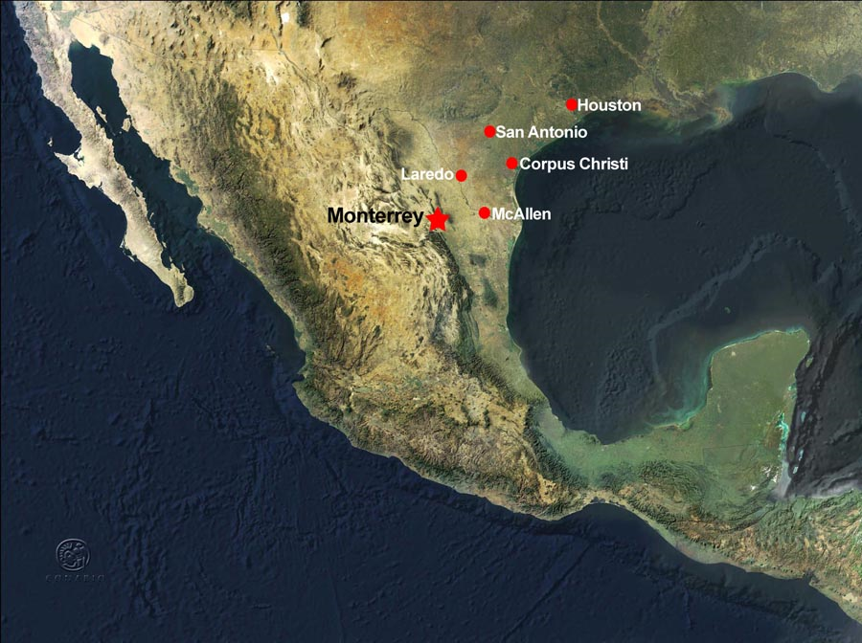
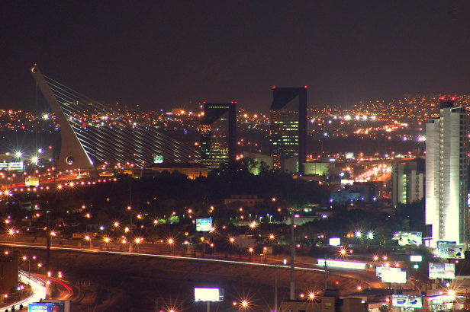
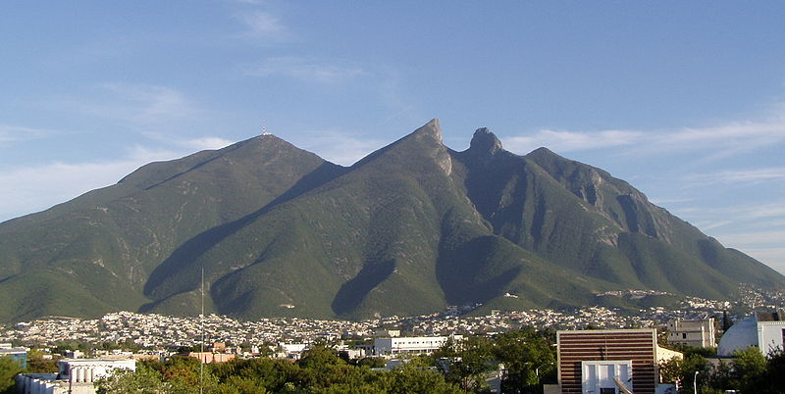
Monterrey, Mexico
Located ~140 miles south from Mexico-US border
Third most populous city in Mexico, home to ~ 3.7 million people.
Major industrial and business center

Slide 3
Introduction
Air Quality Metrics for 2006
Pollutant | Number of days above the standard | Annual average concentration | Maximum IMECA
PM₁₀ | 193 | 85.8 µg/m ³ | 301 +
O₃ | 24 | 26.0 ppb | 152
SO₂ | 0 | 6.27 ppb | 18
CO | 1 | 1.57 ppm | 102
NO₂ | 0 | 20.0 ppb | 81
PM_{2.5} | NA | 36.3 µg/m ³ | NA

Slide 4
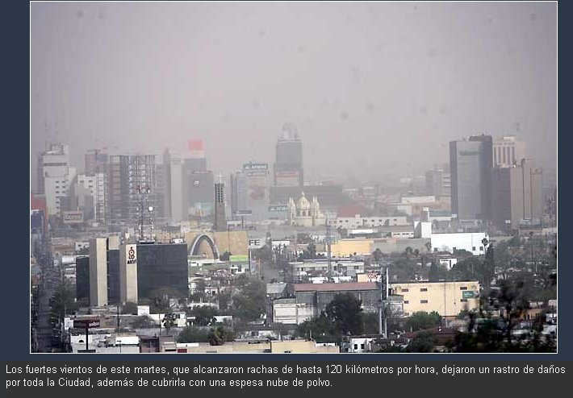
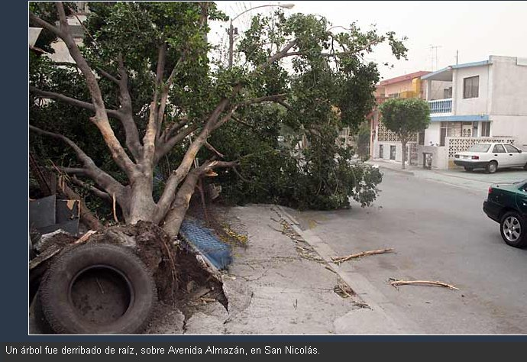
Introduction
On March 18, 2008 high-speed winds struck Monterrey causing great damages in the area (>20 million dlls).
Particulate matter (PM10) reached concentrations >500 μg/m³ , that resulted from the dust cloud that covered the city.

Slide 5
What could have happened?
“A dust storm struck central Mexico on March 18, 2008, and winds transported the dust into southern Texas. The Moderate Resolution Imaging Spectroradiometer (MODIS) on NASA’s Terra satellite took this picture the same day.
This image shows both the plumes of dust from the storm, and fires in the northeast that produce their own plumes of smoke. While the dust ranges in color from orange to tan, the smoke appears fairly uniform gray-beige. Red outlines mark the hotspots caused by the cluster fires. The same winds stirring the dust may also play a role in spreading the fires.
According to news reports, residents of San Antonio, Texas, found abundant mud on their cars on the afternoon of March 18. Dust from Mexico mixed in the atmosphere with rain showers, raining mud over the city and creating what some described as “a car wash owner’s dream,” according to San Antonio’s KSAT.com.”
NASA image courtesy Jeff Schmaltz, MODIS Rapid Response team. Caption by Michon Scott.. Available at: http://earthobservatory.nasa.gov/NaturalHazards/view.php?id=19696&oldid=14751

Slide 6
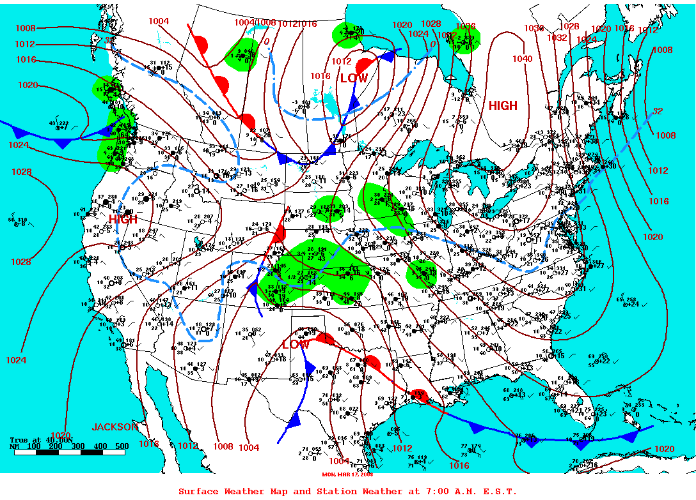
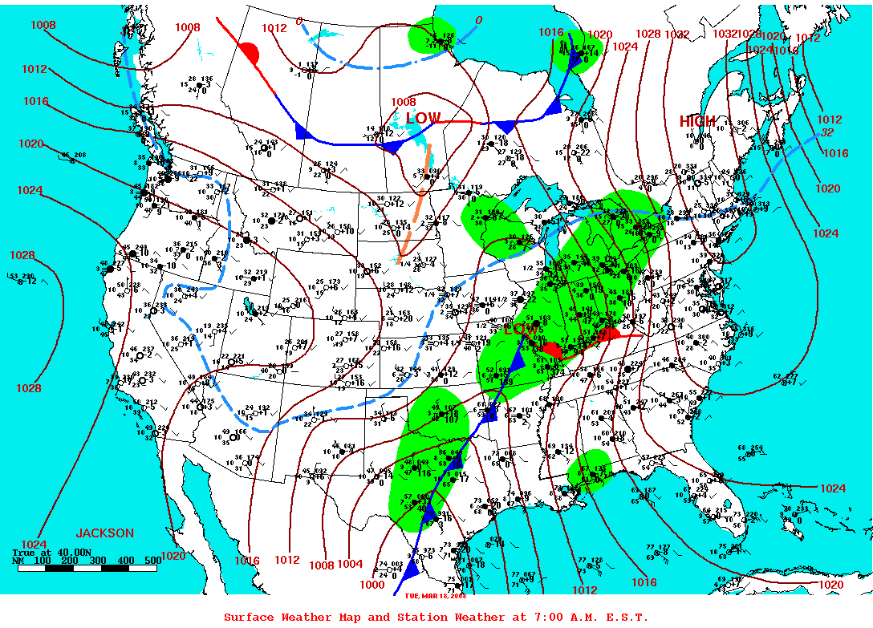
Superficial meteorology

Slide 7
Meteorology at 850 mb

Slide 8
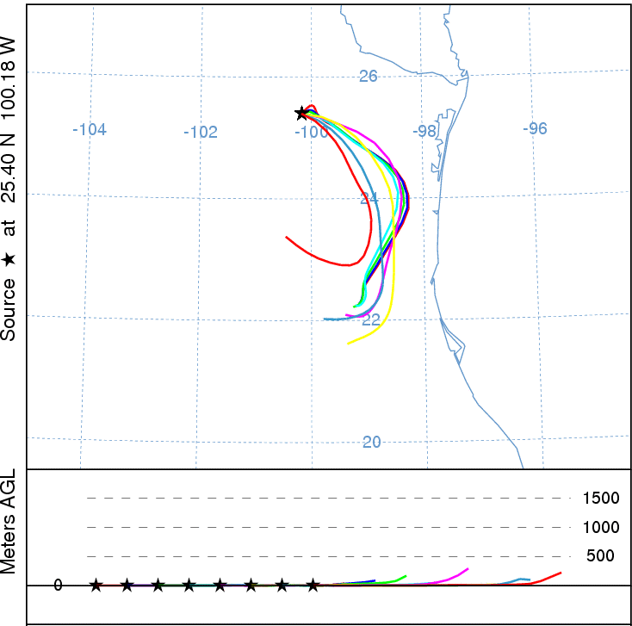
Wind trajectory analysis
Backward trajectories for March 17th.
Forward trajectories during March 18th.

Slide 9
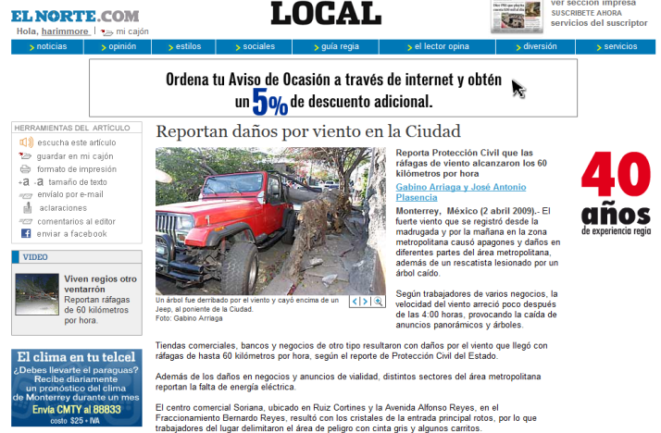
In 2009…
The March 2008 high-wind/high-pollution event was seen as an extraordinary meteorological event.
However, on April 2, 2009 a similar meteorological event struck Monterrey.
How did April 2, 2009 winds compare to those of 2008?
What superficial and upper-atmosphere meteorological conditions influenced the April 2009 event?
How did PM concentrations compare to those observed in 2008?

Slide 10
Wind velocity and PM₁₀ concentrations in Monterrey during April 1-2, 2009

Slide 11
On-going work
Perform further analysis in the meteorological conditions that exacerbated the March 2008 high-pollution event in Monterrey, e.g. analyze atmospheric stability.
Analyze the meteorological conditions under which the April 2009 high-wind/high-pollution event occurred.
Perform a comparison between the March 2008 and April 2009 pollution episodes.
What particular meteorological conditions enhanced the high PM₁₀ episodes occurred in Monterrey during 2008 and 2009?

Slide 12
References
Ahrens, C.D. (1993) Essentials of Meteorology: An Invitation to Atmosphere. West Publishing Company. St. Paul, MI. EEUU.
Draxler, R.R.; Rolph, G.D. (2003) HYSPLIT (Hybrid Single-Particle Lagrangian Integrated Trajectory). Acceso al modelo vía NOAA ARL READY. NOAA Air Resources Laboratory, Silver Spring, MD. Available at: http://www.arl.noaa.gov/ready/hysplt4.html.
Instituto Nacional de Ecología. (2009) Sistema Nacional de Información de la Calidad del Aire. Available at: http://sinaica.ine.gob.mx
NASA Earth Observatory (2009) Dust Storm in Mexico. Available at: http://earthobservatory.nasa.gov/NaturalHazards/natural_hazards_v2.php3?img_id=14751
Texas Comission on Environmental Quality (2009) General Air Pollution and Meteorological Data. Available at: http://www.tceq.state.tx.us/nav/data/air_met_data.html.
Unisys Weather (2009) Upper Air Charts. Disponible en: http://weather.unisys.com.
University of Wyoming (20098) Wyoming Weather Web. Upperair Air Data. Available at: http://weather.uwyo.edu/upperair/

