Slide 1
Properties of observed Arctic ozone and bromine compound based on the back trajectory analysis
EAS 6792 Term project
Ja-Ho Koo

Slide 2
Introduction
Tropospheric ozone depletion event (ODE) usually happens in spring, polar region.
ODE looks strongly related to the amount of atmospheric bromine chemistry based on the heterogeneous reaction (Barrie et al., 1988). Related this, BrO shows well negative correlation with the amount of ozone (e.g. zeng et al., 2003).
Source of bromine is still uncertain bur thermodynamic process of sea ice has been considered as significant source.
Transport of air mass in which ozone is depleted can also influence the ODE.

Slide 3
Basics
Chemistry between ozone and bromine in gas phase (e.g. Zeng et al., 2003)
Br₂ + hv -> Br + Br
Br + O₃ -> BrO + O2
BrO + BrO -> Br₂ + O2
Chemistry between ozone and bromine in Heterogeneous phase (Bromine explosion)
HOBr (aq) + Br- (aq) + H+ (aq) -> Br₂ (aq) (e.g. Fan and Jacob, 1992)
HOBr (aq) + Cl- (aq) + H+ (aq) -> BrCl (aq) (e.g. Foster et al., 2001)
Source of bromine
Frost flower (e.g. Rankin et al., 2002, Kaleschke et al., 2004)
First sea ice (e.g. Simpson et al., 2007)
Transport effect
Back trajectory analysis (e.g. Bottenheim and Chan, 2006)

Slide 4
Motivation and Objective
Case study Using aircraft measurement data and back trajectory calculation.
Influence of air mass transportation for ozone depletion
Back trajectory analysis
Looking into measured data
Relationship between O₃ and Br₂
Focus on the BrO / Br₂ ratio

Slide 5
Method
Measurement (Apr 16 ~ 17, 2008)
Aircraft measurement was executed in ARCTAS 2008 project.
Selecting 7 cases measured below 1 km.
Calculation of 5-day back trajectories
HYSPLIT model serviced by NOAA (Draxler and Rolph, 2003)
Online version (www.ready.noaa.gov/ready/open/hysplit4.html)
Simulations for air mass at noon of 7 cases.
3 heights (100, 500, 1000m)

Slide 6
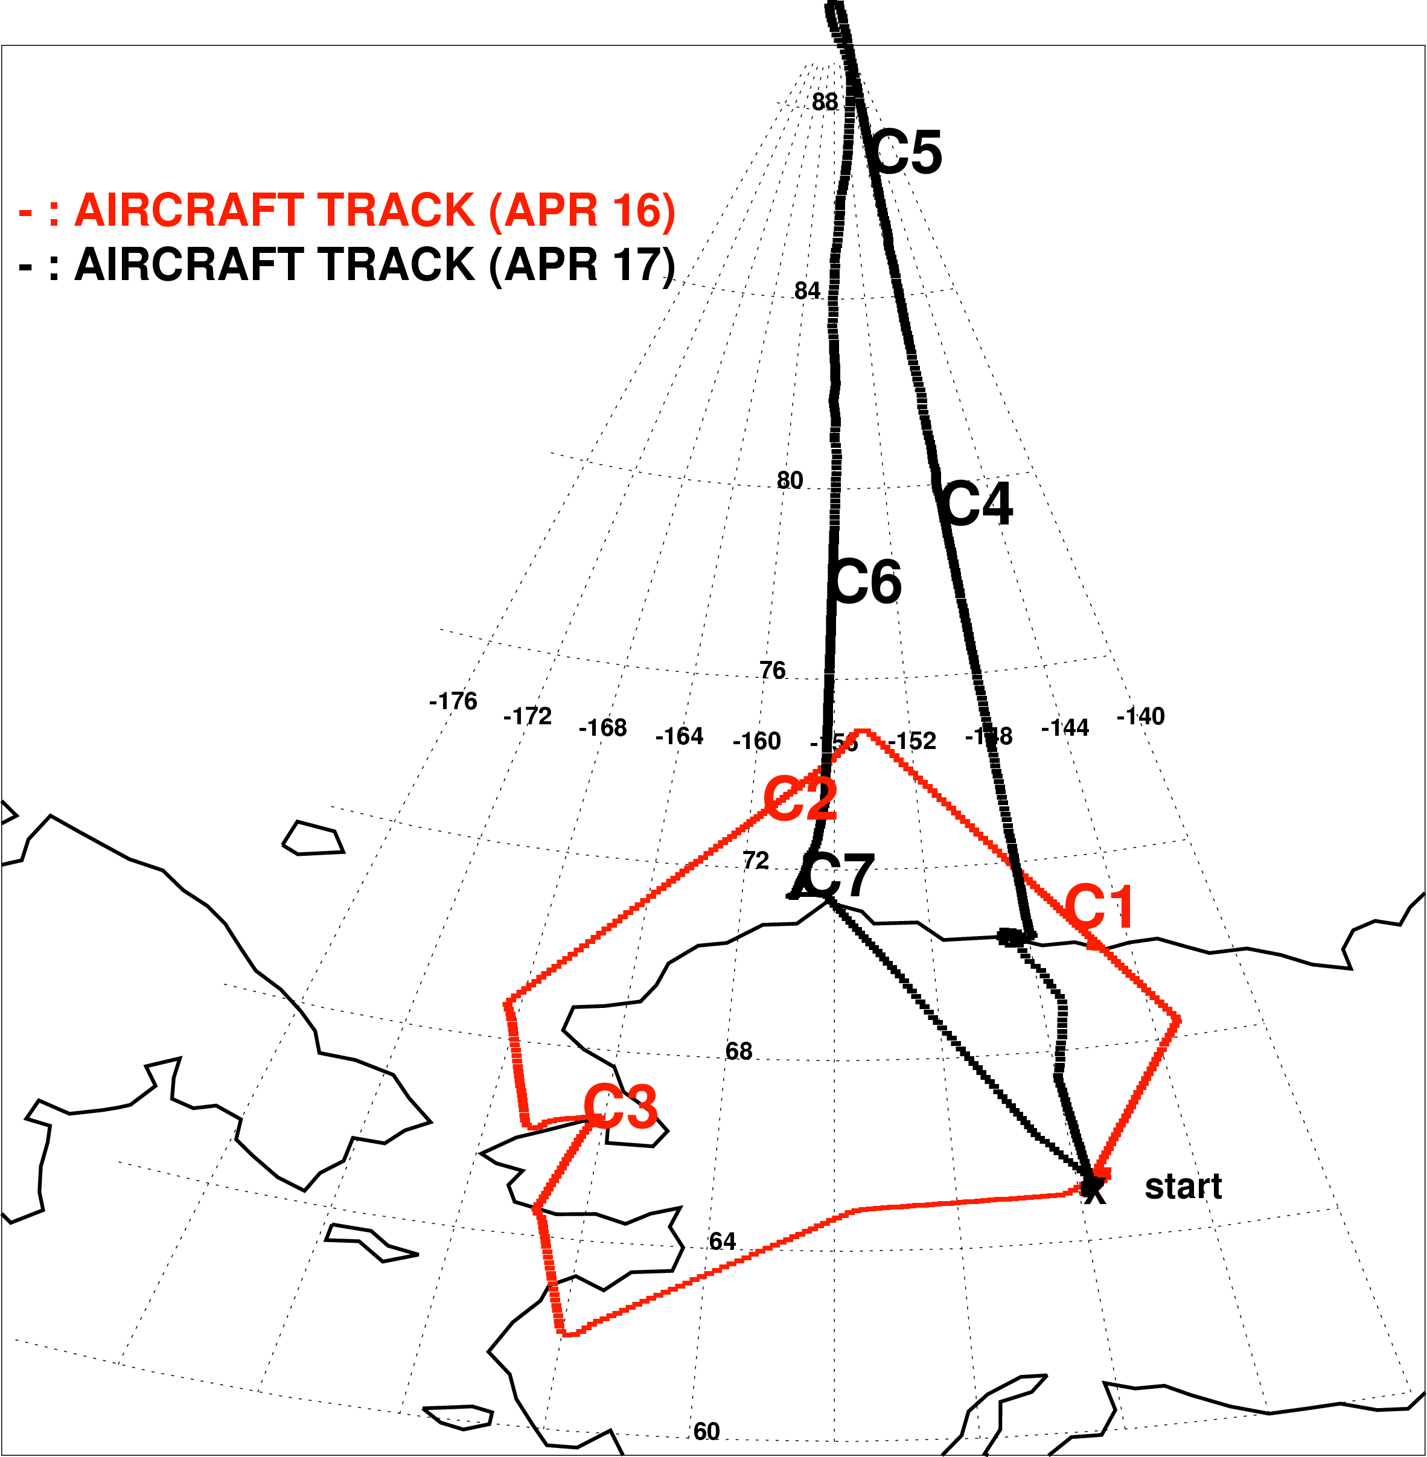
ARCTAS 2008 for bromine
Ozone, BrO, Br₂, soluble bromide is observed.
2-day measurement
Apr 16 : case 1~3
Apr 17 : case 4~7
Case : Aircraft measurement executed below 1km.

Slide 7
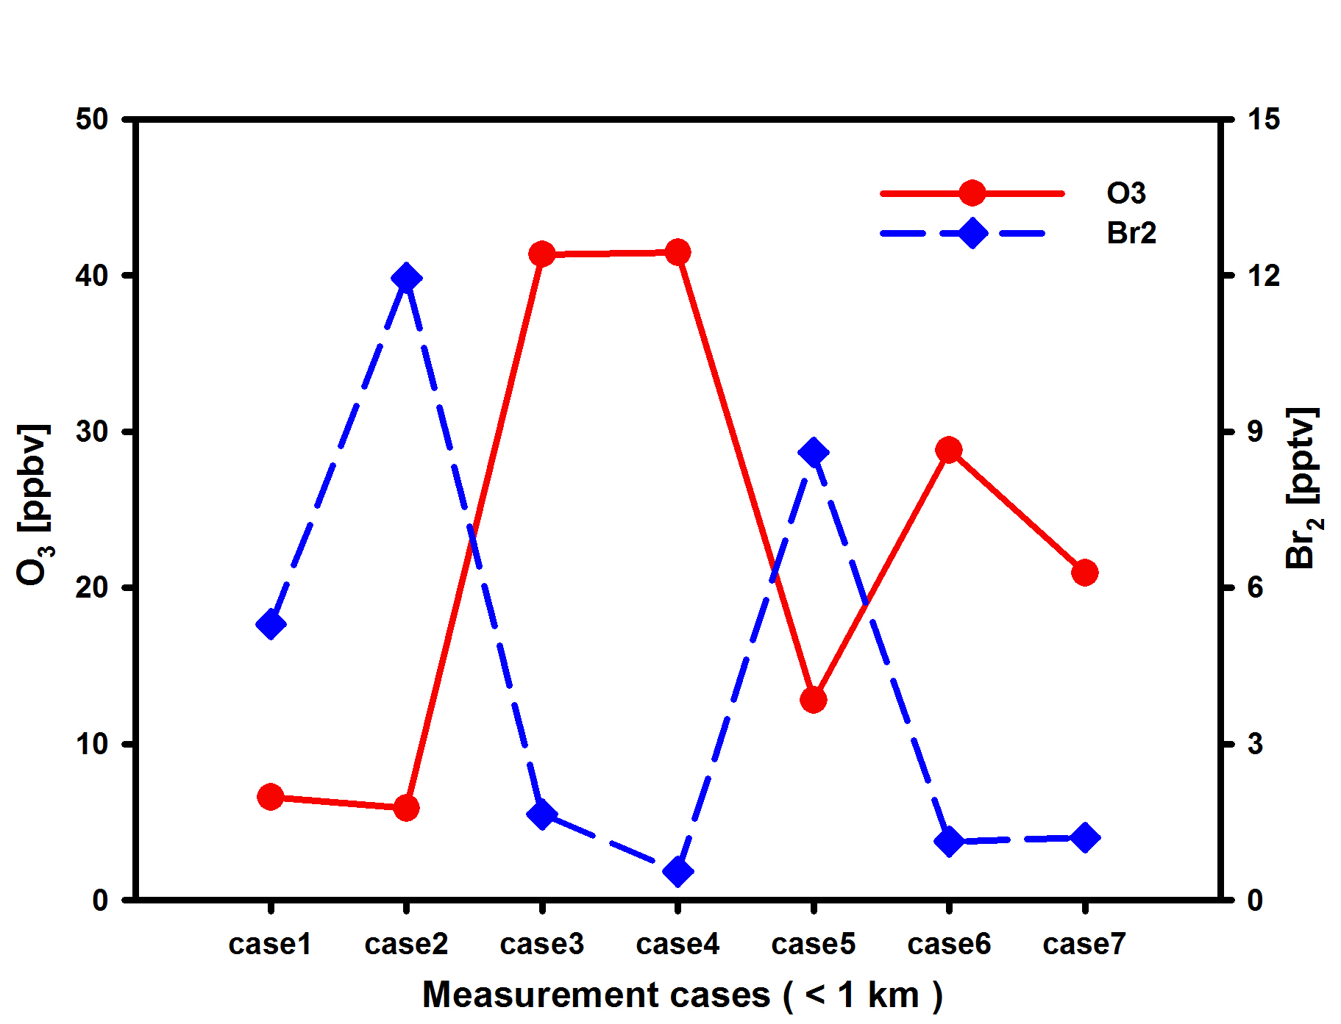
Measurement – (1) O₃ and Br₂
Barrie et al. (Nature, 1988)
Measured O₃ and Br₂ shows distinctly anti-correlated pattern.
Case1 and 2 : strong ozone depletion (< 10 ppbv) happened.

Slide 8
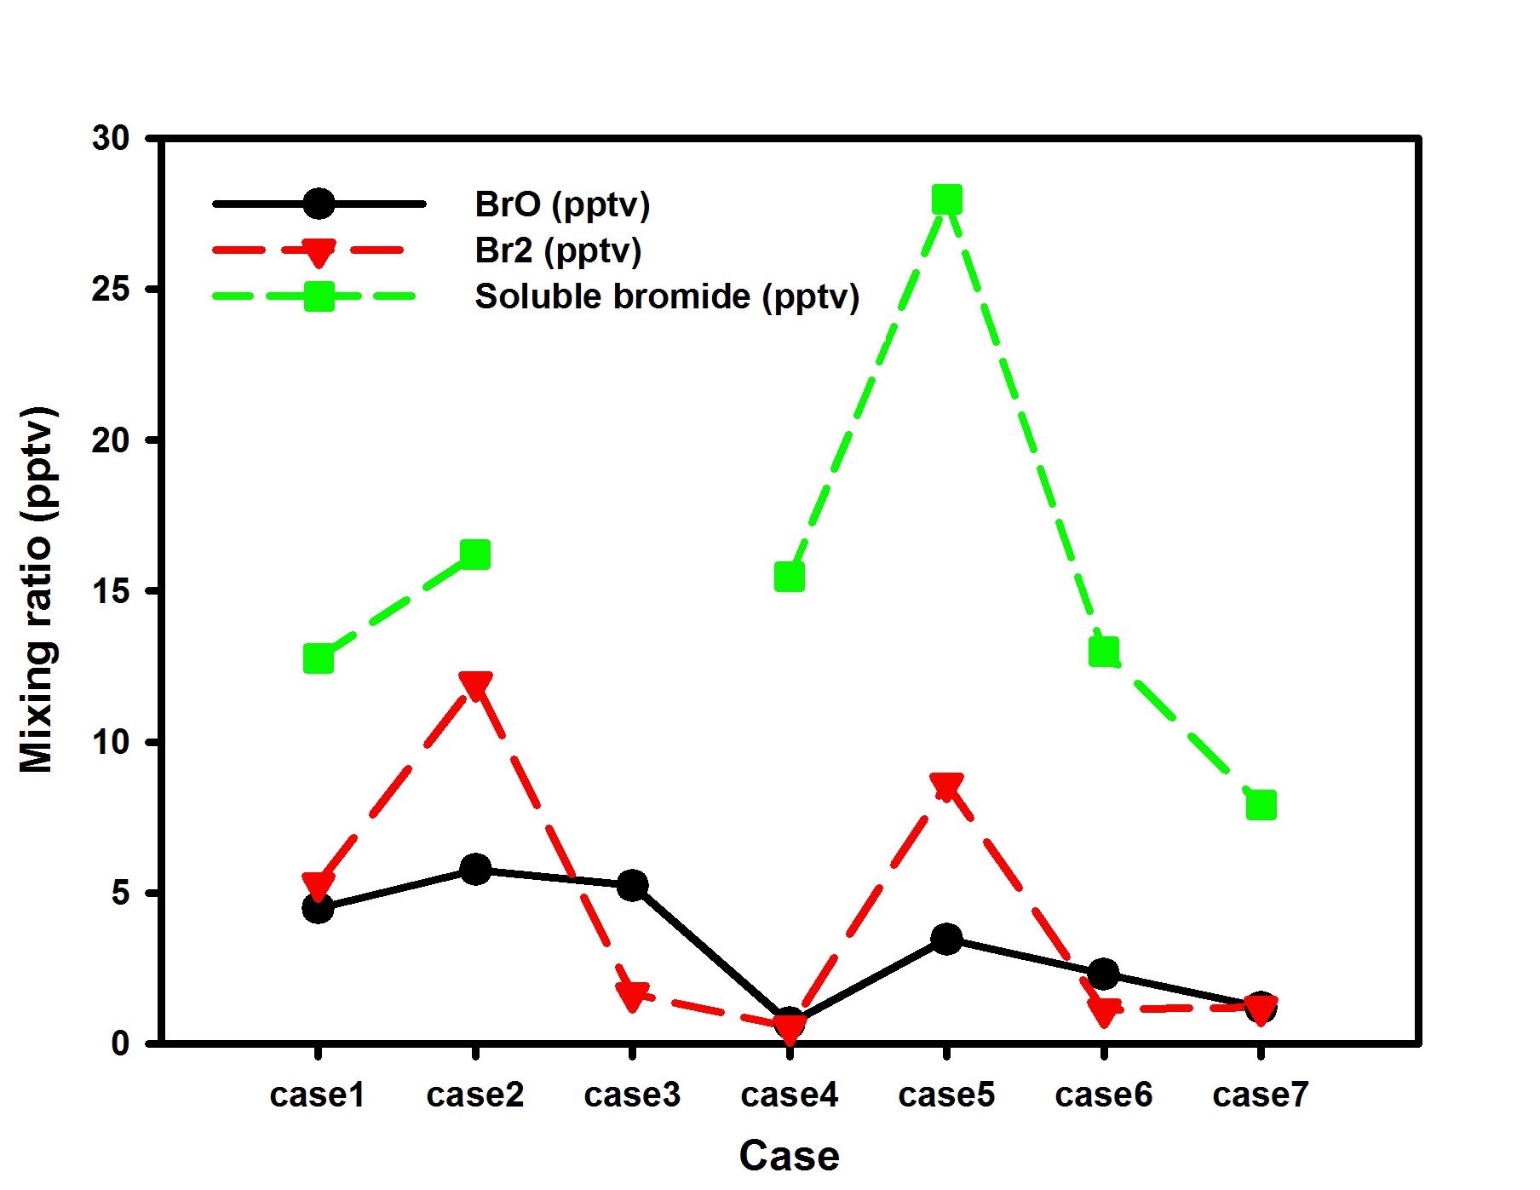
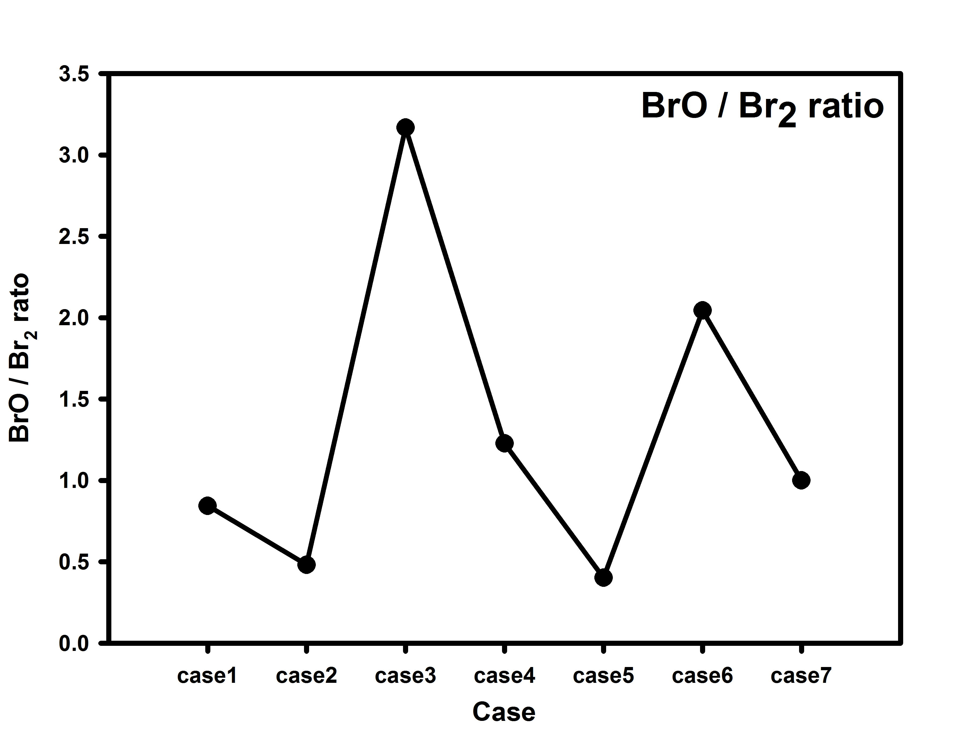
Measurement – (2) Bromine
BrO / Br₂ is less than 1 : Case 1, 2, 5, 7. - shows similar pattern to the ozone mixing ratio.
Soluble bromide is the largest for case 5.

Slide 9
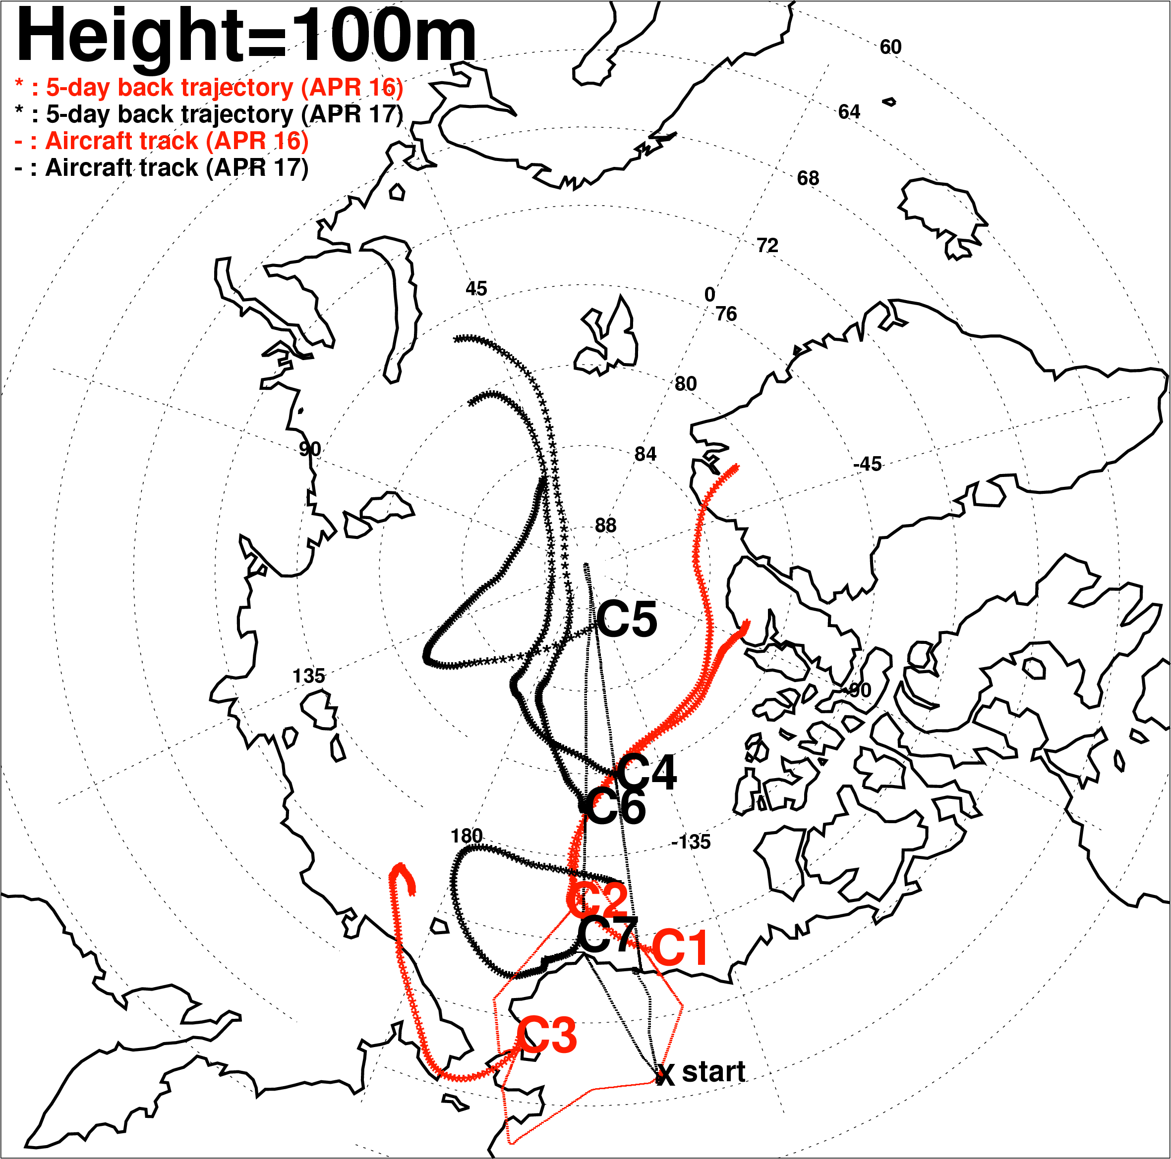
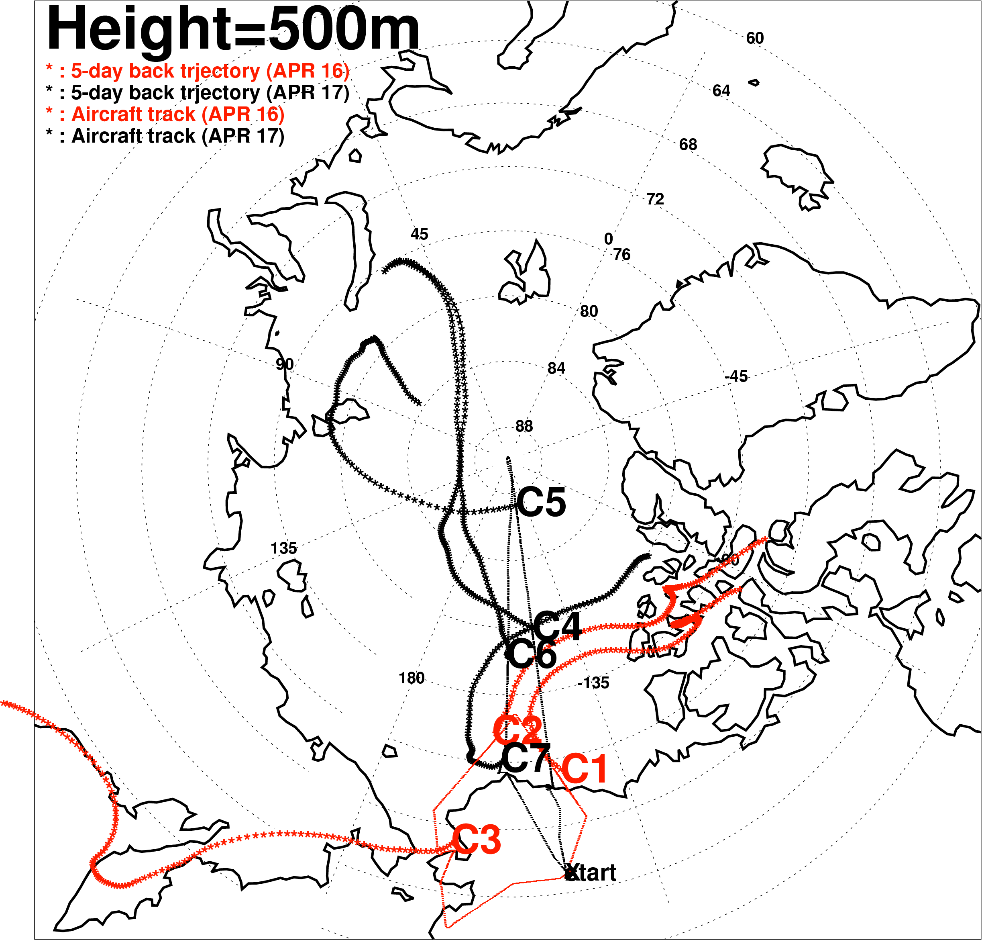
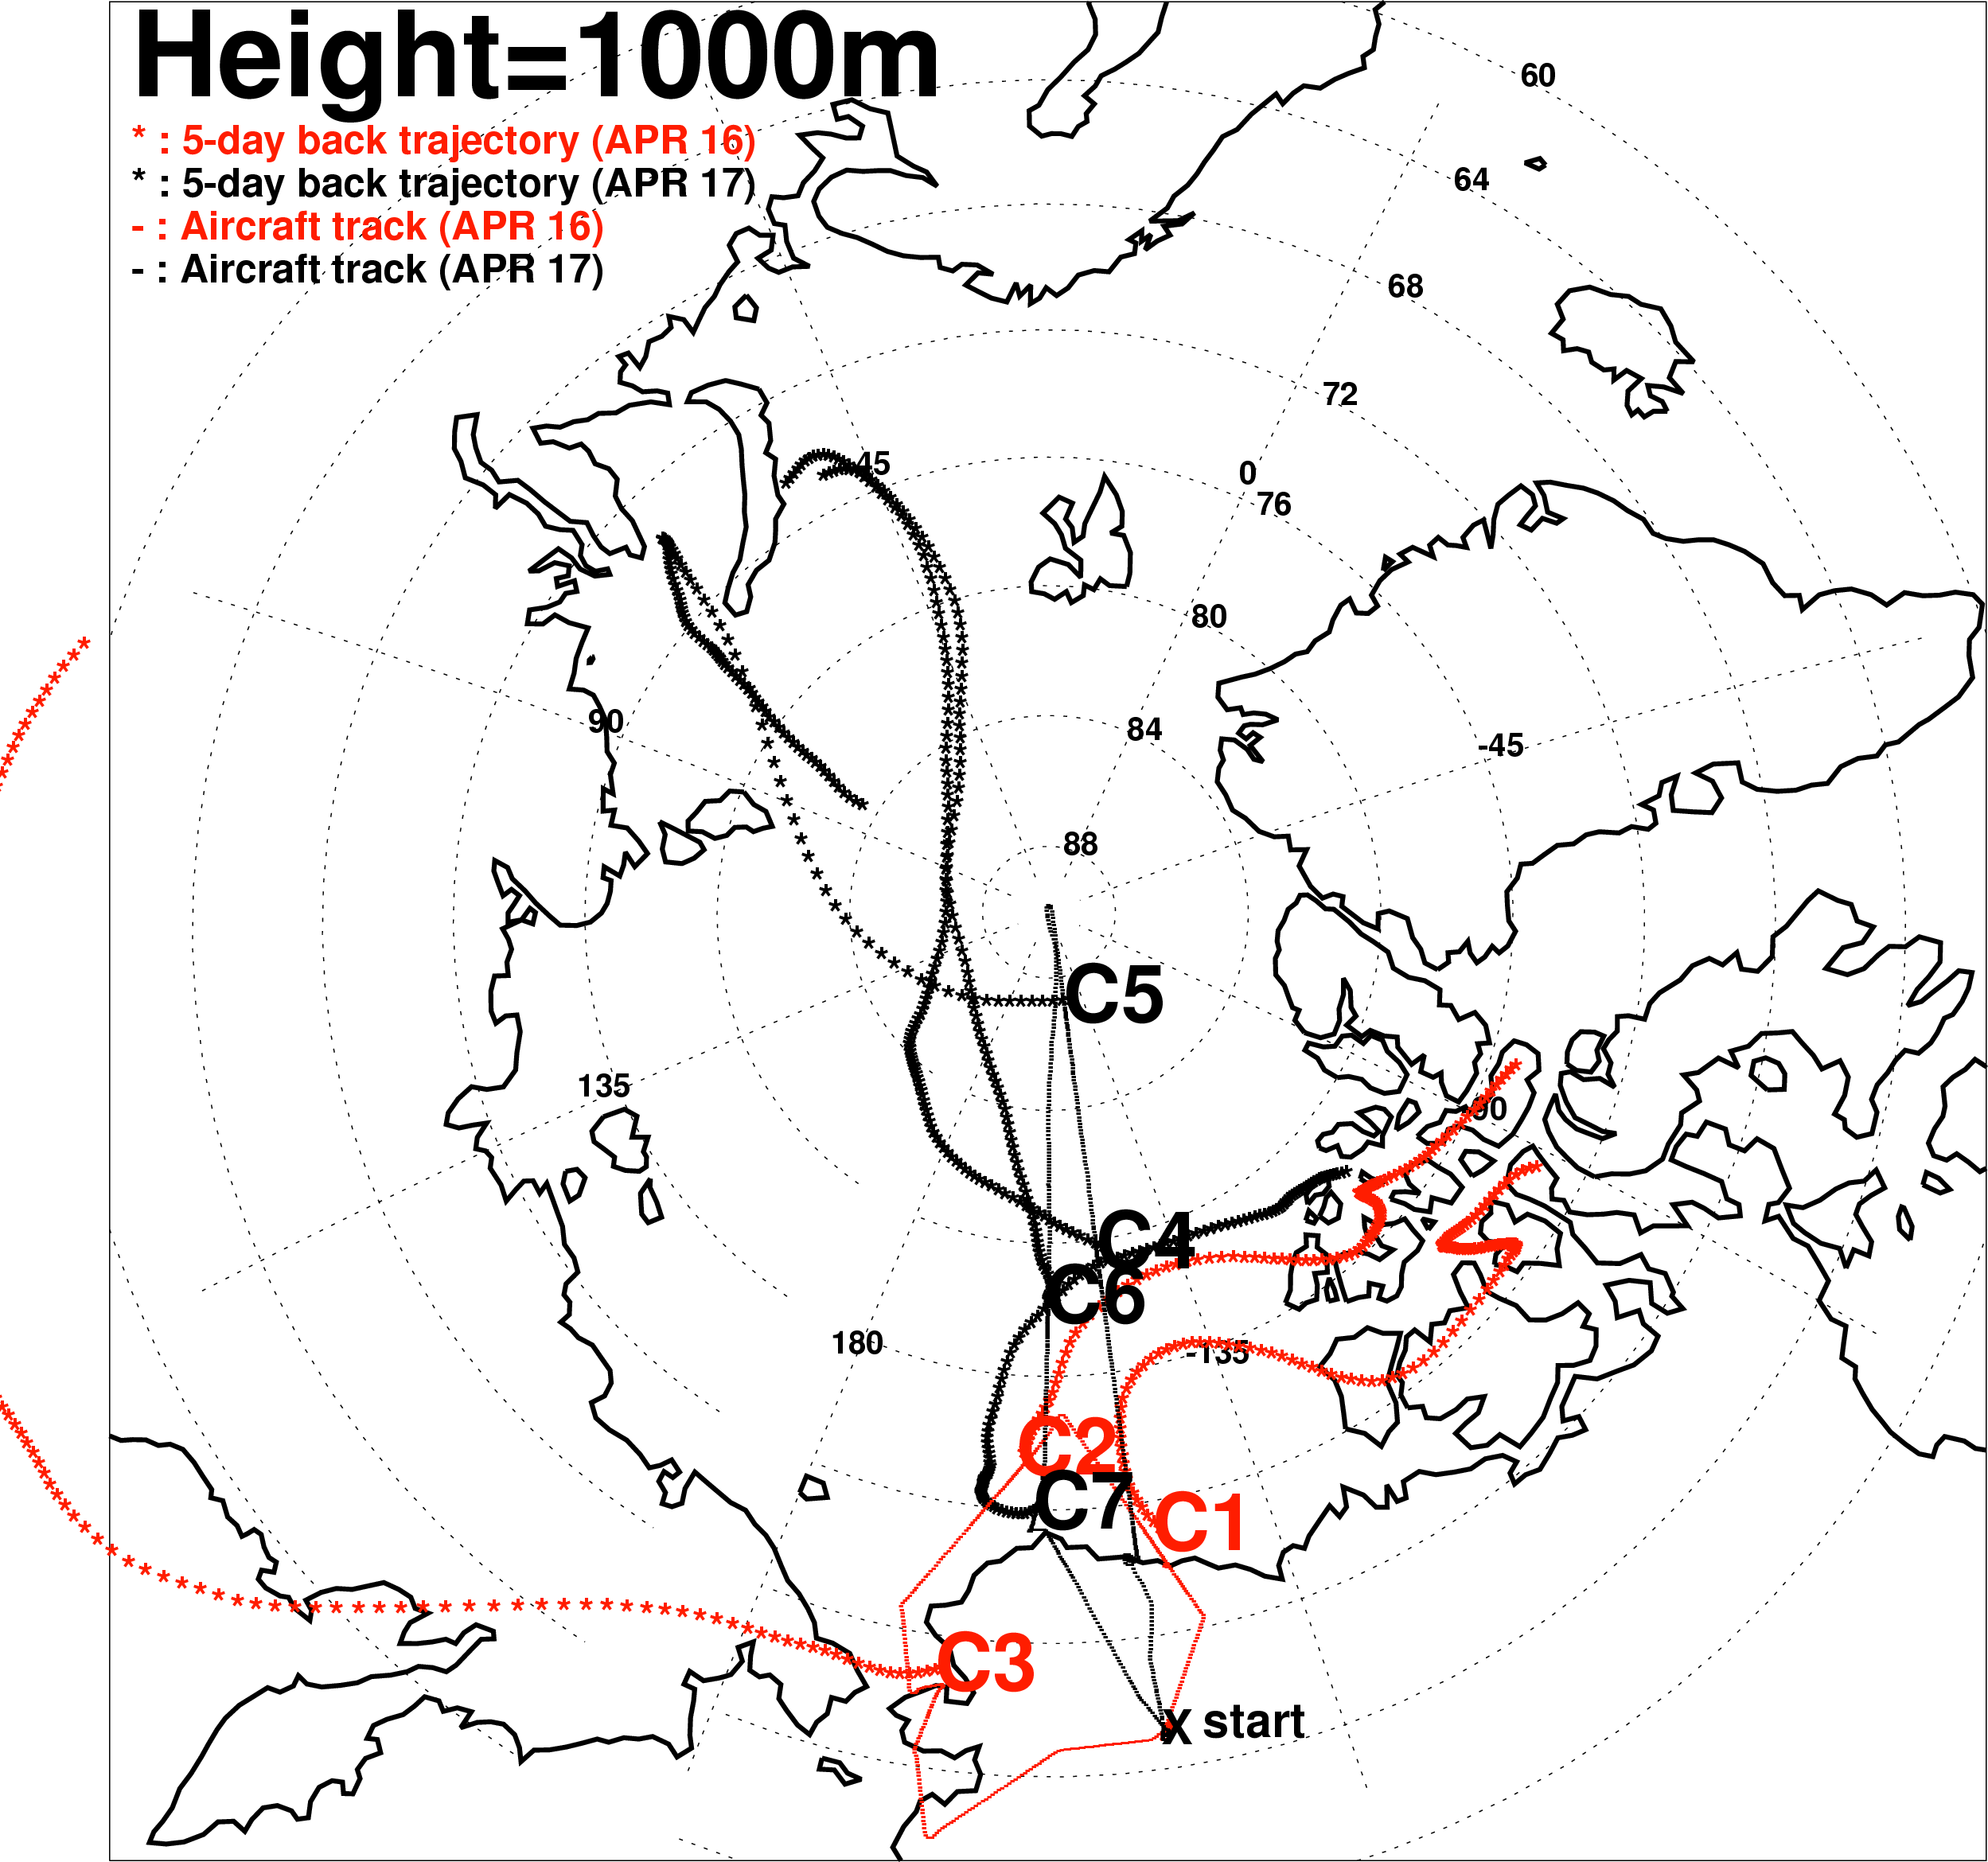
Back trajectory (5-day)
(Calculated by HYSPLIT model – online serviced by NOAA)
Trajectory can show transport effect from the bromine source.
According to the source : Case 1, 2, 7 / case 4,5,6 / case 3
Strong ozone depletion case (case1, case2) shows similar back trajectories.
Notes:
Case 5 : transported from FYI, and soluble bromide show the max. among cases. BrO/Br2 ratio is also strongly small.
-> able to be considered as ODE.
Case 7 : This case is interesting. Trajectory of case 7 is similar to the case 1 and case 2. But little ODE.
Looking into more,

Slide 10
Comparison to previous research
Bottenheim and Chan (JGR, 2006)
Alert
Barrow
Zeppelinfjellet
Alert, Zeppelinfjellet : depletied ozone source – North of Russia.
Usual first year ice region.
Long-range transport for 5~6 days : Far from source.
Barrow : depletied ozone source – North of Alaska.
Close to source.

Slide 11
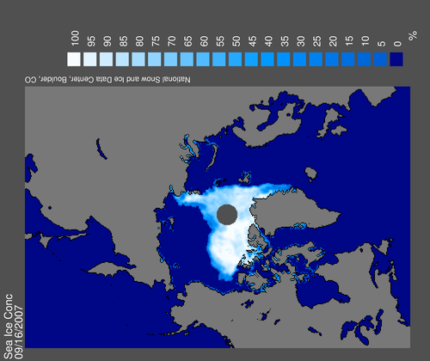
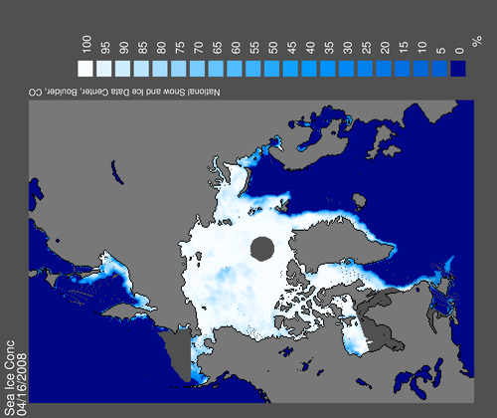
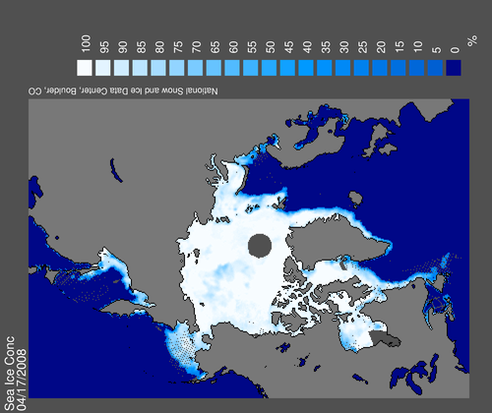
Sea ice concentration (from NSIDC)
Nimbus-7 SMMR and DMSP SSM/I passive microwave data
Sep. 16 2007
Sep. 17 2007
Apr. 16 2008
Apr. 17 2008
Notes:
IDEA : 1-D Lagrangian model following to the back-trajectory.
In this case, Br2 source have to be considered, based on the information of FF, FYI, open leads, polynia, and so on.

Slide 12
Summary and further study
Case summary
Case 1, 2 : Transport from north of Canada, strong ODE.
Case 7 : Transport from north of Canada, little ODE.
Case 4, 6 : Transport from north of Russia, but no ODE.
Case 5 : Transport from north of Russia, weak ODE.
Case 3 : Transport from west, no ODE.
➔ Case 1,2,7 located nearby show the significance of transport.
The amount of ozone seems to be related to Br₂ concentration almost perfectly.
Ozone depletion shows the similar pattern to the BrO/Br₂ ratio and it also looks related to the transportation of air mass.
Notes:
Case 1, 2, 7 is located nearby, north of Alaska where it is known that air mass usually shows depleted-ozone.
Case 1, 2 show ODE but case 7 shows non-ODE. The difference is back trajectory. Case 7 trajectory is shorter, not reaching to the FYI region (north of canada archipelago). If local chemistry is more important, ODE should be shown in case 7.

Slide 13
Thank you

Slide 14
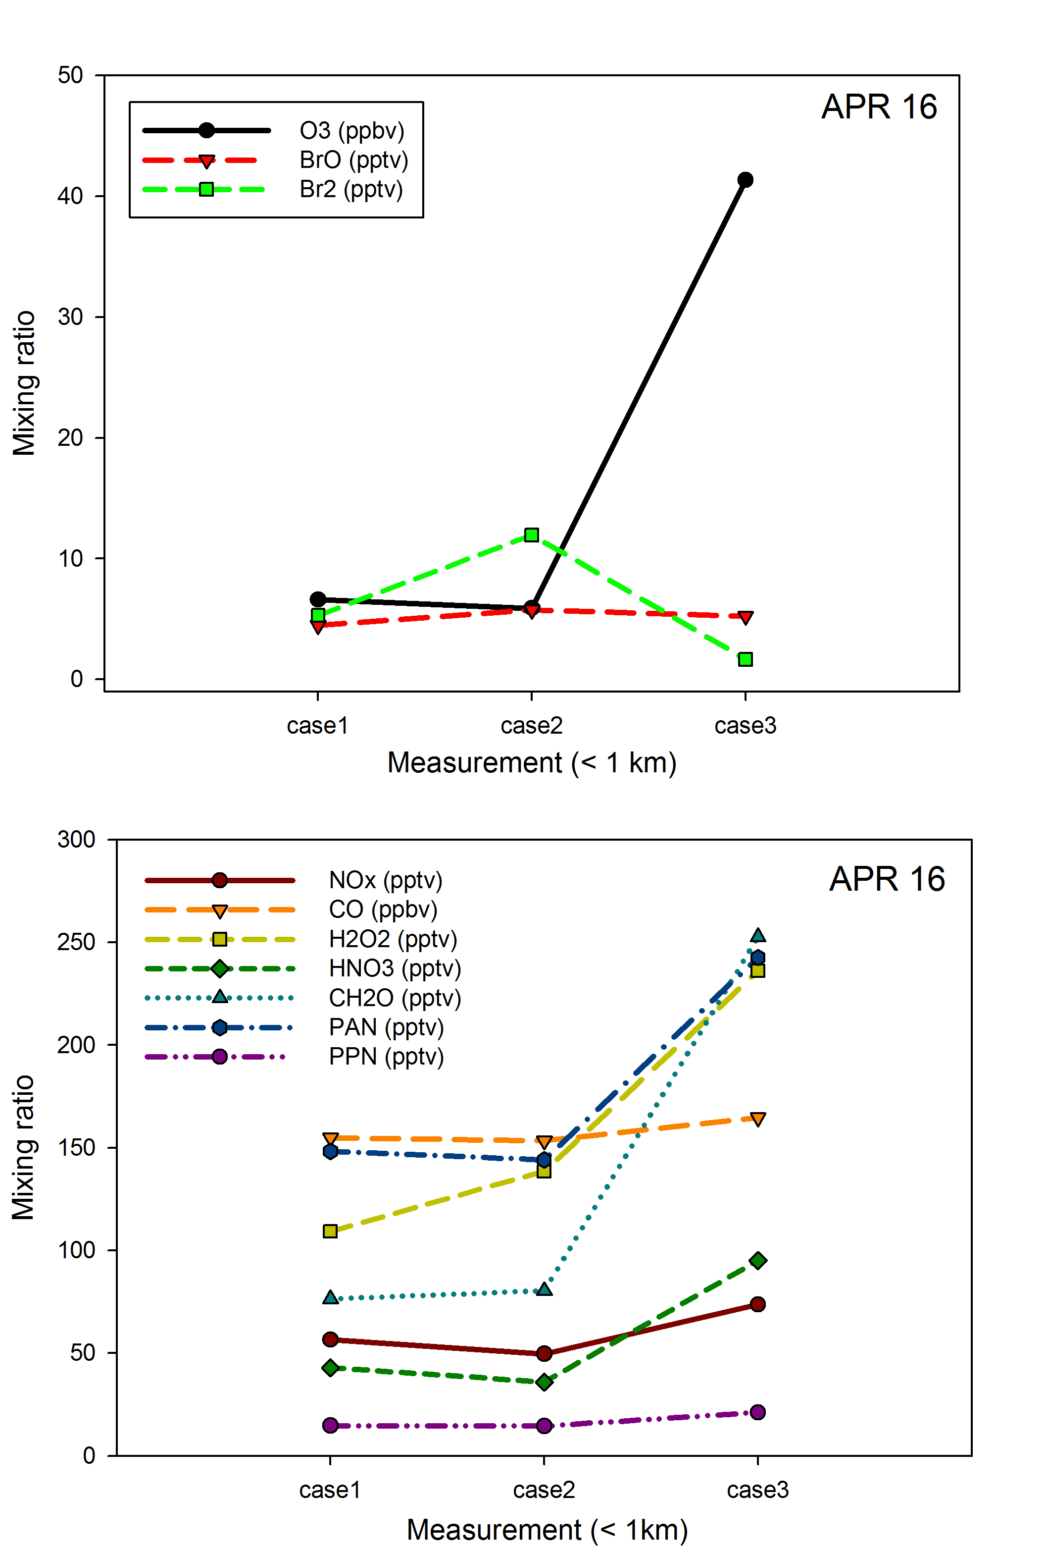
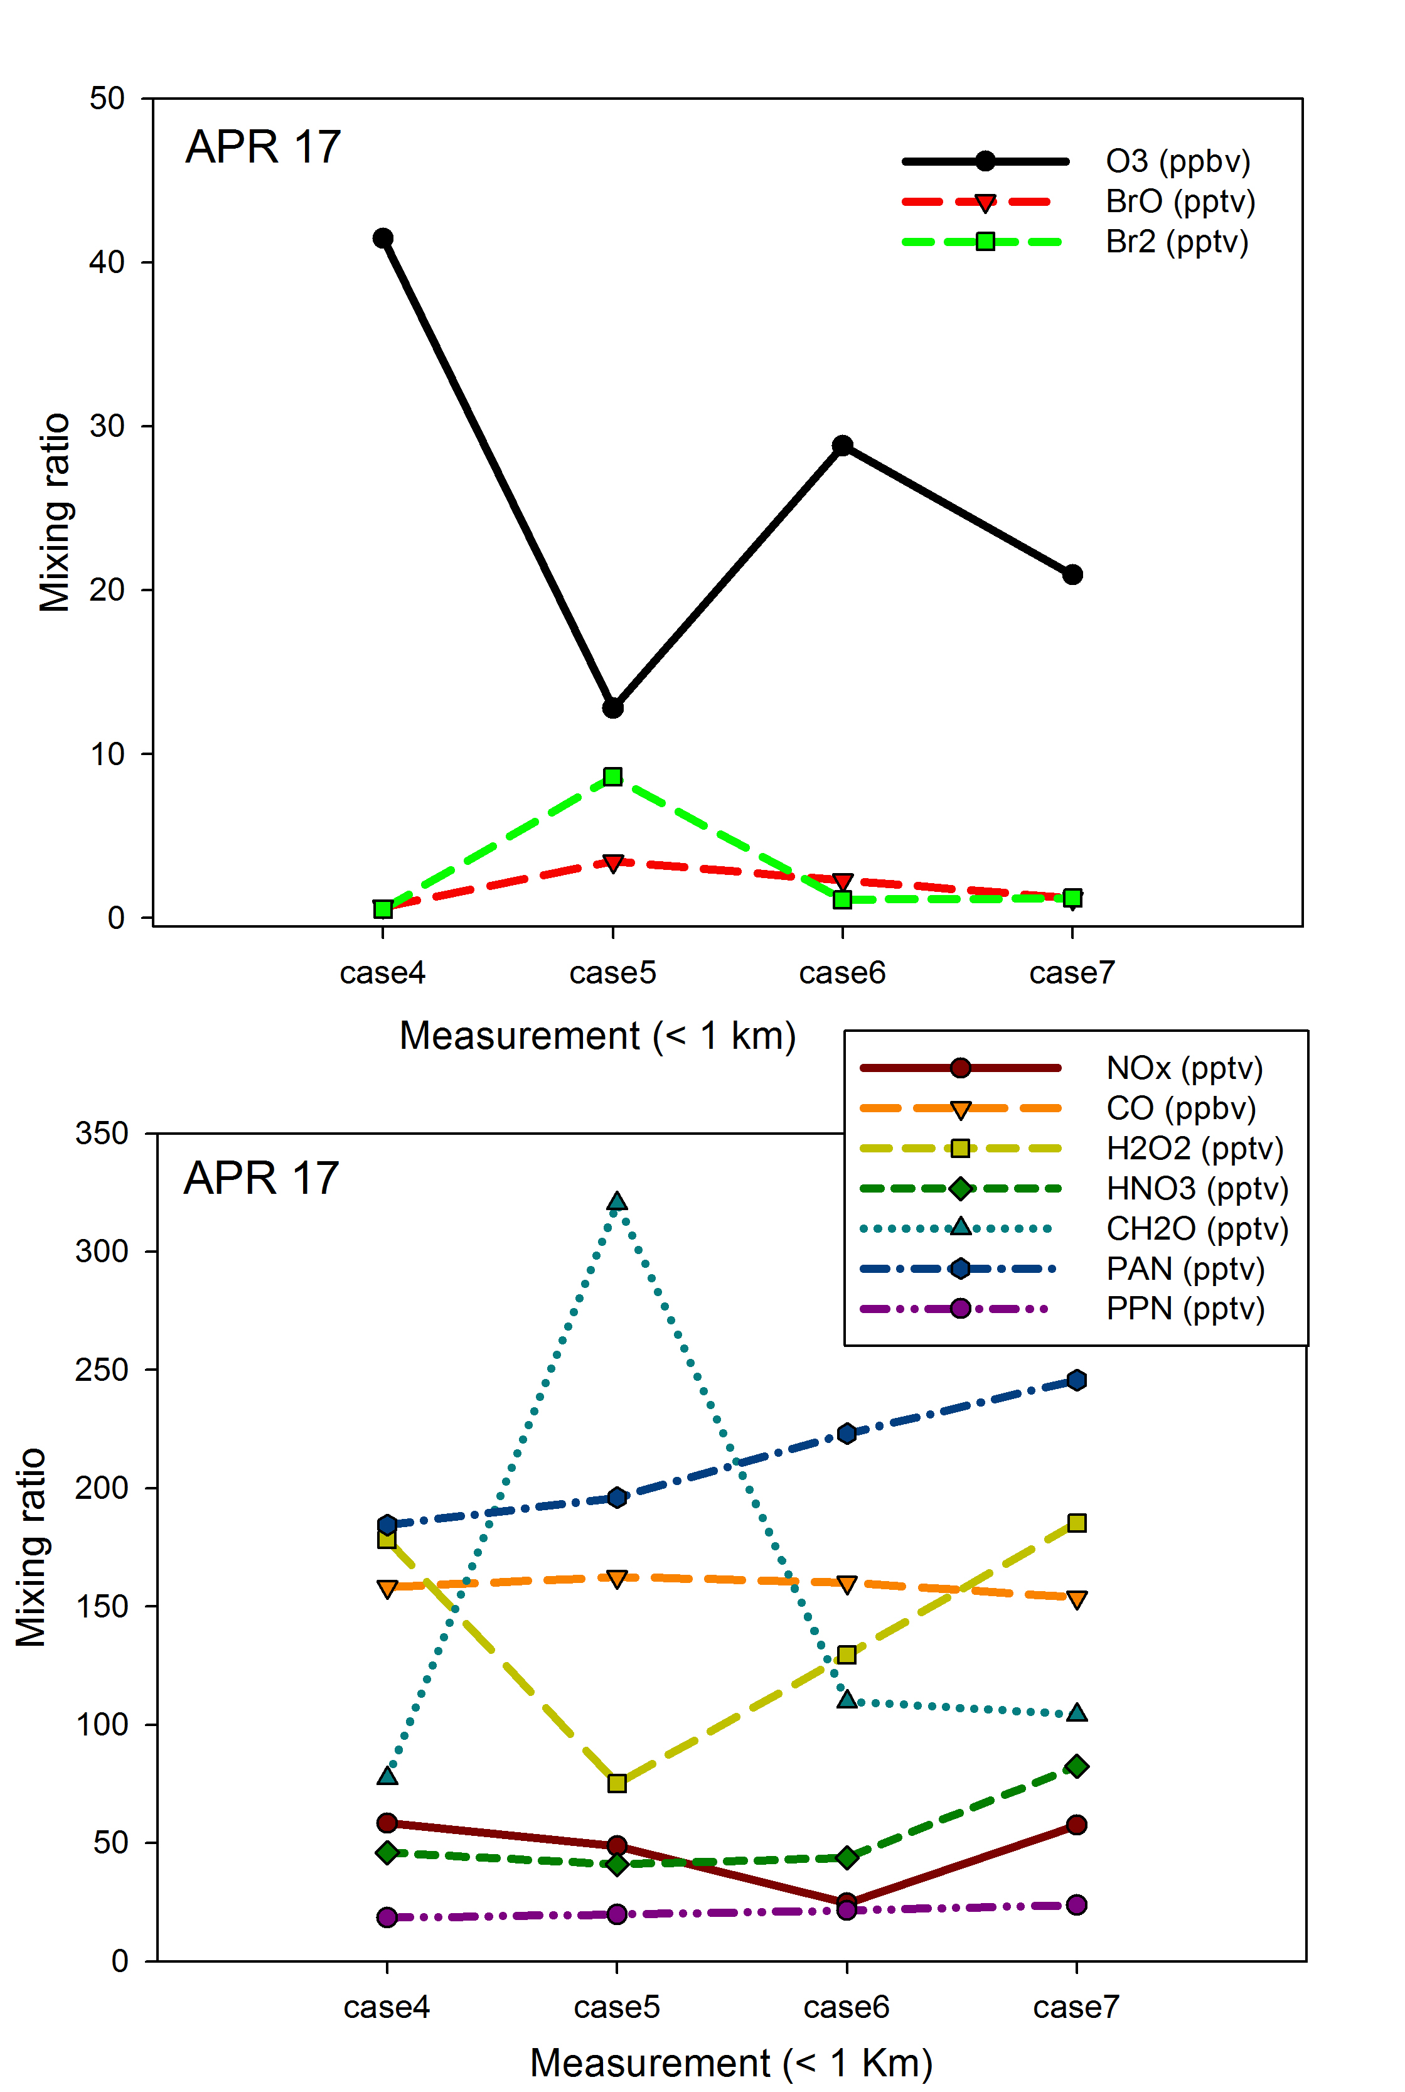

Slide 15
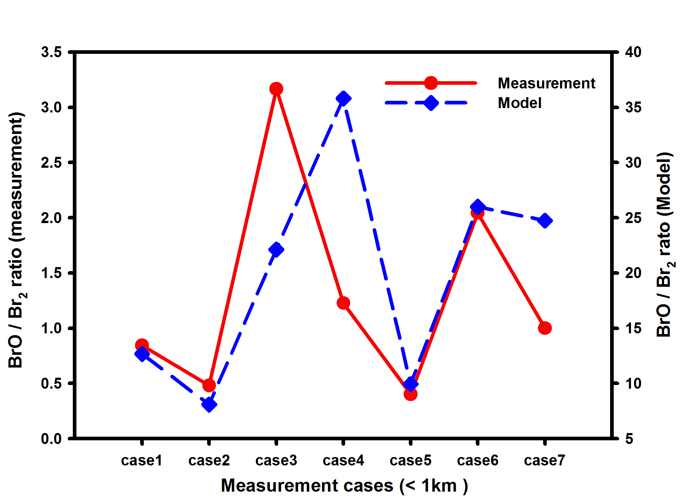
Comparison between measurement and model
Ozone and Br₂ is fixed
BrO/Br2 ratio pattern is similar between measurement and model simulation, but not quantitatively matched.
Heterogeneous reactions will have to be considered
Box model - Simulation for bromine compounds
Based on the chemistry in REAM model, new 41 reactions (33 gas-phase reactions + 8 photolysis reactions) were added related to the halogen (chlorine, bromine) chemistry.
Meteorological field was considered using MM5 simulation.

