Slide 1
Assessment of the Impacts of Global Change on Regional U.S. Air Quality: A synthesis of climate change impacts on ground-level ozone
An Interim Report of the U.S. EPA Global Change Research Program
Presented by Yuzhong Zhang, Chao Wu, Ting Fang
2013.4

Slide 2
Overview
Introduction
Multi-model results
Changes in drivers
Meteorological impacts
Climate impacts on emissions
Challenges and limitations
Future directions

Slide 3
Introduction
“Warming of the climate system is unequivocal, as is now evident from observations of increases in global average air and ocean temperatures, widespread melting of snow and ice, and rising global average sea level.” (IPCC, 2007);
Air pollution should be studied in terms of a global change issue;
Potential impact of long-term, global climate change on regional air quality - the first systematic effort.
Notes:
Historically, air pollution has been studied mostly in terms of immediate local and regional concerns, rather than as a global change issue.
The first systematic effort to apply combined global and regional climate and air quality models to investigations of potential climate change impacts on future U.S. regional air quality.

Slide 4
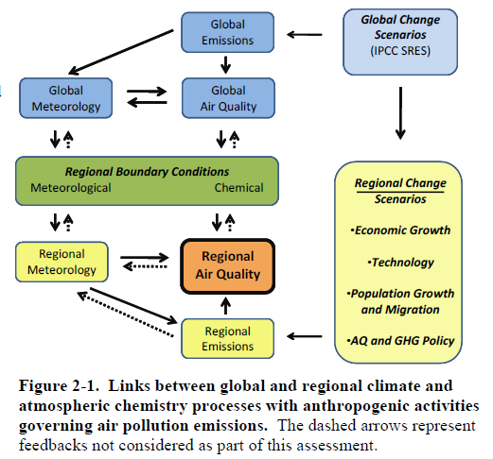
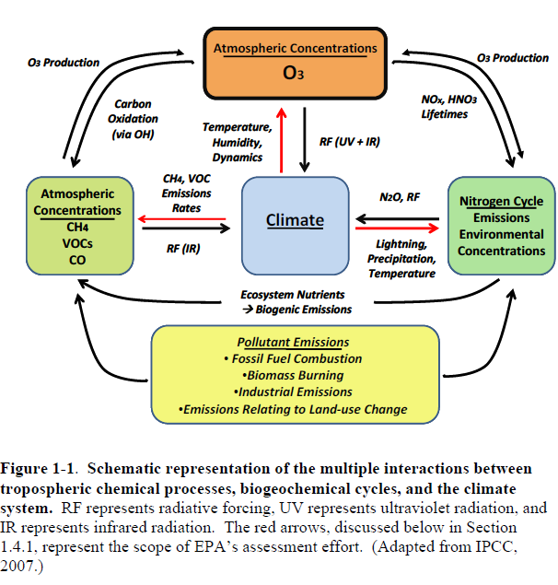
Overall Goal – a phased approach
“Enhance the ability of air quality policy makers and managers to consider global climate change in their decisions through this increased understanding.”
Phase I –meteorological effects on air quality;
Phase II –combined impact of changing climate and changing air pollutant emissions on air quality (O₃).
Notes:
A phased approach has been used to systematically achieve progress toward this overall goal.
Phase I of the effort focuses on augmenting, linking, and applying existing climate and atmospheric chemistry models to investigate the range of current and potential future meteorological effects on air quality. (climate-only studies)
Phase II of the assessment focuses on the combined impact of changing climate and changing air pollutant emissions on air quality. It builds on the findings from the first phase by extending the linked modeling systems developed therein, and also by exploring the scientific uncertainties more comprehensively.
The processes linking global to regional scales
the use of linked systems of global and regional climate and air quality models to investigate potential future changes in O3 that may occur due to climate change.

Slide 5
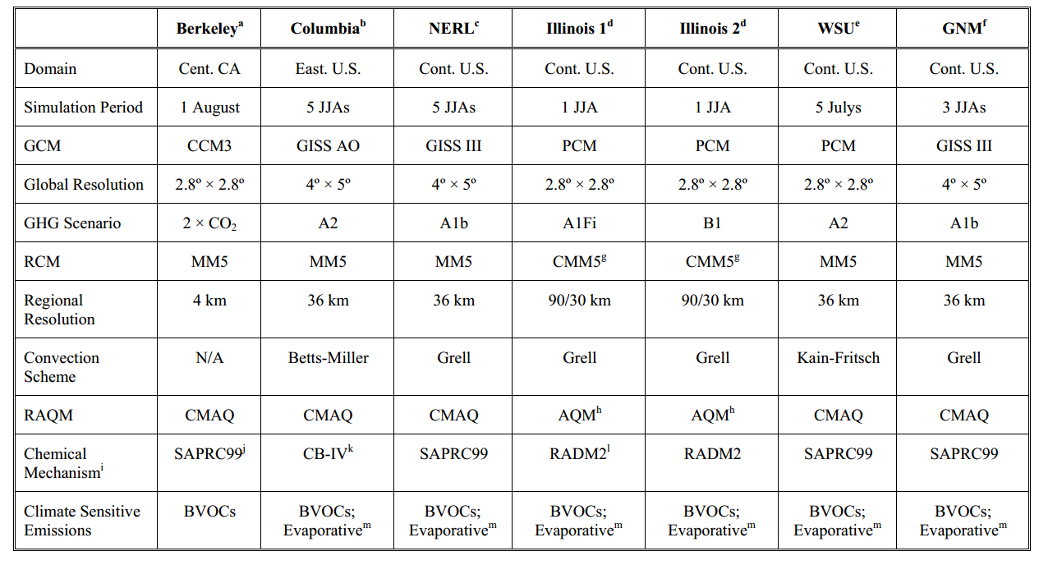
Model assessment approach
downscaling
GCM: Global climate model
RCM: Regional climate model
RAQM: regional air quality model
Anthropogenic emission held constant

Slide 6
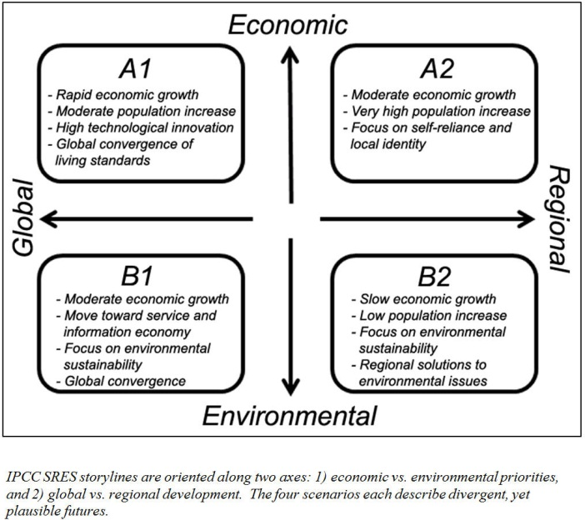
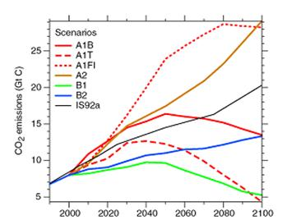
Model assessment approach
downscaling
GCM: Global climate model
RCM: Regional climate model
RAQM: regional air quality model
Anthropogenic emission held constant

Slide 7
Model assessment approach
downscaling
GCM: Global climate model
RCM: Regional climate model
RAQM: regional air quality model
Anthropogenic emission held constant

Slide 8
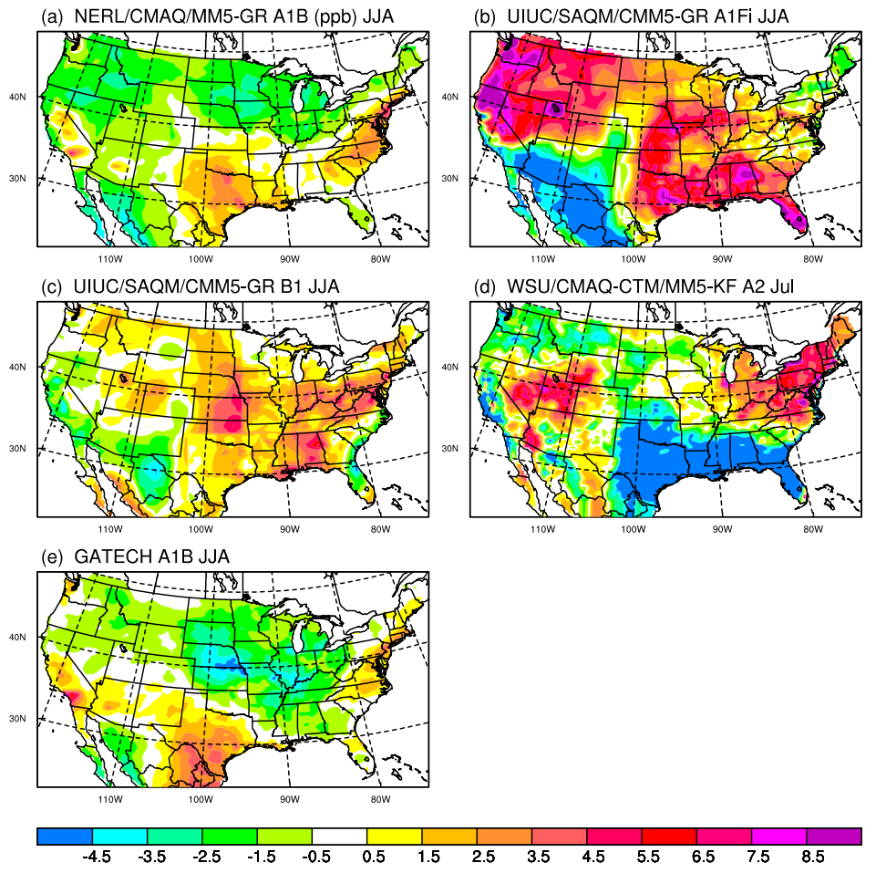
Results: ozone change
Model results 2050 minus 2000
Anthropogenic emission constant
Consistency
Increase in substantial regions
Decrease less pronounced
Discrepancy
“Hot” region
Magnitude
Drivers
ppbv

Slide 9
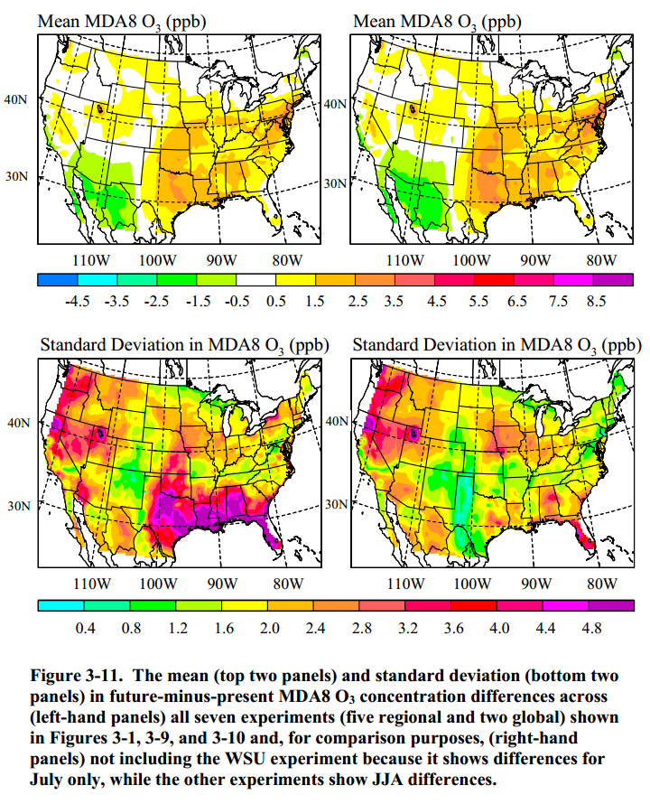
Results: ozone change

Slide 10
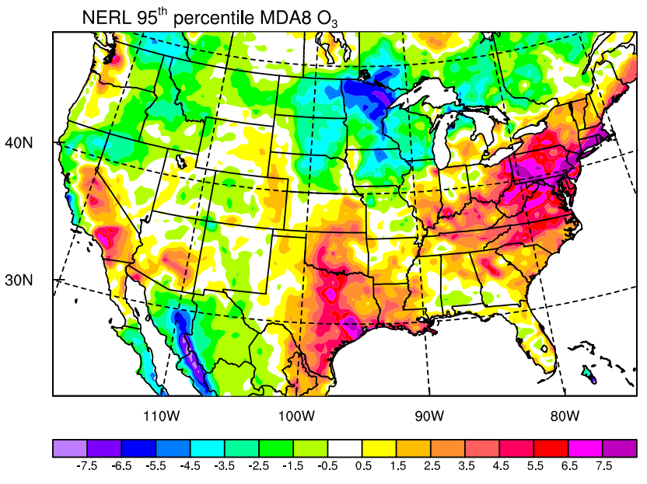
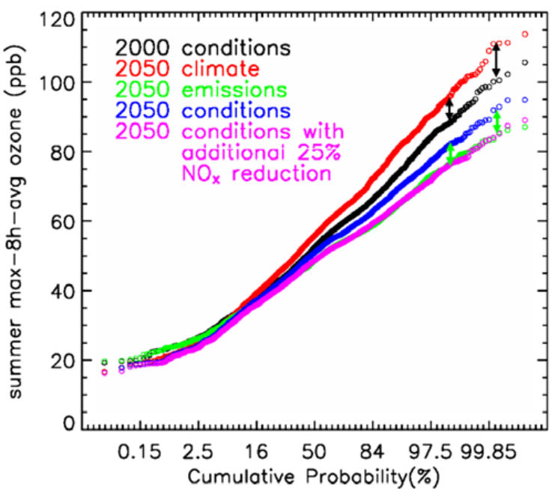
Results: high percentile
Higher peak concentration
Longer episode duration
Relevant to air quality management and health endpoint
ppbv

Slide 11
Results: longer ozone season
EPA, Nolte et al., 2008
June, August
September, October

Slide 12
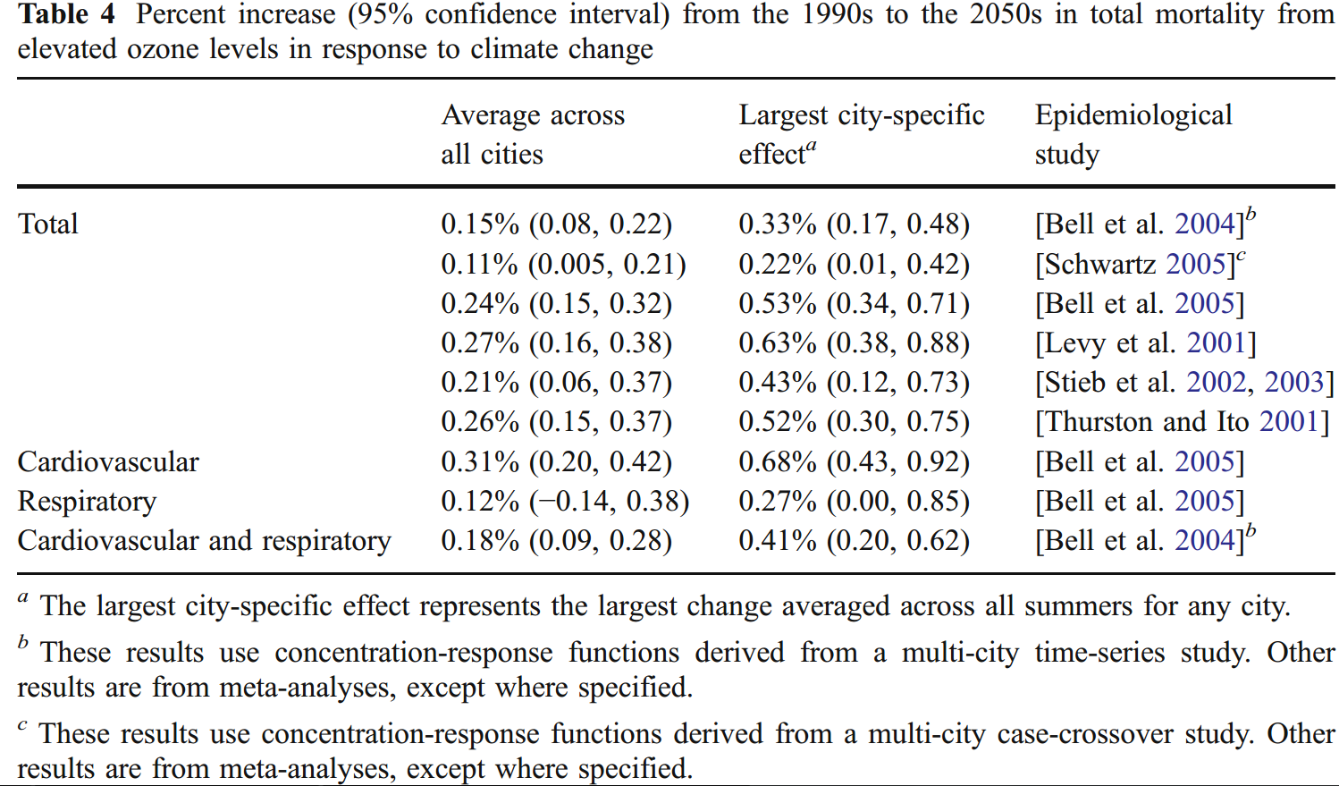
Results: health endpoints
Bell, et al., 2007

Slide 13
Effects of Meteorological Variables
Meteorological conditions play an important role in photochemical processes;
Climate change may alter weather patterns
Notes:
Show the relation between the change of meteorological conditions and change of ozone. Warmer T can increase the reaction rates. Also if the weather is good, sky is clear, a good sunlight also contributes to a strong photochemical process.
In this report, about impacts of climate on ozone. Climate change may alter weather patterns…so climate change affect the Meto Var, Met Var affect photochem, so O2 could be affect
meteorological conditions most favor strong net photochemical production—persistent high pressure, stagnant air, lack of convection, clear skies, and warm temperatures—and vice versa
To the extent that climate change may alter weather patterns, and, hence, the frequency, duration, and intensity of these episodes, for example, O3 concentrations could be significantly affected.

Slide 14
E.g. Potentially important meteorological variables
Near-surface temperature
Near-surface humidity
Precipitation
Cloud cover
…….
Notes:
Here are some eg of meteorological variables.. T affects the reaction rate. Humidity affects the condensation and aerosols, which can change the reaction surface area and water-soluble reactions. Cloud cover, precipation, humidity also affects the radiation…Planetary Boundary Layer (PBL) height Near-surface wind speed and direction
Ventilation and mixing due to convective events
Ventilation and mixing due to synoptic-scale cyclones
Ventilation and mixing due to coastal onshore flow
..transport of pollutant

Slide 15
However
It’s not straightforward
(a) long-term global climate change,
(b) changes in the aspects of (often) short-term meteorological variability
(c) O₃ changes
Changes in the O₃ distribution of a given region reflect a balance among competing changes in multiple factors.
Notes:
the causal chain linking
(a) long-term global climate change,
(b) changes in the aspects of (often) short-term meteorological variability that most directly drive near-surface O3 concentration changes of concern to air quality managers,
(c) any O3 changes that ultimately result from the interaction of these meteorological changes with the pollutants present in the environment (which may themselves be sensitive to meteorology and climate)
may not be straightforward.
Changes in the O3 distribution of a given region due to climate change will reflect a balance among competing changes in multiple factors.

Slide 16
Not independent
together or separately in different combinations
at different locations
over different timescales
Notes:
These variables are not, in general, independent of each other. Instead, they vary, together or separately in different combinations, at different locations over different timescales, in ways that may favor either increases or decreases in O3.

Slide 17
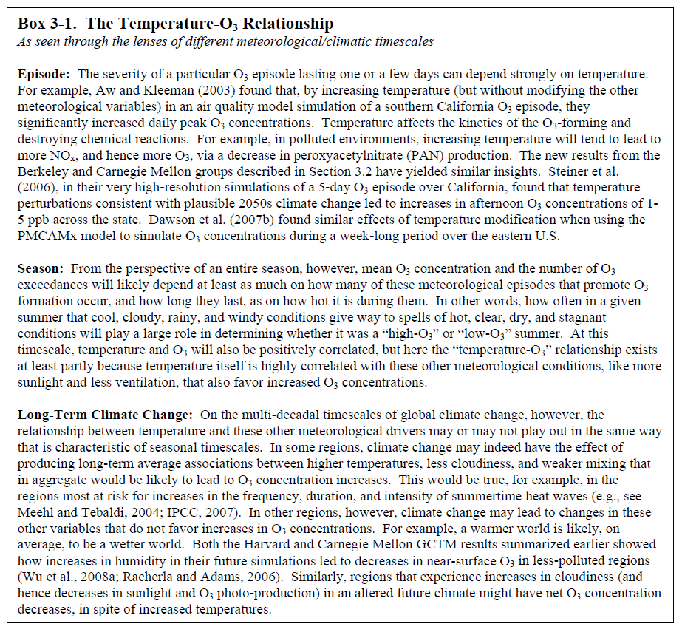
E.g. Temperature in different timescales
Episode
Season
Long-Term
Climate Change
Notes:
For the Episode timescale, that means one or a few days. Many group found that increasing T cause a increasing Ozone. Because T affects the chemical reaction rates, eg, inreasing T tend to lead to more Nox, and hence more O3.
For Season,the relation is not that simple, eg, in summer, we need to consider how often in a given summer that the day is cool, cloudy, rainy and windy. So, at season timescale, the T and O3 will also be positively correlated, but this relationship is partly because T itself is highly correlated with other factors like sunlight, precipitation and ventilation. And these factors affect ozone strongly.
For large time scale, like long term climate change. The relationship may play out in a differernt way. Eg. Climate change cause the average T increase in some regions. These regions suffer a increases in the duration, intensity of summertime, like heat wave, Ozone also increase. However, climate change may lead to changes in humidity. A warmer world is likely wetter, and has more clouds and precipitation. These will decrease the O3

Slide 18
Two most critical meteorological drivers of ground-level O₃
Regional Modeling Results
near-surface air temperature
surface incoming solar radiation
Other variables do not seem to add a great deal to the explanatory power of temperature and surface insolation
Notes:
surface incoming solar radiation (insolation, largely reflect changes in cloud cover)
average daily maximum temperature, precipitation, number of rainy days, and PBL height. At least at this level of analysis, they do not seem to add a great deal to the explanatory power of temperature and surface insolation

Slide 19
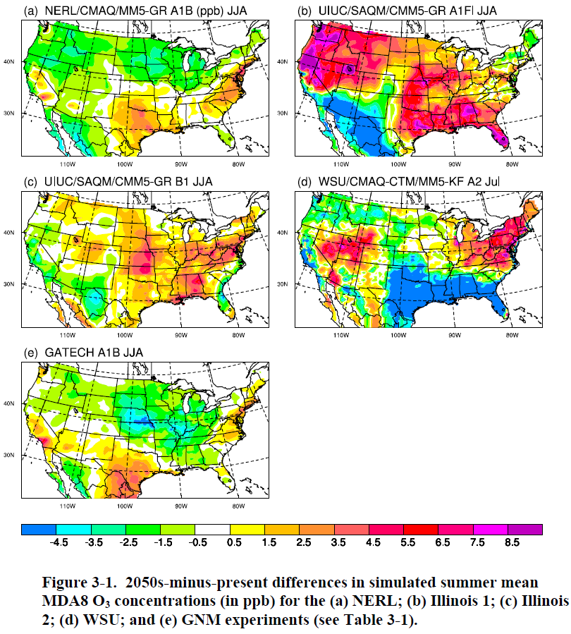
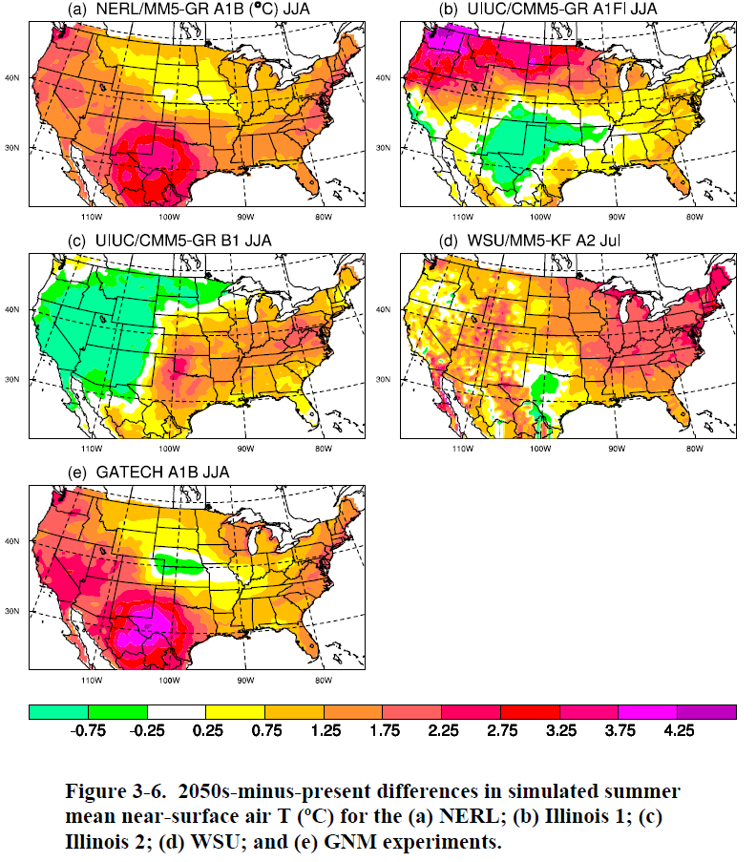
near-surface air temperature
Notes:
First, in many regions the O3 concentration changes (Figure 3-1) seem to correspond relatively well with combined changes in mean temperature (Figure 3-6) and mean surface insolation (Figure 3-7). For example, the NERL results show the O3 increases corresponding with temperature and insolation increases in the Mid-Atlantic and Gulf Coast and O3 decreases associated with the insolation decreases and the local minimum in temperature increases in the upper Midwest and the northern Plains.
In other regions, temperature and insolation vary in opposite directions, with mixed impacts on O3 concentrations. For example, in the Illinois 1 simulations, in spite of insolation decreases over much of the Northwest, the large increase in temperature there seems to drive O3 increases.

Slide 20
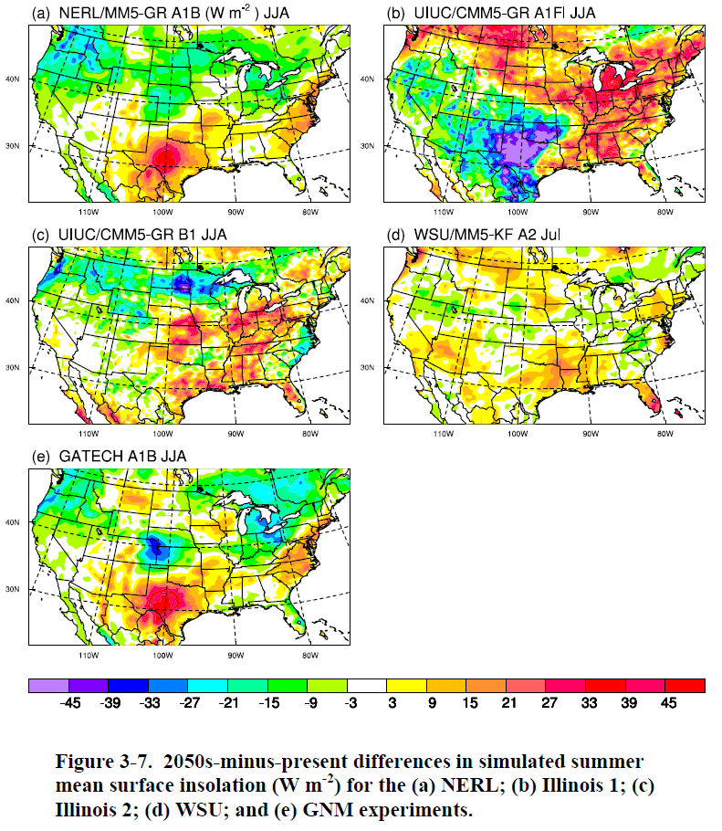
surface incoming solar radiation
Notes:
In a small number of regions across the simulations, there is no strong correspondence between O3 concentrations and either insolation or temperature (e.g., the areas around Oklahoma 3-28 in the Illinois 1 experiment and Nevada/Utah/Idaho in the Illinois 2 experiment), suggesting that other forcing factors may be important, and/or that a correspondence might exist, but only for different averaging periods and statistics of these variables.

Slide 21
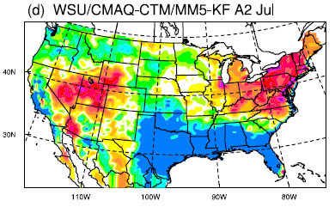
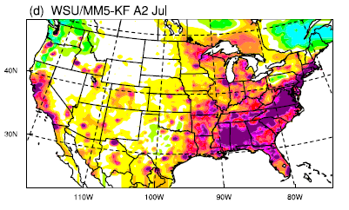
Note: Emission also affect meteorology
VOCs→ Cloud/precipitation → less photoproduction → less O₃
Notes:
Notably, the WSU simulation shows large decreases in O3 in some of the parts of
the Southeast and Gulf Coast where increases in VOC emissions are the strongest, a result that is
partially attributed to increases in precipitation, and hence reduced photo-production.

Slide 22
O₃ responds to the meteorological/emissions drivers in a qualitatively consistent manner across the simulations;
But the regional patterns of relative changes in these drivers are highly variable across these same simulations.
Notes:
One way to summarize the aggregate results presented in Figures 3-1 and 3-6 to 3-8 is to say that O3 responds to the meteorological/emissions drivers in a qualitatively consistent manner across the simulations, but the regional patterns of relative changes in these drivers is highly variable across these same simulations.

Slide 23
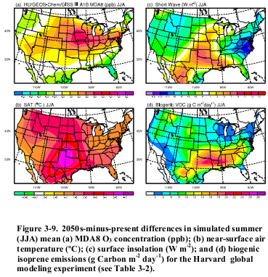
Global Modeling Results
Notes:
The differences between these two sets of re sults can seemingly mostly be explained by two factors: (1) differences in the future simulation of the summertime storm track across the
northern part of the country and (2) differences in the response of O3 to changes in biogenic
VOC emissions in the southeastern United States.

Slide 24
Climate impact on emissions
Isoprene
NOx
Lightning
Soil
Fire
Fuel evaporation
…
Regional importance
Chemical nonlinearity
Great uncertainty

Slide 25
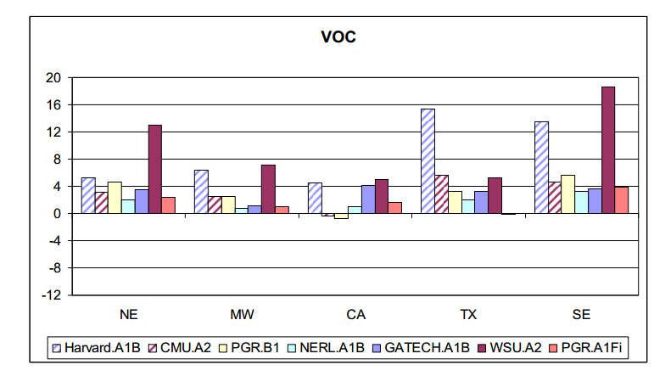
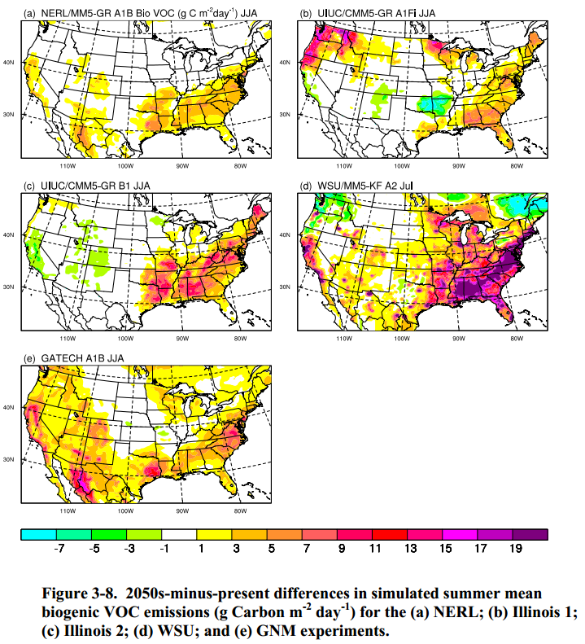
Biogenic VOCs: isoprene
Predict biogenic emission
Emission=f(radiation, temperature,
soil moisture, vegetation type, vegetation growth)
Uncertainty pertaining to land use shift
Calculate impact
Uncertainty of chemical mechanisms
Uncertainty of VOC-aerosol-cloud feedbacks

Slide 26
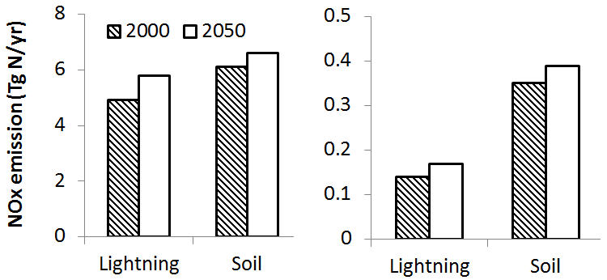
Lightning and soil NOx
11%
21%
Wu et al, 2008
Uncertainty pertaining to lightning parameterization

Slide 27
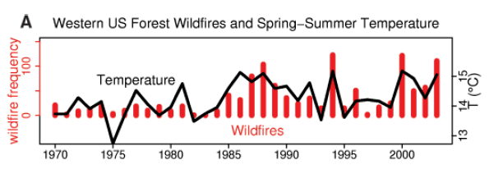
Wildfire
Emission=f(humidity, cumulative precipitation, fuel loading)
Westerling et al., 2006

Slide 28
Challenges and Limitations
Incomplete representation due to technical challenges
e.g. computing power, lack of fundamental understanding, etc.
Inter-model variability and model evaluation
Error sources: 1) the bias in the present-day simulation, 2)and some (hypothetical) bias in simulating the future conditions.
Uncertainties in chemical mechanisms
Notes:
All of the results shown in this section are model-based.
This results from technical challenges, such as limitations on computing power, as well as from a fundamental lack of understanding of certain processes.
Differences
in simulated O3 concentrations among modeling studies may be attributed, in part, to differences in the choice of photochemical mechanism. Each mechanism, in turn, will have characteristic uncertainties as well as biases in simulated O3 concentrations,

Slide 29
Future Directions
Integrated effects of climate changes and changes in anthropogenic emissions
EPA has initiated several projects that are developing new methods and modeling tools for creating regional-scale emissions projections for the United States.
Modeling systems extension
Exploring modeling uncertainties
Additional model development (biogenic emissions representation)
Additional pollutants – PM, Hg
PM – precipitation, model aerosol chemistry, aerosol-cloud interactions, semi-volatile species
Hg – heterogeneous oxidation, dry deposition, Hg chemistry in fog, clouds, photochemical smog.
Notes:
Phase II of the assessment program requires a transition from climate-only studies to an evaluation of the integrated effects of changes in climate and changes in anthropogenic air pollutant emissions.
Uncertainty- Substantial uncertainty remains in the modeling of current biogenic VOC emissions.
Because of the additional complexities and uncertainties associated with PM and its response to climate change, these results were not incorporated into the synthesis, while simulated PM is sensitive to precipitation, model
aerosol chemistry, aerosol-cloud interactions, volatilization of semi-volatile PM species, such as nitrate and secondary organic aerosol (SOA),
Climate change can potentially impact a number of atmospheric processes that help determine the fate of Hg, including heterogeneous oxidation of gas-phase Hg, dry deposition of elemental, reactive gas-phase and particulate Hg, and Hg chemistry in the presence of fog, clouds, and photochemical smog.

Slide 30
Future Directions
Combine impacts of climate and emissions
Detailed scenarios of U.S. anthropogenic precursor pollutants
Modeling the drivers of air pollutant emissions
Economic growth and technology choices;
Land use and transportation
Biogenic VOCs
Wildfires (wildfire-generated O₃ and PM precursor emissions)
Notes:
combined effects of climate and anthropogenic precursor emissions changes are much more sensitive to the assumptions about future emissions trajectories
Human activities, such as population growth and migration, economic growth, land use, and technology change are key drivers affecting emissions. There is a gap in our understanding of how these factors will interact to influence air quality at urban and regional scales in the United States.

Slide 31
THANK YOU!

Slide 32
Brainstorm – What affects future O₃ concentration?
Transport
Chemical Losses
Dry Deposition
Losses
O₃
Meteorology
Others ??
Emissions
VOCs
NOx

Slide 33
Most important factors affecting ozone in 30 years
Temperature (up, O3 up) ?
Cloud cover (up, O3 down)
Humidity (up, ) precip up, ozone down
Humidity up, OH up, O1d+H2O up, complicated
Transportation emission up, o3 up
Transportation emssion down, o3 down
Emission control, power plants, o3 down
Urban sprawling ,voc down, o3 down
Drought dust up, voc down, cloud down, stability up, o3 up
Less summer cyclones, o3 up

