Slide 1
The Impact of Megacities on Air Pollution and Climate
Presented by:
Rawan El-Afifi
Chris Forehand
Lucas Henneman

Slide 2
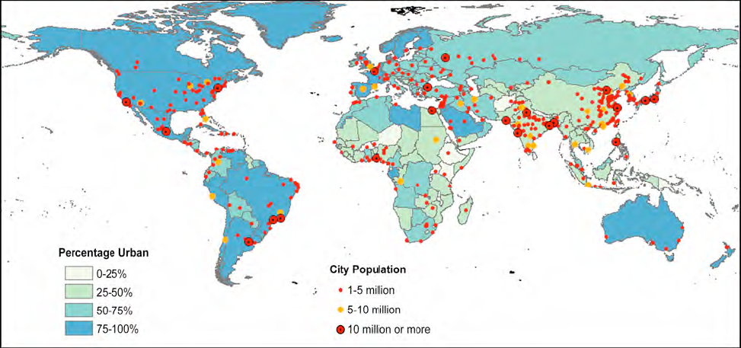
Introduction
What is a megacity, and why are they important in air pollution?
Notes:
As of 2008, for the first time more than half of the world’s population (50.1%) lives in urban areas
Megacities are loosely defined as cities with over 10 million people, and typically have the most intensive human activities that lead to tremendous energy consumption.
Kind of an imperfect definition because it doesn’t account for population density and doesn’t have any criteria for defining boundaries
Most of the world’s megacities are located on the coastal areas – urban and marine air masses tend to clash creating a unique set of chemistry that can cause transport of S and N back to cities and produce ozone

Slide 3
A brief introduction to pollutants
NO_{x}
VOCs
Tropospheric ozone
SO_{x}
Particulate Matter / Aerosols
Lead
CO
Notes:
*NOX -> Sources primarily from fossil fuel combustion via transportation, industrial, and power plants. Lead to ozone formation when combined with VOCs
*VOC -> Anthro sources via combustion, fuel evaporation, solvents, and industrial processes, although they’re also natural
*Tropospheric Ozone -> Formed in a catalytic reaction between VOCs and NOx (also Ch4/CO)
*SO2 -> Typically comes from coal emissions, especially with high sulfer contents. Leads to the formation of acid rain due to high concentrations found in the atmosphere and sulfur compounds tendency to stick to water
*PM/Aerosols -> Originate from all sorts of sources be it natural like dust and sand or from biomass burning
*Lead -> Primary source is in fuels that still include lead, also found in paint and things of that nature
*CO -> Comes from incomplete combustion

Slide 4
Health Impacts
Cardiovascular disease
Respiratory disease
Cancer
Developmental problems
Vector-borne diseases
Notes:
*Cardiovascular Disease -> Particularly affected by particulate matters and ozone. High concentrations of either leads to cardiovascular injury due to changes in heart rate, heart rate variability, blood pressure, vascular tone, blood coagulability, and acceleration of atherosclerosis
*Respiratory disease -> things such as pneumonia, bronchitis, and asthma. 42% of all respiratory diseases are attributable to air pollution, mainly particulate matter and ozone. Ozone oxidizes on the lungs and damages them, and particulate matter of a small enough size is able to penetrate into the alveolar region of the lungs and get into the blood stream
*Cancer -> Potential linking between air pollution and cancer, some 80ish aerosols that were emitted from various sources in a recent EPA study were considered potential carcinogens
*Developmental problems -> Relates to the respiratory diseases like asthma brought on by pollution, but also includes mental deficiency by exposure to lead
*Vector borne diseases -> Not directly relatable to air pollution, but estimated to increase with a changing warmer climate

Slide 5
Regulation
Notes:
*WHO guidelines are some of the most stringent and provide a basis for protecting the public health.
*US NAAQs brought about after the clean air act and then modified later on with amendments
*Each country’s national air quality standards vary according to how they weight health risks, technological feasibility, economic considerations, etc

Slide 6
Monitoring / Studying Methods
Ground, ship, and aircraft observations
Satellites
Emission Inventories
Modeling
Notes:
*First measurements are important because they allow us to detect exceedences in standards, quantify emission sources, and allow us to verify whether or not models are correct. Often have very detailed local and regional views of air pollution
*Sattelite observations -> Great for providing a complementary global and continuous perspective and overcome some of the limitations of local measurements. Able to track through backscattering
*Emission inventories -> Great if well detailed since they provide a great estimation on air pollution emissions and their sources, help to understand atmospheric chemistry. An integrated emissions inventories across borders would provide consistent local, regional, and global inventories
*Modeling -> Excellent for testing different scenarios and determining the importance of particular variables on an output. Can serve to answer questions of why things are the way they are, and to predict things. Should be noted that there is no such thing as a perfect model, but the results can be compared with historical data to determine effectiveness

Slide 7
Introduction to African Air Pollution
Diverse nature of problems
Impact of development
Balance of resources
Lack of available data
Notes:
*Due to the geography of Africa, different climates, and wide variety of development levels, there is no one ‘problem’ facing Africa as far as air pollution is concerned – nor is there one solution
*The population of Africa is expected to grow explosively based on trends that have already been noticed. This will lead to a great increase in air pollution levels from traffic, burning of household wastes, and charcoal / wood as domestic heating. Since it’s a largely developing country, most of the energy is not expected to come from very clean sources
*Again because of it’s developing nature, addressing air pollution must be balanced with other problems – food and energy development, political instability, etc. It should be noted that air pollution and health problems have a significant cost on national economics linked to hospital costs and absenteeism/job losses/ and death
*Air pollution around africa is far from complete, need better emission inventories for example

Slide 8
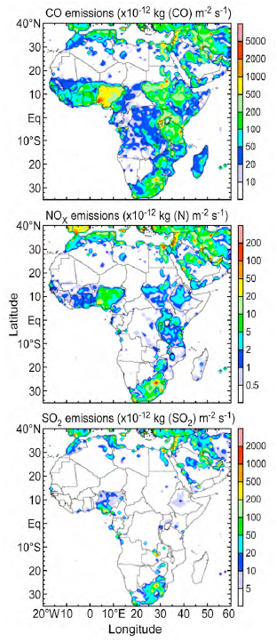
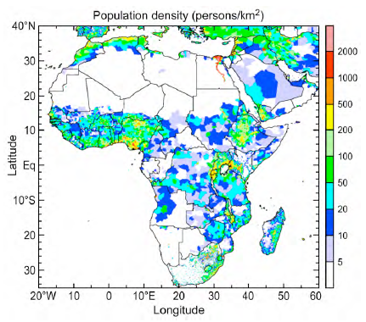

Slide 9
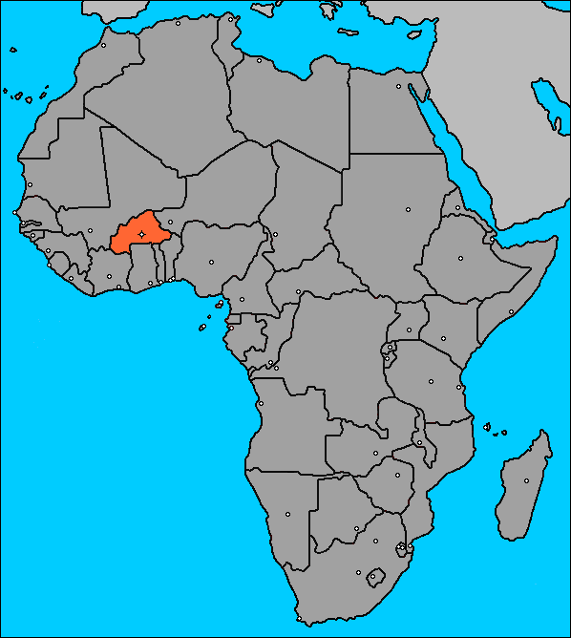
West Africa - Ouagadougou
Country’s largest city (>1.5 million people)
Poor surrounding geography
Temporal variability -> NO2 and PM2.5
Vehicles on the rise
Unfinished emissions inventories
Notes:
*Has a flat topography with a very poor peripheral environment that is swept by Harmattan winds (very dusty). Has a tropical-savanna climate.
*Pollutants tend to fluctuate wildly depending on the season – typically larger amounts of pollutants that exceed WHO norms in the winter (november – may) while acceptable values elsewhere. Should note that it doesn’t exceed it by very much, though, and generally falls within US standards
*With the increase in vehicles pollutants are expecting to rise, as there’s an exponential observation in vehicles on the road
*Emission inventories are largely incomplete and clash with surrounding cities

Slide 10
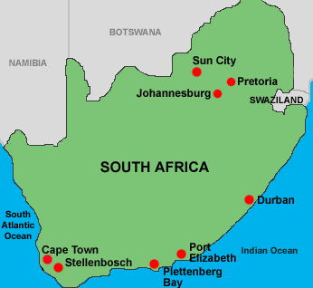
South Africa - Johannesburg
Population of 13 million people
Unstable
Very close proximity to the Vaal triangle
Heavy coal and biomass burning dependence
HI > 34 in the winter, >14 in the summer
Lots of work done on emission inventory
Notes:
*Largest city in south africa, and amongst the 50 largest metropolitan areas in the world
*South Africa is undergoing a lot of social and economic problems which carries on to air pollution problems as funding must be diverted elsewhere. In addition to those, there’s changes in population growth, migration, industrial development, and water shortages that affect the agriculture practices. Increase in traffic as well.
*The Vaal triangle is nicknamed the ‘dirty’ triangle as it’s got notoriously bad air quality from industrial and mining emissions as well as coal burning.
*Power generation is heavily dependant on coal (over 90%) – has relatively low sulphur content but very high in ash content so lots of particulates. 57~75% of PM2.5 concentration due to coal burning
*Coal, biomass burning, etc are also used in the winter as home heating -> very high exposures to people who sit around the hearth, especially women and children.
*HI of 34 is absolutely awful – comes from PM2.5 being so high in specific. Mortality rate due to acute respiratory infections in south africa is 270 times greater than western europe.
*One good thing that they’ve done is that they’ve made great efforts on creating a complete emission inventory

Slide 11
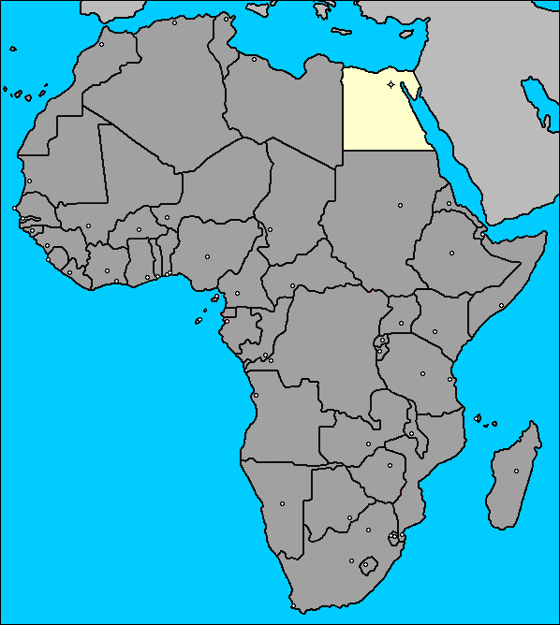
North Africa - Cairo
Population of 15.2 million
Unstable
Dust and sandstorms, unfavorable weather
Very limited pollutant data
Unregulated vehicles and industry
Extremely high PM_{2.5}, NO_{x}, O3, lead
Mortality rate estimated >20k/year
Notes:
*Air pollution and health problems are causing massive loses in national economics due to absenteeism, job losses, and death. Difficult to address air pollution problems with government instability and trying to balance them among other government issues, however.
*The geography of Cairo is such that they are frequently hit by cyclones carrying dust and sand which leads to higher PM2.5 emissions. Very poor dispersion factor due to the lack of rain and the layout of tall buildings with narrow streets. Leads to a haze.
*Very little monitoring and emission data exists for Cairo, difficult to do much on that
*Though they started to make a change in 1995, there’s not much regulation going on for air pollution in Cairo. Cars aren’t required to have catalytic convertors and lead laced fuel is frequently used. In addition, air pollution from industry is high as electronic smelters and other industry emit constantly.
*The levels for all of the above are well in exceedance of WHO standards, with PM reaching over 3 times their levels. Open fire burnings also contribute to the PM2.5, NOX is emitted from cars, ozone comes from the Nox, and lead is high due to the leaded gasoline and factory emissions. Also lots of source metals
*An estimated 20,000 people die every year due to air pollution based mortality, typically caused by respiratory illness like asthma and bronchitis. Also ~28 million restricted activity days, etc.

Slide 12
Introduction to South American Air Pollution
Heterogeneous problems
Lack of coordination
Severe inequity
Unique geography
Population growth and urbanization
Nonurban air pollution sources
Notes:
*No city is really exactly similar to others due to a combination of factors – climate, geography, location to the sea, etc
*There’s very little coordination done between cities in South America – each megacity tends to be looked at independantly. Additionally there’s disperity between emissions inventories and things like that
*Income distribution is very across the board and acts as amplifiers of environmental problems and tends to correlate with increased overall air pollution and domestic air pollution issues
*Most of cities are by the coast so you can get polluted air blowing back into the city. Also rainforests and things like that which play their own role on air pollution
*Cities are growing fast, although the rate of the megacity growth has typically declined across the board. Still lots of room for growth, however
*Non urban air pollution sources come from volcanic eruptions and large scale biomass burning which affects the entire area – generally due to deforestation in the Amazon

Slide 13
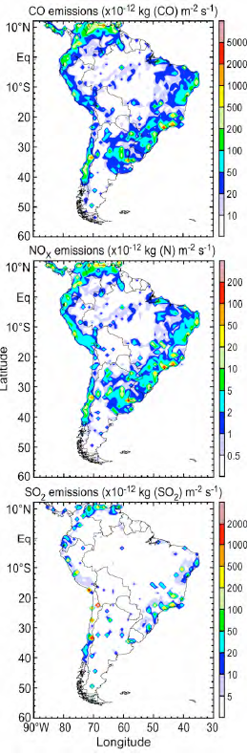
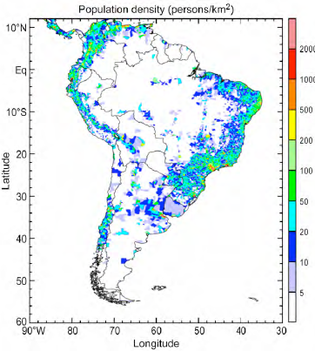

Slide 14
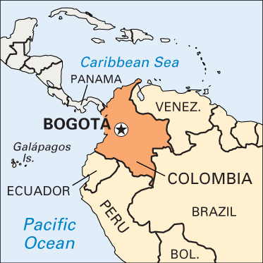
Bogatá, Colombia
Population of 8.5 million, very high population density
Dry and rainy seasons
Initiatives to improve air quality
Increased emissions
Notes:
*Population isn’t super large, but it has extremely high population density. Leads to problems with high density like traffic jams and subsequent emission pooling
*Dry and rainy seasons, when it’s rainy the pollutants tend to be knocked out of the air and the quality is overall cleaner, but of course dry air tends to lead to accumulation of pollutants
*They’ve done a really good job of compiling a comprehensive emissions inventory and taking initiatives to decrease air quality like through implementing a bus service. Coal is being phased to natural gas
*However, even still, emissions have increased around the board and they need to figure out how to deal with it. It’s primarily the particulate matter 10 concentrations that exceed, going above 60 ug/m^3 and ozone that goes above 81 ppb for 1 hour averages due to traffic management

Slide 15
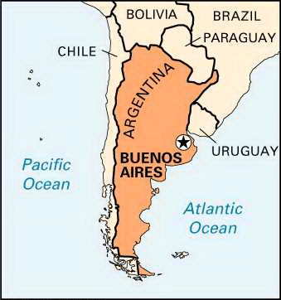
Buenos Aires, Argentina
Population of 13 million
Very limited monitoring, no emission inventory
Little funding available for air pollution control
Unique topography
Overall low pollutant concentrations
Notes:
*Buenos Aires is a very unique city, located in south Argentia. There’s very little monitoring data available for Buenos Aires because they only have one active monitoring site and pretty much no emission inventories available. There’s also little funding that’s available to implement any such controls
*That being said, Buenos Aires is kind of unique because it has atmospheric conditions like air currents coming in from the south and a topography that favors long distance transport. Overall this leads to very little pollution stagnation over Buenos Aires, but this is obviously a problem because it’s transmitting that pollution elsewhere

Slide 16
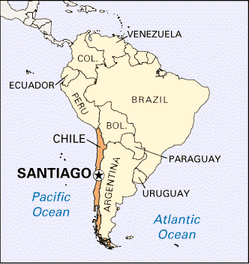
Santiago, Chile
Population of 6 million
City planning issues
Bordered by the Andes mountains
Semi-arid climate
Decent records, though most of it unavailable online
Dirty emitting sources
Pollution relatively stable
Notes:
*Relatively large city, it’s expected to increase.
*Has major traffic and planning issues that lead to gridlock
*Bordered by the Andes mountains which causes a unique effect in air pollution stagnation
*Relatively low amounts of precipitation so pollution has the chance to stagnate
*They’ve done a very good job of keeping up an emissions inventory and have 10 functional monitoring stations set out (used to have 21)
*Somewhat dirty emitting sources between factories and industry and cars without catalytic convertors
*Pollution has remained fairly stable. Ozone and PM10 concentrations are the only things that they have issues with, although their averages remain at levels that are not critical concern (~35 mg/m^3)

Slide 17
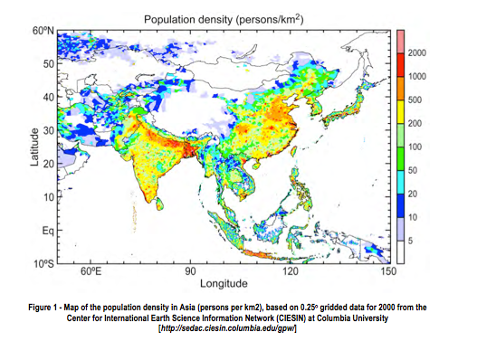
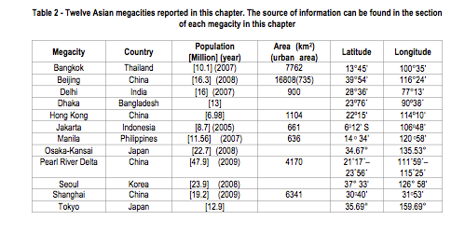
Introduction to Asian Air Pollution
More than 50% of the world population
  10 of 21 world’s megacities
  15 of worlds largest 30 cities
  Fast growth and development
Dust Storms
Notes:
ne of the major reasons for this large difference is that urbanization in Asia is occurring at a fast speed due to the dynamic social and economical development.
he continent of Asia is characterized by high diversity and inhomogeneity in geography, this leads to large spatial variation in the population density in Asia. Figure 1 shows that, besides the hot spots of large cities with high population density, Asia also has large regions with high population density, such as Bangladesh, Indo-Gange plain, and North China plain. Bangladesh is one of the most densely populated regions in the world.
In the well-developed megacities, such as Tokyo, the sources of air pollutants and greenhouse gases (GHGs) are dominated by the vehicle emissions, whereas in the developing megacities, biomasses burning from agriculture waste and forest fires are also important sources to local air pollution.
One unique source of air pollution to the East Asian megacities is dust and sand storm (DSS) that originate in the Mongolia desert and Gobi area every spring. The air quality in megacities like Beijing, Seoul, and Tokyo is frequently deteriorated due to DSS.

Slide 18
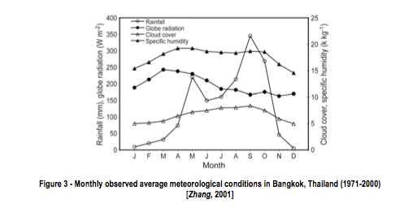
Bangkok, Thailand
Average growth rate of 7% per year
  Lots of vehicles
Monsoon climate – 2 seasons
  Wet season (mid-May – mid-October)
    Southwest monsoon dominates
  Dry Season
    Local Winter (mid-October – mid-February)
    Local summer (mid-February – mid-May)
Sea land breeze
Emission sources:
  Traffic, power plants, industries, incinerators
Air pollutants in exceedance:
  TSP (PM₁₀)
  Ozone
  High PM_{2.5} in dry season
  Globally 25th highest contributions of CO₂/year (from energy uses)
Notes:
TSP (PM10) (annual avg standard: 50 microg/m^3)
Ozone (one hour max: 100 ppb)
High PM2.5 in dry season (50 microg/m^3)
MR experiences the tropical monsoon climate with two distinct seasons. The wet season extends from mid-May to mid-October, when the southwest monsoon dominates and brings in warm, moist air from the Gulf of Thailand and the Andaman Sea. The southwest monsoon and the Inter Tropical Convergence Zone (ITCZ) cause heavy rainfall during the wet season. The dry season can be further classified into two periods. The first period (mid-October to mid-February), known as the local winter, is characterized by mild weather under the influence of the northeast monsoon that brings in cold, dry air associated with a high-pressure ridge extending from the anticyclone in China. The second period of the dry season (mid-February to mid-May) is known as the local summer when weather is the hottest of the year, with the highest temperature occurring in April [TMD, 2009]. Bangkok is also under the influence of a sea land breeze. The southerly sea breeze counteracts the northeasterly monsoon during the winter, which results in low wind conditions over the city. This, in turn, reduces the mixing and enhances pollution build-up [Zhang and Kim Oanh, 2002]. Meteorological conditions, averaged over 1981-2007 period, show the annual average temperature of Bangkok ranges between 26.7-28.0oC and average annual rainfall between 1,320-1,950 mm. Low wind, average of 1.3 m/s and mostly below 3 m/s, is observed throughout the year [TMD, 2009]. Monthly windroses of a 10-year period, 1991 – 2000, show high percentages of calm conditions, ranging from 30% in March to 61% in October [Zhuang, 2001]. Monthly meteorological variables in Bangkok, averaged for 1971 to 2000, are presented in Figure 3.
n recent years, in order to improve air quality, the European standards have been imposed for new vehicles progressively. Thailand has a policy of encouraging use of compressed natural gas (CNG) and ethanol in transport [ESMAP, 2008]. Nowadays, the CNG use is widely spread, especially in taxis and trucks.
Wet season PM 2.5 is 18 microg per m^3
Relationships of the trends to regulations
The air quality management programme in BMR follows the policy and prospective plan of Thailand. This programme covers enhancement and conservation of natural environmental quality, which is a cross-sectoral operation involving the environment, transport, and urban dimensions. The air quality management policy of Thailand for 1997-2016 focuses on the following key issues: (1) air quality in pollution control zones and urban areas, particularly on dust, (2) other pollutants in ambient air, particularly on carbon monoxide, and (3) air pollutants in industrial zones and general communities, particularly on sulphur dioxide and nitrogen oxides, to be within designated Ambient Air Quality Standards [Supat, 1999].
Successful stories include the phasing out of leaded gasoline, establishment of oxygenated gasoline, reducing sulphur content in diesel, and development of the standard for low-smoke 2T lubricating oil. Phasing out of lead in gasoline, starting in January 1996, has substantially reduced Pb in ambient air (Figure 6). At present, lead concentration in ambient air is much lower than the standard. Recently, due to the concern of toxic effects of volatile organic compounds (VOCs), VOC ambient air quality standards have been established [
The Intergovernmental Panel on Climate Change (IPCC) estimated that, as of 2004, Thailand contributes around 265 million tons of CO2 per year, ranked 25th in the world. The data shows that 56.1% of greenhouse gases (GHG) in Thailand are from energy uses (as of 2003), whereas the remaining GHG emissions are from agriculture (24.1%), wastes (7.8%), land use change (6.65%), and industrial sector (5.4%)
Problems remaining
Presently, high PM10 and ozone remain the most serious air quality issue in Bangkok. Traffic is the major sources of air pollution in the city. Air toxics, in particular the volatile organic compounds (VOCs/HC), are also of concern in BMR and need continuous monitoring and standard enforcement. Open burning of agro-residues contributes significantly to air pollution in BMR and appropriate regulations have to be established and enforced in conjunction with the educative measures.

Slide 19
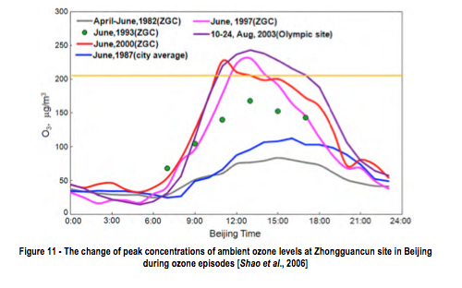
Beijing, China
Fast air quality improvements
Isolated circulation – bad for dispersion
Ozone and PM
  Very severe and complex
  PM_{2.5} 6-10 times higher than EPA
Long-term problems
  Ozone precursors outside of Beijing
  Primary and secondary fine particles
Clear heat island effect
  Limited information on GHG emissions
Notes:
the Taihang Mountain lies to the west, while the Yanshan Mountain lies to the north and the northeast; the Great North China Plain links the south of Beijing all the way to Bohai Bay. The average height of the surrounding mountains is about 1000 m.a.s.l with a descending trend from northwest to southeast. The administration area of Beijing is 16,808 km2, of which 61% is mountainous area. The special topography results in a mountain-plain breeze: north wind at night and south wind during the day. This effect leads to an isolated local circulation that is unfavourable for the dispersion of air pollutants within the city.

Slide 20
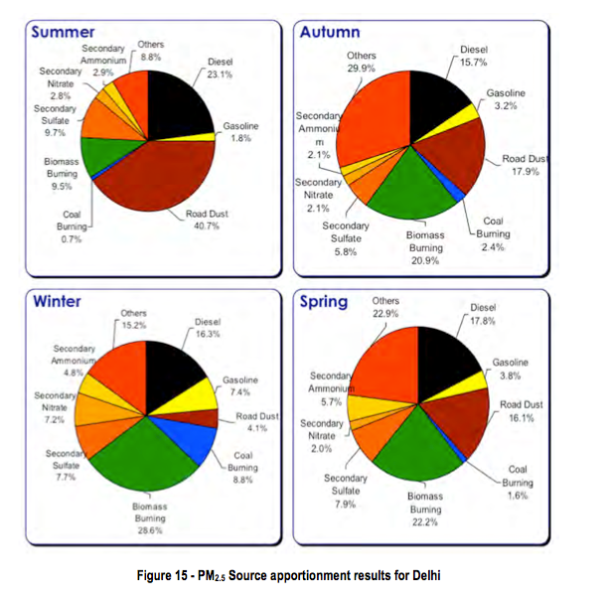
Delhi, India
Rapidly expanding
PM exceedances: 2-3 times daily ambient standard
  Dust Storms in Summer
    Low MC of air
  More biomass burning in winter
Ozone lower than daily standard, higher than 8-hr standard
Seasonal variation of mixing layer height
  Winter months low (increased [pollutant])
40-80% higher in winter months
10 – 60% lower in summer months
  Due to shift in mixing layer heights and wind speeds
Major contributors – Transportation and industries
Compressed Natural Gas Switch
Notes:
In summer, in addition to the road dust already present on the Delhi roads, dust storms from the desert to the southwest [Earth Observatory, 2008] contribute to increased fugitive dust, which is enhanced by growing vehicular movement. This is exacerbated by the low moisture content in the air, leading to higher resuspension of road dust (40 percent of particulate pollution in summer, compared to 4 percent in winter). In the winter months, the mix of pollution sources changes dramatically. The use of biomass, primarily for heating contributes to as much as 30 percent of particulate pollution in winter. Most of this burning takes place at night, when the “mixing layer height” is low due to inversion. In summer, biomass accounts for only 9 percent of particulate pollution.
Agricultural clearing
er height is low which leads to increased air pollutant concentrations. The recurring impacts include heavy persistent smog during the months of November to February, higher pollution levels for all criteria pollutants, frequent delay or cancellation of flights (domestic and international), and reduced visibility causing minor and major accidents along the roads. This wintertime phenomenon is of utmost importance because it starts forming in the month of October, the start of the CWG 2010
DO I WANT TO PUT CORRELATIONS OF POLLUTANTS IN THIS SLIDE?
Truck pollution at night
An important observation in Figure 19 is the diurnal variation of the PM2.5 pollution. Besides the rush hours bumps (8-10 in the morning and 6-9 in the evening) the steady increase in the pollution levels is attributed to two reasons – a direct source from trucks, which are allowed to pass through the city after 9 PM and a change in the mixing layer height. The influence of the truck emissions is more evident in the direct correlation of the PM2.5 and SO2 cycles, possibly originating from the diesel combustion in trucks.
he worst pollution each year starting in October and leading up to February the following year.

Slide 21
Hong Kong, China
Serious particulate and photochemical smog problems
PM_{2.5}
  ~ 70% PM₁₀ concentration
  Vehicle exhaust, electricity generation, navigation, fuel combustion, road dust etc.
O₃ increasing 0.5 ppb_{v}/year
  O₃ higher in rural
Visual impairment more severe in winter than summer
  Northeast monsoon = long range transport of regional pollutants
  Land-sea breeze circulation traps concentrations
    ~80% of high PM days in winter
    O₃ highest in autumn due to more sunlight
Notes:
NO from vehicles remove ozone, biogenic emissions enhance O#
Visibility impairment is usually more severe during the winter than in the summer [Wang, 2003]. During winter, the northeast monsoon facilitates long-range transport of regional pollutants to HKSAR [Louie et al., 2005b; Guo et al., 2009]. Land-sea breeze circulation would further trap and accumulate air pollutants in the PRD region [Lo et al., 2006; 2007], resulting in higher air pollutant concentrations. Winter accounts for ~80% of high PM days [Huang et al., 2009] but O3 concentration is highest in autumn when more sunlight is available for photochemical formation of this pollutant. The southwest monsoon in summer, in contrast, brings in fresh air to HKSAR and the high rainfall help washing away air pollutants in the atmosphere [Wang, 2003; Louie et al., 2005b]. Particulate and photochemical smog problems in summer usually occur with typhoon episodes when the outskirt subsidence of airflow restricts the dilution and dispersion of air pollutants in the PRD region [Huang et al., 2009].

Slide 22
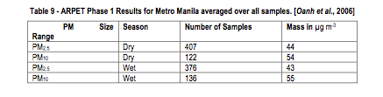
Manila, Philippines
Hot and humid
  20 – 38 deg C
  Dry season (Jan – April)
  Wet (May – December)
Clean Air Act in 1999
  PM has greatest attention
  Improvements, yet still in exceedance
  No PM_{2.5} standard
7 million tons per year for all sources
  CO biggest pollution contributor (50%)
  NO_{x}, VOCs, PM, SO_{x}(in that order)
Challenges
  Difficulty of addressing the issues
Notes:
From the data in Table 9, it is clear that seasonal average PM2.5 concentrations in Metro Manila already exceed the current WHO 24-hour AQG of 25 μg m-3in both dry and wet seasons, while seasonal average PM10 concentrations are almost within the WHO 24-hour AQG of 50 μg m-3in both dry and wet seasons.
According to the latest (2006) inventory, the transportation sector is the major source of air pollution contributing about 65% of the pollutants, while 21% is from stationary [point] sources and 14% from area sources, with total national emissions of seven million tons per year from all sources
CO emissions are caused by the increasing population of gasoline-powered vehicles, which include cars (13.6%) and motorcycles/tricycles (47.9%) [DENR, 2009].
Lead-phase out

Slide 23
Seoul, Korea
Urban air quality structure:
  High-energy intensity associated with primarily fossil fuel energy consumption
  Cars, chemical industries, etc.
Air Poll’n much higher than any other metropolis in region
SO₂
  Growing NO_{x} (# of vehicles are in exceedance)
PM₁₀ and CO
GHG -> clean energy and strengthening emissions standards
Climate Change
  0.23 deg C mean T/decade
  Subtropical climate
Notes:
Asian dust storms and haze event add to the existing air quality problem by aggravating PM10 levels, making the atmosphere more deleterious to health
SICKNESS AND DEATH AN ISSUE
PM10 premature deaths 10,000 per year
The concentration trends for SO2, NO2, CO, PM10 and Pb were evaluated based on the published data by the Ministry of Environment, Republic of Korea (6), the latest being in 2008, with 2007 as the most recent data. The annual average SO2 levels has dramatically decreased by 20 ppbv from 1991 to 1993, and has been decreasing by 2.5 ppbv per year from 1993 to 2000 (Figure 45). It has maintained an annual average value of 5 ppbv from 2001 to 2006, though it has increased by 1 ppbv in 2007. The annual CO levels has also decreased by 0.11 ppmv per year from 1991 to 2002 (Figure 46).
Aim to lower ozone by reducing VOC and Nox, stepwise movement

Slide 24
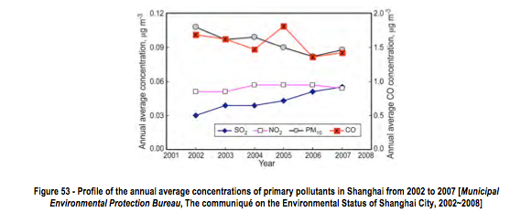
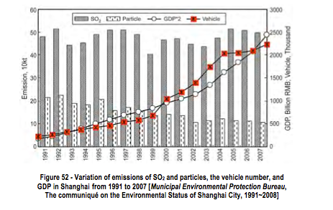
Shanghai, China
Energy consumption 10%/year
  Vehicles too
Ozone very high during summer (much higher than NAAQS)
High ozone => high fine particles
  Acid rain
Bio-energy research to help deal with climate change
Notes:
The emission of SO2 and particulate matter, the vehicle number, and GDP of Shanghai over the past years are shown as Figure 52. The emission of SO2 seemed to be stable in the past with small fluctuations, even though GDP was growing. However, emission of SO2 has increased since the beginning of the 21st century. From 2003 to 2007 emission of SO2 increased by 14.3% to 497.8 kt. The emission of particles decreased gradually in past years. From 2003 to 2007, emission of particles decreased by 50.8% to 106 kt. In addition, the vehicle number increased dramatically with the large growth of GDP in the last decades, especially since this century, which resulted in the increase in emissions of NOX and volatile organic compounds (VOCs). According to the study by Chen et al. [2009], the NOX emission had increased to 599.7 kt in 2007, and the vehicular emission accounted for 14%. More importantly, the contribution of vehicular emission to NOX in urban areas was much larger than that of the whole city, accounting for 40.8%. Obviously, vehicular emission is the largest source of NOX in urban area of Shanghai. The VOCs emission was 597.4 kt in 2007 and vehicle emissions accounted for 14.5%, whereas in the case of urban area, the vehicular emission accounted for 18.8%.
Based on the study by Chen et al. [2009], the major SO2 emission sources are power plants, dispersed combustion processes of industry, and industry furnaces, accounting for 46%, 27%, and 10%, respectively. Similar to SO2, power plants are also the most important source of NOX (34%). Dispersed combustion processes of industry and vehicle emissions contribute 18% and 17% to the total NOX emissions, respectively. In the case of PM10, the largest source is dust resuspension from motorways, accounting for 44%, followed by uncovered yard, dispersed combustion processes of industry, and power plants. Additionally, solvents and other product contributes the largest portion of the VOC emissions, accounting for 28%, followed by industrial processes, 23%, and vehicle emissions, 15%.
In summary, power plants, industry, and vehicular emissions are the major sources of air pollutants in Shanghai and the contribution of vehicular emissions to NOX and VOCs emissions is much larger in urban area than in rural area. Beside these pollution sources, dust is one of the most important sources of PM10.

Slide 25
Tokyo, Japan
Local Meteorology
  Sea-land breeze circulation pattern
  Clear, calm days => southerly winds
  Midnight – early morning: weak, northerly winds dominate
Air Quality trends
  Decrease in O₃ precursors (NO_{x}, NHMC), yet increase in [O₃] in summer
  O₃ can’t be explained by year-to-year variations in meteorological parameters
Source Apportionment is necessary
Notes:
From late spring to mid-summer, a sea-land breeze circulation pattern driven by the heating and cooling of the Kanto Plain during daytime and nighttime, respectively, often prevails [Kondo et al., 2006]. On clear, calm days, southerly winds typically dominate during the daytime, and air is brought from over the ocean to the Tokyo Metropolis and further northward. From midnight to early morning, weak northerly winds dominate and air is transported from the northern Kanto Plain to the Tokyo Metropolis.
Paramters such as solar radiation and temperature

Slide 26
Tehran, Iran
Unusual location
  Diurnally reversing local wind system
    Major influence on vertical stability and surface-layer meteorology
Economic impact of air quality on Iranian economy = $7 billion
Mobile sources = 89% of emissions
CO and PM₁₀ main concern
  Highest PM and SO₂ in autumn, lowest spring
  CO clearest link to health outcomes
Increase in temperature by GHGs and UHI
Plenty of research needed
  Much unanswered questions regarding mesoscale meteorology and advection of pollutants
Notes:
Tehran’s location is unusual; unlike most major cities it is not near a river or even close to the sea. Due to high elevation (approximately 1140 m), aridity, and latitude, Tehran experiences four seasons. Climate can be extremely hot in the summer (with midday temperatures ranging between 30 to 40°C) and cold in winter, when night temperatures can fall well below the freezing point (Figure 61). Local precipitation is absent for 6 months of the year in low lying areas. Originating in the Mediterranean, synoptic scale low pressure systems propagate over the region in spring and autumn, while in winter the southward extension of the Siberian high pressure system can advect cold air over the Iranian Plateau. The average annual rainfall is approximately 230 mm, with most precipitation falling in autumn and winter months. The large scale easterly flow that dominates the area in the summer is thought to be associated with a circulation pattern named ‘the winds of 120 days’ caused by a thermal low over Pakistan [Zawar-Reza, 2008]. Outside of the basin where Tehran is situated westerly winds prevail except in summer when the flow tends to be easterly. The airflow over most of Tehran is influenced by the sloping topography as discussed below.
he predominance of a diurnally reversing local wind system is of special importance to air quality, with a major influence on vertical stability and surface-layer meteorology. During the day, a south south-westerly direction prevails, while at night and early morning, the direction of flow is mostly from a north north-east quadrant (Figure 61). Daytime up-slope winds are most frequent in the summer and autumn seasons. The nocturnal northerly drainage winds are also most prevalent during summer and autumn. The combined effect of less isolation to drive thermally generated flows and the regular passage of the eastward propagating depressions that pass over Tehran make the bi-modal behaviour of wind more diffuse in spring and winter [Zawar-Reza et al., 2010]. During the transition in the diurnal wind direction, the wind speed tends to drop, hence reducing the ventilation capacity of the atmosphere at a time when peak emission of pollutants from rush hour traffic is occurring (Figure 61). In general, the median wind speed does not go above 3 m/s at any hour, so the ventilation capacity of the urban atmosphere is poor.

Slide 27
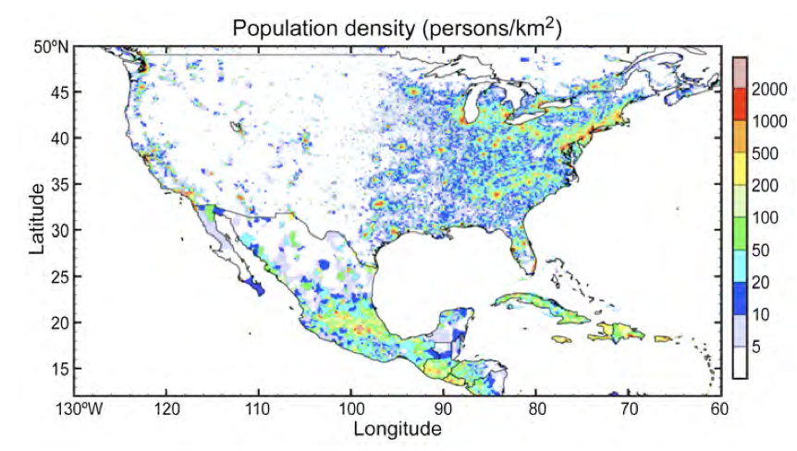
N. America Megacities
Mexico City – 20 million
Los Angeles – 17 million
  Photochemical smog
New York – 22 million
Houston – 6 million (not considered megacity, but …)
Conclusion: growth can proceed along with improvements in air quality

Slide 28
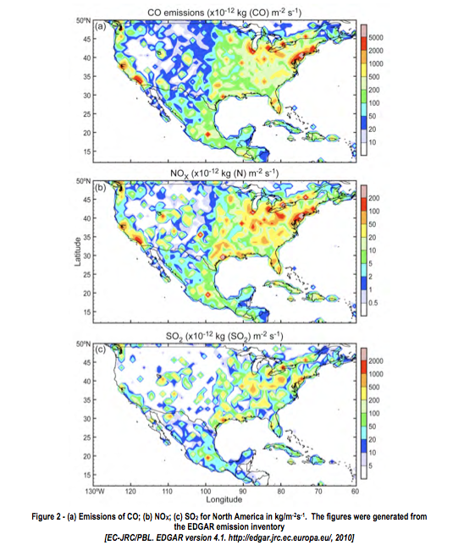

Slide 29
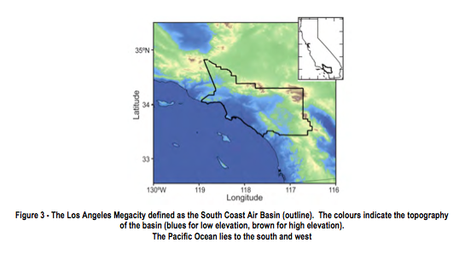
Los Angeles – A Success Story
Los Angeles has seen marked improvements in air quality since 1970s while sustaining economic and population growth
Peak O₃ levels that exceeded 600 ppbv in the 1960’s have not reached 200 ppbv since 1998.
Unique topography and explosive population growth lead to difficulty in reducing pollution
Pollution can circulate within the basin for days
Small percentage of 10 million-strong automobile fleet account for large portion of mobile emissions
Expansion of ports

Slide 30
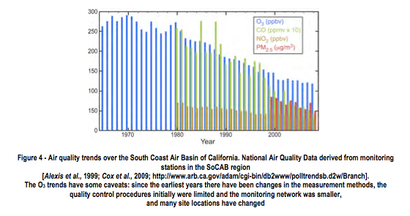
However…
Little improvement over the last 13 years
Ozone standard is still violated
May be shifting to region where VOC reductions are minimally effective

Slide 31
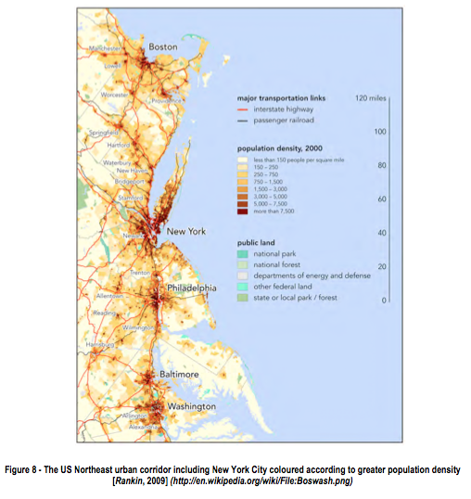
New York, New York
NY: no geographic structures to block wind, more vertical mixing (elevated mixed layer)
Less emission of O₃
precursors and particulates
per capita than Southern
California
Public transit more used
Less clear skies than LA, so
photochemistry is less efficient

Slide 32
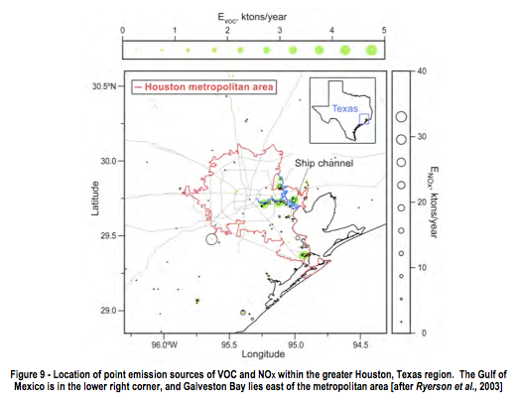
Houston, TX
Less population than NYC, but more industrial emissions, concentrated in a small area of the city
Coastal city – shallow boundary layer and recirculation of pollutants
Between 1999-2004, highest 1-hr O₃ conc. in US

Slide 33
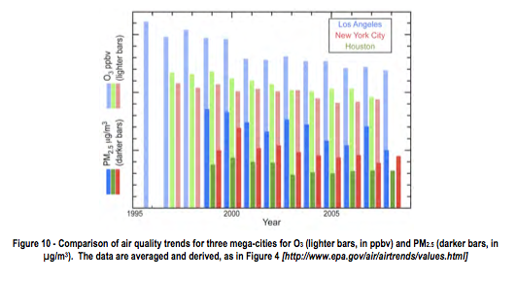
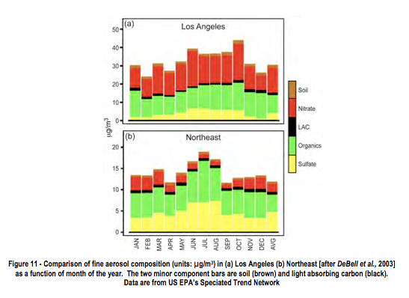

Slide 34
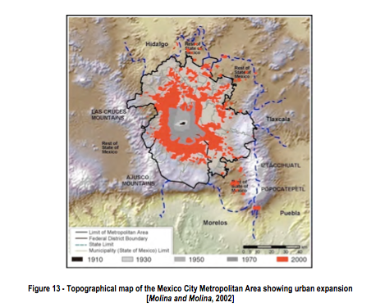
Mexico City
NA’s most populous and rapidly expanding mega city
Situated on an elevated basin, surrounded on 3 sides by mountains
Shallow boundary layer at night, deep BL during the day
Little day-to-day carryover of
pollutants

Slide 35
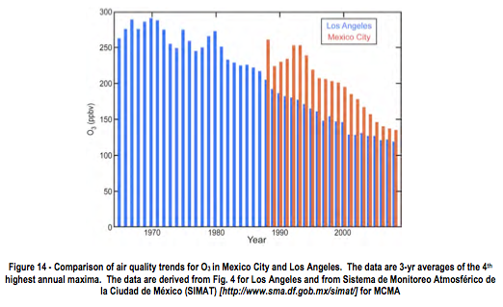
Mexico City
In the 1980’s, O₃ levels exceeded 110 ppb 1-hr standard 90% of days, and exceeded 300 ppb ~45 times per year
Good news: Controls implemented beginning in the late 1980s are working
  Removed lead from gasoline
  Reduced-sulpher diesel
  Substitute natural gas for fuel oil
  Strengthened vehicle inspections and maintenance program
Recent studies suggest the region is moving to VOC-limited

Slide 36
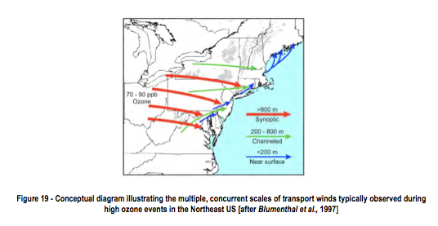
Pollution Transport
Air pollution is a regional (not local) issue
3 important transport-regimes
  Above 800m: flow controlled by synoptic systems
  Flows below 200 to 800 m follow important terrain features, transport air from the southwest along the northeast US urban corridor. particularly important
  Near surface flows (below 200m) bring primary pollutants and aged ozone from areas of shallow mixed layers
Intercontinental transport – e.g. from the NE or from Eastern Asia to the Western US (affects BG ozone levels

Slide 37
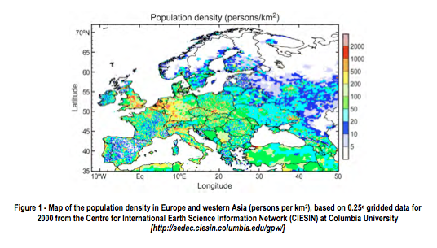
European Megacities
Paris, France – 10.4
London, England – 8.6
Po Valley, Italy – 20
Ruhrgebiet, Germany and BeNeLux region – 33.7
Moscow, Russia – 10.5
Istanbul, Turkey – 10.4

Slide 38
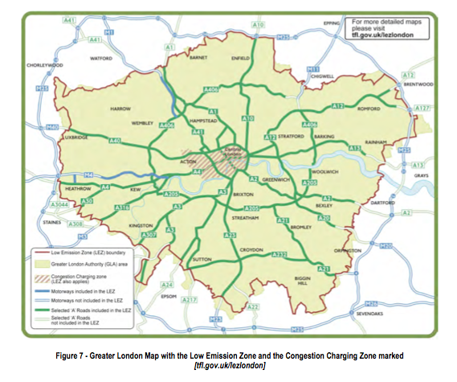
London
Most emissions of NO_{x}, CO, and PM₁₀ is from mobile sources
Detailed regulations on benzene, 1,3-butadiene, carbon monoxide, lead, nitrogen dioxide, particulate matter (both PM2.5 and PM10), sulphur dioxide, polycyclic aromatic hydrocarbons (PAHs), and ozone
Low-Emissions Zone in city center

Slide 39
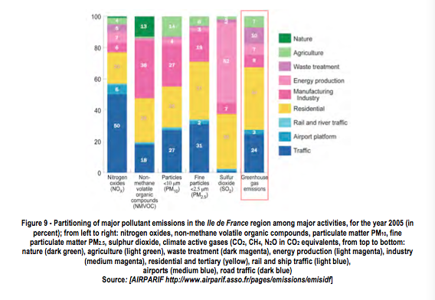
Paris
Traffic and industry are dominant sources
Generally, sustained winds from west allow for good mixing
NO_{x} is the most critical pollutant moving forward

Slide 40
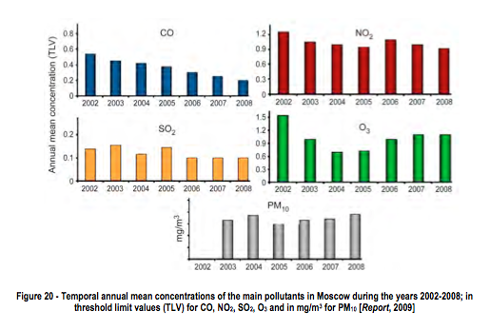
Moscow
Seventh largest megacity
in the world (according to
census of legal residents)
Many cars and stationary
sources do not meet
European standards
Winds bring clean air into the area, but pollution from the Western part are advected to the eastern part
Some improvements were seen with collapse of the USSR, new regulations to bring Moscow within compliance of European standards is planned

Slide 41
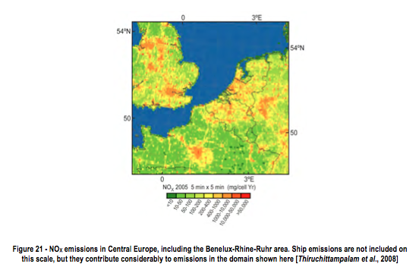
Ruhrgebiet, Germany and BeNeLux
Highly industrialized – factories, automobiles, and shipping contribute to air pollution
Ozone and PM exceedances are common
Transport from other large population centers in Europe is also important
Winter-time anti-cyclone conditions cause inversions and transport from other polluted areas
Since the 1990s, average levels have increased but exceedances have decreased

Slide 42
International Projects
Countries have realized that air pollution is an important issue, and look to benefit from collaboration with other countries
Studies generally include both measurements and modeling to aid in the formation of regulatory policy
Remote sensing (using satellite data) is growing in popularity
East Asia is a hot-spot for these studies

Slide 43
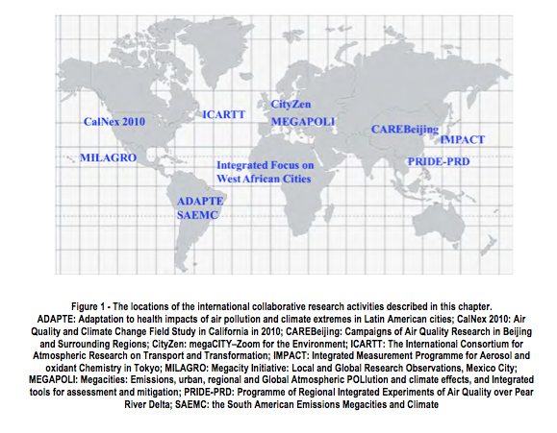
International Projects

Slide 44
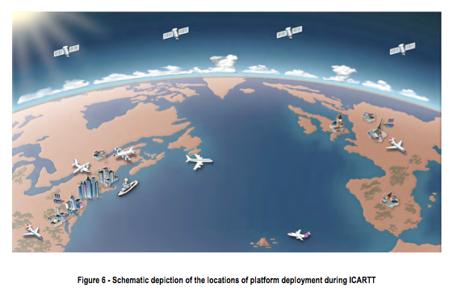
ICARTT: Studies of North America, the Atlantic, and Europe

Slide 45
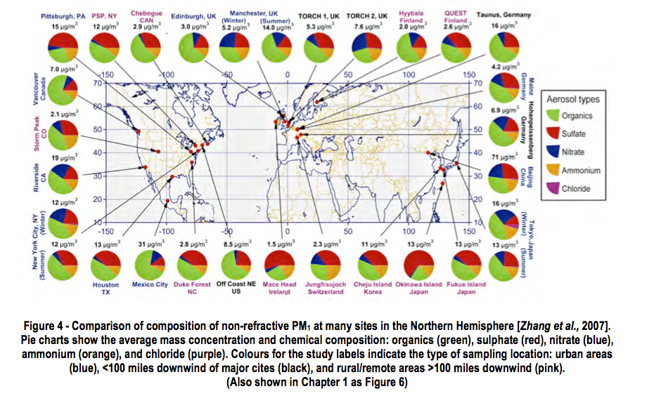
Key Issues and Outlook
Air pollution higher in urban areas than small cities
  Difficult to assess dependence on population
  Comparing air pollutants spatially and temporally of megacities provides effectiveness of control strategies
  Understanding PM is critical
  Northern hempisphere: Sulfate to aerosol
  Organics even more
Notes:
he difficulty of comparing measurements from different cities due to differences in instrument siting, meteorological conditions, and many others, there is little quantitative information regarding how urban pollutant concentrations depend on population.

Slide 46
Organic Aerosol
Organic aerosol (OA) subject of vigorous debate in the scientific community
  Most SOA from biogenic VOCs
Much more SOA in the urban air than models can account for
SOA underestimated by 1-2 orders of magnitude
Relatively poor understanding of the sources of OA
OA accounts for such an important contribution to total PM levels
Notes:
Most OA in rural areas is not directly emitted, but rather forming in the atmosphere from condensation of oxidized VOCs (SOA)
Radiocarbon dating of OA typically shows a very high fraction of modern carbon, suggesting that most SOA is formed from biogenic VOCs
SOA typically correlates very well with the oxidation products of anthropogenic VOCs, suggesting that urban emissions play an important role in its formation
Models underestimate SOA by 1-2 orders of magnitude over a wide range of the degree of the photochemical processing of an air mass.
it is difficult to predict how a reduction in the emissions of precursors will affect the levels of OA in the atmosphere
understanding OA sources is a high priority for establishing effective PM control strategies

Slide 47
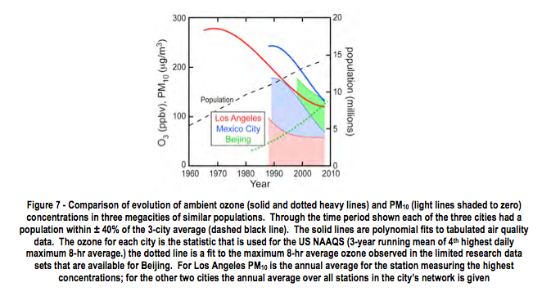
Notes:
Currently developing megacities can benefit from the experiences of megacities developed earlier
Maximum ozone and PM concentrations in three similarly sized megacities
[Ozone] peaked in LA in 1970 and decreased over the following four decades
Mexico City (a late developing megacity), the ozone concentrations never reached the peak observed in Los Angeles and dropped more rapidly, approaching Los Angeles concentrations.
PM concentrations in Mexico City have approximately paralleled the ozone concentrations
Mexico City avoided some to the most severe air pollution problems experienced in Los Angeles through implementation of emission controls before problems became so severe
Pollutant concentrations in Beijing may be following a different trajectory; PM [] are decreasing, but ozone [] which have been low are rising
Interesing!

Slide 48
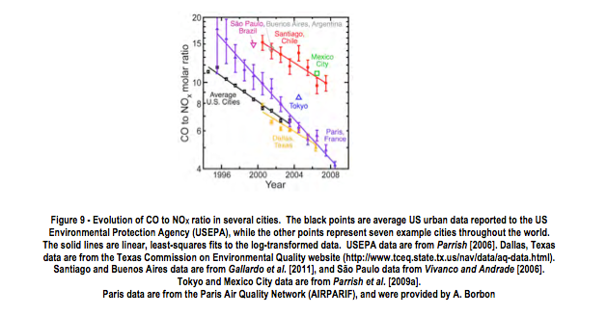
Regional Transport
Example: Beijing CO
  CO high for days
Region wide control strategy is required!
  US faced this in 1980s
Notes:
As one example, CO in Beijing behaves very differently compared to other cities. In a typical urban area, CO has a pronounced peak coincident with the morning vehicle traffic maximum, while in Beijing such peaks are much less obvious, and CO concentrations can remain high for days, presumably due to regional accumulation and transport of CO on regional scales. This is reflected in Figure 8b that shows Beijing CO concentrations much higher than observed in other cities at comparable NOX concentrations. (Regional accumulation and transport are not nearly as important for NOX, due to its much shorter lifetime.)
Model calculations [Zhao et al., 2009] indicate that under high-pressure systems, which suppress ventilation of pollutants from the boundary layer, elevated ozone concentrations can extend over a major fraction of East China (Figure 10). These results indicate that the high pollutant emissions over the vast stretch of the plains of East China makes the region susceptible to regional accumulation of high ozone concentrations. During the episode illustrated in Figure 10, high ozone extended over an area >1 million km2, with a population of >800 million people.
Inter-city differences in the US are attributed to differing average ages of the on-road vehicles. For example the vehicle fleet in El Paso, Texas is significantly older than in Dallas Texas and the US average. The CO/NOX ratio in El Paso (not shown) follows the same rate of decrease, but the absolute trend is approximately 6 years behind the US average. However, other factors may be important in other cities. The CO to NOX emission ratio certainly depends on a variety of factors in addition to average vehicle fleet age, including relative fractions of diesel and gasoline fuelled vehicles, extent of ethanol usage (which is particularly high in São Paulo, Brazil), and emission control strategy and schedule of implementation. Importantly, Chilean emission inventories generally underestimate the observed ratios; a preliminary analysis of the data, and results from inverse modelling techniques for CO, suggest that NOX emissions in Santiago are probably overestimated by a factor 2 to 3 [Gallardo et al., 2011], which accounts for the ambient- inventory ratio differences. The VOC to NOX ratio in on-road vehicle emissions is of more critical importance to modelling of photochemical production of ozone and SOA in urban areas than is the CO to NOX ratio. Parrish [2006] showed that VOC emissions from on-road vehicles have decreased at a similar rate to CO emissions. This correspondence is expected because catalytic converters are the principal control measure for both species. Although emission inventories accurately captured the VOC to NOX ratio in 2000, the subsequent decrease in the ratio was not accurately captured. Consequently, NOX to VOC emission ratios in US urban areas are likely underestimated by current inventories, which will compromise air quality modelling.

Slide 49
Urban Heat Island in megacities
Change in surface balance of energy
  Short and long wave radiation
  Sensible heat and latent fluxes
  Cause of higher temperatures in urban vs suburban/rural
  Beijing, Paris, Tokyo, New York
  Higher health risk
  Anthropogenic heat plays role in UHII and boundary layer development
    Local circulation, diurnal variation
Not well understood
Notes:
Urban structures change the surface of land and sky view factor, and therefore the surface balance of energy, such as the short and long wave radiation, and the sensible and latent heat fluxes. This change together with the anthropogenic heat sources are the main causes of higher temperatures in urban centres than in suburban and rural areas, and hence the formation of urban heat island (UHI).
Urban heat island effect can be described with urban heat island intensity (UHII). UHII is defined as the spatially-averaged temperature difference between an urban area and its surrounding rural area [Kim and Baik, 2005]. UHII can be quantified by calculating air or surface temperature differences between an urban area and nearby rural area simultaneously with similar geographic features; satellite imagery has also been used to obtain surface-temperature based UHII over a study area under clear skies. [Memon et al., 2009].

Slide 50
Conclusion
Wide variety
  Lots of research (LA) to minimal
Megacities learn from each other
  Similarities in emission sources
Must include impact on climate
  “win-win”

Slide 51
Thank you!
ANY Questions?

