Slide 1
Impacts of Climate Change on the U.S.
Benpei Cao
Tianlin Chang
Michael McKenzie

Slide 2
Introduction
Temperature Changes
Extreme Weather Events
Future Climate Change
Global Climate Change
Human Health Impacts
Impacts on Infrastructure
Impacts on Water Resources
Impacts on Agriculture
Impacts on Natural Ecosystems
Ocean Acidification & Temperature Changes
Adaptation & Mitigation

Slide 3
Health Impacts & Water Resources

Slide 4
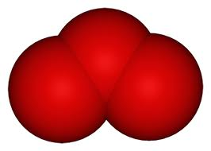
Health Effects: Ozone
Summer O₃ concentrations to increase by 1-10 ppb this century
  1,000 premature deaths per 1.8°F rise in temperature could occur each year related to worsened O₃
  4,300 additional premature deaths per year by 2050
  Total U.S. Healthcare Cost due to O₃:
  $6.5 billion
Notes:
Ground-level ozone is associated with diminished lung function, increased hospital admissions and emergency room visits, and increases in premature mortality

Slide 5
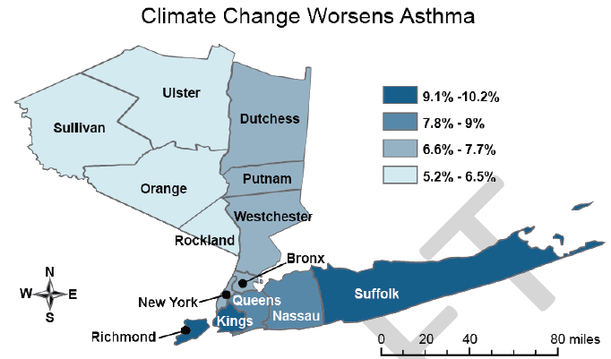
Health Effects: Ozone
Percentage increases in emergency room visits for asthma related to ground-level ozone among children in the New York City region by the 2020s, resulting from the effects of climate change.
Notes:
Asthma accounts for one-quarter of all emergency room visits in the U.S. – 1.75 million each year. Costs for this chronic disease increased from an estimated $53 billion in 2002 to about $56 billion in 2007.
In 2010, an estimated 25.7 million Americans had asthma, which has become a problem in every state, prevalent in California’s Central Valley, where one out of every six children has asthma symptoms.

Slide 6
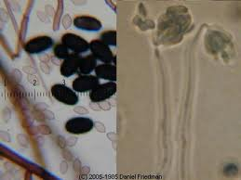
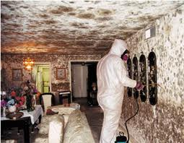
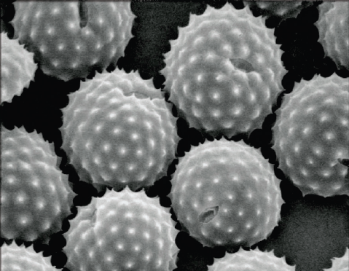
Health Effects: Allergens
Climate change can contribute to increased production of plant-based allergens
  Higher pollen concentrations and longer pollen seasons increase allergic sensitizations and asthma episodes and diminish productivity
  Increased rainfall & temperatures can stimulate indoor fungi and molds
Notes:
Rising temperatures cause pollen seasons to begin earlier and last longer which causes a lot health issues with allergens such as pollen and mold.
(far right): One ragweed plant can produce one billion grains

Slide 7
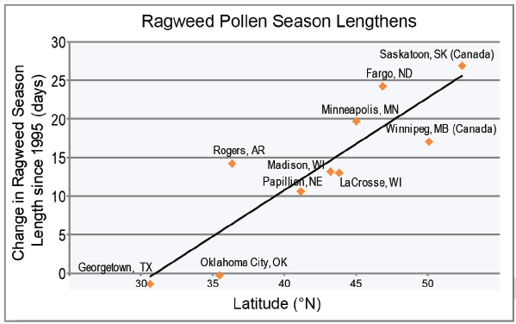
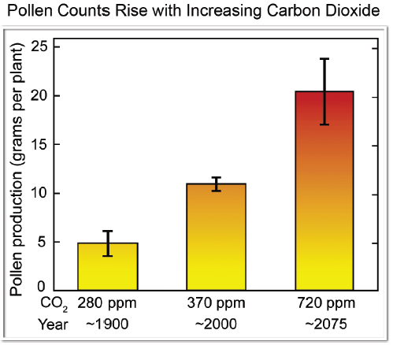
Health Effects: Allergens
Ragweed pollen season length has increased in central North America between 1995-2011, by 13 to 27 days in response to rising temperatures.
Pollen production from ragweed grown in chambers at the CO₂ concentration in 1900 (~5 grams per plant) versus today’s
approximate level (~10 grams), and at a level projected to occur
in 2075 (~20 grams).
Notes:
-Largest increase in pollen seasons has been in Northern cities by about 13-27 days

Slide 8
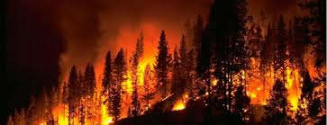
Health Effects: Wildfires
Climate change increases occurrences of wildfires
  PM, CO, NO_{X}, and VOCs (which are O₃ precursors)
  Increases respiratory and cardiovascular hospitalizations, visits for asthma, bronchitis, chest pain, chronic obstructive pulmonary disease, & respiratory infections
  Has been associated with hundreds of thousands of global deaths annually

Slide 9
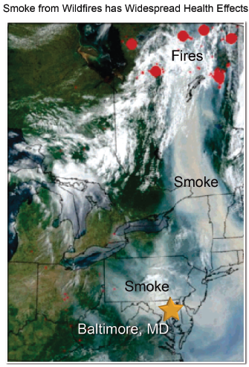
Health Effects: Wildfires
Wildfires can cause health impacts thousands of miles downwind as seen here with smoke travelling from Quebec to Baltimore.
Notes:
Shown here, forest fires in Quebec, Canada during July 2002 resulted in up to a 30-fold increase in airborne fine particle concentrations in Baltimore, Maryland, a city nearly a thousand miles downwind.
-These fine particles, which are extremely harmful to human health, not only effect outdoor air quality, but also penetrate
-The 2012 wildfire season, at almost 9.2 million acres burned
-Estimated global deaths from landscape fire smoke have been estimated at 260,000 to 600,000 annually

Slide 10
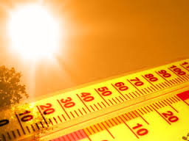
Health Effects: Heat
Heat waves have caused dramatic
increases in death rates
  More frequent extreme heat events predicted
  Increased hospitalizations for cardiovascular, kidney, respiratory disorders, heat stroke, & cerebro-vascular diseases
Solutions
  Some risks decreased due to better forecasting, early warning systems, and increased access to air conditioning
Notes:
Heat can cause complications with pre-existing conditions

Slide 11
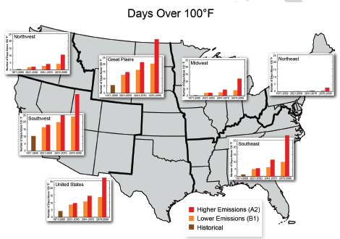
Health Effects: Heat
Notes:
Historical data are for 1971-2000 (farthest left bar in plots). Projections shown are 30-year averages centered on 2035, 2055, and 2085.
Projections of days per year with temperatures greater than 100°F under a lower-emissions scenario in which emissions of heat-trapping gases are substantially reduced and a higher-emissions scenario in which emissions continue to grow

Slide 12
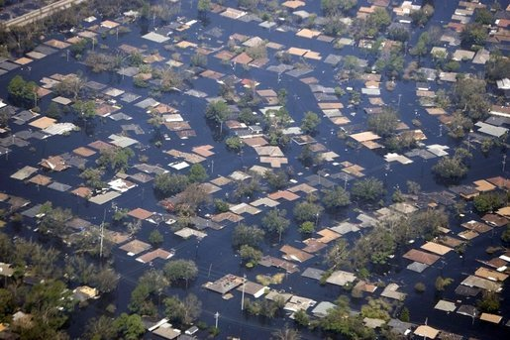
Health Effects: Extreme Events
Floods are the second deadliest of all weather-related hazards in the U.S.
  Drowning
  Waterborne diseases
  Indoor fungi & mold
Notes:
Deaths due to floods are about 98 per year
Majority of deaths is caused by drowning

Slide 13

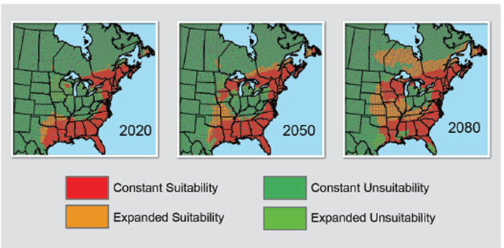
Health Effects: Disease by Insects & Rodents
Climate change can shift the distribution of insects, rodents, and other disease carriers
  Lyme disease, Chagas disease, Dengue fever
Notes:
The geographic and seasonal distribution of insect populations, and the diseases they can carry, depend not only on climate, but on land use, socioeconomic and cultural factors, insect control, access to health care, and human responses to disease risk, among other factors
maps show the projected change in suitable habitat for the tick that 3 transmits Lyme disease for the 2020s, 2050s, and 2080s. The areas in orange are projected to be newly suitable habitat for the tick, by 2080. Parts of Florida, Mississippi, and Texas are projected to see a reduction in suitable habitat by 2080.

Slide 14
Health Effects: Food & Waterborne Diarrheal Disease
Seasonality, air & water temperature, precipitation patterns, and extreme rainfall events are all known to affect disease transmission
  Elderly & those inadequately or untreated groundwater
Notes:
diarrheal diseases including Salmonellosis and Campylobacteriosis are more common when temperatures are higher

Slide 15
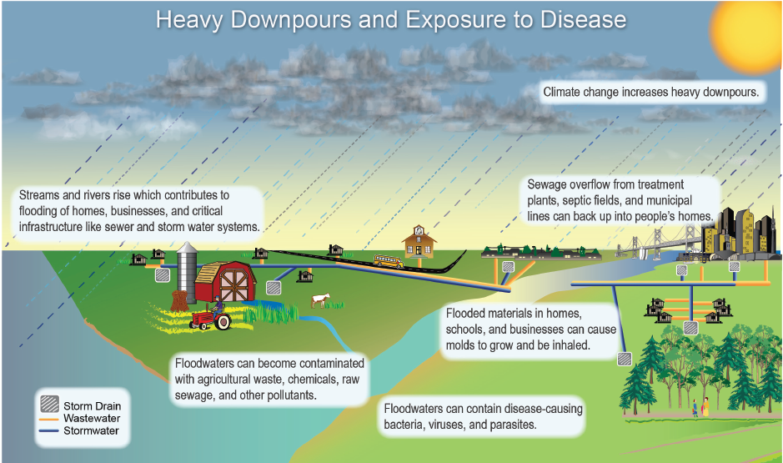
Health Effects: Food & Waterborne Diarrheal Disease Disease
Notes:
illustrates how humans can become exposed to waterborne diseases, which typically present in the weeks following a flood
Human exposures to waterborne diseases can occur via drinking water, as well as recreational waters

Slide 16
Health Effects: Mental Health & Stress
Post-traumatic stress
Increase in suicide, depression, schizophrenia, and dementia correlated with high temperatures

Slide 17
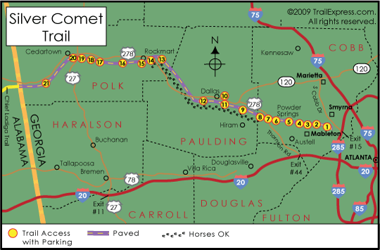
Health Effects: Solutions
Smoking vs. Climate Change awareness
Prevention systems
  Early warning systems (i.e. heat waves, etc.)
  Disease outbreak warnings & prevention
Encouraging active
transit
  Walking, biking, etc.
Public policies
  Independent effects
  on health
Notes:
The public is familiar with the health risks of smoking, but not so for climate change. When asked about climate change, Americans don’t mention health impacts, and when asked about health impacts specifically, most believe it will affect people in a different time or place
Policies and other strategies intended to reduce carbon pollution and mitigate climate change can often have independent influences on human health. For example, reducing CO2 emissions through renewable electrical power generation can reduce air pollutants like particles and sulfur dioxide.

Slide 18
Health Effects: Key Messages
Some of these health impacts are already underway in the U.S.
Climate change will amplify some of the existing health threats. Certain people and communities are especially vulnerable.
Public health actions can protect people from impacts of climate change.
Responding to climate change improves health & well-being across many sectors, including energy, agriculture, and transportation. Many offer a variety of benefits, protecting people while combating climate change and providing other societal benefits.
Notes:
Climate change threatens human health and well-being in many ways, including impacts from increased extreme weather events, wildfire, decreased air quality, diseases transmitted by insects, food and water, and threats to mental health. Some of these health impacts are already underway in the U.S.
Climate change will, absent other changes, amplify some of the existing health threats the nation now faces. Certain people and communities are especially vulnerable, including children, the elderly, the sick, the poor, and some communities of color.
Public health actions, especially preparedness and prevention, can do much to protect people from some of the impacts of climate change. Early action provides the largest health benefits. As threats increase, our ability to adapt to future changes may be limited.
Responding to climate change provides opportunities to improve human health and well-being across many sectors, including energy, agriculture, and transportation. Many of these strategies offer a variety of benefits, protecting people while combating climate change and providing other societal benefits.

Slide 19
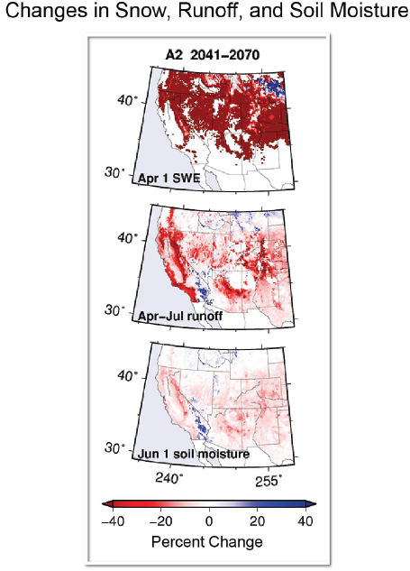
Water Resources: Changing Precipitation
Heavy events (top 1%) increasing along with volume
Increasing in Midwest, Great Plains, & NE
Decreasing in HI, SE, & SW
Decline in snowpack since mid-century
Earth’s surface temperature has increased, but evapotranspiration has declined in US
Notes:
Avg annual precip has increased about 0.2 inches per decade from 1895-2011 but in some areas been decreasing
Caption: These projections, assuming continued increases in heat-trapping gas emissions (A2 scenario), illustrate:
major losses in the water content of snowpack that fills western rivers (snow water equivalent, or SWE);
significant reductions in runoff in California, Arizona, and the Central Rocky Mountains; and
c) reductions in soil moisture across the Southwest. The changes shown are for mid-century (2041-2070) as percentage changes from 1970-2000 conditions

Slide 20
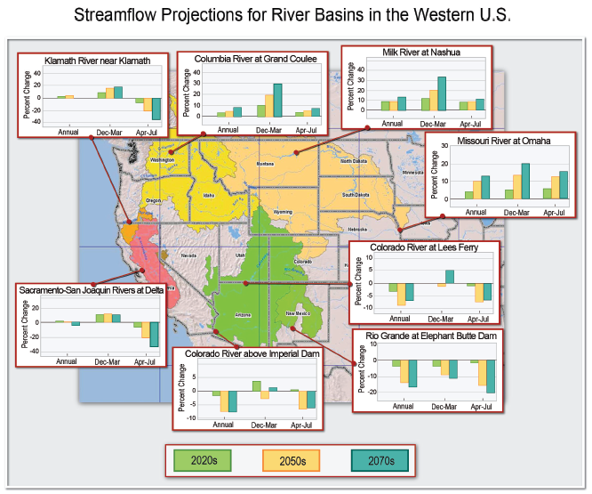
Water Resources: Runoff & Streamflow
Notes:
At regional scales, declined in last century in NW and increased in Mississippi basin and NE, but overall no clear trend in the US
Annual runoff in Colorado River basin declined, while It increased in the Missouri River basin
The figure here illustrates the streamflow projections for eight river basins

Slide 21
Water Resources: Droughts & Floods
Summer droughts to intensify in most regions, with longer reductions in water resources in SW, SE, & HI
Floods anticipated to increase in most regions especially Midwest & NE
Notes:
Due to rising temps and changes in precipitation
Floods anticipated to increase in most regions even regions where precipiation is expected to decline due to a number of factors including soil moisture

Slide 22
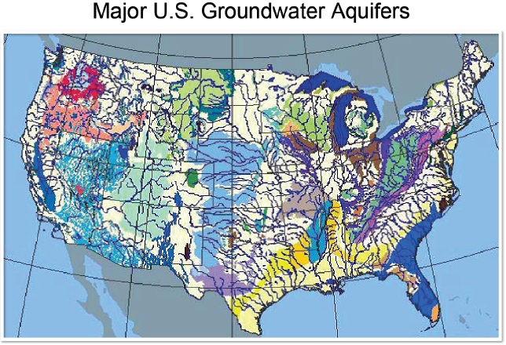
Water Resources: Groundwater Availability
Inadequate aquifer monitoring
Climate models do not include dynamic representations
of groundwater
reservoirs and
their connections to streams, soil-vegetation systems, and
the atmosphere
Notes:
-hampering progress in understanding the potential impacts on groundwater and groundwater- reliant systems of climate change
-Thus, it is difficult to predict how climate changes will impact groundwater resources
-But surface declines have already resulted in increased groundwater use in many areas adding more stress to resources
-In mountainous areas where a disproportionate amount of groundwater recharge is from snowmelt, predictions of disruptions of these recharge rates are very likely
-Caption: Groundwater aquifers are found throughout the U.S., but they vary dramatically in terms of ability to store and recharge water. On this map, differences in geology are illustrated: blue is unconsolidated sand and gravel; yellow is semi-consolidated sand; green is sandstone; brown is carbonate‐rock; and red is igneous and metamorphic rock.

Slide 23
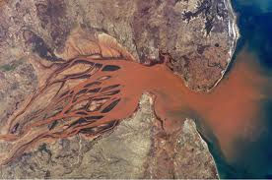
Water Resources: Lakes & Rivers at Risk
Increased precipitation & runoff lead to increased river sediment, nitrogen, and other pollutants
Increased water temperatures and droughts decrease lake mixing, dissolved oxygen, and increase time pollutants remain in water bodies
Notes:
-Over 25-55% increase in sediment runoff expected
-Increased occurences of HABs

Slide 24
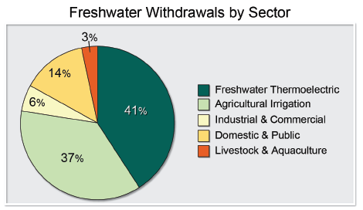
Water Resources: Off-Stream Water Uses
Total freshwater withdrawals since 1980 have fallen from 350 to 100 billion gpd, despite addition of 68 million people
Current trends:
Notes:
-Per capita water withdrawal has decreased due to pricing programs and increased efficiency water use
-Higher water temperatures affect both the effectiveness of electric generation and cooling processes and the ability to discharge heated water to streams
-This increases number of impacts on ecosystems downstream

Slide 25
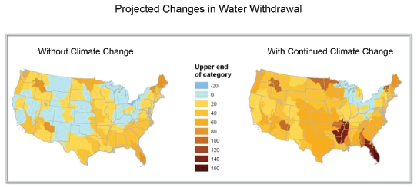
Water Resources: Off-Stream Water Uses
Notes:
2005-2060 associated with increasing temps
-Increasing temperatures will significantly increase demand for water and stress resources even more
-LEFT: best case scenario
-RIGHT: worst case

Slide 26
Agriculture & Ecosystems

Slide 27
Agriculture
Climate disruptions to agriculture production is increasingly negative on most crops and livestock. This trend will continue over the next 25 years.
Major stress comes from loss and degradation of soil and water assets, rising incidence of weather extremes, weeds, diseases, insect pests, etc.
Adaptation of agriculture and socioeconomic systems exists but more efforts need to be made to keep pace with future climate change
Climate change effects on food security in various ways, including crop yields, food processing, storage, transportation, and retailing.

Slide 28
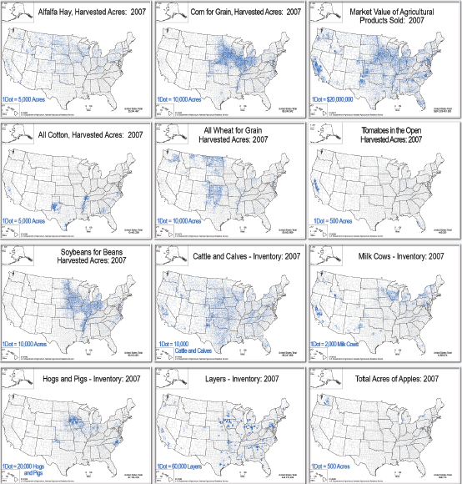
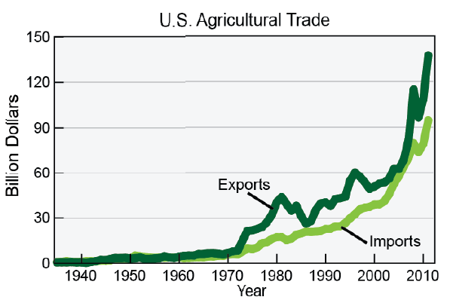
Agricultural Trends
Nine billion people in US by2050
$300 billion per year in agriculture commodities
Various distribution results in differing effects of climate change on these commodities across the nation.
Agriculture distribution

Slide 29
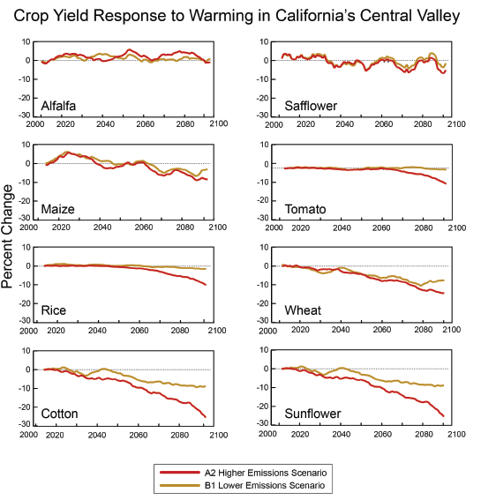
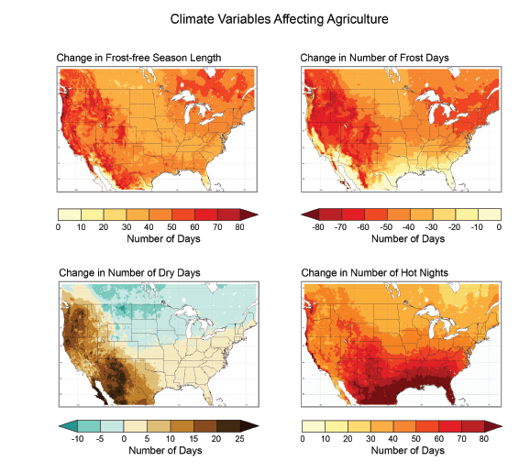
Impact
Factors: CO₂, temperature, solar radiation, precipitation, etc.
Individual species respond differently to warming
Temperature is a major factor in the pollination stage

Slide 30
Impact
Weeds, diseases, and pests
  Some weeds benefit more than crops from increasing temperature and CO₂ level
  Higher humidity favors insects and diseases flourish
Extreme precipitation
  Erosion, compaction, acidification, salinization, net loss of organic matter, etc.
Heat and drought
  Negative impacts on crops and livestock

Slide 31
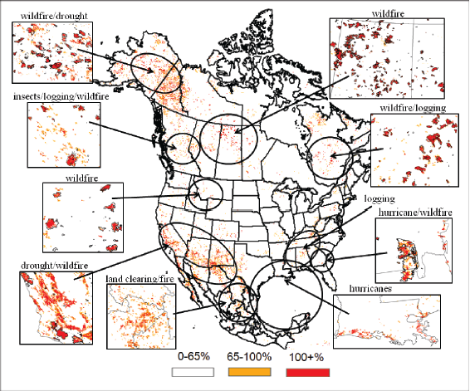
Forestry
Increased vulnerability of forests to climate change through fire, infestations, drought, & disease
Western US are particularly vulnerable
Eastern forests have smaller disturbances but could be more sensitive to drought

Slide 32
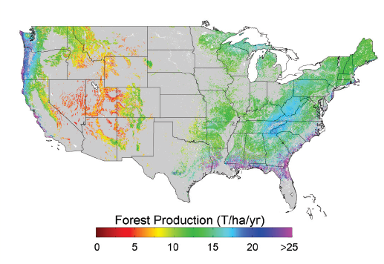
Important Carbon Sink

Slide 33
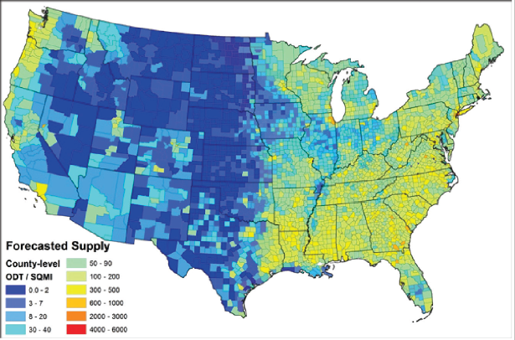
Forestry Bioenergy Resources
Potential forestry bioenergy resources by 2030 at $80
per day ton of biomass based on current forest area.

Slide 34
Ecosystems
Climate change impacts on ecosystems reduce their ability to improve water and regulate water flows
Combined with other stressors, climate change is overwhelming the buffer capacity of ecosystems
Bring disruption to bio-diversity

Slide 35
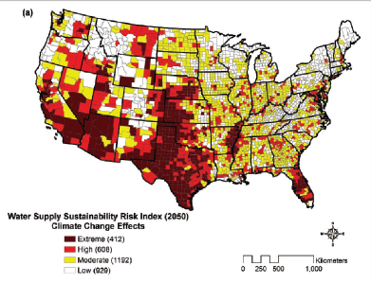
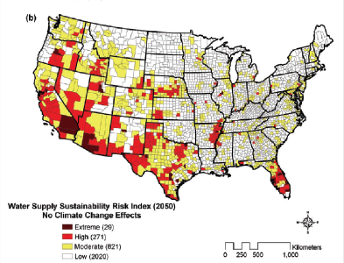
Water
Local extinctions of fish and other aquatic species are projected from combined effects of increased water withdrawal and climate change.
Rising air temperature lead to decline in water quality
Climate change bring impact on N, P, DOC transport from the land to rivers

Slide 36
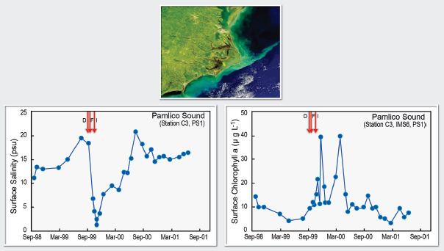
Aftermath of Hurricanes

Slide 37
Other Impacts
Extreme events
  Climate change combined with other stressors is overwhelming the capacity of ecosystems to buffer the impacts from storms, fires, floods etc.
Plants and animals
  Species may disappear, changing some regions so much that their mix of plant and animal life will become unrecognizable
Seasonal pattern
  Timing of critical biological events, shifted by climate change, leads to important impacts on species and habitats

Slide 38
Infrastructure
Focus Area: SE US
Transportation Systems
Structural Systems
Energy Systems
Economic Impacts

Slide 40
Southeast already vulnerable to weather damage- this is projected to increase as magnitude of weather extremes increases

Slide 41
As frequency of large storms increase, major portions of US energy facilities will be at risk.

Slide 42
Water Resources
Increased temperatures/ floods will have adverse impacts on inland navigation & waterways
Stormwater/ Wastewater facilities will need major upgrades to handle contamination and increased flows
Industrial water usage will be severely constrained be decreased availability
R.M. Clayton sewage treatment plant in Atlanta, Georgia, September 23, 2009, was engulfed by floodwaters forcing it to shut down and discharge raw sewage into the Chattahoochee River.

Slide 43
Quantifying Risk in the Southeast
One of the most populous metropolitan areas in the country (Miami) and four of the ten fastest-growing such areas
Three of these (Palm Coast, FL, Cape Coral-Fort Meyers, FL, and Myrtle Beach area, SC) are along the coast and vulnerable to sea level rise and storm surge.
The Gulf and Atlantic coasts are major producers of seafood and home to seven major ports that are also vulnerable.
The SE is a major energy producer of coal, crude oil, and natural gas, and the highest energy user of any of the National Climate Assessment regions.
According to a recent study by the regional utility, Entergy, coastal counties in AL, MS, LA, and TX:
  Population of 12 million
  Assets of about $2 trillion
  Produce$634 billion in annual GDP
  Face significant losses that annually average $14 billion from hurricane winds, land subsidence, and sea level rise.
  Future losses until 2030 could reach $18 billion (with no sea level rise or change in hurricane wind speed) to $23 billion (with nearly 3% increase in hurricane wind speed and just under 6 inches of sea level rise).

Slide 44
Adaptation & Mitigation
Adaptation: Changing current practices to accommodate effects of climate change
Mitigation: Actively attempting to alter the rate of climate change and the severity of its effects

Slide 45
Considerations
Adaptation considerations include local, state, regional, national, and international jurisdictional issues.
Both “bottom up” community planning and “top down” national strategies may help regions deal with impacts such as increases in electrical brownouts, heat stress, floods, and wildfires.
Such a mix of approaches will require cross-boundary coordination at multiple levels as operational agencies integrate adaptation planning into their programs

Slide 46
More Considerations
Adaptation strategies for infrastructure may include elements of structural and non-structural approaches
  Such strategies could take advantage of conventional infrastructure upgrades
    Make already planned upgrades consider climate change factors- kill two birds with one stone

Slide 47
One Last Consideration Before Considering More Things
Infrastructure is vulnerable to climate because it is clustered.
I.e. about half of the nation’s oil refineries are located in only four states.
  Single events in localized spots have wide reaching impacts
  Suggests a more evenly distributed system is desirable
    Good for efficiency, system redundancy, and even national security implications
    Multiple benefits make drastic changes more likely to gain acceptance

Slide 48
Who’s Bothering to Prepare?

Slide 49
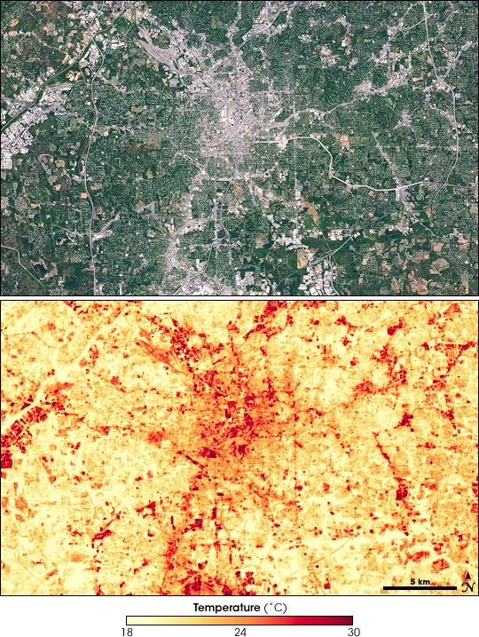
Possible Mitigation Method

Slide 50
The South Florida Ecosystem Portfolio Model (EPM) is a regional land-use planning tool that integrates ecological, economic, and social information and places that information in a context that is relevant to decision-makers and stakeholders.
The EPM uses a multi-criteria evaluation framework that builds on GIS analysis and spatially explicit models that characterize important ecological, economic, and societal consequences of regional land-use/cover change.

Slide 51
Coastal ecosystem restoration projects, such as the one shown in this example from NYC, help protect coastal waterfronts and maintain resilience of coastal infrastructure.

Slide 52
A Success Story
Because of Clayton County, Georgia’s, innovative water recycling project during the 2007-2008 drought, they were able to maintain reservoirs at near capacity and an abundant supply of water while neighboring Lake Lanier, the water supply for Atlanta, was at record lows.
Clayton County developed a series of constructed wetlands used to filter treated water that recharges groundwater and supplies surface reservoirs. They have also implemented efficiency and leak detection programs. (American Rivers et al. 2009).

Slide 53
Questions?

Slide 54
If you don’t have any, here’s some from us.
What are some adaptation/mitigation strategies related to other issues you can think of (health, infrastructure, economy, resources, ecology, etc)?
Is climate change something we can handle gradually by conventional means, (legislation, scientific studies, etc), or do we need more drastic action by national governments, (mandated changes, emergency status declared, etc)?
Does using forest product for biomass energy leads to higher carbon emission or not?
Which climate-related health concern should be the government’s primary target?

