Slide 1
East Asia Winter Monsoon System (EAWM)and Regional Air Pollution ---A Case Study
EAS 6792 Term Project
Yufei Zou
2013-04-23

Slide 2
Outline
Introduction
Methodology
Data Analysis & Discussion
Conclusion

Slide 3
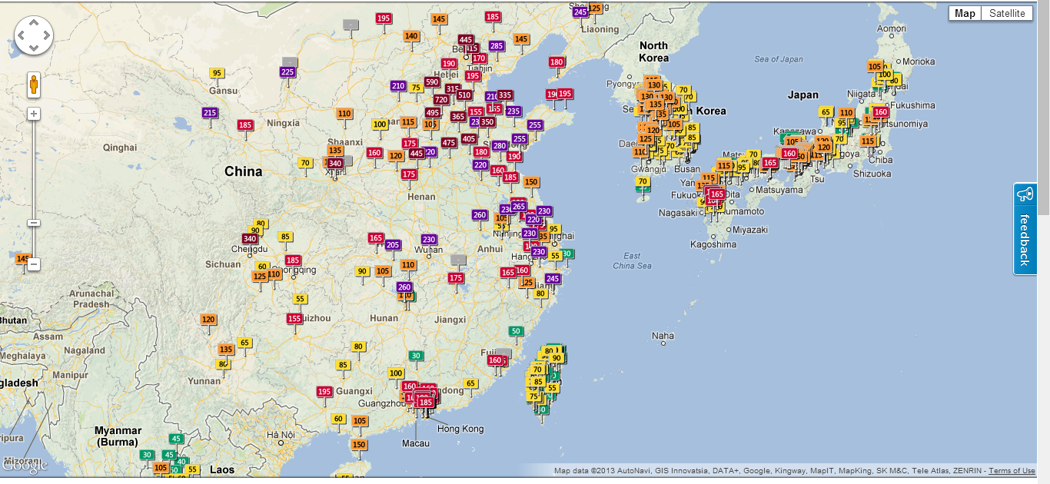
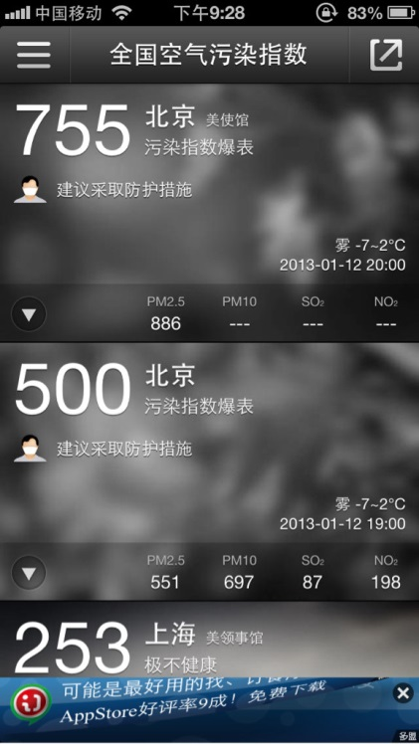
Introduction
Severe air pollution episode in China this Jan
(http://aqicn.org/?map)

Slide 4
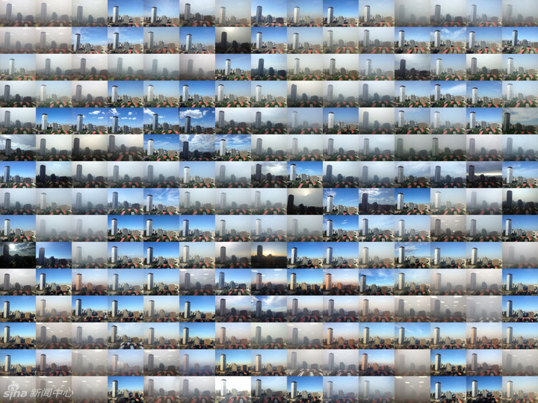
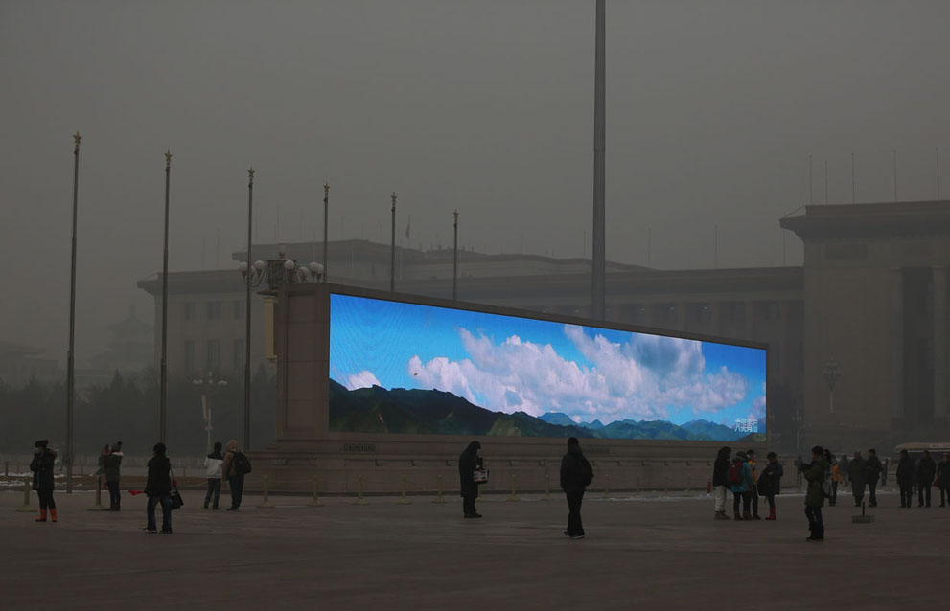
Introduction
Severe air pollution episode in China this Jan
(Sky over Beijing from 2012/03/01-2013/03/06, Sina)

Slide 5
Introduction
What caused this severe air pollution?
Extreme weather?
Lower wind speed/stagnant weather
Higher air temperature/inversion layer
Air Quality
Control factors (I)
Control factors (II)
Less precipitation
Increased Emission?
Natural
/anthropogenic
……

Slide 6
Methodology
Data sources
---air quality: Chinese National Environmental Monitoring Center (CNEMC); MODIS/MISR AOD;
---meteorology: NCEP/NCAR reanalysis( Kalnay et al., 1996).);
---sea ice: NSIDC (Fetterer, F., K. Knowles, W. Meier, and M. Savoie. 2002 )
Data analysis methods
----correlation analysis
----multivariate linear regression analysis

Slide 7
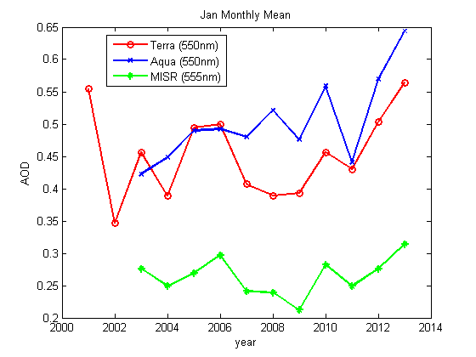
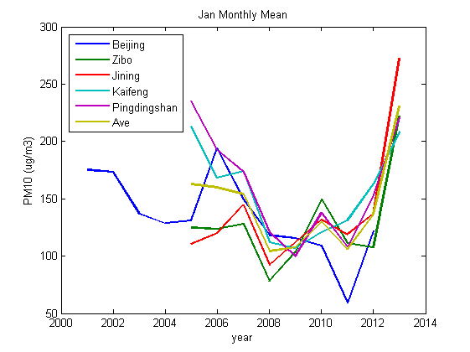
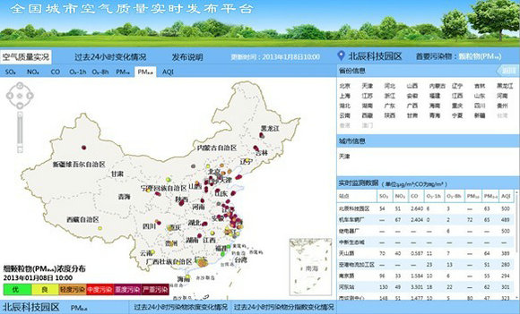
Data analysis---pollution trends
Satellite Data
NCP region
Ground Observation

Slide 8
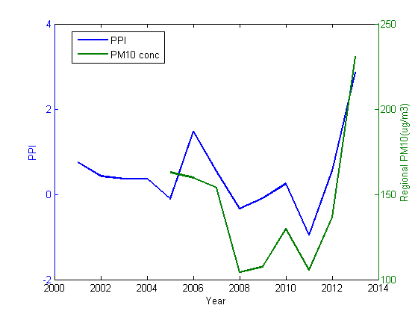
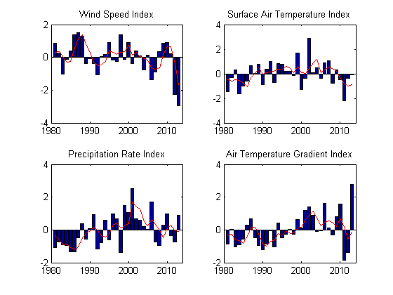
Data analysis---extreme weather
WSI | Correlation Coefficient | P value
Terra | -0.60 | 0.0303
Aqua | -0.57 | 0.0646
MISR | -0.62 | 0.0423
Grd_OBS | -0.75 | 0.0187
TGrdI | Correlation Coefficient | P value
Grd_OBS | 0.65 | 0.0581
PPI | Correlation Coefficient | P value
Grd_OBS | 0.89 | 0.0011
Pollution Potential Index
$$Index=\frac{(\overline{X_{\left(i\right)}}−mean\left(\overline{X}\right))}{std\left(\overline{X}\right)}$$
$PPI=\frac{r_{1}×(−WSI)+r_{2}×TGrdI}{r_{1}+r_{2}}$

Slide 9
Data analysis---EAWM system
 | Description | Equation
SHI | Regional mean of SLP in the center of Siberian High | $\overline{P_{slp}}$*$(40−60N,70−120E)$
TAI | East Asia Trough Axis shift | (Lon(H)-Lon(Hclim))* (35-45N,100-180E)
TII | East Asia Trough Intensity | {[(H min)i - H i+30] + [(H min)i - H i-30] }/2* (40N)
PDI_SLP | SLP difference/Pressure gradient | $\overline{(P_{slp}}1$-$\overline{P_{slp}}2$)* (20/45N,110/120E-150/160E)
PDI_H500 | GPH500 difference/Pressure gradient | $\overline{(P_{h500}}1$-$\overline{P_{h500}}2$)* (50/70N,40/90E-130/160E)
H500 | Regional mean of GPH500 in the center of EAT | $\overline{P_{h500}}$*$(25−45N,110−145E)$
SLP_Arc | Regional mean of SLP over the Arctic Ocean | $\overline{P_{slp}}$*$(70−90N,90E−150W)$
AO | Arctic oscillation | NOAA/ESRL
NAO | North Atlantic oscillation | NOAA/ESRL
PDO | Pacific decadal oscillation | NOAA/ESRL
ENSO | Multivariate ENSO index | NOAA/ESRL
ICE_Arc | Arctic Sea Ice Index | NSIDC

Slide 10
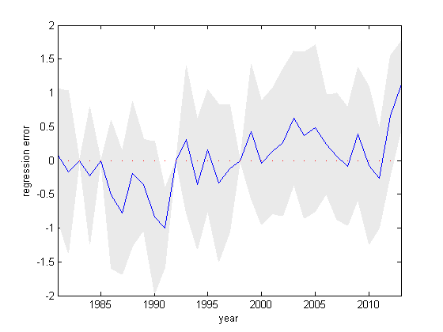
Data analysis--- PPI regression
PPI | SHI | TAI | TII | PDI_SLP | PDI_H500 | H500 | SLP_Arc | AO | NAO | PDO | ENSO | ICE_Arc
Alpha | 0.1894 | 0.4275 | 0.0415 | -0.4632 | -0.2652 | 0.0411 | 0.2784 | 0.1495 | -0.1861 | 0.1532 | 0.031 | -0.1008
Upper (95%) | 0.7462 | 0.8507 | 0.4495 | 0.2416 | 0.1262 | 0.6358 | 0.7448 | 0.6874 | 0.2355 | 0.6201 | 0.5871 | 0.2822
Lower (95%) | -0.3674 | 0.0043 | -0.3664 | -1.1679 | -0.6567 | -0.5536 | -0.1879 | -0.3885 | -0.6077 | -0.3137 | -0.5251 | -0.4837
R²=0.6329
p=0.06, err_var=0.3897

Slide 11
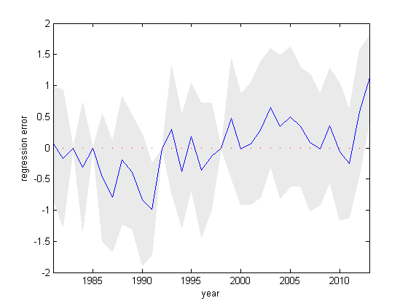
Data analysis--- PPI regression
PPI | SHI | TAI | PDI_SLP | PDI_H500 | SLP_Arc | AO | NAO | PDO | ICE_Arc
Alpha | 0.1701 | 0.4244 | -0.4732 | -0.2535 | 0.2678 | 0.1693 | -0.1796 | 0.1638 | -0.1264
Upper (95%) | 0.6036 | 0.6893 | -0.1187 | 0.0742 | 0.5561 | 0.5901 | 0.2002 | 0.4494 | 0.1848
Lower (95%) | -0.2634 | 0.1595 | -0.8278 | -0.5811 | -0.0204 | -0.2515 | -0.5594 | -0.1218 | -0.4376
R²=0.6304
p=0.009, err_var=0.3304

Slide 12
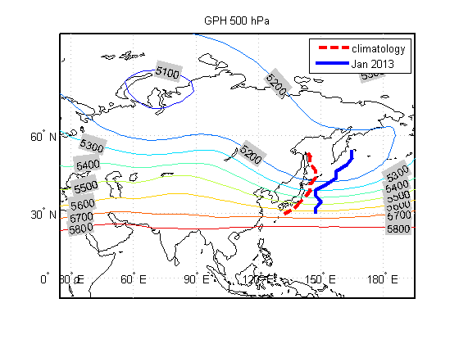
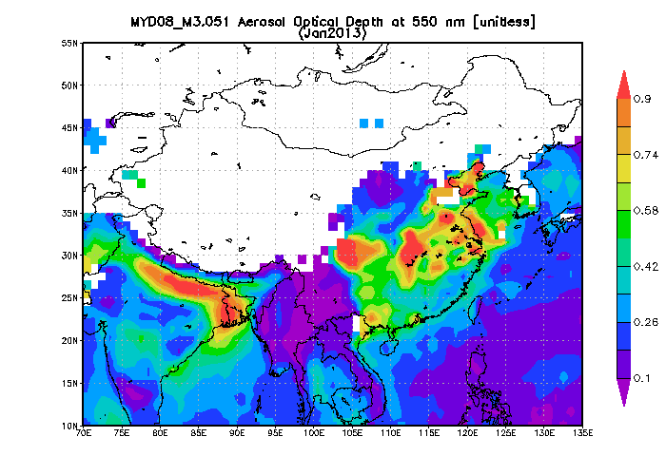
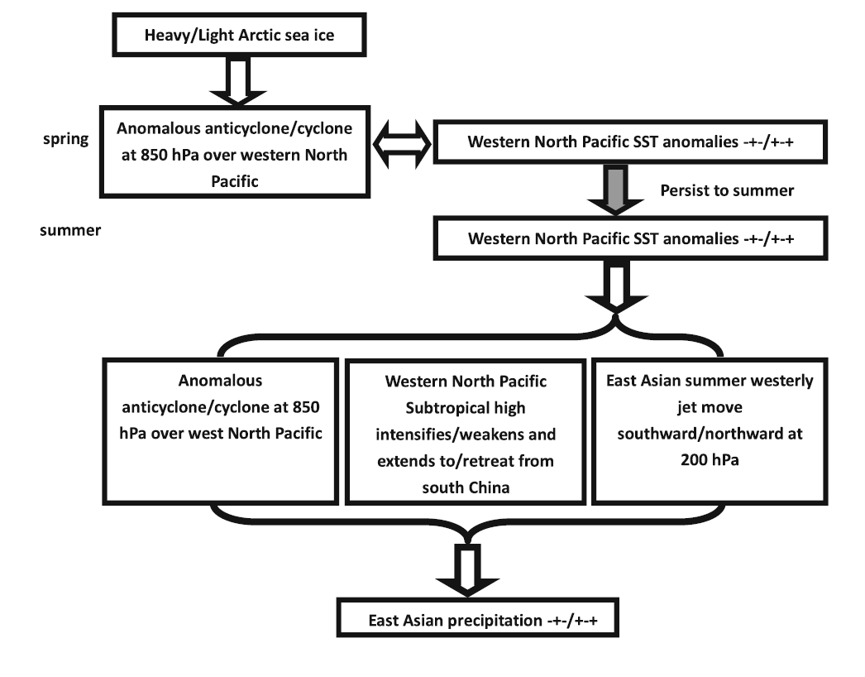
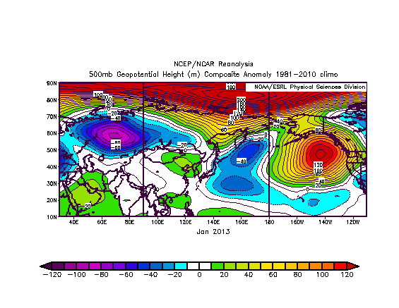
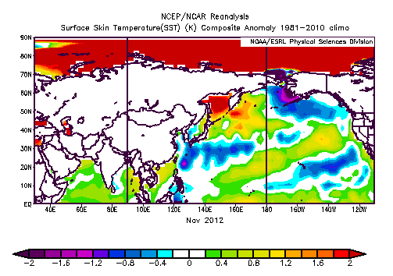
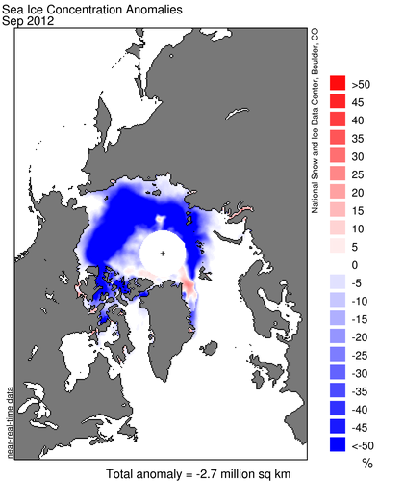
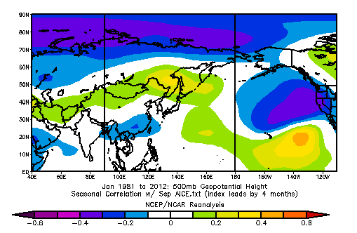
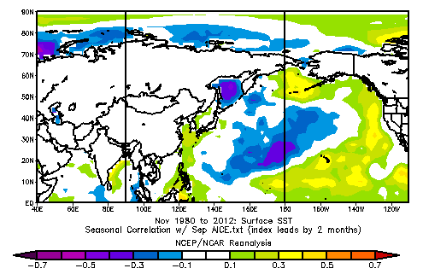
Data analysis---possible mechanism
Air quality
Spring Arctic Sea Ice & EASM
Anomalies
Arctic Sea Ice
Atmos
SST
(Guo et al., 2013)
Spatial correlation

Slide 13
Conclusion
Severe pollution episode in this Jan mainly results from very limited dispersion capability along with regional stagnant weather condition;
East Asia Trough shift and lower sea level pressure gradient are the two major direct factors that contribute most to the adverse weather;
Arctic sea ice reduction anomalies are possible causes resulting in the above variation through Atmosphere-Ocean interactions;

Slide 14
Thanks!

