Slide 1
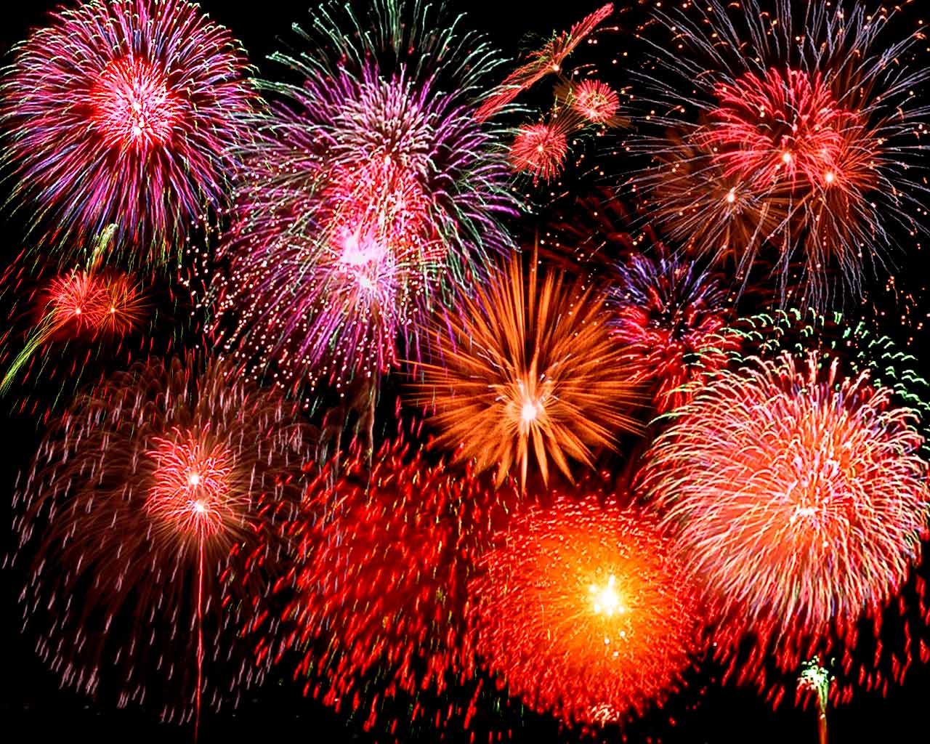
Effects of Fireworks on Ambient Air Quality
tianlinchang
CEE6792
042513

Slide 2
Symbol | Name | Fireworks Usage | Color
Al | Aluminum | Aluminum is used to produce silver and white flames and sparks. | silver, white
Ba | Barium | Barium is used to create green colors in fireworks and used as a stabilizer. | green
C | Carbon | Carbon is one of the main components of black powder, which is used as a propellant in fireworks.
Ca | Calcium | Calcium is used to deepen firework colors. Calcium salts produce orange fireworks. | orange
Cl | Chlorine | Chlorine is an important component of many oxidizers in fireworks. Several of the metal salts that produce colors contain chlorine.
Cs | Cesium | Cesium compounds help to oxidize firework mixtures. Cesium compounds produce an indigo color in fireworks. | indigo
Cu | Copper | Copper produces blue-green colors in fireworks and halides of copper are used to make shades of blue. | blue-green, blue
Fe | Iron | Iron is used to produce sparks. The heat of the metal determines the color of the sparks. | yellow
K | Potassium | Potassium compounds help to oxidize firework mixtures and create a violet-pink color to the sparks. | violet-pink
Li | Lithium | Lithium is a metal that is used to impart a red color to fireworks. | red
Mg | Magnesium | Magnesium burns a very bright white. | white
Rb | Rubidium | Rubidium compounds help to oxidize firework mixtures and produce a violet-red color in fireworks. | violet-red
S | Sulfur | Sulfur is a component of black powder found in a firework's propellant/fuel.
Sr | Strontium | Strontium salts impart a red color to fireworks and serves as a stabilizer. | red
Ti | Titanium | Titanium metal can be burned as powder or flakes to produce silver sparks. | silver
Notes:
-Fireworks composed of many many compounds including:
-metals for colored and explosive effects as well as chemical stabilizers
-carbon & sulfur as fuel and propellant
-Once exploded, these compounds remain in the air for some time causing environmental and health problems

Slide 3
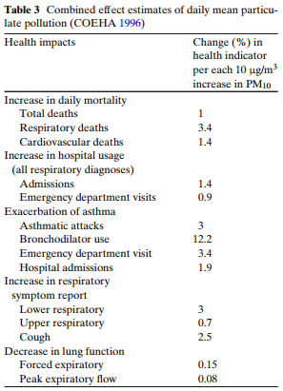
Health Effects
PM₁₀ & PM_{2.5} (Metals, acids, etc.)
Neurological, hematological, carcinogenic effects
Respiratory problems
SO₂ & NO₂
Cardiovascular diseases
Developmental problems (premature births, etc.)
O₃
Respiratory problems (asthma, bronchitis, etc.)
Notes:
-PM usually includes trace metals and acidic compounds which can cause or worsen neurological & hematological conditions & cause cancer
-You can see the figure to the right detailing the increase in health problems for every 10ug/m3 increase in PM10
-There has been a strong correlation between SO2 & NO2 with cardiovascular diseases as well as developmental problems such as premature births
-Groundlevel ozone is a main culprit of asthma, bronchitis, and other respiratory illnesses

Slide 4
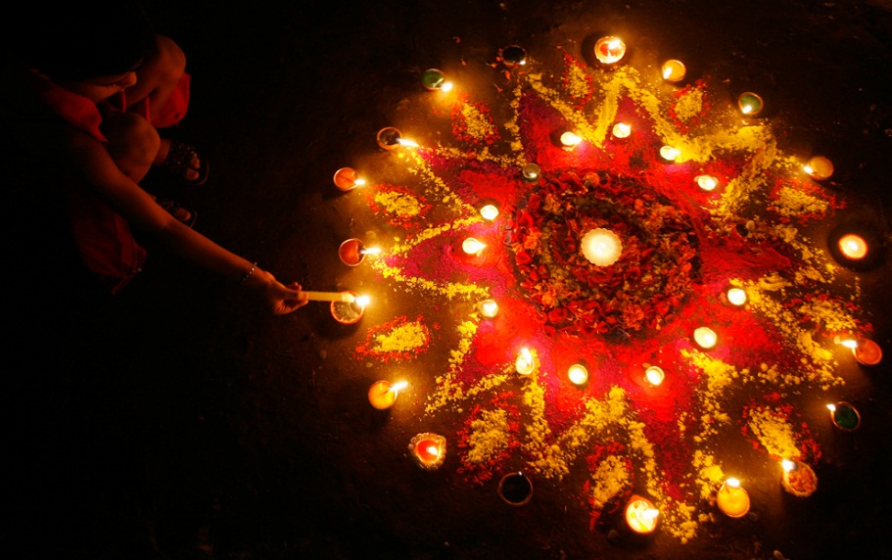
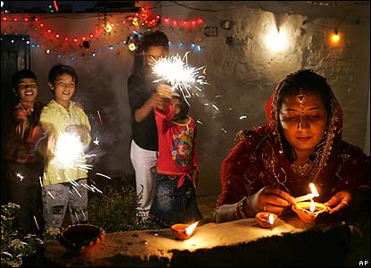
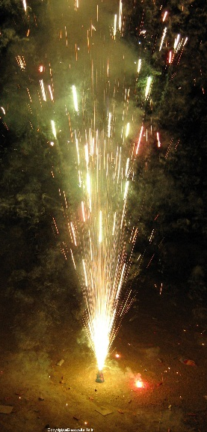
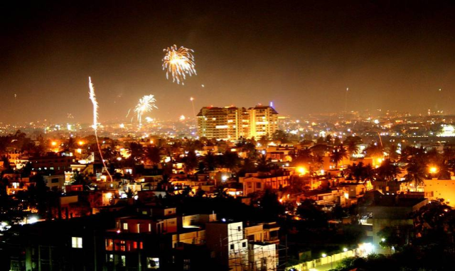
Cultural Background
Delhi & Lucknow, India
Atlanta, GA
Diwali Festival
Hindu “Festival of Lights”
Household-to-household
New Year’s
Independence Day/July 4th
Notes:
-Diwali is the Hindu festival of lights so as you can imagine, so fireworks, fire crackers, sparklers, candles, etc. are used almost in every household- multiply that by for every household in the second most populous country in the world- lots of air pollution.
-Much bigger celebration than New Year’s or July 4th in the U.S. which were used as comparisons in this study

Slide 5
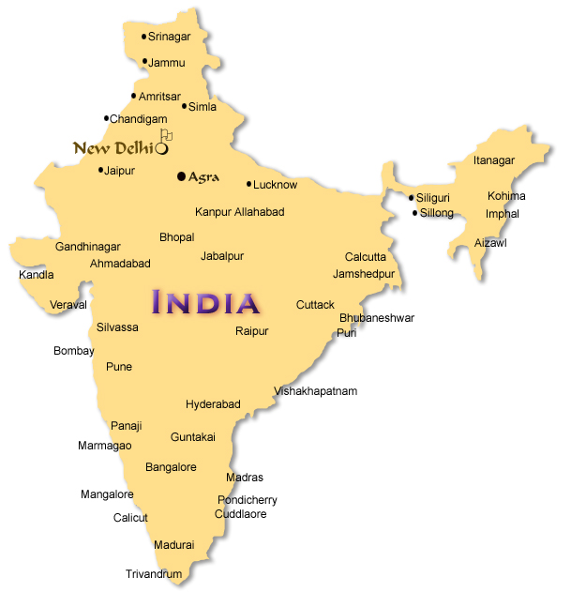
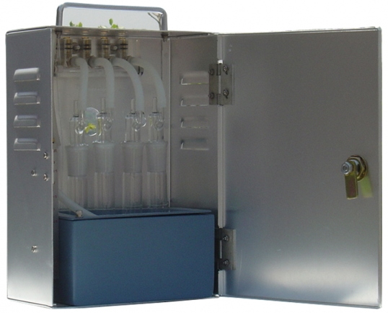
Case Study: Delhi, India
Population: 21 million
PM₁₀, SO₂, NO₂
24 hr. sampling at 13 m
Representative of 2/3 stories
APM-411 gaseous sampler & respirable dust sampler
Notes:
-Capitol city, most populated and located in N. India
Case study sampled at one location 13 m. above groundlevel because representative breathing zone and fire cracker and sparkler use zone for average 2-3 story buildings
APM-411 gaseous sampler & respirable dust sampler
To measure PM10, SO2, & NO2

Slide 6
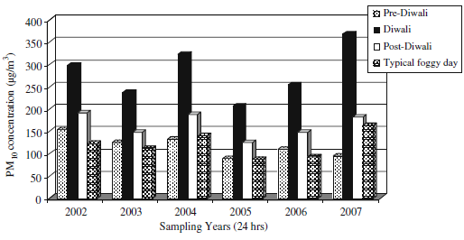
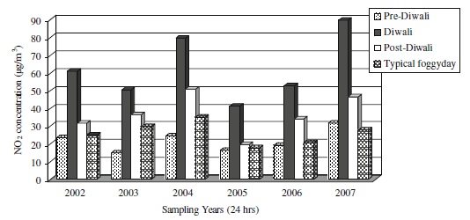
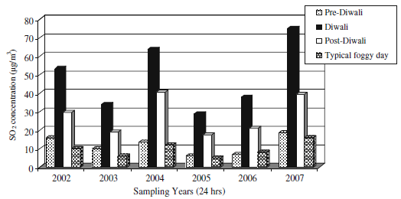
Delhi Results
PM₁₀ Trends
NO₂ Trends
One vs. multiple sites
Exact site location?
Urban vs. suburban
Avg. typical day?
SO₂ Trends
Notes:
-Looked at typical foggy day, pre-Diwali, Diwali, and Post-Diwali
-Clear increases from pre-Diwali to Diwali for all 3 categories across 6 years worth of data
-PM10 doubled from pre-Diwali to Diwali
-NO2 doubled in some case almost tripled
-SO2 almost quadrupled in every year
-The day following Diwali experienced drops but still remained higher then measurements of the emissions on typical foggy days.
-As a side note, Pre-Diwali has higher readings than typical foggy days because some people burn sparklers, etc. the day before but the main celebration is day of Diwali itself
LIMITATIONS:
-only tested at one building site, but it was never said if the building was in a downtown location or more outer edges of the city
-for some reason, chose to contrast data with average foggy day, but not typical weather day
-Would have served as a good comparison as foggy days might show lower concentration trends

Slide 7
Case Study: Lucknow, India
Population: 4.8 million
PM₁₀, SO₂, NO₂, 10 trace metals
24 hr. sampling at 4 residential sites
North, East, South, West
Envirotech respirable dust sampler
Notes:
-Smaller metropolitan city in India, but still very populated.
-Tested for PM10, SO2, NO2, and 10 trace metals
-also using repirable dust sampler
-four testing sites at each corner of the city 10-15 km apart from the center of the city

Slide 8
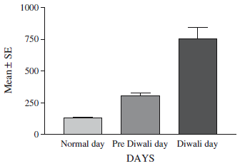
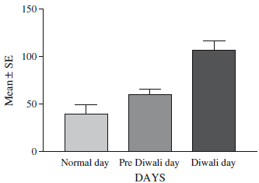
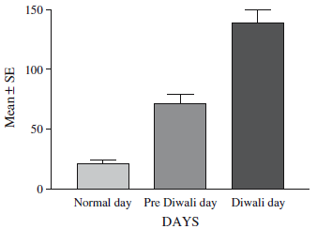
Lucknow Results
PM₁₀ Trends
NO₂ Trends
Sampling height?
Post-Diwali data?
Multiple years
SO₂ Trends
Notes:
-Once again, you see clear increases from Pre-Diwali to Diwali in all categories
-In this case study, they did a statistical analysis of the 10 trace metals they looked at and found that out only 4 of them had statistically significant changes from Pre-Diwali day to Diwali day and night
-which included Co, Nickel, Chromium, and Cadmium
-Some short falls of this study included no description of the sampling height at the four different locations so it might not have been standardized.
-Testing at Ground-level can have a significantly different ambient air quality versus 3 or 4 stories up due to people burning things on the streets
-Also, this study did not record data from the days after Diwali to contrast with pre-Diwali or a normal day.
-The study was only conducted in one celebration unlike the other case study which took measurements every year for 6 yrs. To provide a better set of data

Slide 9
Atlanta Results
Notes:
To compare previous with Atlanta data, I used the EPA database to find measurements of ambient concentrations from 3 days before the event picture here on Day 4 with yellow dots and then two days after for the two major fireworks events in the US which were New Years and Independence Day
I averaged 5 years worth of data together
My data did not match the studies’ data which I will go into further detail in a bit.
But overall, PM 10 did not have a clear increasing trend so I went further and looked at PM2.5, but that also did not show a clear increasing trend. As you can see, none of the R2 values are very significant.
Just as a side note, I found that Independence Day was usually in a higher range probably being due to taking place in the summer when there are higher emissions.

Slide 10
Atlanta Results
Notes:
NO2 & SO2 had drops in the average trends possibly being due to the locaiton of the testing sites in outer Atlanta in Dekalb county instead of downtown where most of the celebrations were. I’ll also go into further detail later.
I also looked at ozone out of curiosity because the studies did not focus on it. I found a decreasing trend for July 4th and an increasing trend for New Year’s so I can’t draw much of a correlation from that.

Slide 11
Limitations to the Atlanta Data
AQS Site specifics unknown
Dekalb County- not representative of downtown Atlanta
Sampling height?
Inconsistent AQS sites
No detailed information as to how EPA data was collected
Non-standardized testing methods
Missing data (days-months/year)
Notes:
-Did not know exact location of site like sampling height, in a park vs. industrial area
-I only knew it was in Dekalb county which is not very representative of downtown ATL
-Some of the data might have showed decreasing trends due to this because maybe there was less traffic due to off days from work and increased traffic going downtown where most celebrations are and not in the suburbs
-Also, the EPA data did not give much details about testing site specifics like location or methods, etc. because I did not have an AQS account with them because they have yet to approve my registration.
-And the data I did find from the website was often missing days or months at a time especially during the 2 times of year I needed most.
-So the averages might not be the most representative

Slide 12
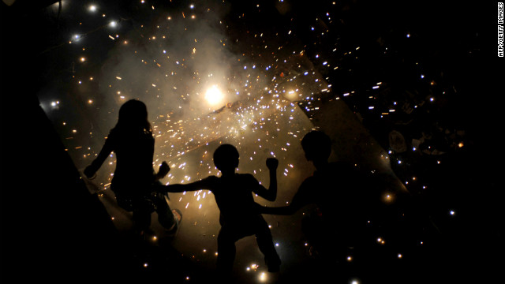
Conclusion
From case studies:
PM₁₀, SO₂, NO₂- clear increase
Co, Ni, Cd, Cr- statistically significant changes
Atlanta data
Skewed data points
PM₁₀- unclear
PM_{2.5}- slight increase
NO₂- clear decrease
SO₂- decrease
O₃- unclear
Possible explanations
Diwali- celebration of MUCH larger magnitude on household scale (1.2 billion vs. 300 million)
Developing country with less regulations- emissions of higher range/scale
Off days + public gatherings downtown ATL- decreased cars and less emissions in suburbs than typical day
Atlanta measurements at ground-level or higher?
Notes:
EXPLANATIONS:
-Diwali is celebrated with fireworks and firecrackers on a household scale. When you look at US, firework events are usually a public gathering vs. a household event.
-Factor in the number of households with the second biggest population in the world of 1.2 billion, you have a much more dramatic increase in ambient concentrations than when compared to the US population of 300 million where as I said most celebrations are public gatherings
-Also, India has much less regulation on emissions from industry and cars so their emissions data will always be in a much higher range than those of the US
-One reason to explain the decreasing trends examined here in Atlanta would be that because the readings were taken in Dekalb county, we can consider it more residential compared to downtown Atlanta.
-Thus, we can argue that because most of the celebrations are downtown, the emissions from cars usually present are now moved away downtown
-Also, these are holidays so no one is going to work or operating so less car and industry emissions in the area also contributing to the decrease
-The Atlanta measurements I mentioned earlier I wasn’t sure if it was taken at ground level or more elevated. I have a feeling that it was taken possibly higher up than ground level which would result in decreased readings for some emissions.

