Slide 1
Meteorological Effects on Morning Rush Hour Air Pollution
Chris Forehand
Atlanta Commuter Exposure (ACE) Project

Slide 2
Background
What is the ACE project?
Funded by the CDC
Joint project between Emory University and Gatech
Uses continuous and time integrated measurement
Why is it important?
High exposure concentrations on a daily basis
Notes:
*The Atlanta Commuter Exposure study was funded by the CDC as a method of looking at in vehicle exposure to air pollution between healthy and asthmatic adults during a 2 hour scripted route along major highways in Atlanta during rush hour traffic
*It’s a joint project between Emory University and Georgia Tech – most of the health measurements are done at Emory while filter analysis and preparation is handled here at Gatech
*We’re examining PM2.5 mass, particle number, black carbon mass, particle bound PAHs and in cabin noise on a continuous basis with time stamps ranging from between 1 to 10 minutes
*EC / OC / WSOC and organic compounds like alkane groups, hopanes, steranes, and PAHs are also being analyzed on filters
*The reason for this project is that many people commute into Atlanta during the morning and given typical congestion may be stuck in traffic for a long time – sometimes in grid lock. Rush hour commuters on major roadways operate a vehicle directly in a source zone of high UFP concentrations due to vehicle emissions. They’re exposed to elevated concentrations during those commutes, generally 5 days out of a week
*Curious about the health effects that might be associated with this, primarily cardiorespiratory diseases and asthma incidence. Some toxicological evidence suggests that since the number size of vehicle emissions is in the ultrafine size range that these particles are able to penetrate the alveolar region of the lungs and cause damage

Slide 3
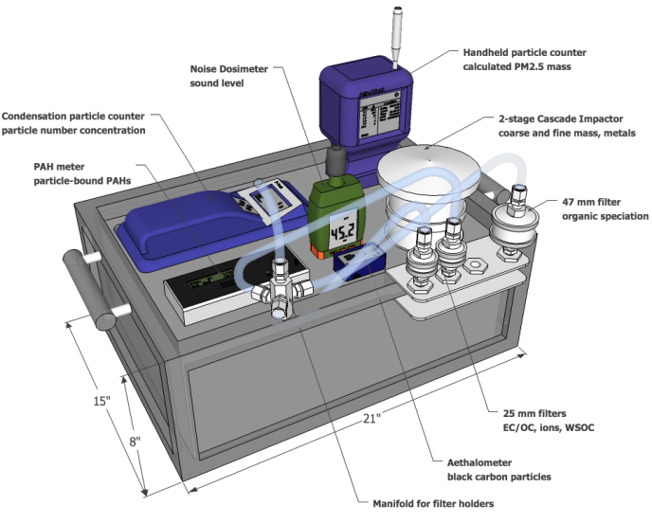
Methodology
Notes:
*Measure in vehicle concentration of PM and PM components for 40 test subjects twice for a total of 80 commutes
*Follow a route of approximately two hours duration from around 7 to 9.
*The filter holders are for measuring EC/OC/WSOC/Elements. We also have a CPC to CPC and PAH meter to measure particle numbers and PAHs, a two stage cascade impactor with teflon filters for measuring fine mass and metals

Slide 4
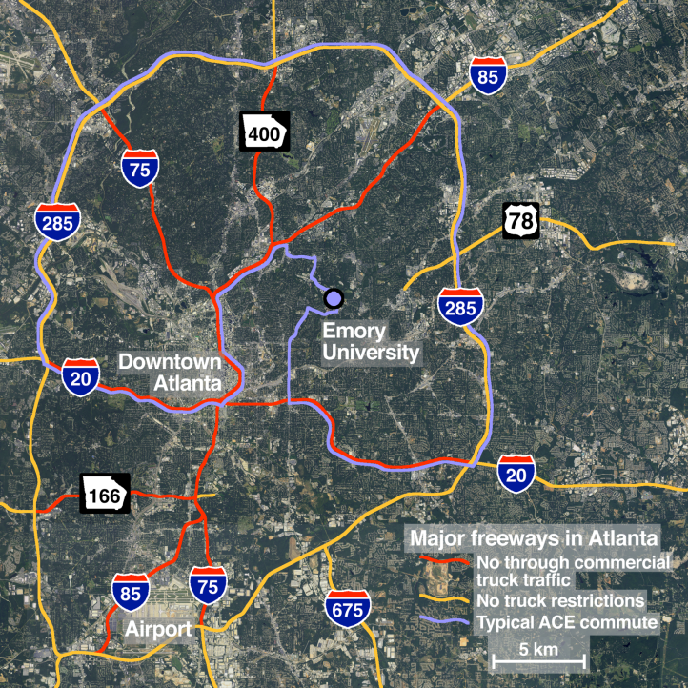
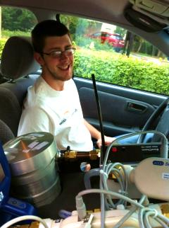
Notes:
This is a map of a typical ACE commute, seen in blue. The areas with the red don’t typically have much commercial truck traffic so on commutes you tend to see lower amounts of EC, while the areas in gold have them so you of course have larger amounts

Slide 5
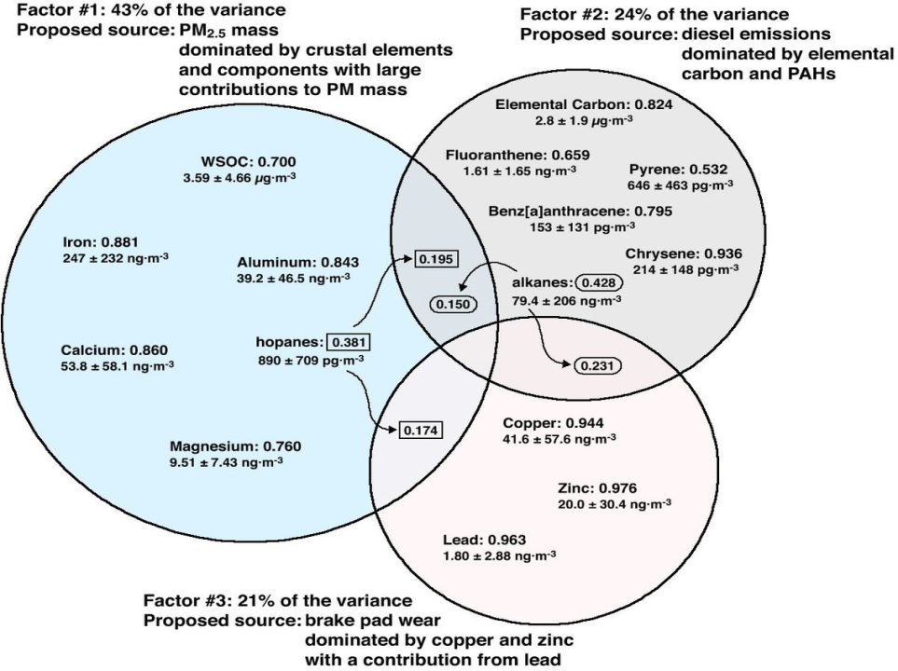
Notes:
This is just a slide I kind of threw in there, we ran a principle component analysis and it showed us that these three factors accounted for approximately 90%~ of the variance. Later I’ll be looking at black carbon in specific which is pretty highly correlated with our elemental carbon with an R^2 value of around .85. It’s not the most ideal, but since I had hourly time stamp emissions

Slide 6
For this class…
Examine the effects of:
Seasonal Trends
Temperature
Relative Humidity
Wind Speed
Precipitation
Limitations:
Mobile measurements
Limited meteorological data
Non-continuous observations
Notes:
*Up until this point it’s thought that source emissions are the primary drivers for pollution on the roadways since you’re basically measuring them at source.
*We’ve noticed a significant impact of precipitation in the past, but we never really looked at the effects of temperature, RH, and wind speed on pollution concentrations before. This term paper was going to look into some of those effects, as they’re summarized here
*To point out before I start, there are some pretty big limitations to this project. For one, they’re mobile measurements and subsequently don’t have a constant source, so it’s more difficult to tease out relationships like with meterology. I also had a lack of detailed meterological data, as though we have hourly timestamps that corresponded with my data, I was using a stationary weather monitoring site and wind data that doesn’t display if it’s over 1mph. Finally, I have non continuous observations which means that since there were only a maximum of two commutes a week the meterological conditions could change rather significantly and all tended to vary – making it more difficult to determine what factors had significant effects

Slide 7
Seasonal Trends
 | EC (ug/m³) | BC (ug/m³) | OC (ug/m³)
Fall | 2.209972693 | 5.351207711 | 20.97853547
Winter | 1.370976827 | 5.327759696 | 13.91420033
Spring | 2.260973924 | 7.706329281 | 14.18891958
Summer | 5.018534266 | 9.479550192 | 21.95192238
Notes:
Initial graph I made of seasonal trends between elemental carbon, black carbon, and organic carbon. As you can see (or maybe can’t see) there’s quite a lot of fluctuation and noise that’s going on there, but we did have some pretty clear trends. Concentrations seem to be higher across the board during summer, and lowest in winter while spring and fall kind of flip flop a bit. I was primarily concerned with the spring measurements since I had more during those times.

Slide 8
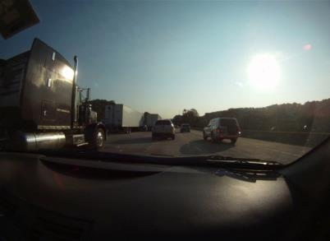
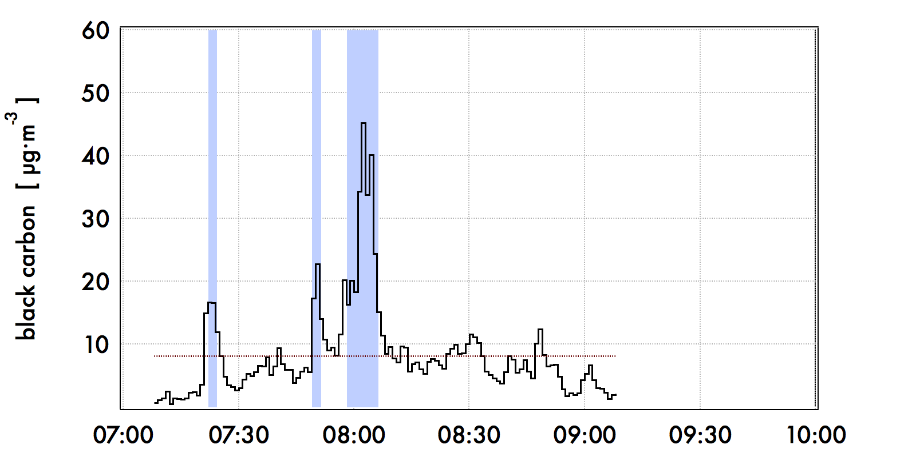
Event Analysis Moving Average
Notes:
*This was a technique that was used by Roby Greenwald in order to automatically point out ‘peaks’ in the datasets that were being run. This method does so by comparing a preceding period of time with the following period of time – if the future average is more than a delta multiple of the past average and the current data point is more than the overall mean plus a standard deviation multiple of the overall standard deviation, then it’s considered an event. When the concentration level falls below that level (with the exception of short little gaps) the event is considered over. Events that are less than one minute are ignored.
*This was utilized in the main study in order to determine where and when peaks were occurring in the data, since these spikes in concentrations are associated most strongly with negative health impact. They also point to times when there’s a very strong source based emission nearby. Most of the peaks that we observed for EC and BC tend to be when the subject car is stuck near “dirty” trucks, and marked times for us to go back and look at the webcam data in order to analyze sources.
*Since these are pretty obvious source generated differences in a short time period, I decided to remove them from my correlations for Temp, RH, and wind speed to help prevent skewing of the data
*Causes the average concentration of black carbon on the commute to go from 7.1 to 9.51
*Average in the beginning to drop from 8.13 to 6.87, average in the middle to drop from 12.42 to 8.81

Slide 9
Temperature
Notes:
*Black carbon showed a very small negative trend in concentration as the temperature went down during analysis in spring
*Seems to contradict the seasonal trends observed earlier, although it’s so small that it might as well be contributed to random scatter
*Other additional explanations are that it is consisting of corrected, ‘event free’ data

Slide 10
Relative Humidity
Notes:
Was expecting there to be a negative trend, as a higher RH concentration should be associated with precipitation events (and thus scavenging of particles in the atmosphere)
Instead, there’s this slight positive trend
Not really sure what the effects of RH would be on black carbon, look it up

Slide 11
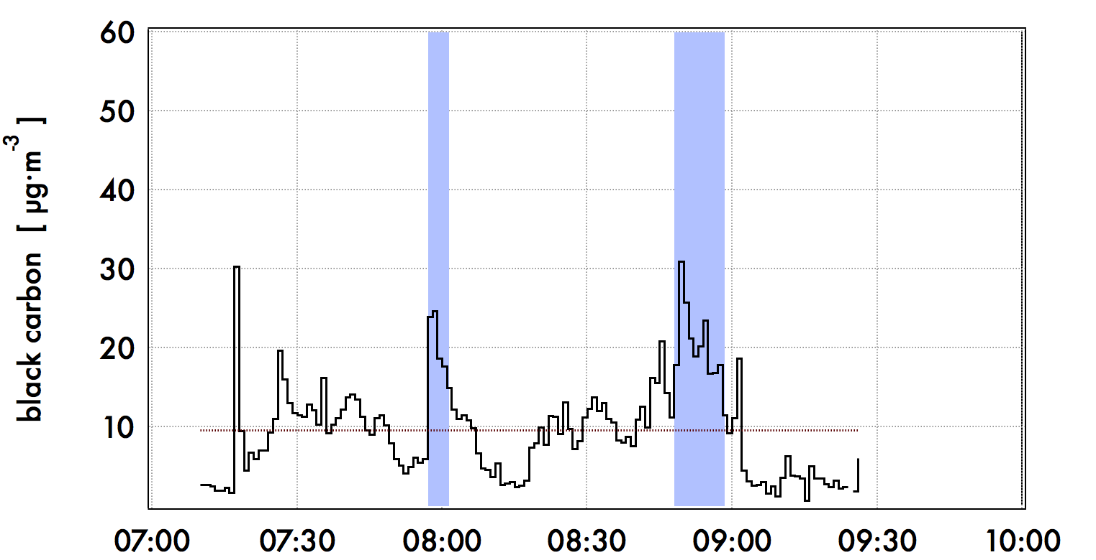
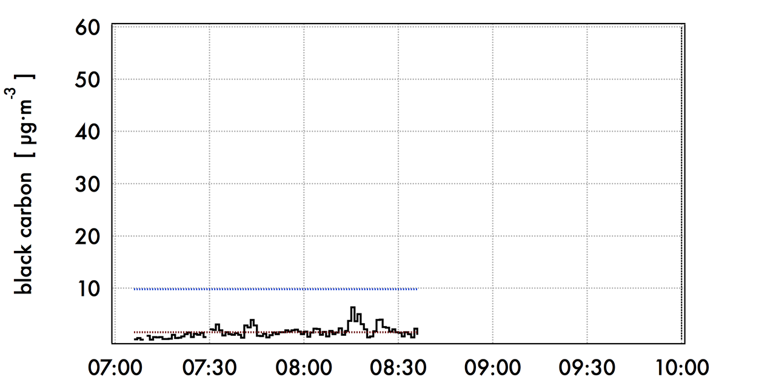
Precipitation Events
Notes:
These are just two examples of precipitation events. The graph on the top was taken from a commute the day before a rainstorm, while the second one was taken two days later during a long rainstorm. The latter one, as you can see, has much lower background concentrations of black carbon, so preciptiation can have a large scavenging effect

Slide 12
Wind Speed
Notes:
Wind speed was one component that I found to have a rather significant effect when compared to the others. This seems to make sense intuitively since you might be blowing particles away from the road and encouraging mixing with the surrounding air. We’ve seen from our measurements here at tech versus the interstate that there’s a rapid drop of particle concentrations as you increase your distance away from the road, so it seems to make sense that mixing would have a very significant effect.
This first graph is taken with all of the recorded wind speed values, while the second involves those same values with all of the points set at zero removed. There’s still some error here as the wind speed data seems to set itself at certain threshold values rather than reporting real wind speed, however

Slide 13
Wind Speed (cont.)
Notes:
This final graph is one I plotted of the averages of the 3 hour graphs and wind speed. The R^2 value seems to improve as you’re taking the averages, which may help to account for the inaccurate wind speed data that was given to us

Slide 14
Conclusions
Seasonal Variation
Too much scatter and too few points to be very conclusive
Pollution seems to dominate in summer, contrary to ABL expectations
Temperature
Seems to be very loosely correlated
Relative Humidity
Little correlation for fresh source particulates
Wind Speed
Limited Data
Mild Correlation
Precipitation
Observable trends

Slide 15
Acknowledgements
Jeremy Sarnat & Roby Greenwald
Emory University, Rollins School of Public Health
Mike Bergin
Georgia Institute of Technology
Martin Shafer
University of Wisconsin
Priya Kewada, James Gooch, Kyle Manning, and everyone else on the ACE / SCAPE team!

