Slide 1
Analysis of Extreme Ozone Episodes
Boundary Layer Meteorology of Extended, High and non-Seasonal Events
Forensic Analysis of Unusual Episodes in 1980-2010 Continental US Ozone Record
EAS 6792 Spring 2013
Tom Loadholt

Slide 2
Purpose for This Study
Vetting of unusual events in the 1980-2010 ozone record
Ozone trend is downward, especially in CA, due to EPA requirements
  Meteorological factors are more significant
  New sources stand out
  Seasonal trends potentially track climate
Already doing informal, implicit boundary layer analysis

Slide 3
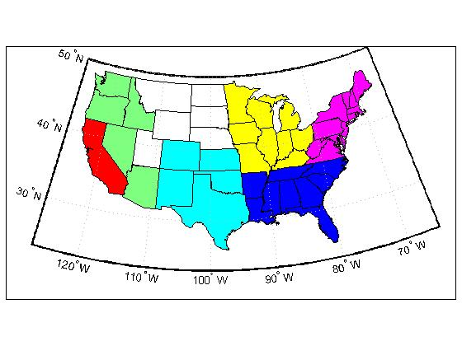
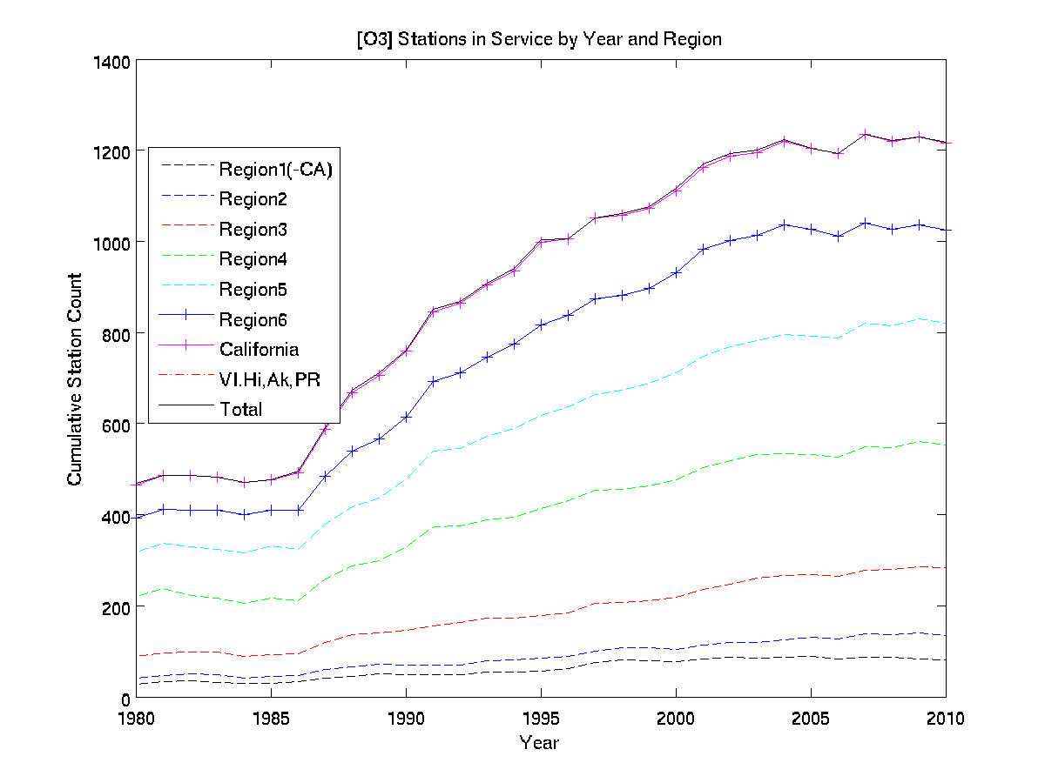
EPA Ozone Stations
1=Green
2=White
3=Light Blue
4=Yellow
5=Magenta
6=Dark Blue
7=Red (California)

Slide 4
Ozone Episode Criteria
EPA – Multilevel severity based on threshold and duration
Extreme for this study
  Durations more than three weeks
  Levels more than 100 ppbv for multi-day events
  Episodes out of season (EPA is JJA)

Slide 5
Three Events
104 day event in San Bernardino County CA
  Early in the record (1981)
  Classic southern CA photochemical episode
  Is there meteorological confirmation of a PBL inversion?
18 day winter event in Utah (2010)
  Out of season
  Recently identified source
21 day event in central NC
  Expect typical summer characterization
  Midway in the record (1987)

Slide 6
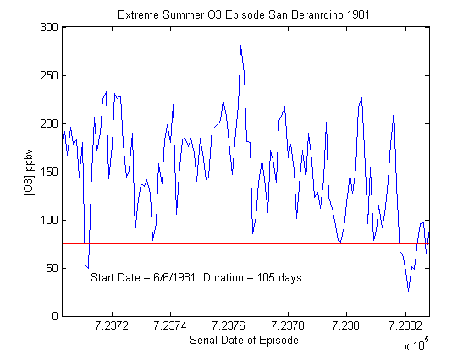
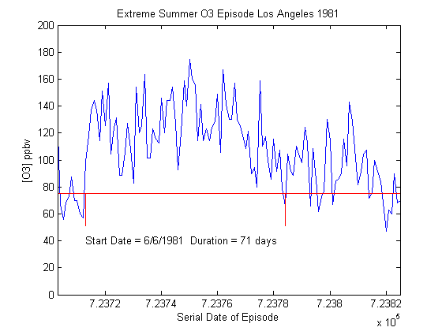
San Bernardino

Slide 7
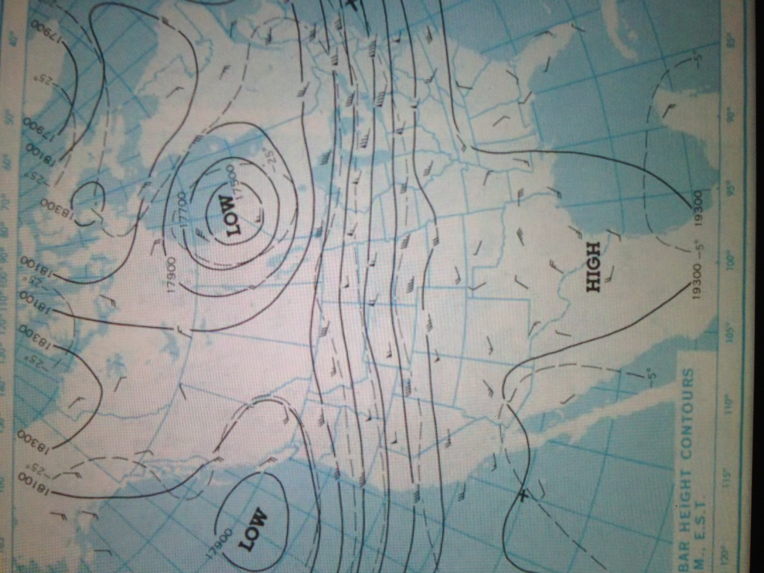
Synoptic Meteorology During San Bernardino Episode

Slide 8
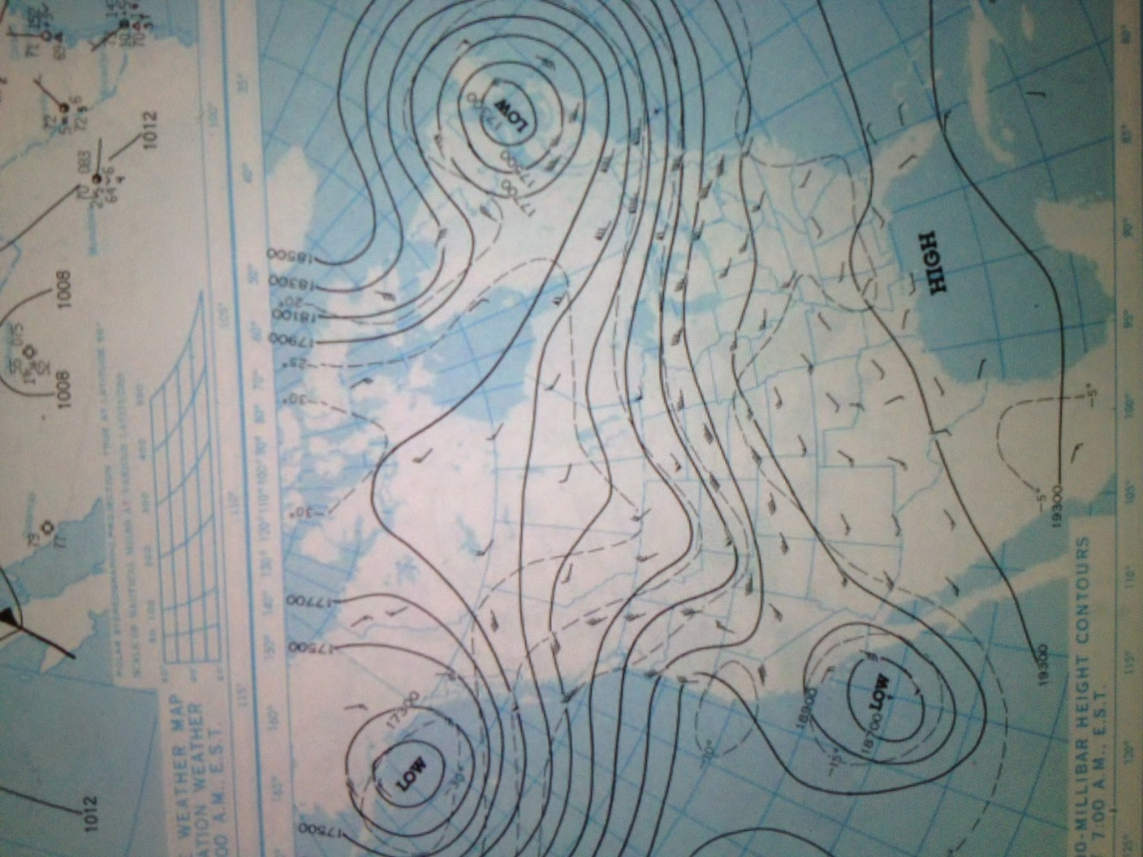
End of San Bernardino Episode

Slide 9
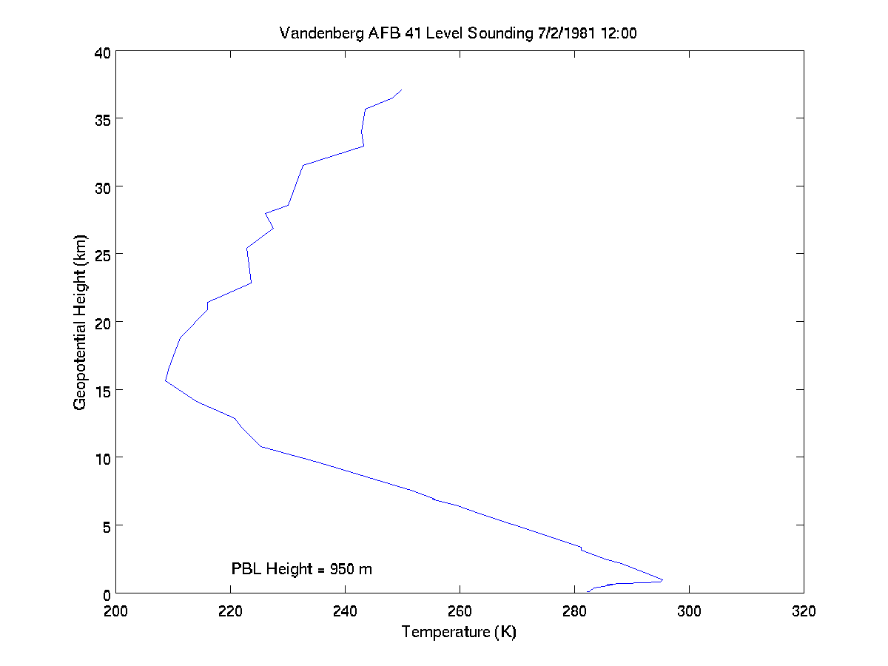
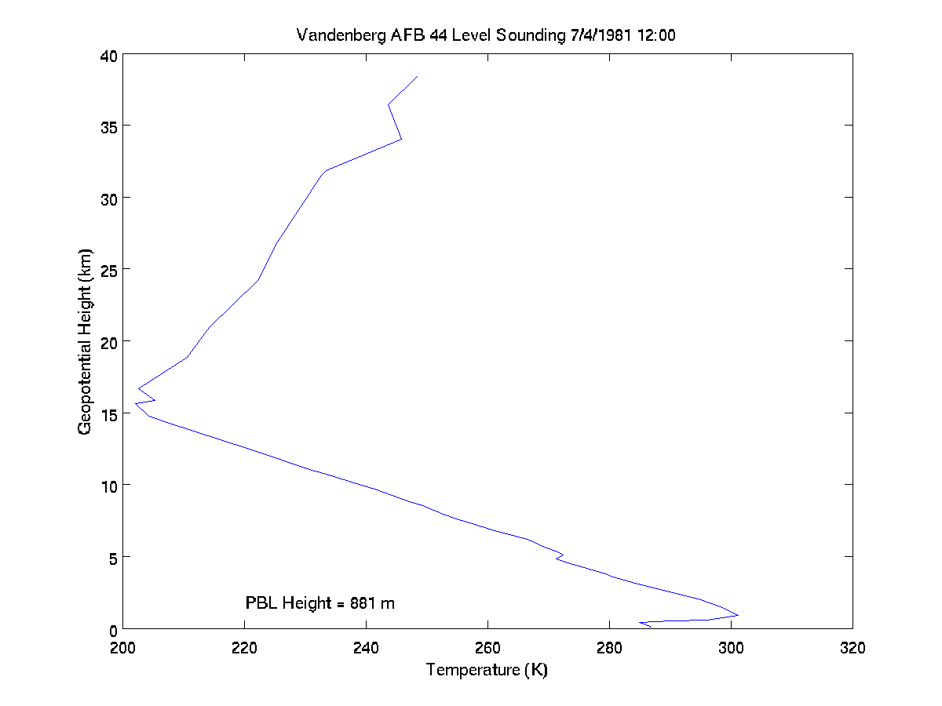
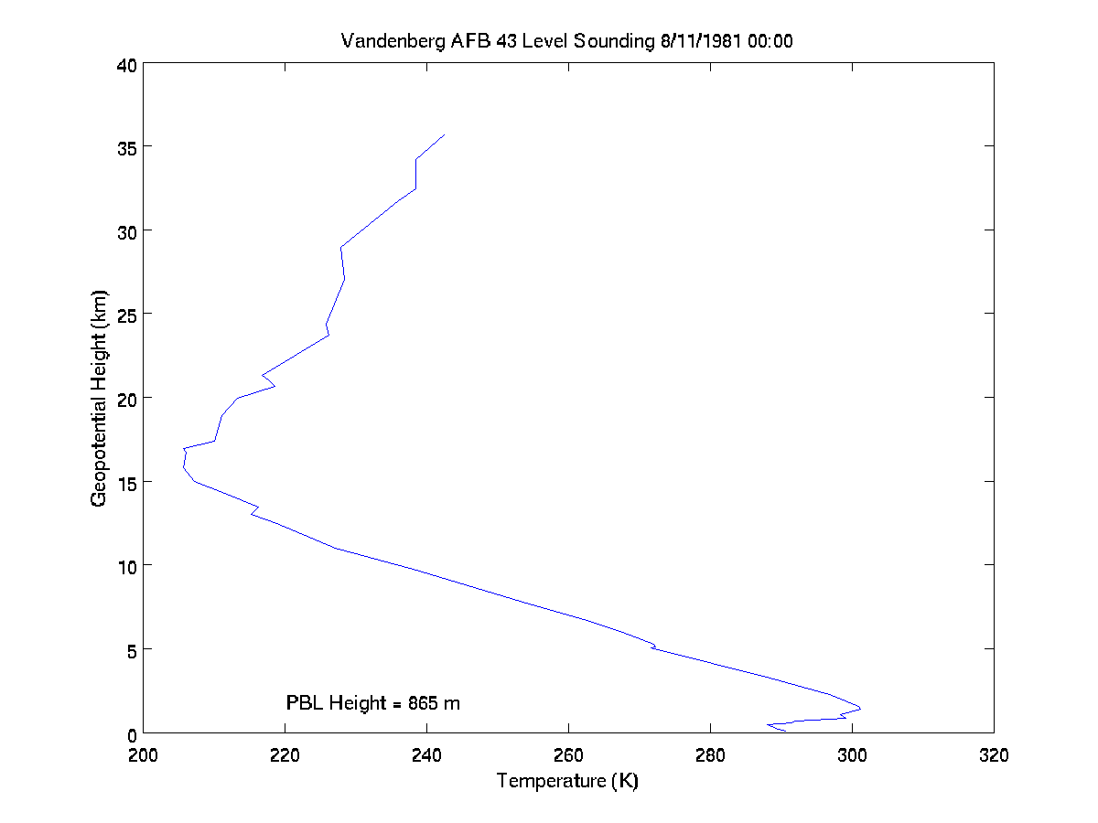
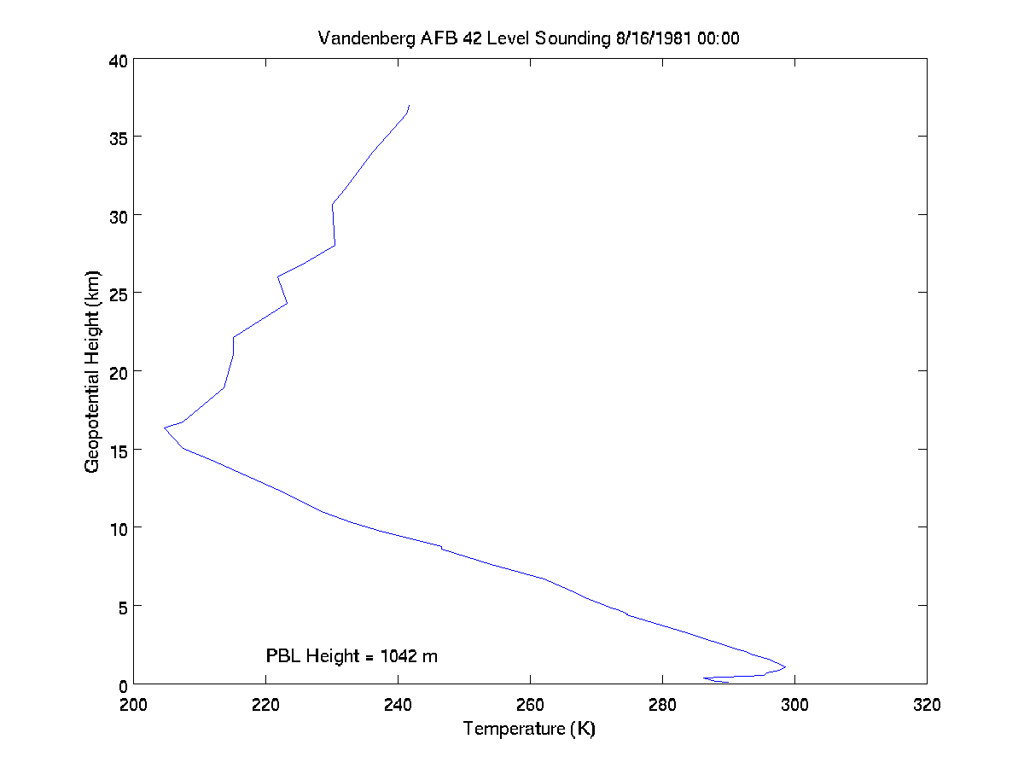
Radiosonde Data Vandenberg

Slide 10
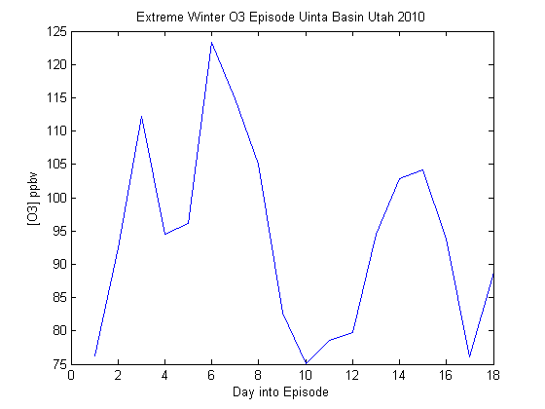
Uintah Basin Utah
Start date 2/16/2010

Slide 11
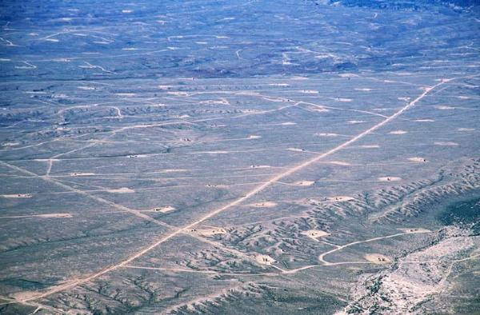
Uintah Basin Utah
Wells have compressors = NO_{x} and VOC’s
Add a winter ingredient = Ozone episode

Slide 12
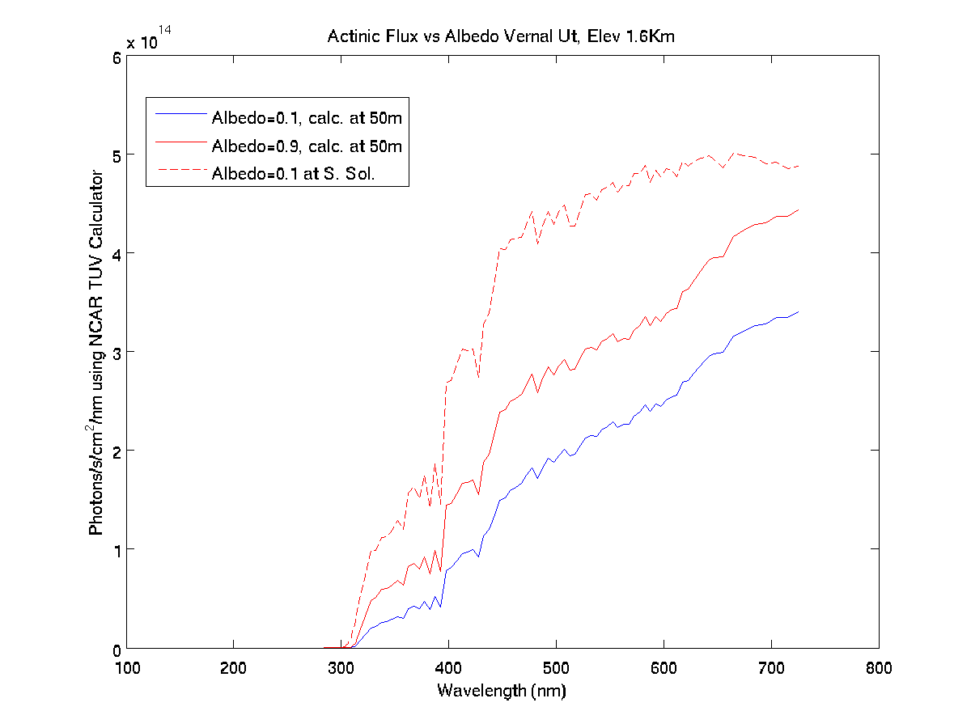
Ozone and Snow
340 nm
New phenomenon? Not really.

Slide 13
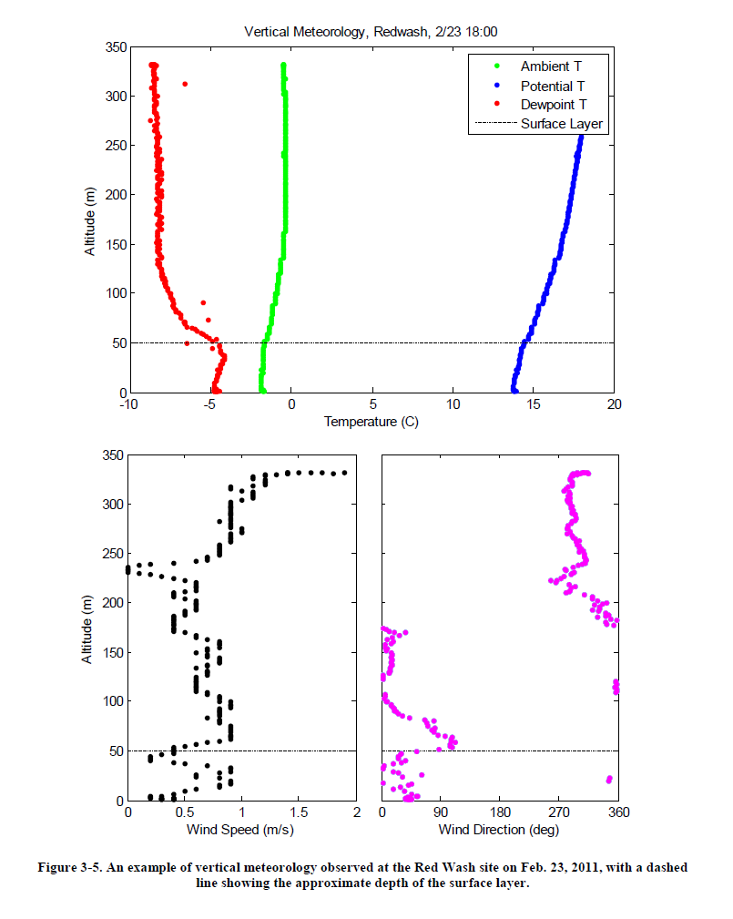
PBL Identification at Uintah
Using Tethered Balloon
Look for Θ_{v}(Z)=Θ_{v}(surface)
Θ=T(P₀/P)^{0.286}
Θ_{v}=(1+0.61q) Θ
Calculations:
RH=80% (surface)
q=0.0026 (surface)
Iteration via MATLAB
confirms PBL~50m

Slide 14
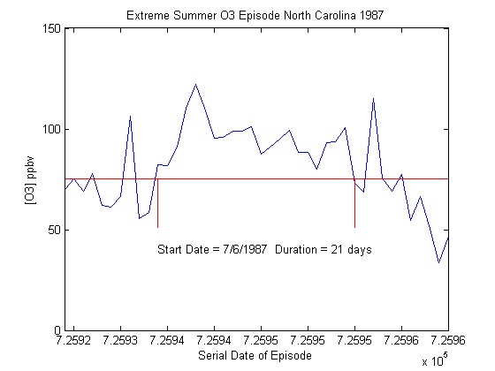
Granville NC

Slide 15
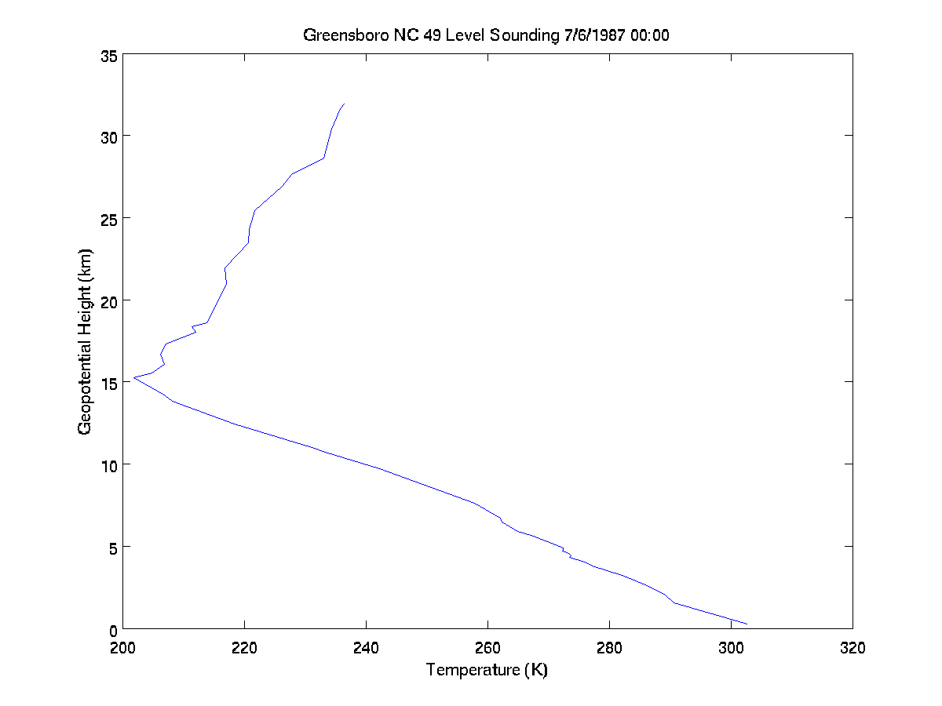
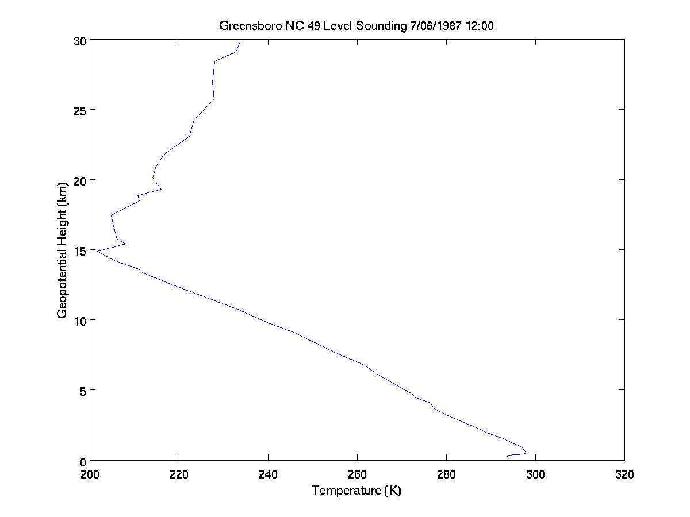
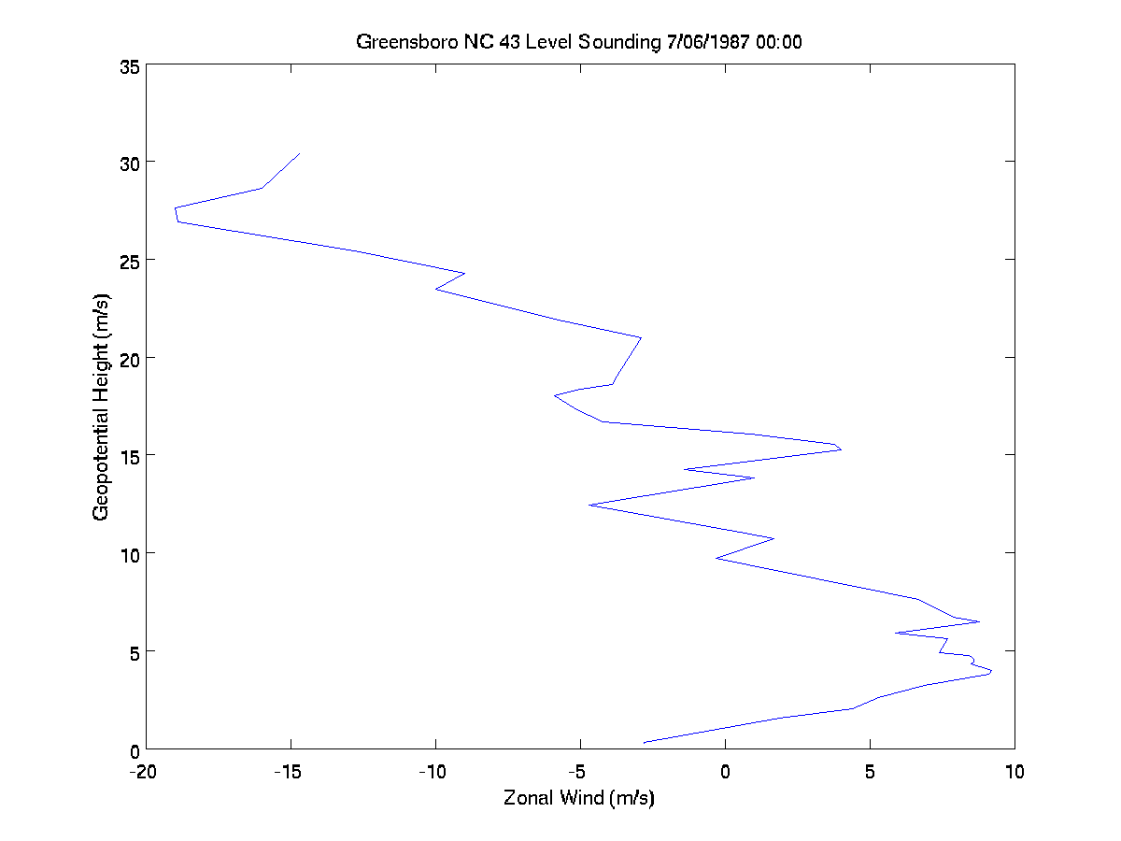
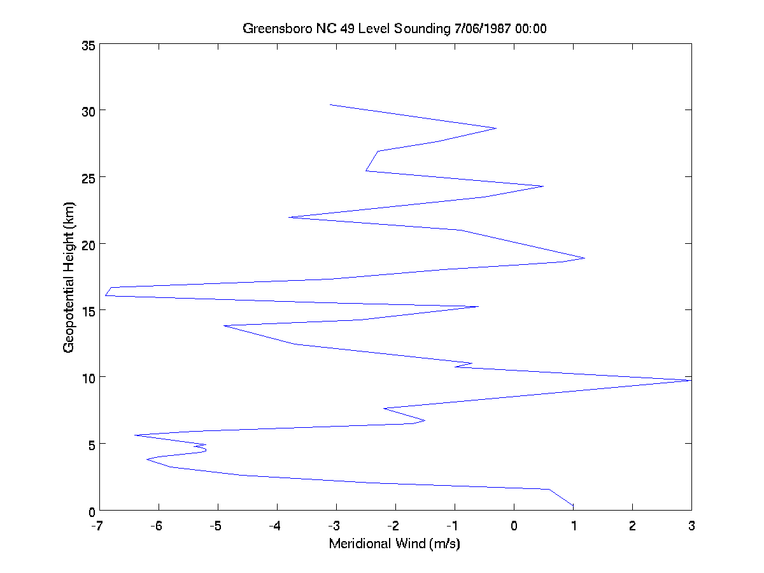
NC Radiosonde Data

Slide 16
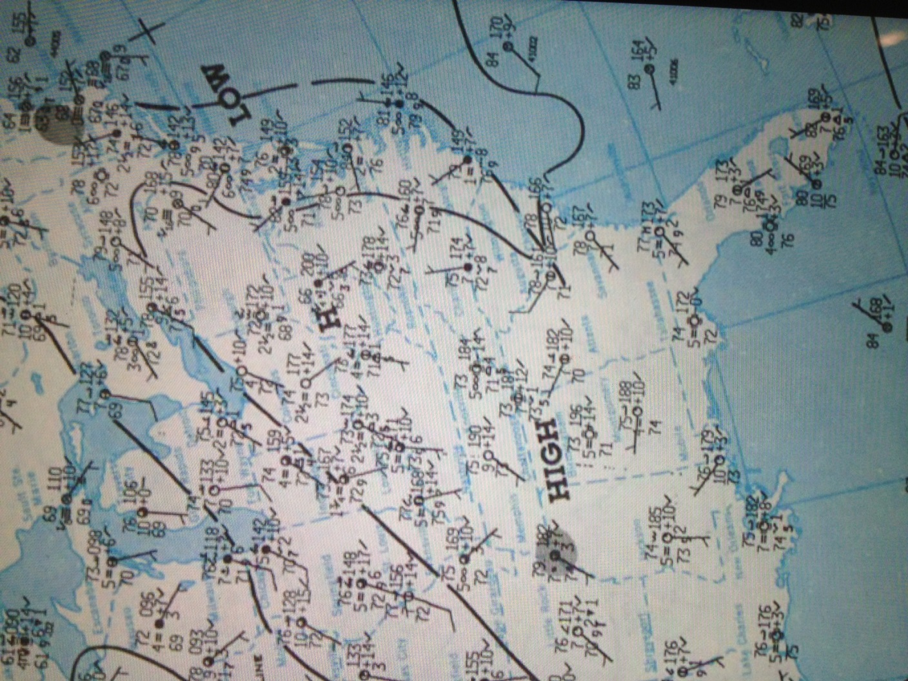
NOAA Rescue Map 7/11/1987

Slide 17
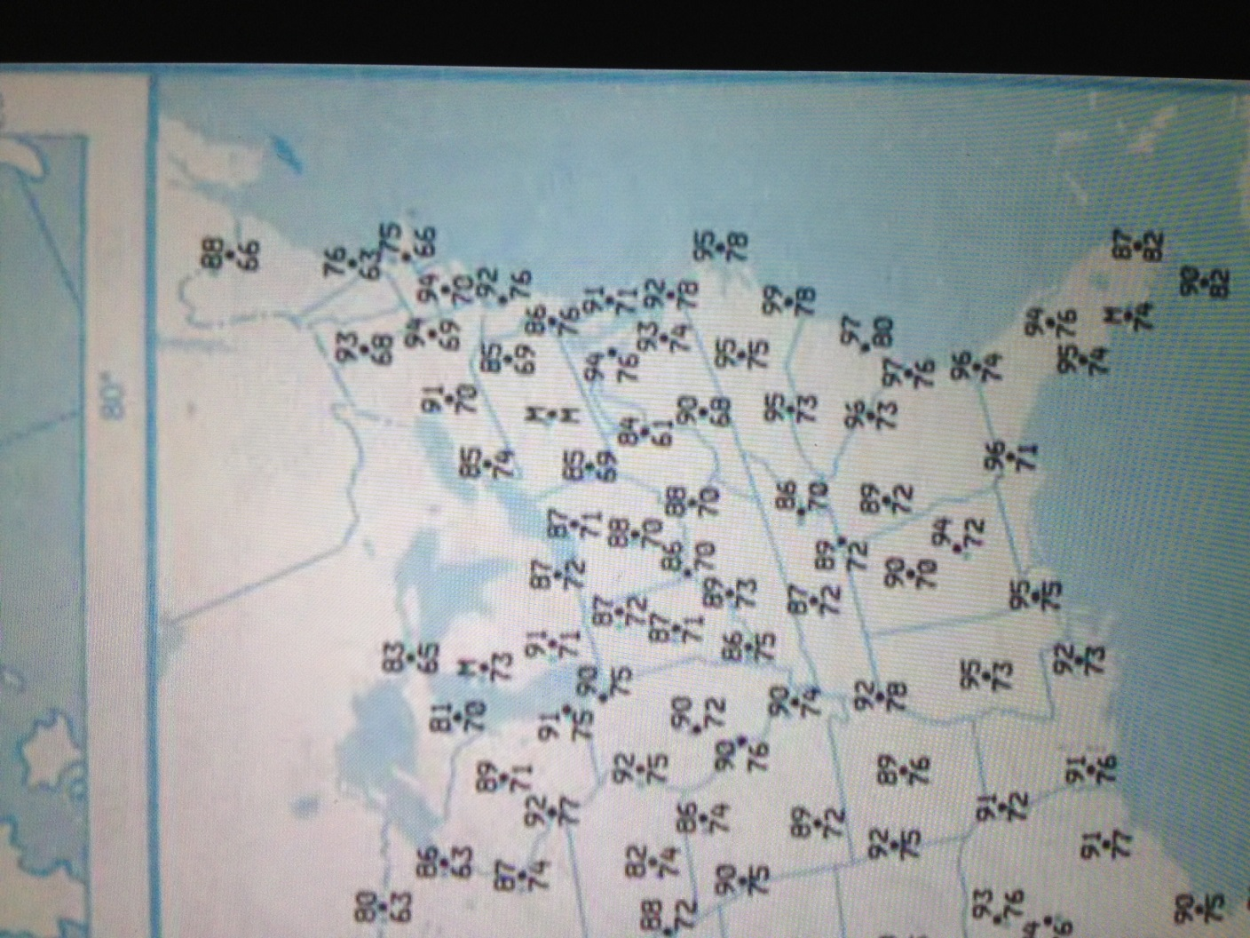
NOAA data continued

Slide 18
Summary
Meteorology data provides a means to vet long duration ozone episodes
Data from multiple sources provides options on characterizing conditions within and near episodes
  Archived surface data
  Radiosonde data
  Station data (where available)
Persistent conditions consistent with long duration ozone appears with each episode reviewed so far

Slide 19
Summary
San Bernardino – classic California episode with a persistent high level ridge
Unitah – a surprise five years ago but consistent with expectations upon analysis
North Carolina – typical summer conditions with an atypical persistence.

Slide 20
Acknowledgements
This study is a supplement to ongoing analysis of ozone trends and events in Dr. Yuhang Wang’s research group.
Ozone data provided by Dr. Yongjia Song within the group

Slide 21
References
DOCUMENT NUMBER: EDL/11-039 REVISION: ORIGINAL RELEASE DATE: JUNE 14, 2011
Final Report:
Uinta Basin Winter Ozone and Air Quality Study
December 2010 - March 2011
Submitted To:
Uintah Impact Mitigation Special Service District
320 North Aggie Boulevard
Vernal, Utah 84078
Submitted By:
Energy Dynamics Laboratory, Utah State University Research Foundation (USURF)
Bingham Research Center
320 North Aggie Boulevard Vernal, Utah 84078
FINAL REPORT
2012 UINTAH BASIN WINTER OZONE & AIR QUALITY STUDY
GENERAL EDITORS
SETH LYMAN AND HOWARD SHORTHILL, UTAH STATE UNIVERSITY
STUDY COORDINATION
UTAH DEPARTMENT OF ENVIRONMENTAL QUALITY
Winter ozone formation and VOC incremental reactivities in the Upper Green River Basin of Wyoming Author(s): Carter, William P. L.; Seinfeld, John H.
Source: ATMOSPHERIC ENVIRONMENT Volume: 50 Pages: 255-266 DOI: 10.1016/j.atmosenv.2011.12.025 Published: APR 2012
Climatology of the planetary boundary layer over the continental United States and Europe
Author(s): Seidel, Dian J.; Zhang, Yehui; Beljaars, Anton; et al.
Source: JOURNAL OF GEOPHYSICAL RESEARCH-ATMOSPHERES Volume: 117 Article Number: D17106 DOI: 10.1029/2012JD018143 Published: SEP 6 2012

