Slide 1
Urban vs. Rural Atlanta
An assessment of :
PM2.5 composition and trends
The Atlanta Urban Heat Island Effect

Slide 2
Outline
Part I: PM2.5 Compositional analysis and trends
Background
Assessment
Composition
Spatial and temporal Analysis
Monthly Analysis
Meteorological Correlations
Part II: Urban Heat Island Index and Effect
Background
Diurnal UHI in urban vs. rural environment
Meteorological Correlations
Part III: Conclusions
Notes:
Past studies [Chow et al., 1992, 1993a, 1996, 1998] have shown that elevated PM concentrations frequently occur in winter, when PM10 concentrations are primarily in the PM2.5 size fraction.

Slide 3
Part I: PM2.5: Why are we so concerned?
Aerosols
PM
Environmental Issues
Health Risks
PM2.5
Humans inhale it
It diffuses
Primary and secondary origin
Formation poorly understood
Notes:
Talk about sourcesIn Atlanta, PM
2.5
concentrations have been decreasing
over the past ten years (E

Slide 4
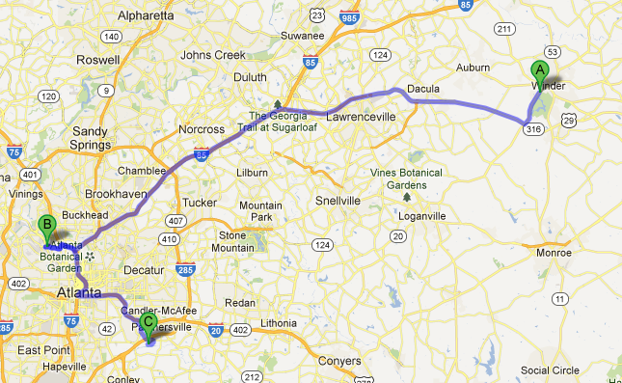
PM2.5 Assessment
Part of Georgia Tech’s ASACA project
3 sites
Fire Station 8 (FSE) (urban) (Daily)
South Dekalb (SD) (urban) (Daily)
Yargo (YG) (rural) (1 in 3 days)
3 filter types
Quartz (EC/OC analysis)
Nylon (wsioi and ions)
Na⁺, NH₄⁺,K⁺,Ca²⁺,Cl⁻,
NO₂⁻, NO₃⁻, SO₄²⁻ ,
CH₃COO⁻, HCOO⁻, C₂O₄²⁻
Teflon (trace metals)
PCM, IC, TOT, TEOM, aeth.
Only 2012 data analyzed
Figure 1: Map of the three different sampling sites. A: Fort Yargo State Park, B: Fire Station Eight, C: South Dekalb site
Notes:
FSE had the highest annual average PM2.5 levels measured in Atlanta
Particle Composition Monitor (PCM), the PM composition was analyzed. Ion chromatography was used to analyze the ionic components, and a thermal-optical transmittance device analyzed the carbonaceous material. TEOM and aetholometer?

Slide 5
PM2.5 Composition in 2012
Notes:
Edit the 4%
As can be seen, organic matter (OM) and sulfate are the dominating components. As expected, the rural site (YG) has the highest organic matter composition, as well as the highest sulfate composition (however, it is not a significant difference). Ammonium dominates more in the urban sites than in the rural sites. As expected, the PM_{2.5} total average concentration is higher at the urban site (FSE) over the rural site (YG). As expected, the urban site has a lot more traffic and vehicular emissions, leading a larger particulate concentration.

Slide 6
PM2.5 Analysis: Spatial and temporal
Notes:
SO4 2- largest contributer in summer, nitrate is largest contributor in the winter
Both EC and NO3– PM2.5 were higher in California, and peaked in winter and autumn.
Because ammo- nium (NH4+) is commonly observed in the forms of ammonium nitrate or ammonium sulfate, the ammonium component of PM2.5 is correlated with SO42– and NO3– compo- nents and consequently exhibits a mix of those components’ spatial and temporal patterns for yearly averages (Figure S8) and seasonal aver- ages (Figure S9). OCM is higher on the west coast (Figures S10 and S11).
Find this correlation tomorrow

Slide 7
PM2.5 Analysis: Spatial and temporal
R Square | 0.833
Adjusted R Square | 0.826
Standard Error | 0.189
 | Coefficients | Standard Error | P-value
Intercept | 0.408 | 0.110 | 0.0011
X Variable 1 | 2.711 | 0.242 | 3.35E-11
Notes:
Tomorrow- do the
NH4NO3 generally accounted for 30 – 60% of PM2.5 during winter [Magliano et al., 1998a, 1998b, 1999; Chow et al., 1999]. Vehicular exhaust and RWC emissions are mostly in the PM2.5 fraction with abundant organic carbon (OC) and elemental carbon (EC).
. At night, the cities experience a build up of primary pollutants emitted from traffic and RWC. Nitric acid (HNO3) can form in the upper layer during nighttime hours through a series of reactions [Atkinson et al., 1986; Stockwell et al., 2000; Pun and Seigneur, 2001]. Prevented from deposition by the surface inversion, this HNO3 would be made available over rural areas with high NH3 emissions to rapidly create NH4NO3. Limited upper air observations [Lehrman et al., 1998] indicate that winds within the valley-wide layer often reach speeds of 1–6 m s􏰣1 while surface winds are <1 m s􏰣1. This implies that secondary NH4NO3 can be mixed throughout the valley in one to two days. When radiative heating breaks the inversion after 􏰤1100 LT, turbulent mixing between the upper and surface layers intensifies, causing a net downward flux of NH4NO3, which escalates near the surface. In urban areas, this mixing also dilutes the concentrations of primary pollutants, creating a complex diurnal pattern of PM2.5

Slide 8
PM2.5 Analysis: Monthly
Notes:
Edit!!
As show in figure I, sulfate concentration peaks in the warmer summer months. Organic carbon concentrations peak in the cooler, winter months, and are generally highest in the downtown FSE site than at the other two sites.

Slide 9
PM2.5 Analysis: Meteorological Correlations
Notes:
Include avg windspeed graphsince you already have half the data\FSE and temp, FSE and windspeed, YG and temp, YG and windspeed; compare them to each other -actually do SD

Slide 10
PM2.5: Meteorological Correlations
Regression Statistics
R Square | 0.0717
Adjusted R Square | 0.0643
Standard Error | 4.727
 | Coefficients | Standard Error | P-value
Intercept | 6.0758 | 1.148 | 5.19E-07
X Variable 1 | 0.181 | 0.058 | 0.00225
Regression Statistics
R Square | 0.12
Adjusted R Square | 0.118
Standard Error | 4.785
 | Coefficients | Standard Error | P-value
Intercept | 12.322 | 0.489 | 9.49E-82
X Variable 1 | -0.855 | 0.121 | 8.92E-12

Slide 11
Part II: Urban Heat Island Index and Effect
Urban Area Temperature > Rural Area Temperature
Population density, geography, building structure and material, vegetation
Urban cities trap radiation near the surface
Large differences in solar radiation and heat and water balances
Notes:
Pertinent to the methods of temperature measurement, two types of UHI can be distinguished: the canopy layer (UCL) heat island, and the boundary layer (UBL) heat island (Oke, 1979). The former consists of air between the roughness elements, e.g., buildings and tree canopies, with an upper boundary just below roof level.
Replacing natural vegetation with artifi- cial surfaces alters the heat balance and hydrology of the local environment. Urban canyons affect wind speed and increased particulate content enhances precipitation down wind of a city.
Artificial surfaces with low albedo absorb much insolation, heating the surface more than if it were a natural surface like
Urbanization, due to its increased ther- mal capacity, lack of water for evapotran- spiration, and the canyon effect, tends to aggravate the negative effects of climate.
● the release (and reflection) of
heat from industrial and domestic
buildings;
● the absorption by concrete, brick
and tarmac of heat during the day,
and its release into the lower atmos-
phere at night; ● the reflection of solar radiation by glass
buildings and windows. The central business districts of some urban areas can therefore have quite high albedo rates (proportion of light reflected);
● the emission of hygroscopic pollu- tants from cars and heavy industry act as condensation nuclei, leading to the formation of cloud and smog, which can trap radiation. In some cases, a pollution dome can also build up;
● Recent research on London’s heat island has shown that the pollution domes can also filter incoming solar radiation, thereby reducing the build up of heat during the day. At night, the dome may trap some of the heat from the day, so these domes might be reducing the sharp differences between urban and rural areas;
● the relative absence of water in urban areas means that less energy is used for evapotranspiration and more is avail- able to heat the lower atmosphere.
Increased heat enhances photochem- ical reactions, which increases the parti- cles in the air and thus contributes to the formation of smog and clouds. London receives approximately 270 fewer hours of sunlight than the surrounding country- side due to clouds and smog. Urban heat islands also increase precipitation in cities and areas downwind of cities.

Slide 12
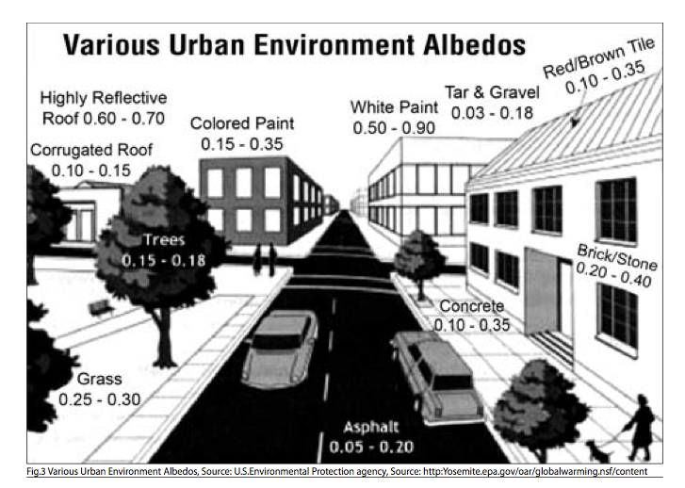
Urban Atlanta Albedo

Slide 13
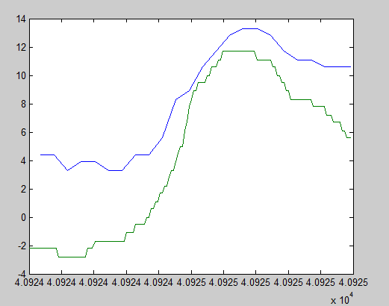
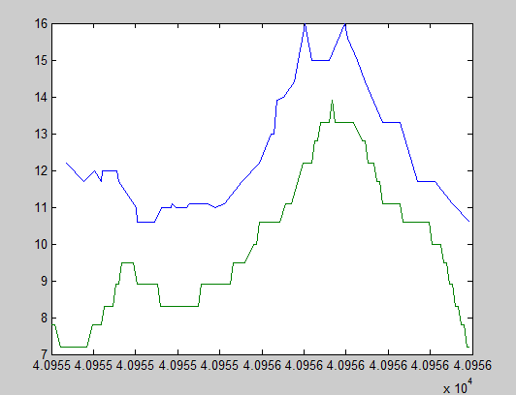
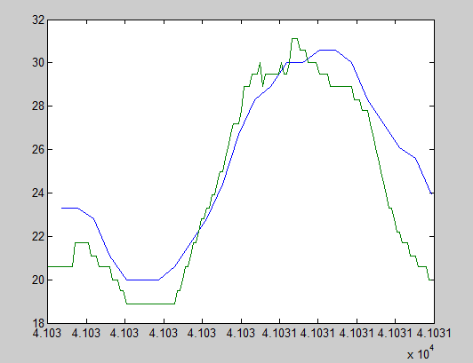
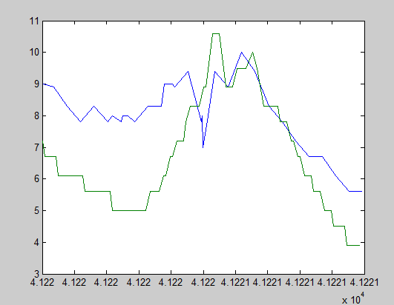
Diurnal UHI in Urban vs Rural Sites
January 16
February 16
May 1
November 7
Notes:
The explanation for the night-time maximum is that the principal cause of UHI is blocking of “sky view” during cool- ing: surfaces lose heat at night principally by radiation to the (comparatively cold) sky, and this is blocked by the buildings in an urban area.

Slide 14
UHII vs Meteorological Correlations
Regression Statistics
Adjusted R Square | 0.112
Standard Error | 2.059
 | Coefficients | Standard Error | P-value
Intercept | 6.032 | 0.1133 | 6.95E-174
X Variable 1 | -0.14 | 0.0204 | 2.92E-11
Regression Statistics
Adjusted R Square | 0.236
Standard Error | 1.910
 | Coefficients | Standard Error | P-value
Intercept | 3.707 | 0.2194 | 1.15E-47
X Variable 1 | -0.0872 | 0.00819 | 2.93E-23
Notes:
According to the 2001 Census, 27.8% of the urban population resides in cities, compared with 25.5% in 1990. The Urban popula- tion is expected to rise to around 40% by 2020.City growth and urban develop- ment are inevitable phenomenon of the 21st century, hence there is a need to explore the causes and peculiarities of the Urban Heat Island Effect and pro- pose solutions to the problem

Slide 15
To sum up…
PM2.5 is of concern in both urban and rural Atlanta
Although composition similar, concentrations need to be monitored
Meteorological factors play a big role
Atlanta is a hub for UHI
More attention needed in diurnal changed in meteorological patterns
A lot can change in a small distance!

Slide 16
Special Thanks to
2012 - 2013 ASACA team
Jeremiah Redman
Kyle Digby
Boris Galvis

Slide 17
References
Bell, et al. "Spatial and Temporal Variation in PM2.5 Chemical Composition in the United States for Health Effects Studies." Environmental Health Perspectives: n. pag. Print.
Chow, et al. "PM2.5 chemical composition and spatiotemporal variability during the California Regional PM10/PM2.5 Air Quality Study (CRPAQS)." Journal of Geophysical Research Atmospheres: n. pag. Print.
Clarke, Azadi-Boogar, and Andrews. "Particle size and chemical composition of urban aerosols." Science of the Total Environment: n. pag. Print.
Kim. "Urban Heat Island." International Journal of Remote Sensing 13.12 (1992): n. pag. Print.
Myrup. "A Numerical Model of the Urban Heat Island." American Meteorology Society: n. pag. Print.
Myrup, Leonard. "A Numerical Model of Urban Heat Island." Journal of Applied Meteorology: n. pag. Print.
The Urban Environment. N.p., n.d. Web. 24 Apr. 2013. <http://www.coa.gov.in/mag/Archi_Apr09-Lowres-pdf/20-25-Urban%20heat%20island.pdf>.
Weng, Lu, and Schubring. "Estimation of land surface temperature–vegetation abundance relationship for urban heat island studies." Remote Sensing of Environment 89.4 (2004): n. pag. Print.

Slide 18
Any questions?
Thanks for listening!

