Slide 1

Surface Ozone during Fall in the Southeastern United States
EAS 6792
Yuzhong Zhang
April 23, 2013

Slide 2
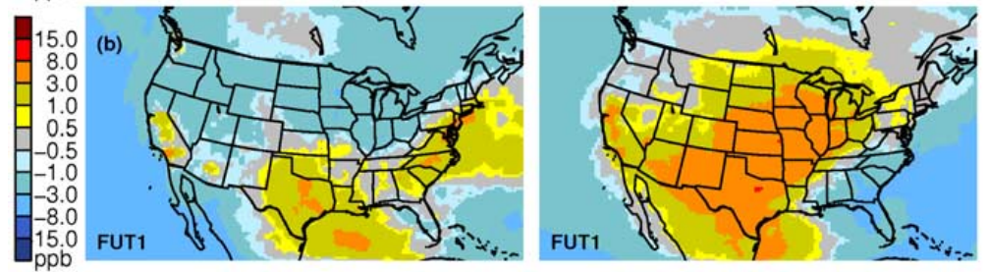
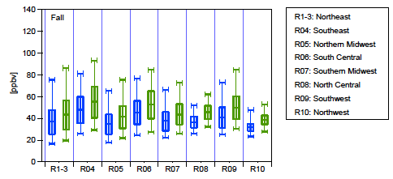

Why cares about ozone during fall?
June, Aug.
Sept., Oct.
Nolte et al., 2008
Chen et al., 2009

Slide 3

What interests us?
Southeast US
October
What are the features of monitoring data in October?
Mean, Trend, Variability， Distribution
What factors affect the October ozone in SE US?
Meteorology, Emission
Features
Factors
Simulation
Sensitivity
Is a current 3D chemical transport model able to simulate October ozone?
Day-to-day, Inter-annual
Is the sensitivity of ground ozone in October different from that in summer months? Implications?
?

Slide 4
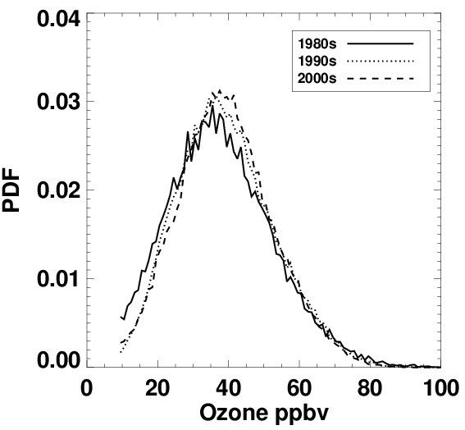
Distribution
Features
MDA8

Slide 5
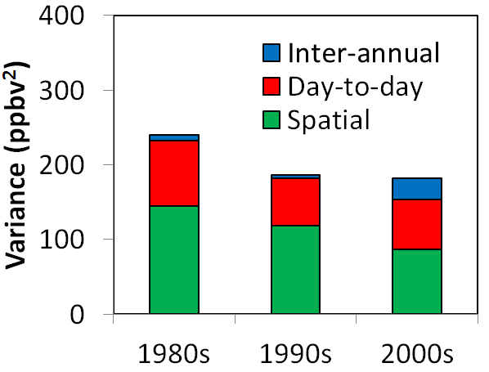
Variance
Features
Var(all) = Var(Spatial) + Var(Inter-annual) + Var(Day-to-day)

Slide 6
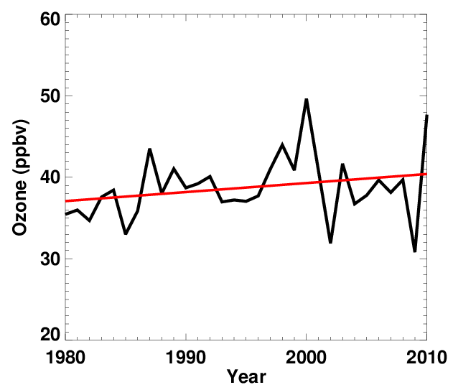
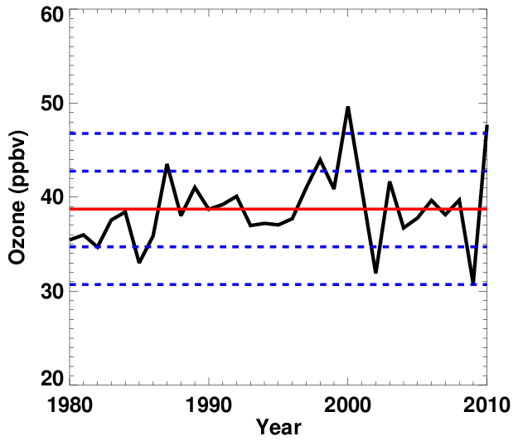
Features
Trend, variability, and extremes
0.11±0.16 ppbv/yr
2σ

Slide 7
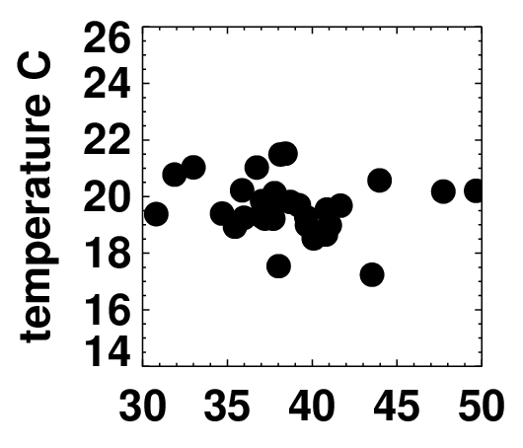
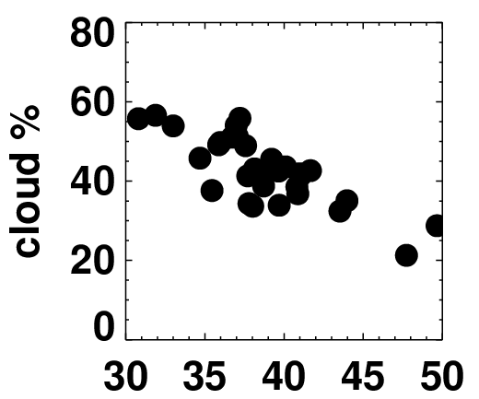
Factors
IAV of O₃ and meteorology
Inter-annual variability of ozone
R = -0.13
R = -0.80
Ozone ppbv
Oct. 2010

Slide 8
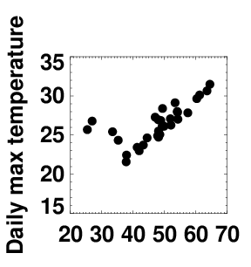
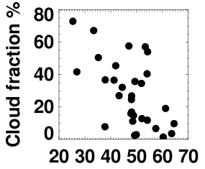
Factors
MDA8 O₃ in Oct. 2010 and met.
Day-to-day variability of ozone
R = 0.71
R = -0.58
Ozone ppbv

Slide 9
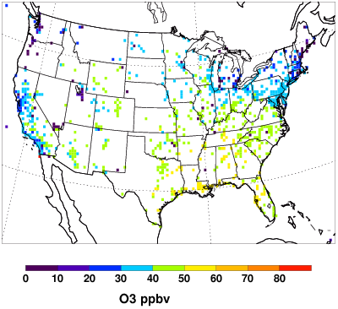
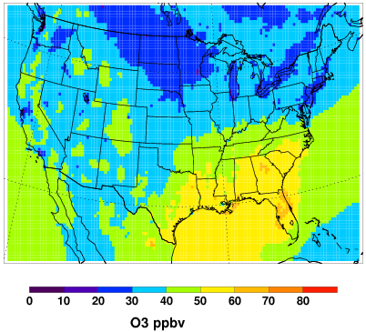
Simulation
Modeled monthly mean
Regional chEmical trAnsport Model (REAM)
Oct., 2010 Monthly mean afternoon ozone
Observation
Model

Slide 10
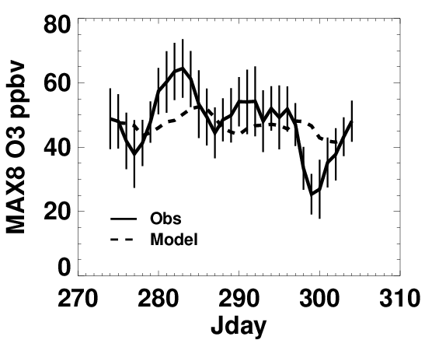
Modeled day-to-day variation
Simulation

Slide 11
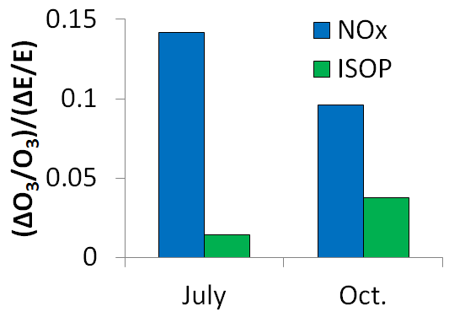
Sensitivity
Comparison with summer
Oct. ozone has
Less effectiveness of NOx emission reduction
Stronger sensitivity to biogenic emission

Slide 12
Conclusions
Records show
No significant trend in last three decades
Increased inter-annual variability
Extremely high ozone year of 2000 and 2010
Correlation between cloud fraction and monthly mean October ozone.

Slide 13
Conclusions
Model simulation shows
Capability to reproduce monthly mean
Less day-to-day variability than observations
Model sensitivity analysis shows
Less benefit from NOx emission reduction
Greater impact of biogenic emission
Climate change may play a bigger role in fall than in summer

Slide 15
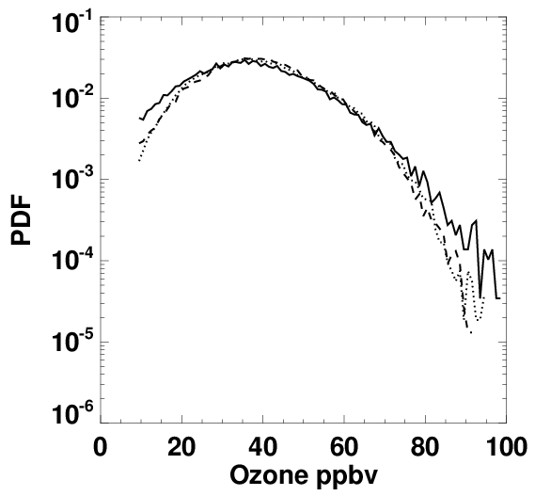
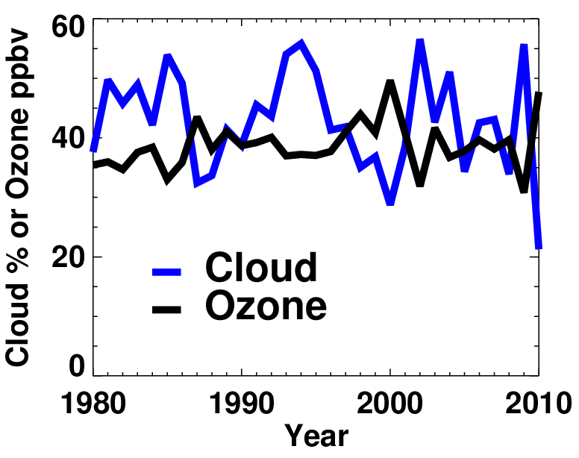
Supplemental slides

Slide 16
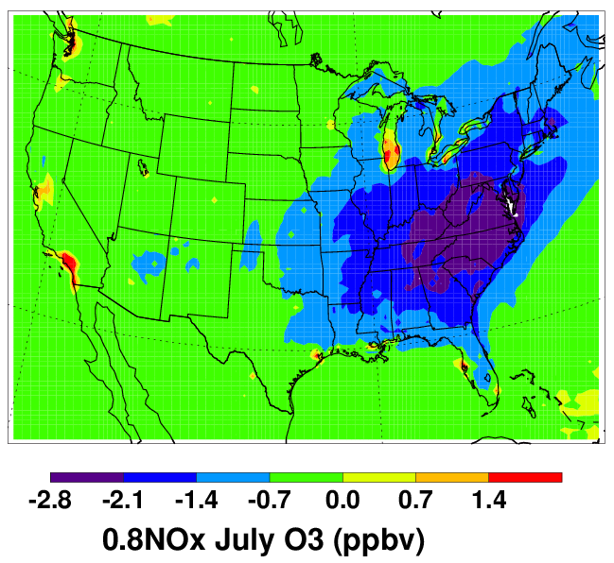
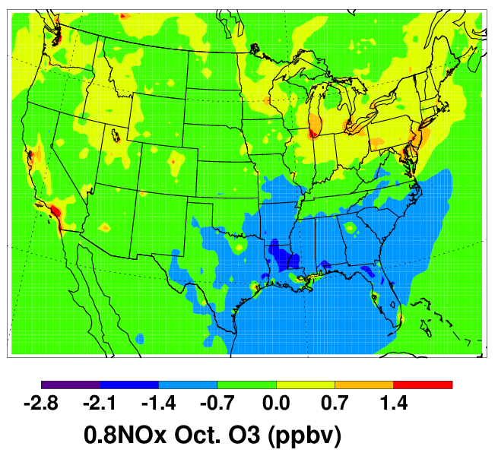
Supplemental slides
ΔO3 due to 20% reduction of NOx emission
Summer
Fall

