Slide 1
Climate Change and Extreme Events
Overview - Definitions

Slide 2
Climate extremes and climate change
Climate extreme
Climate change
‘Value of a weather or climate variable above (or below) a threshold value near the upper/lower ends of the range of observed values of the variable’
Change in the mean and/or variance in climatic properties that persists for an extended period
Time scale of event

Slide 3
Compound events
≥ 2 extreme event simultaneously or successfully
Combinations of extreme events with underlying conditions that amplify the impact when combined
Combinations of events that are not extremes themselves, but that lead to extreme events or impacts
Can be causally unrelated or related via a latent variable/process
    External forcings
    Feedback loops
    Conditional dependence

Slide 4
What causes changes in climate extremes?
Climate change can lead to
Changes in the frequency, duration, intensity, spatial extent and timing of extreme events
Unprecedented events
An accumulation of non-extreme events over time
By altering the underlying distributions of climate variables (Temperature, precipitation, wind speed, etc.)

Slide 5
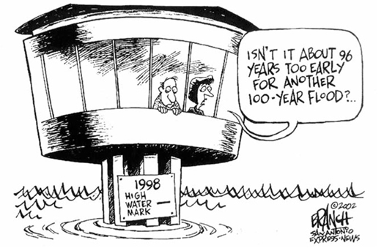
How are extremes defined?
Probability of an event occurring
Extreme events are by definition rare
Typically based on 10th, 5th, 1st, 90th, 95th, and 99th percentiles of data during reference period (1961-1990)
Derived indices
Specific threshold
Tied to biologic, ecologic, and/or human adaptability and rationales

Slide 6
How is evidence for change assessed?
Observational evidence
Projected evidence
Have observations going back to 1950 in many locations
Confidence in evidence is related to:
  Quality and quantity of data
  Availability of studies analyzing data
  Varies greatly by variable and location
Ensemble GCM output
  Agreement between models is important criteria
Expectations based on projected changes to related variables

Slide 7
Potential biases and sources of uncertainty
Poor spatial coverage of observations
Low temporal resolution of observations
Inhomogeneous data
  Changes in methods or equipment used to measure variable
  Changes in the likelihood of observing an event
Poor temporal coverage of observations
Problems of aggregation and scale in predictions
Poorly understood interactions between complex phenomena

Slide 8
How is evidence for change reported?
Confidence
Certainty (only reported if there is high confidence)

Slide 9
Impact of events

Slide 10
Temperature Extremes
Heat waves, cold spells
  Impact health and ecosystem
Industrial revolution
Greenhouse gases
Aerosols offset warming due to greenhouse gases
  Difficult to include in models
Very unlikely that the current global weather pattern can be explained by natural causes
Difficult to assess local scale (low signal-to-noise)

Slide 11
Temperature: Observations
Summers of 2003 and 2010 in Europe surpassed the hottest temperature since 1540 (Barriopedro et al., 2011)
AR4 showed an increase in warm days and nights for 70-75% of land with data (Trenberth et al., 2007)
Anomalies (Alexander et al., 2006) :
  Eastern United States and Greenland
    Increased cold days, decreased warm days
  South America
    Decrease in warm days

Slide 12
Temperature: Causes
Climate models find that observed changes are simulated by anthropogenic forcings
Compare annual maximum and minimum temperature extremes to those simulated with forcings
Models may by overestimating maximum temperature changes and underestimating minimum temperature changes (Christidis et al., 2011b; Zwiers et al., 2011)

Slide 13
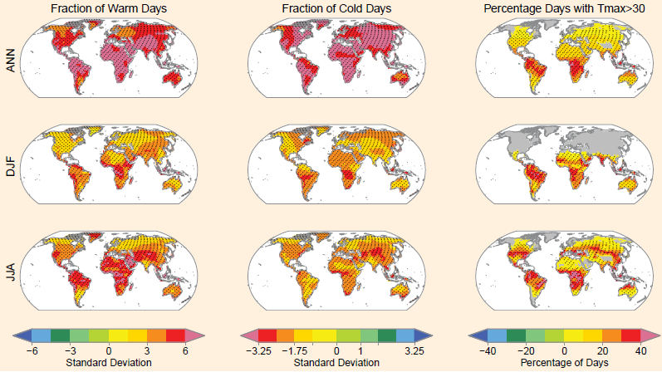
Temperature: Projections
Increase in the number of warm days
Longer, more intense heat waves
Decrease in cold spells (Meehl et al., 2007b)
Estimate of an increase in 1-3ºC in the mid-21st century to 2-5ºC toward the end
Simulated: 2081-2100

Slide 14
Temperature: Summary
Overall global decrease in the number of cold days/nights and increase in the number of warm days/nights (very likely)
Increase in heat waves (medium)
Anthropogenic sources have lead to warming temperature extremes (likely)
Projected increase in frequency and magnitude of warm days/nights (virtually certain)
Increase in length/frequency/intensity of heat waves (very likely)
The hottest day in a 20 year period will become 1 in every 2 year by the end of the 21st century (likely)

Slide 15
Precipitation Extremes
Difficult in defining “extreme precipitation” due to differences in regions
  Percentile and absolute thresholds for regions
Clausius-Clapeyron
  Saturation vapor pressure increases exponentially with temperature
  Relative humidity estimated to be constant
  Therefore, specific humidity increases ~7% per degree
  Increase moisture content

Slide 16
Precipitation: Observations
Increase in heavy precipitation over the second half of the 20th century
Not as spatially coherent or as significant compared to temperature (Alexander et al. (2006))

Slide 17
Precipitation: Causes
In the 20th century, humans have had an influence on the trend of increasing precipitation (more likely than not)
Northern Hemisphere daily precipitation over land was found to be influenced by anthropogenic sources (Min et al., 2011)
Increasing moisture content leads to extreme precipitation
  Affected by rising temperatures

Slide 18
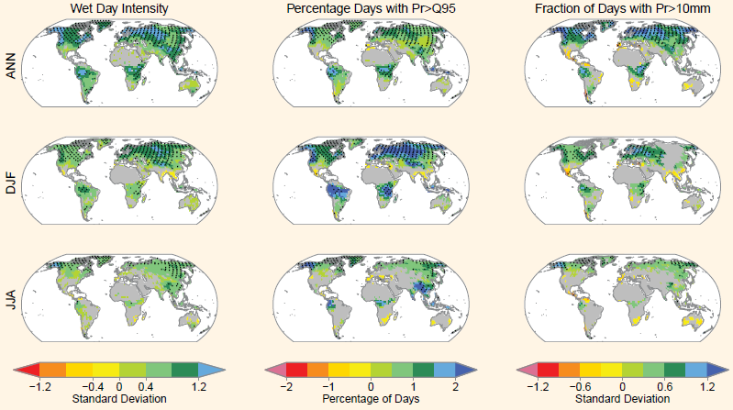
Precipitation: Projections
AR4 suggests increase in frequency and total precipitation
Uncertainties and biases in projections
Difficulty in defining “extreme” for different regions

Slide 19
Precipitation: Summary
Increase in the number of heavy precipitation events in the 20th century (likely)
Frequency and total amount of heavy rainfall will increase in the 21st century (likely)
Single 24-hour maximum rainfall event will go from a 1-in-20 year to a 1-in-5 or -15 year event

Slide 20
Effect: Droughts
“A period of abnormally dry weather long enough to cause a serious hydrological imbalance”
Not only due to less precipitation
  Wind speed, radiation, evaporation
  Precondition: snow, lakes, soil
Dry areas have doubled since 1970 (Trenberth et al., 2007)
Temperature changes, and not precipitation, were found to be the largest effect (Dai et al., 2004)
Anthropogenic influence in the 20th century (medium)
Projected increased duration and intensity (medium)

Slide 21
Effect: Floods
“The overflowing of the normal confines of a stream or other body of water, or the accumulation of water over areas that are not normally submerged”
Little data on the effect of climate change on flooding
Relation to increased precipitation
No evidence of change in magnitude/frequency in the 20th century (Rosenzweig et al., 2007; Bates et al., 2008)
Increasing rainfall leads to increasing local flooding (medium)

Slide 22
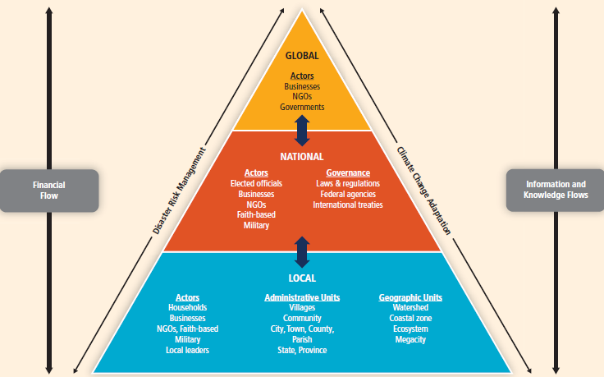
Risk and Risk Management

Slide 23
Risk: Local
Often the most affected
Most immediate response to disaster
Socioeconomic inequality
  Rapid urbanization
Land and city planning
Communication

Slide 24
Risk: National
Legislation
  Climate change and regulation
  Disaster relief/state of emergency
Conservation
Level of preparedness varies between countries
Recent assessments suggest that lack of preparation and management

Slide 25
Risk: International
Interconnectedness
  Communication, economic, ecological
  Shared borders
Both political interests as well as the common good
Global organizations
Shared responsibility: Millennium Declaration (September 2000):
“We recognize that, in addition to our separate responsibilities to our individual societies, we have a collective responsibility to uphold the principles of human dignity, equality and equity at the global level. Global challenges must be managed in a way that distributes the costs and burdens fairly in accordance with basic principles of equity and social justice. Those who suffer or who benefit least deserve help from those who benefit most”

Slide 26
Wind and climate phenomena
Observed and projected changes

Slide 27
Wind
Generally low confidence in any observed or suggested changes
Small-scale phenomena like tornados are not modeled

Slide 28
Monsoons
Likely increase in precipitation in monsoon regions
Lack of evidence to say if or how monsoons will be affected by global climate change

Slide 29
El Nino/La Nina
Medium confidence – recent trend toward more frequent central equatorial Pacific El Nino episodes
Medium confidence - projected increase in frequency of central equatorial Pacific events
Changes are associated with increased wetness on West coast of South America, SE America, and subtropical latitudes of Western N. America; Drought in SE Asia, India, Australia, SE Africa, Amazonia and NE Brazil; fewer tropical cyclones around Australia and N. Atlantic

Slide 30
Other modes of variability
Likely anthropogenic influence on recent trends in SAM (Southern Annular Mode) – trend toward positive phase largely due to changes in stratospheric ozone
Models consistently show strengthening of polar vortex in Southern Hemisphere

Slide 31
Tropical Cyclones
Low confidence that observed long-term increases in tropical cyclone activity are robust
Low confidence in projections of changes in tropical cyclone genesis, locations, tracks, duration or areas of impact
Likely that cyclone rainfall rates will increase with warming
Likely that global frequency of cyclones will either decrease or remain unchanged
Likely increase in mean tropical cyclone maximum wind speed

Slide 32
Extratropical cyclones
Likely poleward shift in storm tracks over the past 50 years
Medium confidence in an anthropogenic influence in this shift
Low confidence in changes in regional intensity and frequency
Medium confidence that increased anthropogenic forcing will lead to a reduction in the number of mid-latitude cyclones averaged over each hemisphere

Slide 33
Impacts
Drought
Flood
Extreme sea level
Waves
Glacier, geomorphological, and geological impacts
Permafrost
Sand and Dust storms
Air pollution????

