Slide 1
Air Pollution in Mega-cities
Hang Qu, Ruixiong Zhang

Slide 2
Introduction

Slide 3
Urbanization
Fast economy growth
Serious pollution proble
Acid Rain
Tropospheric Ozone
Particulate Matter
Climate Change

Slide 4
Pollution cycle

Slide 5
Air pollution and climate change

Slide 6
Pollution in Los Angeles, London and Beijing

Slide 7
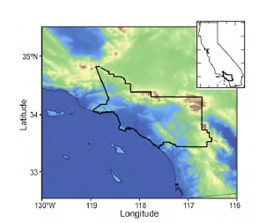
Los Angeles Smog
Time: July 26, 1943
Pollutant: NO_{X}, Ozone, PAN, …
Source: vehicles
Meteorology: basin surrounded by mountains

Slide 8
Los Angeles Smog
1950s: ozone was recognized as the cause and vehicles were identified as source
1963: first Clean Air Act
1970: Clean Air Act of 1970
1975: catalytic converters required for new cars
Today: still some of the “worst” air in U.S.

Slide 9
London Great Smog
Time: December 5-9, 1952
Pollutant: Sulfur dioxide, Sulfate acid, …
Source: coal burning
Meteorology: anticyclone and windless conditions

Slide 10
Beijing Air Pollution
Time: present
Pollutant: particulate matters
Source: vehicles, factories, coal burning, …
Meteorology: surrounded by mountains

Slide 11
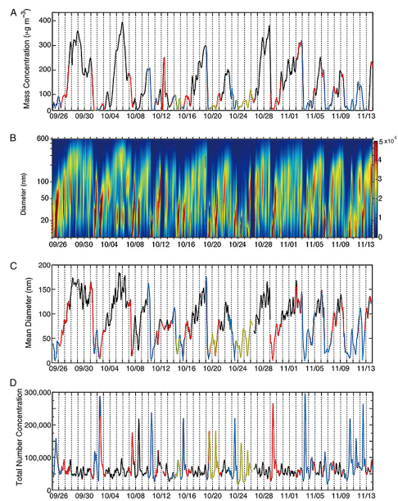
Possible mechanism

Slide 12
Comparison
 | Los Angeles | London | Beijing
Season | Summer | Winter | Winter
Main pollutant | Ozone | Sulfur dioxide | Particulate Matters
Main Source | Vehicles | Coal burning | (Not well-understood)
Mechanism | Photochemistry | Mixing of fog and pollutant | (Not well-understood)
Meteorology | Mountain Surrounding | Anticyclone and windless | Regional pollution

Slide 13
Key Issues and Outlook
Notes:
First, thank every one for coming

Slide 14
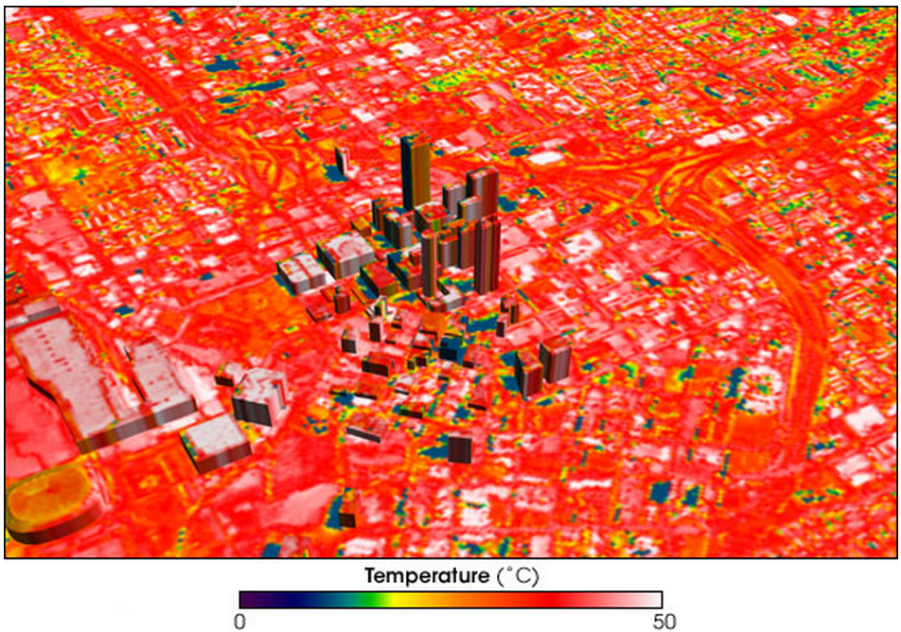
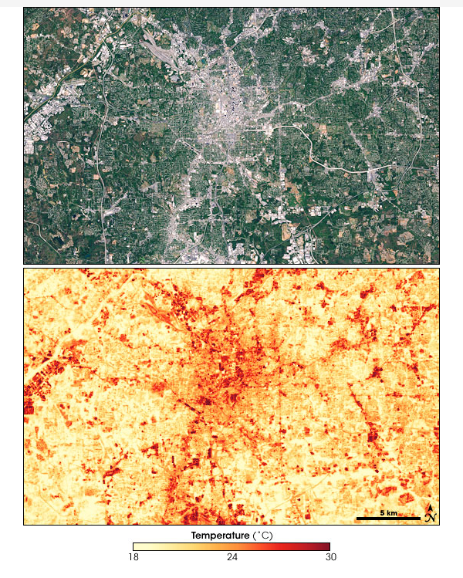
Urban Heat Island
Look at Hot-lanta from sky
courtesy: NASA.gov
Notes:
Strong at night

Slide 15
Urban Heat Island
Definition: Metropolitan area warmer than rural areas.
Temperature difference about $3℃$
Peaks at night
 | Urban Area | Rural Area
Surface difference | Concrete & asphalt absorb shortwave, emit longwave at night (high heat capacity) | Plants’ leaves evaporate H₂O, reflect more radiation
Geometric effects | Buildings help trap sunlight, reduce winds
Waste Heat | Vehicles, air conditioners and etc.
Notes:
Strong at night

Slide 16
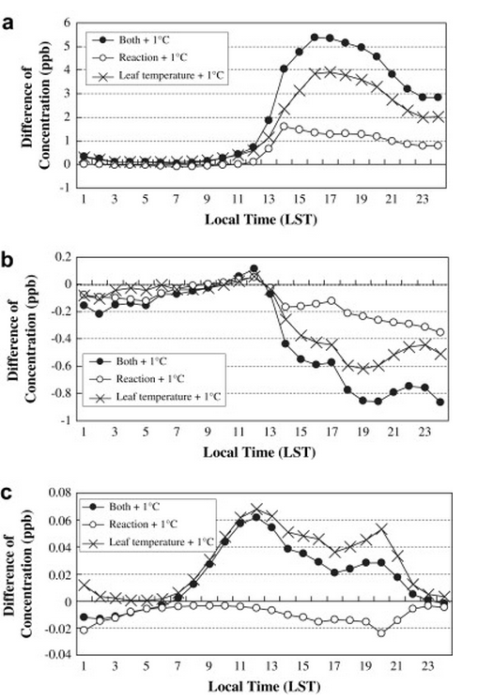
Urban Heat Island
Environment Impacts:
Increase mortality (Extreme heat)
More cooling appliances used
More VOCs emitted by plants
Subsequent more ozone
(Narumi et al., 2009)
a. O₃, b. NOx, c. Isoprene
Notes:
Strong at night

Slide 17
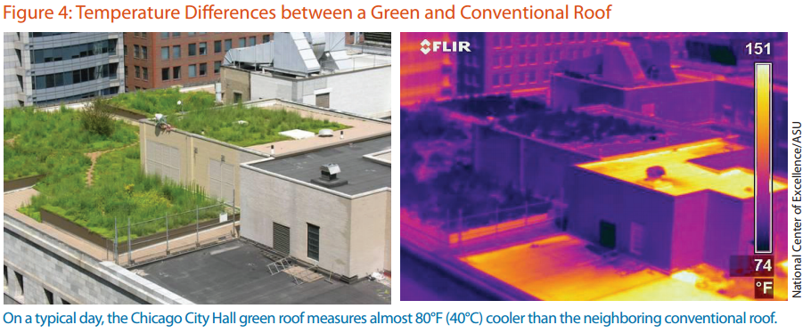
Urban Heat Island
Notes:
First, thank every one for coming

Slide 18
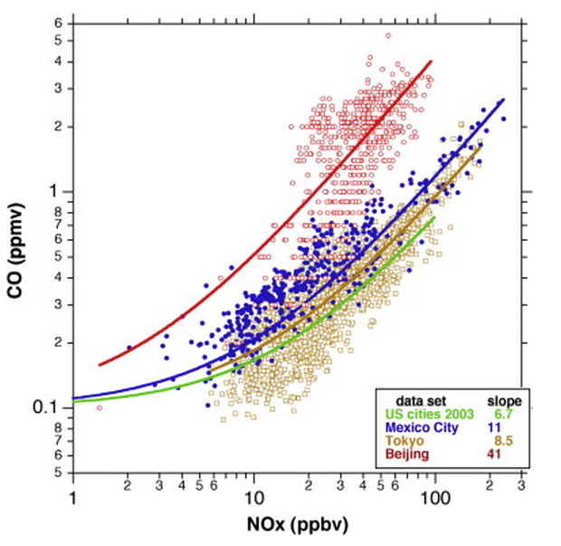
Inter-city transport
Inter-city transport of pollutants can be very important for long-lived species like CO.
Notes:
First, thank every one for coming

Slide 19
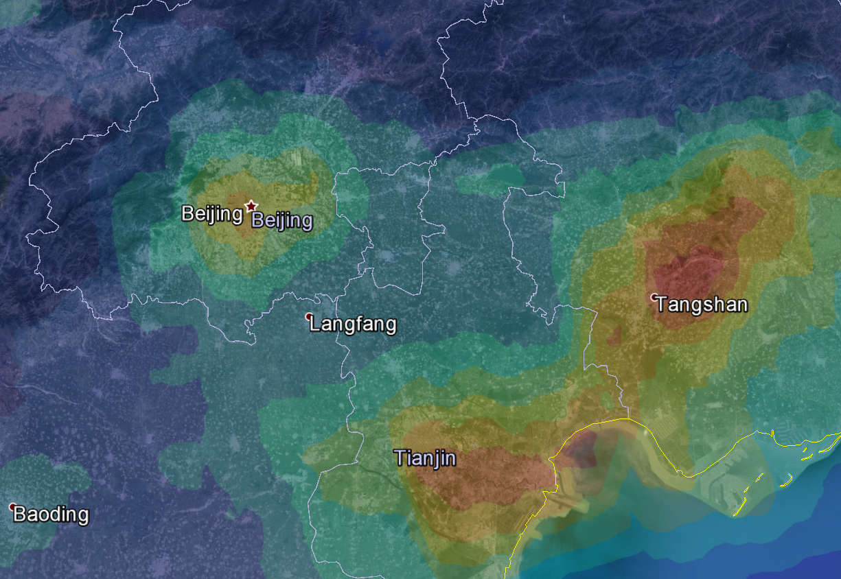
Inter-city transport
Megacity pollution transported to small city
Notes:
First, thank every one for coming

Slide 20
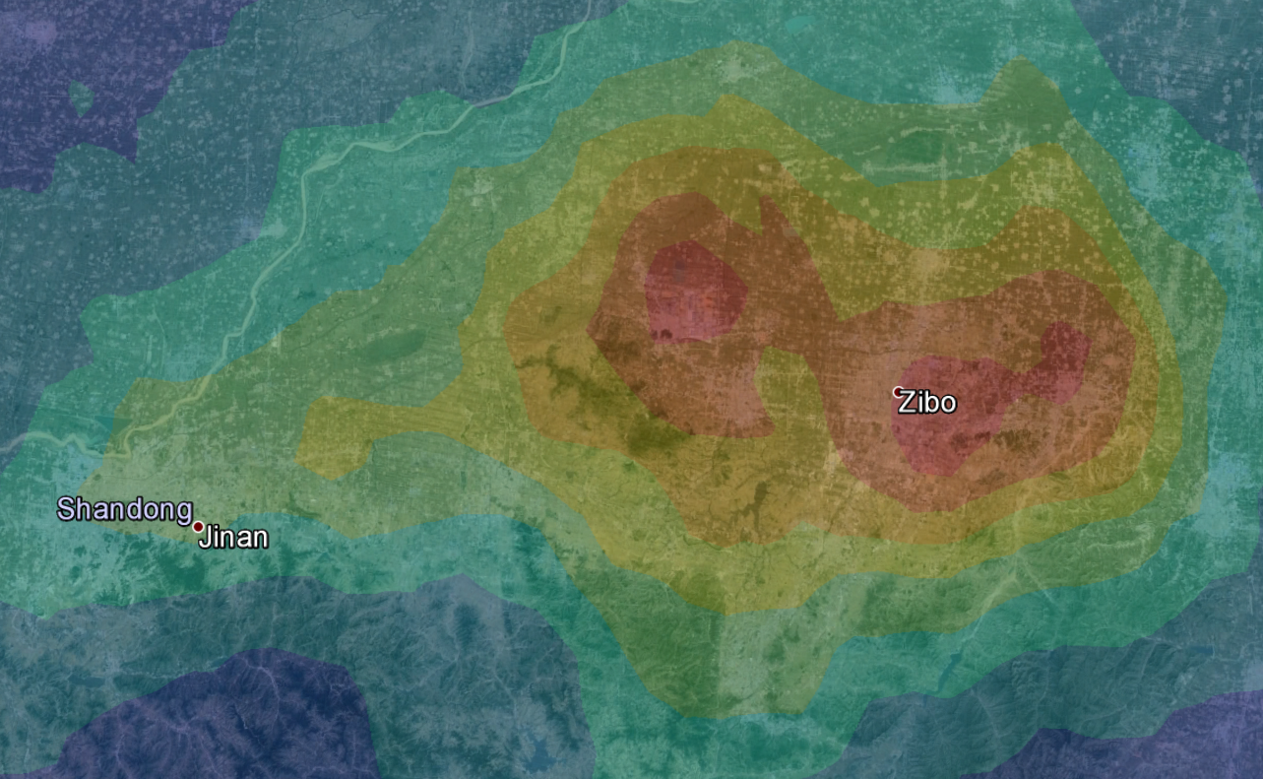
Inter-city transport
Small city pollution transported to megacities
Notes:
First, thank every one for coming

Slide 21
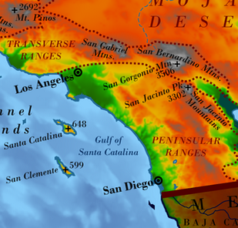
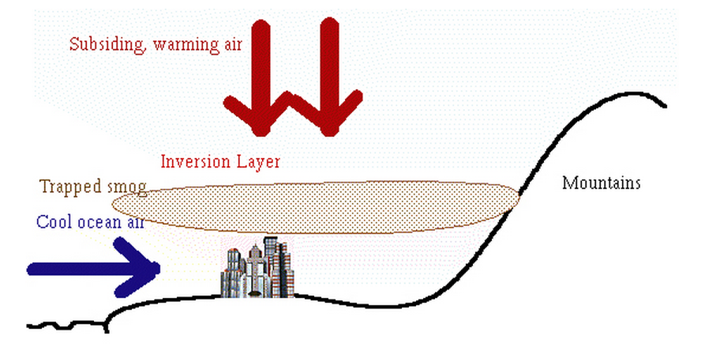
Basin of pollutants
South coast of California basin help trap pollutants at night
Notes:
First, thank every one for coming

Slide 22
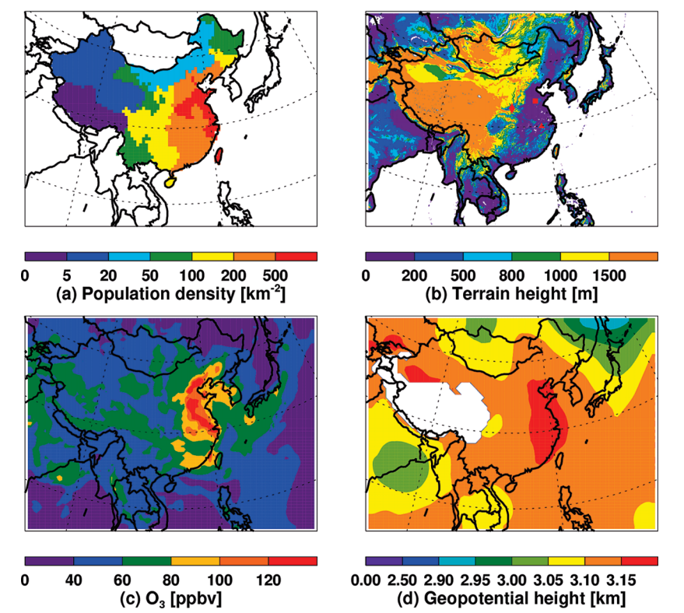
Basin of pollutants
High pressure system during June 9-14 2004
>80ppb O₃ covering >800 million people
Zhao et al., 2009
Notes:
First, thank every one for coming

Slide 23
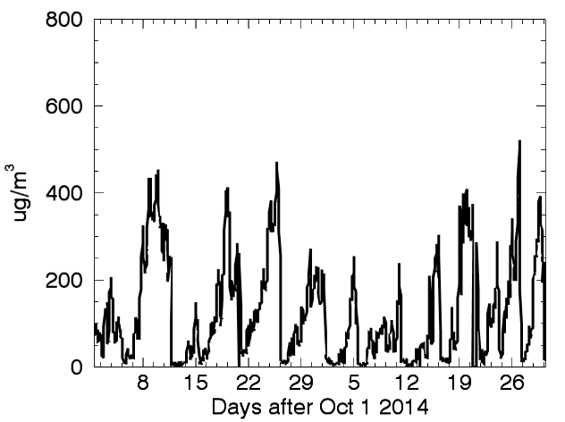
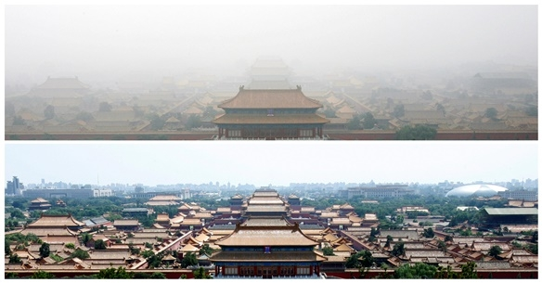
Regional Transport of Pollutants
APEC blue results from both meteorology and emission control
APEC: from Nov 5th to 11th
North winds during APEC for Nov 1st, 2nd, 5th, 6th, 11th and 12th
Notes:
First, thank every one for coming

Slide 24
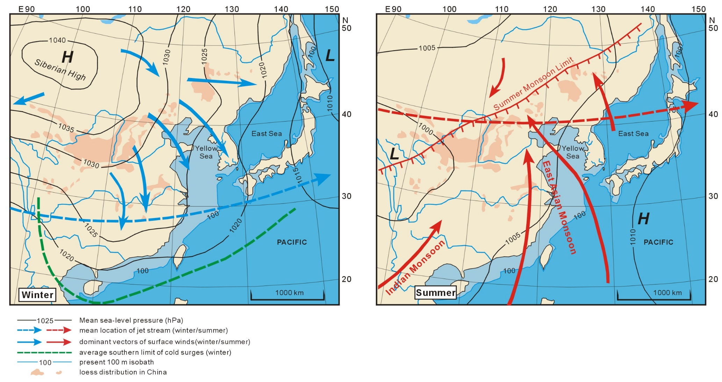
Monsoon
Yi et al., 2011
Notes:
First, thank every one for coming

Slide 25
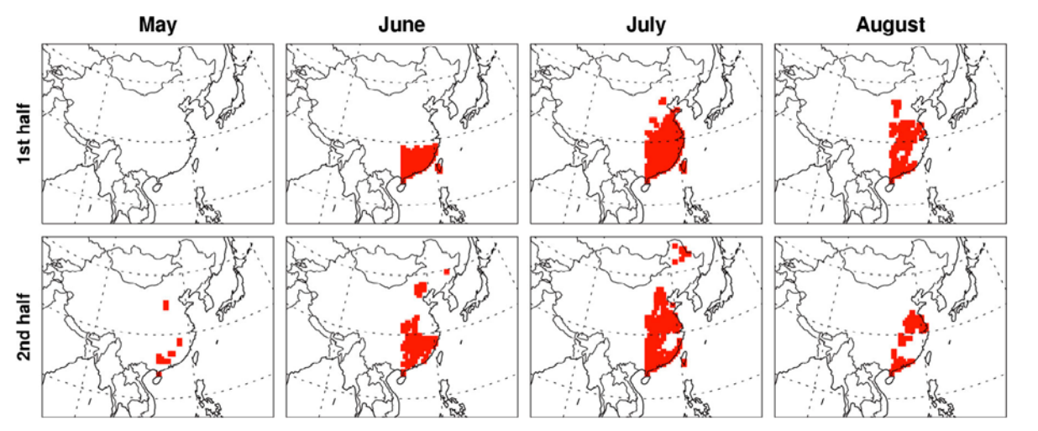
Monsoon
Monsoon
Zhao et al., 2010
Notes:
First, thank every one for coming

Slide 26
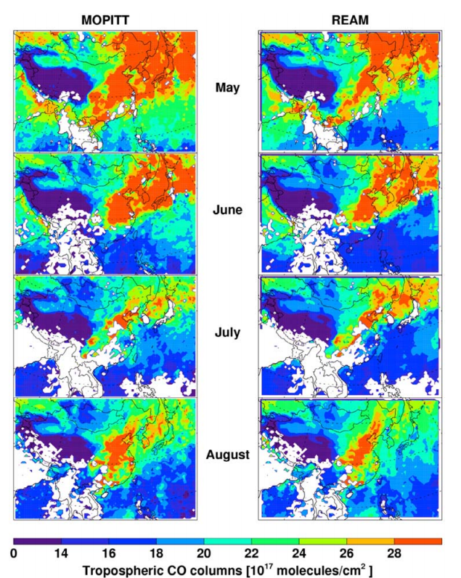
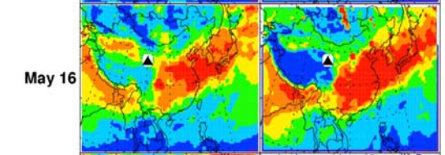
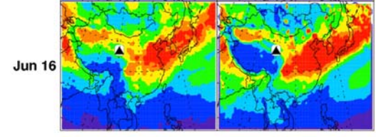
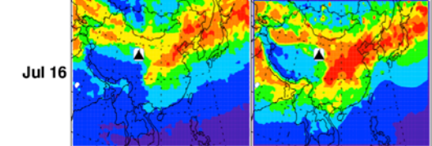
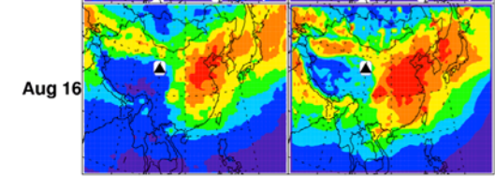
Monsoon
Zhao et al., 2010
Notes:
First, thank every one for coming

Slide 27
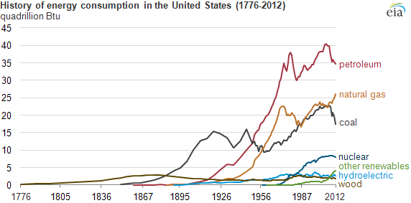
Energy source trend
CO₂, O₃, CH₄, SO₂, PM, VOCs, NO₂, what’s next?
Courtesy: eia.gov
Notes:
First, thank every one for coming

