Slide 1
Ambient Flux: Simulation and Observation
Hang Qu

Slide 2

Data and method
Data set
  Observation in Wangdu, a small town in China
  From June 4th to July 1st
Modelling
  Weather Research and Forecast model (WRF)
  Regional Chemistry and Transport Model (REAM)
Comparing
  $\overline{u}, \overline{w},\overline{T}$
  $u^{∗}=\sqrt{\overline{u^{′}w′}}, Q_{s}=\overline{w^{′}θ′}, Q_{l}=\overline{w^{′}[H_{2}O]′}$
Possible link to pollution

Slide 3
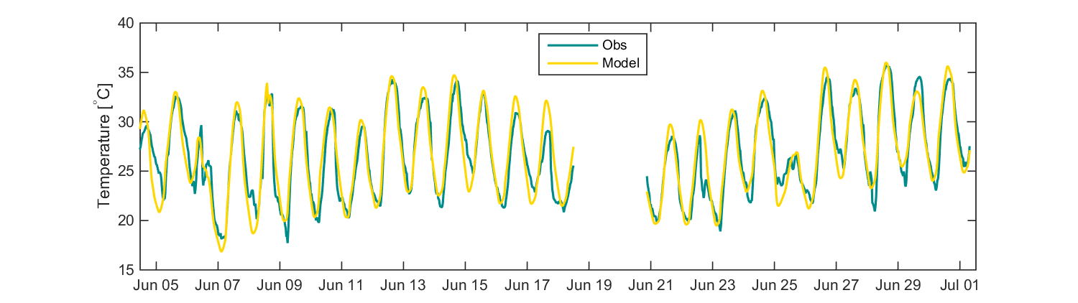
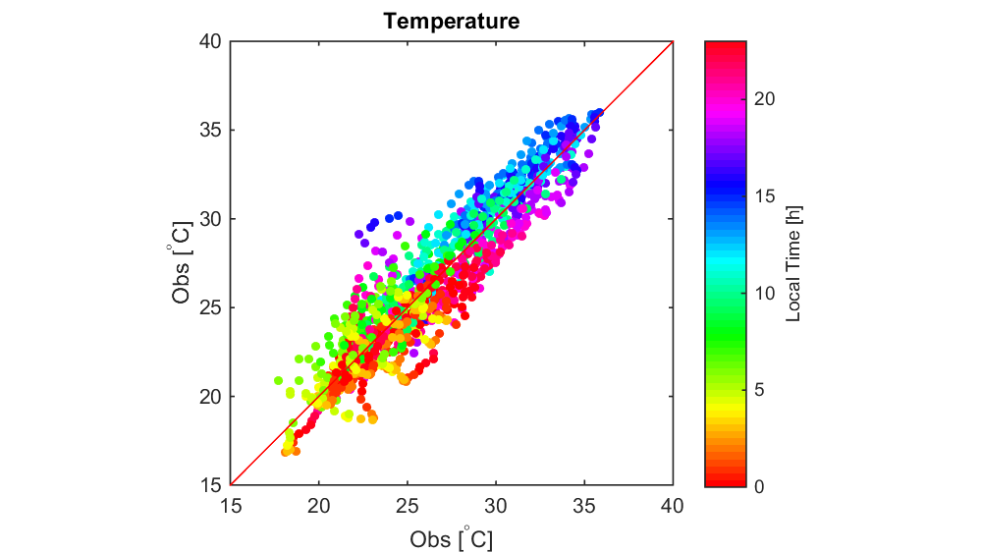
Temperature

Slide 4
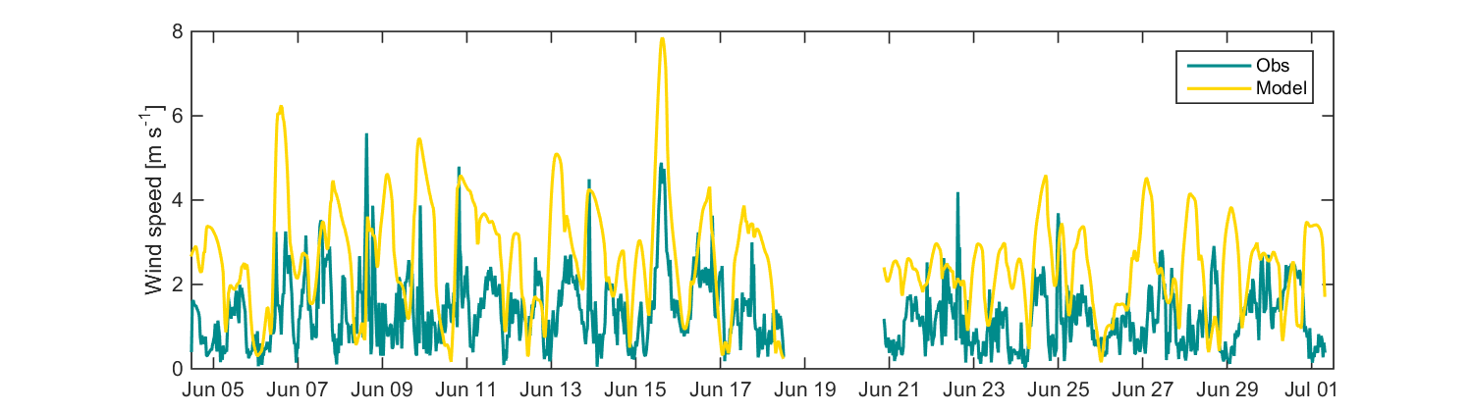
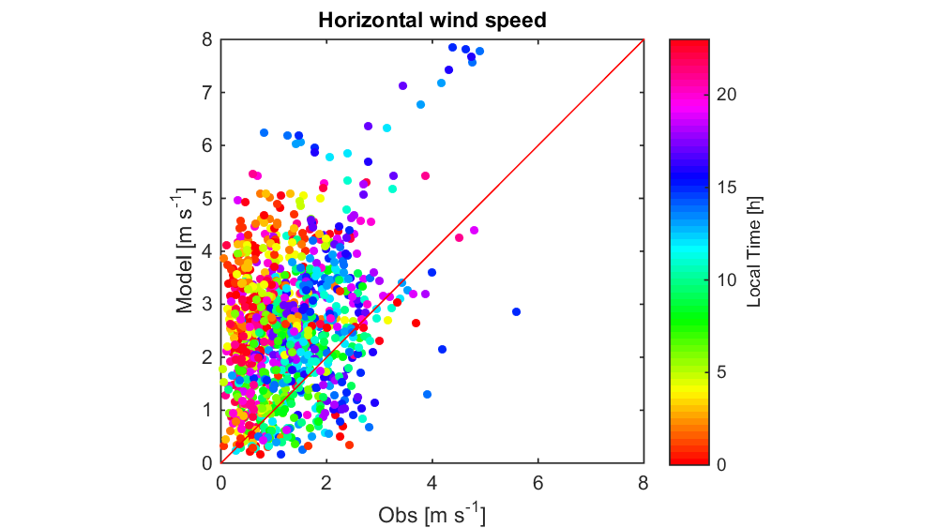
Horizontal wind speed

Slide 5
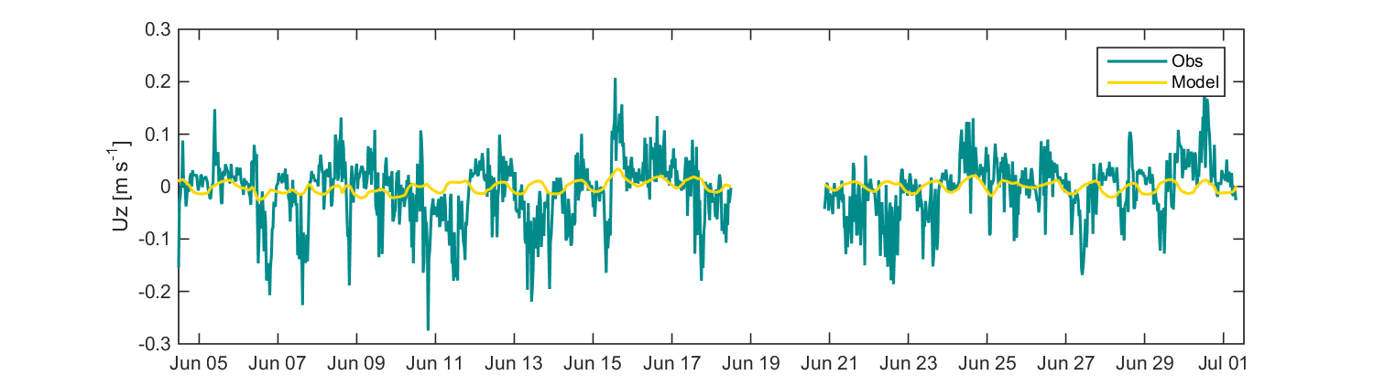
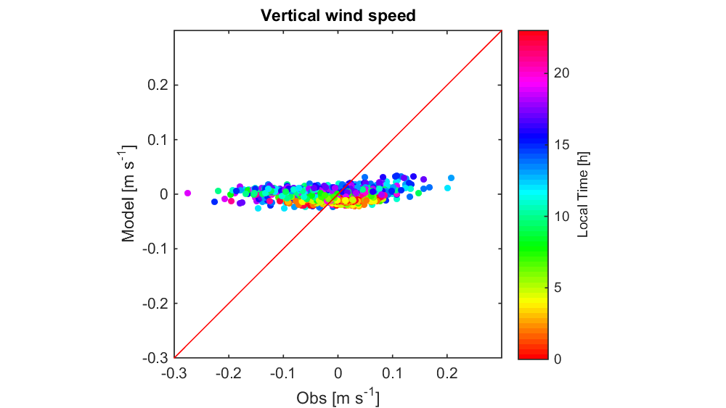
Vertical wind speed

Slide 6
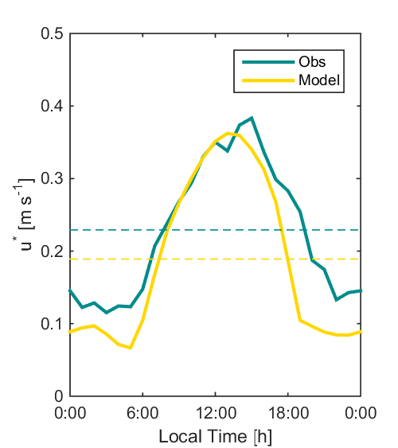
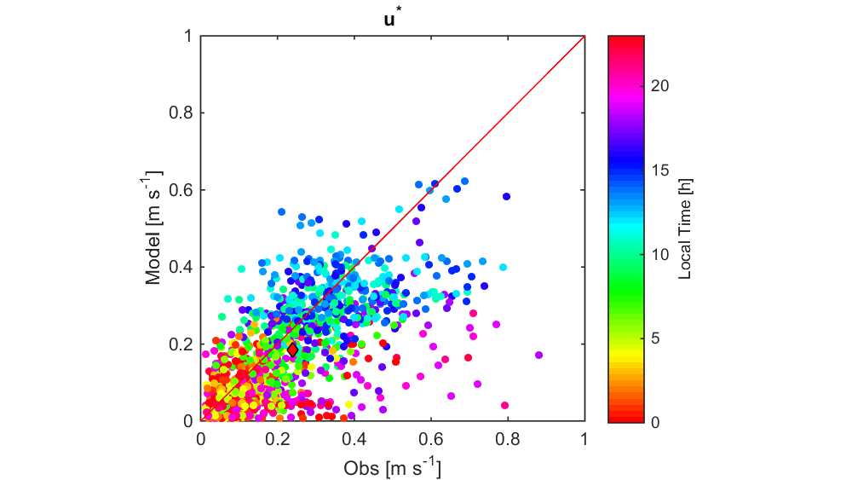
u*

Slide 7
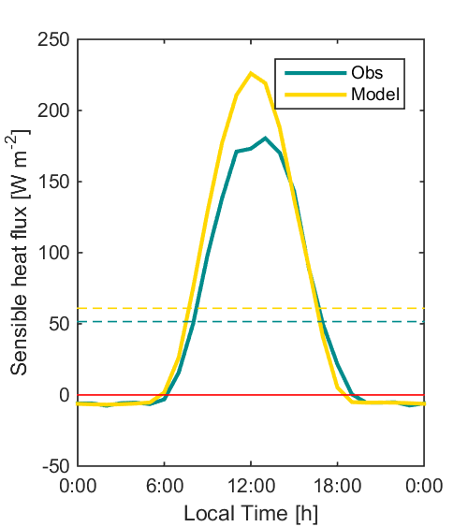
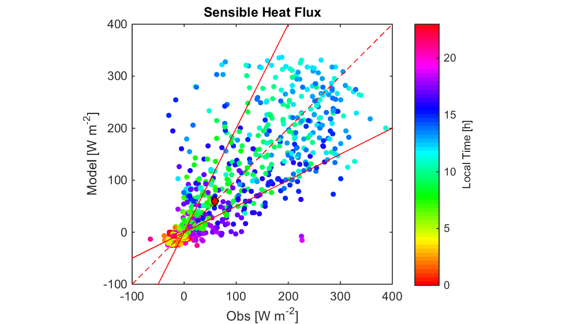
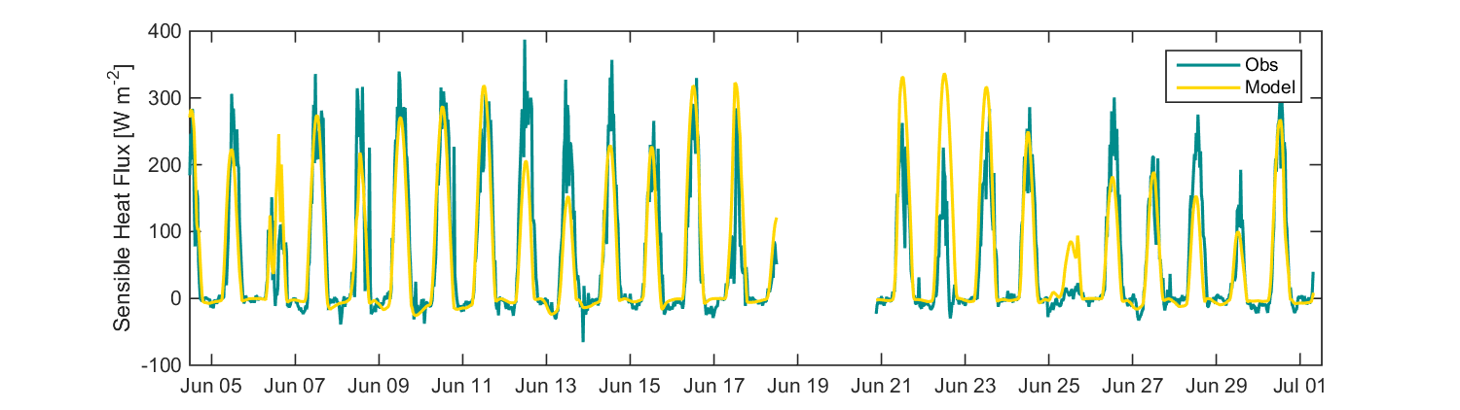
Sensible heat flux

Slide 8
Sensible heat flux

Slide 9
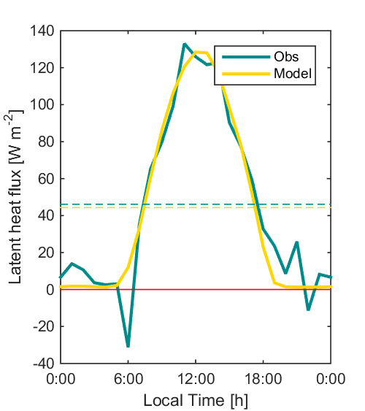
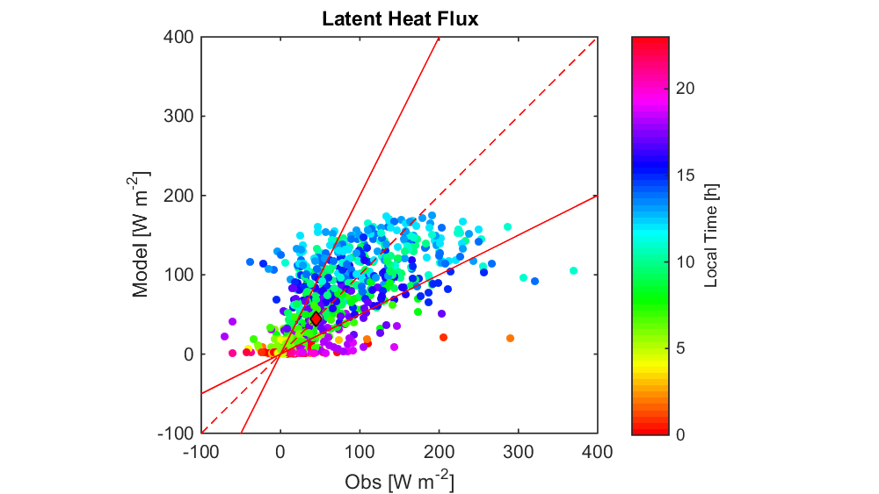
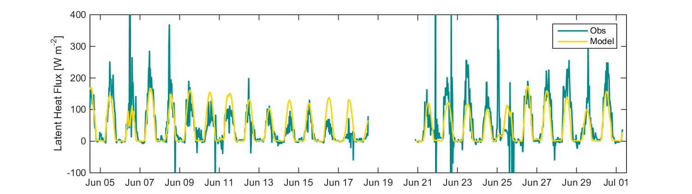
Latent heat flux

Slide 10
Latent heat flux

Slide 11
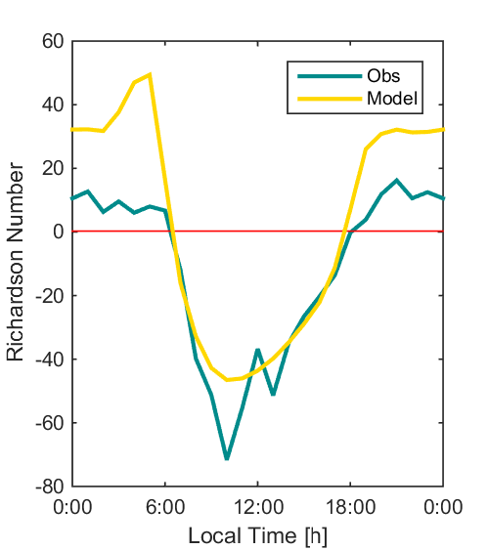

Richardson Number
$$Ri=\frac{1}{1.35}\frac{g}{θ}\frac{\overline{w^{′}θ′}}{{\left(u^{∗}\right)}^{2}}$$

Slide 12
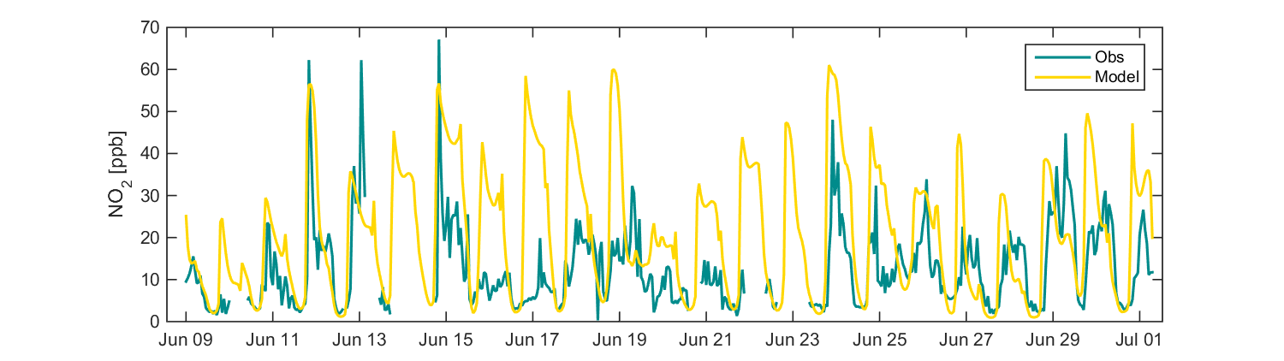
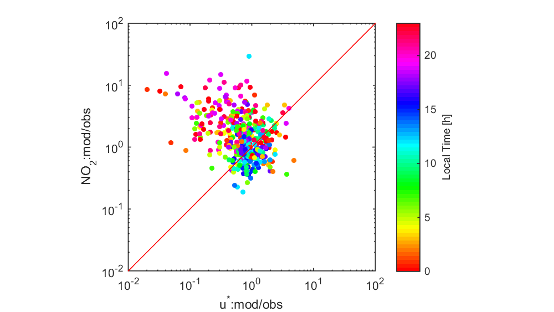
NO₂ Simulation with

Slide 13
Thank you!

