Slide 1
Modelling exposure to Chlorpyrifos in Merida, Mexico
Jessica Belle – Project proposal presentation

Slide 2
Merida city
Capital city of the state of Yucatan, in the Yucatán peninsula in Mexico with a population of ~1,000,000 – They have a Dengue problem, and spray Chlorpyrifos (a pesticide) for mosquito control in areas where Dengue cases have been reported
- Recent study found greater resistance to insecticide in less extensively sprayed areas than in more extensively sprayed areas
Notes:
Pesticide is neurotoxic and linked to developmental defects, anxiety, depression, ADHD, low IQ, cancer, lung problems.

Slide 3
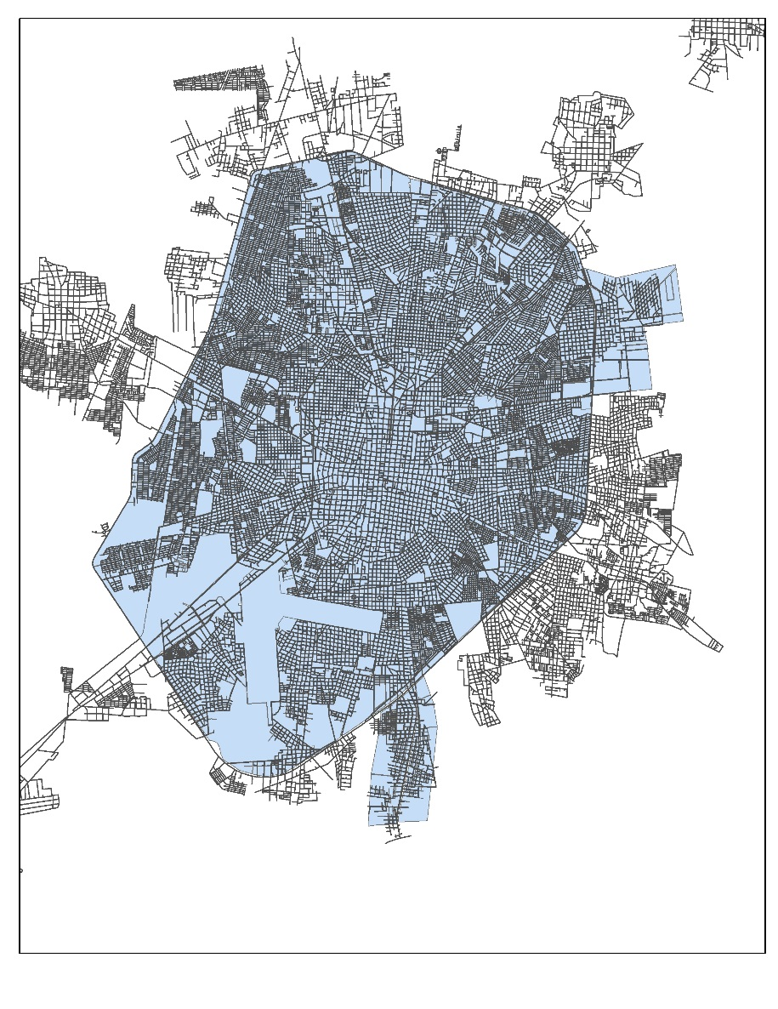
Goal of analysis
Use data on spray campaigns from city, local weather data, and GIS data on streets as model input
Model fate, transport, and deposition for each campaign at discrete time steps (1 second) over time period of study to get estimated concentrations

Slide 4
Model – Gaussian puff with pollutant decay

Slide 5
Deposition and decomposition
In atmosphere chlorpyrifos exists in a mixture of vapor and particulate phases
Vapor phase reacts with OH radicals – reaction has half life ~4.2 hours
Particulate phase is removed via wet and dry deposition
Once deposited on soil it binds tightly, but is degraded by light with a half-life of ~52.5 hours

Slide 6
Model assumptions
Contribution of wet and dry deposition of contaminant dwarfed by chemical decay of contaminant in atmosphere
Only modelling decay by decomposition
Ignoring dispersion in z direction
All spraying was done between dawn and afternoon (spraying not done at dusk or over night)
Unstable atmosphere
Constant diffusion coefficient
Constant boundary layer height
Ignoring effects of humidity on fate and transport
Ignoring effects of local levels and changes in OH concentration in atmosphere when modelling chemical decay
Using random locations within sectors for plumes at each time step

Slide 7
Results – day 1, truck 1
Time series
Map

Slide 8
Conclusions
Model needs to be extended to include more trucks per day and more days in series
Chemical doesn’t seem to disperse much from source before decay

