Slide 1
Diurnal Variation of Nitrogen Dioxide
Jianfeng Li

Slide 2
outline
1. Introduction
2. Datasets, Methods and Model
3. Results and Analysis
4. Conclusion

Slide 3
Introduction
Catalytic ozone destruction in the upper troposphere and lower stratosphere.
Partly control the oxidizing capacity of the troposphere and the abundance of lower tropospheric ozone, which directly affect air quality and human health.
Contribution to nitrate aerosols.
Anthropogenic sources (fossil fuel combustion) contribute up to about 80% in local urban environments.

Slide 4
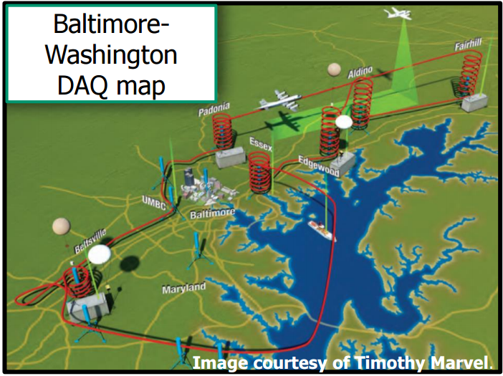
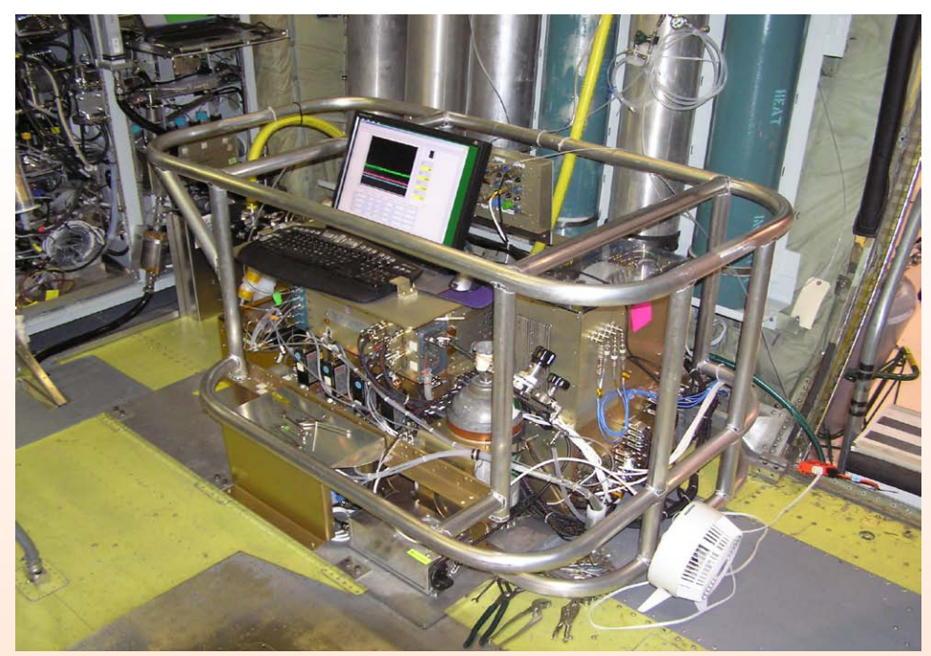
2011 DISCOVER-AQ Campaign Flights
Datasets, Method and Model
Location: Baltimore-Washington, D.C.
Time: June 27 to July 31, 2011
P3-B: NCAR 4-channel Chemiuminescence Instrument
6 sites: Beltsville, Padonia, Fairhill, Aldino, Edgewood and Essex
http://www-air.larc.nasa.gov/missions/discover-aq/docs/pub/AMS_Berkoff_Finalv2.pdf
http://discover-aq.larc.nasa.gov/pdf/2010STM/Weinheimer20101005_DISCOVERAQ_AJW.pdf

Slide 5
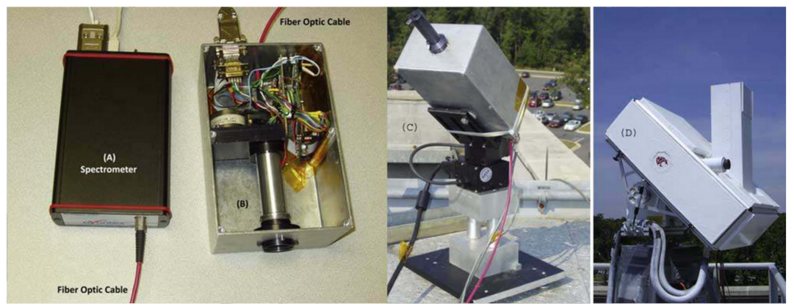
Ground-based instruments: Pandora
Datasets, Method and Model
A small spectrometer system: measure sun and sky radiance from 270 to 530 nm in 0.5 nm steps with a 1.6º field of view; pointing at the sun, the moon, or the sky; NO2 (370 nm – 500 nm)
1% accuracy and 0.1% precision
12 Pandora sites: USNA, UMCP, UMBC, SERC, Padonia, Oldtown, GSFC, Fairhill, Essex, Edgewood, Beltsville, Aldino
Jay Herman et al. 2009

Slide 6
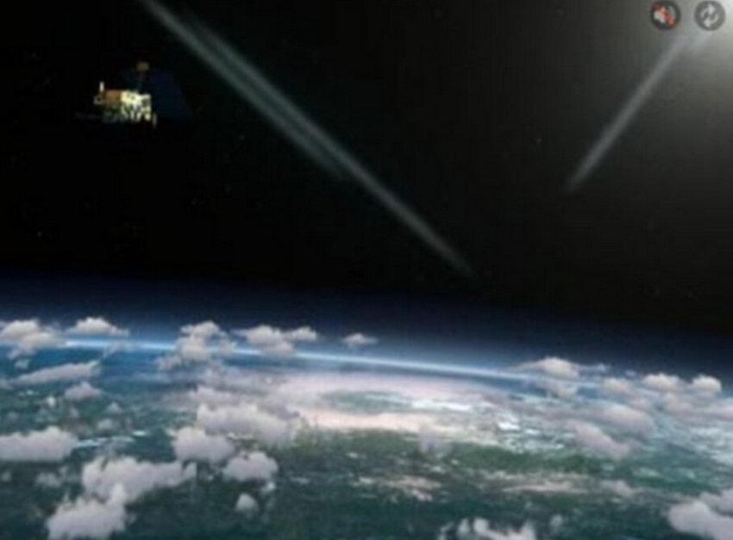
Satellite datasets: GOME2 NO2 Products
Datasets, Method and Model
Global Ozone Monitoring Experiment-2 (GOME2) is a optical spectrometer onboard the MetOp-A satellite launched in 2006: senses the Earth’s backscattered radiance and extraterrestrial solar irradiance; 240 nm – 790 nm with a spectral resolution 0.2 nm – 0.4 nm.
Nadir horizontal resolution: 80×40 km²
Overpass time: 09:30 local time
http://www.eumetsat.int/website/home/Satellites/CurrentSatellites/Metop/MetopDesign/GOME2/index.html

Slide 7
Satellite datasets: OMI NO2 Products
Datasets, Method and Model
OMI (Ozone Monitoring Instrument) is onboard the EOS-Aura satellite which launched in 2004.
A nadir viewing imaging spectrograph that measures the solar radiation backscattered by the Earth’s atmosphere and surface over the entire wavelength range from 270nm to 500nm with a spectral resolution of about 0.5 nm.
Pass cross the equator at 1:45 PM local time
Nadir horizontal resolution of OMI is 24×13 km².
http://aura.gsfc.nasa.gov/index.html
http://www.knmi.nl/omi/research/instrument/index.php

Slide 8
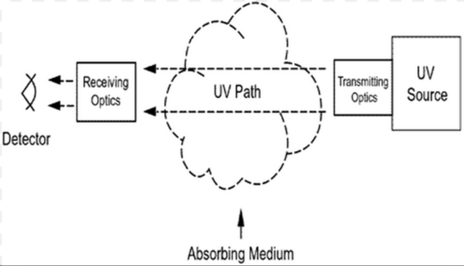
Differential Optical Absorption Spectroscopy Method
Datasets, Method and Model
Retrieve amounts of atmospheric species from measurements of the direct solar light transmitted through the atmosphere as well as of the solar light scattered in the atmosphere or reflected from the earth’s surface
Air mass factor
http://cluin.org/programs/21m2/openpath/uv-doas/

Slide 9
REAM model
Datasets, Method and Model
Regional chEmical trAnsport Model: driven by WRF (Weather Research and Forecast) meteorological fields.
Horizontal resolution of 36 km with 30 vertical layers about in the troposphere.
Initial and boundary conditions from chemical tracers in REAM are obtained from the global simulation for 2011 using the GEOS-CHEM model.
National Emission Inventory 2011.

Slide 10
Anthropogenic NOx emission Diurnal Variation
Results and Analysis
High NOx emissions in daytime and low emissions at night.
Rush hour: 8 - 9 am; 5 – 6 pm
Area sources contribute most of the emissions.
Point sources with stack height over 50 m contribute 16% of the total emissions; those over 100 m contribute 11%.

Slide 11
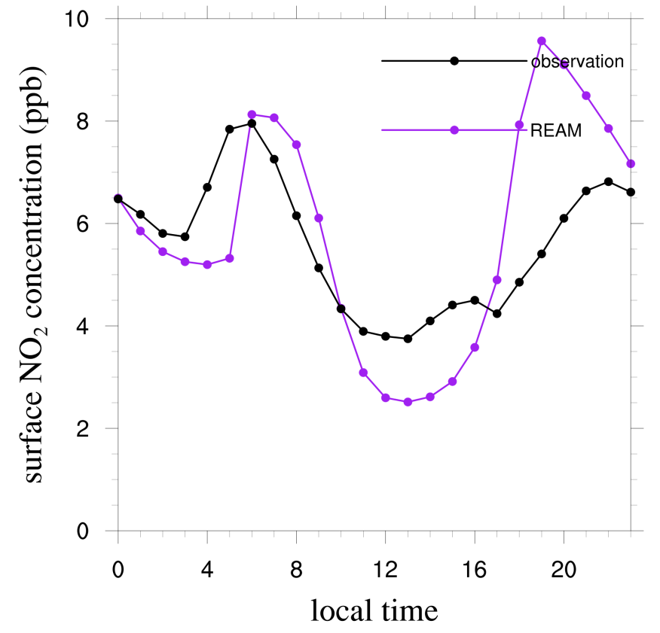
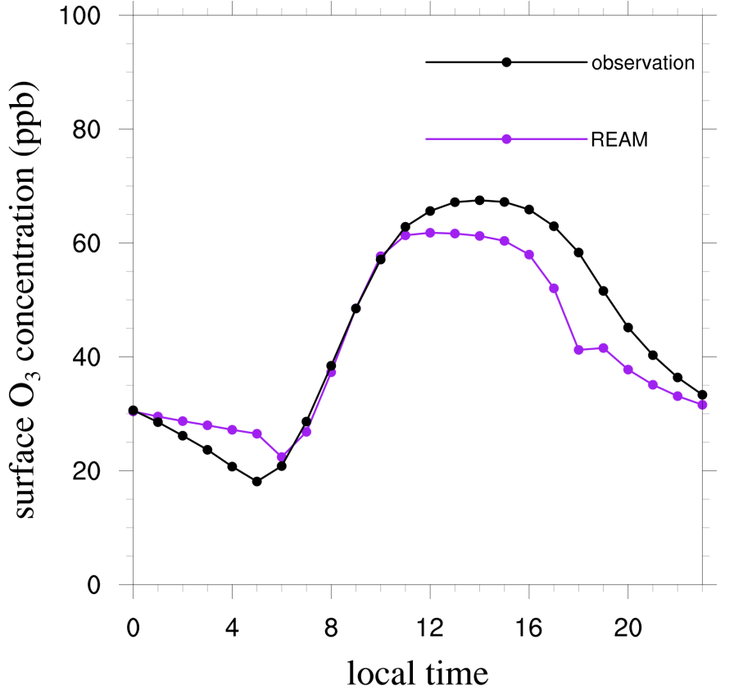
Surface concentration diurnal variation of NO2
Results and Analysis
NO2
O3

Slide 12
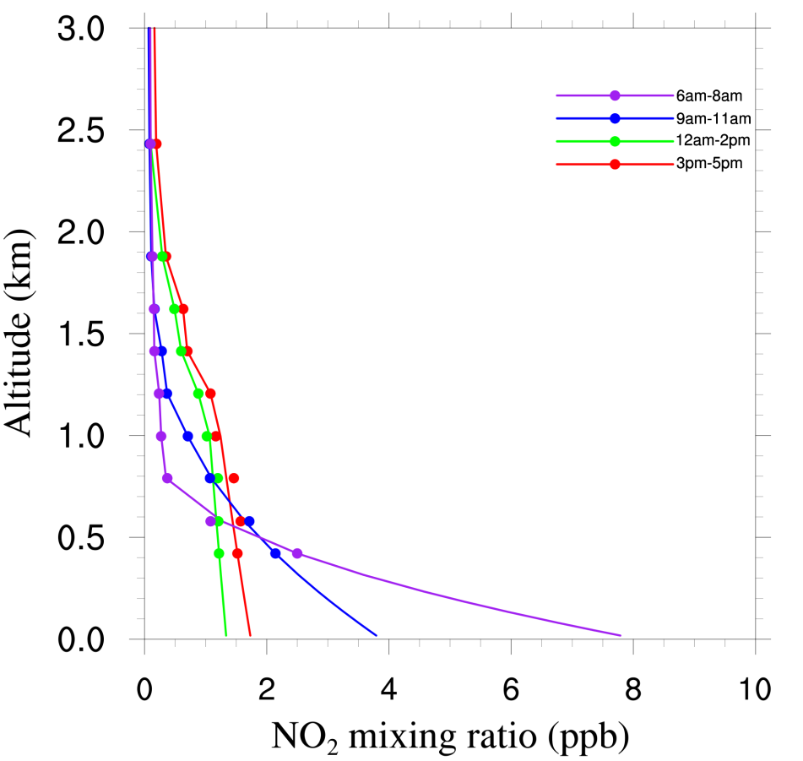
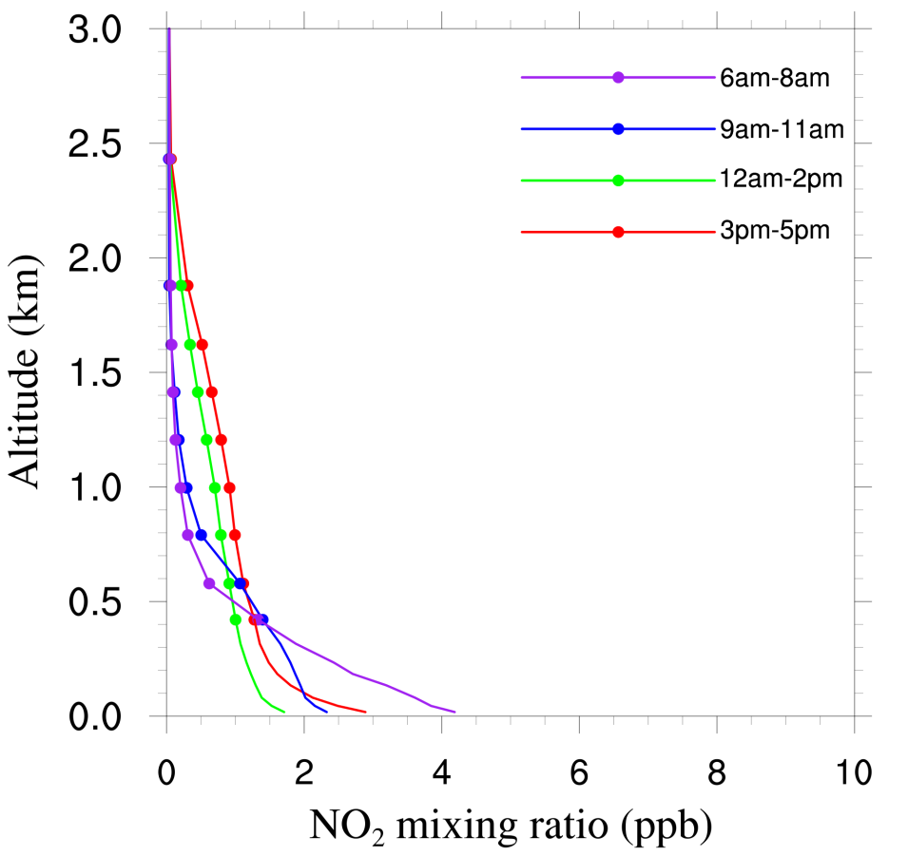
Vertical profile variations in daytime
Results and Analysis
Aircraft
REAM

Slide 13
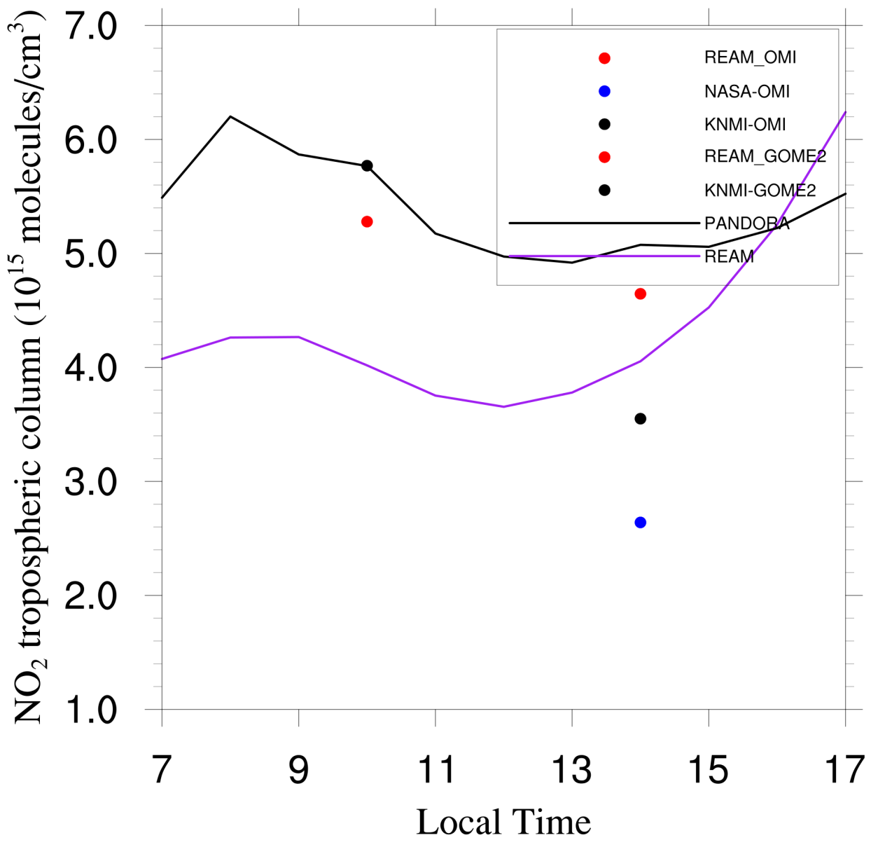
NO2 Column variations
Results and Analysis

