Slide 1

A Journey to Heaven:
Evidence of Inter-Himalaya Transport of Pollutants
Ruixiong Zhang
April 23 2015

Slide 2
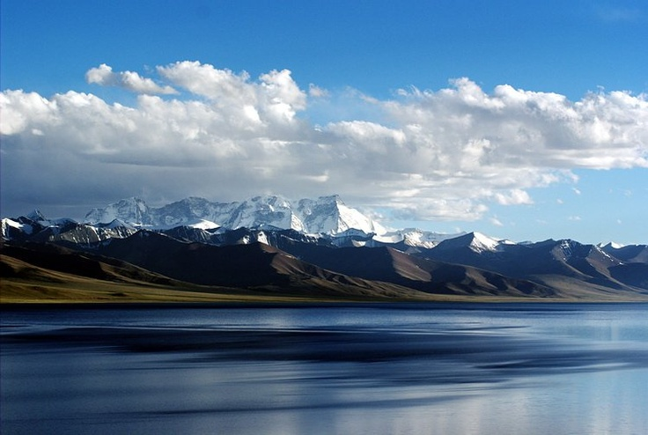
The beauty of the Tibet Plateau

Slide 3
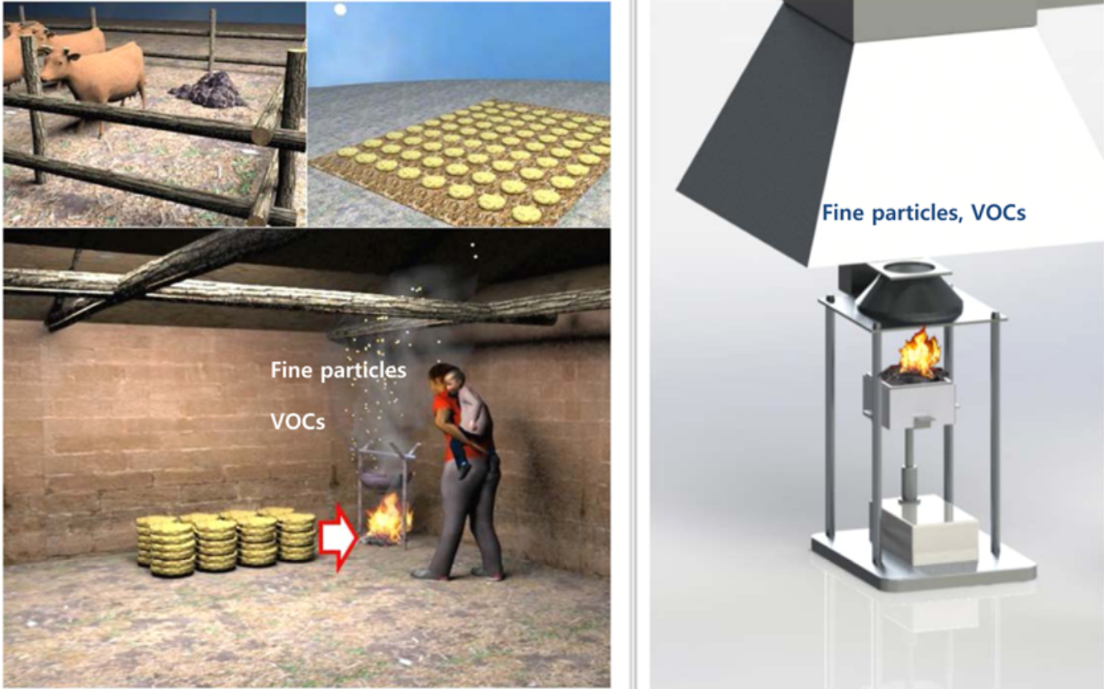
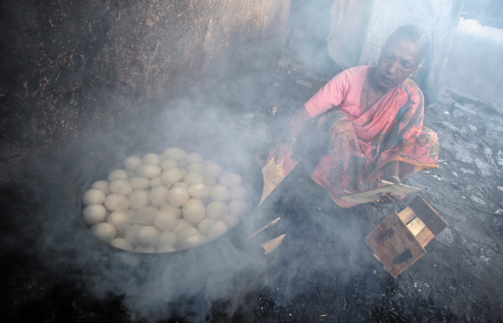
Southeast Asia Biomass Burning
vs
Burning Yuk Dung in Tibet
(Park et al., 2013)
Cooking in Mumbai, India
(Reuters)

Slide 4
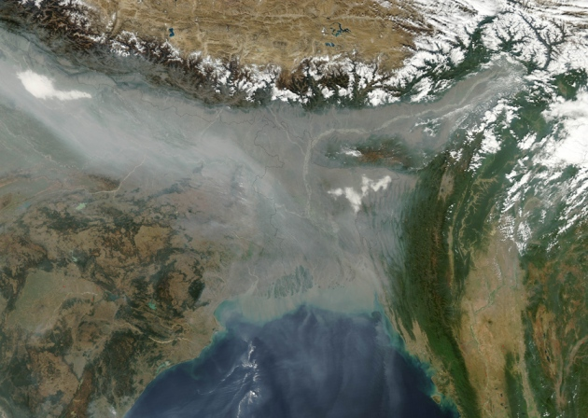
Southeast Asia Biomass Burning
Tibet
India
Bay of Bengal
(Jeff Schmaltz, LANCE MODIS Rapid Response/NASA)

Slide 5
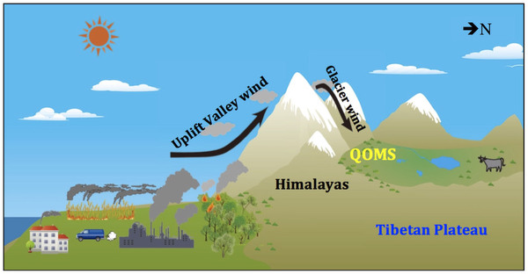
Abnormal Mountain-valley Wind
(Cong et al., 2015)

Slide 6
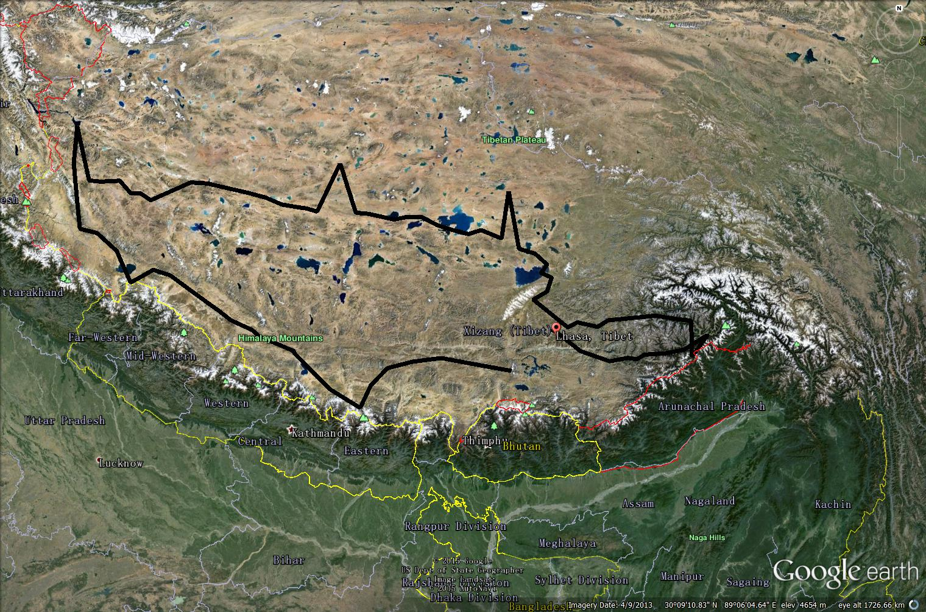
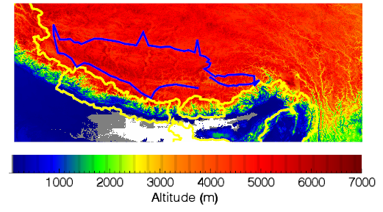
Research Area
NE
NE: Remote area
SW: Remote area, close to Himalaya
SE: Remote area, abundant of water vapor from Indian Ocean through Yarlung Zangbo Grand Canyon
SW
SE
Urban Lhasa

Slide 7
Region | C2H4 | C2H2 | C2H6 | C3H8
NE | 116.4 ( 88.6~ 143.7) | 110.3 ( 79.6~ 171.0) | 96.98 ( 39.4~ 193.1) | 59.38 ( 43.8~ 98.43)
SW | 131.2 ( 70.9~ 171.0) | 145.8 ( 115.~ 171.3) | 122.8 ( 73.2~ 166.0) | 58.29 ( 43.4~ 95.07)
SE | 159.4 ( 127.~ 210.3) | 235.3 ( 203.~ 371.7) | 127.3 ( 74.2~ 296.1) | 101.4 ( 73.6~ 128.9)
Urban | 153.0 ( 124.3~ 182.8) | 296.9 ( 92.68~ 373.9) | 188.7 ( 51.90~ 195.2) | 251.5 ( 129.6~ 1750.)
Region | PRPE | ALK4 | TOL | XYL | ISOP
NE | 88.81 ( 66.7~ 158.7) | 371.4 ( 264.~ 676.8) | 9.682 ( 5.04~ 27.50) | 3.675 ( 1.42~ 12.25) | 2.012 ( 1.17~ 3.902)
SW | 203.0 ( 149.~ 267.6) | 1161. ( 797.~ 1586.) | 49.94 ( 34.0~ 83.29) | 16.23 ( 11.0~ 27.42) | 4.375 ( 2.04~ 6.304)
SE | 227.3 ( 126.~ 441.7) | 1385. ( 673.~ 1982.) | 85.58 ( 32.0~ 110.1) | 38.95 ( 9.22~ 49.80) | 15.91 ( 5.65~ 41.45)
Urban | 468.3 ( 436.4~ 682.7) | 3298. ( 2295.~ 3357.) | 832.7 ( 25.88~ 870.4) | 205.7 ( 6.684~ 281.0) | 20.15 ( 16.30~ 82.21)
Relative long-lived: C₂H₂ C₂H₄ C₂H₆ C₃H₈ (~weeks)
Relative short-lived: PRPE (>3C Alkenes), ALK4 (>4C Alkanes),
TOL, XYL (toluene and xylene like aromatics) (~days)
Very short-lived: ISOP (~hours)

Slide 8
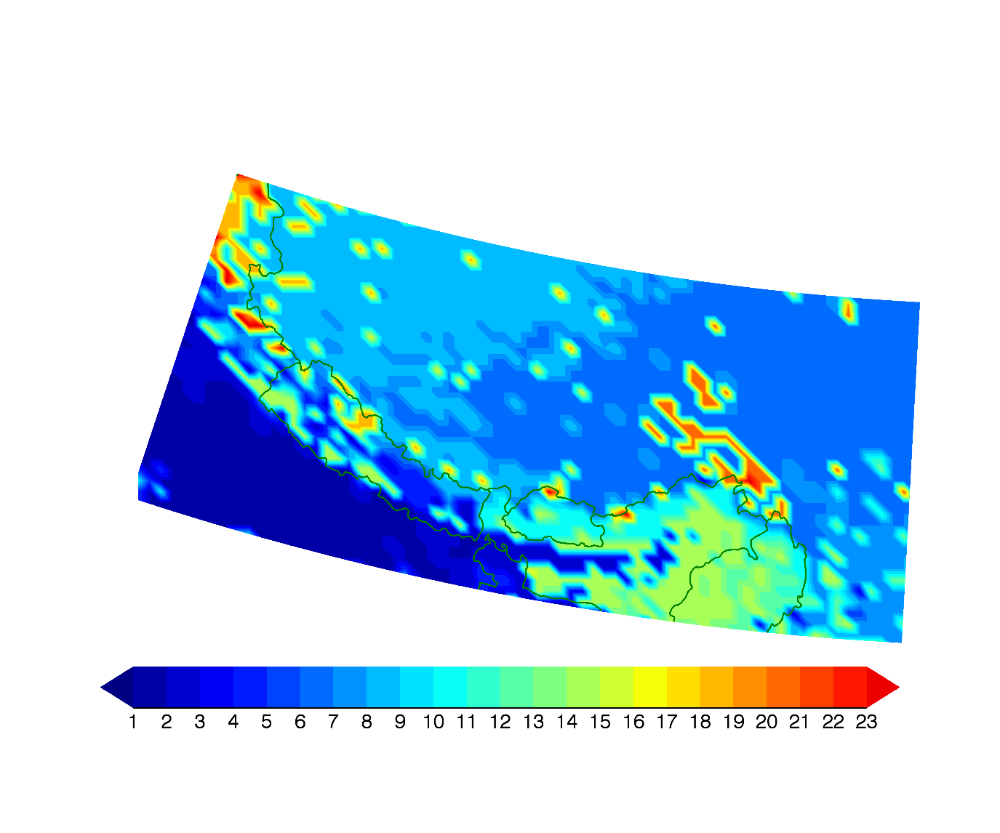
Isoprene and vegetation type
Water vapor transported from the canyon makes different eco-system
Grass and shrubs
Tundra
Crops
Forest

Slide 9
Region | C2H4 | C2H2 | C2H6 | C3H8
NE | 116.4 ( 88.6~ 143.7) | 110.3 ( 79.6~ 171.0) | 96.98 ( 39.4~ 193.1) | 59.38 ( 43.8~ 98.43)
SW | 131.2 ( 70.9~ 171.0) | 145.8 ( 115.~ 171.3) | 122.8 ( 73.2~ 166.0) | 58.29 ( 43.4~ 95.07)
SE | 159.4 ( 127.~ 210.3) | 235.3 ( 203.~ 371.7) | 127.3 ( 74.2~ 296.1) | 101.4 ( 73.6~ 128.9)
Urban | 153.0 ( 124.3~ 182.8) | 296.9 ( 92.68~ 373.9) | 188.7 ( 51.90~ 195.2) | 251.5 ( 129.6~ 1750.)
Region | PRPE | ALK4 | TOL | XYL | ISOP
NE | 88.81 ( 66.7~ 158.7) | 371.4 ( 264.~ 676.8) | 9.682 ( 5.04~ 27.50) | 3.675 ( 1.42~ 12.25) | 2.012 ( 1.17~ 3.902)
SW | 203.0 ( 149.~ 267.6) | 1161. ( 797.~ 1586.) | 49.94 ( 34.0~ 83.29) | 16.23 ( 11.0~ 27.42) | 4.375 ( 2.04~ 6.304)
SE | 227.3 ( 126.~ 441.7) | 1385. ( 673.~ 1982.) | 85.58 ( 32.0~ 110.1) | 38.95 ( 9.22~ 49.80) | 15.91 ( 5.65~ 41.45)
Urban | 468.3 ( 436.4~ 682.7) | 3298. ( 2295.~ 3357.) | 832.7 ( 25.88~ 870.4) | 205.7 ( 6.684~ 281.0) | 20.15 ( 16.30~ 82.21)
Relative long-lived: C₂H₂ C₂H₄ C₂H₆ C₃H₈ (~weeks)
Relative short-lived: PRPE (>3C Alkenes), ALK4 (>4C Alkanes),
TOL, XYL (toluene and xylene like aromatics) (~days)
Very short-lived: ISOP (~hours)

Slide 10
C2H2, C2H4, C2H6, C3H8 are long-lived species and more homogeneous in remote areas
The different ratio between PRPE/ALK4 v.s. XYL/TOL indicate a potential non-local source

Slide 11
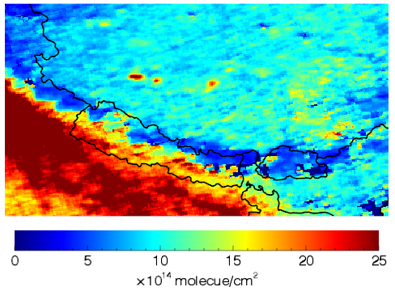
Satellite observed NO₂ column
No obvious difference between
NE and SW regions, indicate no evident local combustion

Slide 12
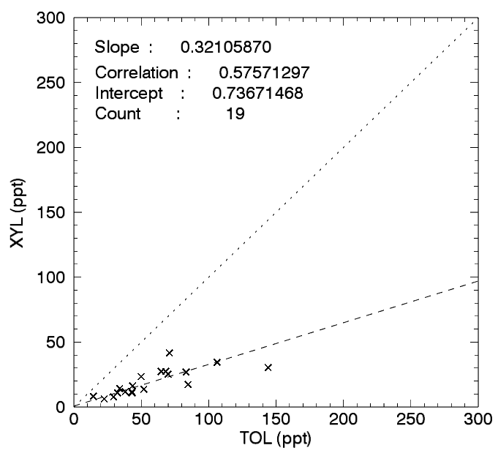
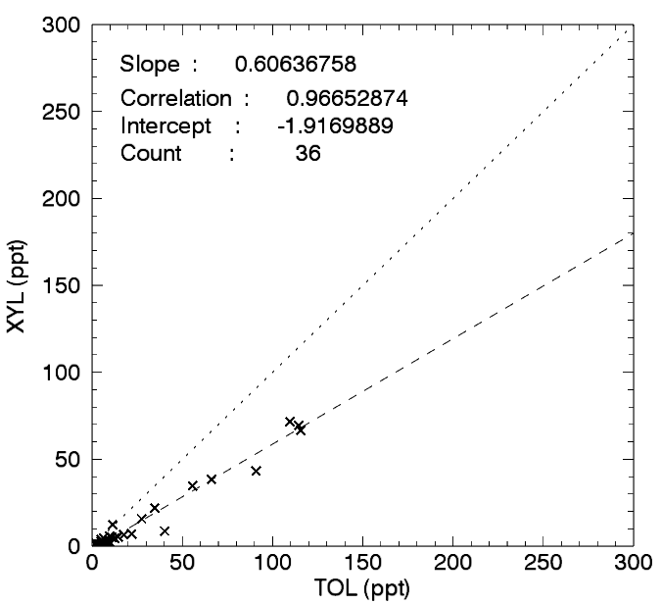
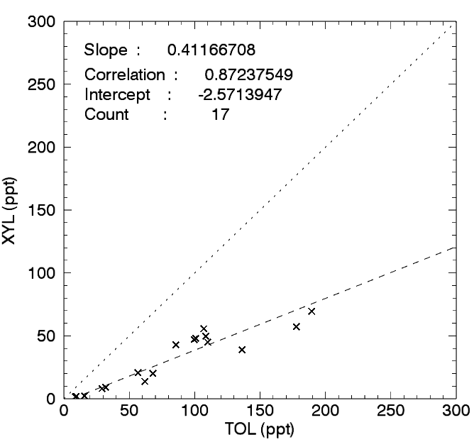
Transport of aromatics
SW
NE
SE
Toluene’s lifetime is longer than Xylene.
More toluene may indicate longer distance from the source.

Slide 13
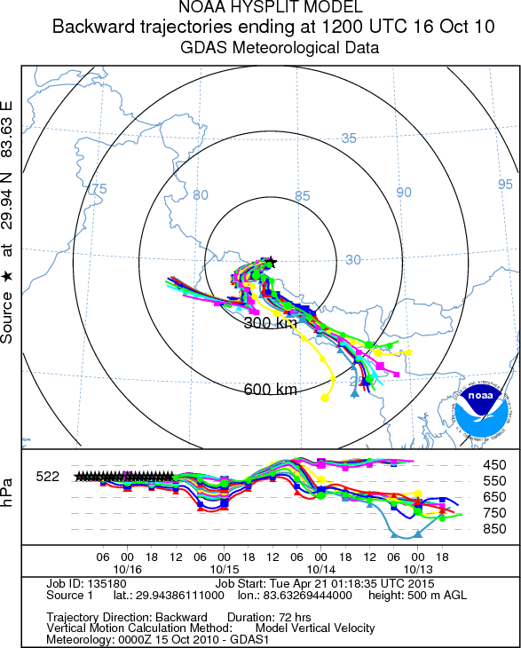
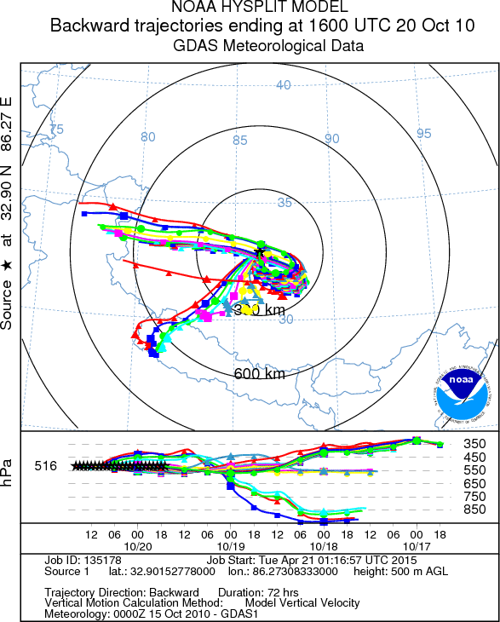
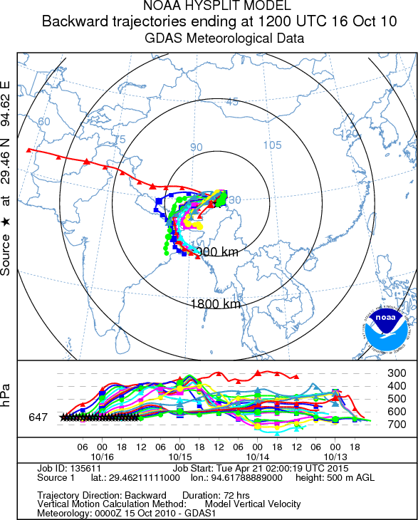
3-day backtrajactory of SW, NE and SE region of Tibet
Affected by Nepal and India
Affected by Nepal and India,
distance is much longer than
SW region
Affected by Lhasa, Nepal and
India

Slide 14
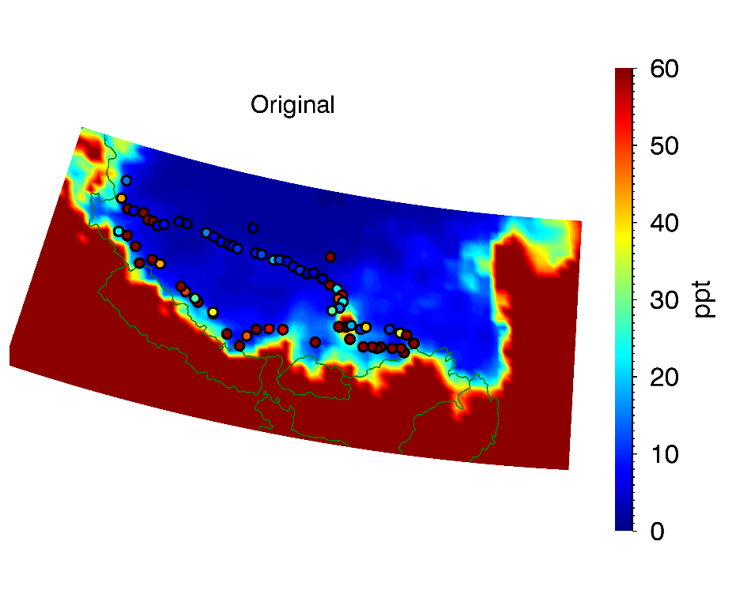
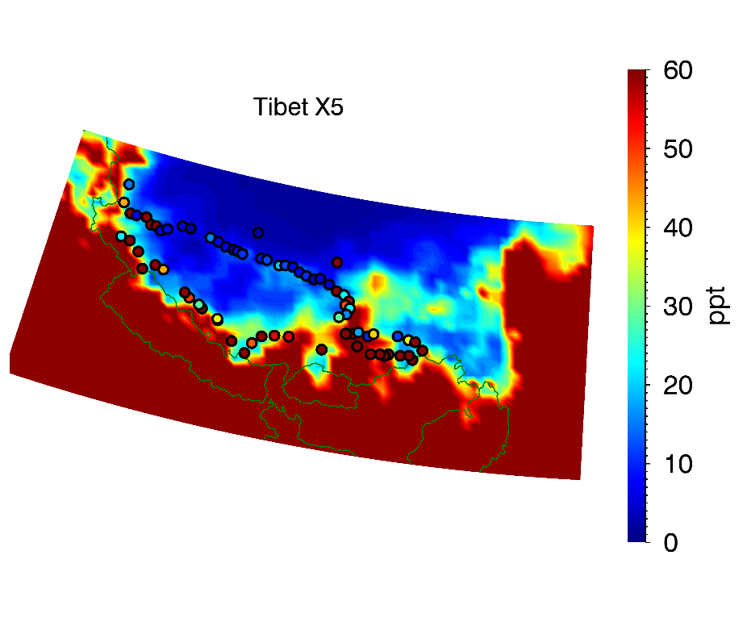
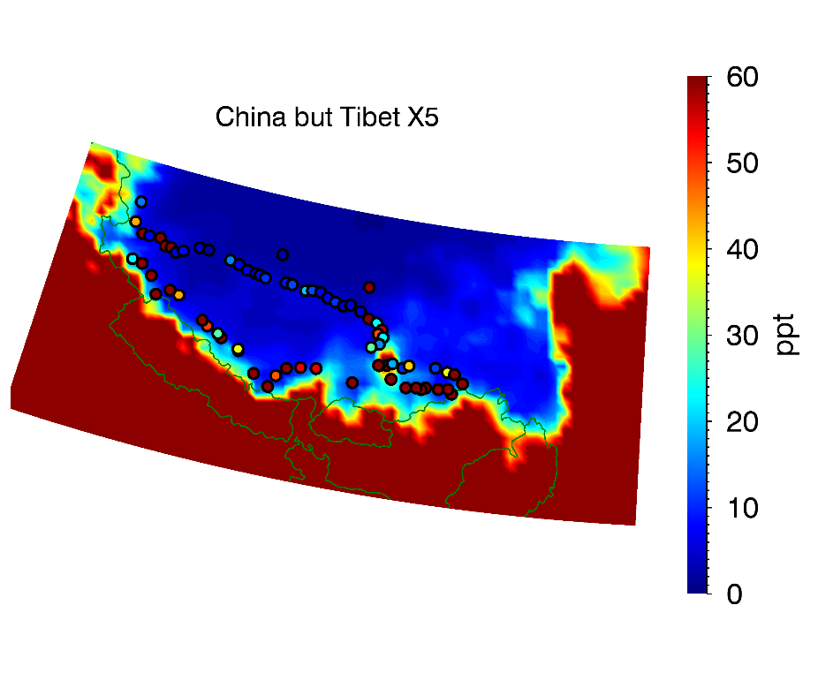
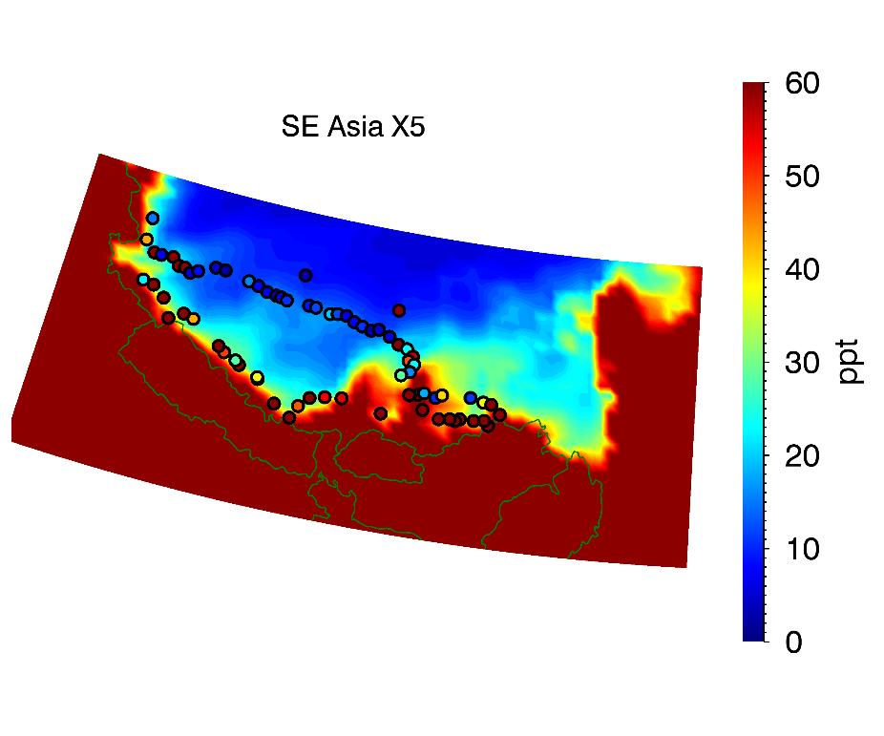
5X ARO emission sensitivity test
Tibet
or
SE Asia?

Slide 15
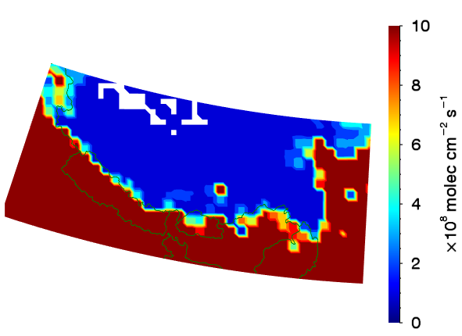
Current ARO emission inventory (70km)
Missing Ngari
A higher resolution emission inventory is needed!
Missed replaced emission pixel

Slide 16
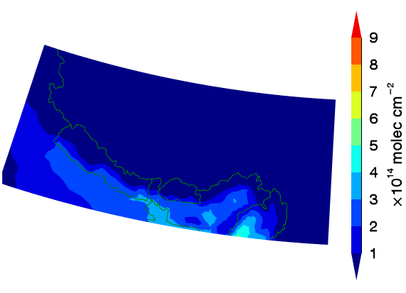
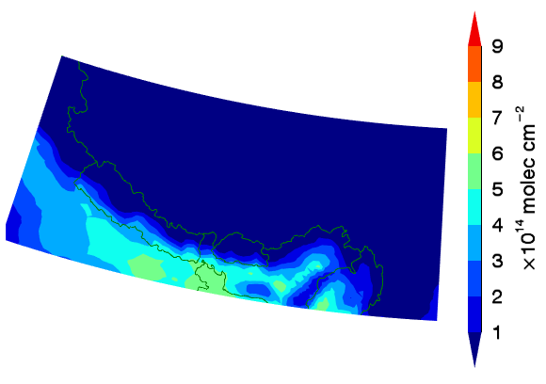
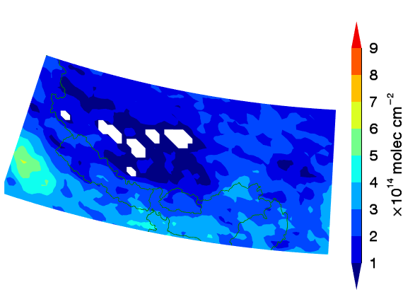
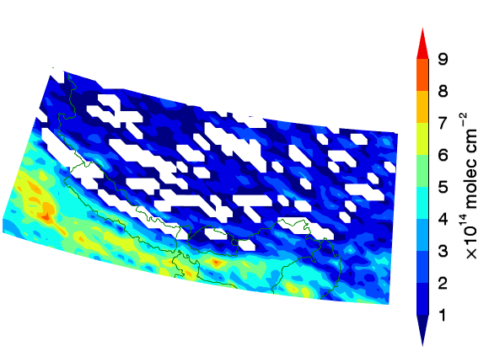
Simulated glyoxal (CHOCHO) columns
REAM simulation
REAM simulation w/ AROX5
5X SE Asia emission
yields more realistic
glyoxal columns
GOME-2
SCIAMACHY
Notes:
Primary glyoxal emission is turned off

Slide 17
Conclusion
VOCs measurements in Tibet indicate a possible transport of pollutants from SE Asia, which is also proved by our chemical transport model
Update of emission inventory is needed to investigate on the possibility of a local source

