Slide 1
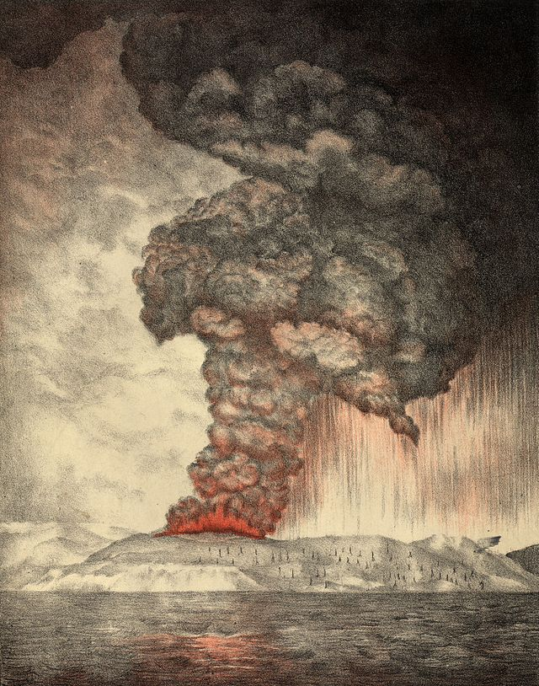

Numerical study of volcanic plume height in Pinatubo 1991 eruption
Yanqing Su
EAS/CEE 6792 Term Project

Slide 2

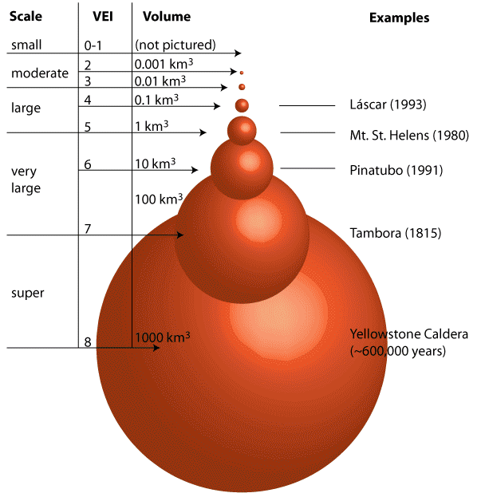
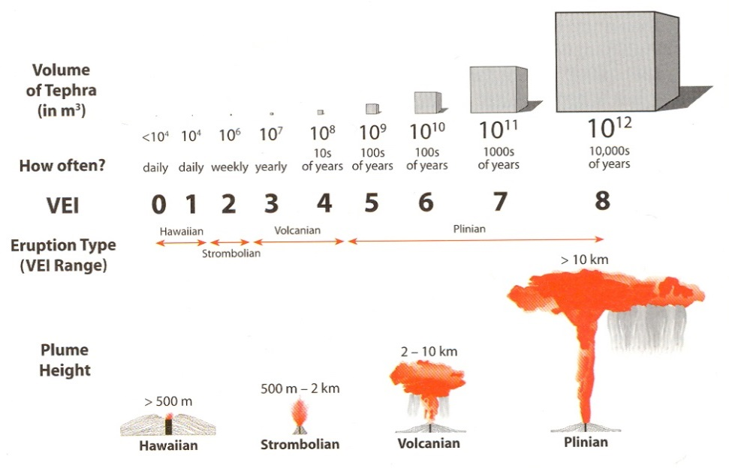
Volcanic eruptions
VEI
Eruption Style
Figure sources: 1, http://plutons.science.oregonstate.edu/supervolcano
2, http://homepages.neiu.edu/~jmhemzac/courses/121S15_5.html

Slide 3
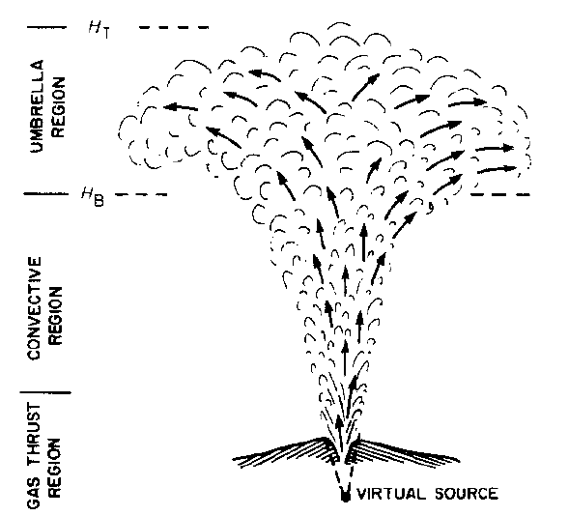
Volcanic plume
Multiphase mixture of particles and gas
Non zero mass and momentum flow rate
Initial density is much higher than the surroundings
Carey, S., and R. S. J. Sparks (1986)

Slide 4
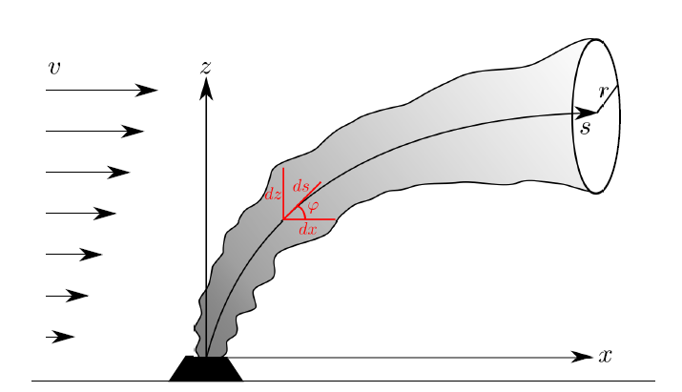
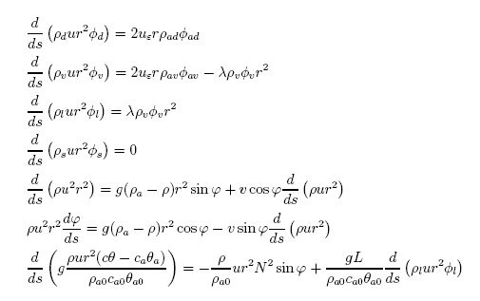
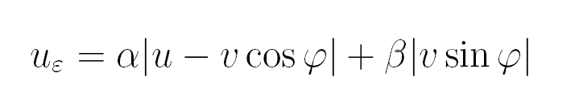
Model
Degruyter, W., and C. Bonadonna (2012)
Mass
axial
Momentum
radial
Heat flow rate
0.1~0.15 [Carazzo et al., 2008]
0.1315 [Morton et al. 1956]
0.09 [Woods, 1998]

Slide 5
Vent Velocity = 300 m/s
Zero terminal velocity height: 22.33 km
Kalnay, E. et al. (1996), The NCEP/NCAR 40-year reanalysis project, Bulletin of the American meteorological Society, 77(3), 437-471.
Neutral buoyancy height: 17.7 km

Slide 6
Several different factors
Notes:
No condensation
Va: T0=1000;u0=300;w%=0.03;vent width=150;
Vent Width: T0=1000;u0=300;w%=0.03;Va=reanalysis
T0: vent width=150;u0=300;w%=0.03;Va=reanalysis

Slide 7
Several different factors
Notes:
No condensation
Va: T0=1000;u0=300;w%=0.03;vent width=150;
Vent Width: T0=1000;u0=300;w%=0.03;Va=reanalysis
T0: vent width=150;u0=300;w%=0.03;Va=reanalysis

Slide 8
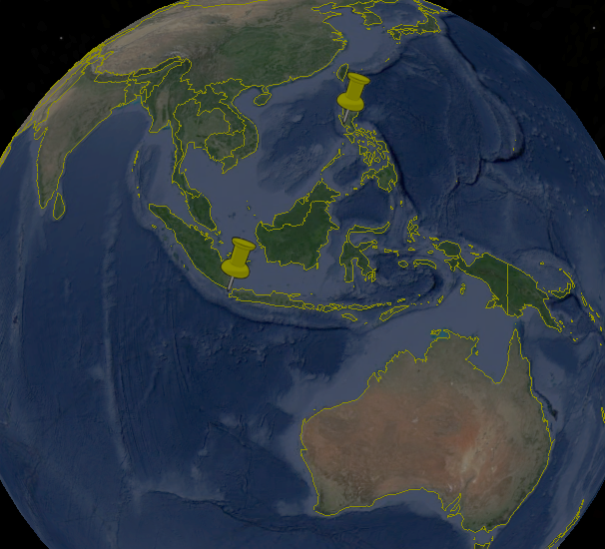
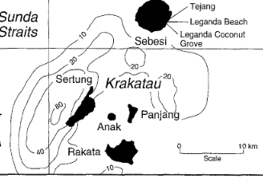
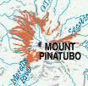
Two historical eruptions
Krakatoa 26/08/1883
Pinatubo 15/06/1991
VEI: 6
Ash cloud of 27 km high
18-21 km³ erupted materials
Ignimbrite: 1.1 M km²
20 Mt Sulfur
1.2 C decrease in Northern hemisphere
VEI: 6
Ash cloud of 24 km high
10 km³ erupted materials
Ignimbrite: 0.125 M km²
17 Mt Sulfur
0.5 C decrease in Northern hemisphere
Notes:
1, Indonesia
2, philipine
Figureright, http://pubs.usgs.gov/fs/1997/fs115-97/
Figureleft, Carey, S., H. Sigurdsson, C. Mandeville, and S. Bronto (1996)

Slide 9
Before eruption: 1.745 km
After eruption: 1.445 km
Caldera Lake: 2 km in diameter
Kalnay, E. et al. (1996), The NCEP/NCAR 40-year reanalysis project, Bulletin of the American meteorological Society, 77(3), 437-471.

Slide 10
Zero terminal velocity height: 40.3 km (40 km)
Esimated Mass flow rate: 2.09 Mt/s
Neutral buoyancy height: 27.2 km (24~26 km)

Slide 11
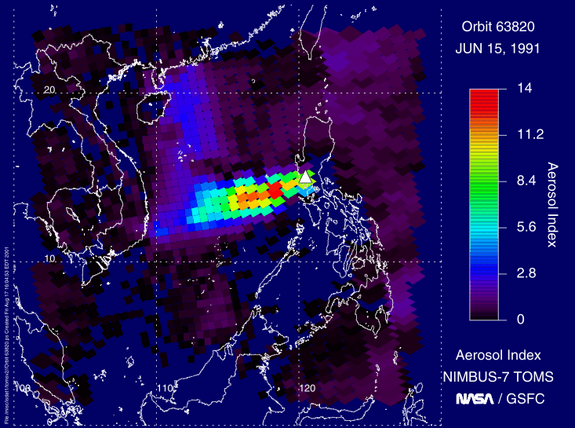
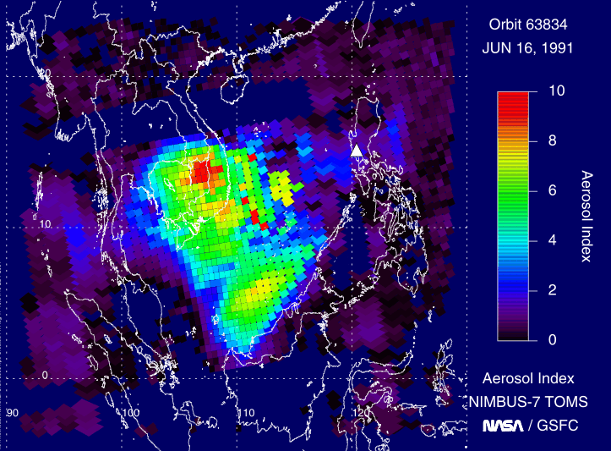
NCEP Reanalysis
Sulfur Dioxide Image Galleries from NASA

Slide 12
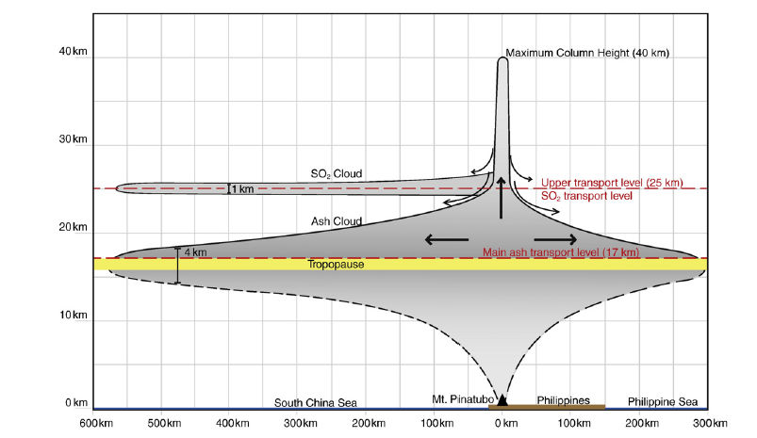
Fero, J., S. N. Carey, and J. T. Merrill (2009)

Slide 13
Conclusion
Important factors
  Mass injection rate
  Atmosphere wind/temperature profile
Future work
  Vent Width
  Exit velocity
  Fall out impact
  Higher dimensions

