Slide 1
Contributions from different sources to regional relationship of O3 and CO/CH2O
Ye Cheng

Slide 2
△ O3/ △ CO from different types of sources
△ O3/ △ CO from local emission and transporting

Slide 3
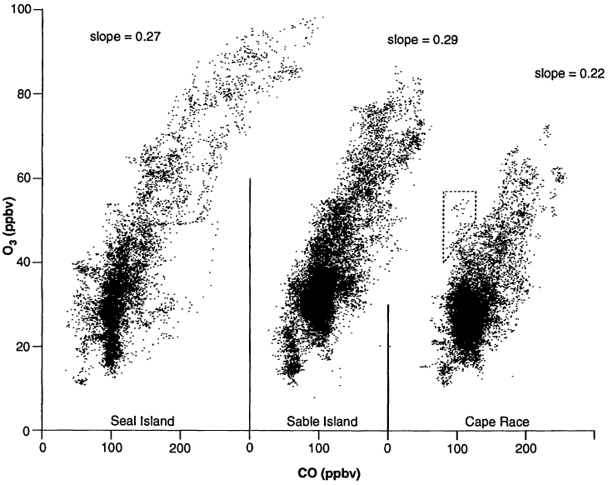
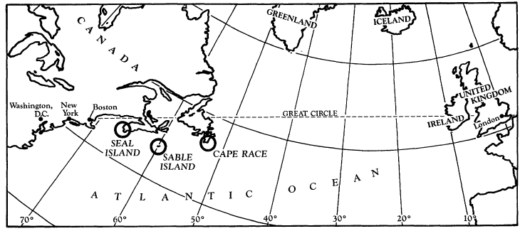
Linear regression
Slope=△ O3/ △ CO
Anthropogenic O3 estimation
Export and Transport
Other sources ---- ISOPRENE
Simultaneously emission
from anthropogenic activity
automobile exhaust
power plants
industries
(David D. Parrish, 1993)
CO
NOx
O3
(David D. Parrish, 1993)

Slide 4
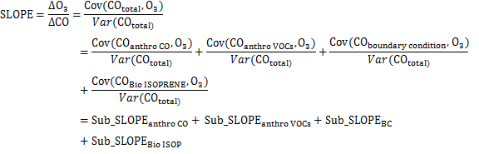
△ O3/ △ CO from different sources
hv, OH
CO
ISOPRENE →
· RO2
→
NO2
→
O3
Anthropogenic CO
Anthropogenic VOCs → CO
Boundary conditions CO

Slide 5
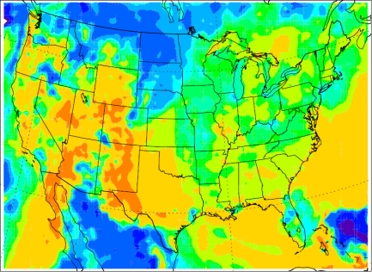
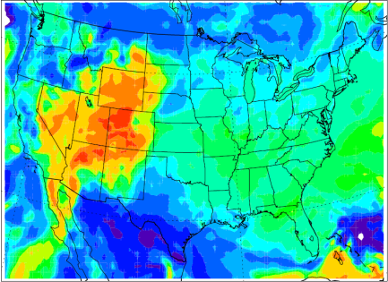
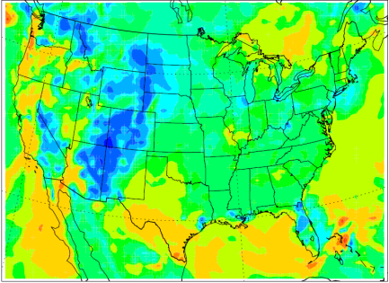
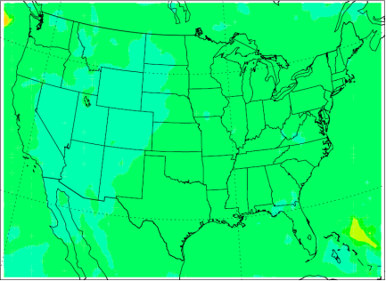
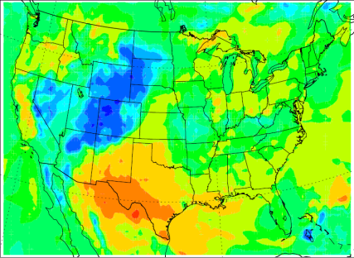
CO-O3 slope in US
Standard
BC
Anthro CO
Anthro VOCs
Bio Isop

Slide 6
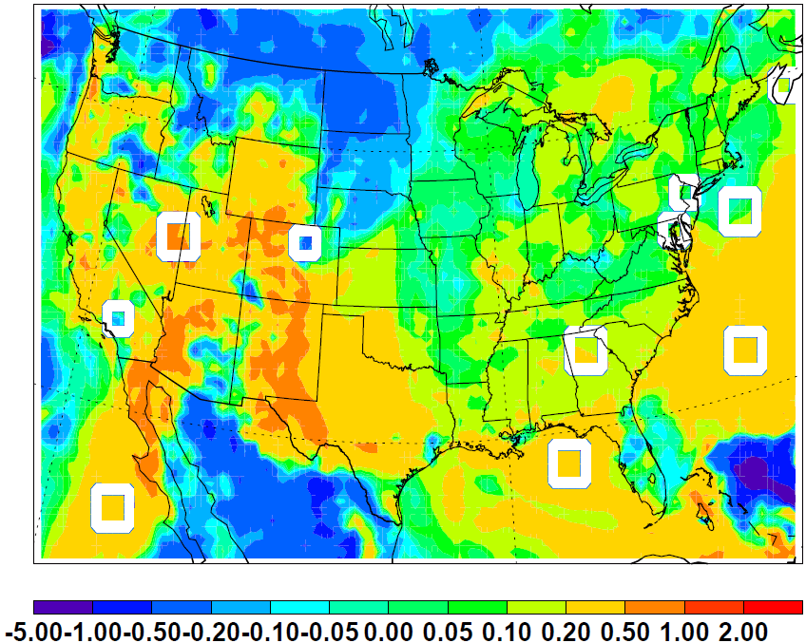

Slide 7
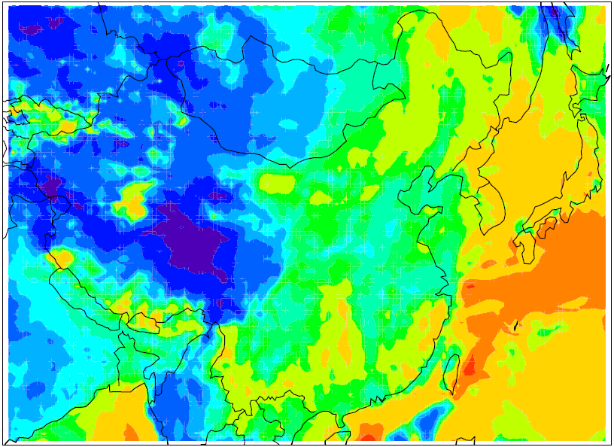
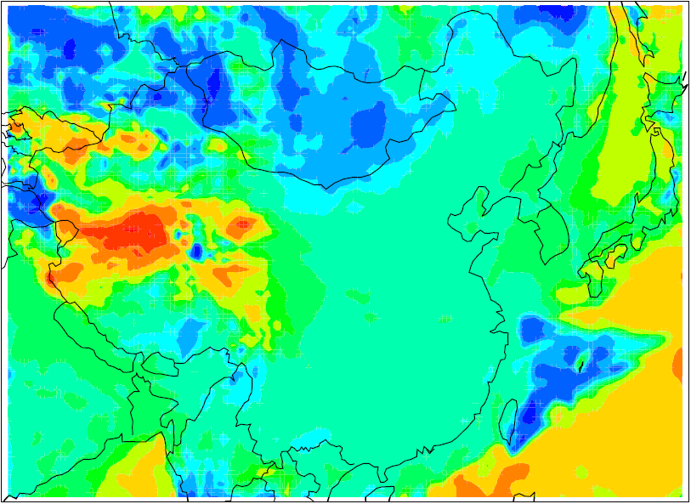
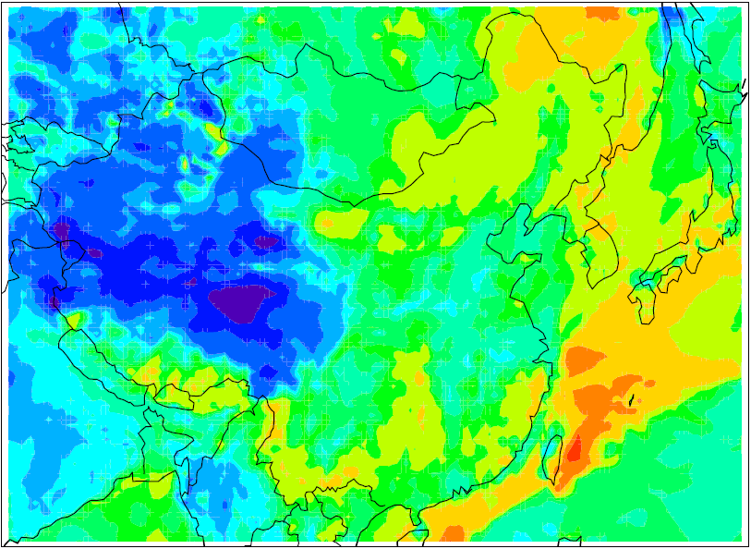
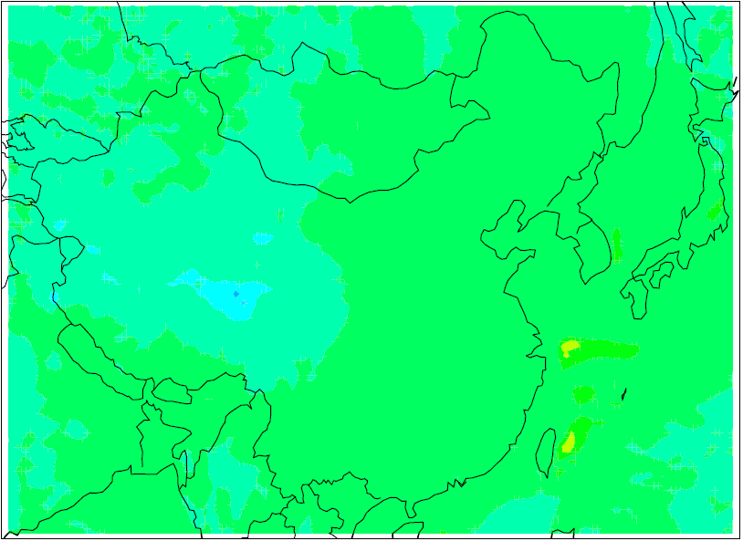
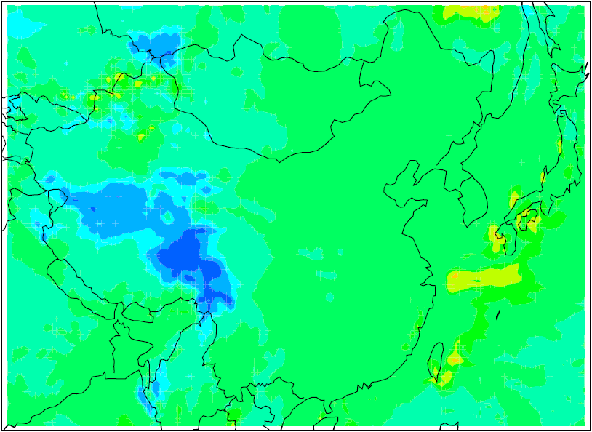
CO-O3 slope in China
Standard
BC
Anthro CO
Anthro VOCs
Bio Isop

Slide 8
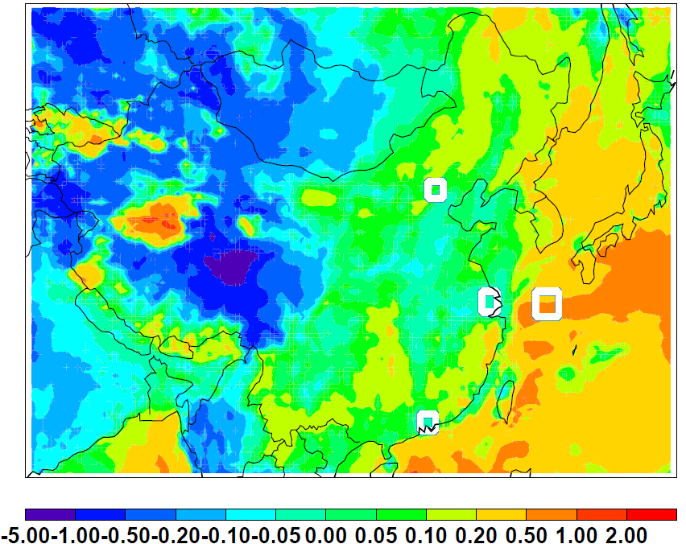

Slide 9
△CH2O / △O3 from different sources
People found a strong linear correlation between CH2O and O3 from observation.
Using △CH2O / △O3 (inverted slope)

Slide 10
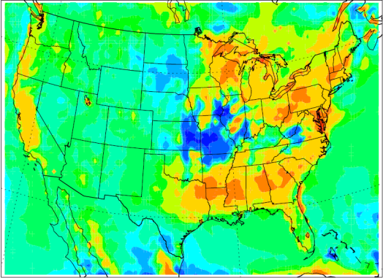
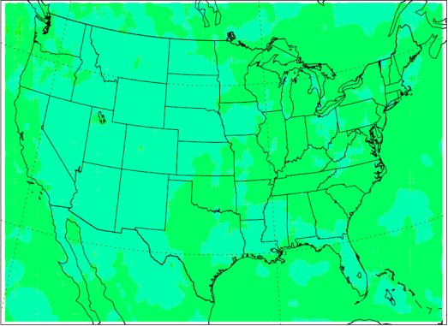
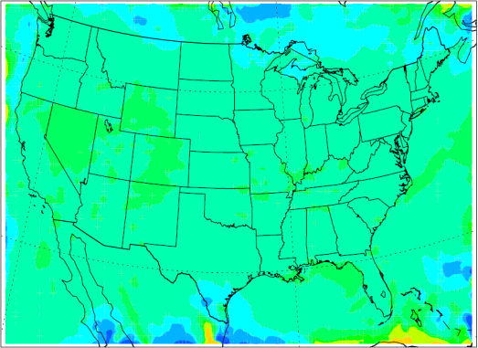
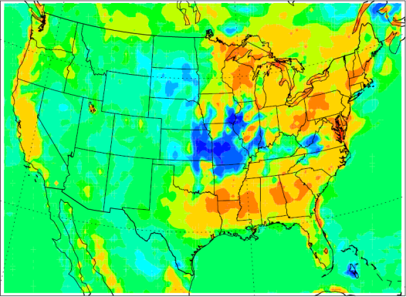
CH2O-O3 Slope in US
Standard
BC
Bio Isop
Anthro VOCs

Slide 11
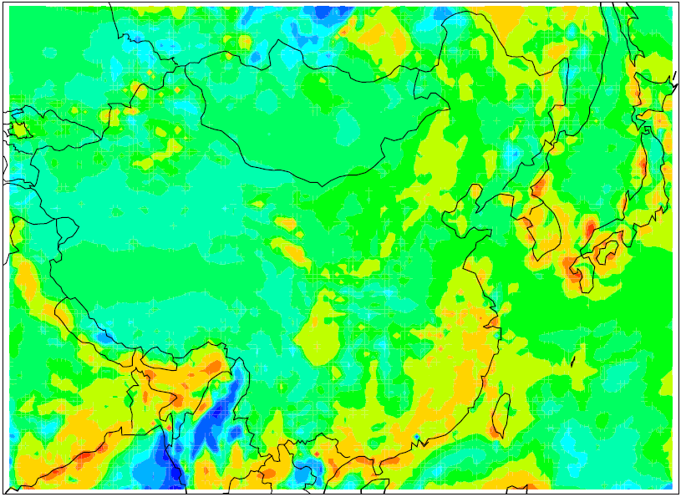
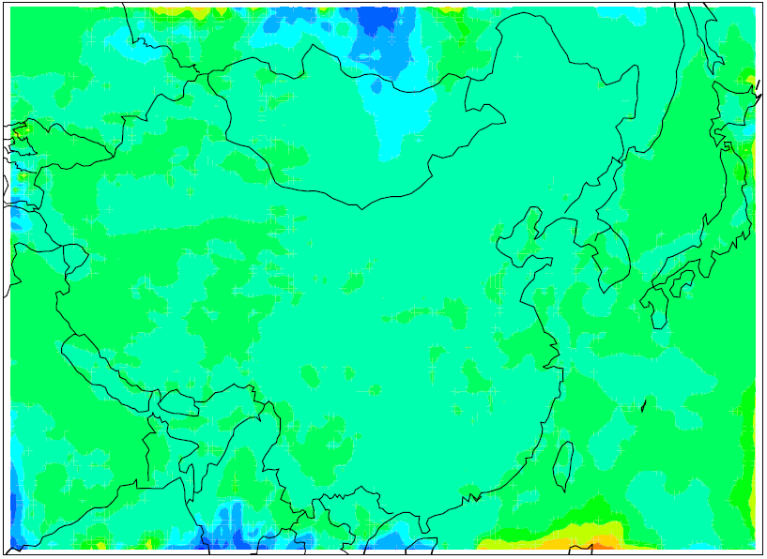
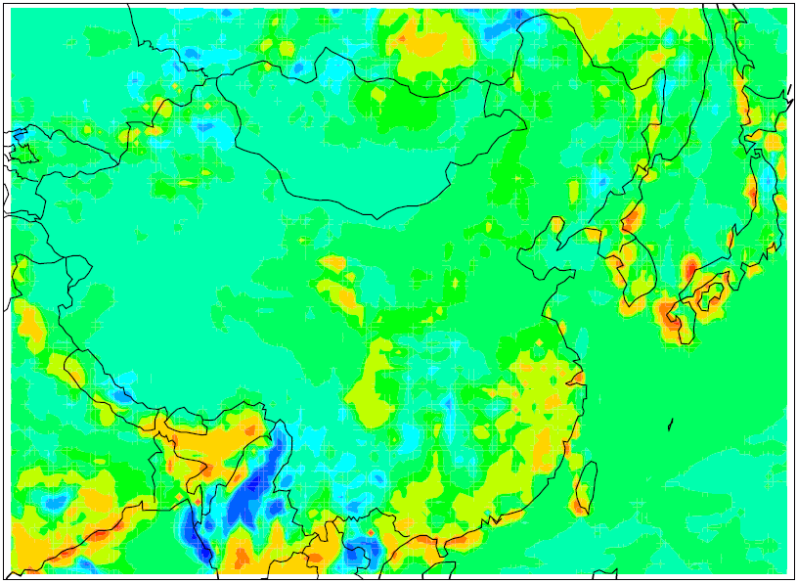
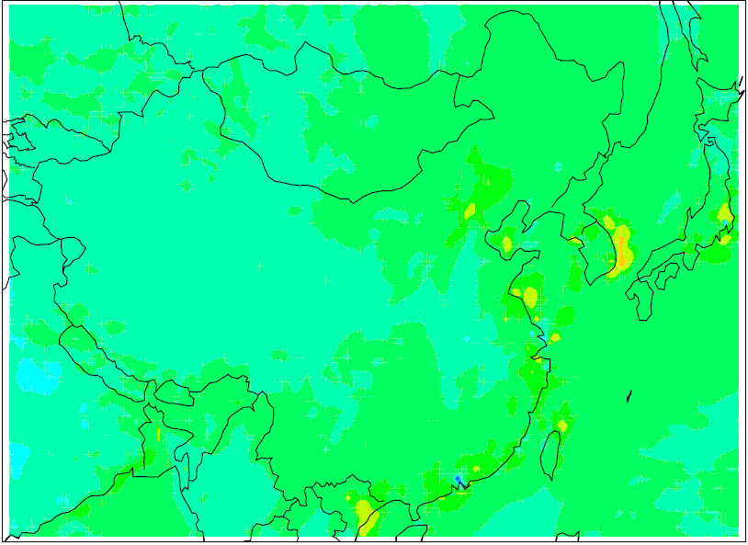
CH2O-O3 Slope in China
Standard
BC
Bio Isop
Anthro VOCs

Slide 12

△ O3/ △ CO from local emission and transporting
Beijing
Pearl River Delta
Los Angeles
Atlanta

Slide 13
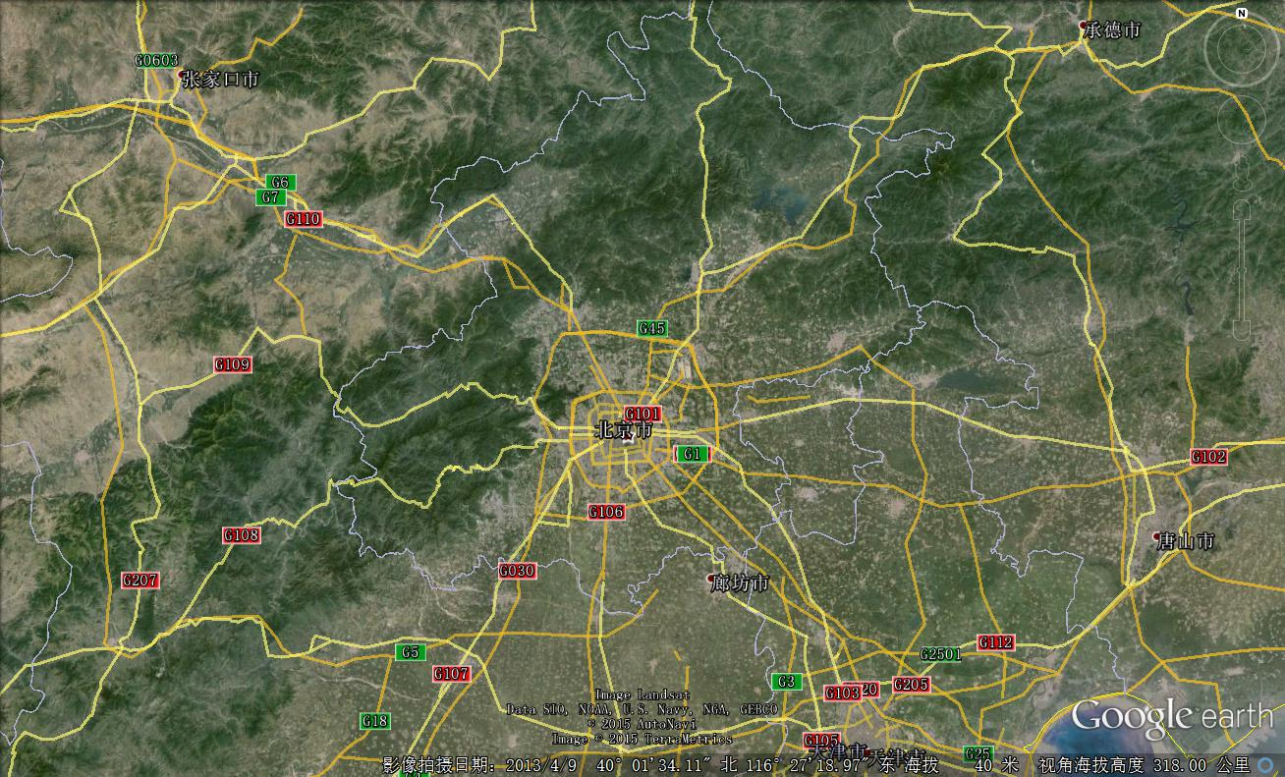



Beijing
Local
Transported

Slide 14
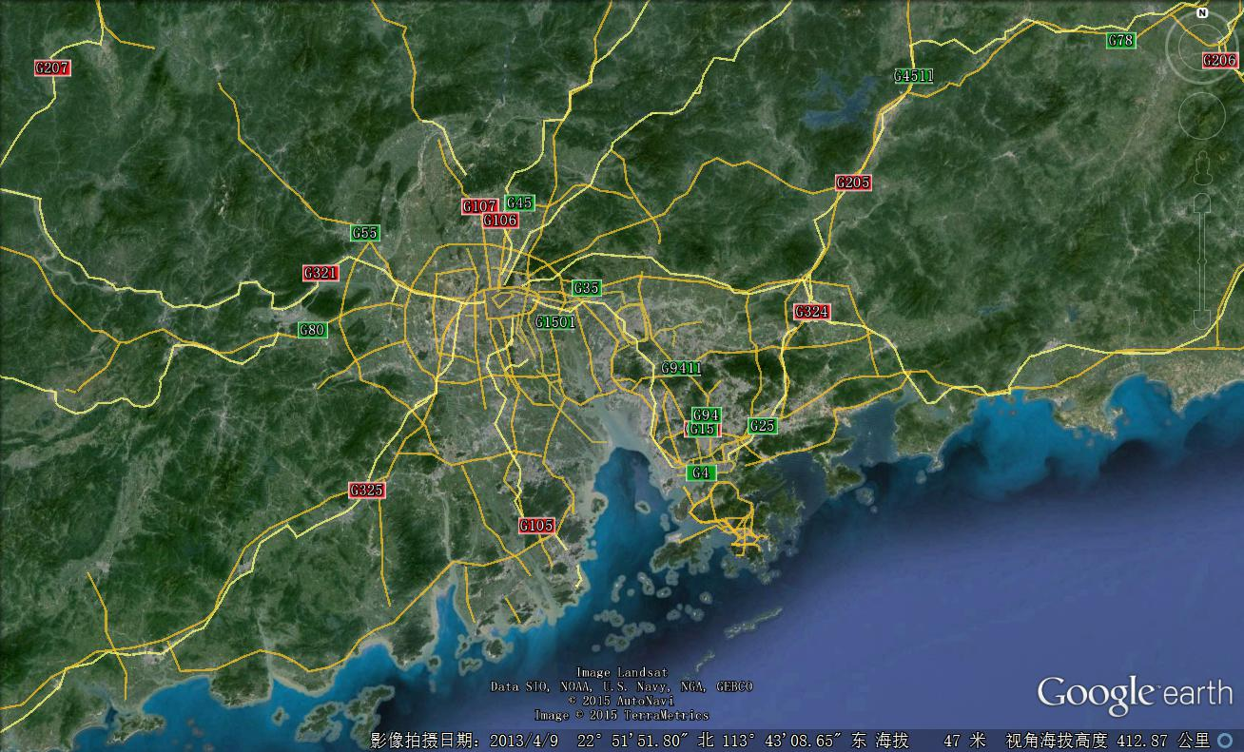


Pearl River Delta （PRD）
Economic Zone
Local
Transported

Slide 15
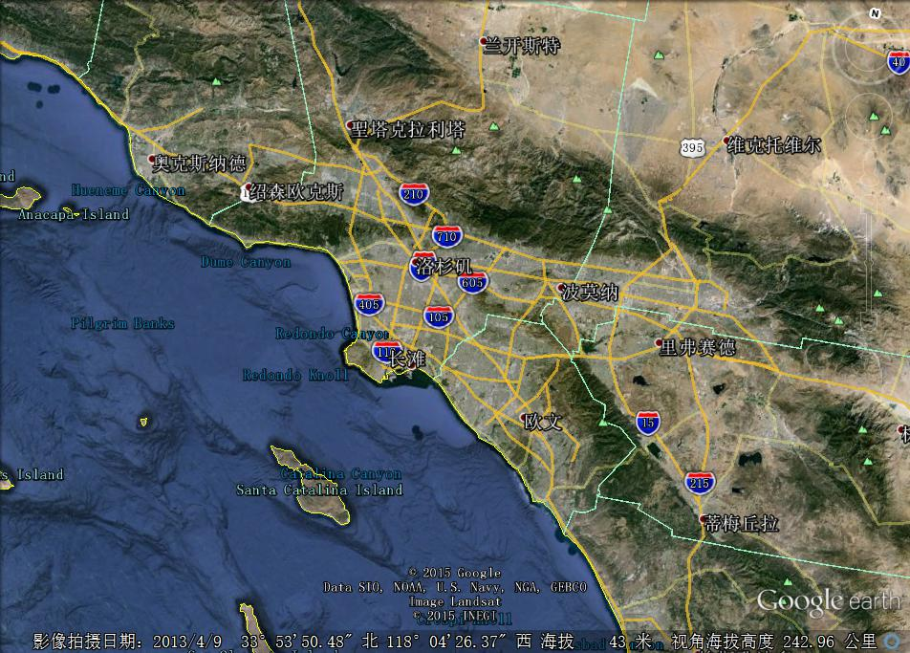


Los Angeles
Local
Transported

Slide 16
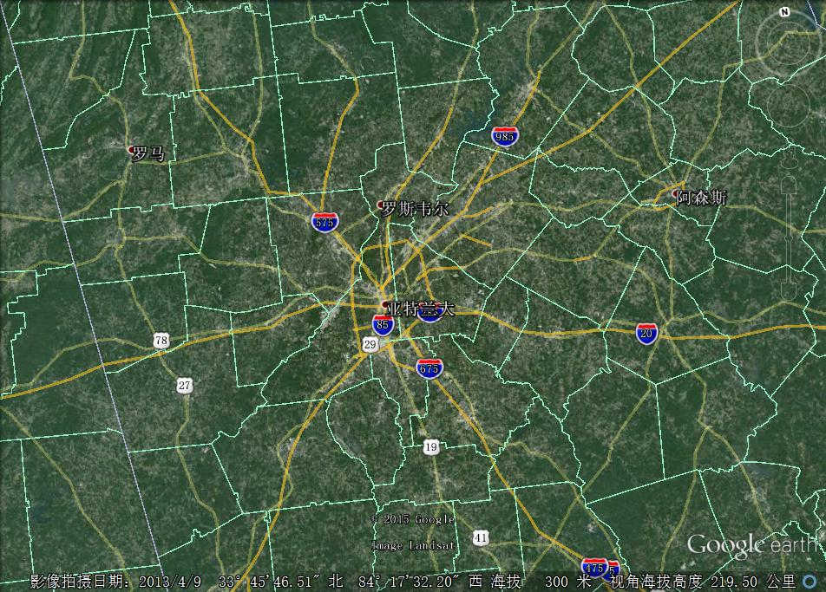


Atlanta
Local
Transported

Slide 17
conclusion
Biogenic ISOPRENE make a significant contribution to the O3-CO slope in US; But in China, the slope is majorly anthropogenic CO controlled.
O3-CH2O slope is Biogenic ISOPRENE controlled in both US and China.
Beijing’s O3-CO slope is controlled by transport; Los Angeles's is local emission controlled; PRD and Atlanta both have half-half contributions.

