Slide 1
Wildfire Plume Height Simulations
by Ziming Ke

Slide 2
1. Introduction: why bother ?
Fire smoke: human health, visibility, air quality, regional climate change.
The injection heights of wildfire plumes are where smoke emissions are released into atmosphere. If injection heights are lower than boundary layer, the impact is locally; If injection heights are higher than boundary layer, smoke emissions can impact hundreds miles away and have longer lifetime.
Examples: CMAQ with DaySomke presented a more reasonable PM2.5 profile, compared to observation, over Atlanta (Hu et al., 2008;Liu et al., 2009).

Slide 3
1. Introduction: Plume-rise Implementations
CMAQ DaySmoke and AERO-RAMS
Dynamic model: WRF with 1D Plume-rise model (Freitas et al., 2010). Application: Grell et al., 2010.
Empirical parameterization: ECHAM6-HAM2.2 with Sofiev Parameterization (SP). Default setting is released around boundary layer. Application: Veira et al. 2015

Slide 4
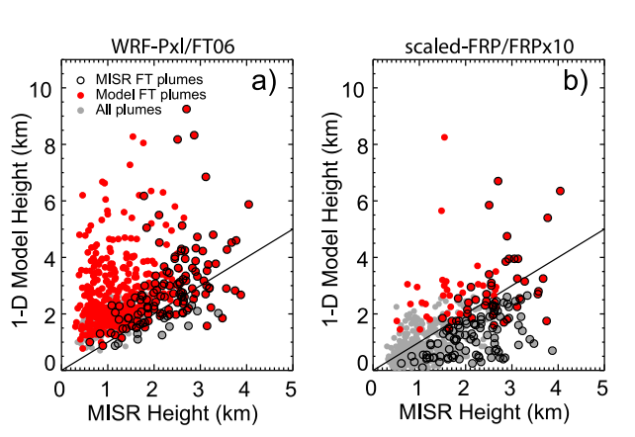
1. Introduction: advantage and disadvantage
Dynamic model
Physical governing equations
Micro-cloud physics: latent heat
Borrowed from Cloud-Convection Scheme
Computational costs: offline calculation.
Boundary condition setting
Val Martin et al., 2010; 2012

Slide 5
1. Introduction: advantage and disadvantage
Empirical model
Capture most important factors
Avoid boundary condition
Fast and suit for online coupled climate model
Water vapor is not considered
Can not be validated in afternoon

Slide 6
2. Research Plan
Research target: improve both dynamic and empirical models. The latter will be implemented into climate model, and the former will be used as offline and validation source for empirical model when observation are not available.
Dynamic model: change kzz profile
adding Gaussian diffusion term
change entrainment parameter
Empirical model: refine MISR data
fitting with FRP and meteorology parameters

Slide 7
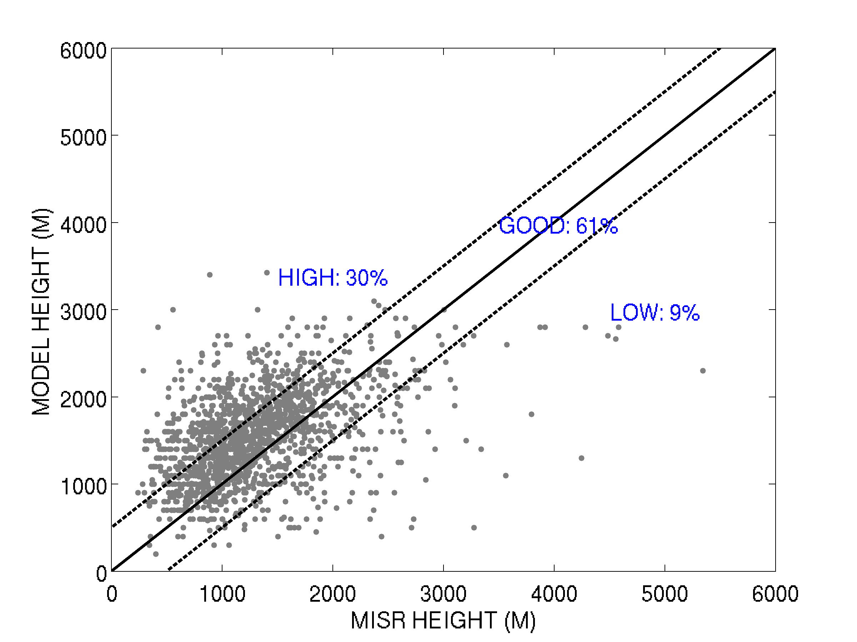
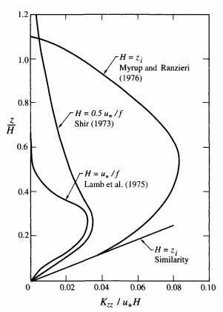
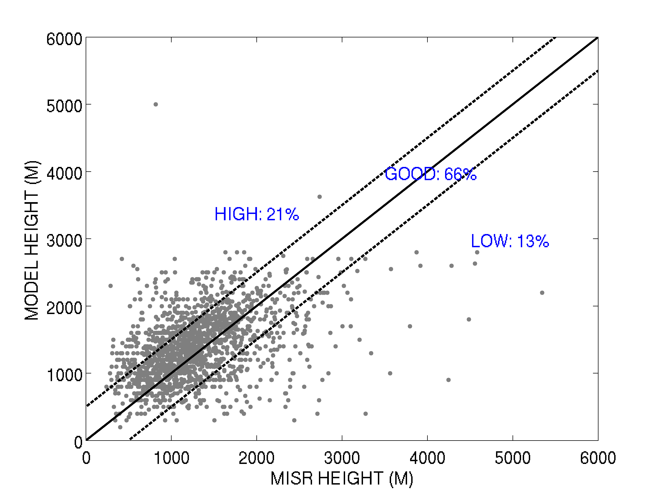
3. Results: Dynamic Model
$$\frac{∂}{∂z}\left(K_{zz}\frac{∂T}{∂z}\right)=K_{zz}\frac{∂^{2}T}{∂z^{2}}+\frac{∂K_{zz}}{∂z}\left(\frac{∂T}{∂z}\right)$$

Slide 8
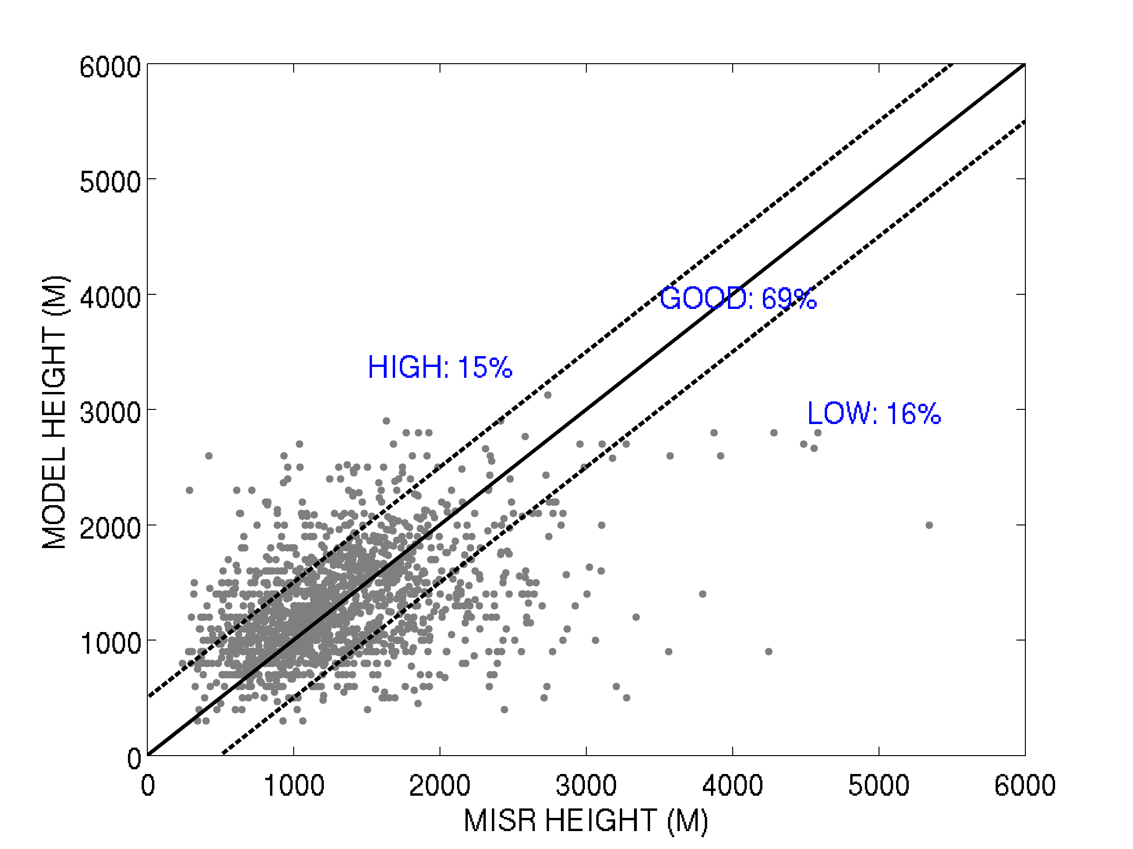
3. Results: Dynamic Model
control
New setting

Slide 9
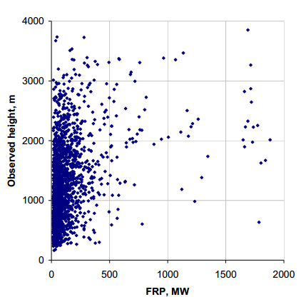
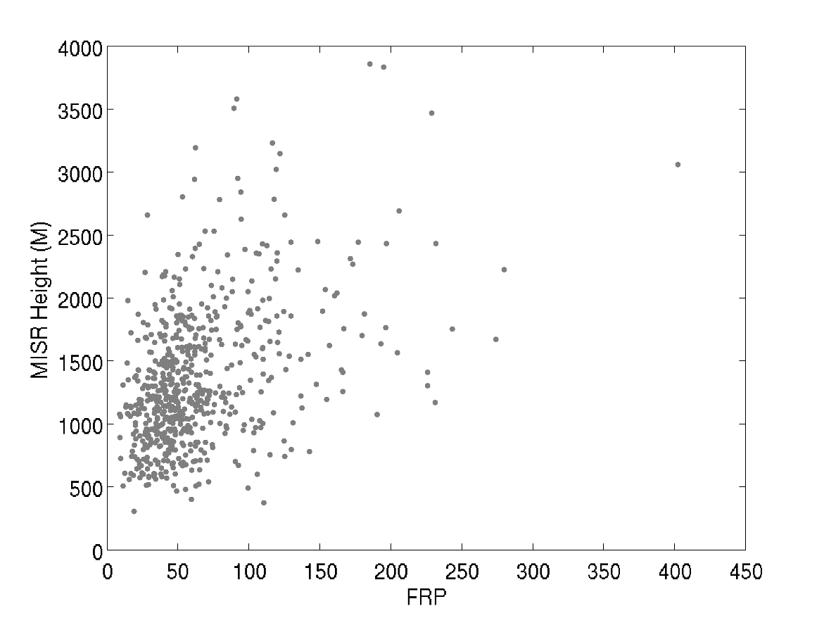
3. Empirical Model: refine MISR data
Hypothesis: the plume height should be positively related to FRP under the same meteorology condition
MISR data left: 1748 (7843)
Grid data left: 663
Plumes
CFSR grid box
Grid box average

Slide 10
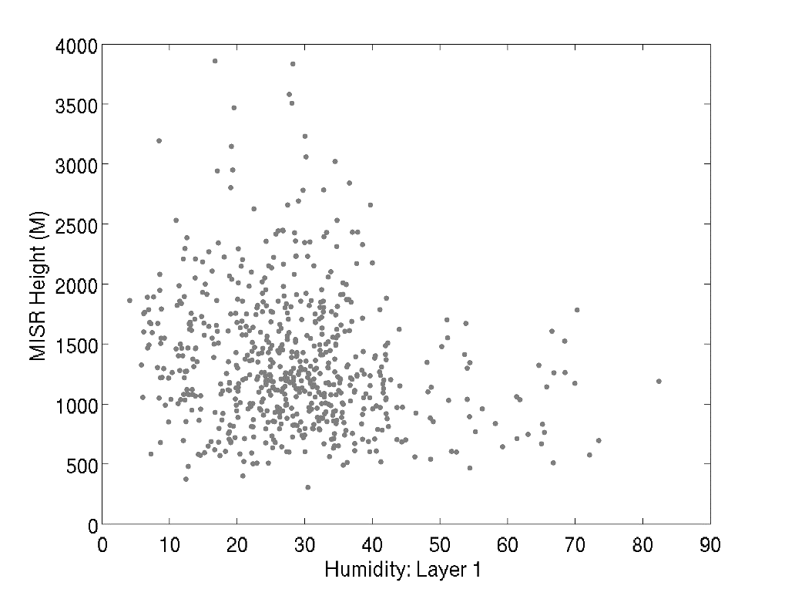
3. Empirical Model: Linear Regression
FRP
Boundary layer height
Inversion strength
Horizontal winds
Environment specific humidity
Heights = a1*FRP + a2*PBL + a3*Inversion + a4*winds + a5*Humidity

Slide 11
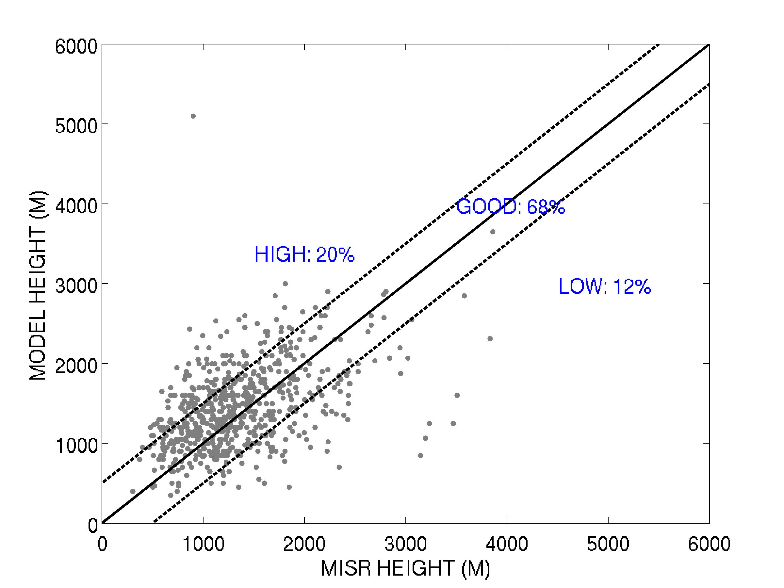
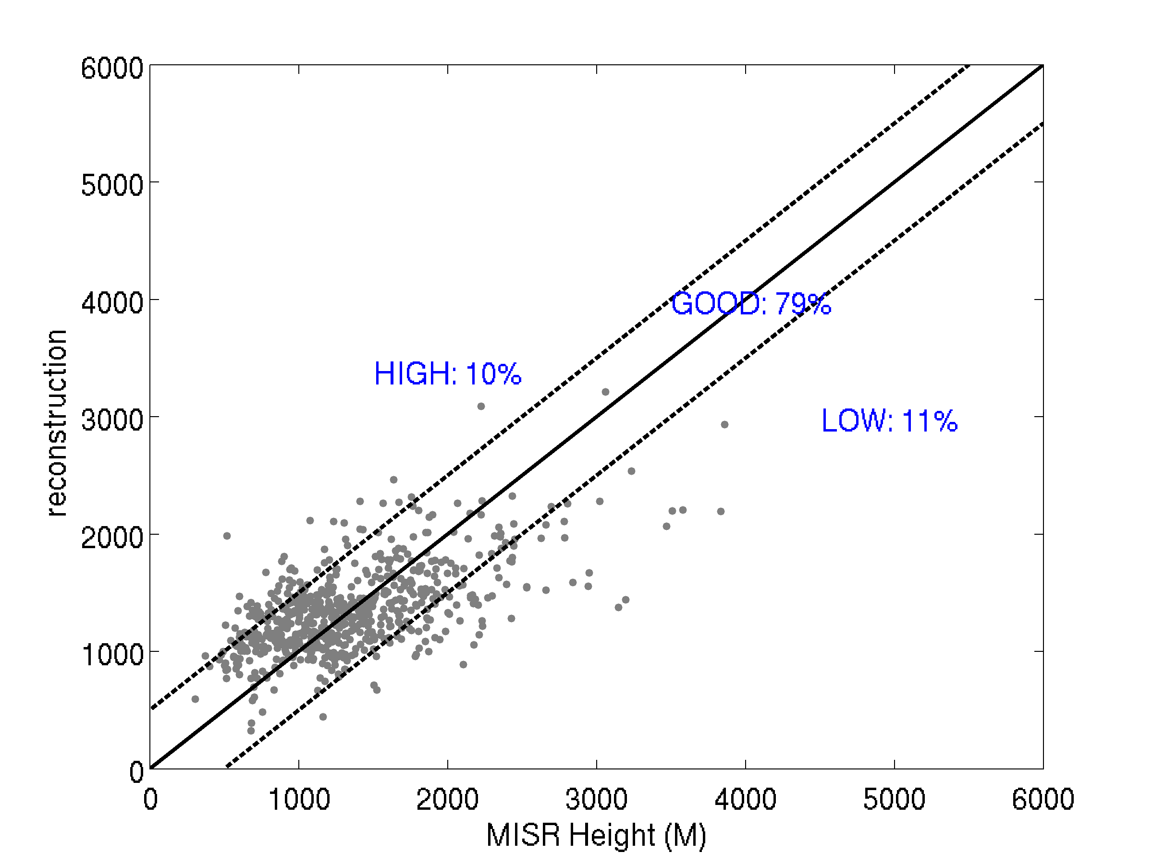
3. Fitting results
Dynamic Model
Results
MISR
Dynamic Model

Slide 12
4. Conclusion and future work
By changing kzz parameterization, the dynamical model results can be improved.
By refining the MISR data, the plume heights can be represented by FRP and meteorology data.
Improve the linear fitting method in order to reconstruct the plume heights in other time of a day.

Slide 13
Questions

