Slide 1
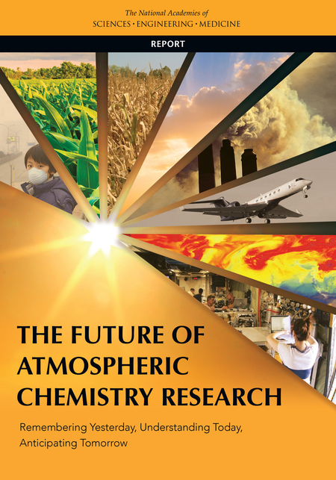
The Future of Atmospheric
Chemistry Research
Group Member:
Justin Min, Kezhen Chong, Yuhan Yang

Slide 2
Why this report?
Last atmospheric chemistry related report was Global Tropospheric Chemistry: A Plan for Action (NRC, 1984a)
Since then there has been technological advancement and new investigations into further understanding the extent of natural and human perturbations in the atmosphere.
National Academies of Science established a committee for an updated version.

Slide 3
Presentation Outline
Remembering Yesterday
Understanding Today
Anticipating Tomorrow: Societal Challenges

Slide 4
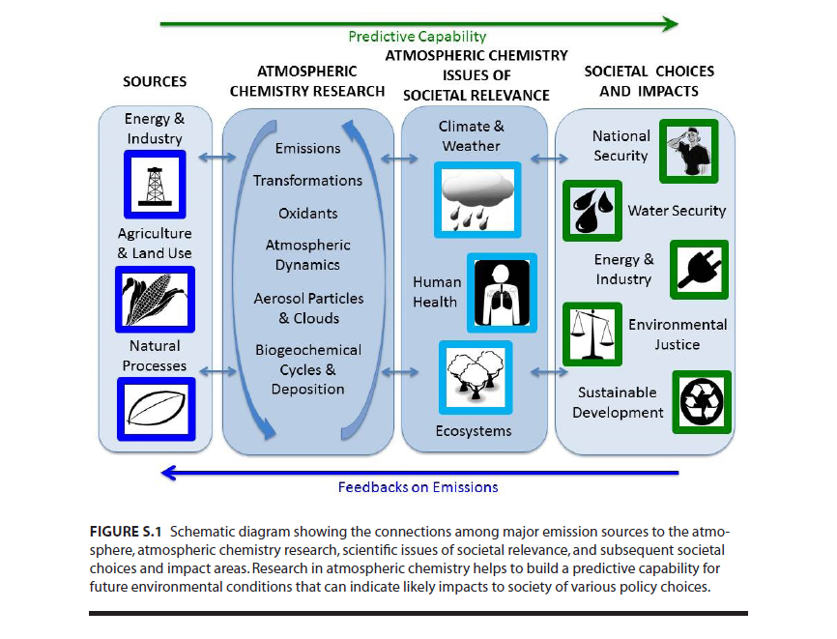

Slide 5
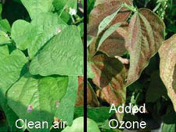
Past Research in Atmospheric Chemistry (Case 1)
1940s air pollution and smog issue and crop damage.
Lab studies showed ozone formation from photolysis of hydrocarbons and nitrogen oxides (NOx)
Ozone and fine particles have adverse health effects on human health, welfare, agricultural damage, and reduced ecosystem productivity.
Riverside, CA

Slide 6
Past Research in Atmospheric Chemistry (Case 2)
Acid Rain Dilemma
HNO3 and H2SO4 deposition causes acidification of ecosystems, and has negative effects on crops and building structures.
Power plant emissions from midwest could be transported to the northeast and damage ecosystems.
Issues regarding air pollution have long distance impacts, not just local.

Slide 7
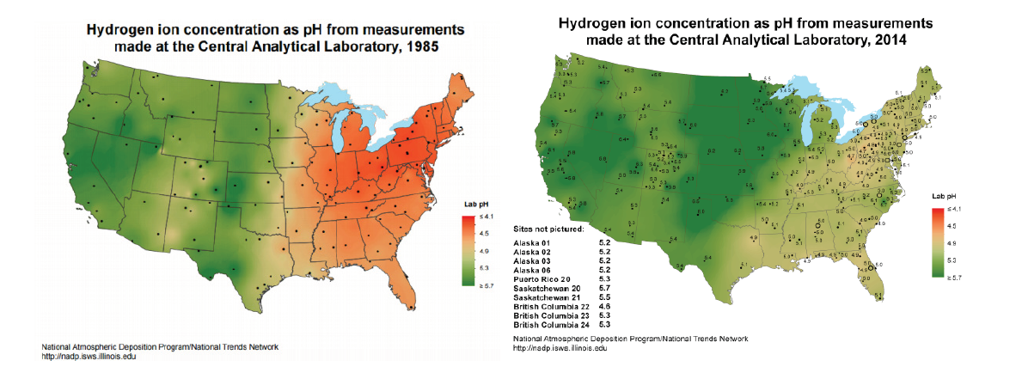
Past Research in Atmospheric Chemistry (Case 2)
Notes:
These results were followed up by technology such as SO2 scrubbers that have lead to decrease in SO2 emissions in the last few decades. As a result pH in the east coast has increased.

Slide 8
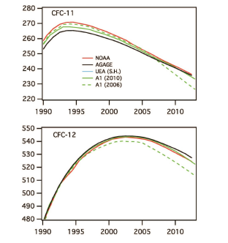
Past Research in Atmospheric Chemistry (Case 3)
CFCs and stratospheric ozone
CFC’s banned in 1996
Global Mean (ppt)
Global Mean (ppt)
year
year

Slide 9
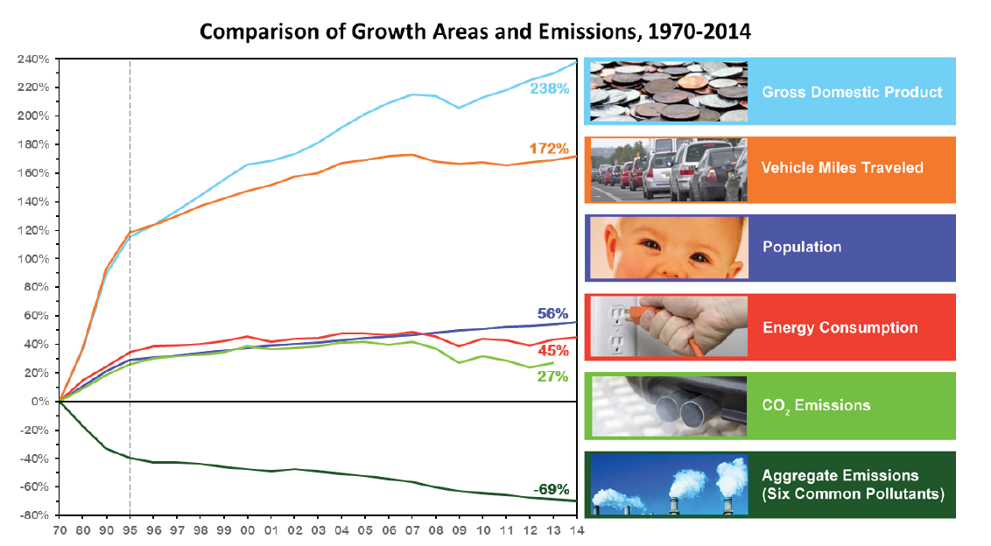
Atmospheric Chemistry Research and Policy
Air Pollution Control Act (1955)
Provided research and technical assistance related to air pollution control
Air pollution is a danger to public health and welfare
Clean Air Act (1963)
Federal law mandating air pollution on a national level for both stationary and mobile sources. Start of National Ambient Air Quality Standards (NAAQS).
Notes:
The 3 cases have informed policy in some way. Despite the increase in population growth, GDP, energy usage, and miles driven. Air pollutants have been decreasing as a result of environmental policies.
Y axis is percentage change.

Slide 10
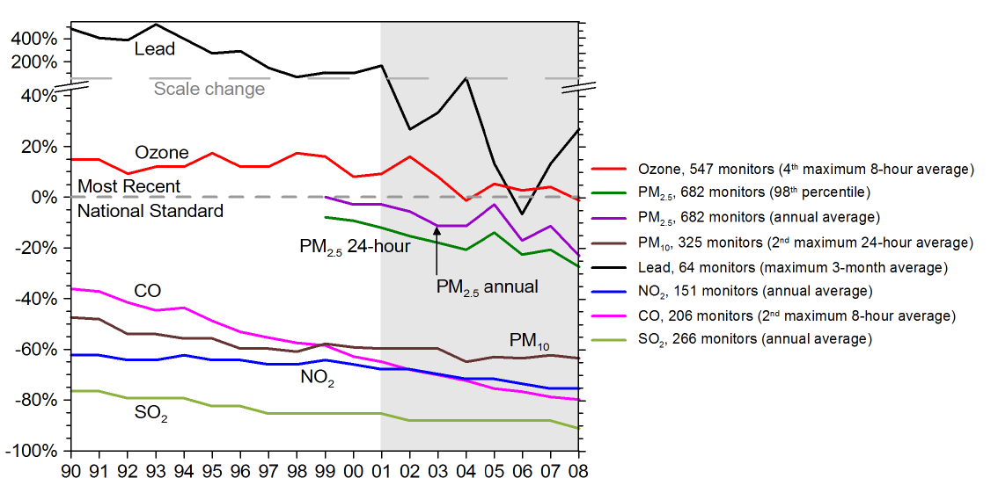
Notes:
Declines in contaminant concentration have been made possible by advances in understanding sources of emission and mechanisms of transformation in the atmosphere. If you look at the figure, most of the six criteria pollutants are below the NAAQS standards.

Slide 11
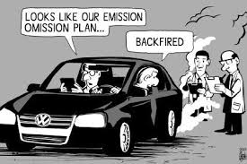
Atmospheric Chemistry Research Important to Today’s Challenges
Air pollution in developing countries
Volkswagen emissions scandal
Picture Source: Greg Baker—AFP/Getty Images
Need for improved predictive capability for new challenges
Picture Source: Sinann’s gallery, 2015
Notes:
The main goal of atmospheric chemistry research is to identify how these components and chemical processes affect climate change, human health and ecosystem. Then apply these understandings to policy making so as to protect wealth and human health.
But have we solved all these questions/problems? Apparently not.
As the picture shows, air pollution problem in developing countries, for example China, has become more and more important nowadays, and has caused great impact on public health and ecosystem in the country, as well as the whole world.
VW emission scandal Another well concerned problem is vehicle emissions. programming in certain models had been set to activate NOx emission controls only during laboratory emission testing. As a result, these vehicles may be emitting 10 ~ 40 times more NOx than anticipated, which might be a great risk of public health
Owing to all these unsolved air pollution problems, we need to improve predictive capability for new challenges in the changing world.

Slide 12
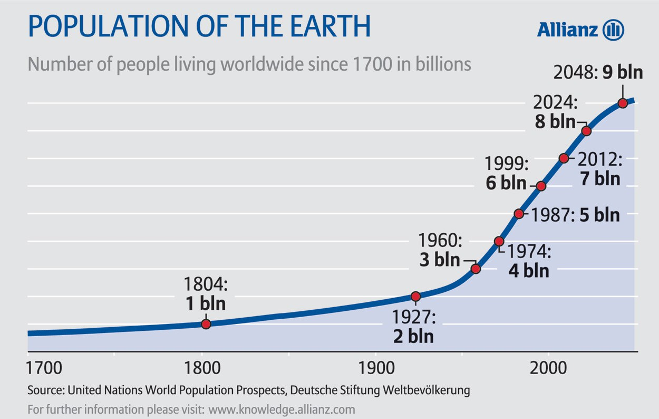
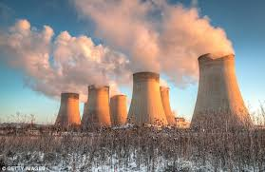
Changing World, Changing Atmosphere
Global human population has grown
6.1 billion to 7.7 billion in last 20 yrs
50%+ of population now lives in urban areas
Increasing energy demands, industry activities, and intensification of agricultural activities
Rapidly changing emissions
Enormous changing to Earth’s Atmosphere
Picture Source: United Nations World Population Prospects
Notes:
So how this world changes? The global population has grown 1.6 billion during the past 20 years. And more than 50% of the world population lives in urban areas. This increase in population will of course increase energy demands, food demands, therefore will affect industry activities and agricultural activities, All of these will lead to rapidly changing emissions, thus will enormously changes the earth’s atmosphere.

Slide 13
Core Areas Related to Chemical Nature of Atmosphere
Human activities and natural processes govern emissions
Determine chemical composition of atmosphere
Chemical transformations
Affect spatial and temporal variability of gases and particles
Atmospheric oxidants
Control the lifetimes and products of emitted species
Atmospheric dynamic
Control the distribution of trace gases and particles
Particle chemical and physical properties
Affect cloud and aerosol radiative properties, cloud microphysics, and precipitation processes
Impact of gases and particles on global biogeochemical cycles
Notes:
In this report, they identified 6 core areas related to the chemical nature of the atmosphere.

Slide 14
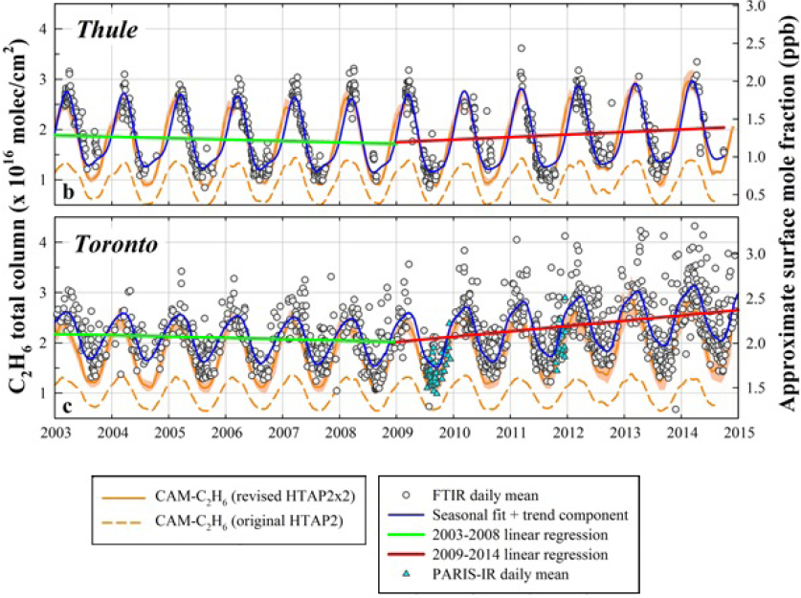
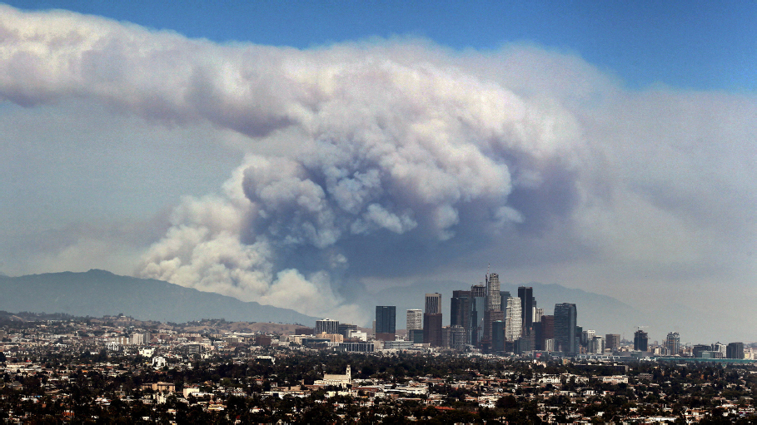
Human and Natural Processes Govern Emissions
Integrated approaches
“Bottom-up” vs. “Top-down”
Emissions from specific sources
Anthropogenic vs. Biogenic
Picture Source: Associated Press
Franco et al., 2016
Notes:
Emission
The amount, location, and timing of emissions to the atmosphere are controlled by both environmental conditions and human activities. There are several approaches related to emission estimates. For example, “Bottom-up” approaches typically combine knowledge of emission rates and the activities that contribute to them. “Top-down” approaches use models to infer emissions from measured concentrations of atmospheric constituents. Improvements to quantifying emission data require the integration of these different approaches.
The relative magnitude of emissions from biogenic or anthropogenic sources can play a key role in atmospheric chemistry. Vegetation is the dominant source of reactive hydrocarbons.
In urban areas, anthropogenic emissions drive the chemistry and result ozone and particulate pollution.
Wildfires are also an important source of emissions. This photo of smoke is from wildfire burning in Angeles National Forest in LA.
This figure shows the measurements of ethane from multiple sites in the northern hemisphere. It suggested an increase in concentrations of this long-lived compound since 2010.

Slide 15
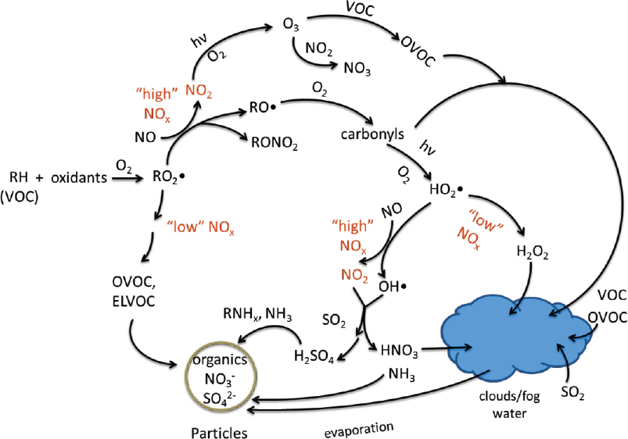
Fundamental Elements of Distribution, Transport, and Fate of Atmospheric Chemicals
Chemical transformations
Kinetics, mechanisms, and products of gas-phase reactions
Phase and partitioning
Chemistry and photochemistry in the condensed phase and at interfaces
Oxidant distributions
O3, OH, HO2, ROS
Relationship with atmospheric dynamics
Troposphere: extratropical cyclones
Stratosphere: Brewer-Dobson circulation
Notes:
This figure provides an overview of some important cycles in the troposphere. Nitric oxide (NO), the major nitrogen oxide species emitted during combustion, is converted to nitrogen dioxide (NO2) and ultimately forms ozone, nitric acid, and organic nitrates. Sulfur dioxide (SO2) emitted during combustion of fossil fuels is converted by oxidation in both the gas and condensed phases to form sulfuric acid as well as organic sulfates. Nitric and sulfuric acids react with ammonia and amines to form particles.
Dynamical processes in both the troposphere and stratosphere can drive gases and particles transportation in these regions. As a result, will drive changes in the distribution of the trace constituents, which can feed back on the dynamics, and influence weather, air quality, and climate.

Slide 16
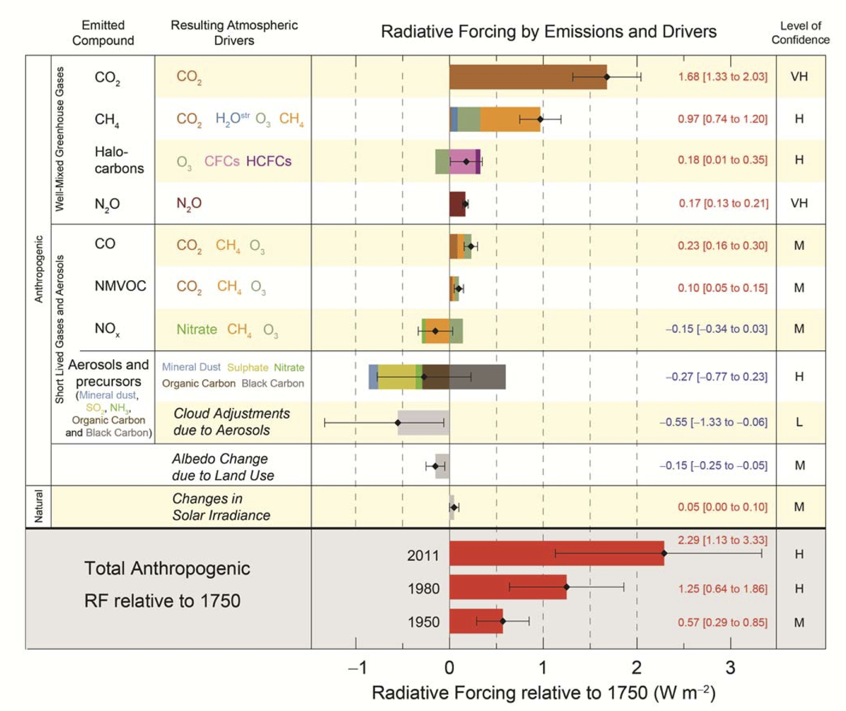
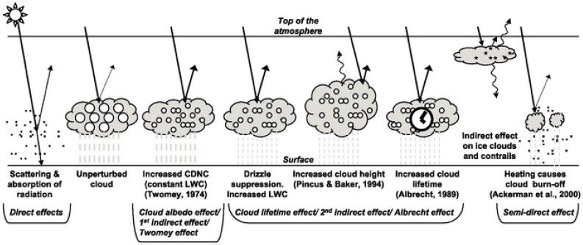
Particle Chemical and Physical Properties
Aerosol direct effect
scattering aerosols vs. absorbing aerosols (BC)
Aerosol indirect effect
cloud condensation nuclei (CCN) vs. ice nuclei (IN)
Picture source: IPCC, 2013
Notes:
Generally, aerosol has two main effects. The direct effect is scattering and absorbing radiation and affecting the energy balance. The indirect effect is based on interacting with surrounding clouds and result in influence on climate. The diagram on the bottom left shows the various radiative mechanisms associated with cloud effects.
While estimates of aerosol direct effect are typically dominated by scattering aerosols, the degree of warming provided by absorbing aerosol has been an active area of research. For example, black carbon is considered as the second most important climate warming agent, after CO2. However, there’s a large uncertainty in its ultimate impact on the absorption of solar radiation. The mechanism behind it, as well as brown carbon, is also an open research area.

Slide 17
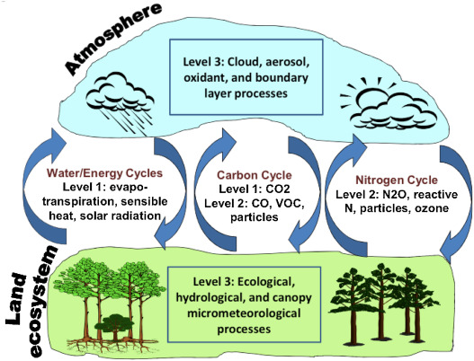
Impact of Gases and Particles on Global Biogeochemical Cycles
Positive impact: Nutrient exchange
Nitrogen
Phosphorus
Negative impact: Tropospheric ozone
Guenther et al., 2011
Notes:
Atmospheric chemistry also plays a central role in the biogeochemical cycling through the Earth’s system.
For example, owing to the development of industrial ammonia fertilizer, as well as fossil fuel emissions of nitrogen oxides, the nitrogen supply of the atmosphere has dramatically enhanced. Deposition of this nitrogen can be a beneficial nutrient supply in both terrestrial and marine ecosystems.
Another example is phosphorus, which is a limiting nutrient for many forest ecosystems including the Amazon. It could be supplied through the transport of smoke particles, bioparticles, and mineral dust.
Also, air pollution problems can have negative impact on ecosystem. Tropospheric ozone can damage vegetation, leading to reductions in the global land carbon sink and declines in global agricultural productivity.

Slide 18
Priority Science Areas (PSAs)
Scientific imperative
Societal relevance
PSAs
Fundamental Atmospheric Chemistry
Societal Challenges
Develop a predictive capability for distributions, reactions, lifetimes
Quantify emissions and removal
Improve climate modeling and weather forecasting
Elucidate role of atmospheric chemistry in human health impacts
Understand feedbacks with natural and managed ecosystems

Slide 19
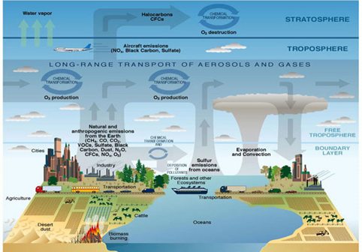
Priority Science Area 1:
Advance the fundamental atmospheric chemistry knowledge.
Actions to address key scientific gaps
reaction rates and detailed chemical mechanisms
atmospheric oxidants or other reactants that lead to transformation and removal across broad spatial and temporal scales
heterogeneous chemistry
coupling between chemical and meteorological processes in the troposphere.
coupling between chemical, dynamical, and radiative processes involving stratospheric chemistry.
Picture Source: Courtesy United States Climate Change Science Program (Illustrated by P. Rekacewicz).

Slide 20
Priority Science Area 2:
Quantify emissions and depositions
Actions to address key scientific gaps：
emissions and their spatial and temporal variations and trends
rates by which wet and dry deposition
the role of meteorology
the role of global change
Picture Source: NOAA

Slide 21
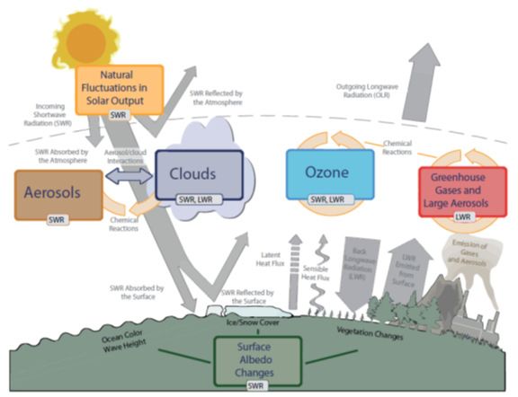
Priority Science Area 3:
Advance the integration in climate models
Actions to address key scientific gaps
distributions and variability of trace gases and aerosol particles
the role of aerosol particles as a modulator of cloud microphysics and precipitation efficiency
Develop accurate descriptions in models
Picture Source: IPCC AR5, 2013

Slide 22
Priority Science Area 4:
Understand the sources and processes related to species most deleterious to human health
Actions to address key scientific gaps
Develop mechanistic understanding to predict the composition and transformations of atmospheric trace species that contribute to impacts on human health.
Quantify the distribution of atmospheric constituents that impact human health.
Determine what unique sources and chemical reactions occur in indoor environments that have implications for atmospheric chemistry and human health.
Picture Source: Health Policy Watch

Slide 23
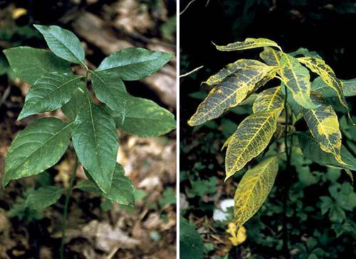
Priority Science Area 5:
Understand the feedbacks between atmospheric chemistry and the biogeochemistry of natural and managed ecosystems
Actions to address key scientific gaps
Quantify the full suite of trace gases and particles deposited from the atmosphere and connect these to ecosystem responses.
Identify and quantify the chemical composition, transformations, bioavailability, and transport of nutrients and contaminants in the global atmosphere and their interactions with the biosphere.
Identify important feedbacks between atmospheric chemistry and the biosphere under global change.
Picture Source: Bingham, A., and E. Porter. 2015. Ozone effects on two ecosystem services at Great Smoky Mountains National Park, USA. Park Science 32(1):71-79

Slide 24
Priority Science Areas (PSAs)
PSAs
Fundamental Atmospheric Chemistry
Societal Challenges
Develop a predictive capability for distributions, reactions, lifetimes
Quantify emissions and removal
Improve climate modeling and weather forecasting
Elucidate role of atmospheric chemistry in human health impacts
Understand feedbacks with natural and managed ecosystems

Slide 25
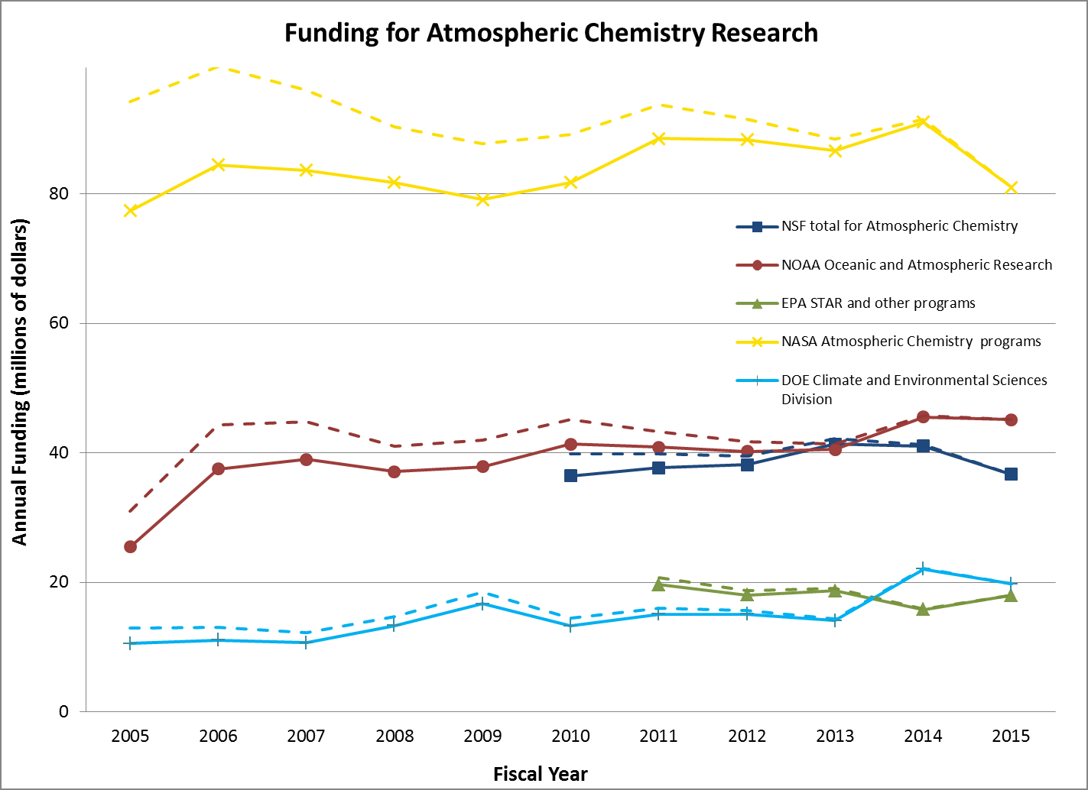
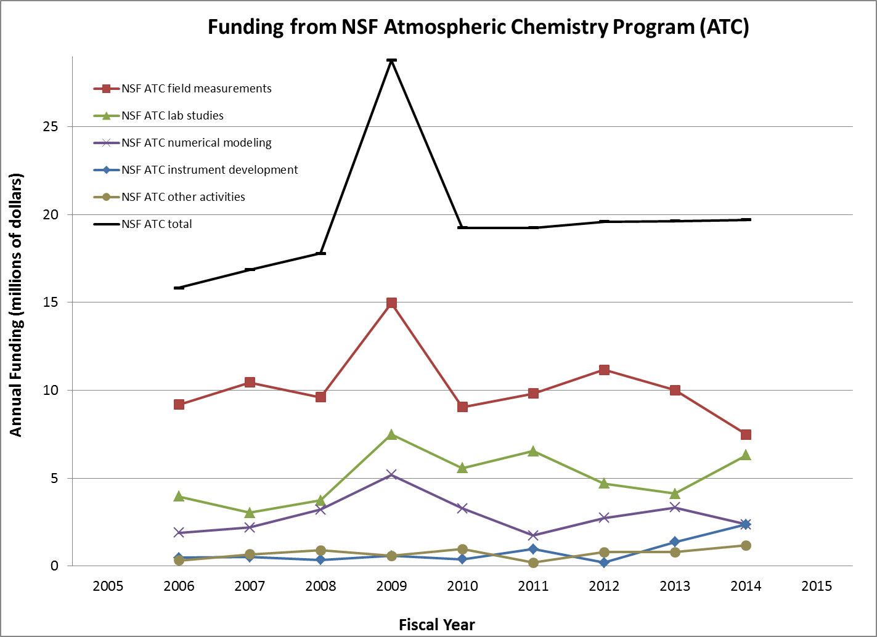
Trends in atmospheric chemistry
The field has been expanding
The amount of funding has not increased substantially
The appropriate balance will depend on the nature of the issues being addressed

Slide 26
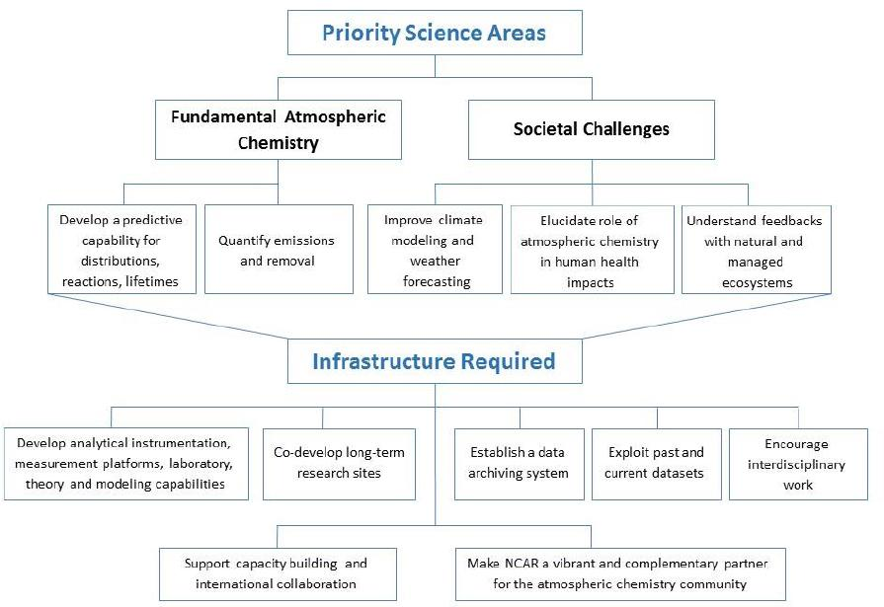

Slide 27
Development of tools
Lab experiments and theoretical studies
Instrument and instrument platform development
Model development
Recommendation 1: NSF should ensure adequate support for the development of the tools necessary to accomplish the scientific goals for the atmospheric chemistry community, including the development of new laboratory and analytical instrumentation, measurement platforms, and modeling capabilities.

Slide 28
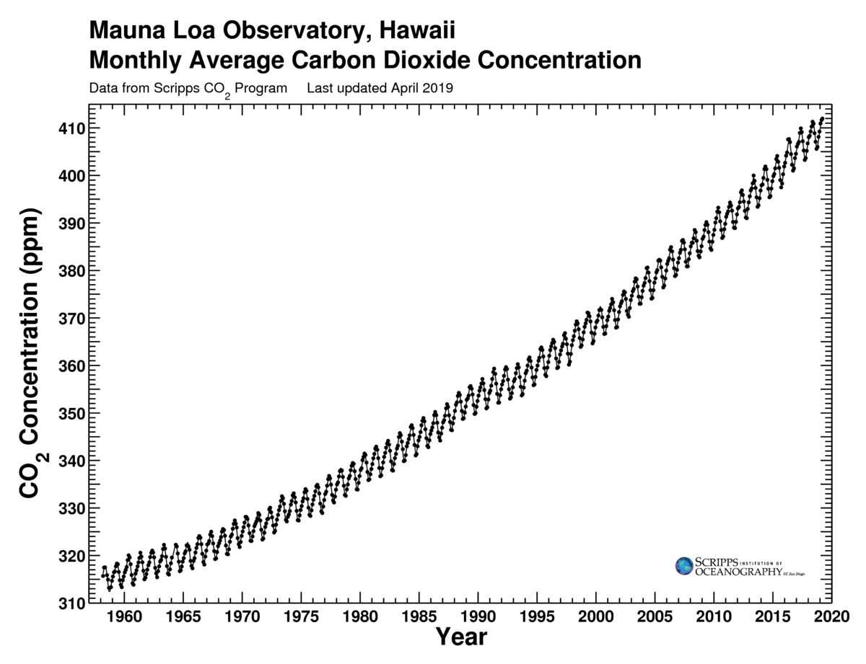
Long-term research sites
Recommendation 2: NSF should take the lead in coordinating with other agencies to identify the scientific need for long-term measurements and to establish synergies with existing sites that could provide core support for long-term atmospheric chemistry measurements, including biosphere-atmosphere exchange of trace gases and aerosol particles.

Slide 29
Resources for data analysis
Data management and big data
Recommendation 3: NSF should encourage mining and integration of measurements and model results that can merge and exploit past datasets to provide insight into atmospheric processes, as well as guide planning for future studies.
.shp
.nc
.xlsx
.grb
.txt
.csv
.dat
.hdf
Recommendation 4: NSF should establish a data archiving system for NSF-supported atmospheric chemistry research and take the lead in coordinating with other federal and possibly state agencies to create a comprehensive, compatible, and accessible data archive system.

Slide 30
Interdisciplinary work
Capacity building & international collaboration
Recommendation 5: NSF should improve opportunities that encourage interdisciplinary work in atmospheric chemistry and facilitate integration of expertise across disciplines and across academia, institutes, government, and industry. This improvement may include support of focused teams and virtual or physical centers of sizes appropriate to the problem at hand.
Recommendation 6: NSF, in coordination with other agencies, should continue to encourage and support U.S. scientists involved in atmospheric chemistry research to engage with underserved groups, in capacity building activities, and in international collaborations.

Slide 31
Role of a national center
Recommendation 7: NCAR, in conjunction with NSF, should develop and implement a strategy to make NCAR a vibrant and complementary partner within the atmospheric chemistry community. This strategy should ensure that scientific leadership at NCAR has the latitude to set an energizing vision with appropriate personnel, infrastructure, and allocation of resources; and that the research capabilities and facilities at NCAR serve a unique and essential role to the NSF atmospheric chemistry community.

Slide 32
References
National Academies of Sciences, Engineering, and Medicine. 2016. The Future of Atmospheric Chemistry Research: Remembering Yesterday, Understanding Today, Anticipating Tomorrow. Washington, DC: The National Academies Press. DOI: 10.17226/235730
Franco, B., E. Mahieu, L. Emmons, Z. Tzompa-Sosa, E. Fischer, K. Sudo, B. Bovy, S. Conway, D. Griffin, J. Hannigan, K. Strong, and K. Walker. 2016. Evaluating ethane and methane emissions associated with the development of oil and natural gas extraction in North America Environmental Research Letters 11. DOI: 10.1088/1748-9326/11/4/044010.
Guenther, A., Kulmala, M., Turnipseed, A., Rinne, J., Suni, T., and Reissell, A.: Integrated land ecosystem-atmosphere processes study (iLEAPS) assessment of global observational networks, Boreal Environ. Res., 16, 321–336, 2011.

Slide 33
Discussion Questions
What are the similarities and differences for air pollution control strategies in U.S. and China?
How atmospheric chemistry is related to our daily life?
What can we do to make people know the importance of Atmospheric Chemistry?
In addition to predicting how much damage factories can do to environment, what else can we do for those companies?
What’s the integral impact of aerosol on climate and Earth’s energy budget?
Should ammonia emissions be regulated like the six criteria pollutants?

