Slide 1
NO2: comparison between simulations and observations
Kezhen Chong
4/18/2019

Slide 2
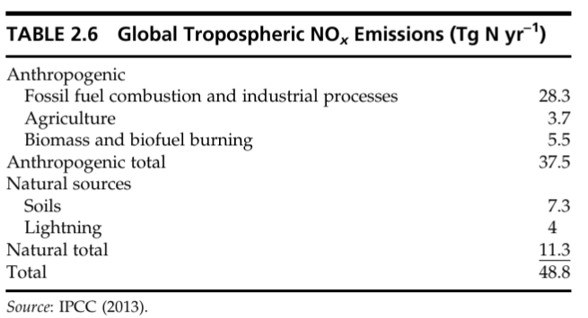
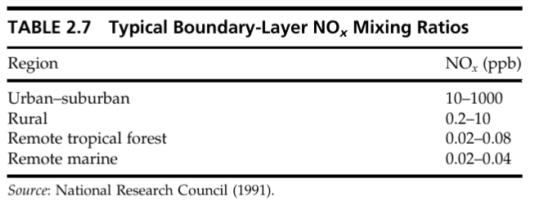
NO2 basics:
$${NO}_{x}=NO+{NO}_{2}$$

Slide 3
Project outline:
Evaluate the model simulation of NO2
Surface concentration
Time series
Diurnal cycle
Vertical profile
Tropospheric column
Time series
Spatial distribution

Slide 4
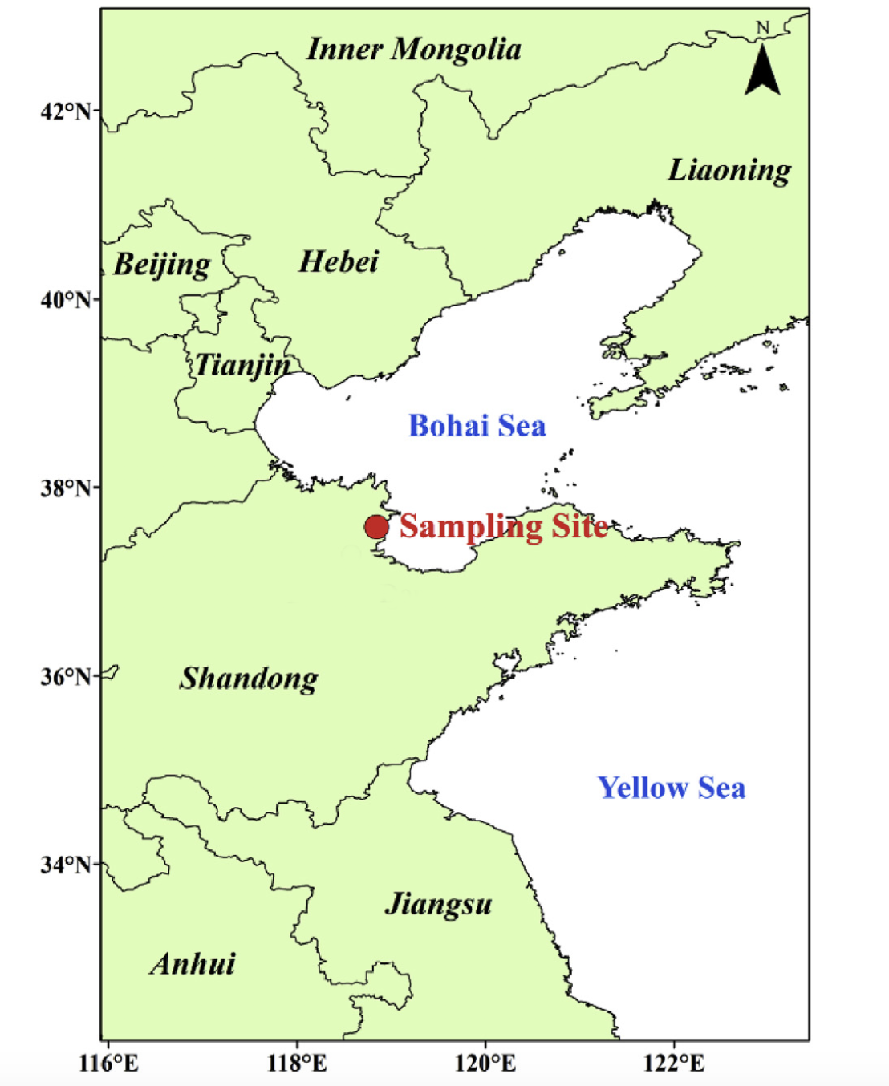
Data and methods
Ground-based:
NO2 surface concentration
NO2 vertical profile from Multi-Axis Differential Optical Absorption Spectroscopy (MAX-DOAS)
Satellite-based:
TROPOspheric Monitoring Instrument (TROPOMI) tropospheric column NO2 L2 product (local time ~ 1pm)
Model simulation:
Regional chEmical trAnsport Model (REAM)
37.76N 118.98E

Slide 5
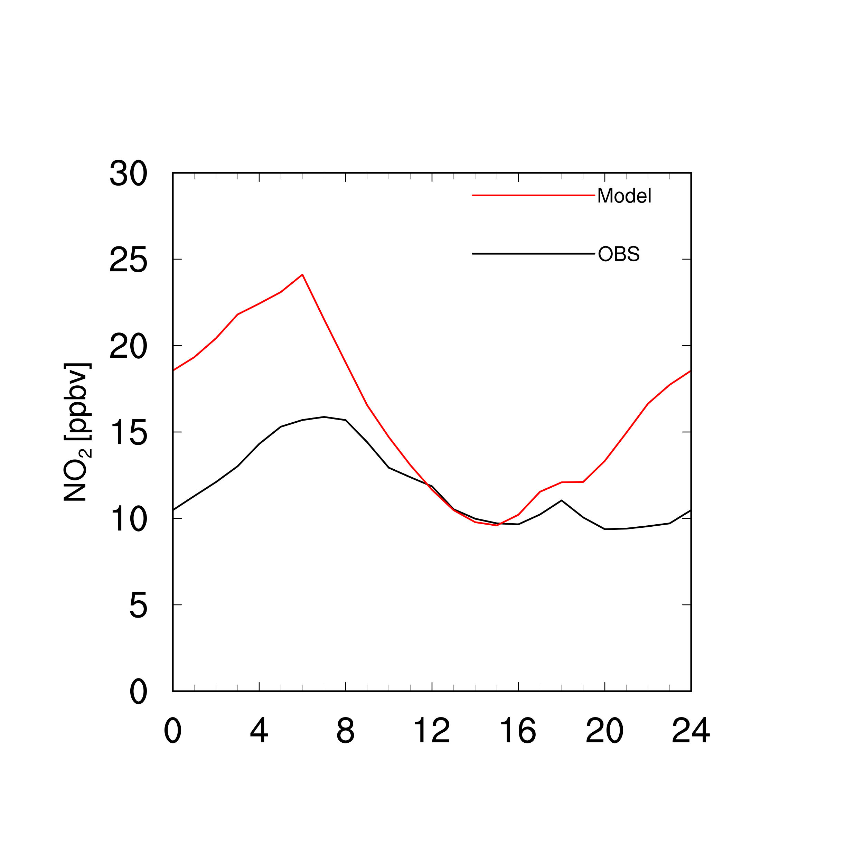
Surface concentration

Slide 6
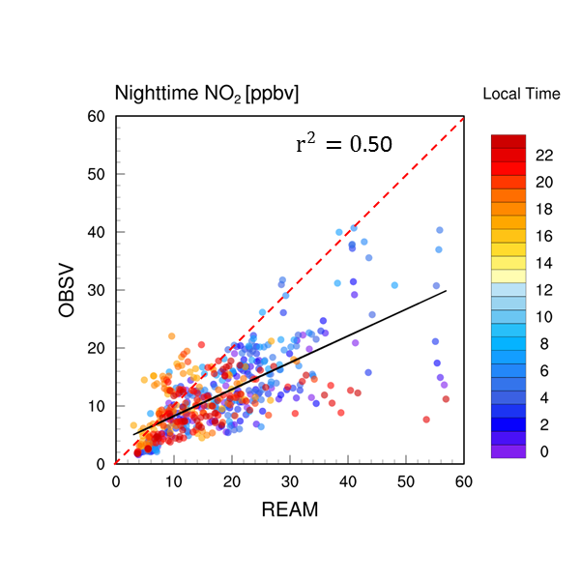
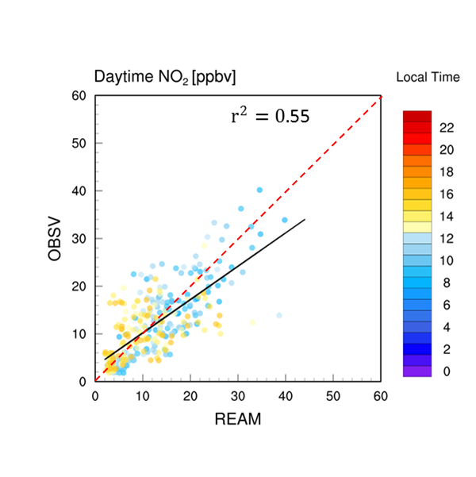
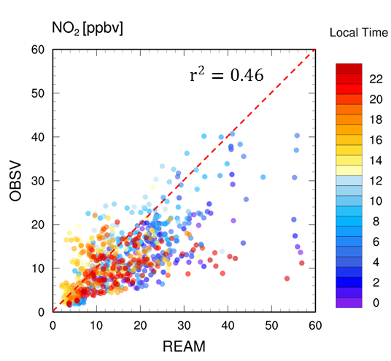
Surface concentration

Slide 7
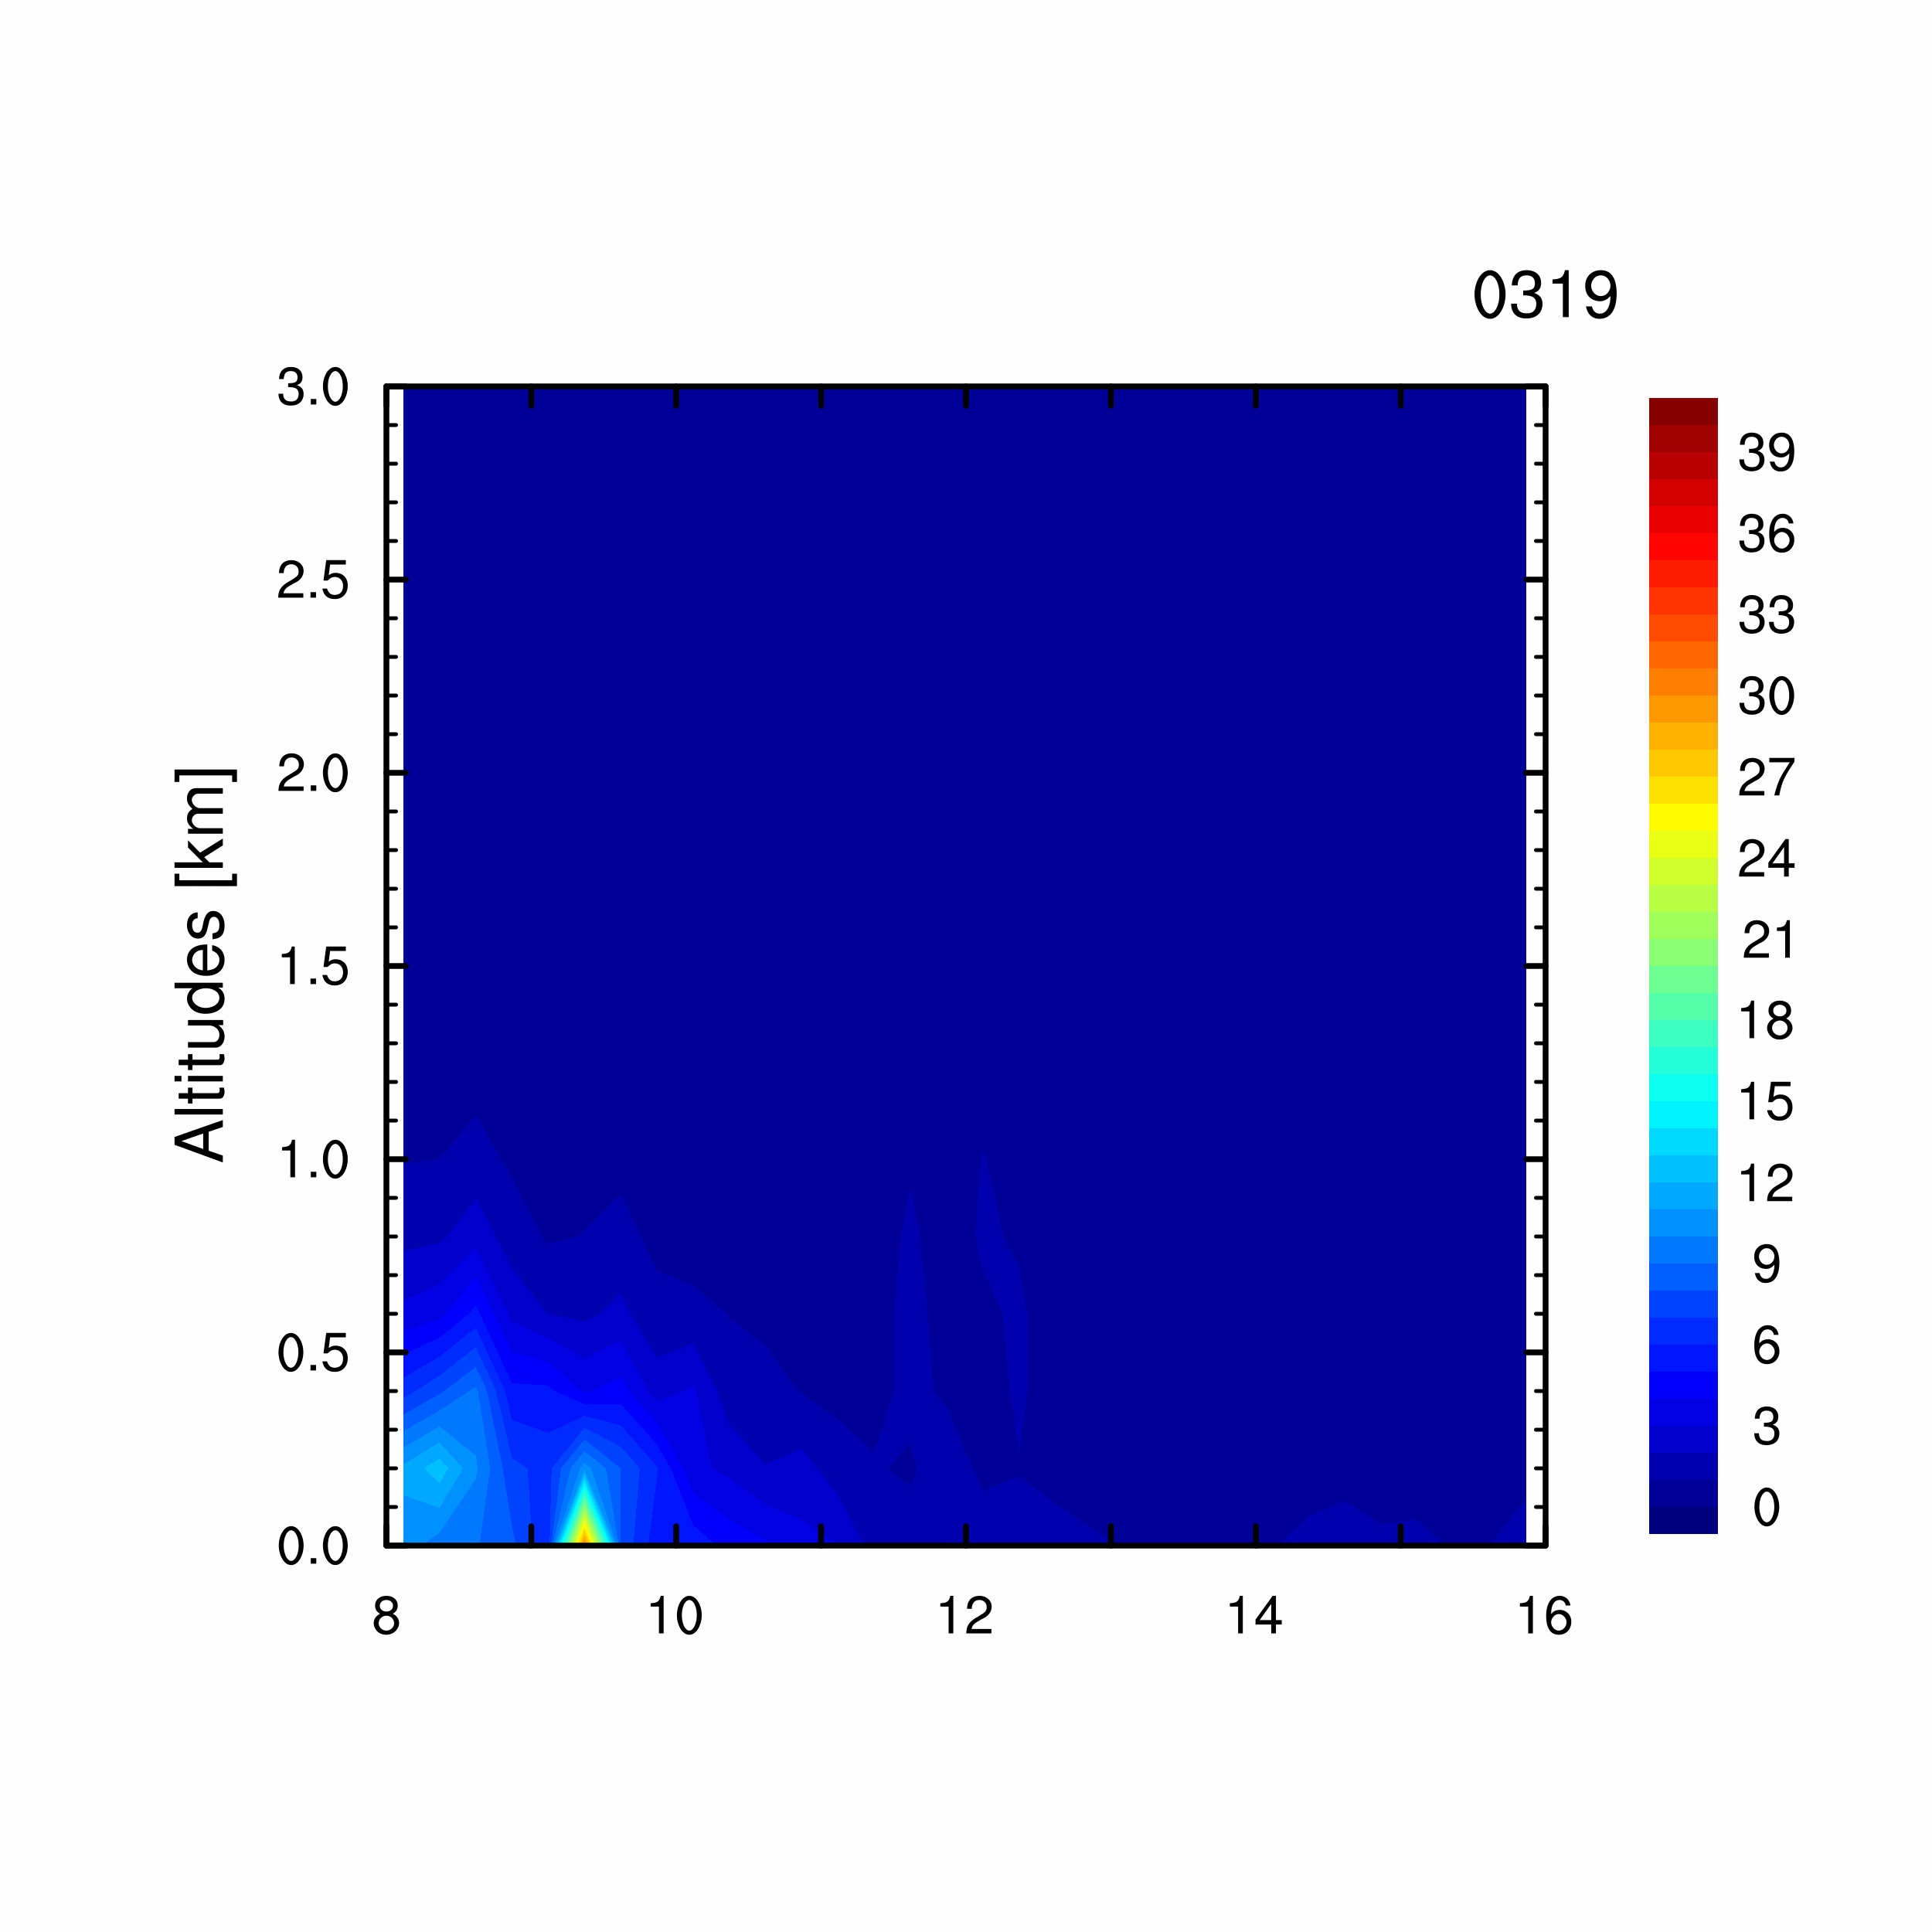
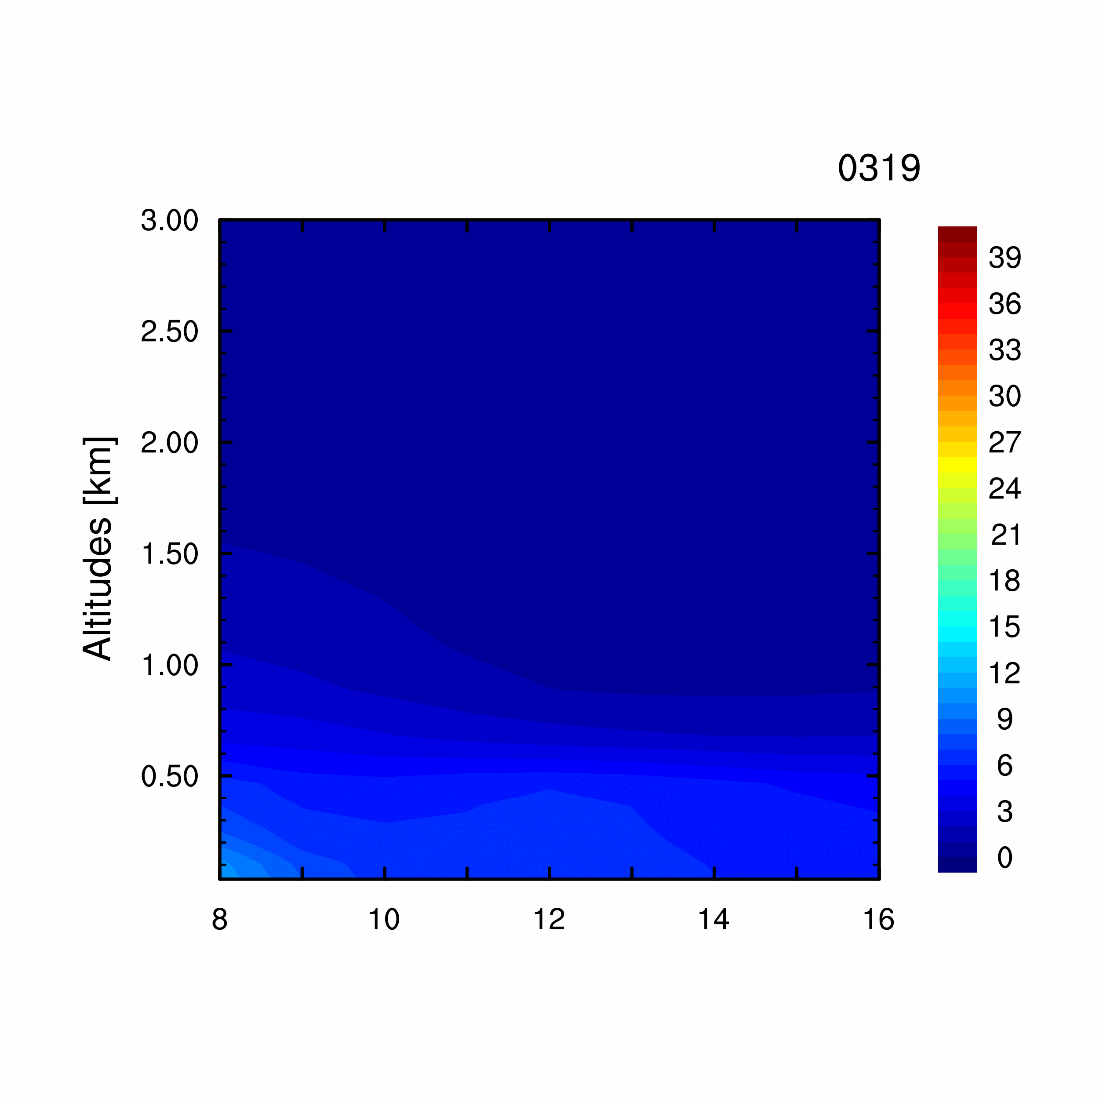
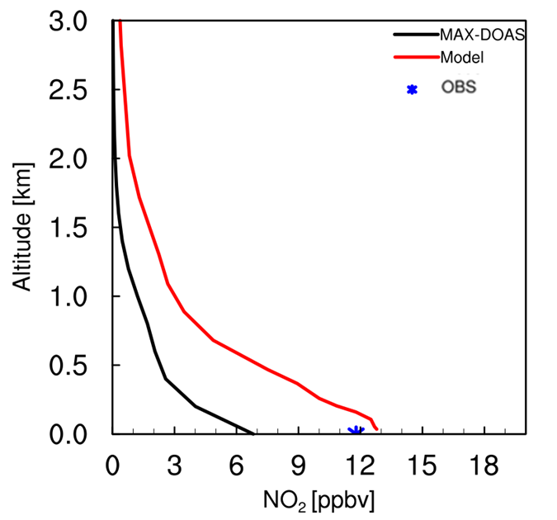
Vertical Profiles
MAX-DOAS
REAM

Slide 8
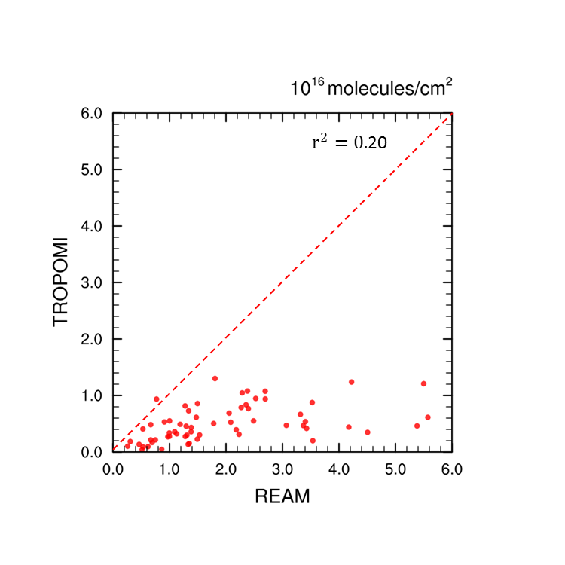
Tropospheric Column NO2

Slide 9
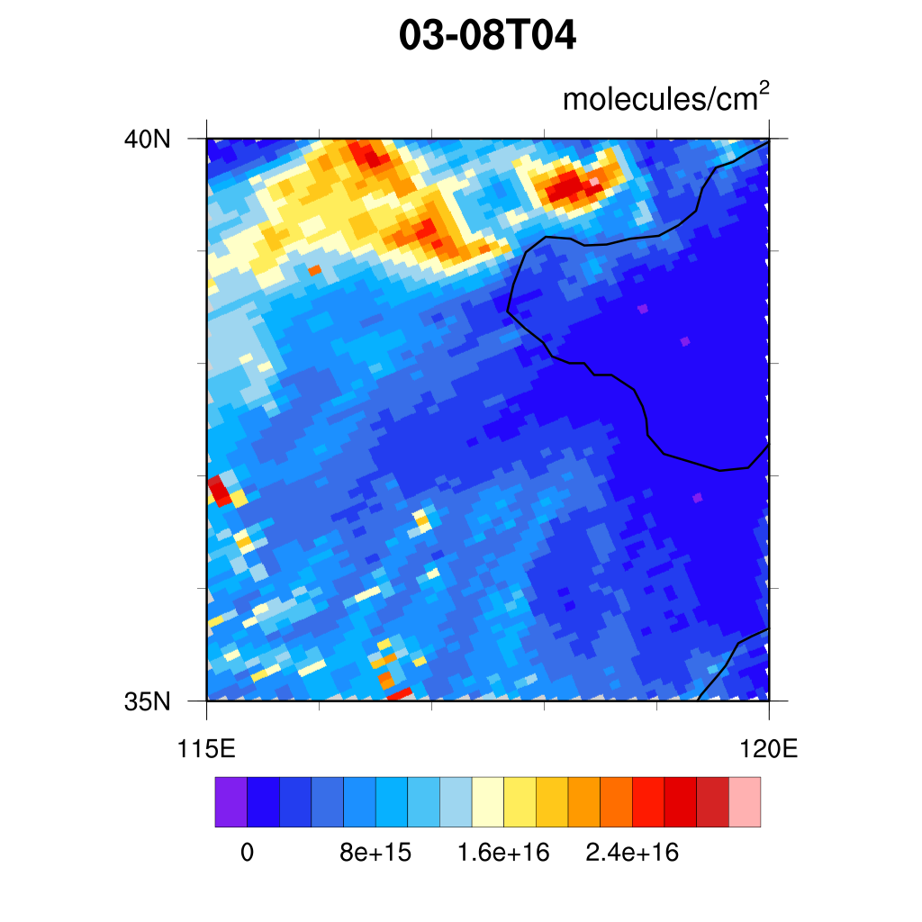
Spatial Distribution – 0308T04
TROPOMI
REAM

Slide 10
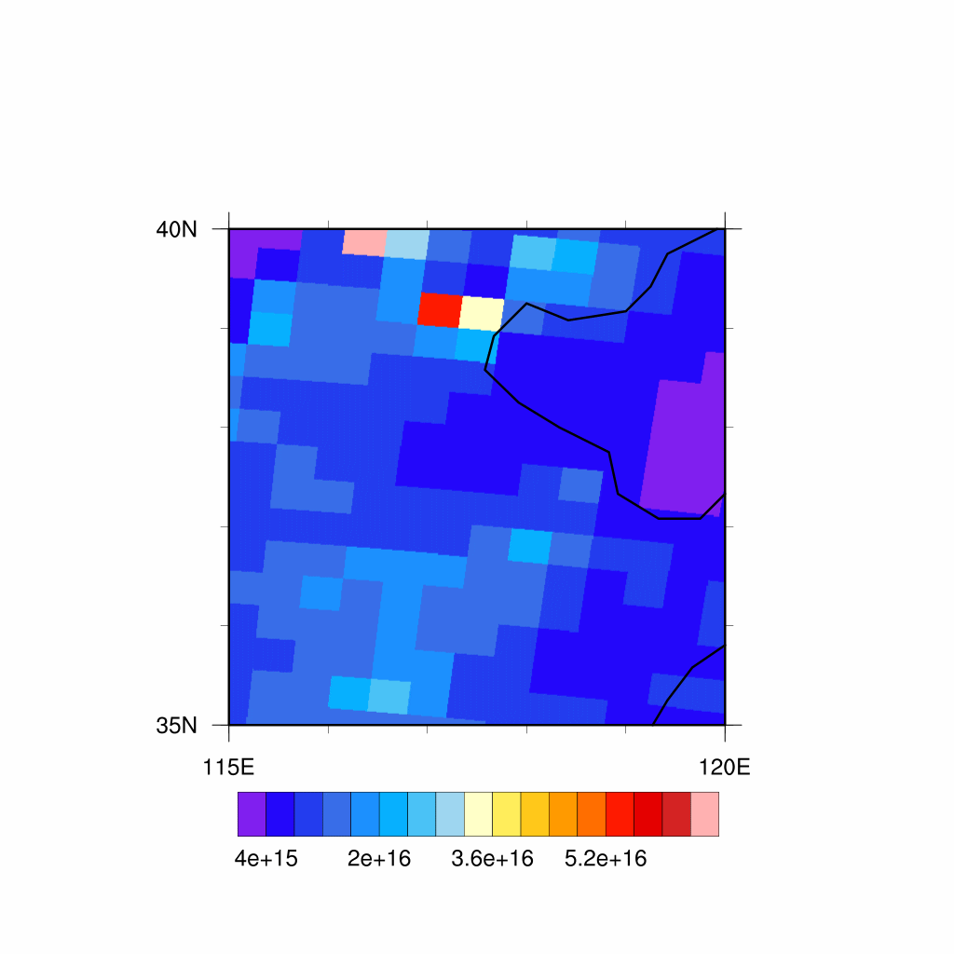
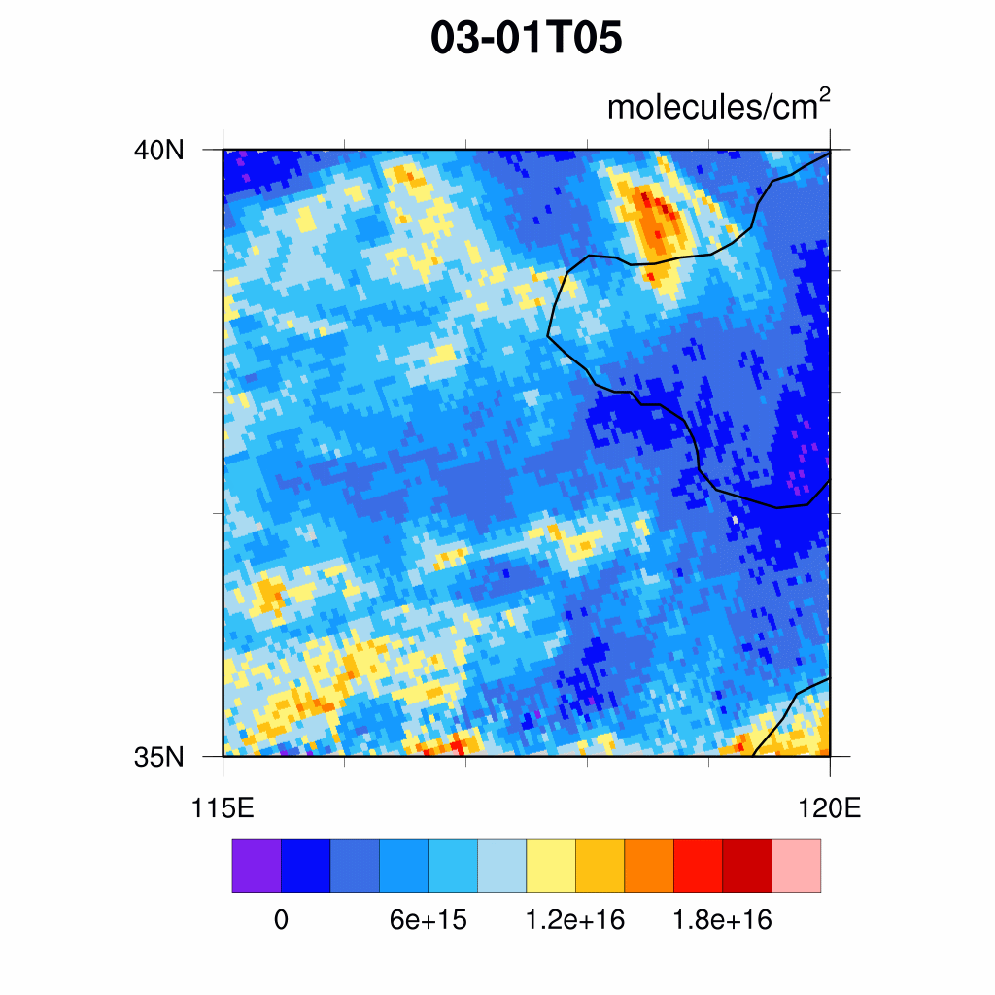
Spatial Distribution – 0308T04

Slide 11
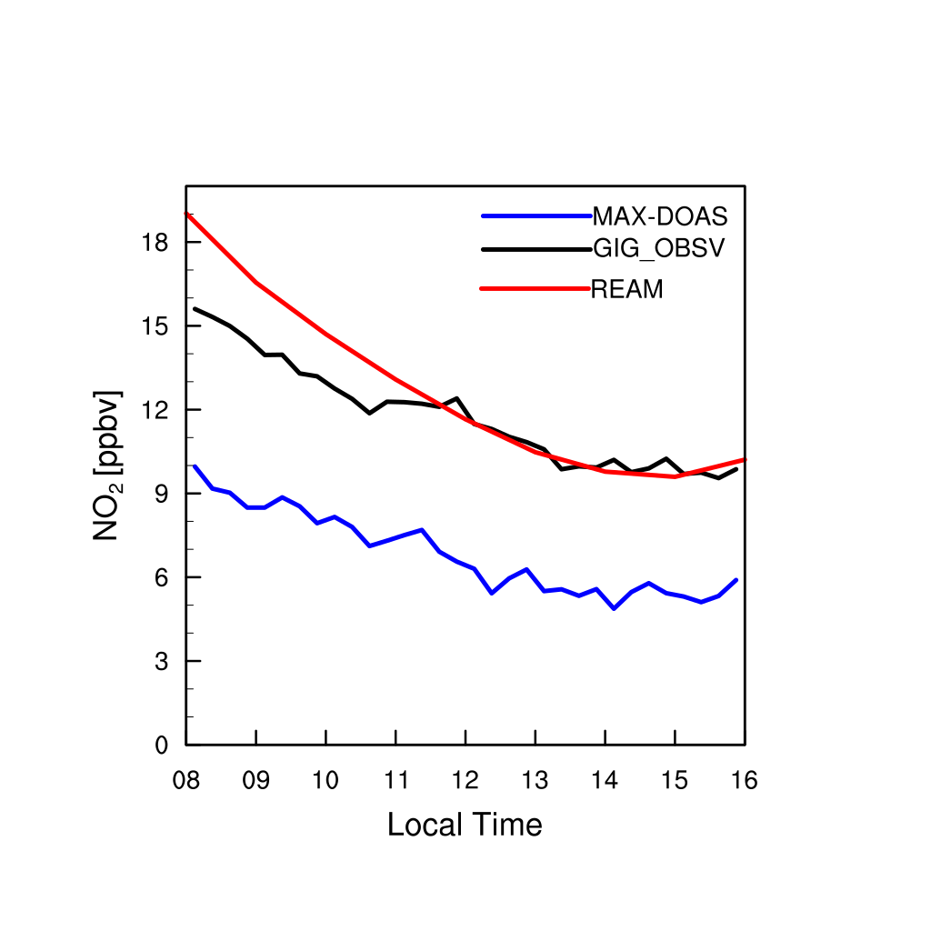
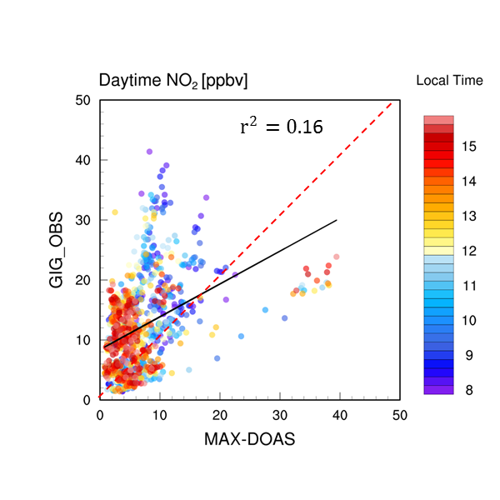
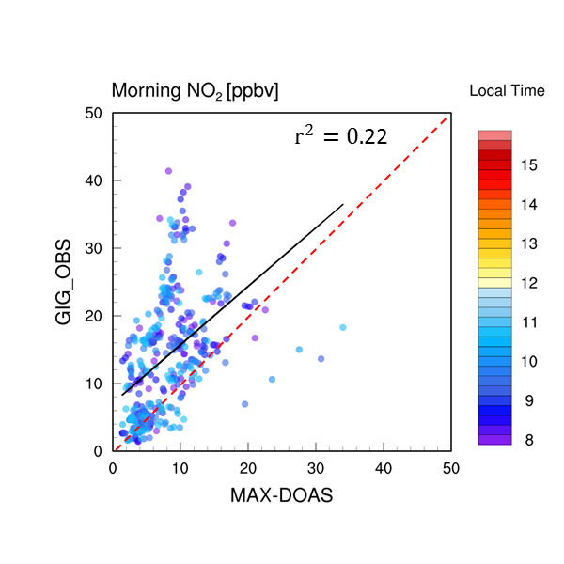
Biases of MAX-DOAS

Slide 12
Summary
REAM tends to overestimate nighttime NO2
Meteorological field:
Mixing layer height -> diffusion coefficient simulation
Low deposition rate
Chemical:
High emission input
Lack of nighttime O3

Slide 13
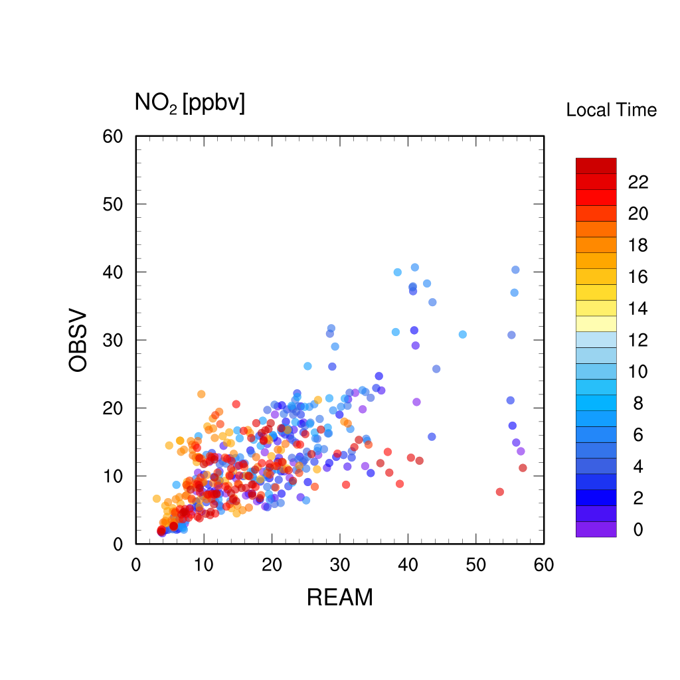
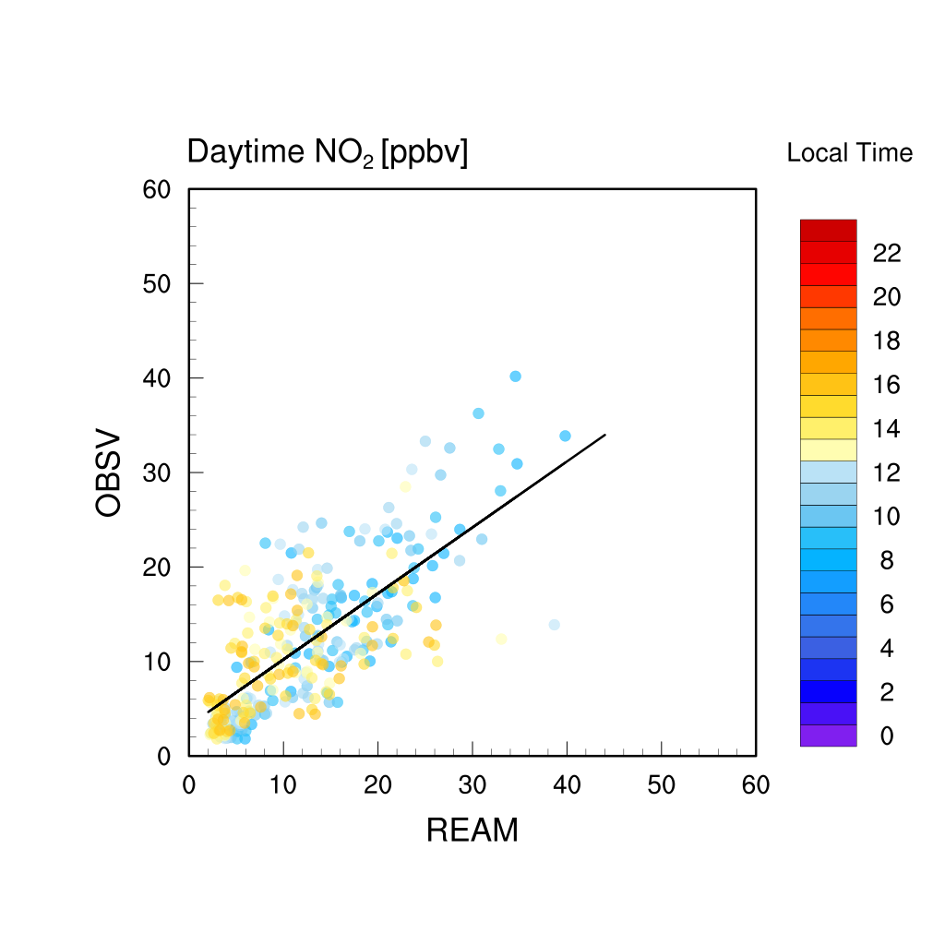
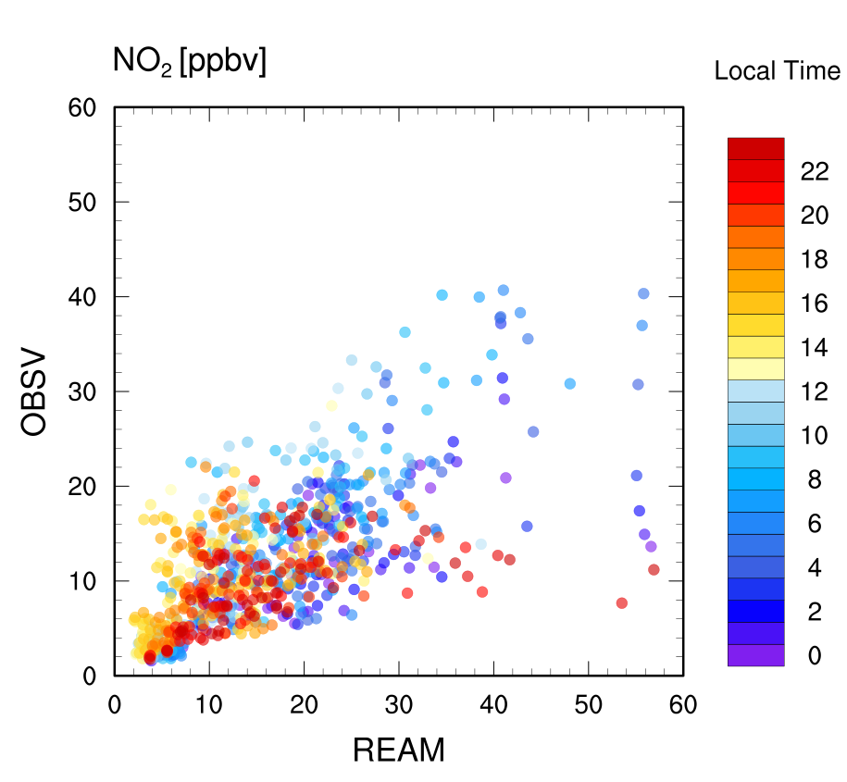
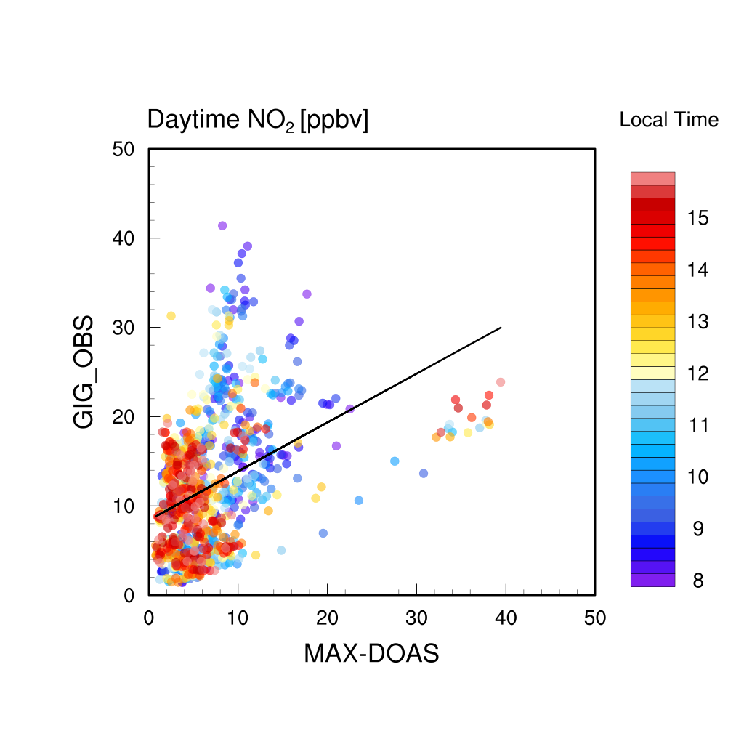
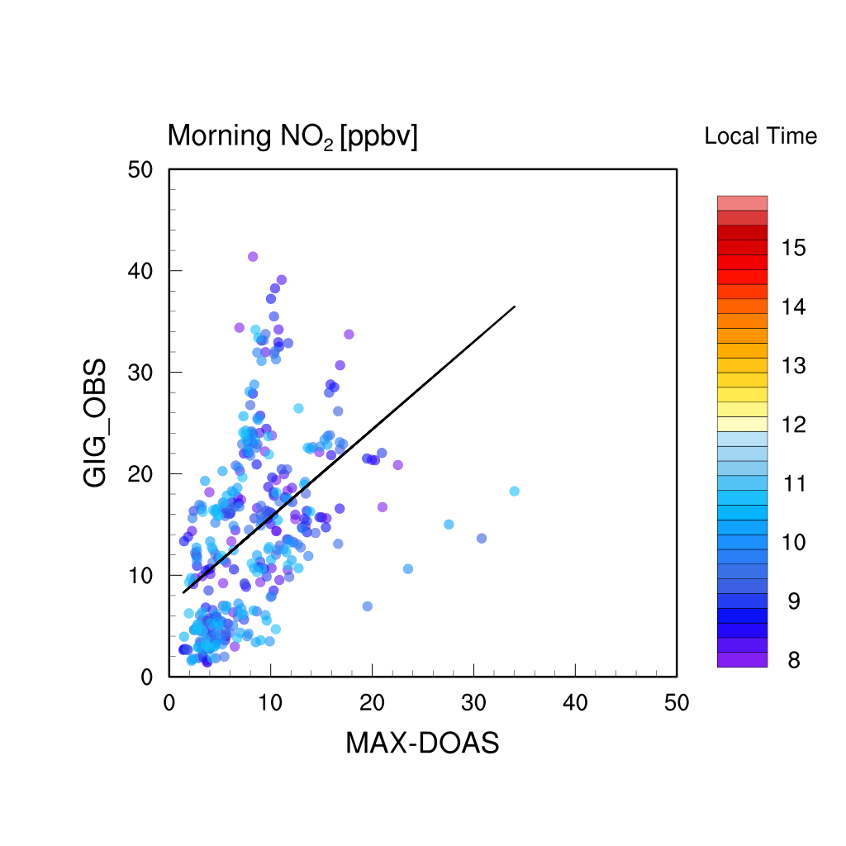
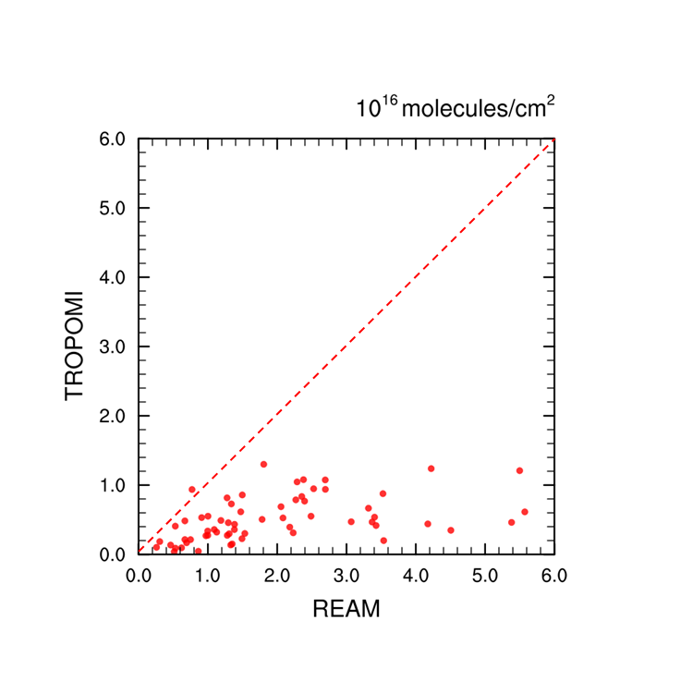
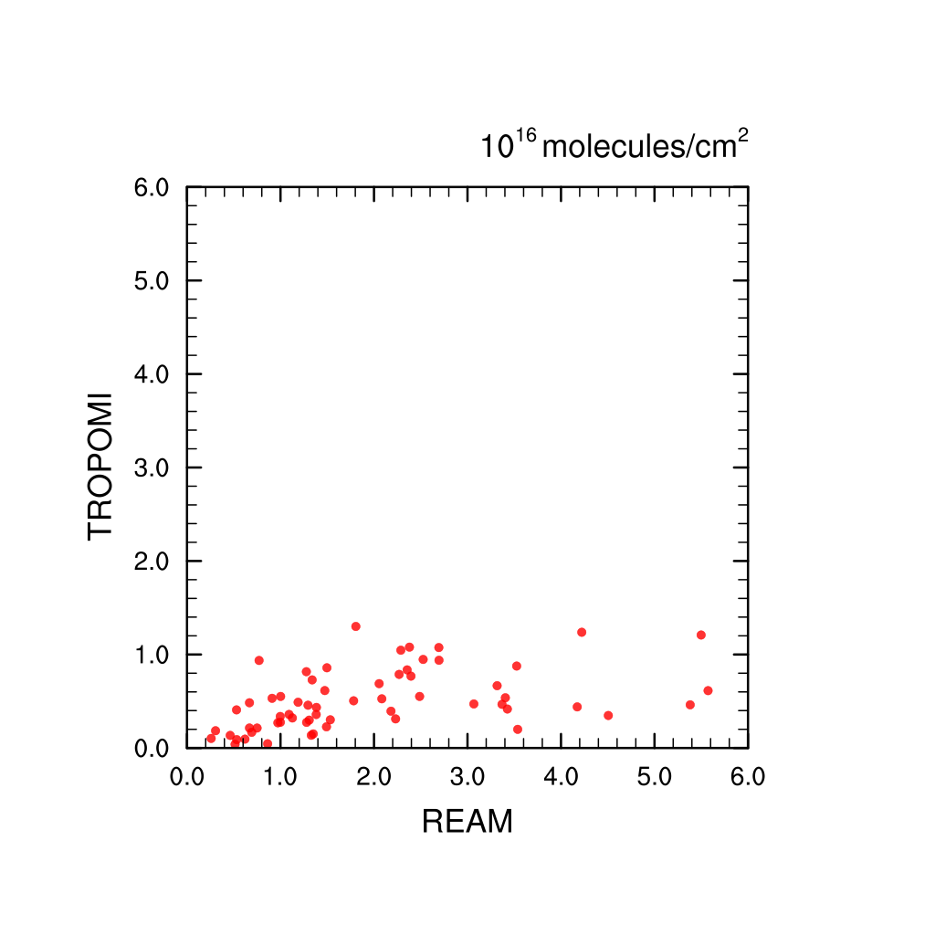
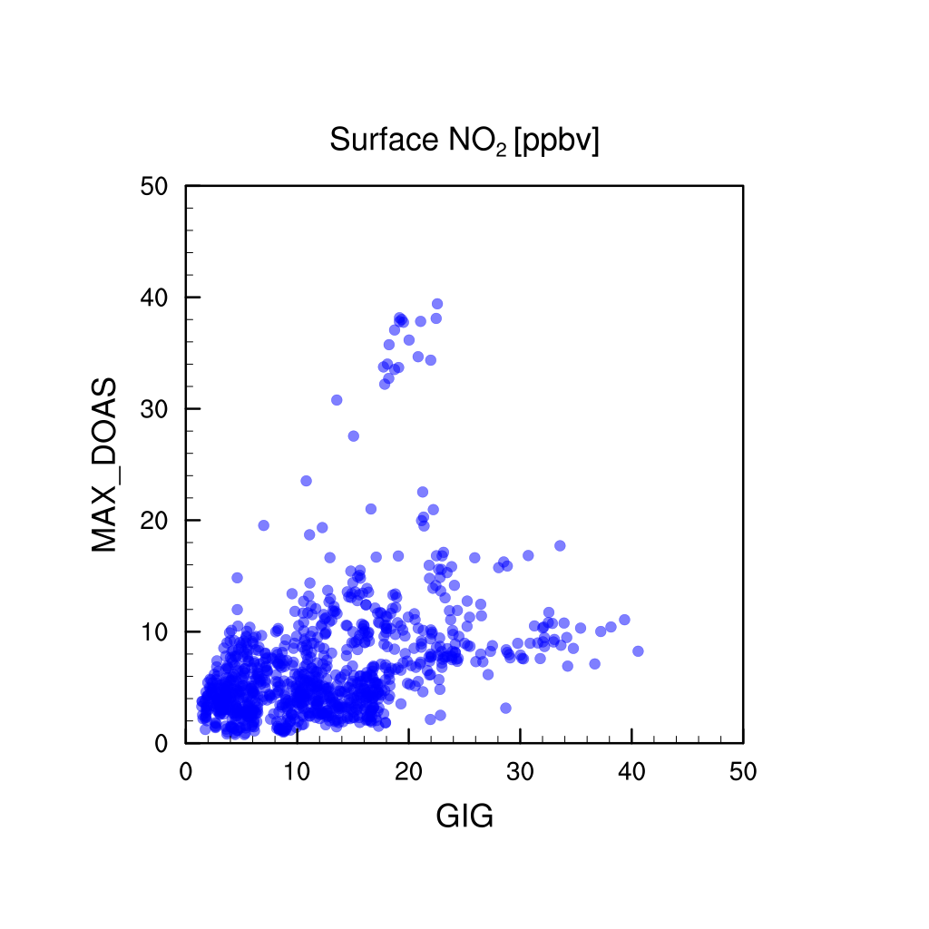
$r^{2}=0.$55
$r^{2}=0.$50
$r^{2}=0.$16
$r^{2}=0.$22
$r^{2}=0.$50
O3
$r^{2}=0.$20
NO2
O3
NO
HO2
$$r^{2}=0.16$$
$$r^{2}=0.46$$

