Slide 1
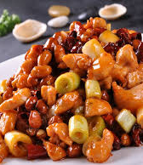
How does Kung Pao Chicken affect indoor air quality? -- cooking impact on indoor PM concentration
EAS 6792
Yuhan Yang
4/18/19

Slide 2
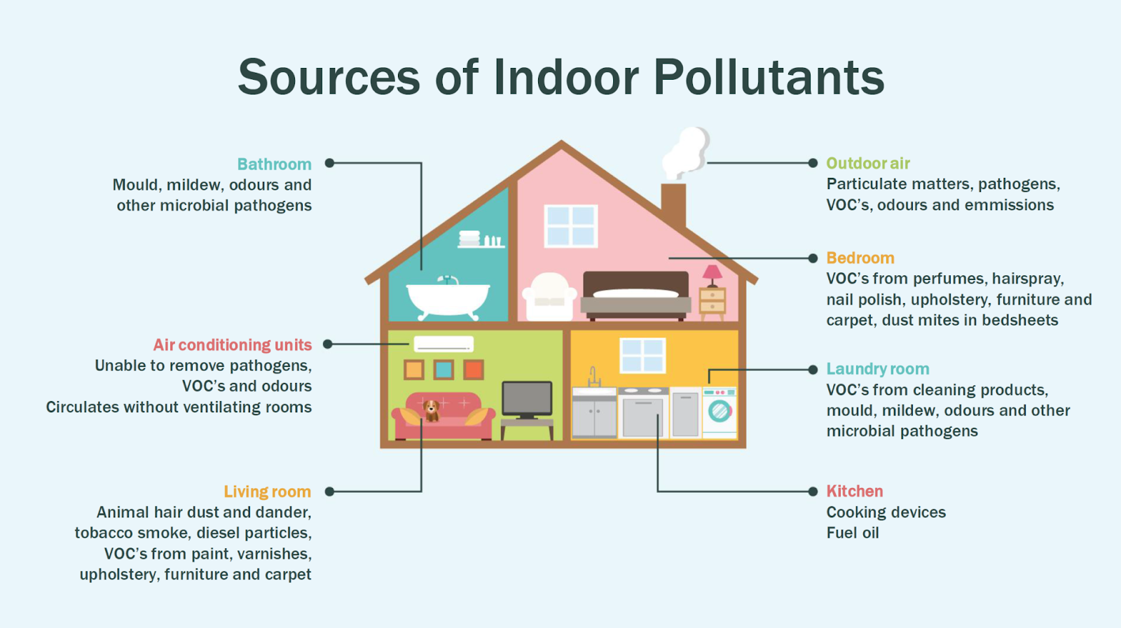
Indoor Particulate Matter
IAQ and health
- immediate effects: irritation, headache, dizziness
- Long-term effects: respiratory disease, heart disease, cancer
Primary causes
pollutant sources: cooking, combustion activities (stoves, heaters, fireplaces and chimneys, environmental tobacco smoke)
- inadequate ventilation
- outdoor air pollution: infiltration, natural ventilation, and mechanical ventilation
Picture source: Pinterest

Slide 3
Simple One Box Model
Assumptions
Cooking is the only source of primary PM2.5
Ignore chemical production / loss i.e. No secondary PM2.5
Air in the room is uniform / perfectly mixed
ACH (air change per hour) is constant
Ignore infiltration
Ignore resuspension of particles
Particles with different sizes have the same deposition rate
Average cooking/emission time ~ 10 min
Ambient air concentration is constant in one simulation day

Slide 4
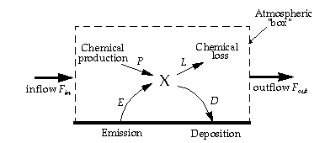
Simple One Box Model
$$V\frac{dC}{dt}=E−D+{F_{in}−F_{out}=E−k_{d}C+Q}_{in}C_{in}−Q_{out}C_{out}$$
V – volume of air
E – emission rate
D – deposition rate = kd*Cin
Cout – ambient concentration of PM2.5
Q – air flow rate = ACH*V
C0 = Cbackground
Daniel Jacob, 1999

Slide 5
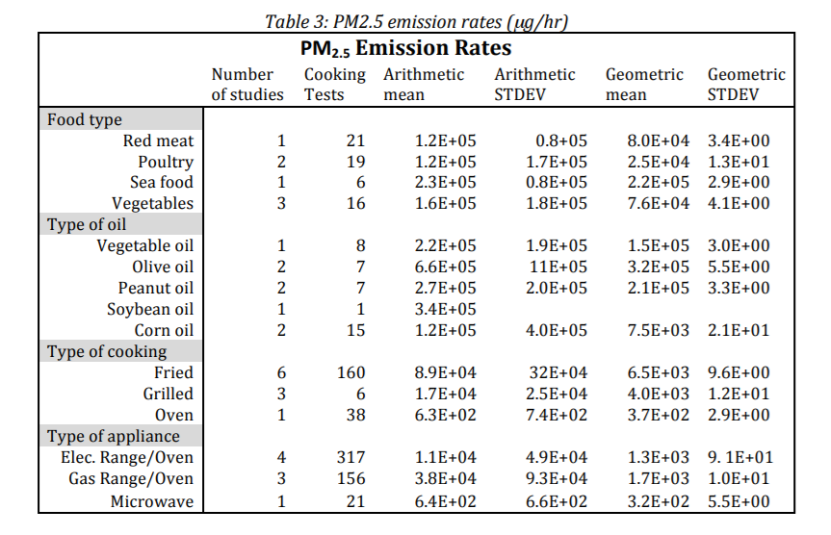
Emissions of Different Cooking Styles
Sea food has the highest PM2.5 emission rate, which is 10 times of poultry emission
Indoor PM concentration increases rapidly after cooking and gradually reduces below the EPA PM2.5 standard (35μg/m³) after 2.5hrs
Hu et al., 2012

Slide 6
Impact of Ventilation
Normally, air change rate (ACH) is 0.5 ~ 3.0
When ACH > 3.0, PM concentration decreases rapidly: reduces to the EPA standard in 1 hour
In a bad ventilation room, PM concentration can maintain to a high level for a long period (more than 3 hrs) after cooking

Slide 7
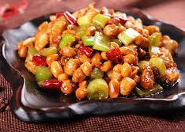
Case Study: Cooking a Kung Pao Chicken
Date & Time – 08/07/18, EST 12:00 pm – 5:00 pm
V – open kitchen, volume of kitchen plus living room ~ 55m³
E – poultry + vegetables + peanut oil ~ 3.11E+05 μg/hr
D – room with carpet, no plants, kd ~ 0.62
Q – good ventilation, ACH ~ 3.0
Cout – EPA, outdoor air quality data at Plymouth site (42.06N, 71.01W) in Boston, MA on Aug 7th ~ 22.3 μg/m³
C0 – Cbackground ~ 20μg/m³

Slide 8
Result: Modeling vs. Measurement
Correlation between observation and simulation result is 0.93 (r²)
Emission is over estimated
Decreasing rate is over estimated
Possible reasons:
great error in cooking emission inventory
emission rate is not constant
there are other PM sources
ventilation is not good enough
interval time of measurement is 10 mins. might miss the peak concentration
ambient PM data is diurnal mean

Slide 9
Result: Modeling vs. Measurement
Case 1: E1= 3.11E+05 μg/hr, ACH = 3.0
Case 2: E2= 3.11E+05 μg/hr, ACH = 2.0
Case 3: E3= 2.07E+05 μg/hr, ACH = 2.0
Case 3 is most close to measurement, r² = 0.99

Slide 10
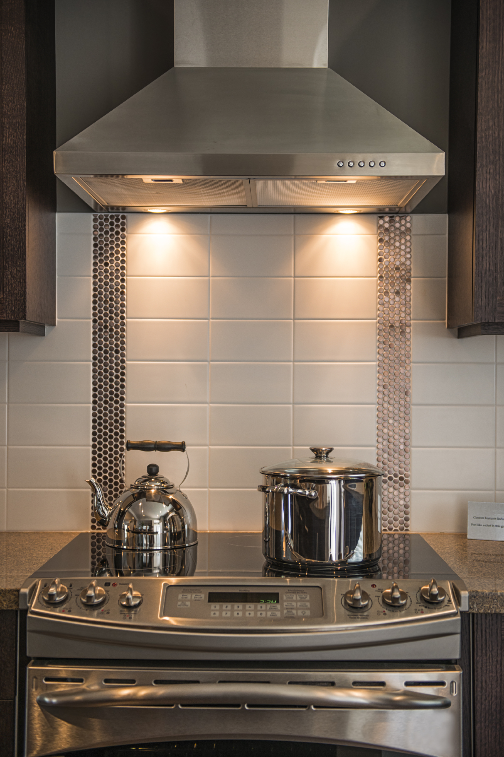
Suggestions for Ruixiong
Control the emission
use vegetable oil instead of olive / peanut oil
eat more poultry rather than red meat or sea food (if possible…)
refuse fried food which is unhealthy and polluted
Increase the deposition rate
grow some indoor plants
Better ventilation
use a properly-installed, high efficiency range hood
open more windows while cooking
Move to a cleaner city… lol

Slide 11
References & Acknowledgement
Afshari, A. and C. Reinhold (2008). "Deposition of Fine and Ultrafine Particles on Indoor Surface Materials." Indoor and Built Environment 17(3): 247-251.
Abdullahi, Karimatu L., Juana Maria Delgado-Saborit, and Roy M. Harrison. "Emissions and Indoor Concentrations of Particulate Matter and Its Specific Chemical Components from Cooking: A Review." Atmospheric Environment 71 (2013): 260-94.
Hu, Tianchao, Brett CcSinger, and Jennifer M Logue. "Compilation Of published pm2.5 emission rates For cooking, candles and incense for Use in Modeling of exposures in residences." Ernest Orlando Lawrence Berkeley National Laboratory (2012).
FOGH, CHRISTIAN L., MIRIAM A. BYRNE, J0RN ROED, and ANTONY J. H. GODDARD. "Size Specific Indoor Aerosol Deposition Measurements and Derived I/O Concentrations Ratios ". Atmospheric Environment 31, no. 15 (1997): 2193-203.
Qian, Jing, Andrea R. Ferro, and Kathleen R. Fowler. "Estimating the Resuspension Rate and Residence Time of Indoor Particles." Journal of the Air & Waste Management Association 58, no. 4 (2012): 502-16.
JACOB, DANIEL J. “Introduction to Atmospheric Chemistry”. PRINCETON, NEW JERSEY: Princeton University Press, (1999). http://www.jstor.org/stable/j.ctt7t8hg.
Thanks Dr. Wang for the guidance and suggestions.
Thanks Dr. Ruixiong Zhang for sharing the indoor PM measurement data and offering great help.

