Slide 1
New Particle Formation in Southern Great Plains during HISCALE 2016 with Model and Observed Measurements
EAS 6792 (Spring 2019)
Justin Min
2019-04-18

Slide 2
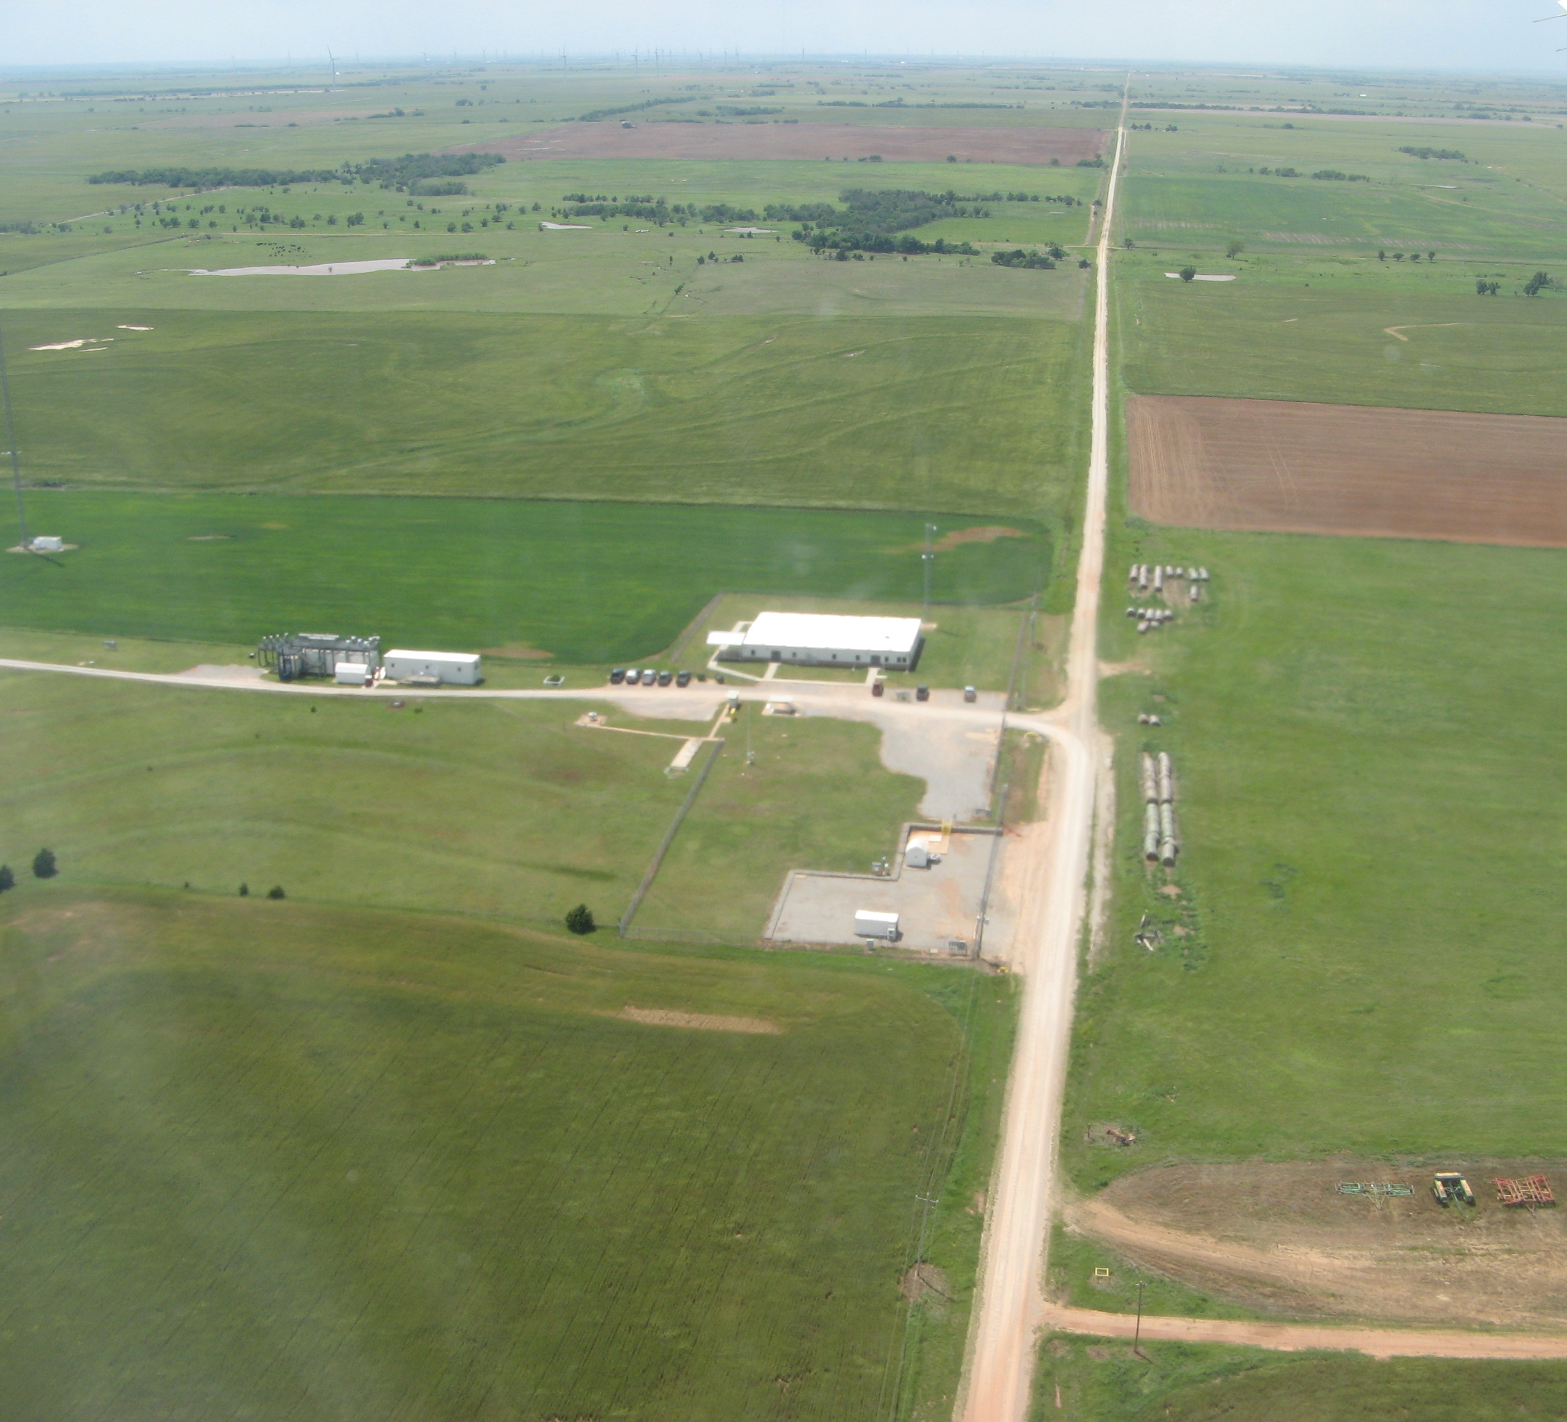
Outline
Introduction
Methods/Observations
Results
Conclusion

Slide 3
Introduction
Purpose was to investigate the similarities and differences of the multicomponent nucleation theories and compare them with observed nucleation rates during a field study.
  Multicomponent Nucleation Theories (most common):
    Binary
    Ternary
    Ion-Induced

Slide 4
What is new particle Formation (NPF)? And why is it important?
Cluster formation: Number
< 1 nm
sulfuric acid
organics
ammonia/amines
Heterogeneous Nucleation/Growth: Survival
1 – 1.5 nm
critical clusters
Growth
3 nm
Activation:
Fraction
NPF is a large source for CCN
100 nm
CCN active
> 1 µm

Slide 5
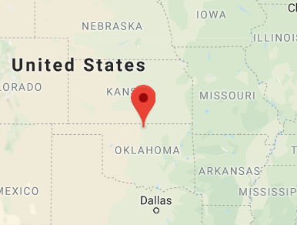
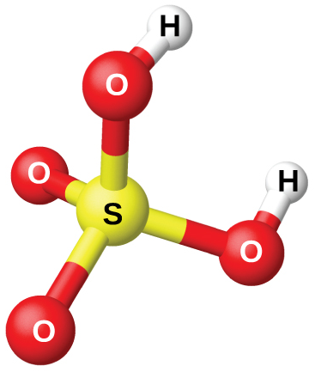
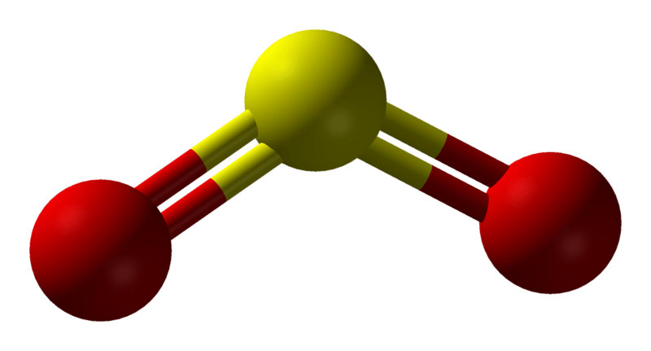
Methods:
Atmospheric Radiation Measurement (ARM) Site
in Lamont, Oklahoma, USA
Instruments:
  Nano Scanning Mobility Particle Sizer (nano-SMPS)
      Outputs: Particle diameters (3-50 nm) + number counts = size distribution
  Scanning Mobility Particle Sizer (SMPS)
      Outputs: Particle diameters (10-500 nm) + number counts = size distribution
  SO₂ Monitor
      Outputs: SO₂ concentration in ppb
  Nitrate Chemical Ionization Mass Spectrometer
      Outputs: number concentration (#/cm³) of gas-phase sulfuric acid
Sulfuric Acid
Organics
Ammonia

Slide 6

Nucleation Rate Calculations:
Classical Nucleation Theory
$J=C∗\exp\left(\frac{−∆G^{∗}}{kT}\right)$
Nucleation Rate from (Riipinen et al., ACP 2007)
$J_{1}\left(t\right)=J_{3}\left(t^{′}\right)exp\left[γ∙\frac{CS^{′}}{GR_{1−3}}∙\left(\frac{1}{1 nm}−\frac{1}{3 nm}\right)\right]$
Parameterized Equations for Binary Nucleation (Vehkamaki et al., JGR 2002)
Parameterized Equations for Ternary Nucleation (Merikanto et al., JGR 2007)

Slide 7
Results: New Particle Formation Event
NPF is identified in the aerosol size distribution. The plot shows the particle size and number evolving as a function of time. “Banana Plot” is visible.
UTC

Slide 8
Preliminary Results
Binary nucleation model predictions severely underestimate the observed nucleation rates.
Both models are sensitive to small temperature changes, but ternary nucleation model is most sensitive to temperature changes.

Slide 9
Conclusion
Binary Nucleation does not capture what is happening at southern great plains site.
Ternary Nucleation appears to capture atmospherically relevant conditions of J₁ only at low temperatures.
There are still unaccounted species that may be contributing to the overall nucleation rate.

Slide 10
References
Merikanto, J., Napari, I., Vehkamäki, H., Anttila, T., Kulmala, M., 2007. New parameterization of sulfuric acid-ammonia-water ternary nucleation rates at tropospheric conditions. Journal of Geophysical Research 112.
Riipinen, I., 2007. Connections between atmospheric sulphuric acid and new particle formation during QUEST III–IV campaigns in Heidelberg and Hyytiala. Atmos. Chem. Phys. 16.
Vehkamäki, H., 2002. An improved parameterization for sulfuric acid–water nucleation rates for tropospheric and stratospheric conditions. Journal of Geophysical Research 107.

Slide 11
Extra slide
The theoretical nucleation rates as functions of sulfuric acid concentration at various ambient temperatures and fixed relative humidity. The shaded region of the plot is the range of ambient concentrations for gas-phase sulfuric acid observed at SGP.

