Slide 1
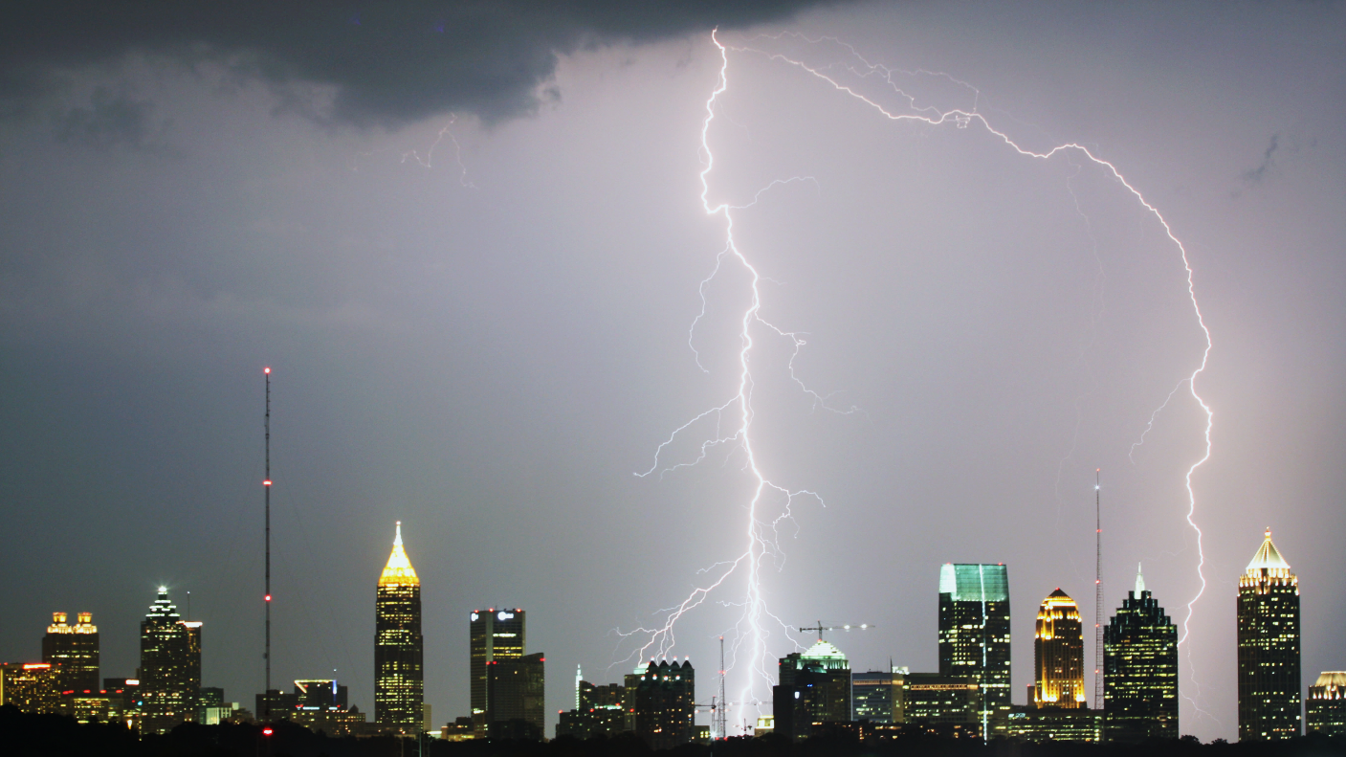
Estimate Arctic Sea Ice Coverage Using VLF Radio Waves
Kevin Whitmore
4/18/2019
EAS 6792
Term Project

Slide 2
Table of Contents
Background
Motivation
Algorithm
Results
Future Work

Slide 3
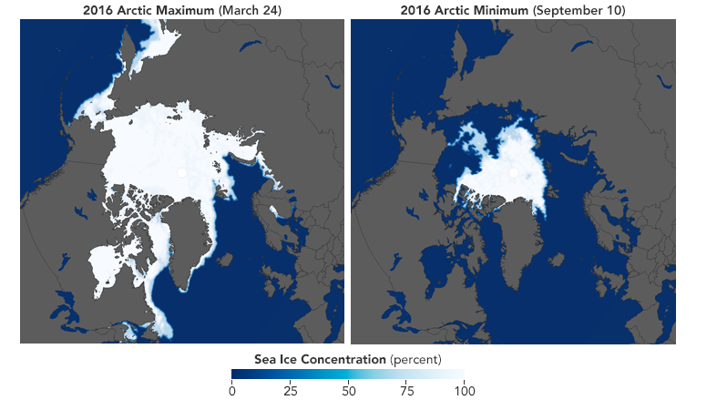
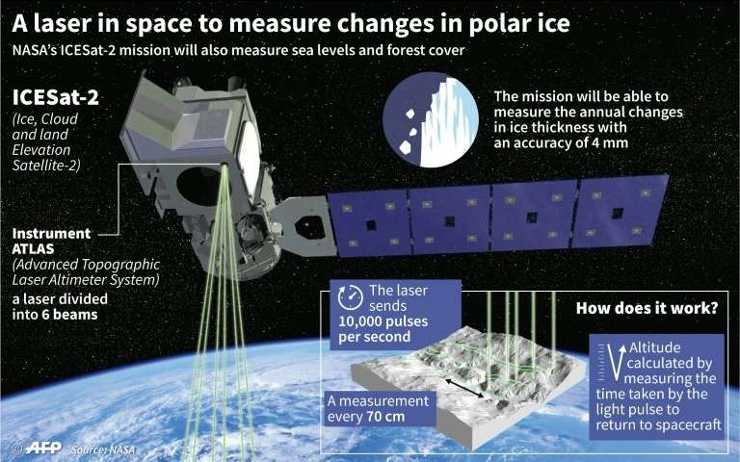
Background
Arctic sea ice coverage varies widely between the summer and winter months
Maximum in March
Minimum in September
Currently satellite networks measure sea ice coverage
NASA’s ICESat-2 Launched in 2018
https://earthobservatory.nasa.gov/features/SeaIce
https://phys.org/news/2018-09-nasa-space-lasers-reveal-depths.html

Slide 4
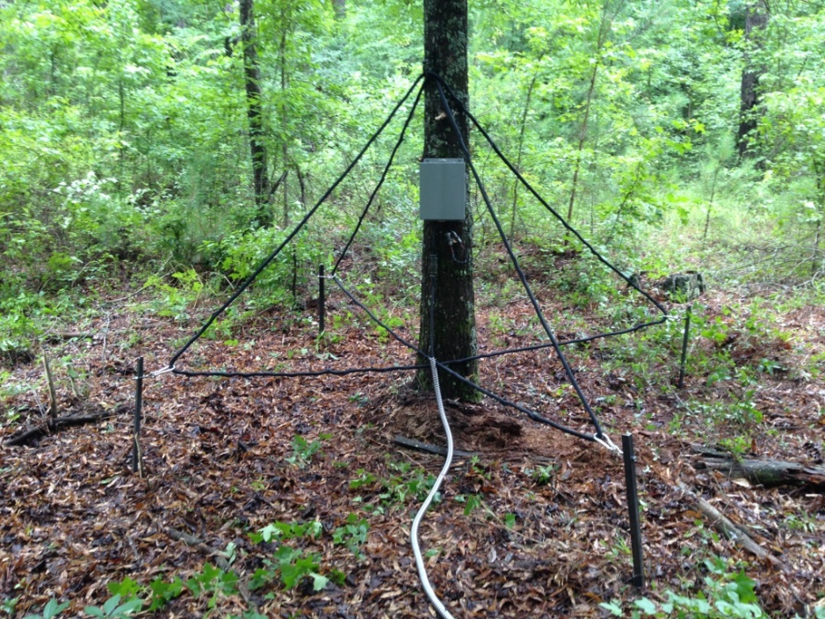
Background
ELF/VLF waves in the atmosphere:
Lightning strike bursts (sferics)
Majority of energy emitted in the 10-100 kHz band
Travel multiple times around the globe in the Earth-Ionosphere wave guide
Ionosphere (70-1000 km)
Lightning
Transmitter
‘Sferic’
Earth
LF Receiver

Slide 5
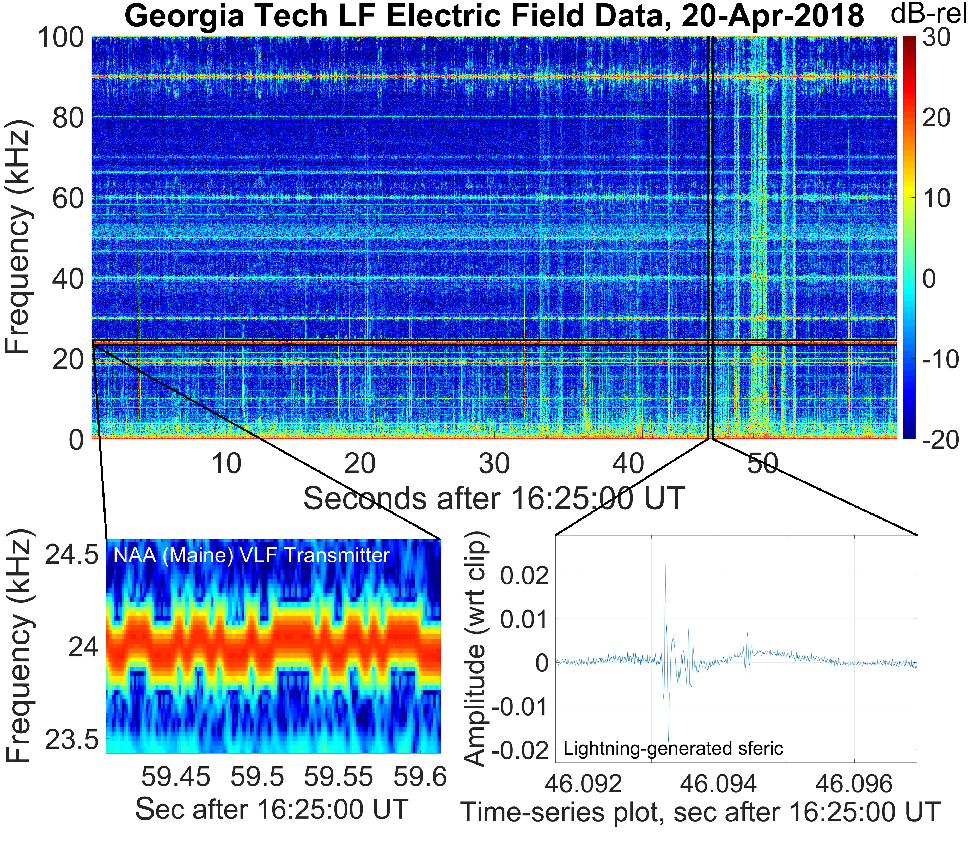
Background
ELF/VLF waves travel globally with little attenuation
Magnetic field strength is measured in pico-Tesla
The waves travel very well over water
Ice will absorb energy and the wave will attenuate over the arctic
Gurses, Whitmore 2018

Slide 6
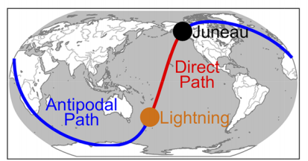
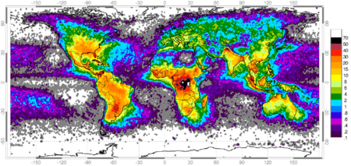
Approach
Define a specific area to analyze for lighting
Latitude, longitude, peak current
Find direct path distance and arrival time
Find antipodal path distance and arrival time
Compare the ratio of field amplitudes between each path for an entire year
Look for seasonal trends
Cohen et al 2018
NASA World Wide Lightning Distribution
https://www.nasa.gov/centers/goddard/news/topstory/2004/0621lightning.html

Slide 7
Algorithm
Extract data from VLF/ELF database
corresponding to arrival times
Calculate peak magnetic field strength for each path
Look for seasonal trends
GLD360 Lightning Database
Filter data to keep only strikes with large peak current and path over arctic
Calculate expected arrival time at receiver for direct and antipodal paths
Calculate the ratio of maximum current amplitude to peak field strength
Compare this value for each path

Slide 8
Results
Results are in progress…
Simulation Time
~5.5 million lightning strikes per day
~2 billion per year
Each attempt must process ~10 billion data points

Slide 9
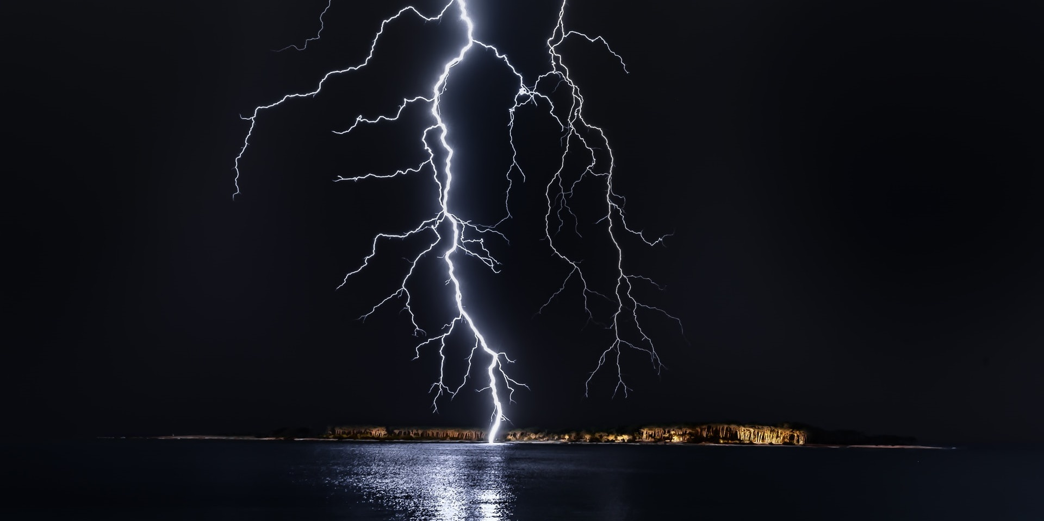
Thank You
Questions?

