Slide 1
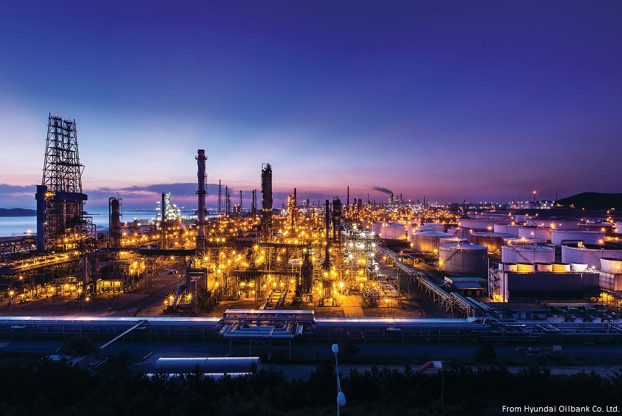
Ozone Production Efficiency
Young Ro Lee
Notes:
Liu SC, Trainer M, Fehsenfeld FC, Parrish DD,Williams EJ, Fahey
DW, et al. Ozone production in the rural troposphere and the implications
for regional and global ozone distributions. J Geophys Res
Atmos. 1987;92(D4):4191–207.

Slide 2
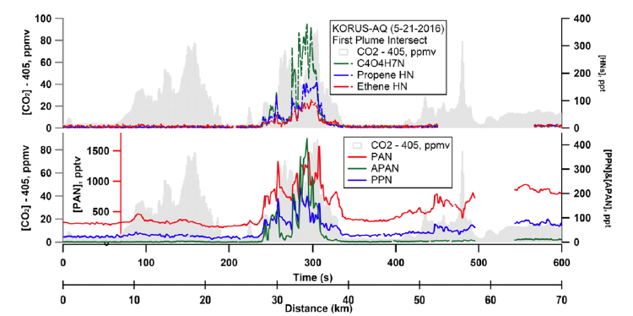
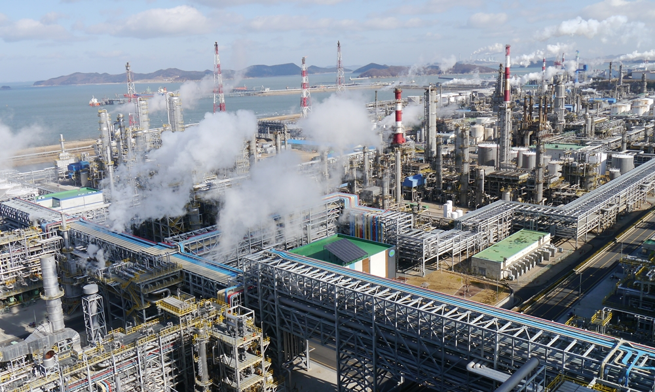
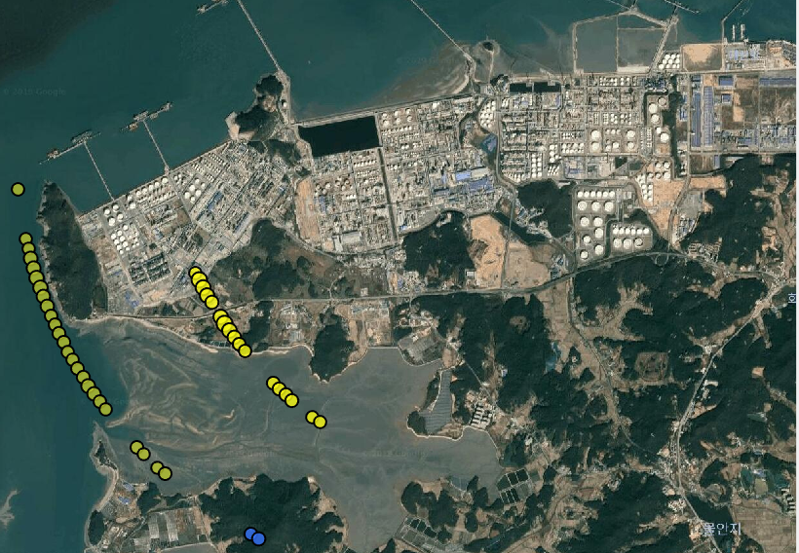

Petrochemical Plume
Large amounts of NOx from electric utility power plants
Highly reactive VOC compounds
  Continuous or episodic emissions
  Ethene, propene, 1,3-butadiene and other VOCs
Efficient production of ozone and NOz (e.g., PANs + ANs + HNO₃)
Notes:
Liu SC, Trainer M, Fehsenfeld FC, Parrish DD,Williams EJ, Fahey
DW, et al. Ozone production in the rural troposphere and the implications
for regional and global ozone distributions. J Geophys Res
Atmos. 1987;92(D4):4191–207.

Slide 3
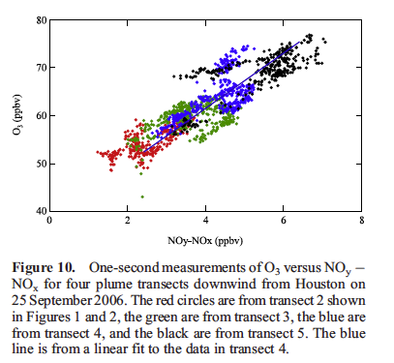
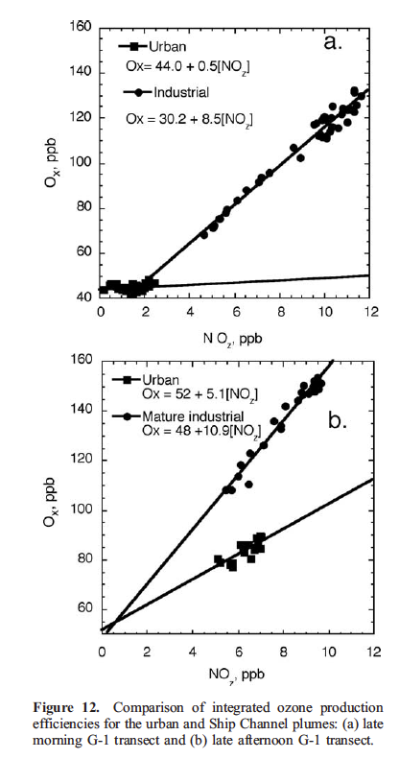
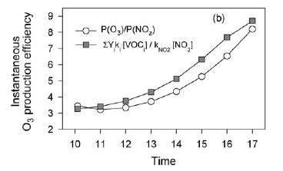
Ozone Production Efficiency (OPE)
  Different approaches to derive OPE
  Observation (Trainer et al., 1993, Daum et al., 2003, Ryerson et al., 2003,
  Neuman et al., 2009)
  Integrated OPE
  O3 = Intercept + OPE*NOz
  Ox (O3 + NO2) = Intercept + OPE*NOz
  Model (Liu et al., 1987, Lin et al., 1988)
  Instantaneous OPE
  OPE = P(O3)/L(NOx) ~ ([HO2] + [RO2])*NO / L(NOx)
  OPE = P(O3) - L(O3)/L(NOx) = Net(O3)/L(NOx)
  OPE = P(O3) - L(O3)/P(NOz) = Net(O3)/P(NOz)
  Stoichiometry + Observation (Sillman 1990; Kleinman 2002)
  OPE at the point
  OPE = Sum(Yield_{i} * [VOC]_{i}*[OH]/P(NOz)
Neuman et al., 2009
Daum et al., 2003
Kleinman et al., 2002
Notes:
Liu SC, Trainer M, Fehsenfeld FC, Parrish DD,Williams EJ, Fahey
DW, et al. Ozone production in the rural troposphere and the implications
for regional and global ozone distributions. J Geophys Res
Atmos. 1987;92(D4):4191–207.

Slide 4
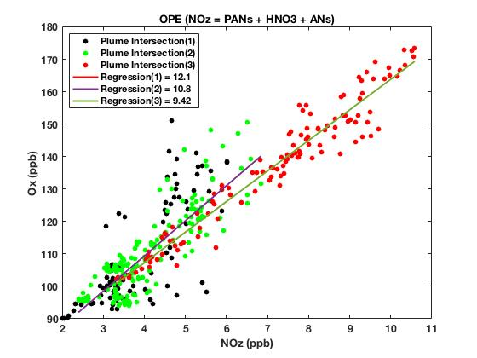
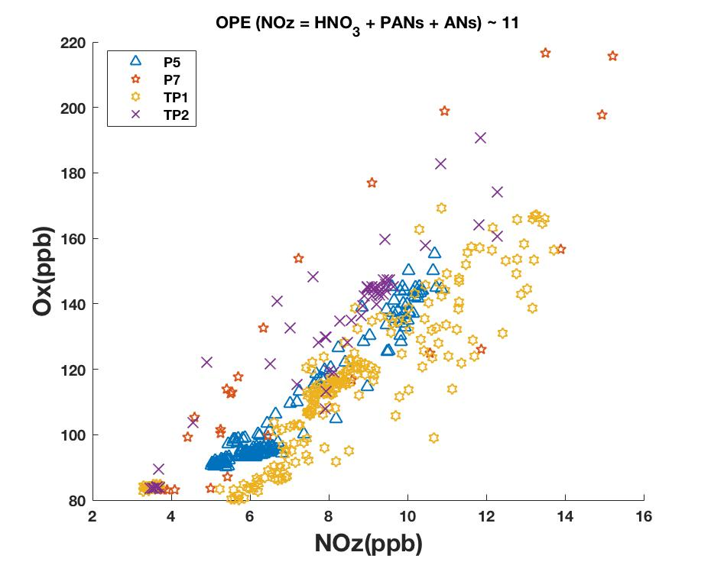
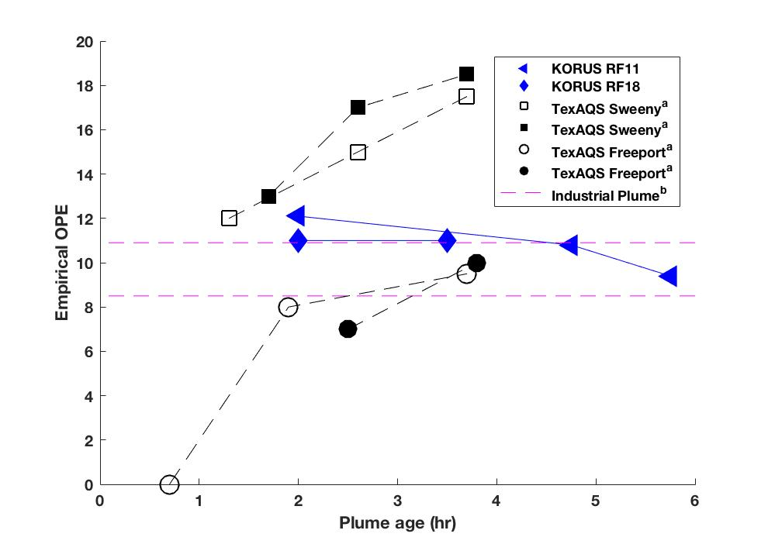
Ozone Production Efficiency (OPE)
  1. Empirical OPE : KORUS RF11 and RF18
Ryerson et al. [2003] and Daum et al. [2003] during TexAQS 2000
& KORUS-AQ OPE
Ox_{(O3+NO2)}= Intercept + OPE*NO_{z}
Where NOz = PANs_{GTCIMS} (PAN + PPN + APAN) + HNO3_{CIT} + ANs_{Berkeley}

Slide 5
Ozone Production Efficiency (OPE)
  2. OPE from Model Case Study
  Hypothetical plume replicating KORUS RF11 – May 21st 2016
  Tracked most of peroxynitrates (PNs;118 species) and alkyl nitrates (ANs; 442 species) in the MCM mechanism
  Calculated Production_{model}(PNs_{tagged} + ANs_{tagged} + HNO3) ~ P(NOz)
  Calculated Production_{model}(PAN + APAN + PPN + ANs + HNO3) ~ P(NOz_{PAN})
  Calculated Loss(NO_{x})
  Calculated net rate of ozone Net(O₃)
  Calculated OPE = Net(O3)/P(NOz) or Net(O3)/P(NOz_{PAN}) or Net(O3)/Loss(NOx)
  If tagging worked well, P(NOz) should be close to Loss(NOx)

Slide 6
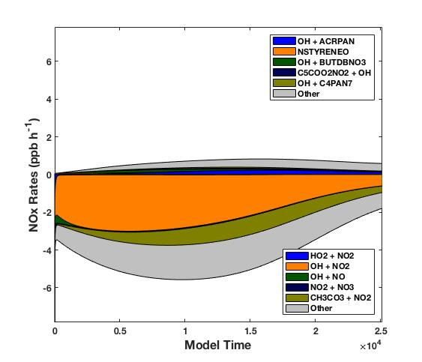
Ozone Production Efficiency (OPE)
  2. OPE from Model Case Study : KORUS RF11 – May 21st 2016
  Major loss of NOx family : HO + NO2
  Peroxyacetyl + NO2 is temporary loss of NO2 (equilibrium reactions are considered as Keq to find the net rate of NOx)
  APAN + OH → redistribute NO₂

Slide 7
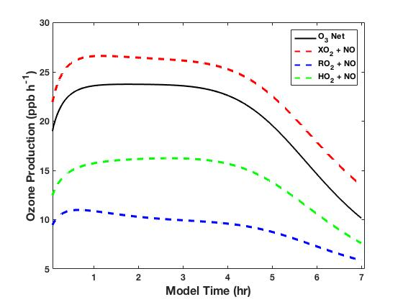
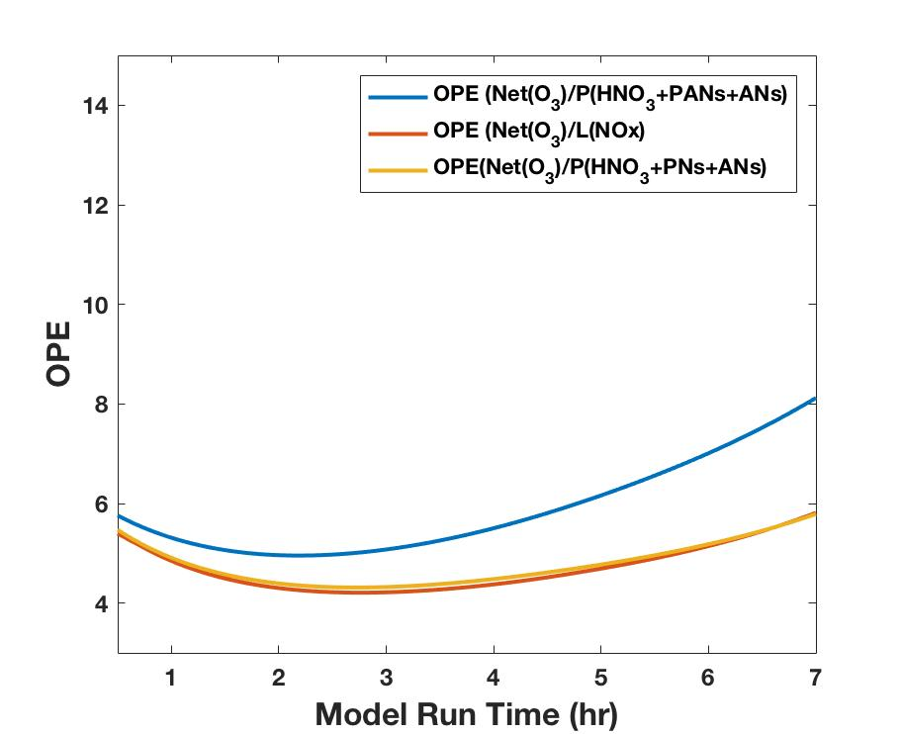
Ozone Production Efficiency (OPE)
  2. OPE from Model Case Study : KORUS RF11 – May 21st 2016
Net rate of ozone production compared to XO2 (HO2 + RO2), HO2 and RO2 + NO
Continuous OPE (right)

Slide 8
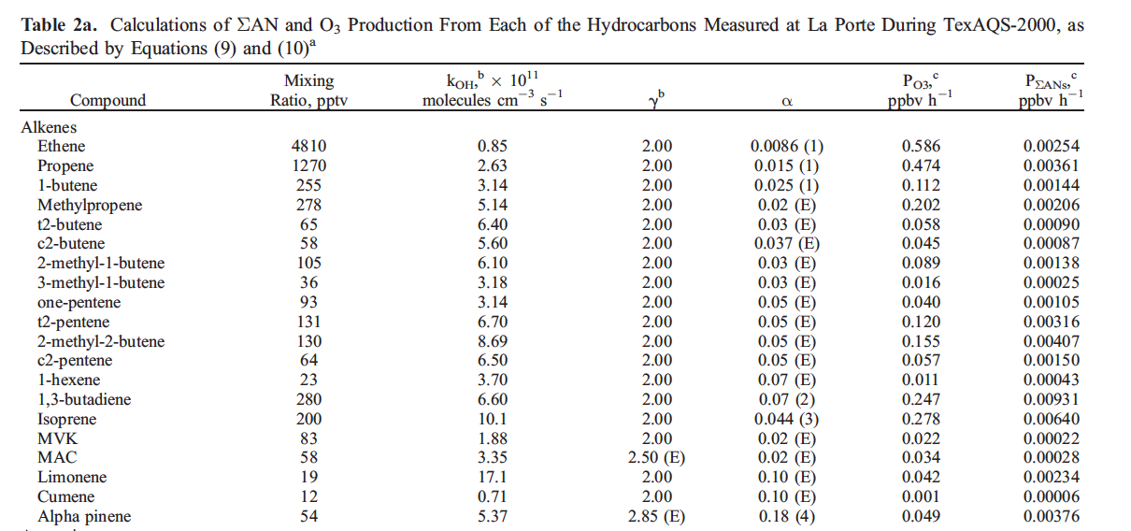
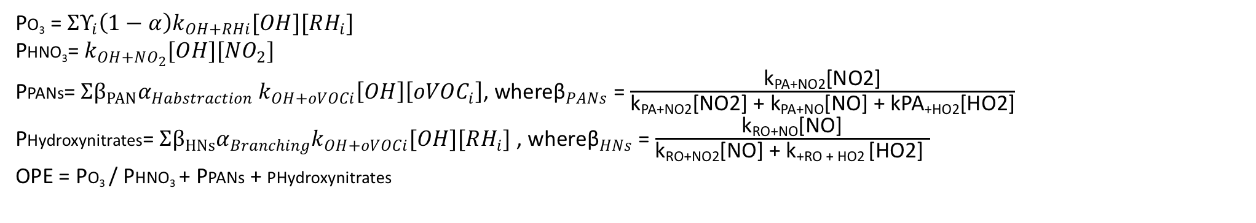
Ozone Production Efficiency (OPE)
  3. OPE from Model Case Study : KORUS RF11 – May 21st 2016
PO₃ = $ΣΥ_{i}\left(1−α\right)k_{OH+RHi}[OH][RH_{i}]$
PHNO₃= $k_{OH+NO_{2}}[OH][NO_{2}]$
PPANs= $Σβ_{PAN}α_{Habstraction} k_{OH+oVOCi}\left[OH\right]\left[oVOC_{i}\right]$, where${\text{β}}_{PANs}$= $\frac{\text{k}\text{PA}\text{+}\text{NO}\text{2[}\text{NO}\text{2]}}{\text{k}\text{PA}\text{+}\text{NO}\text{2[}\text{NO}\text{2]} \text{+} \text{k}\text{PA}\text{+}\text{NO}\text{[}\text{NO}\text{]} \text{+} \text{kPA}\text{+}\text{HO}\text{2[}\text{HO}\text{2]}}$
PHydroxynitrates= $Σβ_{HNs}α_{Branching}k_{OH+oVOCi}[OH][RH_{i}]$ , where${\text{β}}_{HNs}$= $\frac{\text{k}\text{RO}\text{+}\text{NO}\text{[}\text{NO}\text{]}}{\text{k}\text{RO}\text{+}\text{NO}\text{2[}\text{NO}\text{]} \text{+} \text{k}\text{+}\text{RO}\text{ + }\text{HO}\text{2 [}\text{HO}\text{2]} }$
OPE = PO₃ / PHNO₃ + PPANs + PHydroxynitrates
Rosen et al., 2004

Slide 9
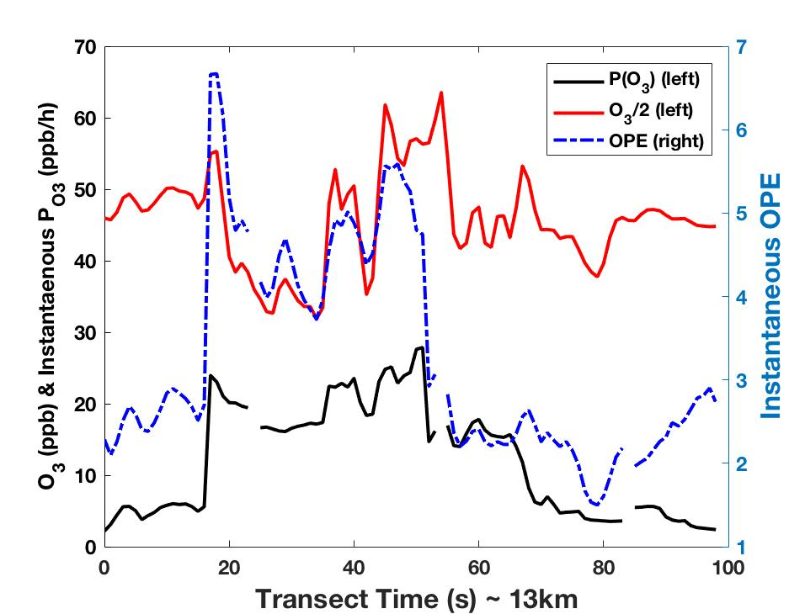
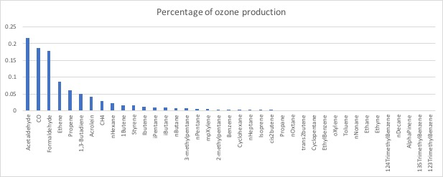
Ozone Production Efficiency (OPE)
  3. OPE from Model Case Study : KORUS RF11 – May 21st 2016

Slide 10
Reference
1. Daum PH. A comparative study of O3formation in the Houston urban and industrial plumes during the 2000 Texas Air Quality Study. J Geophys Res. 2003;108(D23):4715.
2. Kleinman LI, et al. Ozone production efficiency in an urban area. J Geophys Res Atmos. 2002;107(D23):ACH 23-1–ACH 23-12.
3. Liu SC, Trainer M, Fehsenfeld FC, Parrish DD,Williams EJ, Fahey DW, et al. Ozone production in the rural troposphere and the implications for regional and global ozone distributions. J Geophys Res Atmos. 1987;92(D4):4191–207
4. Lin X, Trainer M, Liu SC. On the nonlinearity of the troposphere ozone production. J Geophys Res-Atmos. 1988;93(D12):15879–88.
5. Ryerson TB. Effect of petrochemical industrial emissions of reactive alkenes and NOx on tropospheric ozone formation in Houston, Texas. J Geophys Res. 2003;108(D8):4249.
6. Rosen, R. S., E. C. Wood, P. J. Wooldridge, J. A. Thornton, D. A. Day, W. Kuster, E. J. Williams, B. T. Jobson, and R. C. Cohen (2004), Observations of total alkyl nitrates during Texas Air Quality Study 2000: Implications for O3 and alkyl nitrate photochemistry, J. Geophys. Res., 109, D07303, doi:10.1029/2003JD004227.
7. Sillman, S., Logan, J.A., Wofsy, S.C., 1990. The sensitivity of ozone to nitrogen oxides and hydrocarbons in regional ozone episodes. J. Geophys. Res. 95 (D2), 1837–
1851.
8. Teng, A. P., J. D. Crounse, L. Lee, J. M. St. Clair, R. C. Cohen, and P. O. Wennberg (2015), Hydroxy nitrate production in the OH-initiated oxidation of alkenes, Atmos. Chem. Phys., 15(8), 4297-4316, doi: 10.5194/acp-15-4297-2015.
9. Trainer M, Parrish DD, Buhr MP, Norton RB, Fehsenfeld FC, Anlauf KG, et al. Correlation of ozone with NOy in photochemically aged air. J Geophys Res-Atmos. 1993;98(D2):2917–25.
10. Neuman JA, Nowak JB, Zheng W, Flocke F, Ryerson TB, Trainer M, et al. Relationship between photochemical ozone production and NOx oxidation in Houston, Texas. J Geophys Res. 2009;114: D00F08.

