Slide 1
The Impact of Winter Cyclones on PM2.5 Distribution over the East China
Zhenyu YOU
04/20/2021

Slide 2
Outlines
This study examines how winter cyclone activities would affect the PM2.5 distribution in the eastern China from 2000 to 2005.
Data used
Cyclone tracks (with time interval of 6 h) in 2000-2005 winters have already been extracted. The extraction is based on the sea level pressure of ERA-Interim data from ECMWF.
The PM2.5 data (daily average, 0.1º×0.1º) comes from the TAP dataset (Tracking Air Pollution in China) by Tsinghua University (http://tapdata.org/).
Winds at 957 mb are obtained from the ERA-interim dataset by ECMWF. The spatial resolution is approximately 0.75º×0.75º.

Slide 3
Distribution of winter cyclone tracks
During the winters of 2000 - 2005, 75 extratropical cyclones passed through the East China area (80-130E, 20-60N).
The cyclone tracks are extracted based on surface pressure from ERA-Interim data (6h, 0.75°×0.75°).

Slide 4
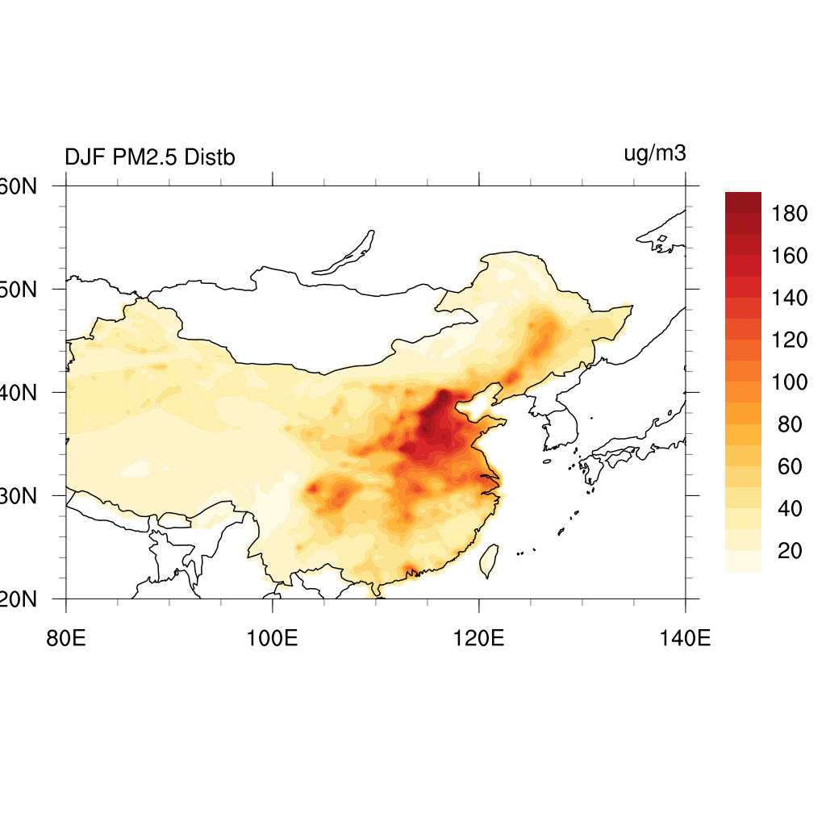
Distribution of PM2.5 in winter
Daily average PM2.5 distribution in winter from 2000 to 2005.
The data was constructed by Tsinghua Universitiy with emissions, numerical modeling and satellite observations
(0.1°×0.1°).

Slide 5
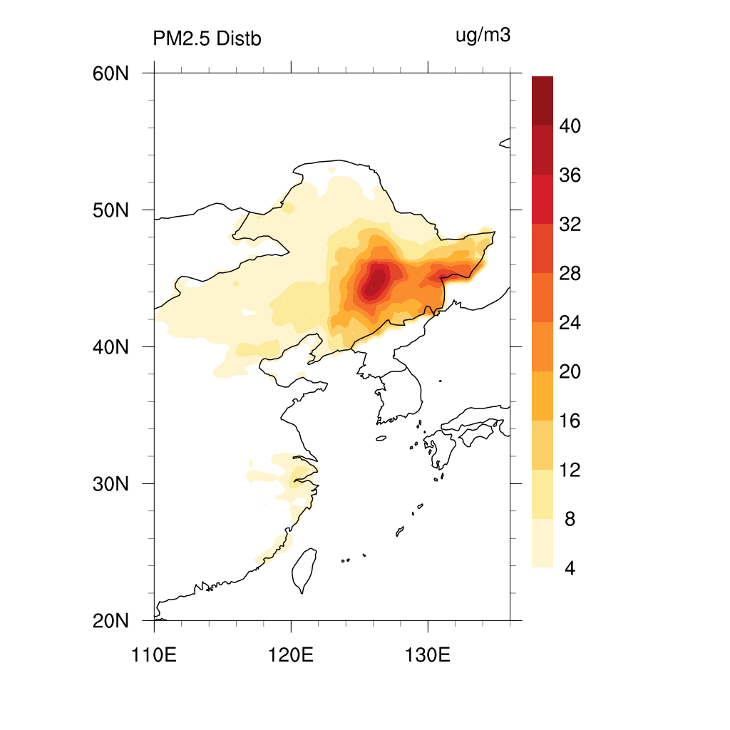
Distribution of PM2.5 with winter cyclones
Cumulative PM2.5 distribution associated with winter cyclones.
The locations of cyclone centers are daily averaged lats and lons.
box sizes: 10°×10°

Slide 6
Clustering of cyclone tracks
K-means clustering analysis was performed on 75 cyclone tracks.
3 representative points were picked for each track.
initial position
3 major clusters of tracks were obtained:
cluster 1: 34 tracks (45.3%)
cluster 2: 26 tracks (34.7%)
cluster 3: 15 tracks (20.0%)
final
position
80%
Northeast
highest
intensity
20% Southeast

Slide 7
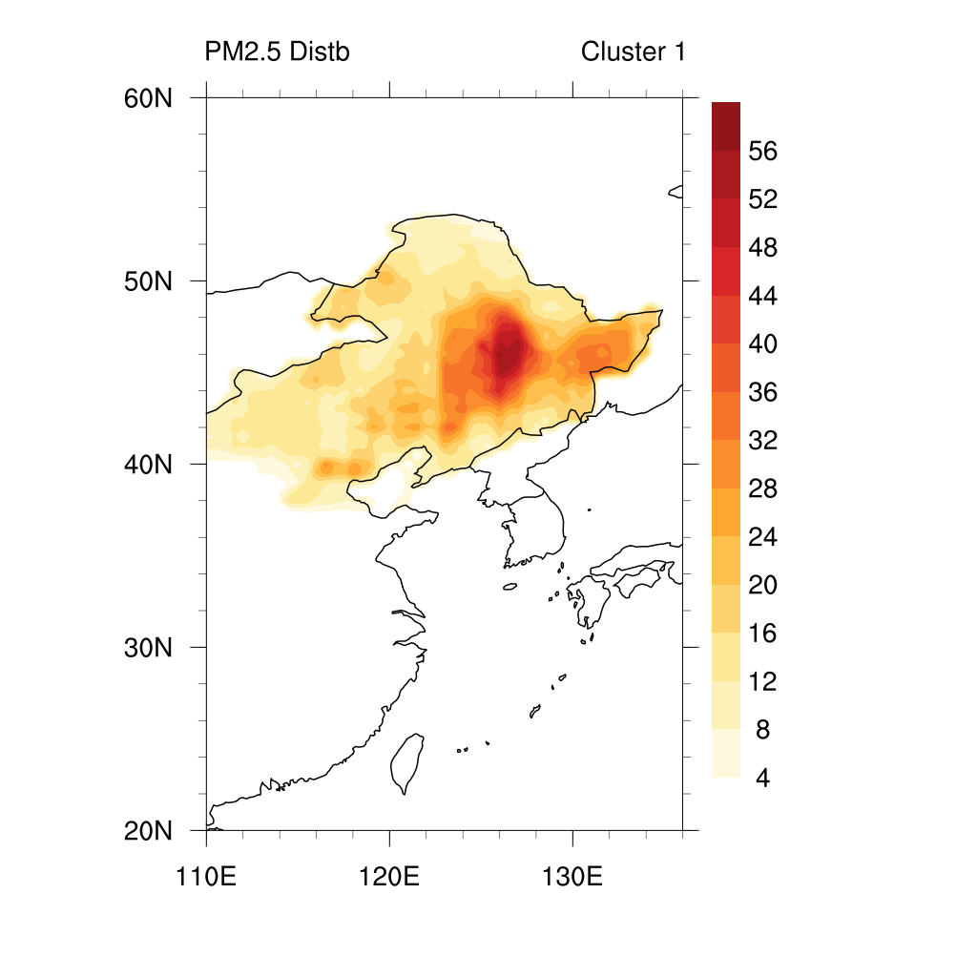
Cyclone tracks and associated PM2.5
Cluster 1:
45.3%
Mongolia cyclones that pass through the Northeast China.

Slide 8
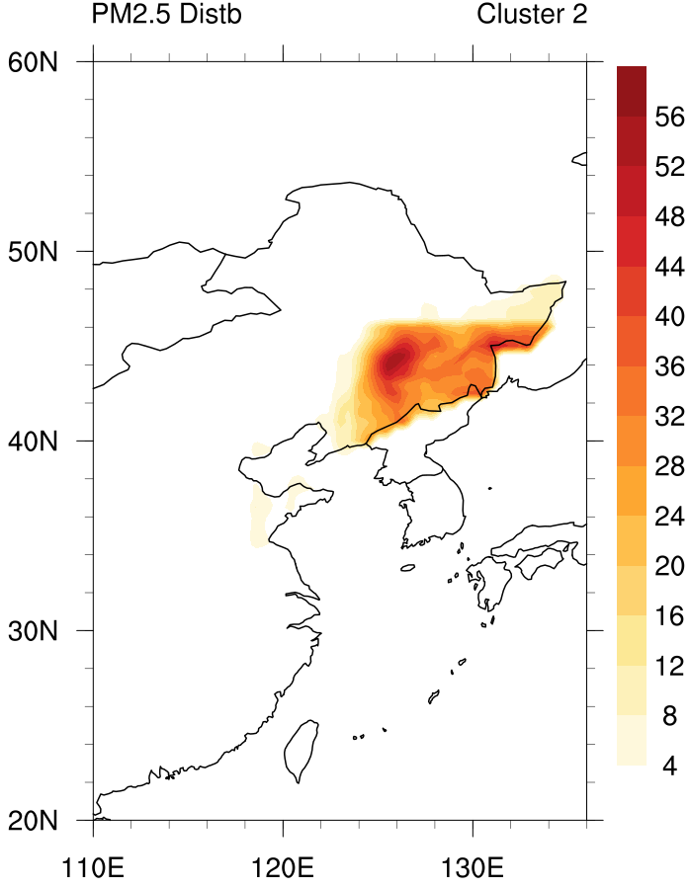
Cyclone tracks and associated PM2.5
Cluster 2:
34.7%
Cyclones origin from the Yellow Sea and the Sea of Japan.

Slide 9
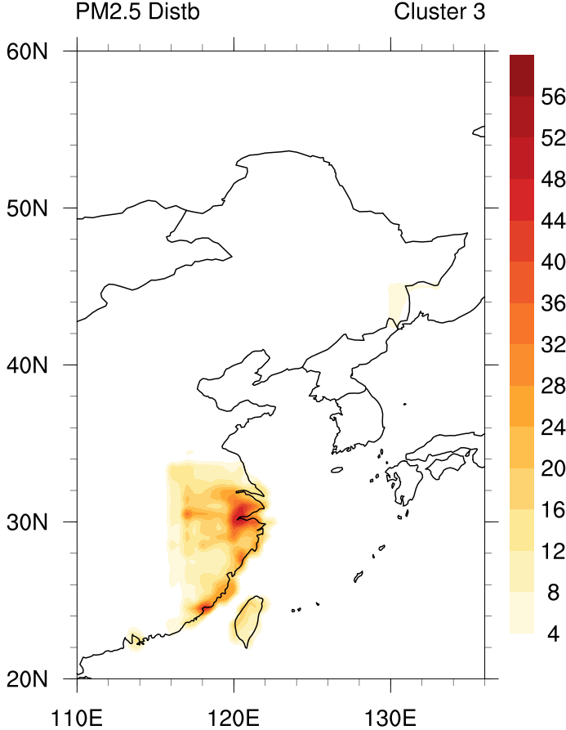
Cyclone tracks and associated PM2.5
Cluster 3:
20.0%
Cyclones origin from the East China Sea.

Slide 10
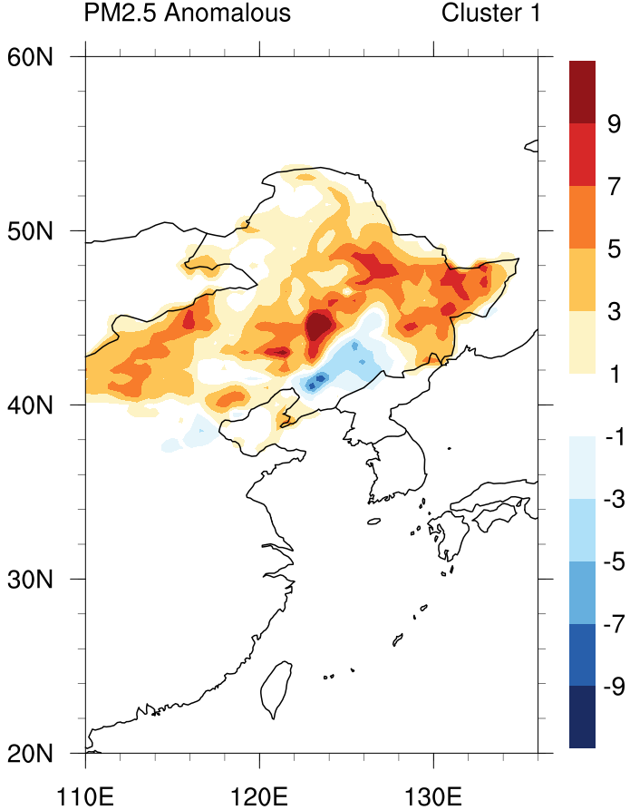
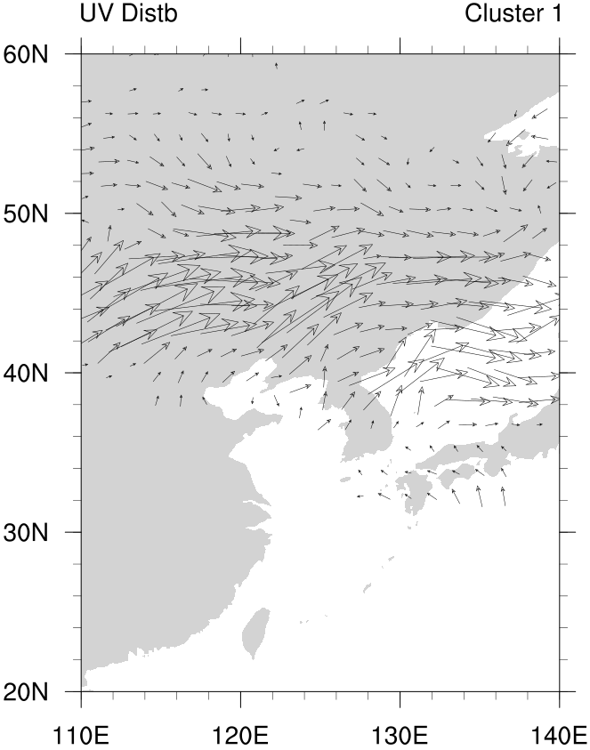
Anomalous PM2.5 and wind patterns
Cluster 1:
34.7%
Transport from the North China Plain
v.s. from the Yellow Sea

Slide 11
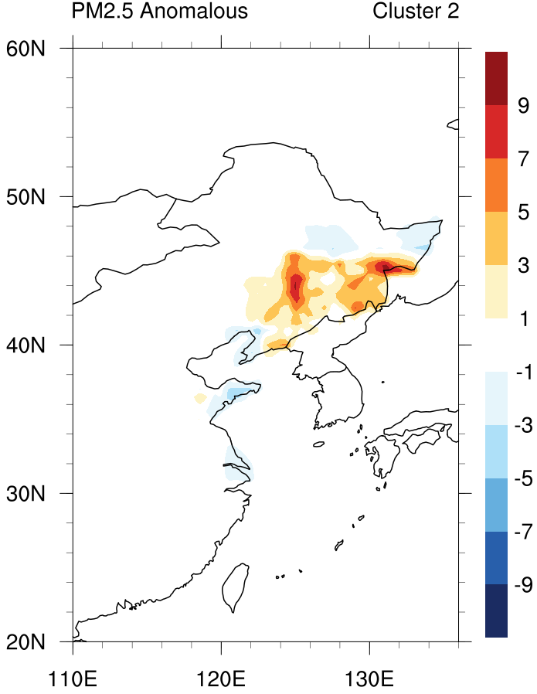
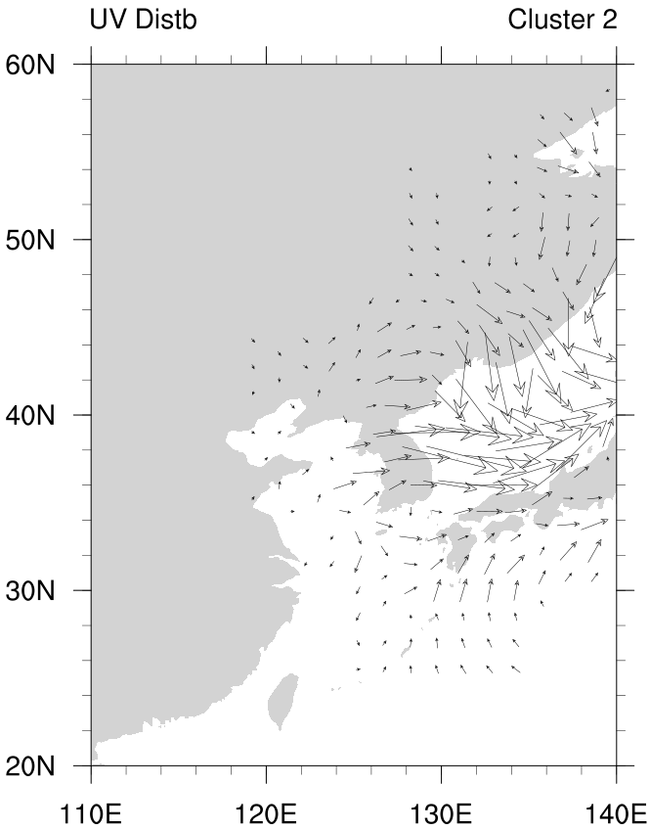
Anomalous PM2.5 and wind patterns
Cluster 2:
34.7%
Transport from the north of Liaoning Province

Slide 12
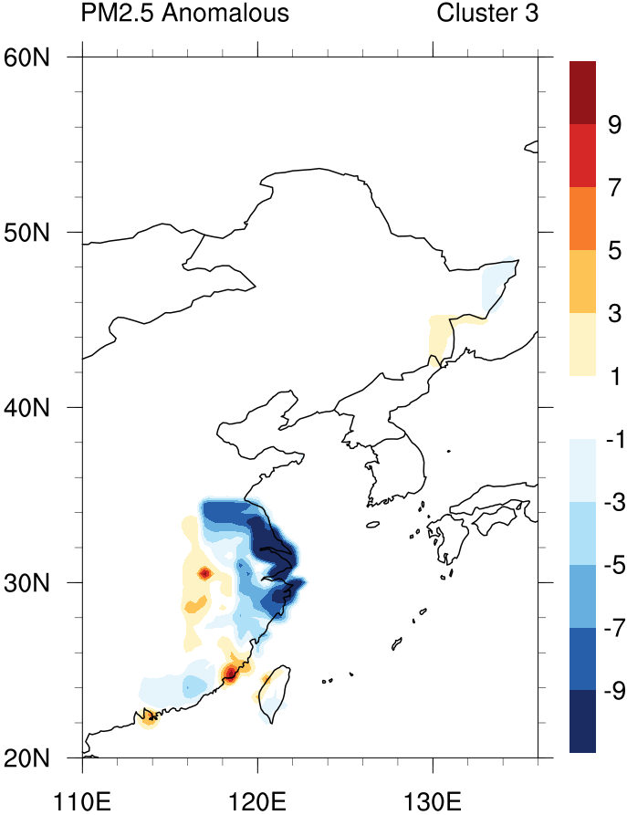
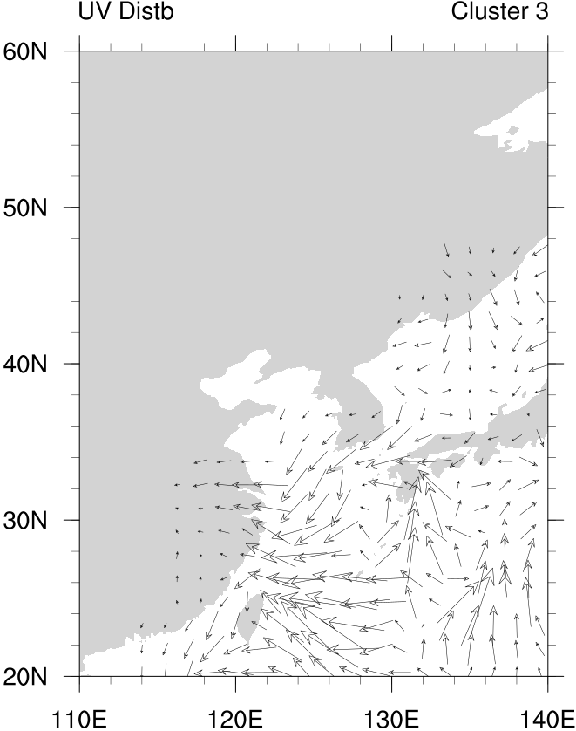
Anomalous PM2.5 and wind patterns
Cluster 3:
20.0%
Transport from the East China Sea

Slide 13
Patterns associated with a cyclone
Common patterns around the cyclone centers (wind, PM2.5 (anomalous), etc.)
On each grid point, calculate the average of non-zero values.
average of non-zero values
Box size: 10°×10°

Slide 14
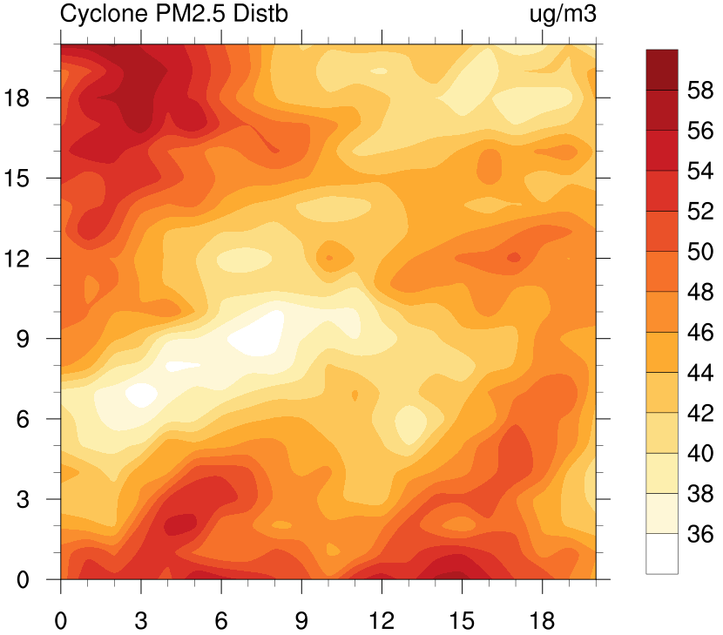
Patterns associated with a cyclone
PM2.5 distribution
wind distribution

Slide 15
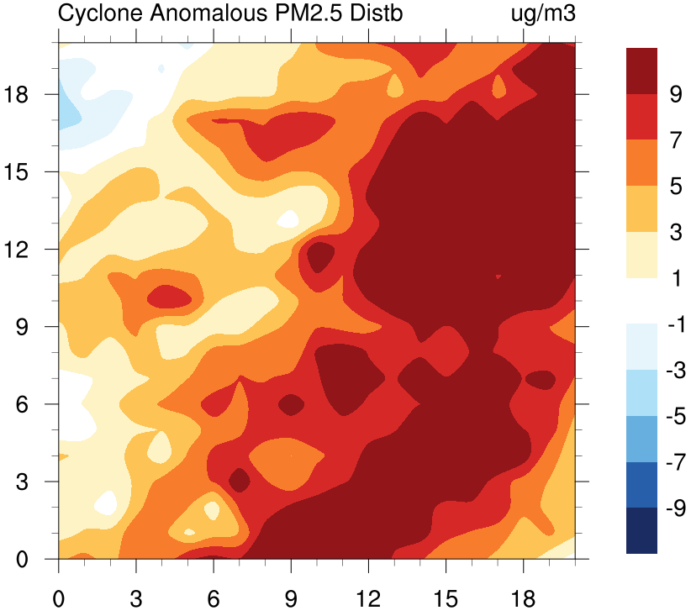
Patterns associated with a cyclone
Anomalous PM2.5 distribution
wind distribution

Slide 16
Summary
75 cyclones have passed the East China from 2000 to 2005.
By clustering analysis, the tracks are divided into three groups. 80% of them affected the Northeast China, while 20% affected the South.
Cluster 1: cyclones origin from the Mongolia Plateau and travel across the Northeast China. They have brought anomalous high PM concentration in the north and low concentration in the south, by transportation from the North China Plain and the Yellow Sea, respectively.
Cluster 2: origin from the Yellow Sea and the Sea of Japan. Anomalous high PM concentration in the Northeast from the polluted industrial areas in Liaoning.
Cluster 3: origin from the East China Sea. Anomalous low PM concentration in the Southeast by transporting clean air from the ocean.
A typical pattern of high anomalous PM concentration ahead of the cyclone center, probably due to transportation by strong southwesterly winds.

